Slide 1
0. Prerequisite: Sign account on GITHub
Please check doc:
https://docs.github.com/en/get-started/start-your-journey/creating-an-account-on-github

Slide 2
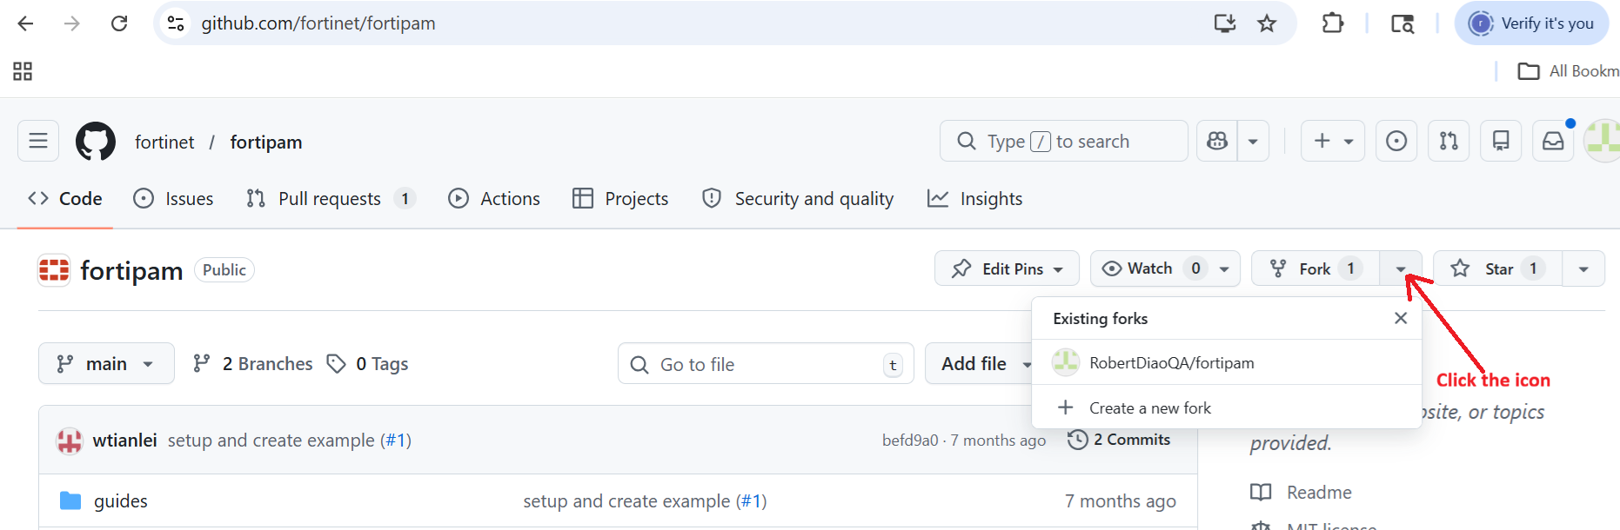
1. Create a new fork of github.com/Fortinet.fortipam
Login to fortinet/fortipam with your account, then click “Create a new fork”

Slide 3
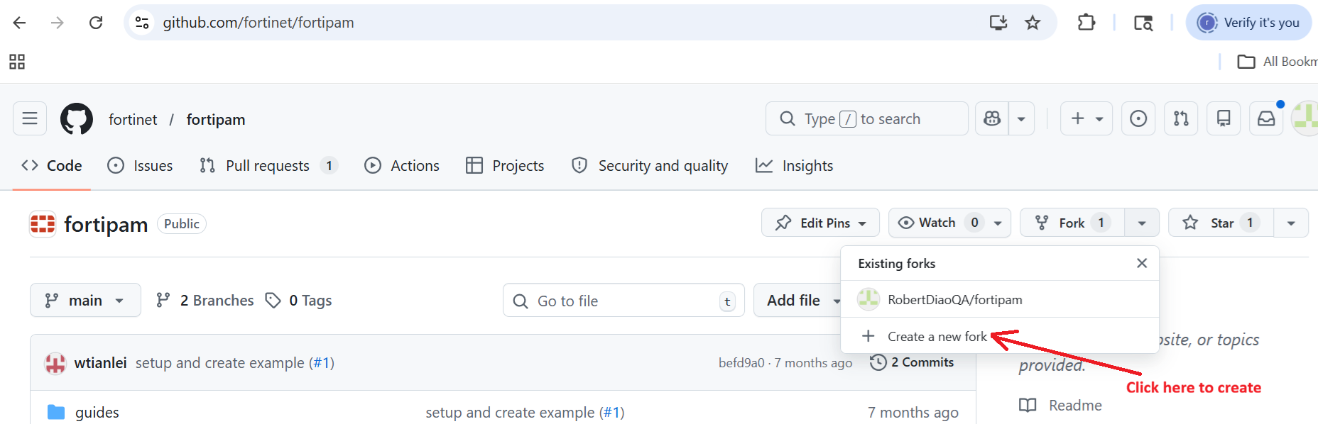

Slide 4
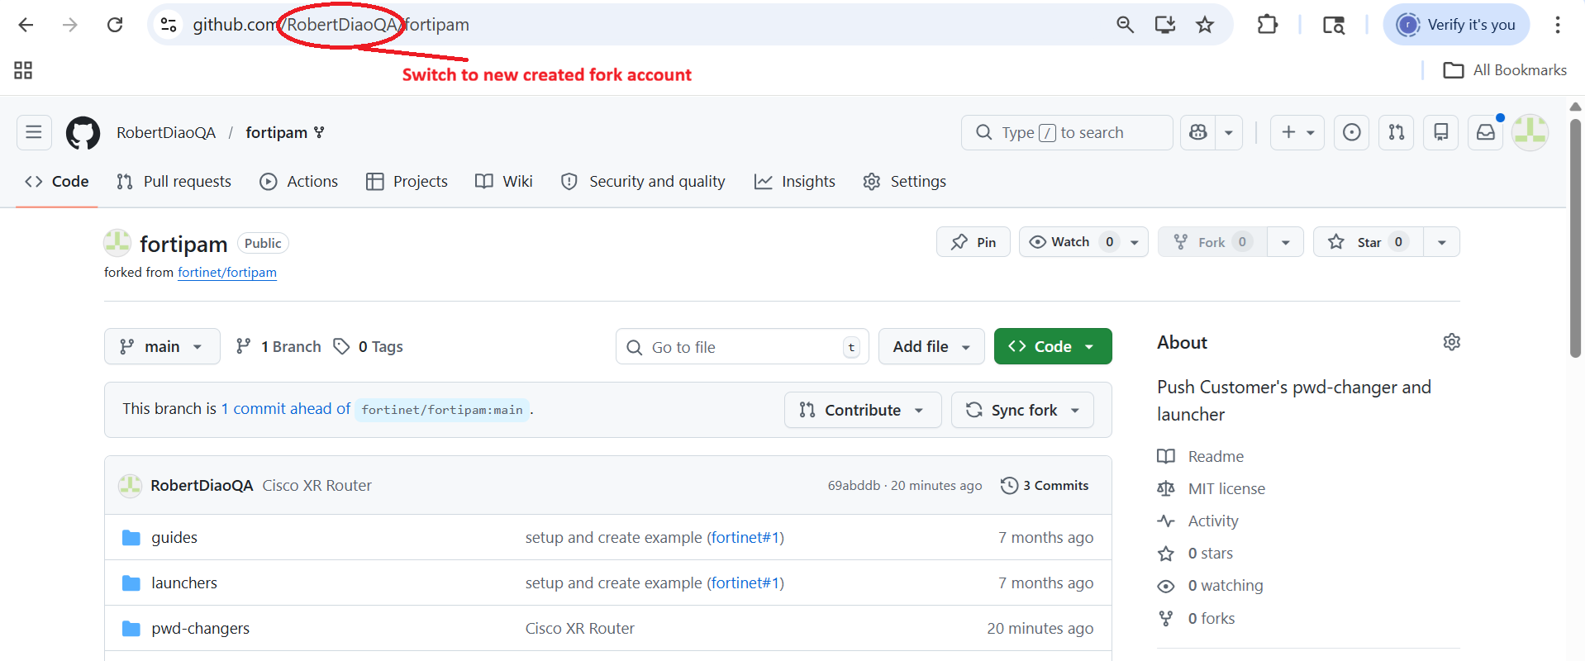
2. Switch to your new forked account repo

Slide 5
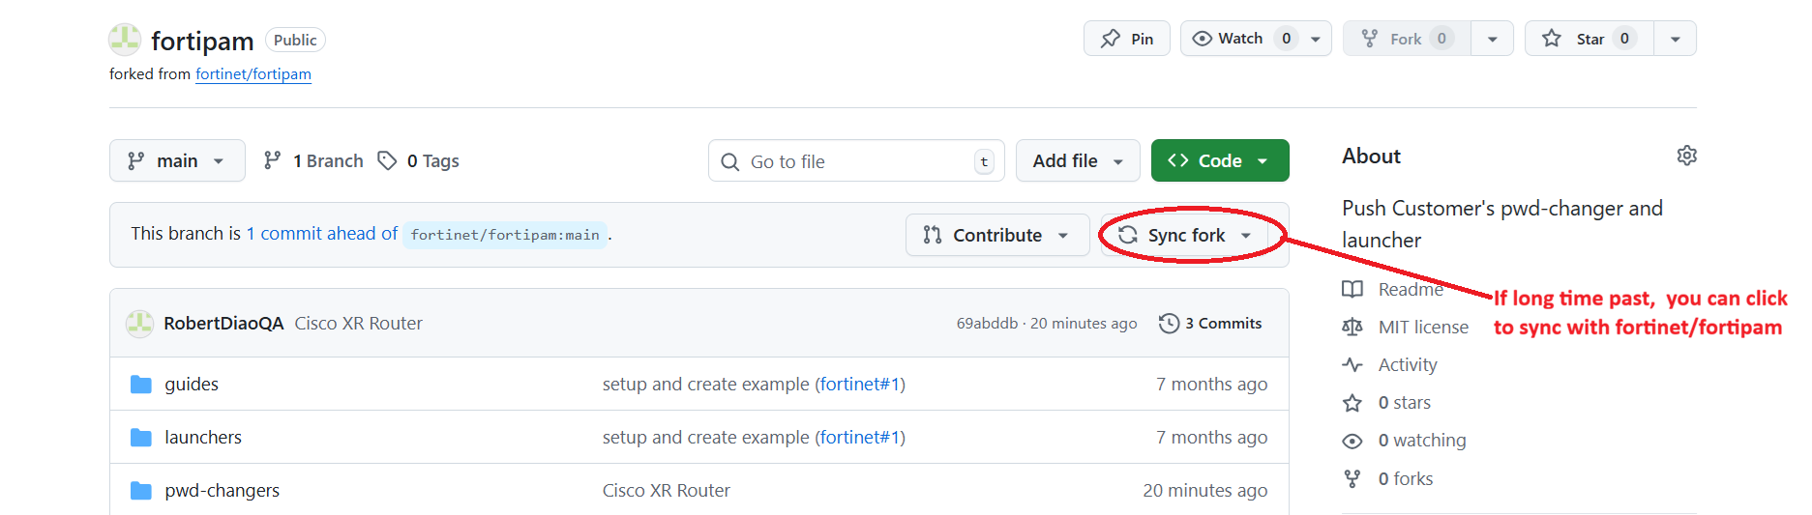

Slide 6
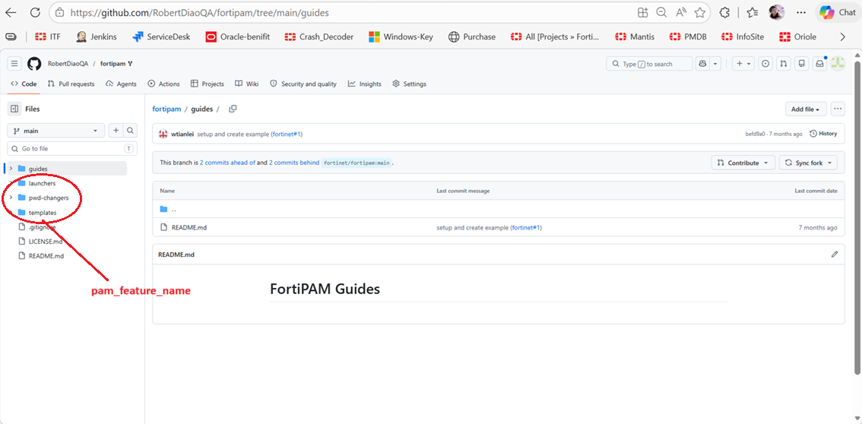
3. Folder/Files Structure
In the project, the files structure as below: PAM_Feature_Name/Vendor_Name/Device(App)_Name/
The root folder is pam_feature_name, which includes below options:
pwd-changers
launchers
templates
…

Slide 7
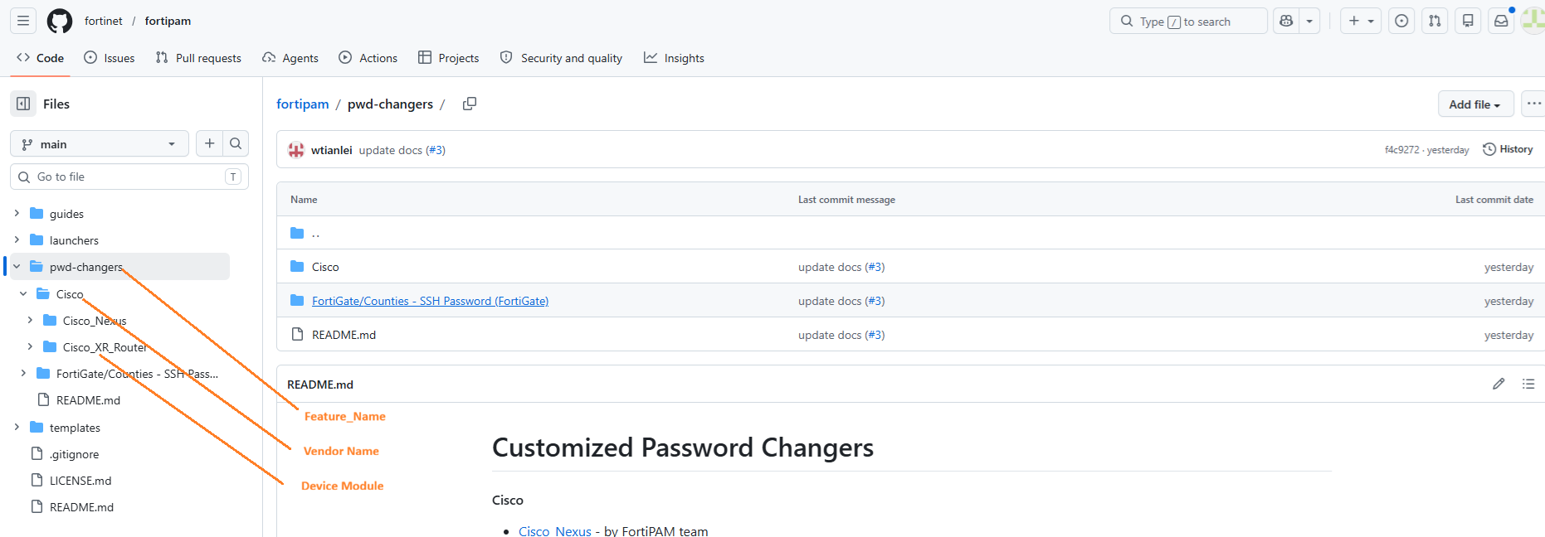
3. Folder/Files Structure
The second folder is Vendor Name of target device or app client:
Cisco
Juniper
Microsoft
Siemens

Slide 8
3. Folder/Files Structure
The third folder is Device Module or APP Name:
Cisco_XR
Cisco_7200
TIA_Portal
etc

Slide 9
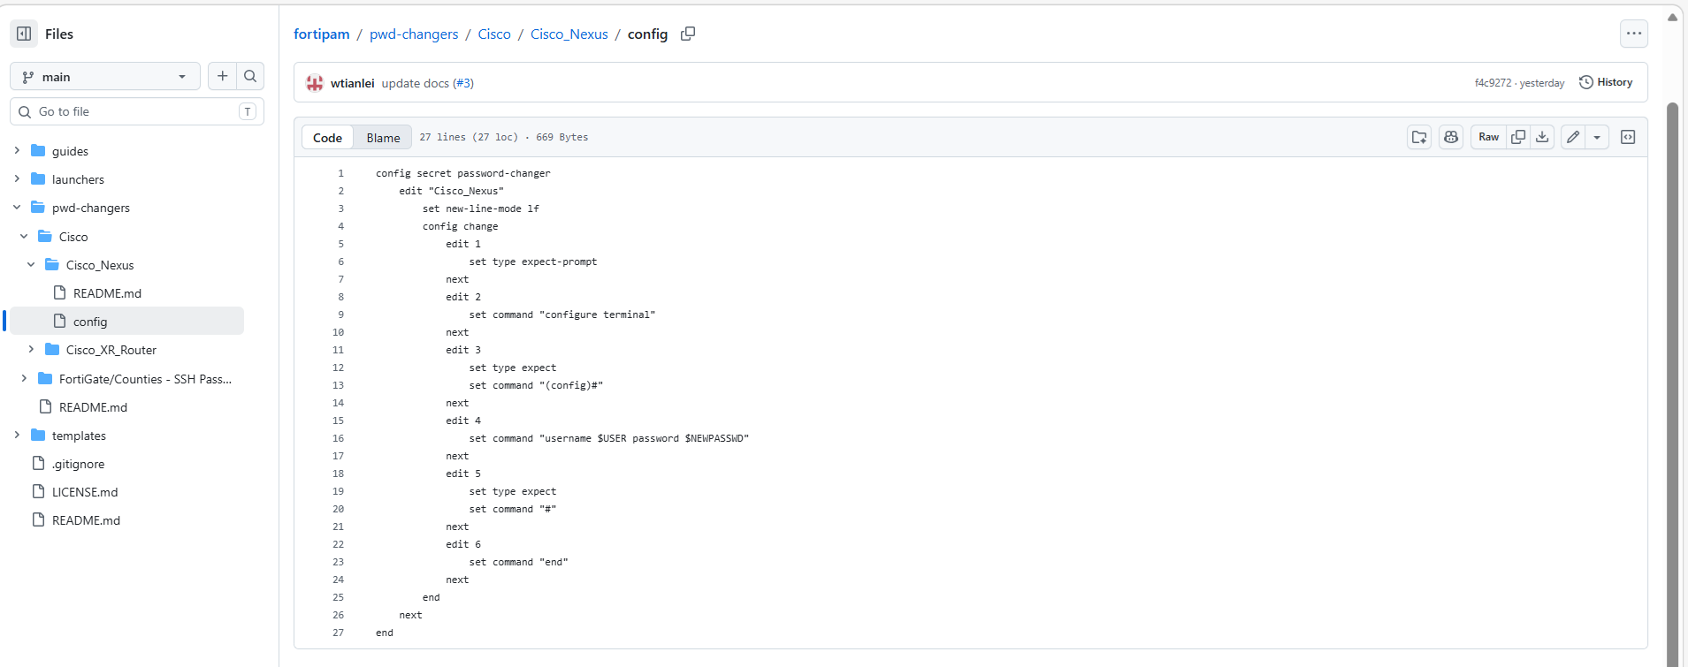
3. Folder/Files Structure
The Files:
config: This the CLI configuration of pwd-changer/launcher/template in PAM
GUI.pdf or GUI.png: The PAM GUI of pwd-changer/launcher/template in PAM
README.md: The PAM version, and configure introduction

Slide 10
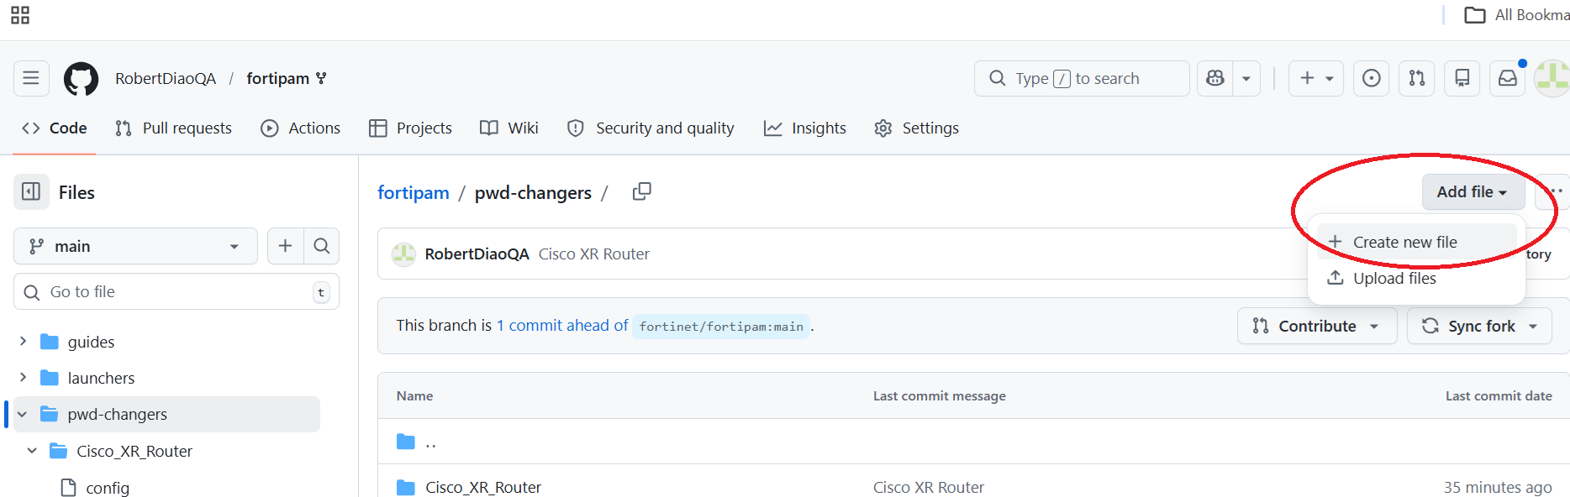
4. Example: Add a pwd-changer

Slide 11
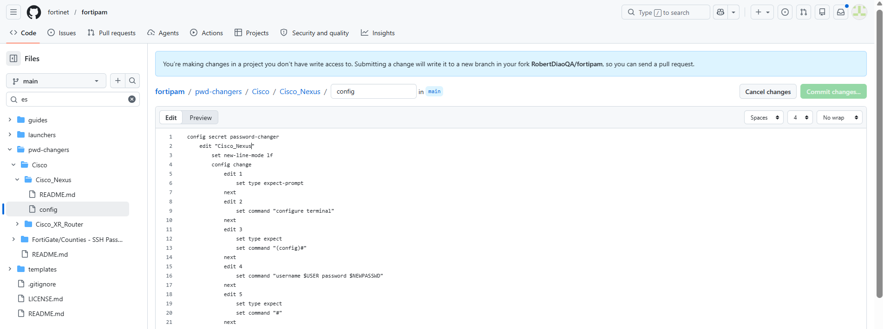
4. Example: Add a pwd-changer

Slide 12
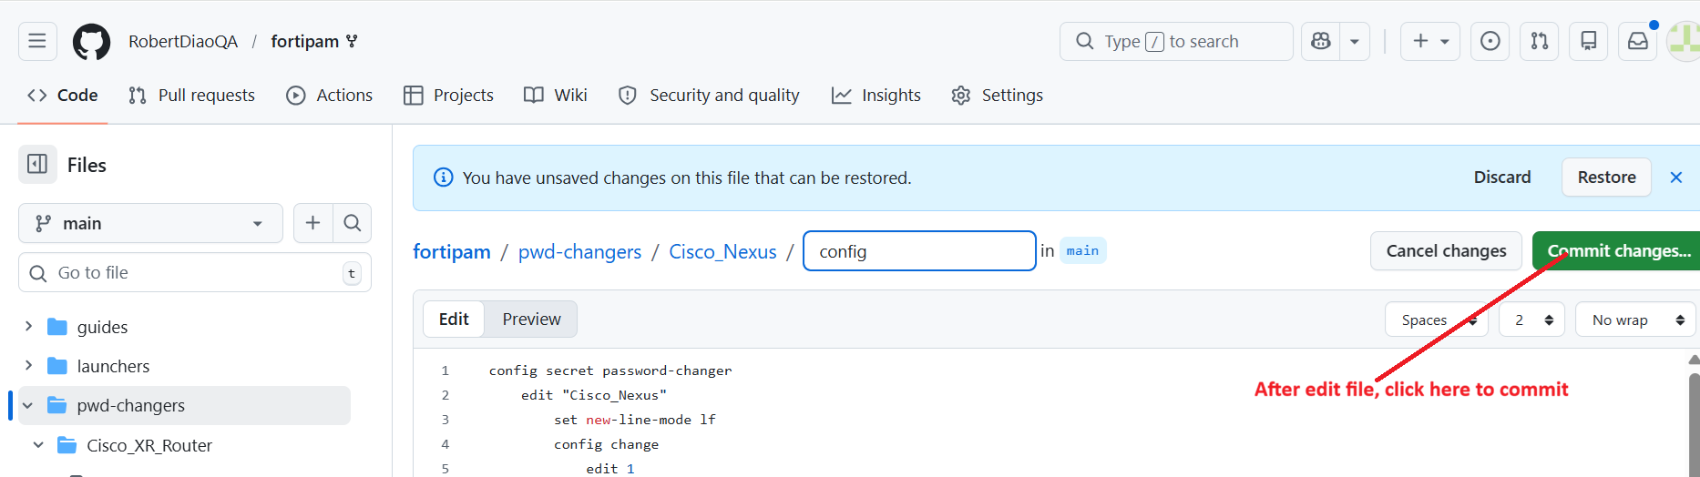
4. Example: Add a pwd-changer

Slide 13
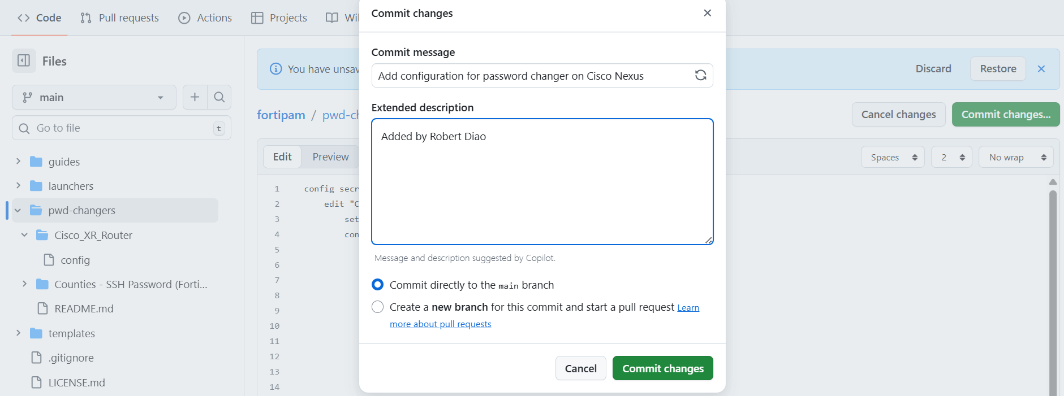
4. Example: Add a pwd-changer

Slide 14
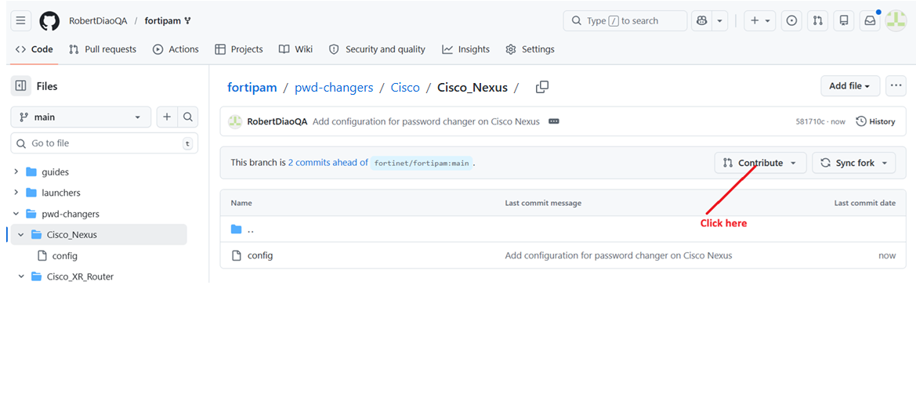
5. Push Request

Slide 15
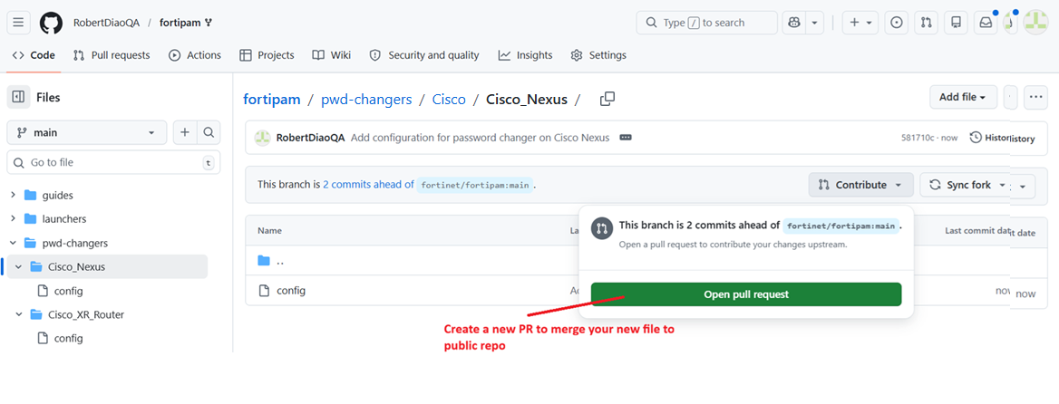
5. Push Request

Slide 16
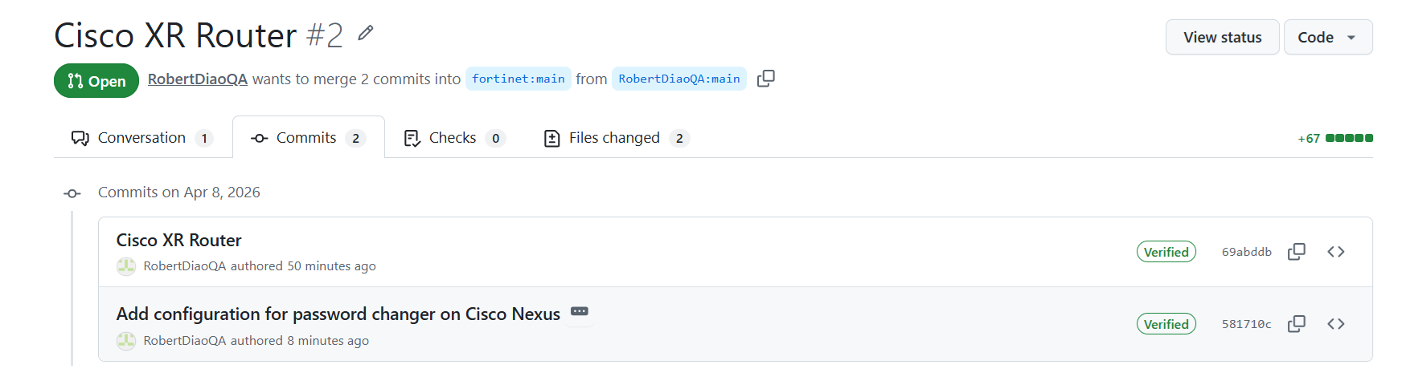
6. Check PR status

