Slide 1
OAuth
Amazon Web Services
https://projects.spring.io/spring-security-oauth/docs/oauth2.html#resource-server-configuration

Slide 2
What is OAuth2?
OAUth2 is a protocol that allows to grant limited access to their resources from one site to another without exposing credentials.
oauth2 enables a third-party application to obtain limited access to an HTTP service :
either on behalf of a resource owner by orchestrating an approval interaction between the resource owner and the HTTP service
Or
by allowing the third-party application to obtain access on its own behalf.

Slide 3
Problem Statement
HackRank Login using Linkedin or Facebook.
Acloudguru
Quora

Slide 4
Analogy
Luxury Car
Original Key
Valet Key
Cannot run more than a km or two
Unable to trunk

Slide 5
Terminology
Client- Who wants to use application
Resource Server – Who has data and return it to authentic client. The resource server is the OAuth 2.0 term for your API server. The resource server handles authenticated requests after the application has obtained an access token.
Resource Owner – An entity capable of granting access to a protected resource. When the resource owner is a person, it is referred to as an end-user.
Authorization Server (Google/Facebook/Linkedin) – Who authenticate the user entity and return a token . This token is accepted by resource server and validate your identity.
Access Token
specific scopes
durations of access
granted by the resource owner

Slide 6
Oauth – Code Grant
5. Redirect the control to client + AUTH Code
Google Login
2. Redirect to google login page
3. Submit login credentials
4. Google accept
Authorization Server
Martin
O. Client Register with google
AuthCode
-----------------
AuthCode + Client Id+ Scope
in DB
1. Click on link
(Resource Owner)
(Google authorization server)
6. Request for Access token
(client id+ client secrete+Auth Code)
Give client id and client secrete
Quora.com
7. Return Access Token
Client
Client id
Client Secret
Redirecturi
Set Scope = permission to read photps or contact
Your Google Photos
9 . Validate Access Token
8. Request for contacts/photos
Your Google Contacts
https://oauth.net/about/introduction/
(Resource server)

Slide 7
Spring Security filter chain in order to implement OAuth 2.0 Authorization Server:
AuthorizationEndpoint is used to service requests for authorization. Default URL: /oauth/authorize.
TokenEndpoint is used to service requests for access tokens. Default URL: /oauth/token.
In client:
security:
basic:
enabled: false
oauth2:
client:
clientId: ClientId
clientSecret: secret
accessTokenUri: http://localhost:8081/auth/oauth/token
userAuthorizationUri: http://localhost:8081/auth/oauth/authorize

Slide 8
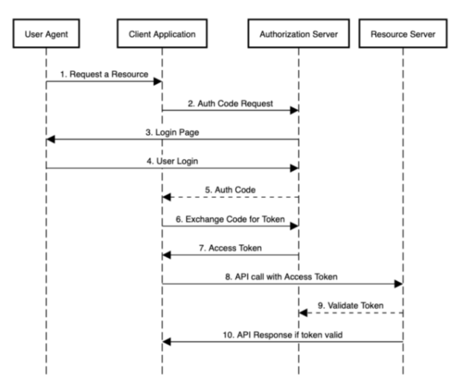

Slide 9
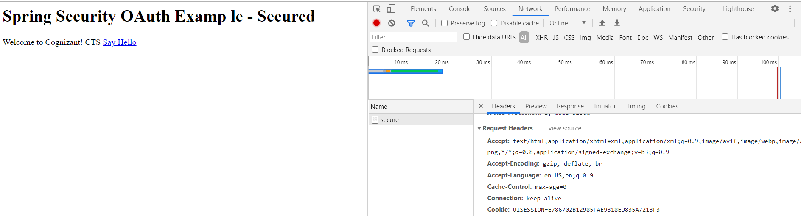
Open inspector-> Network->Refresh page->Secure-> Header-> Cookie

