Slide 1
Fortran Package Manager
Brad Richardson
Ondrej Certik
Milan Curcic
FortranCon2020

Slide 2
Outline
What problems does a package manager solve?
How does fpm solve them?
Live demo
Future development
Questions

Slide 3
What problems does a package manager solve?
How do I manage my external dependencies?
How do I build my project?
How do I test my project?
How do I create a new project?
How do I find available libraries?

Slide 4
How does fpm solve these problems?
Managing Dependencies
Specify the name of the dependency
Where to find it
And what version you need
[dependencies]
library1 = { git = “https://github.com/someone/library1.git”, tag = “v1.2.3” }
package2 = { git = “https://github.com/other/package2.git”, rev = “a12bc3” }

Slide 5
How does fpm solve these problems?
Building
fpm build
Fetches any dependencies
Scans your sources
Builds them in the proper order

Slide 6
How does fpm solve these problems?
Testing
fpm test
A program in test/main.f90 is compiled and run
Other test programs can be specified in fpm.toml

Slide 7
How does fpm solve these problems?
New Projects
fpm new new_project_name [--with-executable] [--with-test]
Creates new project with
  basic fpm.toml
  a module with a single subroutine that prints “Hello, new_project_name!”
  (optionally) a program that just calls the provided subroutine
  (optionally) a test that just prints “Put some tests in here!”

Slide 8
How does fpm solve these problems?
Finding Libraries
COMING SOON
`fpm search for_something`
Check the registry for packages with matching names and/or descriptions

Slide 9
Demo Time

Slide 10
Future Development
Detailed Specification
Re-write in Fortran
Centralized Registry

Slide 11
Learn more at:
https://github.com/fortran-lang/fpm

Slide 12
Questions
Email: everythingfunctional@protonmail.com
Github: everythingfunctional
Twitter: @everythingfunct

Slide 13
Demo Backup Slides

Slide 14
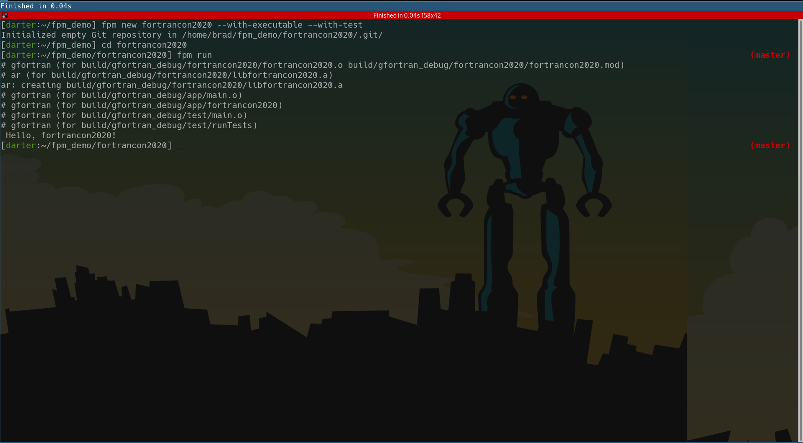

Slide 15
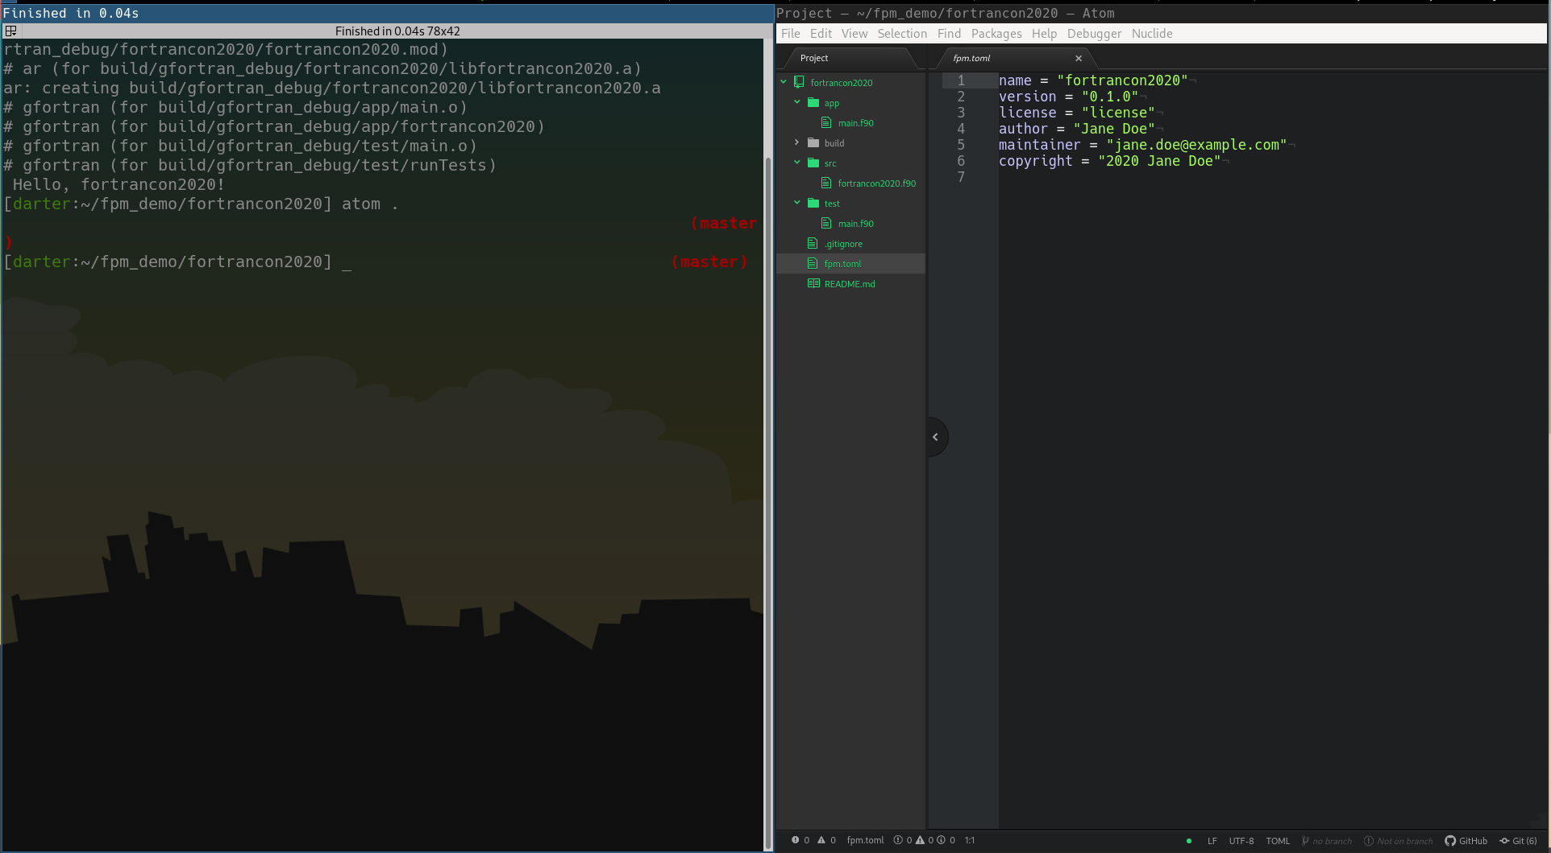

Slide 16
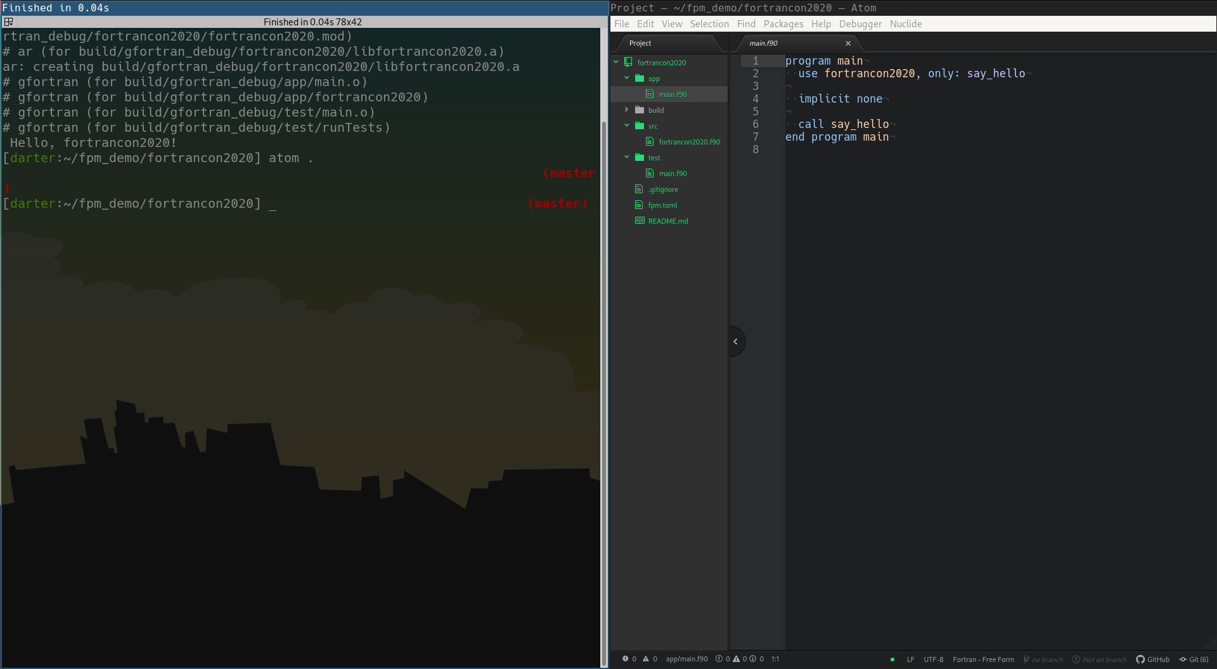

Slide 17
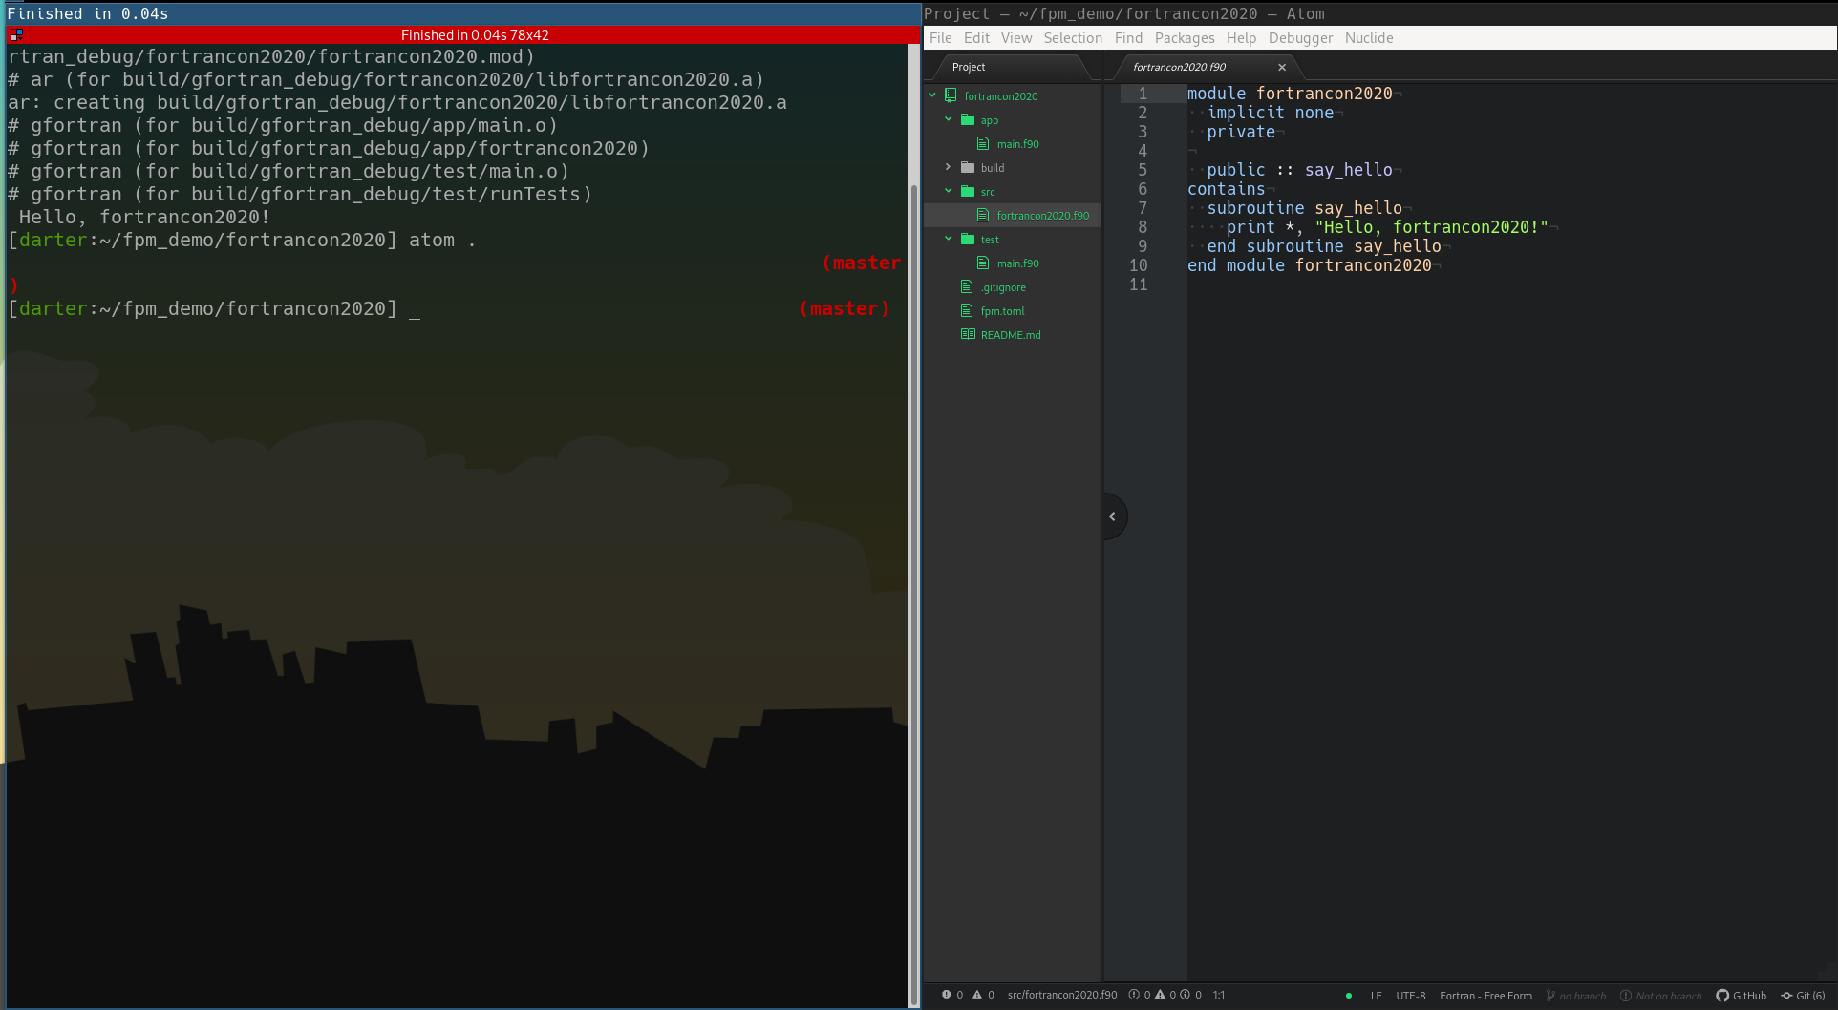

Slide 18
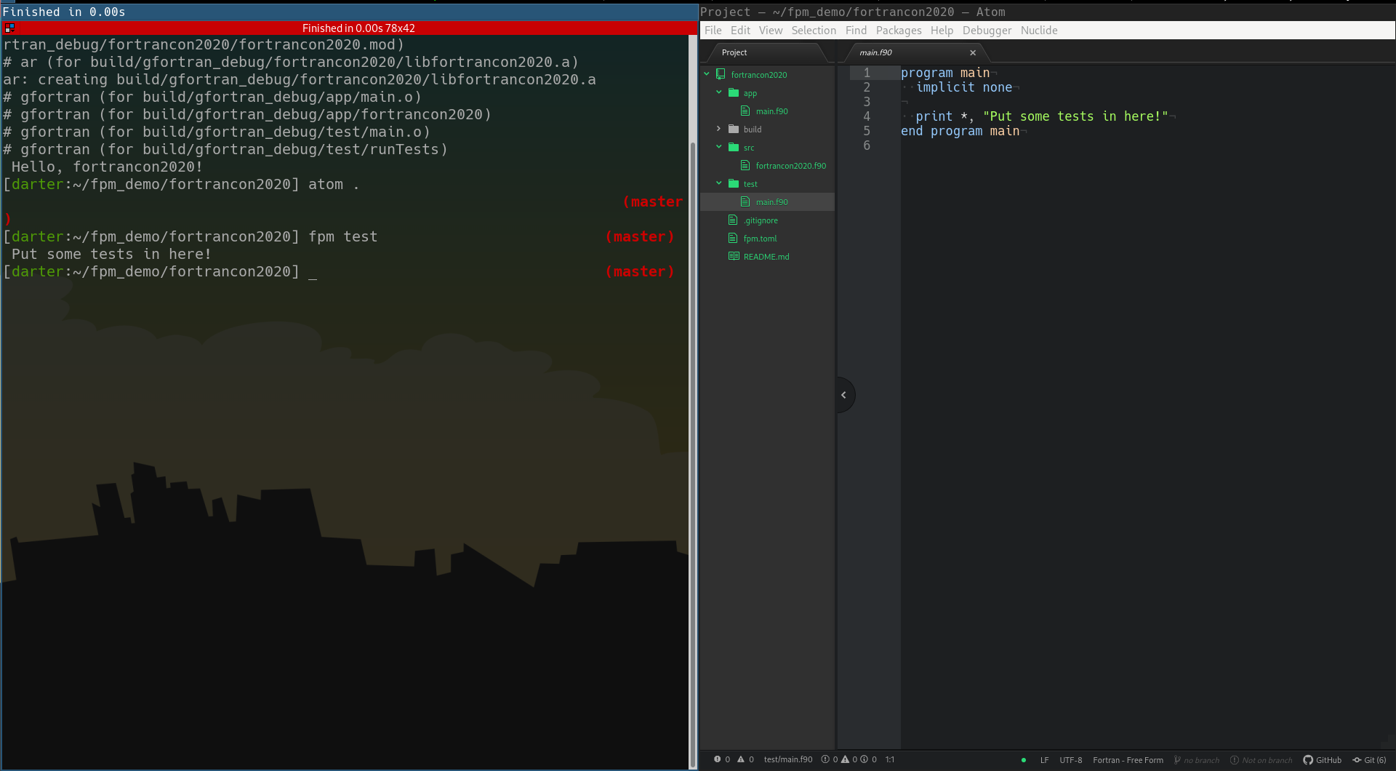

Slide 19
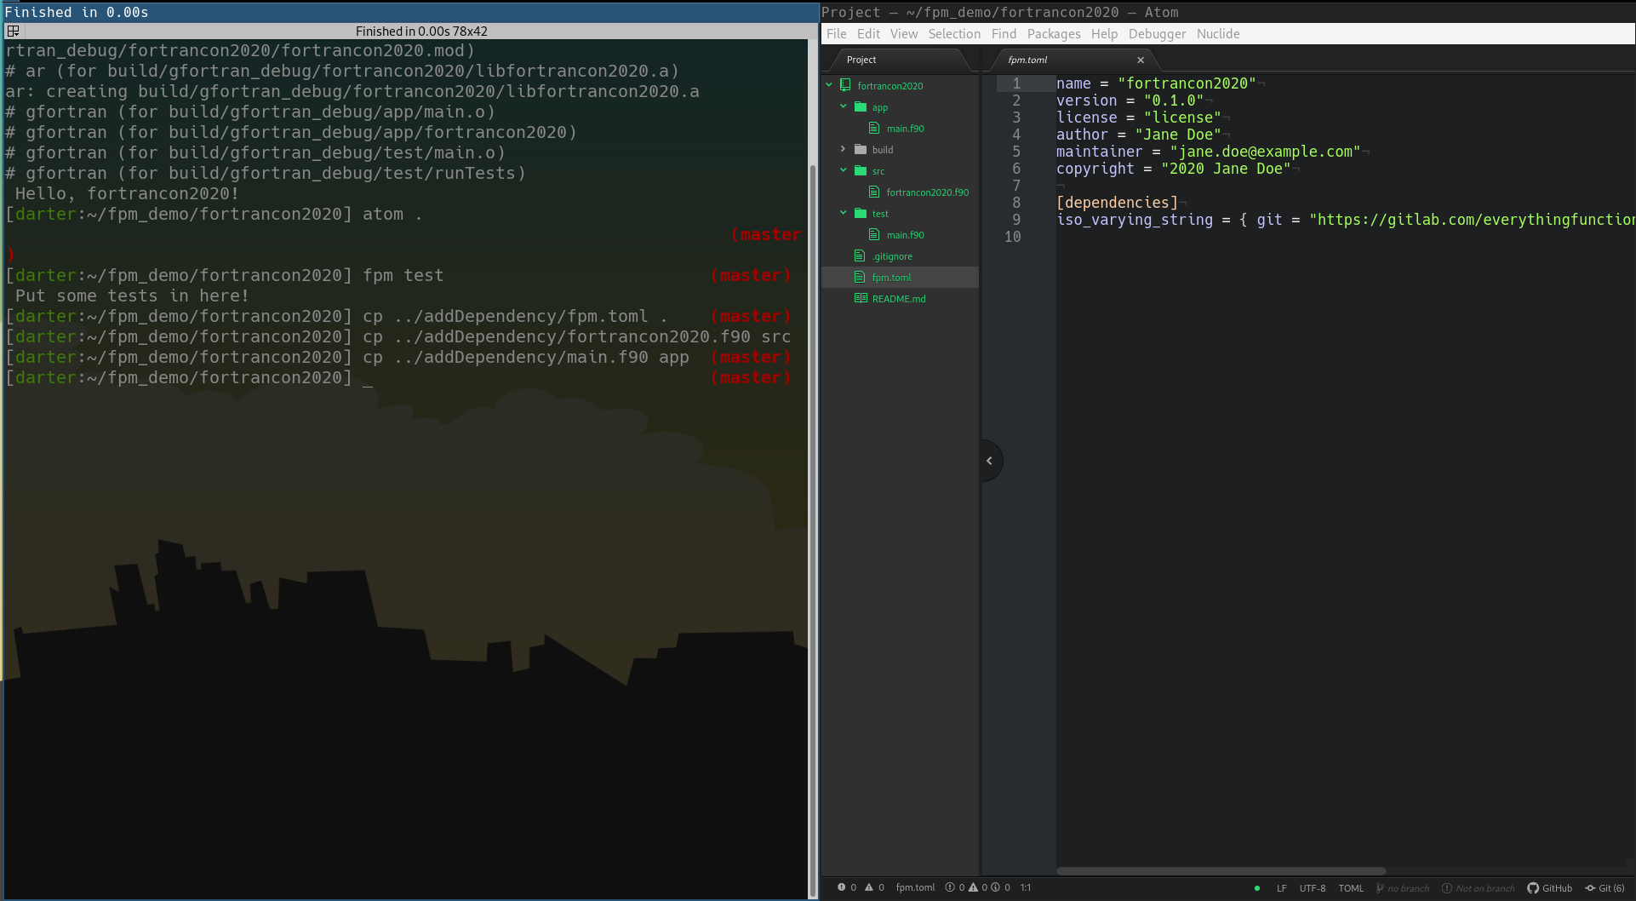

Slide 20
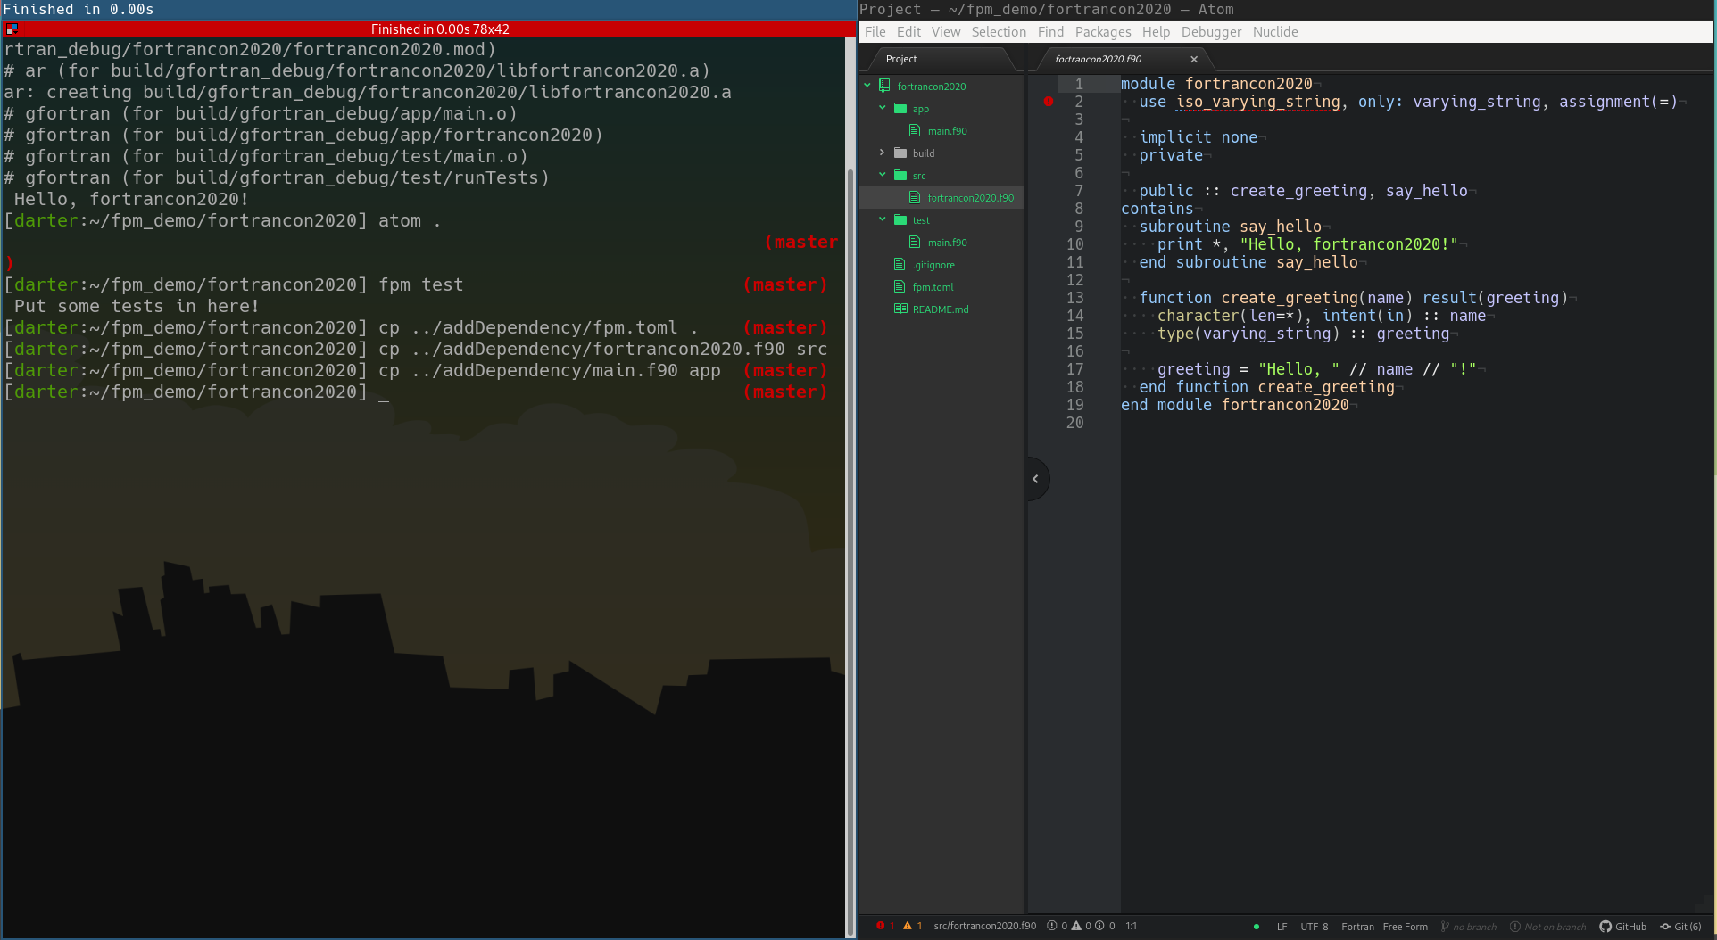

Slide 21
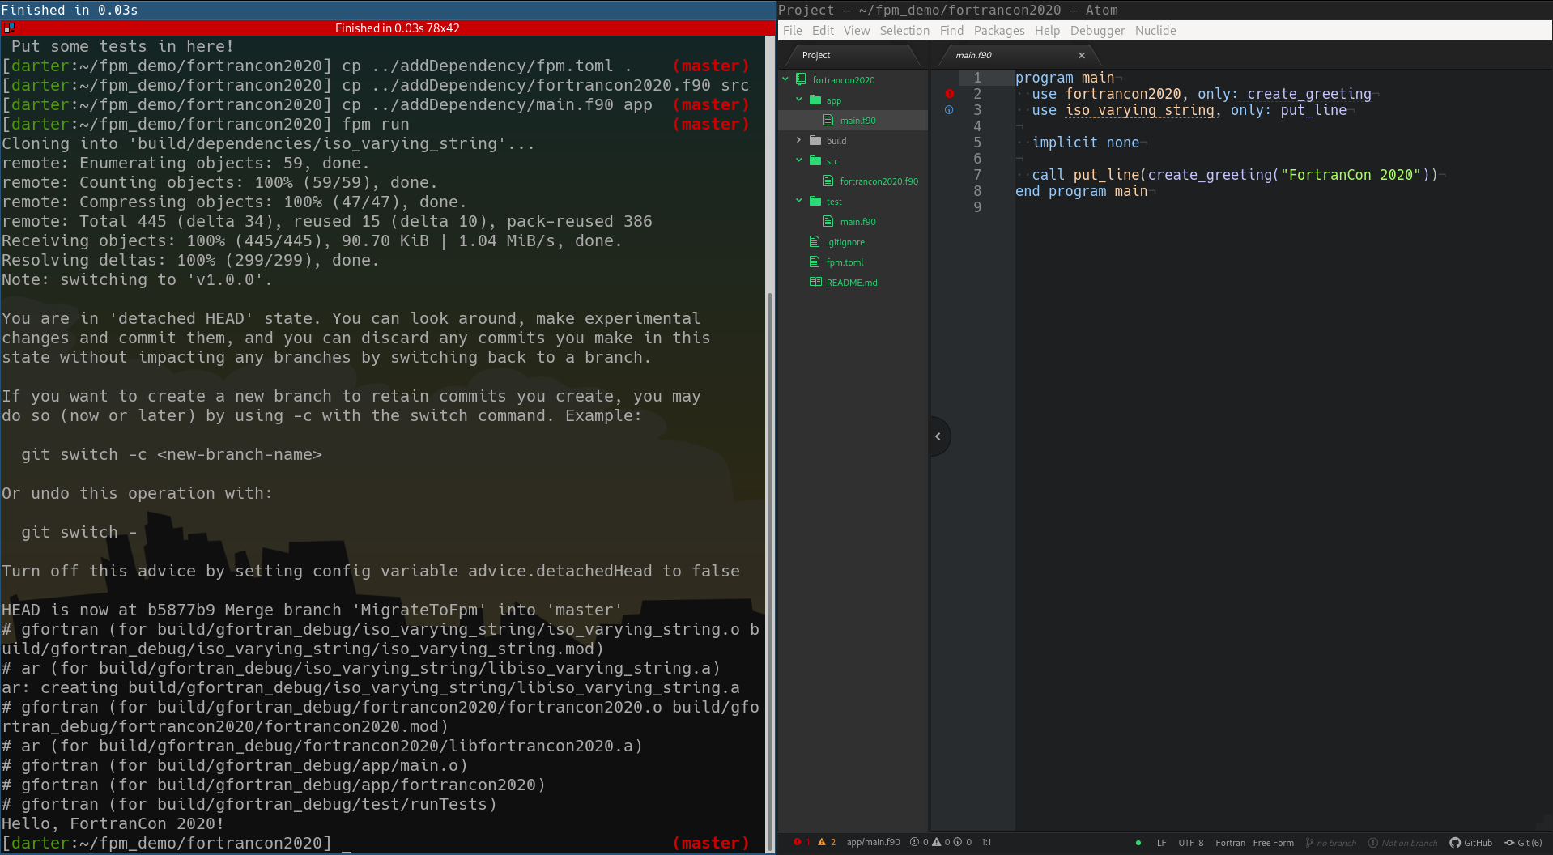

Slide 22
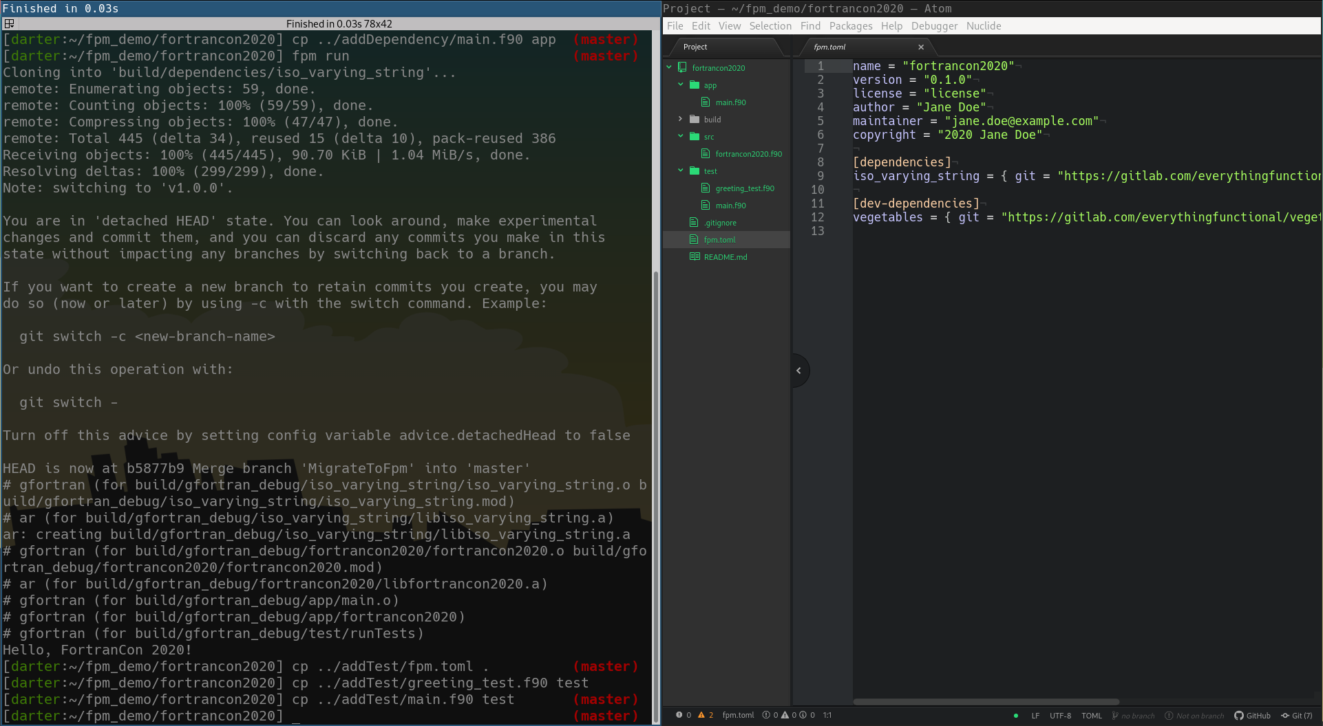

Slide 23
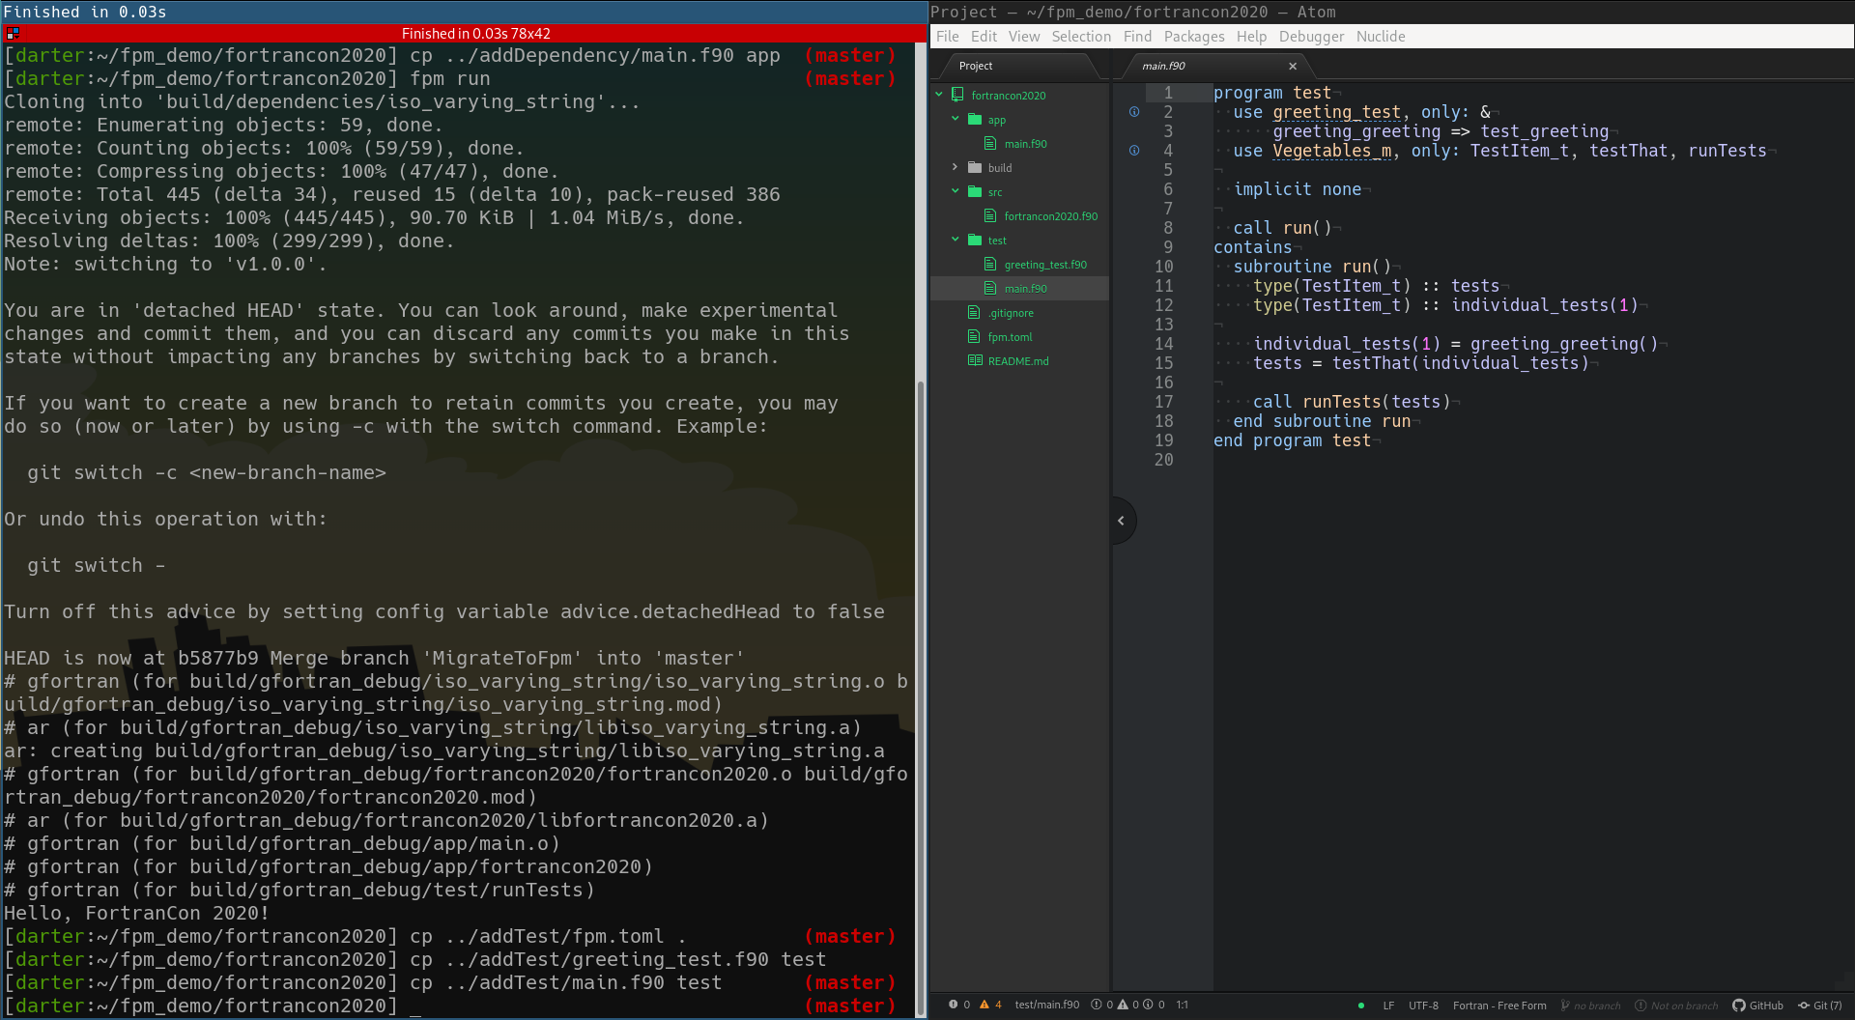

Slide 24
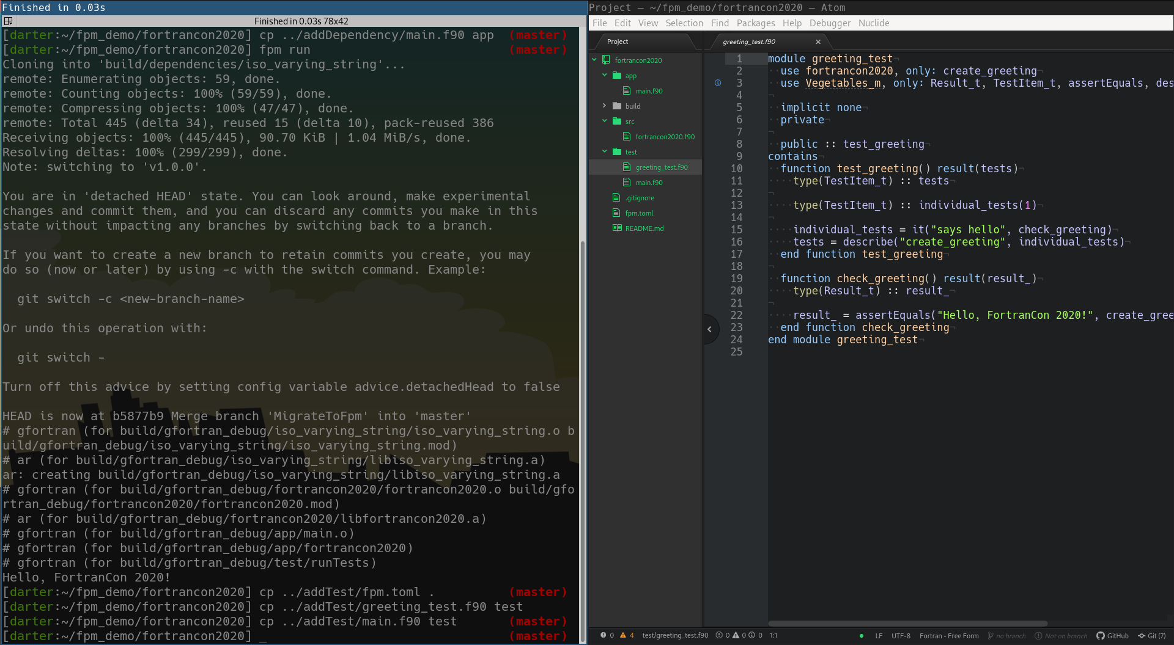

Slide 25
