Slide 1
Your Requirements Specification as an Executable Test Suite
Brad Richardson
Archaeologic, Inc.
Website: https://everythingfunctional.com
Email: everythingfunctional@protonmail.com
Twitter: @everythingfunct
Everywhere else: @everythingfunctional
Notes:
Been doing Fortran development
In the nuclear industry
For over a decade
With emphasis on Quality Assurance

Slide 2

What are software tests?
Notes:
A Set of operations performed
On a software system
For the purposes of verifying its behavior

Slide 3
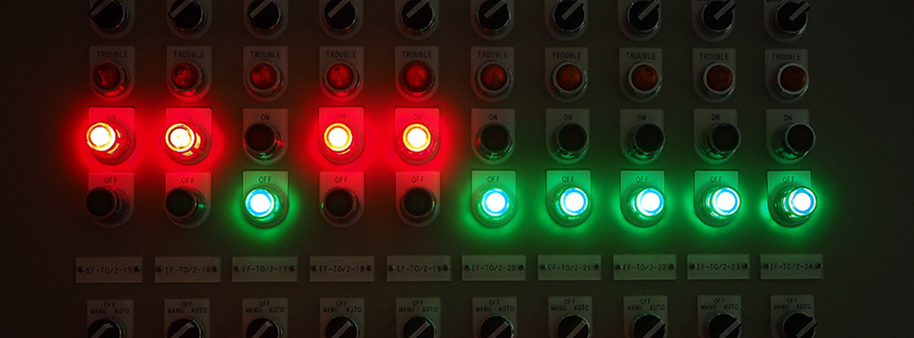
What are automated tests?
Notes:
A set of claims made
In a sufficiently structured format
That a computer can verify them

Slide 4
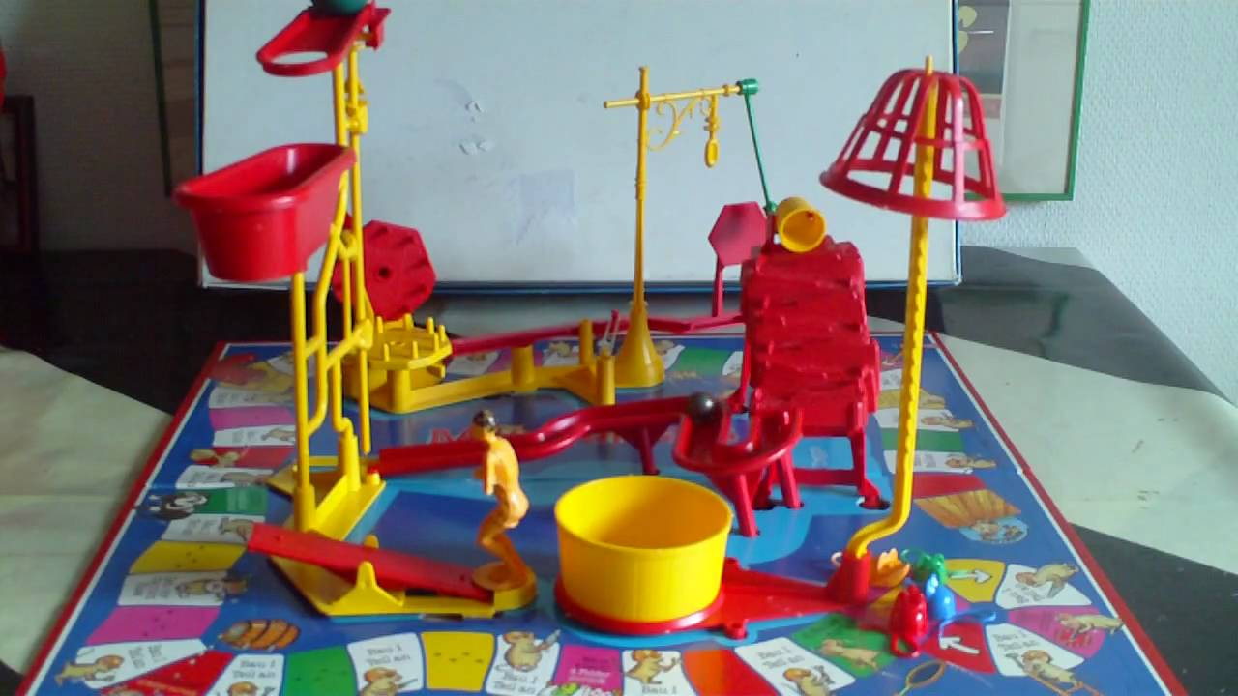

What makes a good test?
Notes:
Write tests for the people trying to understand the code it is testing.
What does “it works” mean?
For tests to be helpful to anyone later, they must do more than just test the functionality, they must clearly express the expected behavior to the reader
Behavior Based
- How
* What sequence of calls
* What are the inputs
* What are the outputs
- What
* In what scenario
* I do what things
* And expect what outcome
Property Based
- Any input or state
- What can be performed
- And what is always true

Slide 5
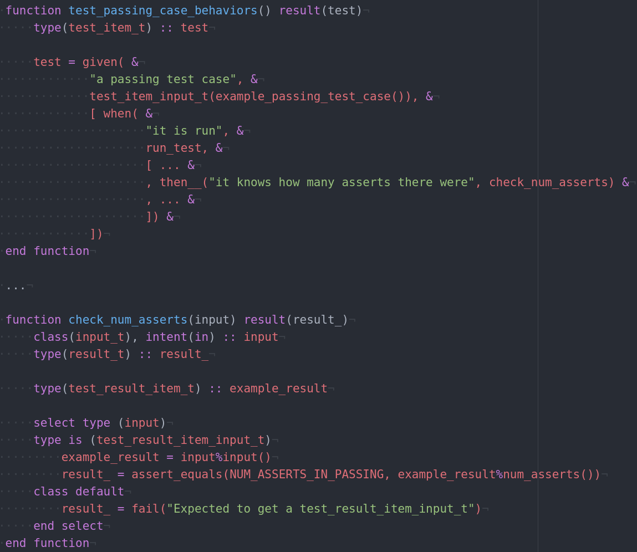
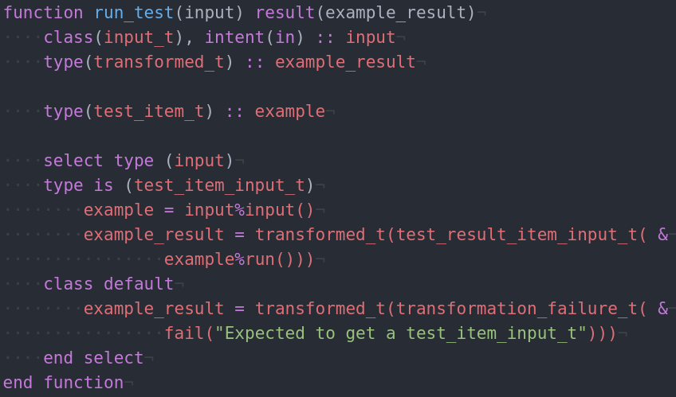
Organizing Behavior Tests (What)
In what scenario
I do what thing
And expect what outcome
Notes:
The next few examples are taken directly from the test suite for vegetables
They are written using vegetables
Not that you couldn’t write tests like this in using another framework, or even without a framework,
But Vegetables was designed specifically to facilitate and encourage writing tests in this style
Notice how we can have a direct correspondence to the breakdown I just explained

Slide 6
Organizing Behavior Tests (How)
What are the inputs
What are the outputs
What sequence of calls
Notes:
And not that it’s immediately obvious if you’re brand new to the framework,
But we also have a reasonable correspondence between what the specification says, and what the test is doing

Slide 7
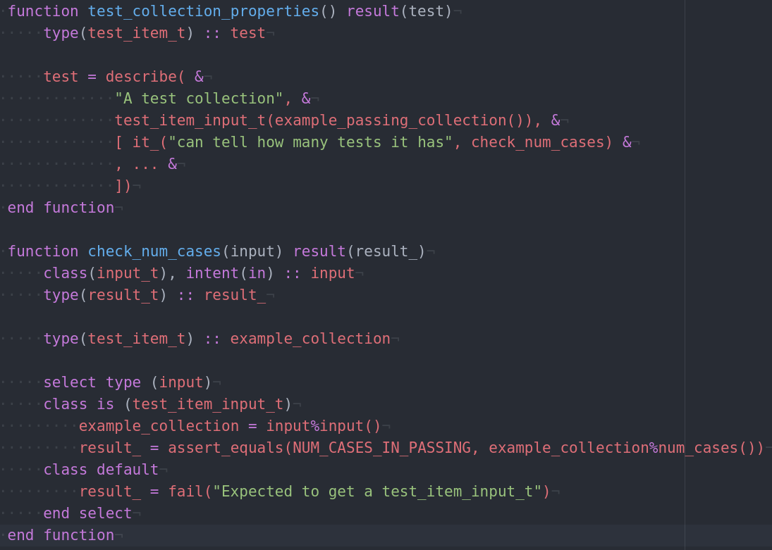
Organizing Property Tests
Any input or state
What is always true
What can be performed
Notes:
Meaningful property tests can be a bit harder to devise, but the mechanics are in some ways similar.
This example requires we know the answer based on the input, but more advanced ideas can be possible, like the associativity of addition. Given any 3 numbers, I should get the same answer whether I add the first two or last two first.

Slide 8
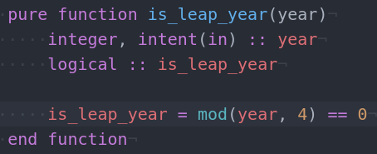
An Example: What is a leap year?
Notes:
Let’s look at a simpler example to motivate some tests we might want to write.
Let’s say we need to be able to tell whether a year is a leap year or not for some reason. You might write a function like this.
This one is very simple, and some of you are already jumping up and down screaming “I see a problem”, but don’t ruin the surprise for the rest of us.
Let’s look at what a test you might write for this might look like.

Slide 9
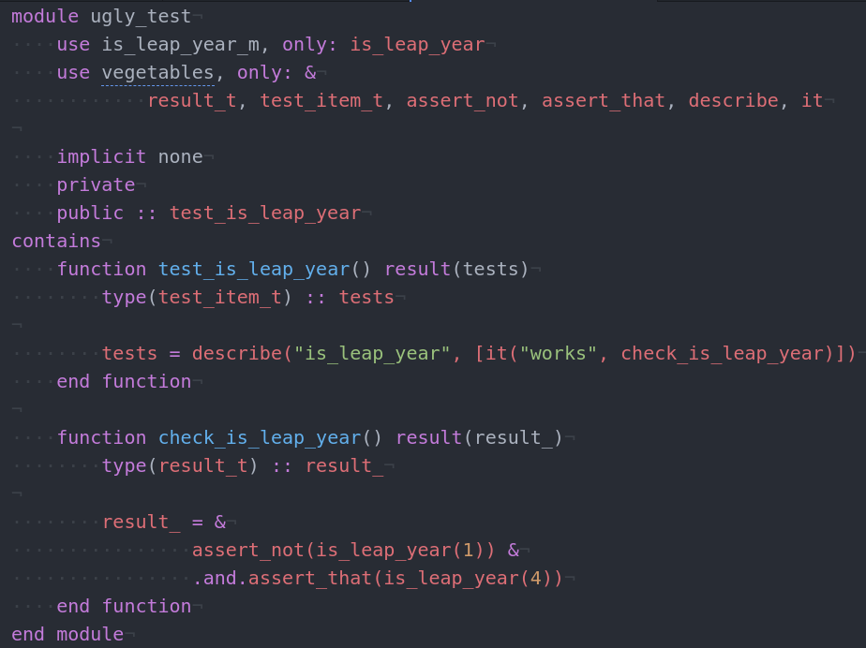
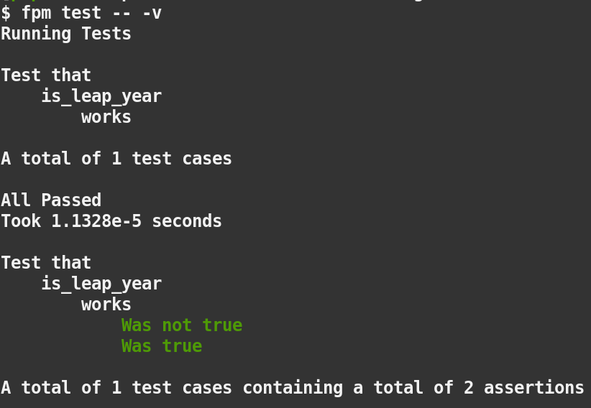
The Ugly
Notes:
If your only goal is to just have tests, you might write something like this.
And, to some extent it is testing the code.
But what does this test tell us about how the code is supposed to work?
What happens if we run these tests?
We can do better.

Slide 10
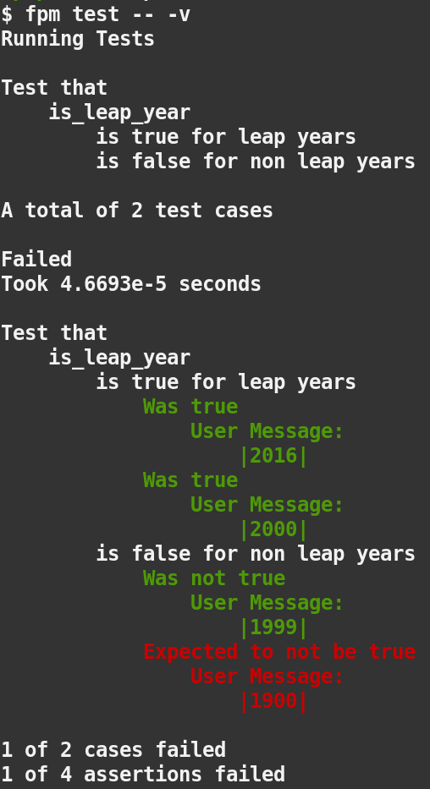
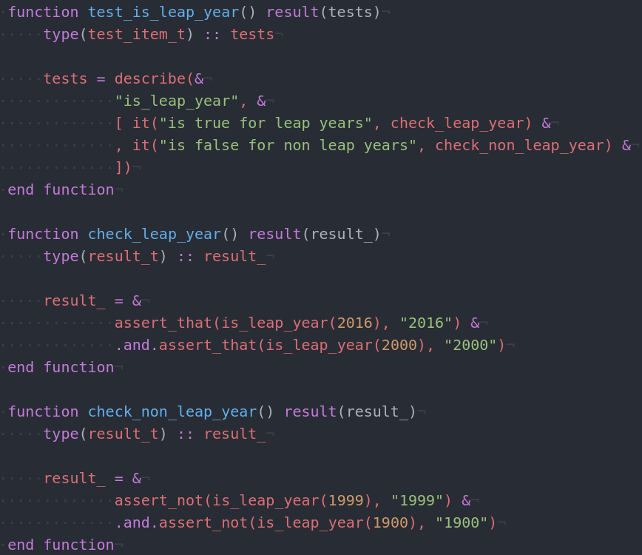
The Bad
Notes:
Ok, this is head shoulders above the previous one, but still not that great.
We can see that we’re using years as input now, and that we’ve organized the tests around the two possible outputs.
But why are those years leap years, and why aren’t the other years leap years.
When we run these, now we see that one of our tests fails.
We’ve got some information about which input fails, but what’s meaningful about why that one fails?

Slide 11
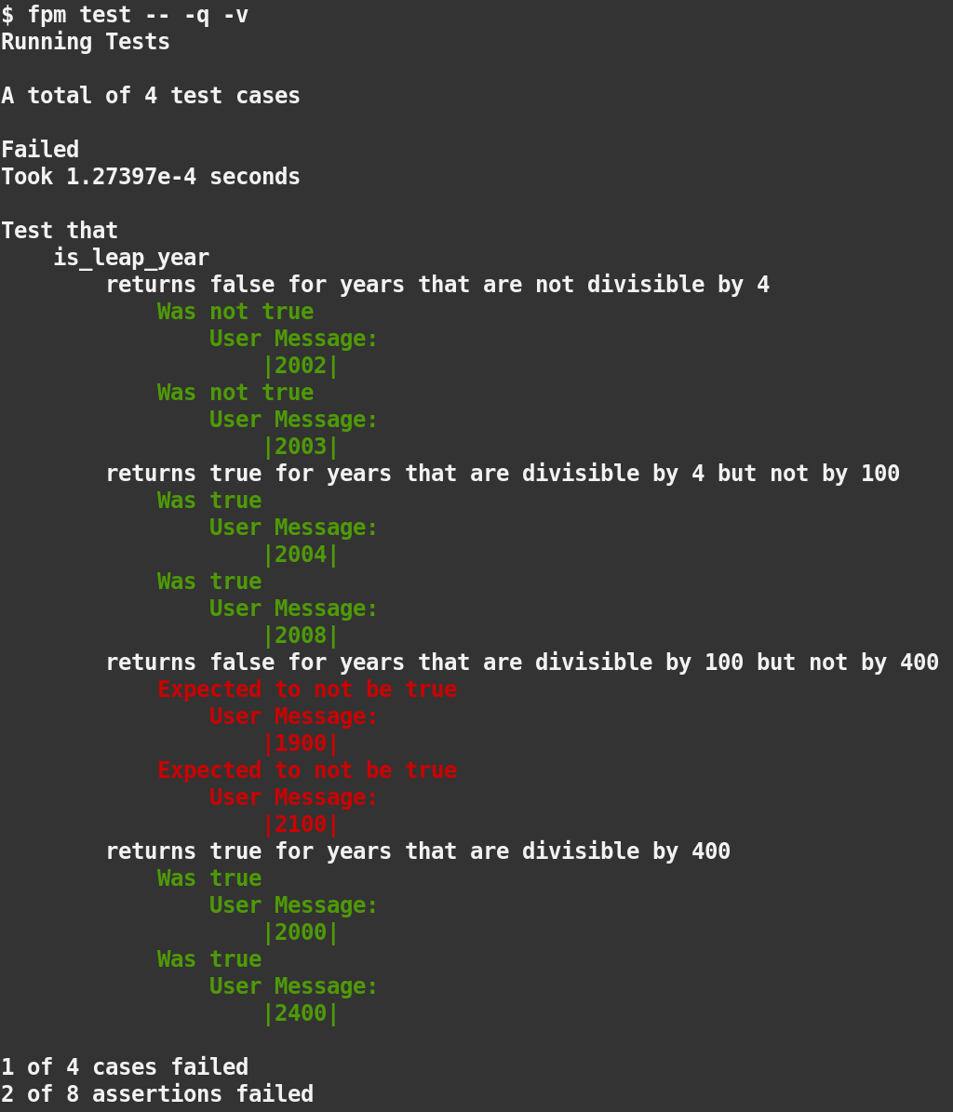
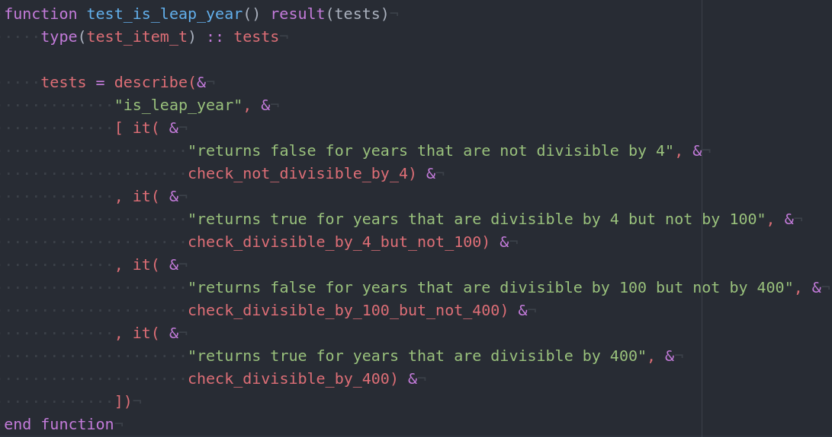
The Good
Notes:
With this specification, now we can see all the important aspects about how is leap year is supposed to work.
The test that fails makes clear which case we aren’t handling correctly.

Slide 12
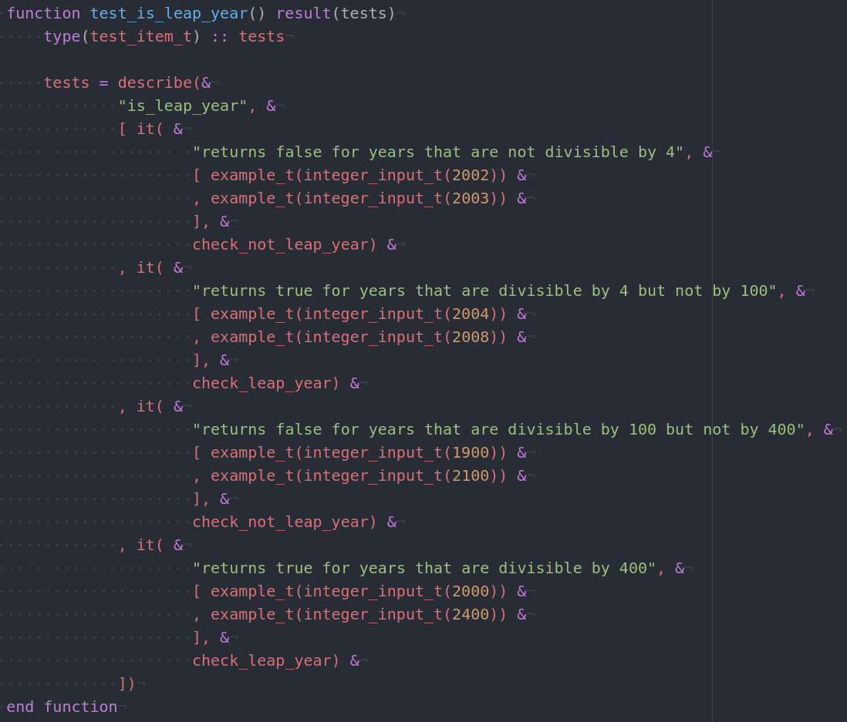
The Fancy
Notes:
If we want to get fancy with it, we can pull the example inputs up closer to our specification, so all the important bits are close together, and we can still get the same output from our tests.

Slide 13
Additional Resources
Much inspiration for the examples was taken from Kevlin Henney’s talk here: https://www.youtube.com/watch?v=tWn8RA_DEic
Many of my views on testing techniques were taken from The Art of Unit Testing by Roy Osherove: https://www.manning.com/books/the-art-of-unit-testing-second-edition
You can find the Vegetables source code at: https://gitlab.com/everythingfunctional/vegetables
Feel free to reach out with questions and comments at: everythingfunctional@protonmail.com
Slides and code at https://github.com/fortran-lang/talks
Notes:
There are a ton of details that got left out, but this hopefully will have given you a taste of what’s possible, and hopefully some motivation to strive for a better test suite.
Here are some additional resources to start learning more, and of course, I’m available for questions, and for hire if you’re looking for help trying any of this stuff in your own projects.

