Slide 1

Customer Shopping Behaviour Analysis
Uncovering insights from 3,900 purchases to guide strategic business decisions

Slide 2

Project Scope
Our Mission
The Dataset
Analyze transactional data to uncover spending patterns, customer segments, product preferences, and subscription behaviour across various categories.
3,900 customer transactions
18 data columns analyzed
Demographics, purchases, and behaviour tracked

Slide 3

Data Foundation
Customer Demographics
Purchase Details
Shopping Behaviour
Age, gender, location, and subscription status
Items, categories, amounts, seasons, sizes, and colors
Discounts, promo codes, purchase frequency, ratings, and shipping
Missing data: 37 values in Review Rating column were imputed using median ratings by product category.

Slide 4

Data Preparation Journey
01
Data Loading & Exploration
Imported dataset using pandas, examined structure with df.info() and summary statistics
02
Cleaning & Standardization
Handled missing values, renamed columns to snake_case for consistency
03
Feature Engineering
Created age_group bins and purchase_frequency_days columns
04
Database Integration
Connected to PostgreSQL and loaded cleaned data for SQL analysis

Slide 5
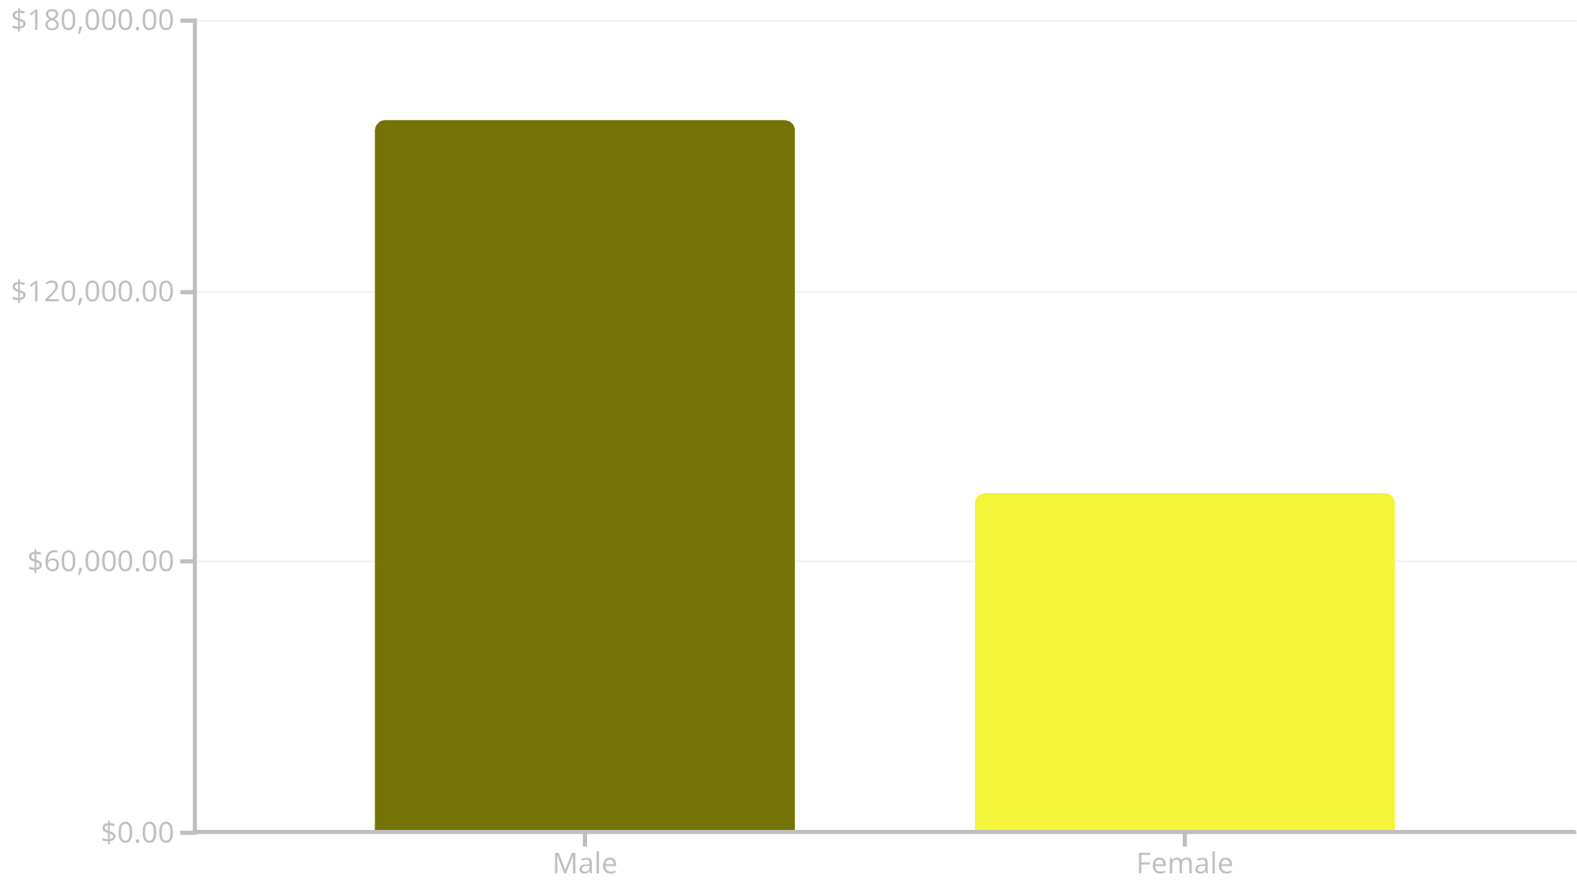
Revenue Insights
Gender Revenue Gap
Male customers generate 2.1x more revenue than female customers, representing a significant opportunity for targeted marketing strategies.
839 customers used discounts but still spent above average purchase amounts.

Slide 6
Product Performance
1
2
3
Gloves
Sandals
Boots
Rating: 3.86
Rating: 3.84
Rating: 3.82
4
5
Hat
Skirt
Rating: 3.80
Rating: 3.78
Express shipping customers spend $2.02 more on average ($60.48) compared to Standard shipping ($58.46).

Slide 7



Customer Segmentation
Returning
701 customers (18.0%)
Growth opportunity
Loyal
3,116 customers (79.9%)
Backbone of revenue
New
83 customers (2.1%)
Future potential
Of customers with >5 purchases, 958 are subscribers while 2,518 are not—indicating untapped subscription potential among repeat buyers.

Slide 8
Subscription Analysis
1,053
2,847
The Opportunity
Non-subscribers slightly outspend subscribers but represent 73% of the customer base. Converting even 10% could add $17,000+ in revenue.
Subscribers
Non-Subscribers
Average spend: $59.49
Average spend: $59.87
Subscribers generate $62,645 total revenue vs. $170,436 from non-subscribers.

Slide 9
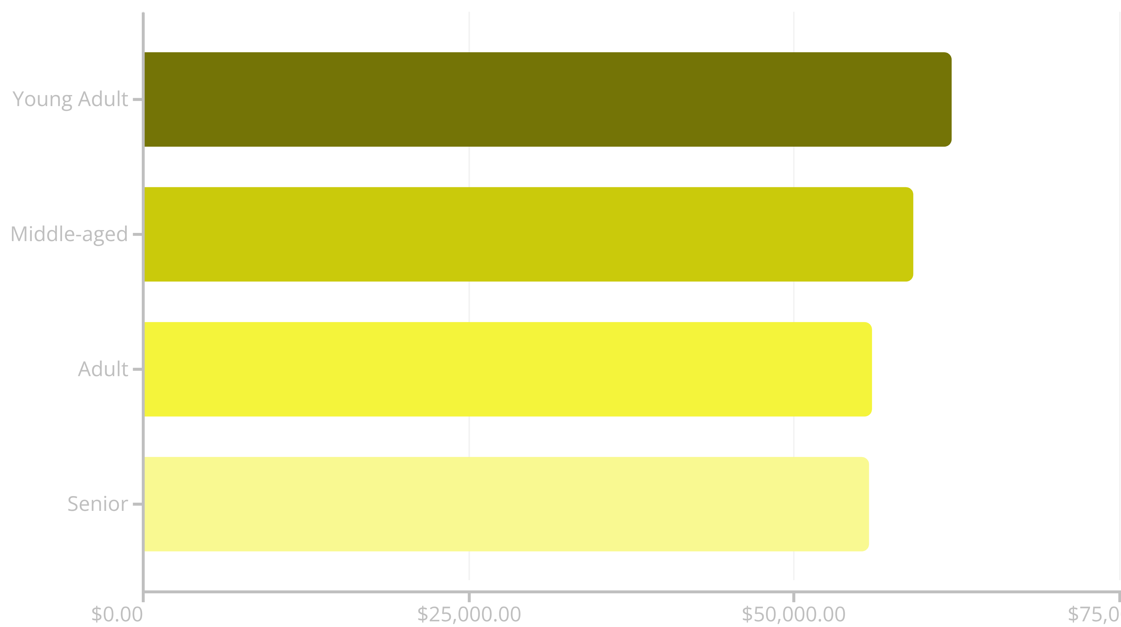
Age Group Revenue Distribution
Young adults lead revenue generation, but all age groups contribute relatively evenly—suggesting broad market appeal and opportunities for age-specific campaigns.

Slide 10
Strategic Recommendations
Boost Subscriptions
Loyalty Programs
Review Discounts
Targeted Marketing
Promote exclusive benefits to convert repeat buyers into subscribers
Reward repeat buyers to strengthen the loyal customer segment
Balance sales boosts with margin control for sustainable growth
Focus on high-revenue age groups and express-shipping users

