Slide 1
Paper Reading
July 8, 2022

Slide 2
Outline
Learning What Makes a Difference from Counterfactual Examples and Gradient Supervision (ECCV2020)
NORMALIZATION OF LANGUAGE EMBEDDINGS FOR CROSS-LINGUAL ALIGNMENT (ICLR2022)
The Secret is in the Spectra: Predicting Cross-lingual Task Performance with Spectral Similarity Measures (EMNLP2020)
FILIP: FINE-GRAINED INTERACTIVE LANGUAGEIMAGE PRE-TRAINING (ICLR2022)

Slide 3
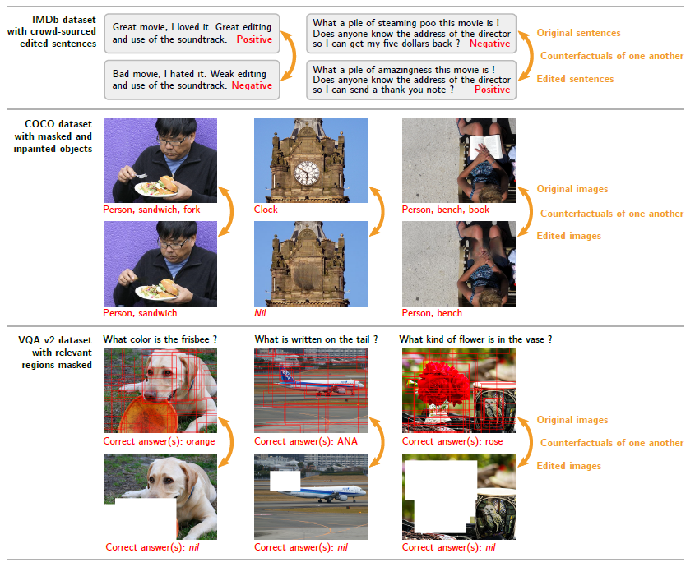
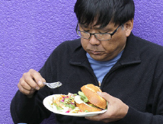

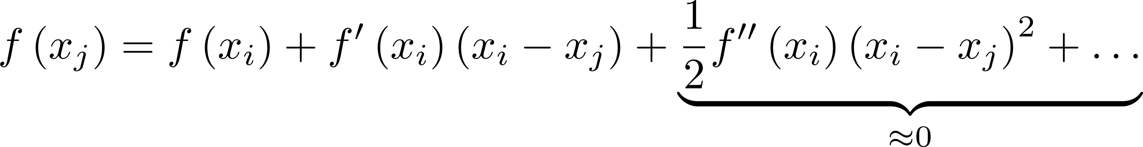


Learning What Makes a Difference from Counterfactual Examples and Gradient Supervision
co-occurrence of fork and man
The susceptibility of deep learning to learning spurious correlations rather than the underlying mechanisms of the task
$$x_{i}$$
$$x_{j}$$
Counterfactual or contrasting examples, with minimal changes
In binary classification:
virtually vanish

Slide 4
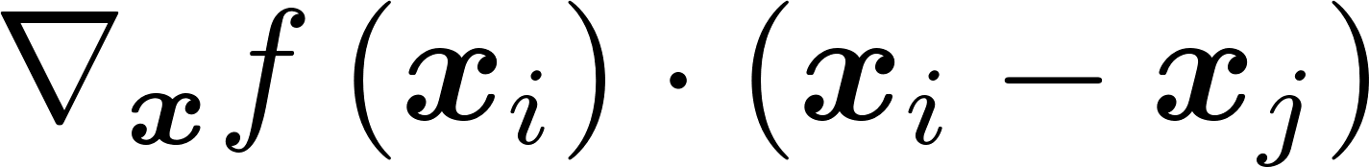
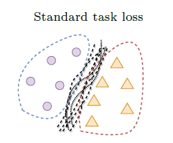
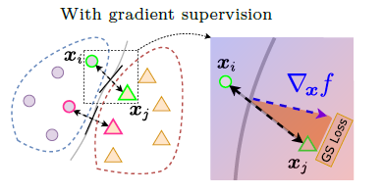

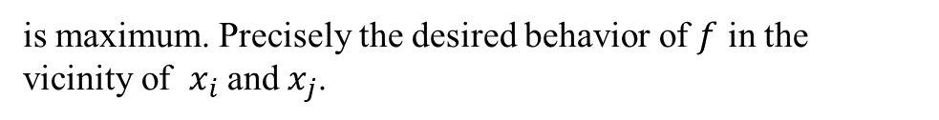
Learning What Makes a Difference from Counterfactual Examples and Gradient Supervision
The distance between $f\left(x_{i}\right)$ and $f\left(x_{j}\right)$is maximized when
virtually vanish
Local linearization of the network $f$:
is maximum. Precisely the desired behavior of $f$ in the vicinity of $x_{i}$and $x_{j}$.
possible decision boundaries consistent with a conventional supervised loss for two classes
The gradient supervision uses pairs of counterfactual examples to constrain classier such that its local gradient aligns with the vector between these points.

Slide 5
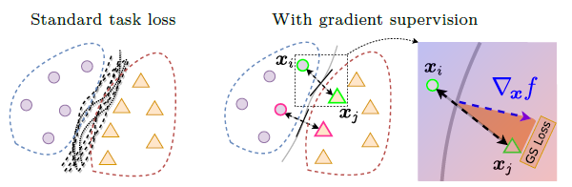
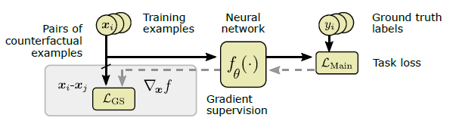
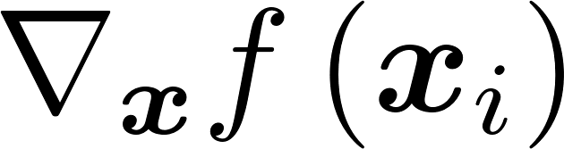

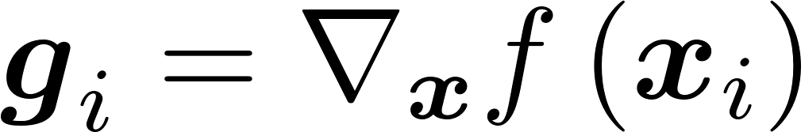
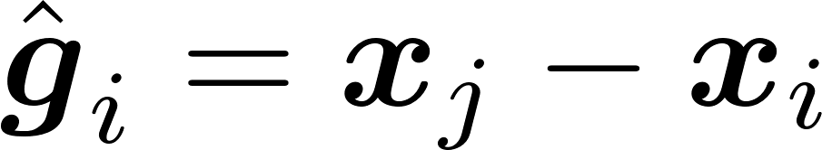
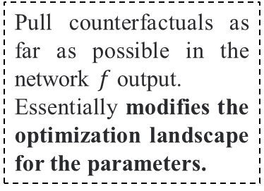
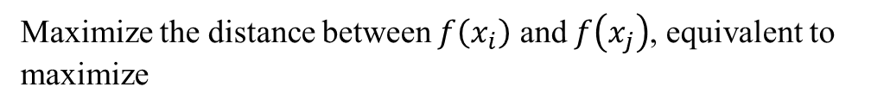
Learning What Makes a Difference from Counterfactual Examples and Gradient Supervision
Maximize the distance between $f\left(x_{i}\right)$ and $f\left(x_{j}\right)$, equivalent to maximize
curve fitting
curve aligning
Gradient Supervision encourages to align with a ground truth gradient vector
assign the correct labels.
Pull counterfactuals as far as possible in the network $f$ output.
Essentially modifies the optimization landscape for the parameters.
Where and .

Slide 6
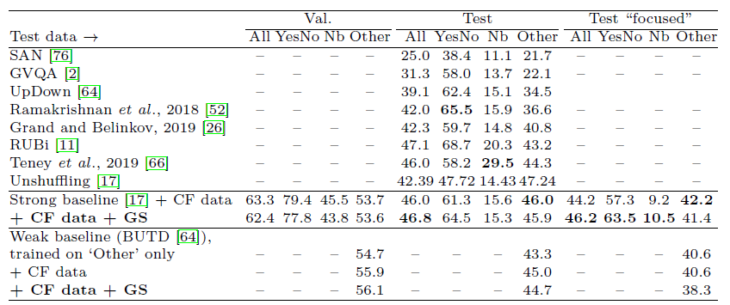
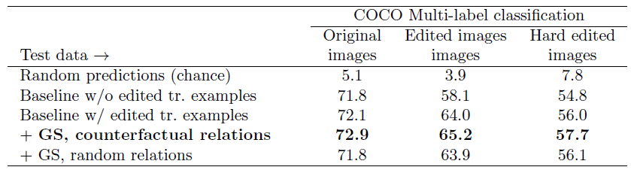
Learning What Makes a Difference from Counterfactual Examples and Gradient Supervision
Experiments
VQA
Multi-label Classification

Slide 7
NORMALIZATION OF LANGUAGE EMBEDDINGS FOR CROSS-LINGUAL ALIGNMENT
Nature of the language:
(not only) Semantic
(but) Structural profiles, such as, word frequency,
differing across languages.
……
When these profiles differ across languages, it correlates with how well languages can align.
Language 1
Remove the geometry of data intrinsic to particular languages (but not shared across languages) while preserving similarity properties. Unless this data geometry is “normalized” it inhibits the alignment from optimizing over the entirety of this large space.
Language 2

Slide 8
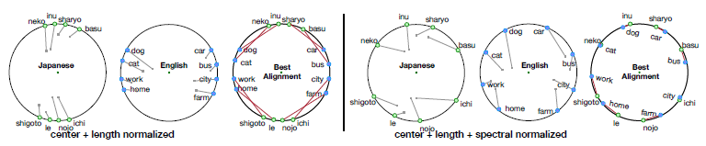
NORMALIZATION OF LANGUAGE EMBEDDINGS FOR CROSS-LINGUAL ALIGNMENT
Mean Centering
does not change the Euclidean distance between any pair of points in an embedding, and also preserves any linear property like analogies.
Length Normalization
makes each vector have a 2-norm equal to 1, but retains its direction from the origin. This preprocessing step does not change the cosine distance.
PCA Removal
computes the PCA of an embedding, and then projects away from the direction of the top principal component, removing it.
After center and length normalization, centered at the origin, but may have uneven clustering.
Spectral
Normalization
can disperse these clusters allowing
improved alignment.

Slide 9

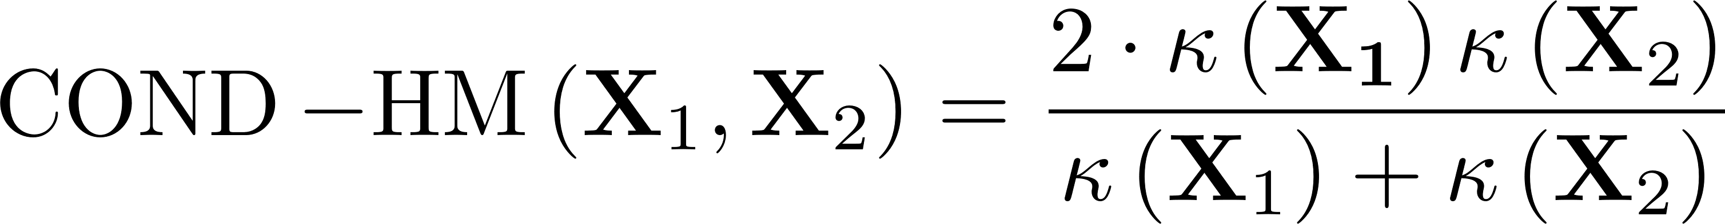
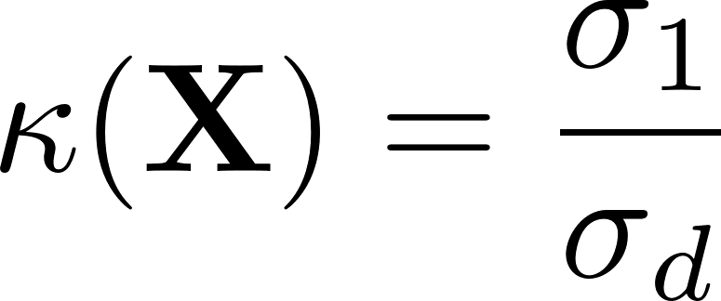
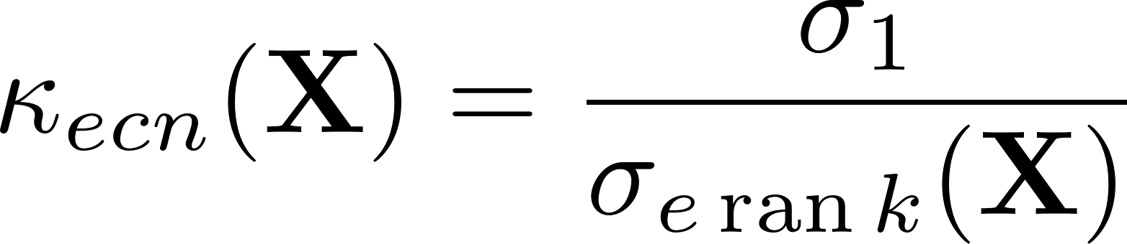
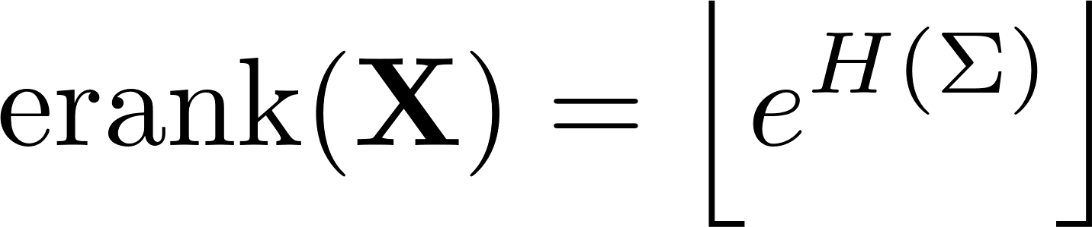
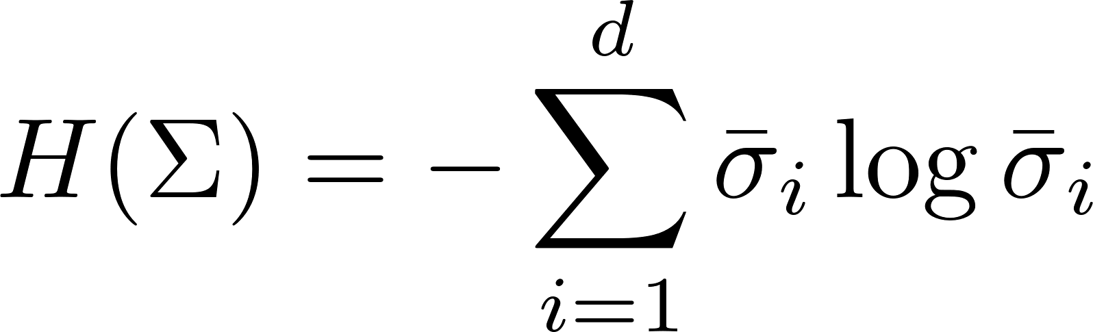
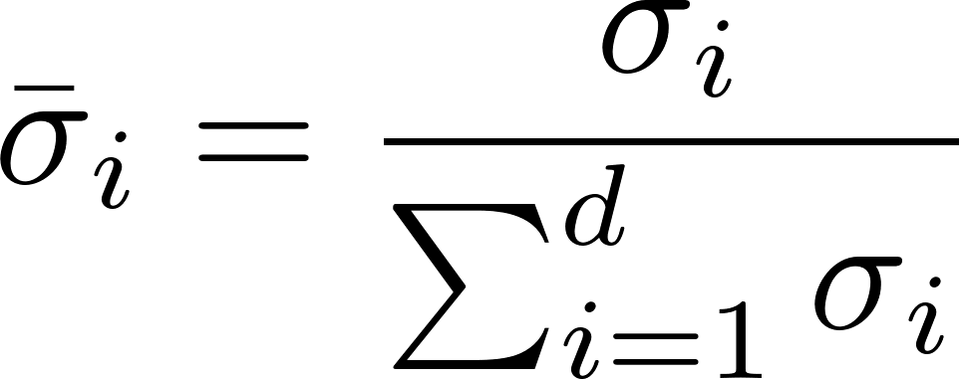
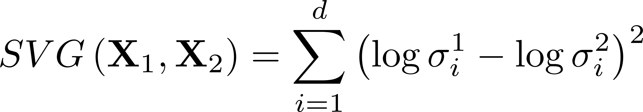
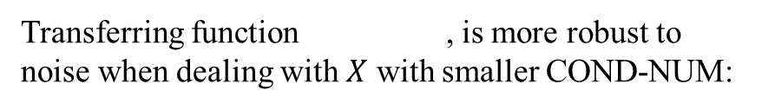
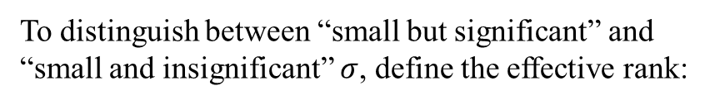
NORMALIZATION OF LANGUAGE EMBEDDINGS FOR CROSS-LINGUAL ALIGNMENT
Topological Isomorphism (Homomorphism), the crown in the field of cross-domain alignment.
One solution: Substitute Spectral Statistics for standard isomorphism measures^{[1]} .
Transferring function , is more robust to noise when dealing with $X$ with smaller COND-NUM:
Harmonic Mean of Condition Number (COND-HM):
To distinguish between “small but significant” and “small and insignificant” $σ$, define the effective rank:
where , .
Singular Value Gap:
where , .
Note that:
[1] The Secret is in the Spectra: Predicting Cross-lingual Task Performance with Spectral Similarity Measures

Slide 10
NORMALIZATION OF LANGUAGE EMBEDDINGS FOR CROSS-LINGUAL ALIGNMENT
Topological Isomorphism (Homomorphism), the crown in the field of cross-domain alignment.
One solution: Substitute Spectral Statistics for standard isomorphism measures^{[1]} .
Harmonic Mean of Condition Number (COND-HM):
A way to evaluate the ‘transferability potential’ of two spaces. The higher COND-HM, the higher its sensitivity to perturbations. HM treats large discrepancies between two numbers in a manner that leans towards the smaller one.
where , .
Singular Value Gap:
The intuition here is that two embedding spaces with similar singular values at the same index will be more isomorphic and therefore easier to align into a shared space, and enable more effective cross-lingual transfer.
[1] The Secret is in the Spectra: Predicting Cross-lingual Task Performance with Spectral Similarity Measures

Slide 11
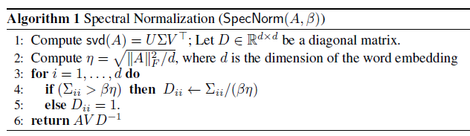
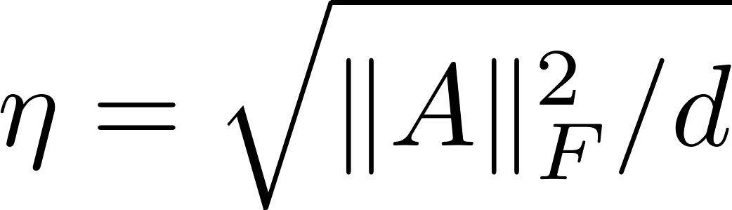

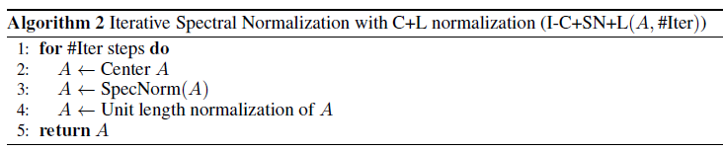
NORMALIZATION OF LANGUAGE EMBEDDINGS FOR CROSS-LINGUAL ALIGNMENT
Motivated by PCA Removal and spectral statistics in isomorphism quantifying:
where , the average of singular values, . All of the top directions are given the same singular value. Otherwise, if it is below $βη$, it is considered a minor effect (some are quite small, and fairly noisy), and it is left alone.
Iterative Spectral Normalization:

Slide 12
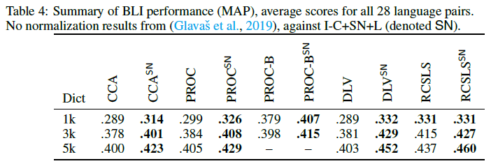
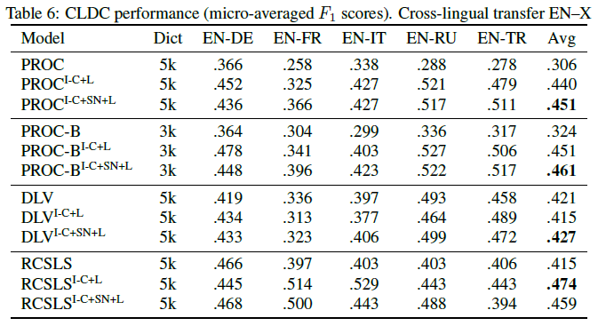
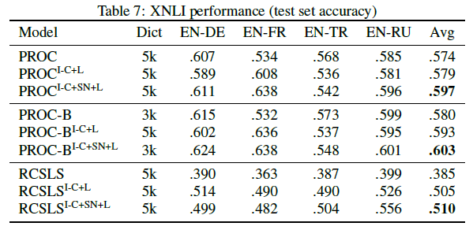
NORMALIZATION OF LANGUAGE EMBEDDINGS FOR CROSS-LINGUAL ALIGNMENT
Experiments

Slide 13
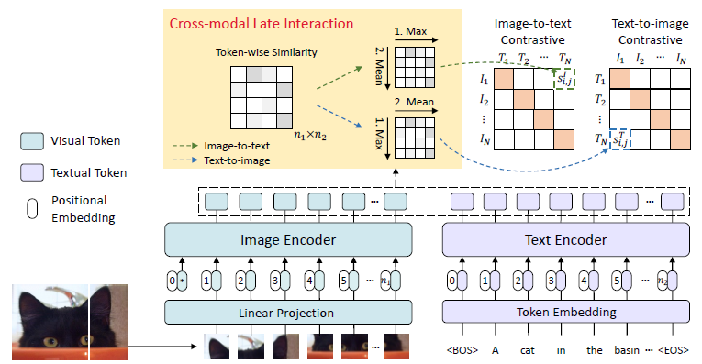
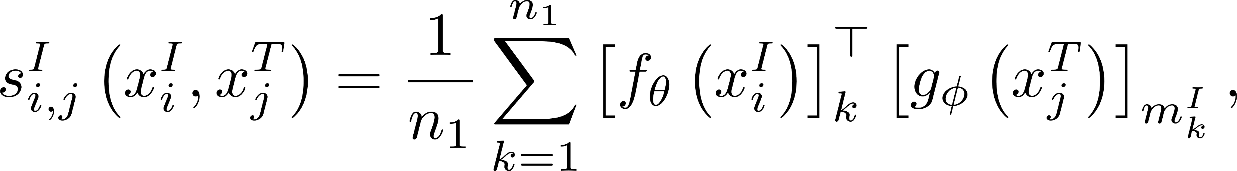
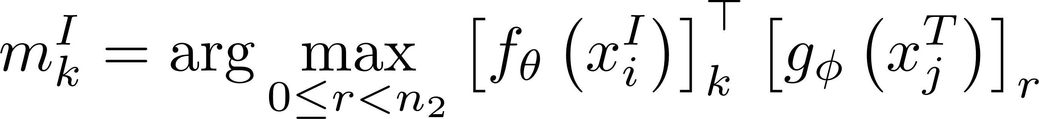
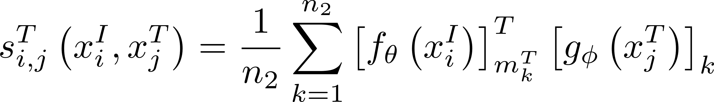
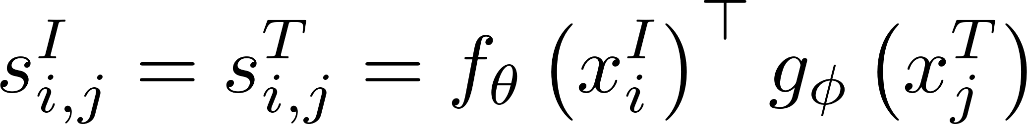
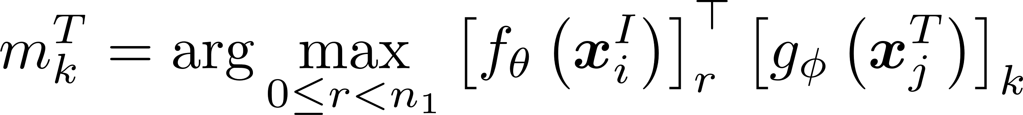
FILIP: FINE-GRAINED INTERACTIVE LANGUAGEIMAGE PRE-TRAINING
FILIP formulates the similarities between text and image in image-to-text as:
where
and similarities between text and image in image-to-text as:
CLIP, ALIGN: can be pre-computed offline, but via solely the similarity of the global feature
where
Cross Attention, Self Attention: fine-grained level, but the data from both modalities are intertwined, can not go offline.

Slide 14
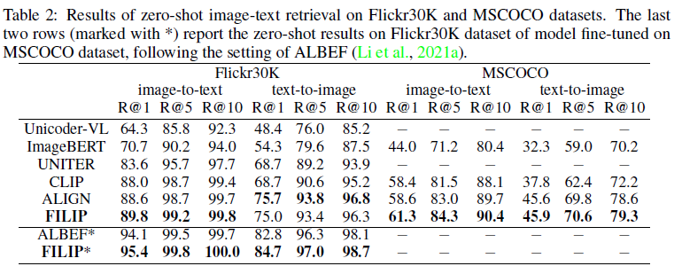
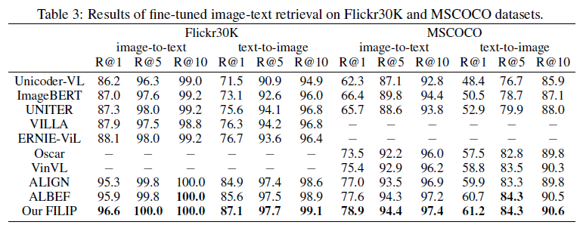
FILIP: FINE-GRAINED INTERACTIVE LANGUAGEIMAGE PRE-TRAINING
Experiments

Slide 15
The end

