Slide 1
Monogame
The game framework for C#

Slide 2

About me
Technical Lead - Confused.com
MVC
Azure
Forms over data
Entity framework
SQL Server
Blah blah blah
Notes:
day to day development
Love my job but sometimes…

Slide 3

Notes:
Add joke about the original title being “C# with fricking laser beams” but didn’t want people to think I was talking about a new javascript framework
Lead into history of game frameworks on windows

Slide 4
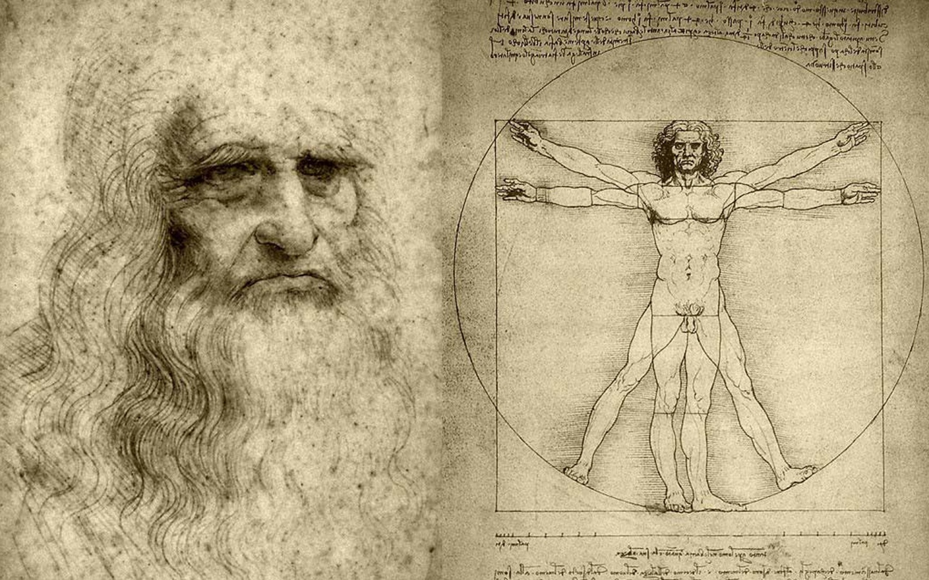
Making games is hard
Build game engine
Physics
Collision Detection
Animation
Create Assets
Characters
Sound Effects
Music
Menu Design
Notes:
Estimated Watchdogs had a dev team of 400-600 people
Torchlight (“Indie” game) ~15-20 people
Fez – 2 people
No Man Sky – 14 people

Slide 5

The Evolution of Monogame - DirectX
Access to GPU
C++
2D / 3D
.net access (via interop)
Notes:
Release in 95 (Windows 95)
Now in 12th iteration
3D libraries were introduced in 2nd/3rd edition.

Slide 6

The Evolution of Monogame - XNA
.net
Platform options
Windows
Windows Phone
Xbox 360
Zune!
2D / 3D
Notes:
2004 created.
Xbox indie marketplace – access to avatars
Some interesting games (Terraria, Kodu, illomilo ) but mostly garbage (see App Stores)
2013 – Microsoft stopped active development

Slide 7

The Evolution of Monogame
Familiar API
Multi platform
Windows
Mobile
Console
Open Source
2D / 3D
Notes:
Evolution of XNA Touch

Slide 8
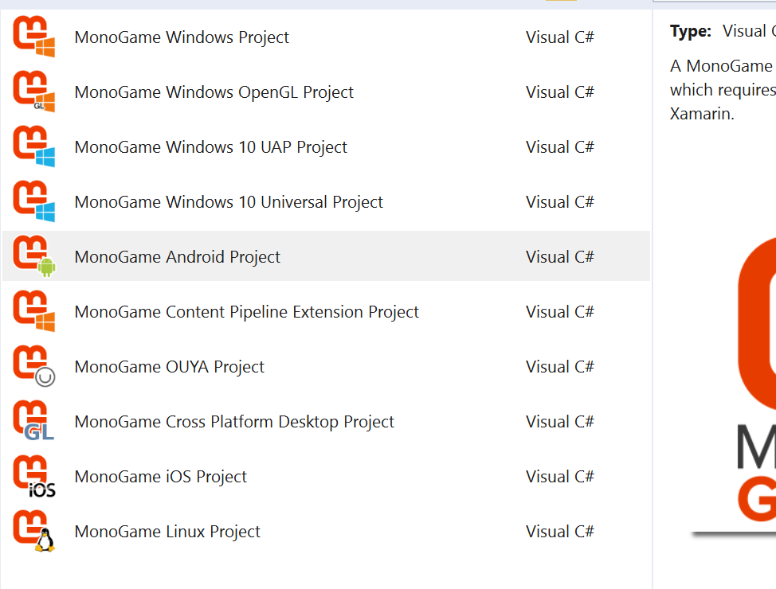
Getting started
Nuget (search monogame) ☹
Installer ☺

Slide 9
The game loop
Initialize Objects
Load Assets
Check for input
Game logic
Draw assets
Notes:
Mention performance (FPS)
Briefly describe assets

Slide 10
Initialize objects
Game
Components
Services
GraphicsDevice

Slide 11

Loading content
Content Types
Content.mgcb
Content Pipeline
Content Importers
Content Processors
Game.Content.Load<T>(“ContentIdentifier”)
Notes:
Talk about cross platform oddities

Slide 12

Draw (2D)
SpriteBatch
Draw method
Positioning
Animation

Slide 13
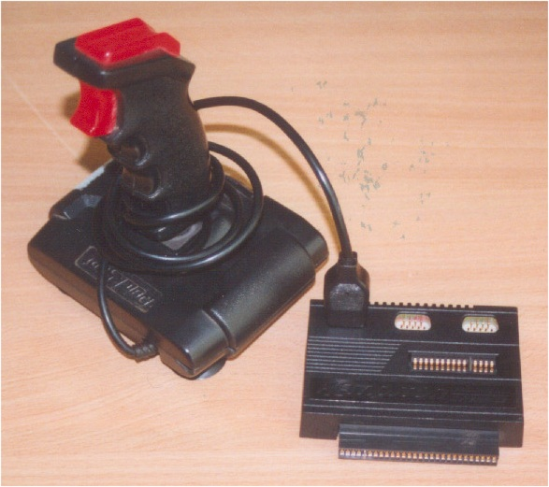
Update
Input
Keyboard (KeyboardState)
Touch (TouchPanel)
Controller (GamePad)
Mouse
Transform
Notes:
More on Input later

Slide 14

Lets build a game
Created in 1979
2D
Simple
ASTEROIDS
Notes:
Is being made into a film

Slide 15
Any questions….
Twitter: memleek
Xbox: memoryleek
Steam: memoryleek
Notes:
Currently playing fallout4, rocket league, lego dimensions

Slide 18
end

Slide 19

SHOWREEL
What are people making with Monogame

