Slide 1
MACHINE LEARNING in BIOINFORMATICS
Predicting Liver DISEASE USING LOGISTIC Regression and GENETIC Algorithm

Slide 2
OUTLINE
Results
Comparative Study
Conclusion
Acknowledgement
References
Introduction
What is Machine Learning?
Definition
Logistic Regression
Genetic Algorithm
Dataset
Implementation
Pipeline
Data Pre-processing
Feature Selection
Logistic Regression Model
Hyper-parameter tuning with Genetic Algorithm
GUI Demo

Slide 3
Introduction
In this short presentation, we would like to talk about and explore the various ways popular machine learning algorithms can help us extract useful and actionable data from seemingly ordinary datasets with its implementation.
We would also explore some popular machine learning algorithms and how they work.

Slide 4
WHAT IS MACHINE LEARNING?

Slide 5
DEFINITION
Some popular definitions are as follows
Arthur Samuel(1959): Field of study that gives computers the ability to learn without being explicitly programmed.
Tom Mitchell(1998): A computer program is said to learn from experience(E) with respect to some task (T) and some performance measure (P) , if its performance on T , as measured by P , improves with experience E.

Slide 6

LOGISTIC REGRESSIOn
Logistic regression is a supervised machine learning algorithm used for solving classification problems.
For example,
1. To predict whether an email is spam (1) or (0)
2. Whether the tumor is malignant (1) or not (0)
the logistic regression model uses the sigmoid function to squeeze the output of a linear hypothesis (θTx) between 0 and 1.
Here "sig(t)" represents the sigmoid function and "t" is the linear hypothesis,
The output of sigmoid funcition is the estimated probabilty that the "y = 1" ( i.e the prediction is positive)
for a given "x" (input)

Slide 7
GENETIC ALGORITHM
A Genetic Algorithms is a type of optimization algorithms. It is a stochastic method for function optimization based on the mechanics of natural genetics and biological evolution.
A genetic algorithm is a search heuristic that is inspired by Charles Darwin’s theory of natural evolution. This algorithm reflects the process of natural selection where the fittest individuals are selected for reproduction in order to produce offspring of the next generation.

Slide 8
DATASET

Slide 9
IMPLEMENTATION

Slide 10
PIPELINE
Pipeline Goes here

Slide 11
DATA PRE-PROCESSING

Slide 12
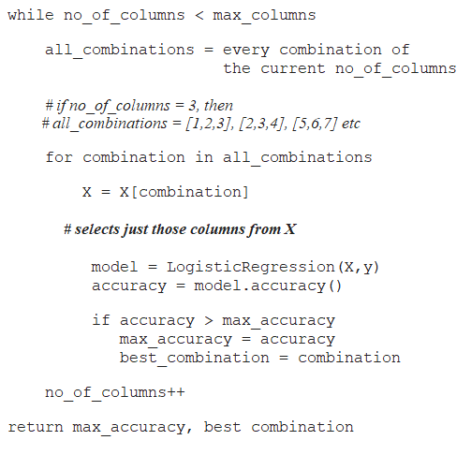
FEATURE SELECTION
we tried to find the optimum combination among the different features of the dataset that results in the maximum accuracy of the model. For that we are iterating through all the possible combination of all the possible sizes of the features, and choosing the combination that results in the optimum accuracy.

Slide 13
LOGISTIC REGESSION MODEL
After selecting features our logistic regression model consist of the following parameters:
C default value=1.0 : Inverse of regularization strength; must be a positive float. Like in support vector machines, smaller values specify stronger regularization.
tolfloat, default=1e-4 :Tolerance for stopping criteria.
penalty{‘l1’, ‘l2’, ‘elasticnet’, ‘none’}, default=’l2’ :Used to specify the norm used in the penalization.
solver{‘newton-cg’, ‘lbfgs’, ‘liblinear’, ‘sag’, ‘saga’}, default=’lbfgs’: Algorithm to use in the optimization problem.

Slide 14
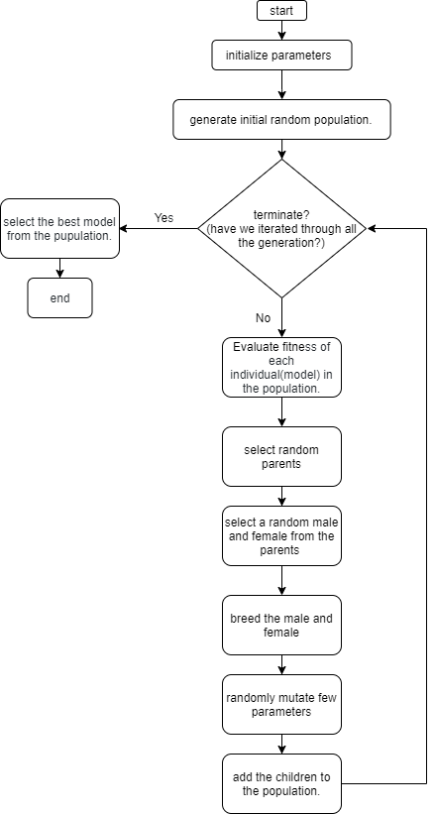
HYPER-PARAMETER TUNING USING GENETIC ALGORITHM
Components of Genetic Algorithm.
1. Random initial population.
2. Fitness Function
3. Selection of random parents
4. Breeding
5. Mutation

Slide 15
Graphical USER-INTERFACE

Slide 16
RESULTS

Slide 17
ACCURACY

Slide 18
LOGISTIC CURVE

Slide 19
CONFUSION MATRIX

Slide 20
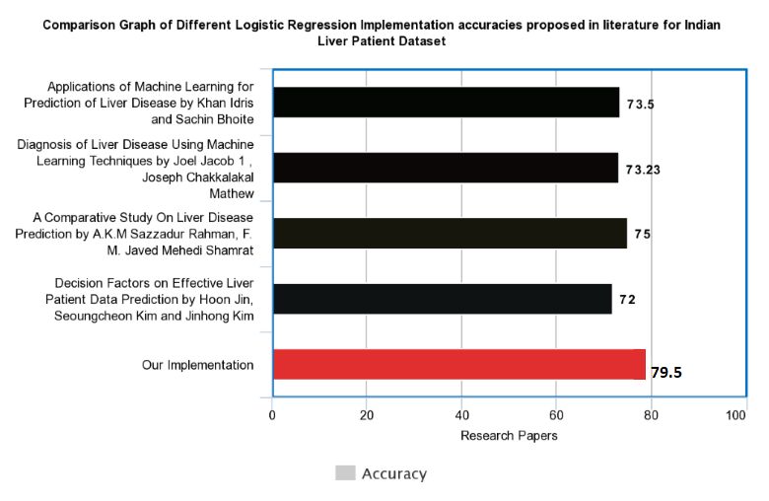
Comparative Study

Slide 21
CONCLUSION
As we can observe, there is plenty of scope in the field of Bio-Medical Informatics for us, as budding Computer Science students to explore and implement ground-breaking algorithms & machine learning pipelines to extract meaningful inferences that can directly help people.
It is our conviction that we would contribute to this ever-growing field and improve our initial understandings.

Slide 22
Acknowledgment
We would like to thank our mentor Mr. Sabyasachi Mukherjee Sir, for his continuous guidance during the preparation for this topic.
We would like to thank the Head of Computer Science & Engineering department, Dr. Monish Chatterjee for providing us with the opportunity to explore such technological fields.

Slide 23
REFERENCES
1. Dataset was taken from the popular UCI Machine Learning Repository
http://archive.ics.uci.edu/ml/machine-learning-databases/heart-disease/
2. The Python in-built machine learning module "Scikit-Learn"
https://scikit-learn.org/stable/
3. Understanding of the Algorithms and various Data Science costructs from the popular MOOC by Andrew Ng
https://www.coursera.org/learn/machine-learning-with-python

