Slide 1
MACHINE LEARNING PARADIGMS
IN BIOINFORMATICS
Presented By
Farooq Ansari (10800116102)
Rohit Kumar Majee (10800116061)
Arkadeep Bagal (10800116108)
Rohan Kumar Singh (10800116062)

Slide 2
Introduction
In this short presentation, we would like to talk about and explore the various ways popular machine learning algorithms can help us extract useful and actionable data from seemingly ordinary datasets with its implementation.
We would also explore some popular machine learning algorithms and how they work.

Slide 3
Outline
Introduction
What is Machine Learning?
Types of Machine Learning Algorithms
Implementation of a Working Model
Planned Future Work
Conclusion
Acknowledgement
References

Slide 4
What is Machine Learning?
Some popular definitions are as follows
Arthur Samuel(1959): Field of study that gives computers the ability to learn without being explicitly programmed.
Tom Mitchell(1998): A computer program is said to learn from experience(E) with respect to some task (T) and some performance measure (P) , if its performance on T , as measured by P , improves with experience E.

Slide 5
Types of Machine Learning Algorithms

Slide 6
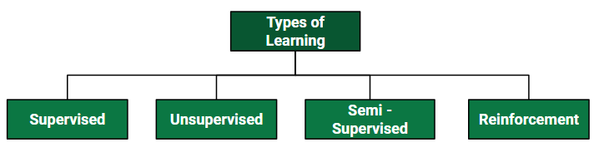
Machine Learning Algorithms

Slide 7
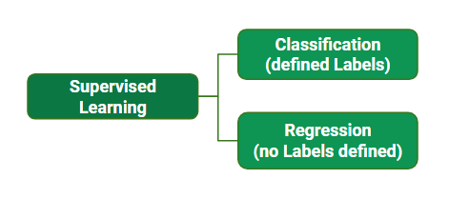
Supervised Learning

Slide 8
Supervised Learning
Supervised learning is when the model is getting trained on a labelled dataset.
Labelled dataset is one which have both input and output parameters. In this type of learning both training and validation datasets are labelled
Example:
Linear Regression
Logistic Regression

Slide 9
Types of Supervised Learning
Classification Algorithms
These are the kinds of algorithms with produces defined labels or discrete values as output.
Ex. - Logistic Regression, Neural Networks

Slide 10
Types of Supervised Learning
Logistic Regression is a Machine Learning classification algorithm that is used to predict the probability of a categorical dependent variable.
In logistic regression, the dependent output variable is a binary variable that contains data coded as 1 (yes, success, etc.) or 0 (no, failure, etc.).

Slide 11
Types of Supervised Learning
Regression Algorithms
Here, we fit a curve / line to the data points, in such a manner that the differences between the distances of data points from the curve or line is minimized. We obtain a continuos output variable.
Ex. - Linear Regression, Support Vector Regression

Slide 12
Types of Supervised Learning
Linear Regression is a supervised machine learning algorithm where the predicted output is continuous and has a constant slope. It’s used to predict values within a continuous range, (e.g. sales, price) rather than trying to classify them into categories (e.g. cat, dog).

Slide 13
Unsupervised Learning
It is the training of machine using information that is neither classified nor labeled and allowing the algorithm to act on that information without guidance. Here the task of machine is to group
unsorted information according to similarities, patterns and differences without any prior training of data.
Ex. K-Means Clustering, Principle Component Analysis

Slide 14
Types of Unsupervised Learning
K-Means Clustering is an iterative clustering algorithm which helps you to find the highest value for every iteration. Initially, the desired number of clusters are selected. In this clustering method, you need to cluster the data points into k groups.
The output of the algorithm is a group of "labels." It assigns data point to one of the k groups. In k-means clustering, each group is defined by creating a centroid for each group, they capture the points closest to them and adds them to the cluster.

Slide 15
Implementation of Machine Learning for Bioinformatics

Slide 16
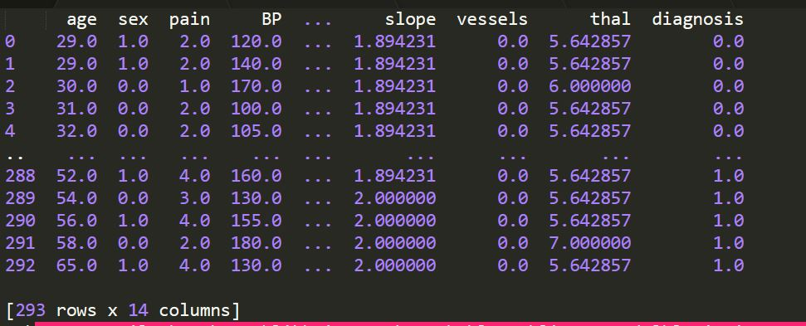
The Hungarian Heart Disease Dataset

Slide 17
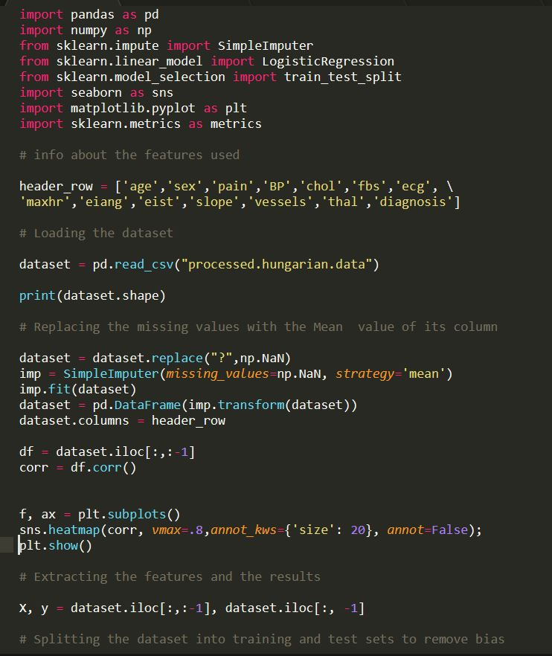
Source Code

Slide 18
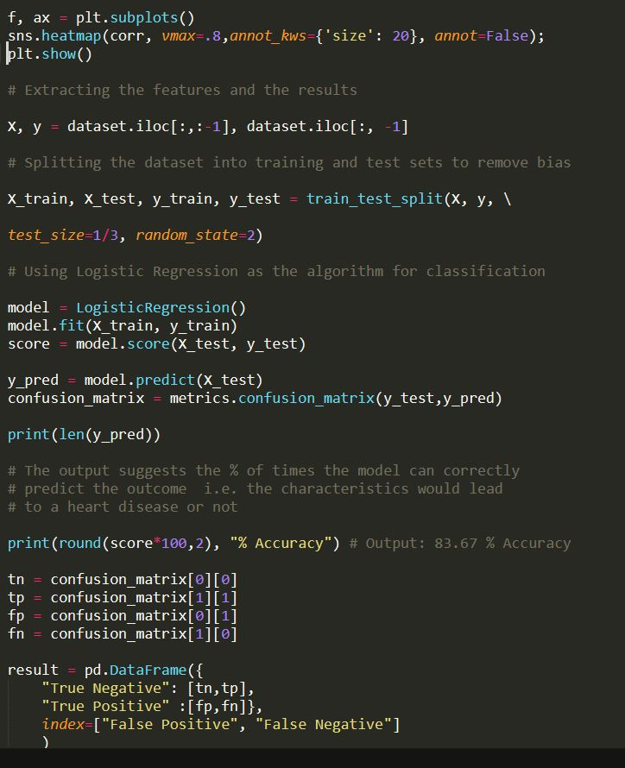
Source Code

Slide 19
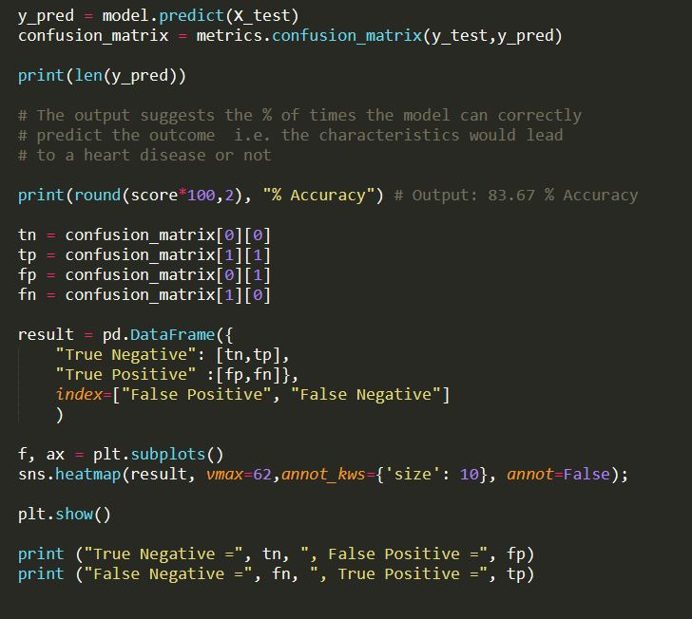

Slide 20
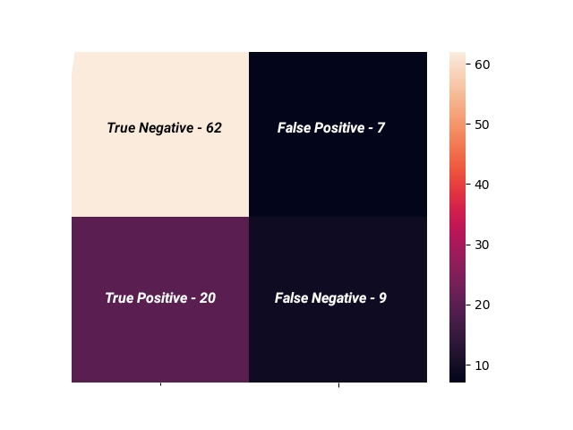
Result

Slide 22
Future Work
More visually descriptive
Improving the accuracy
Cleaning the data
Performance measures.
Analyzing the original 1987 Dataset

Slide 23
Conclusion
As we can observe, there is plenty of scope in the field of Bio-Medical Informatics for us, as budding Computer Science students to explore and implement ground-breaking algorithms & machine learning pipelines to extract meaningful inferences that can directly help people.
It is our conviction that we would contribute to this ever-growing field and improve our initial understandings.

Slide 24
Acknowledgement
We would like to thank our mentor Mr. Sabyasachi Mukherjee Sir, for his continuous guidance during the preparation for this topic.
We would like to thank the Head of Computer Science & Engineering department, Dr. Monish Chatterjee for providing us with the opportunity to explore such technological fields.

Slide 25
References
1. Dataset was taken from the popular UCI Machine Learning Repository
http://archive.ics.uci.edu/ml/machine-learning-databases/heart-disease/
2. The Python in-built machine learning module "Scikit-Learn"
https://scikit-learn.org/stable/
3. Understanding of the Algorithms and various Data Science costructs from the popular MOOC by Andrew Ng
https://www.coursera.org/learn/machine-learning-with-python

