Slide 1




FINAL LAB SESSION
Zero-Knowledge
Attribute Proofs
Veritasia × CineVault • Circom mini-lab • End-to-end demo
Debrup Chatterjee | February 2026 | Hackathon Lecture Series

Slide 2





OVERVIEW
Agenda
60 minutes
1
2
3
4
5
Framing &
Use Case
Circom
Mini-Lab
End-to-end
Demo
Protocol
Landscape
Resources &
Wrap-up
Final Lab • ZK Attribute Proofs

Slide 3





THE CHALLENGE
Prove a predicate about
an attribute without
revealing the attribute.
Predicate
Boolean function over hidden data
Privacy
Verifier learns only accept / reject
Multi-verifier
Same credential, many verifiers
Nonce
Fresh challenge prevents replay
Attribute
Predicate
Proof
Verifier
Final Lab • ZK Attribute Proofs

Slide 4



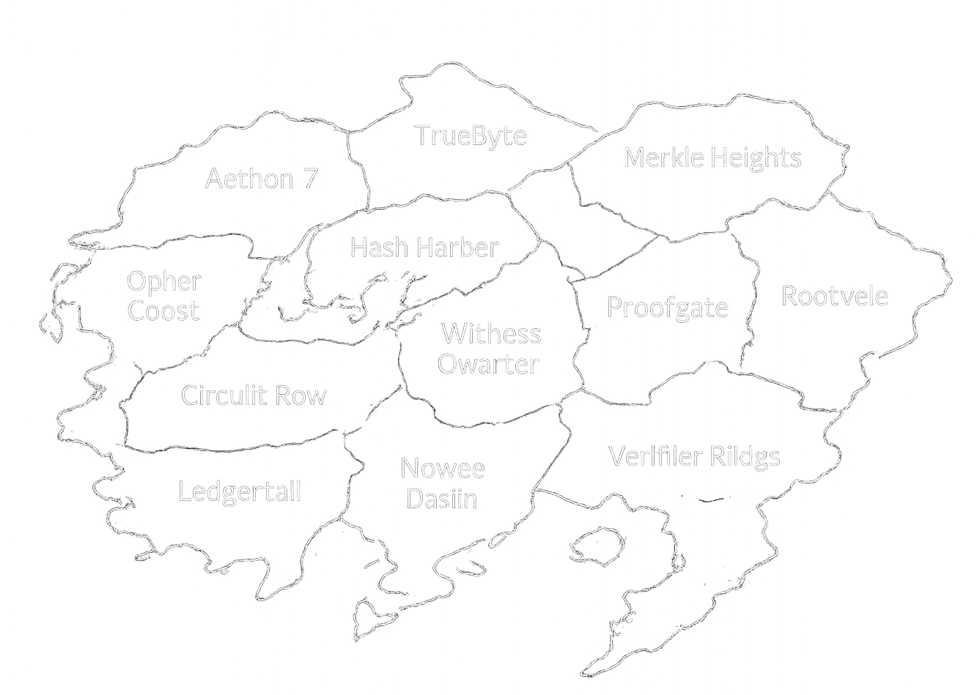


USE CASE
01
Issue Credential
Veritasia ↔ CineVault
Veritasia issues a credential with attributes (e.g., birth year) to the holder.
02
Nonce Challenge
CineVault sends a fresh nonce requesting an eligibility proof (age ≥ 18).
03
Prove Without Revealing
User generates a ZK proof - verifier learns only accept/reject, never the raw attribute.
Final Lab • ZK Attribute Proofs

Slide 5




Building the story
Demo Use case
I wanna see the movie!
CineVault
Show me you are of age !!
After Dark Protocol
Final Lab • ZK Attribute Proofs

Slide 6

MAPPING TO ZKP
Story → ZKP Objects
Attribute
Predicate
Private Input
Proved Statement
Birth year, membership tier, score - the value hidden from the verifier.
Boolean function the circuit enforces: age ≥ 18, tier ∈ {gold, platinum}.
Public Output
Verification Context
Accept / Reject
Nonce + Params
The single bit the verifier learns - nothing more, nothing less.
Nonce binds proof to session; issuer root anchors trust chain.
Final Lab • ZK Attribute Proofs

Slide 7

ARCHITECTURE
Roles & Message Flow
proof + signals
credential / root
Verifier A
CineVault
Issuer
Holder / Prover
Veritasia
User Wallet
← nonce
Verifier B
proof + signals
Other Service
Final Lab • ZK Attribute Proofs

Slide 8

02
Circom Mini-Lab
Build the ≥ 18 circuit • Compile • Generate witness
Final Lab • ZK Attribute Proofs

Slide 9




CIRCOM
What It Is
What
When
Output
A constraint-system DSL for authoring ZK circuits. Signal relationships become R1CS constraints.
Encode predicates and math relations - not UI, networking, or business logic.
Compiled artifacts (.r1cs, .wasm, .zkey) feed the prover/verifier toolchain.
Final Lab • ZK Attribute Proofs

Slide 10


PIPELINE
Circuit → Proof
1
2
3
4
5
Write
Circuit
Compile
(R1CS)
Generate
Witness
Prove
Verify
Final Lab • ZK Attribute Proofs

Slide 11
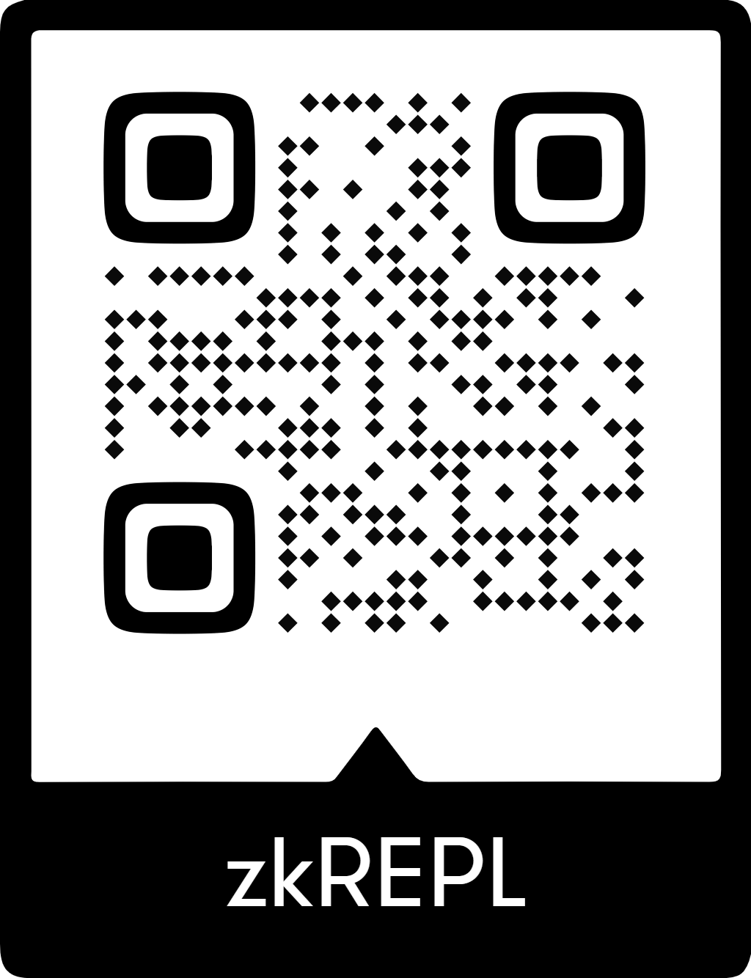
MINI-LAB
Build the
≥ 18 Circuit
$ cd circuits/age-check
$ circom ageCheck.circom --r1cs --wasm
template instances: 1
non-linear constraints: 2
Compiled successfully.
$ node generate_witness.js \
ageCheck.wasm input.json witness.wtns
Witness generated. ✓
✓
Edit circuit template
✓
Compile to R1CS + WASM
✓
Generate & check witness
Final Lab • ZK Attribute Proofs

Slide 12
CIRCUIT SKETCH
≥ 18 Predicate
Signals
// ageCheck.circom
pragma circom 2.0.0;
template AgeCheck() {
signal input birthYear;
signal input currentYear;
signal input thresholdAge;
signal input nonce;
signal output ok;
// core constraint
signal age <== currentYear - birthYear;
ok <== age >= thresholdAge ? 1 : 0;
}
PRIVATE INPUTS
birthYear - user's birth year
nonce - verifier challenge
PUBLIC INPUTS
currentYear
thresholdAge - 18
OUTPUT
ok
- 1 = accept, 0 = reject
Final Lab • ZK Attribute Proofs

Slide 13
03
End-to-End Demo
Issue → Prove → Verify • Three services, one flow
Final Lab • ZK Attribute Proofs

Slide 14
DEMO FLOW
Three Steps
01
02
03
Issue / Enroll
Generate the Proof
Verification of proof
Veritasia issues a credential with attributes to the holder wallet.
Holder generates a ZK proof bound to CineVault's nonce challenge.
CineVault verifies the proof shared by the user and accepts or rejects the proof.
Final Lab • ZK Attribute Proofs

Slide 15
COMPONENT
Issuer (Veritasia)
Maintains user registry & attribute store
$ node issuer/start.js
Issuer service running on :3001
$ curl -X POST :3001/enroll \
-d '{ "userId": "alice" }'
→ credential issued, root updated
Signs credential with issuer private key
Publishes Merkle root / public params
Final Lab • ZK Attribute Proofs

Slide 16
COMPONENT
Prover / Holder
Receives nonce from verifier endpoint
$ node prover/prove.js --nonce abc123
Loading credential for alice...
Generating witness...
Computing proof (Groth16)...
Proof generated ✓
Public signals: [1, ...]
Loads credential + private attributes
Generates ZK proof + public signals
Final Lab • ZK Attribute Proofs

Slide 17
COMPONENT
Verifier(s)
Verifier - CineVault
$ curl :3002/nonce
→ { "nonce": "abc123" }
$ curl -X POST :3002/verify \
-d '{ "proof": ..., "signals": ... }'
→ ACCEPT ✓
Final Lab • ZK Attribute Proofs

Slide 18

04
Protocol Landscape
Options, deliverables & resources
Final Lab • ZK Attribute Proofs

Slide 19
COMPARISON
Protocol Options
Protocol | Setup | Proof Size | Strengths | Trade-offs
Groth16 | Trusted (per-circuit) | ~200 B | Smallest proof, fast verification | Trusted setup per circuit
PLONK | Universal (one-time) | ~400 B | Universal SRS, reusable | Slightly larger proofs
Halo 2 | Transparent (IPA) | ~1–5 KB | No trusted setup, recursive | Slower verification
Bulletproofs | Transparent | ~700 B | Range proofs, no setup | Linear verification time
STARKs | Transparent (FRI) | ~50–200 KB | Post-quantum, scalable | Large proofs
Sizes vary by curve, implementation, and statement complexity.
Final Lab • ZK Attribute Proofs

Slide 20


DELIVERABLES
What You'll Ship & What's Next
Checklist
Extension Ideas
✓
Design document (protocol + dataflow)
Add membership / range predicates
Swap Groth16 for PLONK (universal SRS)
✓
Working prototype (issuer/holder/verifier(s))
Add revocation via on-chain nullifiers
✓
Automated demo script (happy path)
Build a mobile wallet UI
✓
Benchmarks / evaluation report
Integrate with DID / Verifiable Credentials
Benchmark proof times across protocols
✓
Short demo video (3–5 min)
Final Lab • ZK Attribute Proofs

Slide 21

Resources
Run This Lab
Learn / Reference
Repository
Circom Documentation
https://github.com/fortytwolabs/hackathon-2026-fortytwo-labs-deck
docs.circom.io
Demo Runbook
snarkjs (iden3)
See repo/README.md
github.com/iden3/snarkjs
zkREPL (fallback)
Groth16 / PLONK Papers
zkrepl.dev
eprint.iacr.org
Slides PDF
Bulletproofs / Halo2 / STARKs
See repo /ppt/
Various - see runbook
Secure Today. Future Ready.

Slide 22
#
Circom Mini Lab Slides
Extra Resources
Final Lab • ZK Attribute Proofs

Slide 23


Arithmetic Circuits
Fix a finite field for some prime p > 2
Arithmetic circuit
Directed Acyclic Graph(DAG) where internal nodes are labled + or × and inputs are labled 1, x₁, …, x_{n}
Defines an n variate polynomial with an evaluation recipe.
23

Slide 24
Arithmetic Circuits
Fix a finite field for some prime p > 2
Arithmetic circuit
Directed Acyclic Graph(DAG) where internal nodes are labled + or × and inputs are labled 1, x₁, …, x_{n}
Defines an n variate polynomial with an evaluation recipe.
(x₁+x₂+1)(x₂+1)
×
+
+
x₁
x₂
1
24

Slide 25
Arithmetic Circuits
Fix a finite field for some prime p > 2
Arithmetic circuit
Directed Acyclic Graph(DAG) where internal nodes are labled + or × and inputs are labled 1, x₁, …, x_{n}
Defines an n variate polynomial with an evaluation recipe.
|C| = # gates in C
Examples:
C_{SHA}(h, m): outputs 0 if SHA256(m) = h , and ≠0 otherwise
C_{hSHA}(h, m) = (h – SHA256(m)) , |C_{SHA}| ≈ 20K gates
(x₁+x₂+1)(x₂+1)
×
+
+
x₁
x₂
1
25

Slide 26
ZKPs for predicate 𝜙
Prover knows 𝜙, 𝑥, y
Verifier knows 𝜙, 𝑥
Proof 𝜋 shows that 𝜙(𝑥, a) holds but does not reveal a
26
26

Slide 27
ZKPs for predicate 𝜙
Prover knows 𝜙, 𝑥, y
Verifier knows 𝜙, 𝑥
Proof 𝜋 shows that 𝜙(𝑥, a) holds but does not reveal a
Key Question: what can 𝜙 be?​
27
27

Slide 28
ZKPs for predicate 𝜙
Prover knows 𝜙, 𝑥, y
Verifier knows 𝜙, 𝑥
Proof 𝜋 shows that 𝜙(𝑥, a) holds but does not reveal a
Key Question: what can 𝜙 be?​
𝜙 in theory​
a is a factorization of​ integer 𝑥​
𝜙 in practice
𝜙 is an “arithmetic circuit” over inputs 𝑥, a
28
28

Slide 29
R1CS: a common Arithmetic Circuit format
Definition:
𝑥: field elements 𝑥₁, … , 𝑥_{ℓ}
y: y₁, … , y_{n-ℓ}
𝜙: 𝑛 equations of form 𝛼×𝛽 = 𝛾
where 𝛼, 𝛽, 𝛾 are affine combinations of variables
29
29

Slide 30
R1CS: a common Arithmetic Circuit format
Definition:
𝑥: field elements 𝑥₁, … , 𝑥_{ℓ}
y: y₁, … , y_{n-ℓ}
𝜙: 𝑛 equations of form 𝛼×𝛽 = 𝛾
where 𝛼, 𝛽, 𝛾 are affine combinations of variables
Examples:
y₁ × (y₂ - y₃ − 1) = 𝑥₁
y₁×y₂ = y₃
y₁×y₂×y₃ = 𝑥₁
y₁ ×y₂ = y₄
y₄ ×y₃ = 𝑥₁
30
30

Slide 31



R1CS: a common Arithmetic Circuit format
Definition:
𝑥: field elements 𝑥₁, … , 𝑥_{ℓ}
y: y₁, … , y_{n-ℓ}
𝜙: 𝑛 equations of form 𝛼×𝛽 = 𝛾
where 𝛼, 𝛽, 𝛾 are affine combinations of variables
Examples:
y₁ × (y₂ - y₃ − 1) = 𝑥₁
y₁×y₂ = y₃
y₁×y₂×y₃ = 𝑥₁
y₁ ×y₂ = y₄
y₄ ×y₃ = 𝑥₁
31
31

Slide 32
CIRCOM & SNARKJS
1
Design your arithmetic circuit and write your circuit using circom
High-level circuit
description
Use your own code or Use safe templates from Circomlib

Slide 33
CIRCOM & SNARKJS
1
Design your arithmetic circuit and write your circuit using circom
High-level circuit
description
Circuit Compiler (circom)
Use your own code or Use safe templates from Circomlib
2
Compile the circuit to get a low-level representation (R1CS)
$ circom circuit.circom --r1cs --wasm --sym

Slide 34
CIRCOM & SNARKJS
1
Design your arithmetic circuit and write your circuit using circom
High-level circuit
description
Circuit Compiler (circom)
Low-level circuit description
Use your own code or Use safe templates from Circomlib
2
Compile the circuit to get a low-level representation (R1CS)
$ circom circuit.circom --r1cs --wasm --sym
3
Use snarkjs to compute your witness
$ node generate_witness.js multiplier2.wasm input.json witness.wtns

Slide 35
CIRCOM & SNARKJS
1
Design your arithmetic circuit and write your circuit using circom
High-level circuit
description
Circuit Compiler (circom)
Low-level circuit description
Use your own code or Use safe templates from Circomlib
2
Compile the circuit to get a low-level representation (R1CS)
$ circom circuit.circom --r1cs --wasm --sym
Crypto Compiler (snarkjs)
3
Use snarkjs to compute your witness
$ node generate_witness.js multiplier2.wasm input.json witness.wtns
(Trusted Setup)
4
Generate a trusted setup and get your verification key
Proving key
Validation key
$ snarkjs groth16 setup multiplier2.r1cs pot12_final.ptau multiplier2_0000.zkey
$ snarkjs zkey contribute multiplier2_0000.zkey multiplier2_final.zkey
--name="1st Contributor" -v
$ snarkjs zkey export verificationkey multiplier2_final.zkey verification_key.json

Slide 36
CIRCOM & SNARKJS
1
Design your arithmetic circuit and write your circuit using circom
High-level circuit
description
Circuit Compiler (circom)
Low-level circuit description
Use your own code or Use safe templates from Circomlib
2
Compile the circuit to get a low-level representation (R1CS)
$ circom circuit.circom --r1cs --wasm --sym
Crypto Compiler (snarkjs)
3
Use snarkjs to compute your witness
$ node generate_witness.js multiplier2.wasm input.json witness.wtns
(Trusted Setup)
4
Generate a trusted setup and get your verification key
Proving key
Validation key
$ snarkjs groth16 setup multiplier2.r1cs pot12_final.ptau multiplier2_0000.zkey
$ snarkjs zkey contribute multiplier2_0000.zkey multiplier2_final.zkey
--name="1st Contributor" -v
$ snarkjs zkey export verificationkey multiplier2_final.zkey verification_key.json
Inputs
( public, private )
5
Generateyour proof and validate it!
Crypto Compiler (snarkjs)
Crypto Compiler (snarkjs)
$ snarkjs groth16 prove multiplier2_final.zkey witness.wtns proof.json public.json
$ snarkjs groth16 verify verification_key.json public.json proof.json
ZK-SNARK Proof π
Verifier

