Slide 1


TRINITY
Faith • Community • Hope
A Nonprofit Ministry for the Romanian Orthodox Diaspora in the United States
Endorsed by the Romanian Consulate in Los Angeles & the Romanian Patriarchate

Slide 2
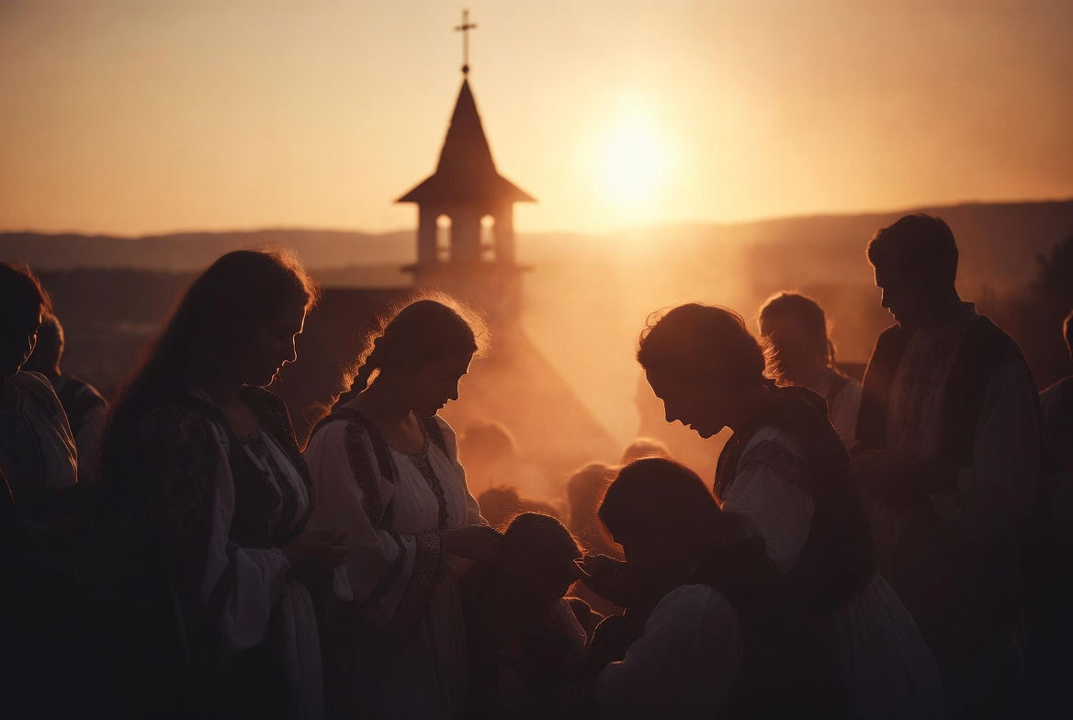
THE NEED
Bridging the Gap for
Romanian Orthodox Faithful
Over one million Romanians call the United States home. Many face the quiet ache of spiritual disconnection — far from ancestral parishes, navigating life in a new land while striving to pass on the beauty of Orthodox faith and Romanian culture to their children.
Trinity was born to answer this call: a living bridge of faith, practical help, and authentic community for the diaspora.

Slide 3
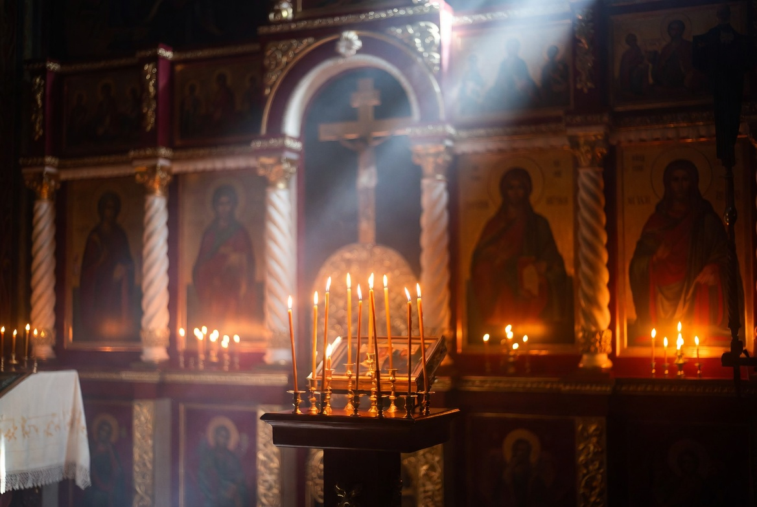



INTRODUCING TRINITY
Three Pillars. One Sacred Mission.
Rooted in the Holy Trinity and the rich tradition of the Romanian Orthodox Church, Trinity offers a holistic ministry of presence, compassion, and celebration for Romanians across America.
HELP
CONNECT
EVENTS
Tangible compassion and practical support for families and individuals in need.
Authentic relationships, spiritual networks, and a true sense of belonging.
Vibrant celebrations of faith, culture, and the joy of Orthodox life together.

Slide 4
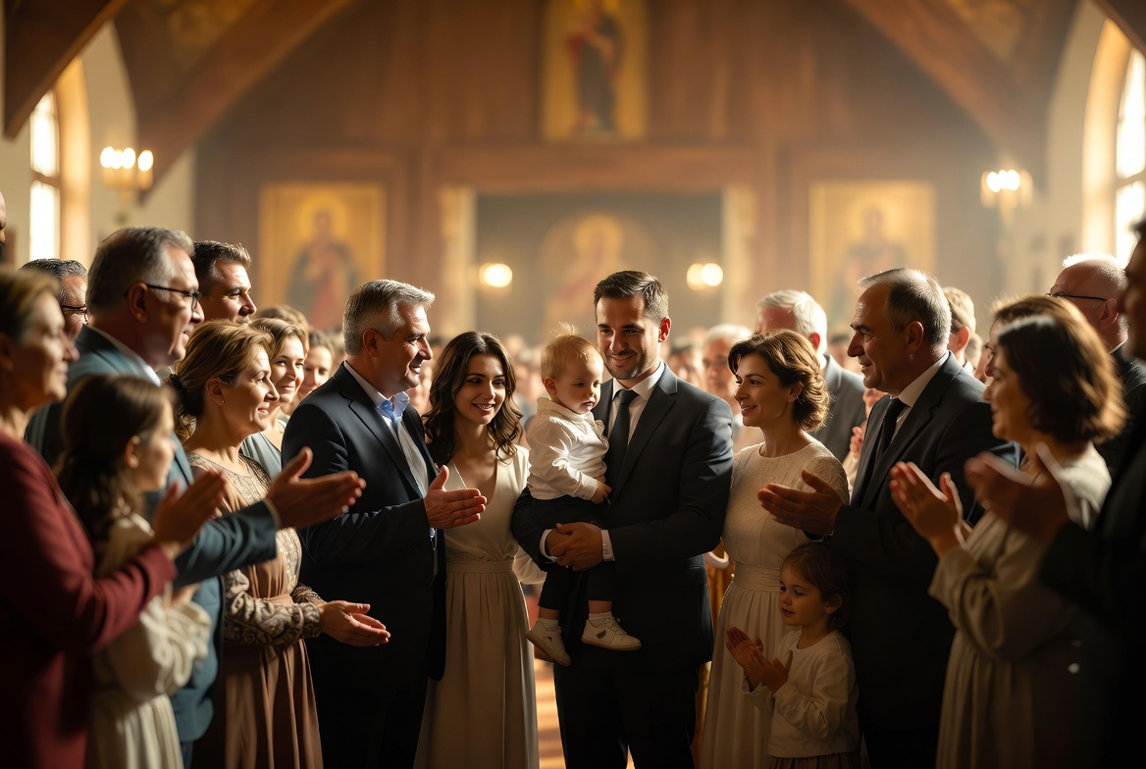

PILLAR ONE
HELP
Compassion in Action
We walk alongside Romanian families and individuals with practical love and spiritual care:
Emergency financial assistance & charitable aid
Family counseling and pastoral care
New immigrant integration support
Youth mentorship & educational resources
Confidential guidance through life's transitions

Slide 5
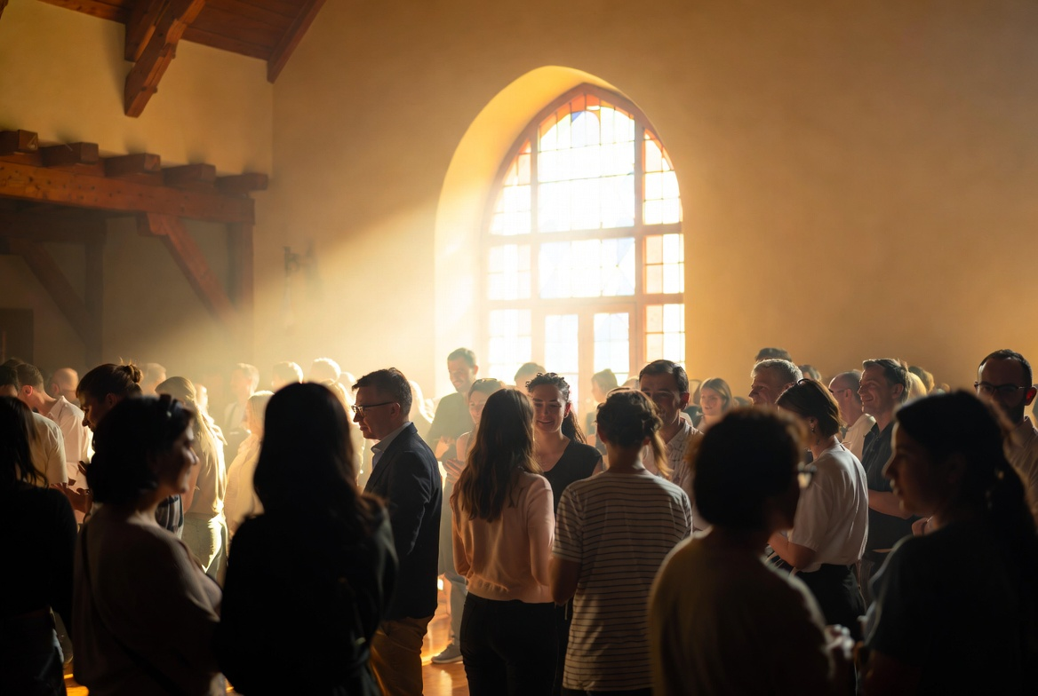
PILLAR TWO
CONNECT
A Family Away From Home
Parish-based & online small faith groups
Intergenerational mentorship programs
Prayer chains & spiritual companionship
Cultural & linguistic heritage initiatives
Dedicated digital platform for the diaspora

Slide 6
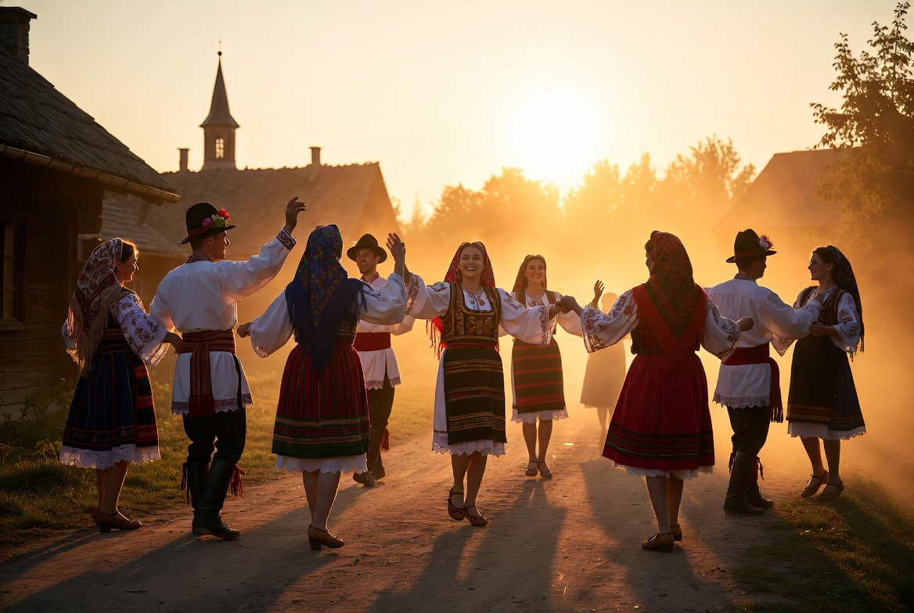
PILLAR THREE
EVENTS
Celebrating Faith & Heritage
Holy Liturgy & major feast day services
Romanian cultural festivals & traditions
Educational workshops & faith lectures
Youth retreats and family gatherings
Annual charity galas & outreach events

Slide 7
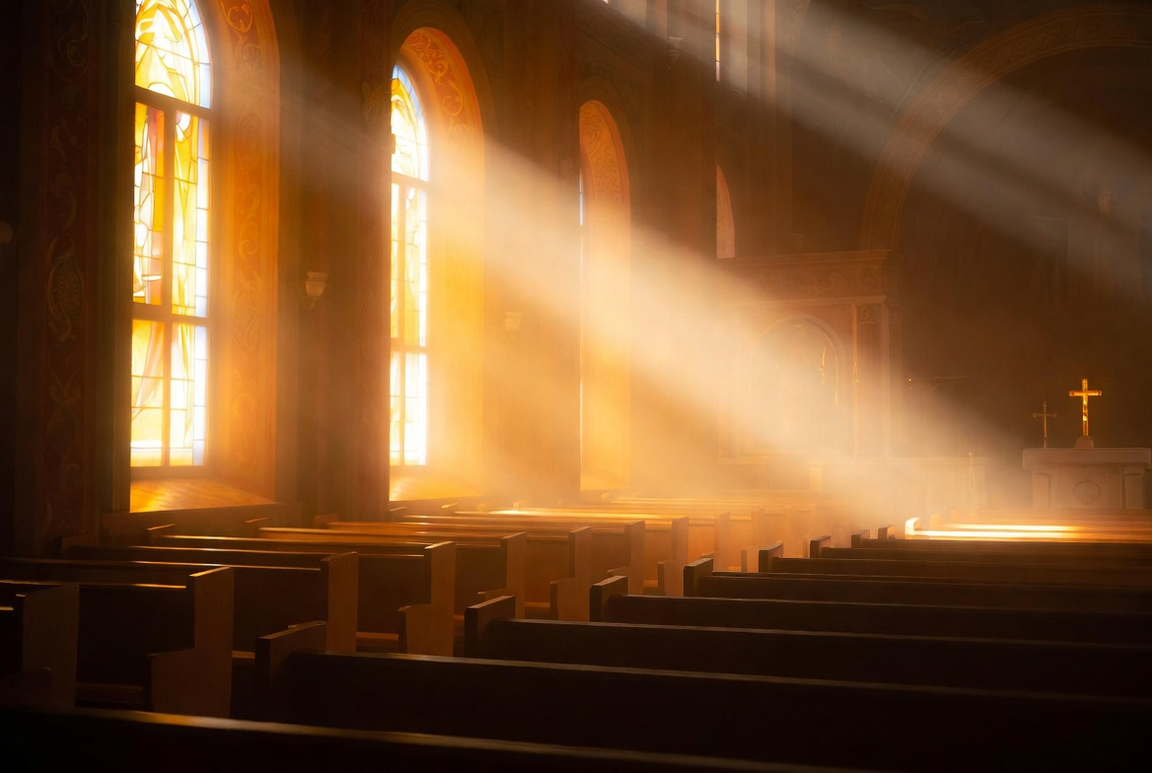
OUR MODEL
Sustainable Ministry Through
Monthly Subscription
Trinity operates as a 501(c)(3) nonprofit, sustained by the faithful monthly commitments of our community. This model ensures stable, long-term impact and allows us to plan meaningful programs without the uncertainty of one-time giving.
Companion
Family
Patron
$10 / month
$25 / month
$50 / month
Prayer support • Newsletter • Event updates
All Companion benefits + Event discounts • Small group access
All Family benefits + Private events • Recognition • Direct impact reports

Slide 8


ENDORSED & TRUSTED
Building Legacy Together
Trinity is honored to serve under the blessing and endorsement of:
Romanian Consulate
in Los Angeles
The Romanian
Patriarchate
Join the Trinity Family
Monthly Subscription • Volunteer • Partner with Us
"Where two or three are gathered in My name, there I am in the midst of them."
— Matthew 18:20
Trinity Ministry | Romanian Orthodox Diaspora | Los Angeles, California

