Slide 1
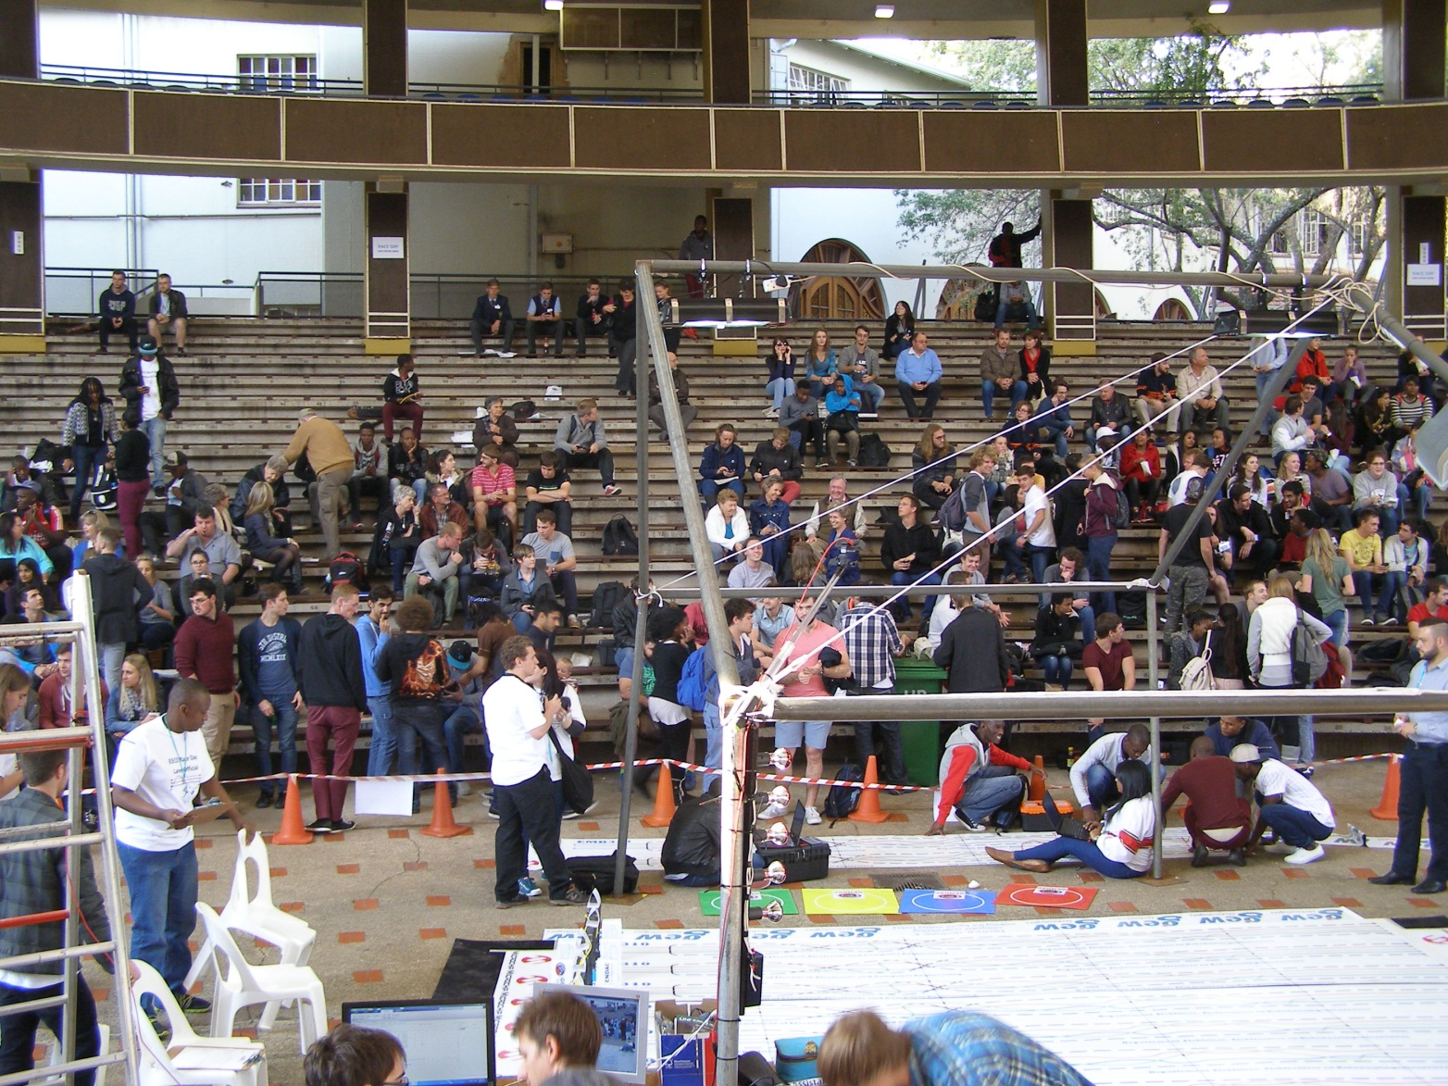
Welcome to EMK310 continued…

Slide 2
Assistant Lecturers
AGS - Mr Alkmaar Swart
Race Day - Mr Bernard Bauermeister
Pracs - Mr Duayne Strydom
Theory - Mr Jacques Van der Westhuizen
General – Ms Elizabeth Stanley

Slide 3
Practicals: Hardware
Collect on Friday
PICkit 3 included in tuition fees
Microchip samples (sponsored by Microchip)
N20-kit brushed dc motor included in tuition fees (compulsory motor for ARV)
Collection of PICkit3, motor & sponsored components
Refer to ClickUp page for date and time
Must be registered for the module
Bring along anti-static packaging for the samples (e.g. a piece of polystyrene covered with foil)

Slide 4

Test and exams
Semester tests
First: Theory
Multiple choice
Second: Application
Coding in computer lab; upload code onto server.
Open book. Refer to study guide.
100% penalization if code does not compile.
Automatic grading
Class tests
First: Application
Same rules apply as for semester test 2
Second: Theory
Same rules apply as for semester test 1
Exam
Theory and coding
Open book. Refer to study guide.
In computer lab
100% penalization if code does not compile.
Automatic grading
Semester test 1 & Class test 2
(Theory)

Slide 5
Automatic grading software (AGS)
Objective
Subsections of code
Strict syntax requirements
Immediate results
Binary marking for subsections (as was the case since always)
Opportunity for practice via old tests and exams
(this means you'll never get an old paper, so don't memorize old memos)

Slide 6

AGS panel
Objective: optimization of AGS for variations in interpretation and implementation.
Members: good students appointed by class through class reps
3 Electronic
3 Electrical
4 Computer
Responsibilities: All coding tests graded
by AGS including sick & supp.
Approach: Panel’s code will be put through AGS first, AGS is then optimized after which bulk of tests are graded.
Tested in 2014 > extremely effective.
Please…

Slide 7
Subminima
Semester mark (Exam entrance)
40% for pracs
40% for theory (textbook) component
40% for application (code) component
Examination
40% for theory (textbook) component
40% for application (code) component

Slide 8
Schedule
Complete schedule, including class tests, practical tutor sessions, additional lectures, practical demonstrations, etc. is given on the module’s ClickUp site.
Under development to (i) align with ENE310 and (ii) disrupt-proof the module.

Slide 9
What do I do in my EMK time?
Bioengineering!
Cochlear Implants

Slide 10
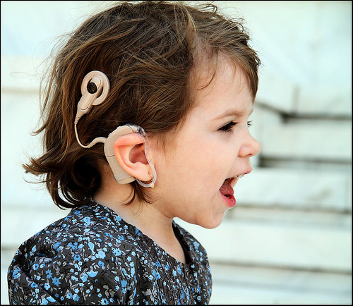
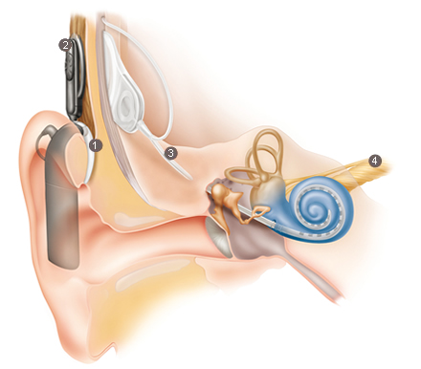
What is a cochlear implant?
Sound processor
Transcutaneous telemetry coil for power and data transfer
Implanted electronics and electrode array
Hearing nerve

Slide 11
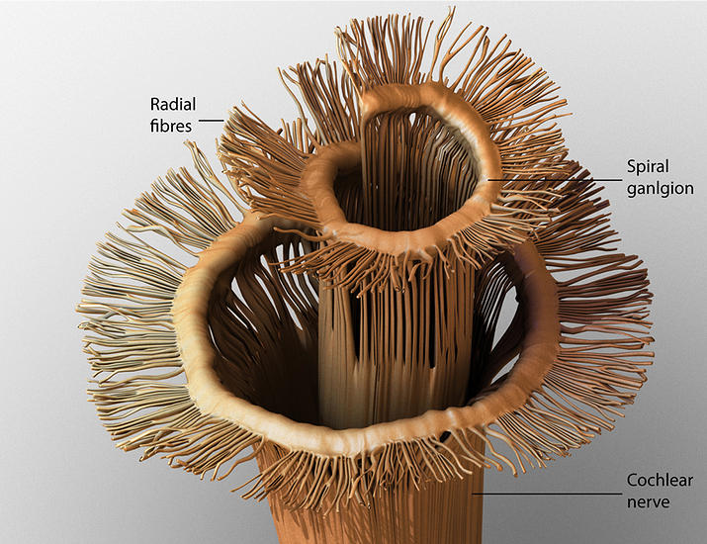
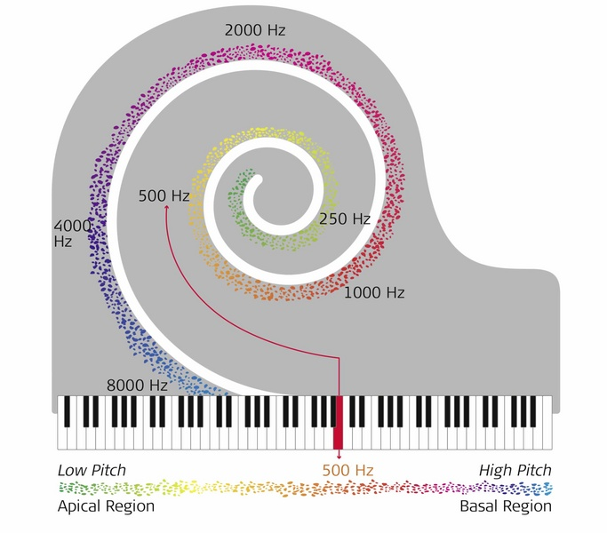
Why do cochlear implants work?
Nerve fibres are electrically excitable
Tonotopic organization of nerve fibres
Neural excitation dictated by electrode-nerve fibre interface

Slide 12
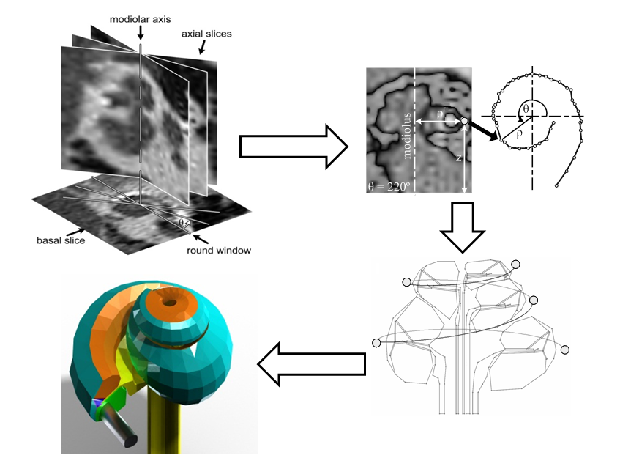
Generation of user-specific models

Slide 13
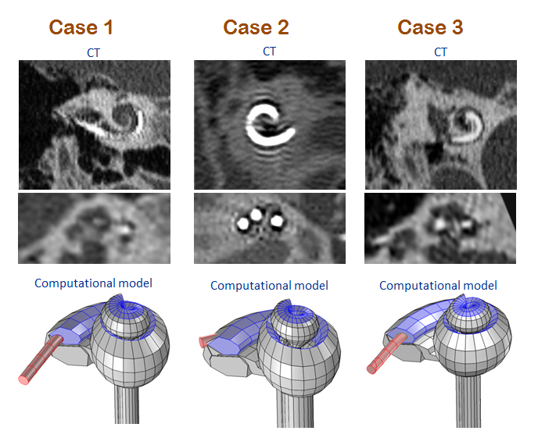
User-specific models

Slide 14
Opportunities
Our research group is internationally recognised and respected.
We publish our research in leading international journals.
If you are interested to apply your engineering skills to solve problems in neuroscience, perception, music perception, cochlear implants or psychoacoustics, postgraduate studies in the bioengineering group are for you!
Talk to me or Prof Johan Hanekom about opportunities for full-time postgraduate study.

Slide 15
EMK310 Lecture 1 Introduction to Microcontrollers & PIC Theory & Application Professor Tania Hanekom tania.hanekom@up.ac.za Copyright reserved by University of Pretoria
References:
Bolton chapter 1
Projects.pdf
PIC18 datasheet & reference manual
Your own background reading in other relevant sources

Slide 16
SO WHAT IS A μP OR A μC?
Before we start on the car, we need to have a little background…

Slide 17
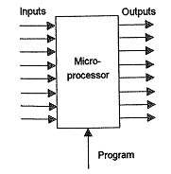
A microprocessor is a…
digital device that
accepts data from a number of input lines
processes the data according to software in the micro
produces a number of output signals
and has inputs and outputs
discrete on/off signal from sensor or other device, i.e. 1 or 0
parallel group to represent binary number, e.g. 10110010

Slide 18
Microcontroller vs microprocessor
A microcontroller consistes of
a microprocessor, i.e. CPU
onboard memory, and
onboard peripherals, e.g. ADC, PWM, etc.

Slide 19
Where do microprocessors come from and where do we use them?
Became commercially available in 1971
4 bit Intel 4004
4 bit micros still used today for simple applications
1980s came 8 bit micros
4  8  16  32  64 bit microprocessors
Today they are being used in…
… and as the controller for our ARV.

Desktop
microcomputers

PCs

Slide 20
"OUR" micros
PIC18F45K20 (95% of module's focus)
PIC32MX220F032 (5% of module's focus)

Slide 21
Micros can’t think…
…so you have to tell them exactly what to do.
Programs (software)
set of instructions stored in computer's memory
machine instructions coded as binary numbers
Instruction are
fetched from memory
decoded in control unit of CPU…
which generates control signals to trigger operation

Slide 22
Data representation in micros
Digital system signals in one of two states: 0 or 1
Binary digits = bits
Bits represented by voltage levels
Logic 1 = 5 V (ideal)
Logic 0 = 0 V (ideal)
TTL (transistor-transistor logic)
Inputs Low 0 to 0.8 V High 2.0 to 5.0 V
Outputs Low 0 to 1.5 V High 3.5 to 5.0 V
CMOS (complementary metal oxide semiconductors)
Inputs Low 0 to 1.5 V High 3.5 to 5.0 V
Outputs Low 0 V High 5.0 V

Slide 23
Assembly language
Programmer needs to enter instructions, debug and maintain code
using binary format
e.g. 0000 1000 0000 0011 (Not likely!)
or in hex
0803h (Still doesn't mean anything to the novice.)
or perhaps
movf 03h, 0 (Looks a tiny bit better. Maybe move something?)
or how about
movf STATUS, W
meaning "Move the contents of a file register called Status into a register called W."
Yes, much better if we know what "STATUS" and "W" means!

Slide 24
Assembly language (2)
Assembly language
was developed to simplify the programming job.
is a low-level programming language which is used to manipulate microcontroller on bit and word level.
How does it get into the μ?
Source code: the code we write
instructions: PIC understands them
directives: control how the assembler builds the object code (see MPLAB help)
Assembled to hex file (object code) by assembler software
Assembler must understand each line of code to be able to do the translation

Slide 25
High-level languages
To code in Assembler, the programmer must know hardware architecture of micro on which software is to be executed
(This is exactly why we program in Assembler in EMK310)
High-level languages require less knowledge of underlying hardware and the code is easier to follow. However,…
machine code compiled from high-level language is much longer and cannot run as fast as equivalent Assembler code.
time-critical applications frequently written in Assembler.

Slide 26
Number systems (ERS220)
Selfstudy
Binary
Octal
Hexadecimal
BCD
Binary arithmetic
Floating points
ASCII

Slide 27
Architecture

Slide 28
Architecture
What is "microcontroller architecture"?
What microcontrollers look like and the principles on which it operates.
The term includes a description of
the type of instruction set,
the memory structure,
the hardware setup,
how instructions are executed (pipelined or not),
word size.

Slide 29
Microprocessor systems
Components
Central processing unit (CPU)
Memory to store data & instructions
Input/output interfaces (ports)
Digital signals move from one component to another along three buses
Data bus
Address bus
Control bus

Slide 30
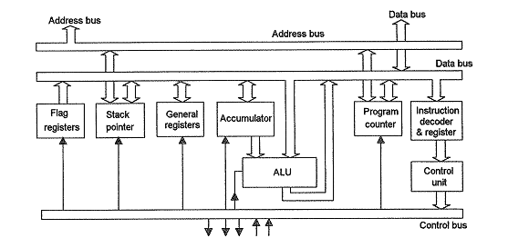
Architecture: Hardware setup
Microcontroller consists of
CPU modules
Arithmetic and logic unit (ALU)
Afrikaans: rekenkundige-en-logiese-bewerkingseenheid
8 bit on the 8 bit PICs
Registers
Control unit [beheereenheid]
Other devices
Separate memories to store program & data
Oscillator & timers
Interfaces, e.g. ports, ADC, comparators, PWM
CPU Architecture
External control signals

Slide 31
Architecture
PIC18F45K20
datasheet p. 15
I/O Ports
ALU
Clock & timing unit
Timers

Slide 32
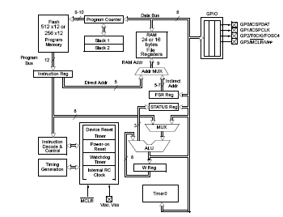
PIC10F200
datasheet p. 10
6 pin!

Slide 33
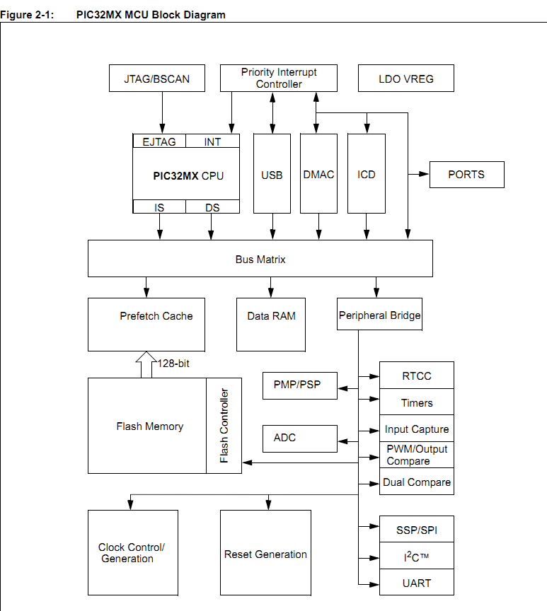
PIC32MX220F032B
PIC32 family reference manual

Slide 34
MEMORY

Slide 35
Memory
Memory location (information unit)
Address & content
0 1 0 0 1 0 0 1
03h

Slide 36
Memory
Microcontrollers have data memory and program memory.
Data memory is used to store numbers that you are working with.
Program memory is where the program, consisting of instructions, is stored.

Slide 37
Architecture: Memory structure
Harvard architecture
program & data accessed from separate memories via separate busses
word width, timing, implementation technology, and memory address structure can differ
instruction memory often wider than data memory
advantage: bandwidth, i.e. much faster
vs Von Neumann architecture…

Slide 38
Word sizes
A word is a collection of bits that are required to represent data or address
e.g. if 10 bits are used to represent address in micro, it uses a 10 bit address word
e.g. if 8 bits are used to represent data in micro, it uses an 8 bit data word
There is frequently (mostly) a difference between the address word size and the data word size in a microprocessor.

Slide 39
Word sizes (2)
The PIC18F45K20 has a(n)
8-bit wide data path – remember: microprocessors are classified according to size of data bus/data word, i.e. 8 bit micro has an 8 bit data bus/word
16-bit wide instruction set.

Slide 40
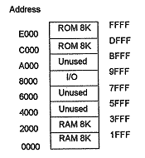
Memory maps
Provides a "map" to show which addresses are used for which microprocessor element

Slide 41
Types of memory
Two very general types of memory
on-chip
external (e.g., I²C EEPROM of Prac 2)
On-chip memory
Can be divided into
program memory (instruction code)
data memory (variables)
For PIC processors the two blocks of memory each has its own bus
access to each in same oscillator cycle

Slide 42
Program memory
21-bit program counter, capable of addressing 2 MB program memory space
(2²¹ = 2 097 152)
32 Kbytes of Flash Memory implemented on PIC18F45K20
8000h = 32 768d
up to 16,384 single-word instructions (remember, one instruction word is 2 bytes wide)

Slide 43
Data memory
Data memory consists of
Special Function Registers (SFR)
control the operation of the device
General Purpose Registers (GPR)
general area for data storage and scratch pad operations.

Slide 44
Communication inside the microcontroller

Slide 45
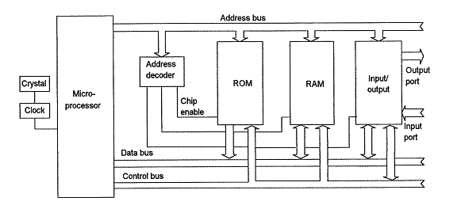
Standard buses
Address bus
Data bus
Control bus
Chip select / enable
Clock
Ports

Slide 46
Data bus
A bus is a "collection of wires" through which communication occurs
Carries data that needs to be processed
Tristate output interfaces to prevent devices that are not in use to provide low impedance current path that could prevent correct logic levels at device being addressed
Three states: high signal, low signal & high impedance

Slide 47
Data bus (continued)
Width of the data path/bus
determines the number of input lines on which data can enter the microprocessor
Data bus
lines carrying the data
electrical conductors, i.e. hardware implementation

Slide 48
Data bus (continued)
Microprocessors are classified according to size of data bus/data word
i.e. 8 bit micro has an 8 bit data bus/word
LSB is bit 0
MSB is bit 7
Note:
8 bits = byte (always)
4 bits = nibble (always)

Slide 49
Zero condition 1
An 8 bit micro's data are stored in 8 bit registers
If you pass a 16 bit binary number in your code to an 8 bit data register, what happens to the most significant 8 bits?
Will your program work?
If you do this in a test or exam, you get 0 for the entire test or exam.
Same fundamental principle as that 2 litres of water cannot fit into a 1 litre container…
7
0
Register
Data bits

Slide 50
Address bus
Each storage location (register) in a memory device has an address so that system can locate instructions or data in memory.
Each input/output interface has an address too.
Only the device/memory location whose address is placed on the address bus is enabled for communication.
Address decoder is used when there are many devices to be addressed
Output of address decoder activates the device via its chip select (CS) input.

Slide 51
Control bus
Carries control signals e.g. read/write & clock signals
READ/WRITE line
1 on line = read (receive a signal)
0 on line = write (send a signal)
Clock
Signal to synchronise microprocessor functions
External or internal

Slide 52
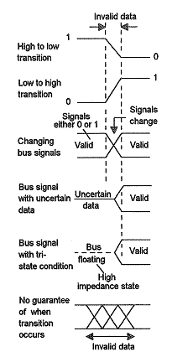
Signal conditions on lines or buses
Invalid data
signal transition
Shows how long a transition takes
Bit signal level shown with line
Bus signal levels shown with bar

Slide 53
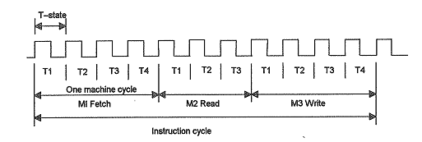
Timing diagrams to show sequence of events on lines, buses and inside registers
T-state = 1 clock cycle = T
Machine cycle = number of clock cycles required to complete a basic operation (e.g. fetch, read or write) x T
Instruction cycle = number of clock cycles required to complete
an instruction x T
Timing diagrams are used to show the chronological sequence of events or signals in a digital system

Slide 54
INSTRUCTIONS

Slide 55
Architecture: Instruction set
RISC
reduced instruction set computer
simplified instructions which "do less" may still provide for higher performance if this simplicity can be utilized to make instructions execute very fast
PICs are RISK machines
vs CISC (complex instruction set computer…)

Slide 56
Architecture: execution of instructions
Fetch-execute cycle
Fetch operator code (instruction) from memory & store in instruction register
Decode instruction in instruction decoder
Fetch further data if required
Execute the instruction
Goto 1.

Slide 57
READY TO GO…

Slide 58
Flashing an LED = “Hello World”
What do we need?
power to power the μ
clock source required for processing
code to tell the PIC what to do
LED and resistor to limit current through LED
port pins can source/sink 25 mA but it is better design practice to use a resistor

Slide 59
But…
PICs understand only 0 and 1 because they are made of transistors (switches)
we don't think in terms of 0 and 1 (maybe students do the day or two after RAG…)

Slide 60
What to do?
We decided that none of the following techniques are suitable for programming at this stage:
Binary machine code (e.g. 0111001010001010)
Hex (e.g. 0803h)
Assembler using only numbers in the operant fields (e.g. movf 03h, 0)
We'll rather use instructions with register names that are more understandable
movf STATUS, W

Slide 61
Mnemonics
Interface between student and microcontroller
An assembler is used to translate the code written using mnemonics (that we understand easier) to machine code (the micro’s language)
some people learn to understand machine code as if it were English!

Slide 62
Example of Assembler code
Label Mnemonic Operand Comments
Instruction
Directive
Title "Our first program" (directive)
list p=pic18f45k20 ; processor type (directive)
;
; ------------- (comment)
; PROGRAM START (comment)
; ------------- (comment)
;
org 0h ; startup address = 0000 (directive)
start movlw 0x00 ; simple code (instruction)
movwf 0F80h (instruction)
goto start ; do this loop forever (instruction)
end (directive)
projects.pdf p. 16

Slide 63
Agenda: Coding lecture (next week)
MPLAB X demo
new project;
editing code;
compile;
debugger & MPLAB sim;
run (watchdog timer timeout);
configuration bits (explain + not accessible after PIC has been programmed);
oscillator;
watchdog (reset PIC after some predefined time);
power up timer.

Slide 64
Homework
Form teams
Work through Prac assignment
Start on planning documentation
What do you want to learn next week? Class reps?

