Slide 1
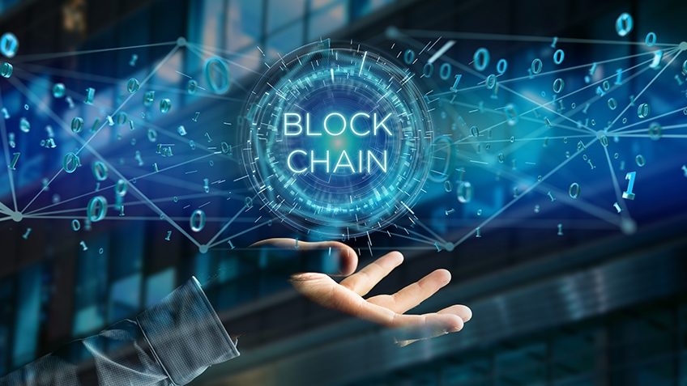
topic: BLOCKCHAIN
SubmitTed by:
Soumya p naikar

Slide 2
CONTENTS
Block chain
Simple definition
A quick synopsis of block chain technology
History of block chain
Block chain technology
Block chain work
Blockchain applications
Money transfer use cases

Slide 3
BLOCK CHAIN
A block chain is a digital public ledger that records online transactions.
Block chain is the core technology for cryptocurrencies like bitcoin. a block chain ensures the integrity of a cryptocurrency by encrypting validating and permanently recording transactions.
A block chain is similar to a banks ledger but open and accessible to everyone who utilize the cryptocurrency is supports .

Slide 4
SIMPLE DEFINATION
Block chain is a system of recording information in a way that makes it difficult or impossible to change, hack , or cheat the system. a block chain is essentially a digital ledger of transactions that is duplicated and distributed across the entire network of computer system on the block chain .

Slide 5
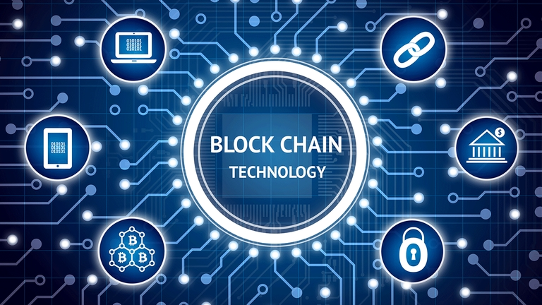
A QUICK SYNOPSIS OF BLOCKCHAIN TECHNOLOGY
The block chain is an open, immutable distributed public ledger that allows transactions to take place in a decentralised manner without a need for a trusted third party. bitcoin, the first successful cryptocurrency, is a peer-to-peer electronic payment system.

Slide 6
HISTORY OF BLOCK CHAIN
Block chain has the potential to grow to be a bedrock of the world wide record-keeping systems , but was launched just 10 years ago.
It was created by the unknown persons behind the online cash currency bitcoin, under the pseudonym of satoshi nakamoto.

Slide 7
BLOCK CHAIN TECHNOLOGY
Blockchain, sometimes refer red to as a distributed ledger technology (dlt), makes the history of any digital asset unalterable and transparent through the use of decentralization and cryptographic hashing.
a simple analogy for understanding block chain technology. is a google doc. when we create document and share it with a group of people ,the document and is distributed instead of copied or transferred.

Slide 8
BLOCKCHAIN WORK
The whole point of using a blockchain is to let people –in particular ,people who don’t trust one another –share valuable data in a secure , temperproof way.
Blockchain consists of three important concepts….
1.Blocks
2.Nodes
3.Miners
Blocks-every chain consists of multiple blocks and each block has three basic elements

Slide 9
BLOCKCHAIN APPLICATIONS
Secure sharing of medical data
Music royalties tracking
Cross –border payments
Voting mechanism
Real estates processing platform

Slide 10
Industry: health care location: Denver,colorado
How it is using blockchain: burstiqs big data blockchain contracts help patients and doctors securely transfer sensitive medical information. The smart constracts estlablish the parameters of what data can be shared and even displays details of pernsolized health plans for each patient

Slide 11
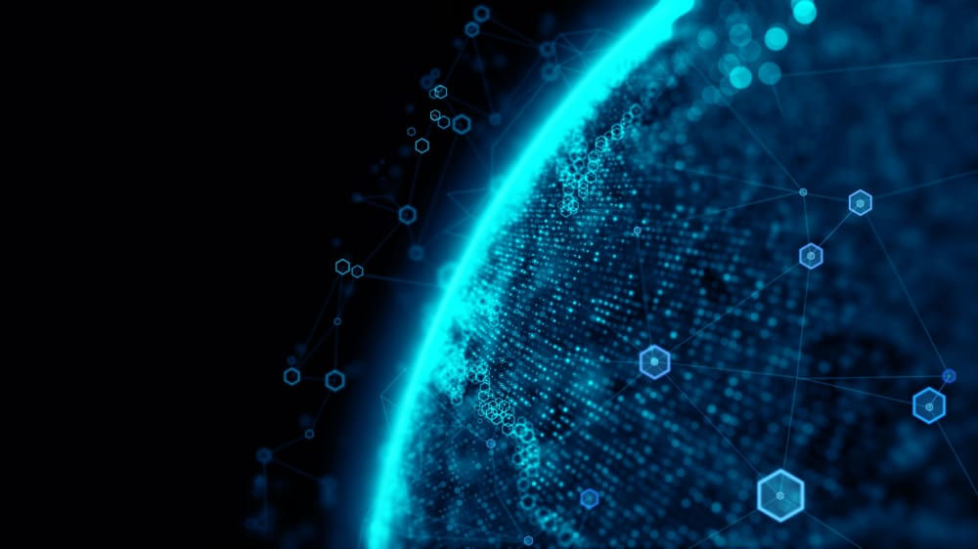
MONEY TRANSFER USE CASES
Pioneered by bitcoin
Cryptocurrency transfer apps are exploding in popularity right now.blockchain is especially popular in finance for the money and time it can save financial companies of all sizes.
blockchain can save the largest banks $8-$12 billion a year

Slide 12
CONCLUSION
Blockchain is a viable technology that can improve the healthcare data sharing and storing system owing to its decentralization, immutability, transparency and
Tracebality features. However adopt blockchain technology due to threats such as security and authoration issue. interoperability issues and lack of technical
Skills related to block chain technology

Slide 13
THANK YOU

