Slide 1
补充材料-2 Operations Strategy & Competitiveness (Ii)

Slide 2
What you should learn
Just-In-Time (JIT)
Value Stream Mapping (VSM) for lean manufacturing
Theory of Constraints (TOC)

Slide 3
What you should learn
Just-In-Time (JIT)
Value Stream Mapping (VSM) for lean manufacturing
Theory of Constraints (TOC)

Slide 4
JIT/Lean Operations
Good production systems require that managers address three issues that are pervasive and fundamental to operations management: eliminate waste, remove variability, and improve throughput

Slide 5
1. Eliminate Waste
Waste is anything that does not add value from the customer point of view
Storage, inspection, delay, waiting in queues, and defective products do not add value and are 100% waste

Slide 6
Ohno’s Seven Wastes
Overproduction
Queues
Transportation
Inventory
Motion
Overprocessing
Defective products

Slide 7
Eliminate Waste
Other resources such as energy, water, and air are often wasted
Efficient, sustainable production minimizes inputs, reduces waste
Traditional “housekeeping” has been expanded to the 5 Ss

Slide 8
The 5 Ss
Sort/segregate – when in doubt, throw it out
Simplify/straighten – methods analysis tools
Shine/sweep – clean daily
Standardize – remove variations from processes
Sustain/self-discipline – review work and recognize progress

Slide 9
The 5 Ss
Sort/segregate – when in doubt, throw it out
Simplify/straighten – methods analysis tools
Shine/sweep – clean daily
Standardize – remove variations from processes
Sustain/self-discipline – review work and recognize progress
Two additional Ss
Safety – build in good practices
Support/maintenance – reduce variability and unplanned downtime

Slide 10
2. Remove Variability
JIT systems require managers to reduce variability caused by both internal and external factors
Variability is any deviation from the optimum process
Inventory hides variability
Less variability results in less waste

Slide 11
Sources of Variability
Incomplete or inaccurate drawings or specifications
Poor production processes resulting in incorrect quantities, late, or non-conforming units
Unknown customer demands

Slide 12
Sources of Variability
Incomplete or inaccurate drawings or specifications
Poor production processes resulting in incorrect quantities, late, or non-conforming units
Unknown customer demands
Both JIT and inventory reduction are effective tools in identifying causes of variability

Slide 13
3. Improve Throughput
The time it takes to move an order from receipt to delivery
The time between the arrival of raw materials and the shipping of the finished order is called manufacturing cycle time
A pull system increases throughput

Slide 14
Improve Throughput
By pulling material in small lots, inventory cushions are removed, exposing problems and emphasizing continual improvement
Manufacturing cycle time is reduced
Push systems dump orders on the downstream stations regardless of the need

Slide 15
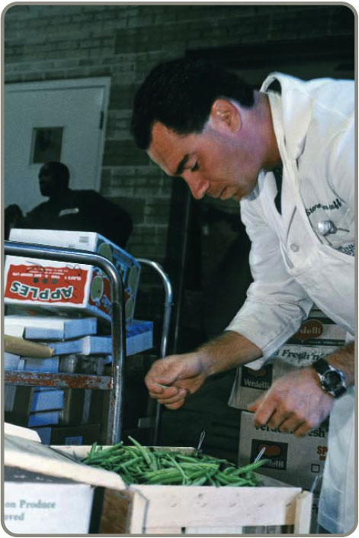
Just-In-Time (JIT)
Powerful strategy for improving operations
Materials arrive where they are needed when they are needed
Identifying problems and driving out waste reduces costs and variability and improves throughput
Requires a meaningful buyer-supplier relationship

Slide 16
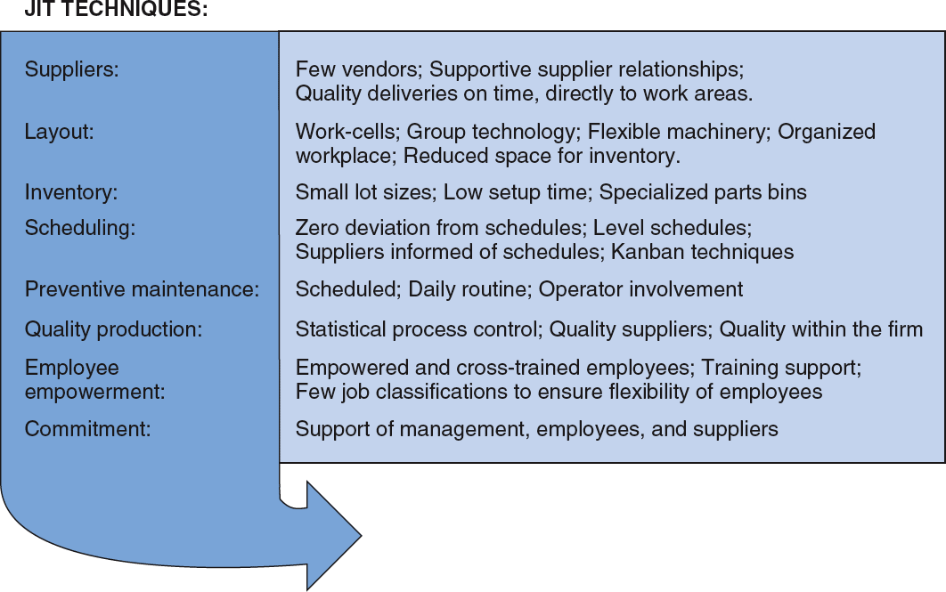
JIT and Competitive Advantage

Slide 17
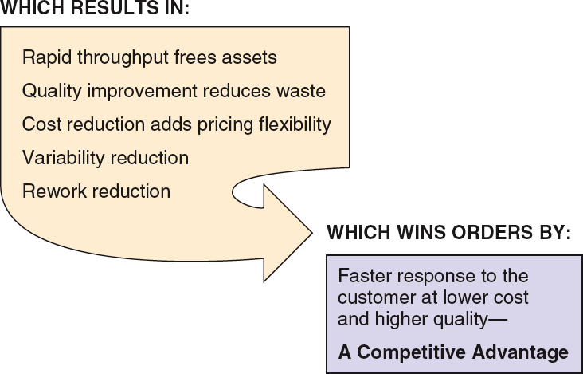
JIT and Competitive Advantage

Slide 18
JIT Partnerships
JIT partnerships exist when a supplier and purchaser work together to remove waste and drive down costs
Four goals of JIT partnerships are:
Removal of unnecessary activities
Removal of in-plant inventory
Removal of in-transit inventory
Improved quality and reliability

Slide 19
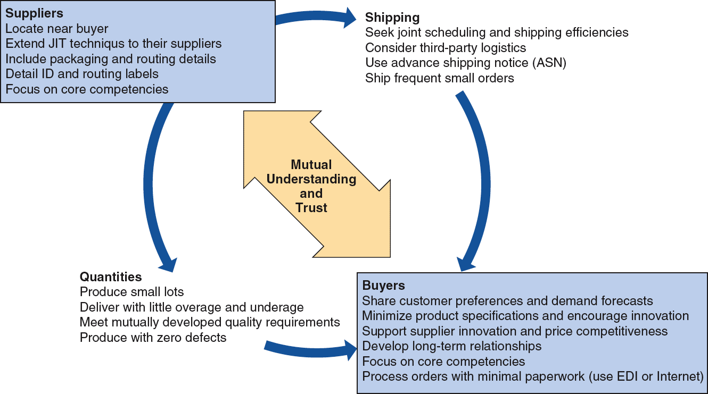
JIT Partnerships

Slide 20
JIT Layout
Reduce waste due to movement
JIT Layout Tactics
Build work cells for families of products
Include a large number operations in a small area
Minimize distance
Design little space for inventory
Improve employee communication
Use poka-yoke (fail safe) devices
Build flexible or movable equipment
Cross-train workers to add flexibility

Slide 21
Process layouts

Slide 22
Group technology layout

Slide 23
Distance Reduction
Large lots and long production lines with single-purpose machinery are being replaced by smaller flexible cells
Often U-shaped for shorter paths and improved communication
Often using group technology concepts

Slide 24
Increased Flexibility
Cells designed to be rearranged as volume or designs change
Applicable in office environments as well as production settings
Facilitates both product and process improvement

Slide 25
Impact on Employees
Employees may be cross trained for flexibility and efficiency
Improved communications facilitate the passing on of important information about the process
With little or no inventory buffer, getting it right the first time is critical

Slide 26
Reduced Space and Inventory
With reduced space, inventory must be in very small lots
Units are always moving because there is no storage

Slide 27
JIT Inventory
Inventory is at the minimum level necessary to keep operations running
JIT Inventory Tactics
Use a pull system to move inventory
Reduce lot sizes
Develop just-in-time delivery systems with suppliers
Deliver directly to point of use
Perform to schedule
Reduce setup time
Use group technology

Slide 28
Reduce Variability
Inventory level
Process downtime
Scrap
Setup time
Quality problems
Late deliveries

Slide 29
Reduce Variability
Inventory level
Process downtime
Scrap
Setup time
Quality problems
Late deliveries

Slide 30
Reduce Variability
Inventory level
No scrap
Quality problems removed
Setup time reduced
Process downtime removed
Late deliveries

Slide 31
Reduce Inventory
Reducing inventory uncovers the “rocks”
Problems are exposed
Ultimately there will be virtually no inventory and no problems
Shingo says “Inventory is evil”

Slide 32
Reduce Lot Sizes
200 –
100 –
Q₁ When average order size = 200
average inventory is 100
Inventory
Q₂ When average order size = 100
average inventory is 50
Time

Slide 33
Reduce Lot Sizes
Ideal situation is to have lot sizes of one pulled from one process to the next
Often not feasible
Can use EOQ analysis to calculate desired setup time
Two key changes necessary
Improve material handling
Reduce setup time

Slide 34
Reduce Setup Costs
High setup costs encourage large lot sizes
Reducing setup costs reduces lot size and reduces average inventory
Setup time can be reduced through preparation prior to shutdown and changeover

Slide 35
Lower Setup Costs
Holding cost
Sum of ordering and holding costs
Cost
T₁
Setup cost curves (S₁, S₂)
T₂
S₁
S₂
Lot size

Slide 36
Reduce Setup Times
Single Minute Exchange of Dies (SMED)
Initial Setup Time
90 min —
Separate setup into preparation and actual setup, doing as much as possible while the machine/process is operating
(save 30 minutes)
Step 1
60 min —
Move material closer and improve material handling (save 20 minutes)
Step 2
Standardize and improve tooling (save 15 minutes)
45 min —
Step 3
25 min —
Step 4
Use one-touch system to eliminate adjustments (save 10 minutes)
15 min —
Training operators and standardizing work procedures (save 2 minutes)
13 min —
Step 5
Step 6
Repeat cycle until subminute setup is achieved
—

Slide 37
JIT Scheduling
Schedules must be communicated inside and outside the organization
Level schedules
Process frequent small batches
Freezing the schedule helps stability
Kanban
Signals used in a pull system

Slide 38
JIT Scheduling
Better scheduling improves performance
JIT Scheduling Tactics
Communicate schedules to suppliers
Make level schedules
Freeze part of the schedule
Perform to schedule
Seek one-piece-make and one-piece move
Eliminate waste
Produce in small lots
Use kanbans
Make each operation produce a perfect part

Slide 39
Level Schedules
Process frequent small batches rather than a few large batches
Make and move small lots so the level schedule is economical
“Jelly bean” scheduling
Freezing the schedule closest to the due dates can improve performance

Slide 40

Scheduling Small Lots
JIT Level Material-Use Approach
A
A
B
B
B
C
A
A
B
B
B
C
Large-Lot Approach
A
A
A
A
A
A
B
B
B
B
B
B
B
B
B
C
C
C
Time

Slide 41
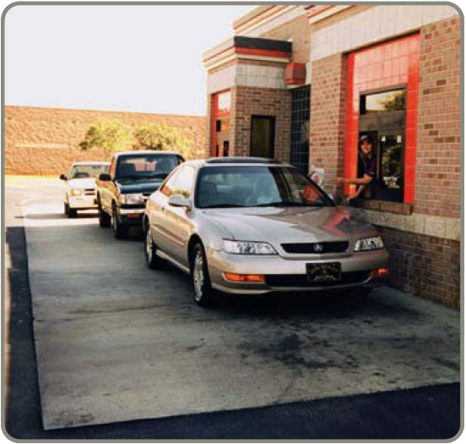
Kanban
Kanban is the Japanese word for card
The card is an authorization for the next container of material to be produced
A sequence of kanbans pulls material through the process
Many different sorts of signals are used, but the system is still called a kanban

Slide 42
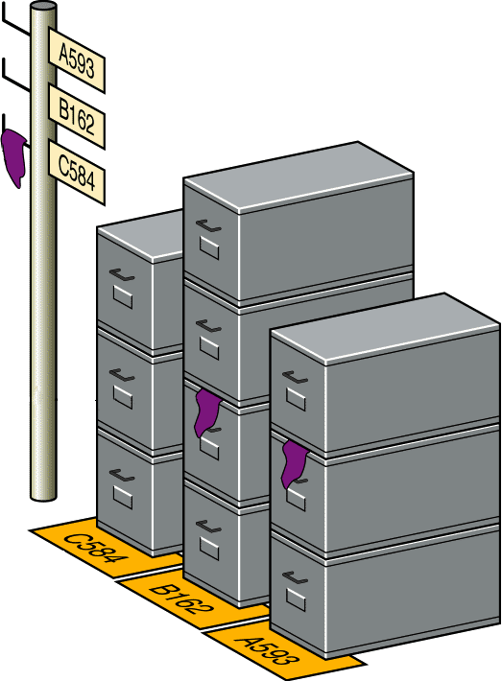
Kanban
User removes a standard sized container
Signal is seen by the producing department as authorization to replenish
Signal marker on boxes
Part numbers mark location

Slide 43
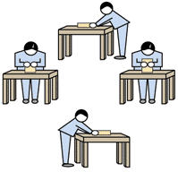




Kanban
Material/Parts Supplier
Final assembly
Finished goods
Customer order
Work cell
Kanban
Kanban
Kanban

Slide 44
JIT Quality
Strong relationship
JIT cuts the cost of obtaining good quality because JIT exposes poor quality
Because lead times are shorter, quality problems are exposed sooner
Better quality means fewer buffers and allows simpler JIT systems to be used

Slide 45
JIT Quality Tactics
Use statistical process control
Empower employees
Build fail-safe methods (poka-yoke, checklists, etc.)
Expose poor quality with small lot JIT
Provide immediate feedback

Slide 46
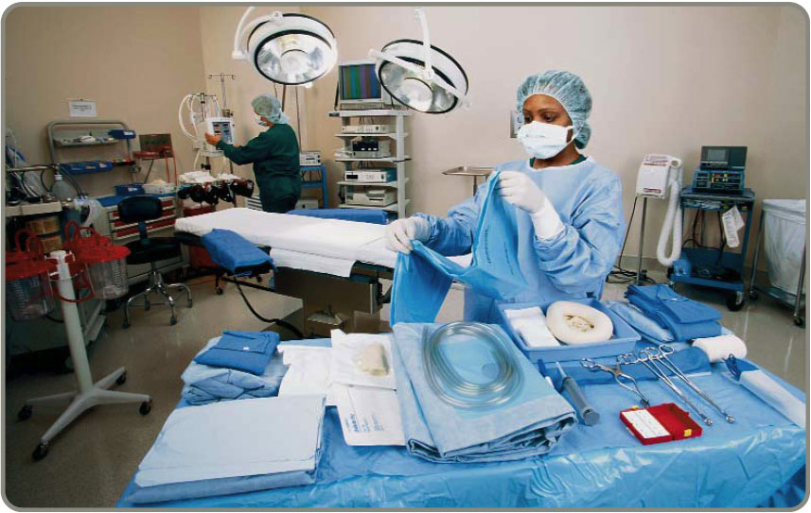
JIT in Services
The JIT techniques used in manufacturing are used in services
Suppliers
Layouts
Inventory
Scheduling

Slide 47
What you should learn
Just-In-Time (JIT)
Value Stream Mapping (VSM) for lean manufacturing
Theory of Constraints (TOC)

Slide 48
Lean Manufacturing
"Lean," is a production practice that considers the expenditure of resources for any goal other than the creation of value for the end customer to be wasteful, and thus a target for elimination.
---- John Krafcik (1988)

Slide 49
Obstacle of Traction:
Waste

Slide 50
What is WASTE?
Any Activity that DOES NOT increase the Market Form or Function of the Product or Service based on the Critical Customer Requirements.
These are things the customer is NOT willing to pay for.

Slide 51
Definition of Value Added
Value Added
Any activity that increases the market form or function of the product or service. (These are things the customer is willing to pay for.)
Non-Value Added
Any activity that does not add market form or function or is not necessary. (These activities should be eliminated, simplified, reduced, or integrated.)

Slide 52
Lean = Eliminating the Wastes
Value Added
Non-Value Added
Defects
Overproduction
Waiting
Not Utilizing Employees
Transportation
Inventory
Motion
Excess Processing
Typically 95% of all lead time is non-value added

Slide 53
Where is the Waste?
Defects – incomplete or incorrect information
Overproduction – releasing work before next process can work on them, unbalanced work loads
Waiting – unbalanced work loads, slow system response, incomplete information, approvals
Not Utilizing Employees – old guard thinking, politics, high turnover, low investment in training
Transportation – poor layout, poor flow
Inventory – large batches, complexity to complete task
Motion – poor organization, no standard work
Excess Processing – excess communication, lack of communication, unnecessary approvals, customer requirements are not clearly understood
All processes have waste.

Slide 54

Without Change
There Can Be No Improvement
“The definition of insanity is doing the same thing over and over and expecting different results.”
Albert Einstein

Slide 55
Value Stream mapping
Value Stream Mapping is a tool used to create a material and information flow map of a product or processes. It allows firms to map the flow of products in the back door as raw material, through all manufacturing process steps, and off the loading dock as finished product.

Slide 56
The Lean Process
Current
state
Identify
waste
Continuous
Incremental
Improvement
Measure
&
Adjust
Future
state
Implement

Slide 57
Benefit of Value Stream Mapping
Understanding the Process
Information and Material Flow
Data Driven Decision Process

Slide 58
Lean Operations
Different from JIT in that it is externally focused on the customer
Starts with understanding what the customer wants
Optimize the entire process from the customer’s perspective

Slide 59
Look for Value Streams
“Whenever there is a product or service for a customer, there is a value stream.
The challenge lies in seeing it.”

Slide 60
Value Stream Mapping Steps
Product / Service
family
Select product / service family
Draw Current State map. Understanding how the process currently operates.
Identify opportunities for elimination of waste and areas of improvement to meet customer’s needs.
Draw the Future State map. Design a lean flow using lean techniques.
Develop action plan and implement it.
Current state
drawing
Future state
drawing
Plan and
Implementation

Slide 61
Basic Steps of VSM
Define the boundaries
Define the value
Identify the tasks and flows of material and information between them.
Identify resources for each task and flow
Create the current state map
Identify value added and waste
Reconfigure the process to eliminate waste
Visualize the “Ideal State” and create future state map
Develop Action plans and tracking

Slide 62
Semi-Weekly
Ship Schedule
Incoming
Orders
Order Entry Process
Current State - Sept. 2007
MRP
MRP
Production
Schedule
Information
Weekly Fax
Receive Order
Check Credit
Review & Enter Order
Reconcile Order
Confirm Order
Finalize Order
IN
IN
IN
IN
IN
IN
Fax
FIN
MRP
MRP
Phone
MRP
P/T = ½ min
Batch = 4
hours
P/T = 1 min
% Accept = 90%
Batch = 4 hours
P/T = 10 min
% C&A = 60%
Batch = 1.6 hours
P/T = 1 min
%C&A = 75%
Batch = 1.6 hours
P/T =7 min
%C&A = 85%
Batch = 2 hours
P/T = 5 min
Batch = 1day
Material
.5 days
.5 days
.2 days
.2 days
.25 days
1 day
½ min
1 min
10 min
1 min
7 min
5 min
Total Lead Time = 2.65 days
Total Processing Time= 24.5 min
First Pass Yield = 34.4%
Notes:
________________________________________________________________________________________________________________________________________________________________________________________________________________________________________________________________________________________________________________________________________________________________________

Slide 63
Future State Questions
What does the customer really need?
How often will we check our performance to customer needs?
Which steps create value and which are waste?
How can we flow work with fewer interruptions?
How do we control work between interruptions? How will work be prioritized?
Is there an opportunity to balance the work load and/or different activities?
What process improvements will be necessary?
Notes:
________________________________________________________________________________________________________________________________________________________________________________________________________________________________________________________________________________________________________________________________________________________________________

Slide 64
Semi-Weekly
Ship Schedule
Incoming
Orders
Order Entry Process
Current State - Sept. 2007
What does the customer really need?
MRP
MRP
Production
Schedule
Weekly Fax
All orders will be processed within one hour of receipt (6 orders processed each hour).
Receive Order
Check Credit
Review & Enter Order
Reconcile Order
Confirm Order
Finalize Order
IN
IN
IN
IN
IN
IN
Fax
FIN
MRP
MRP
Phone
MRP
How often will we check our performance to customer needs?
P/T = ½ min
Batch = 4
hours
P/T = 1 min
% Accept = 90%
Batch = 4 hours
P/T = 10 min
% C&A = 60%
Batch = 1.6 hours
P/T = 1 min
%C&A = 75%
Batch = 1.6 hours
P/T =7 min
%C&A = 85%
Batch = 2 hours
P/T = 5 min
Batch = 1day
.5 days
.5 days
.2 days
.2 days
.25 days
1 day
Each hour.
½ min
1 min
10 min
1 min
7 min
5 min
460 minutes
46 Orders
Total Lead Time = 2.65 days
Takt Time =
= 10 minutes/order
Total Processing Time= 24.5 min
First Pass Yield = 34.4%
Notes:
________________________________________________________________________________________________________________________________________________________________________________________________________________________________________________________________________________________________________________________________________________________________________

Slide 65
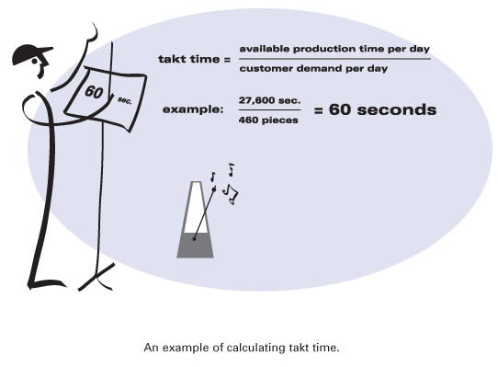
Takt Time
Takt time:
the available production time divided by customer demand.

Slide 66
Semi-Weekly
Ship Schedule
Incoming
Orders
Order Entry Process
Current State - Sept. 2007
MRP
MRP
Production
Schedule
Phone
Or WEB
Weekly Fax
Stop walking to the FAX that’s waste!!!
Rework
Over Processing
Receive Order
Check Credit
Review & Enter Order
Reconcile Order
Confirm Order
Finalize Order
Waste
Waste
IN
IN
IN
IN
IN
IN
Fax
FIN
MRP
MRP
Phone
MRP
Which steps create value?
Which are waste?
P/T = ½ min
Batch = 4
hours
P/T = 1 min
% Accept = 90%
Batch = 4 hours
P/T = 10 min
% C&A = 60%
Batch = 1.6 hours
P/T = 1 min
%C&A = 75%
Batch = 1.6 hours
P/T =7 min
%C&A = 85%
Batch = 2 hours
P/T = 5 min
Batch = 1day
.5 days
.5 days
.2 days
.2 days
.25 days
1 day
½ min
1 min
10 min
1 min
7 min
5 min
460 minutes
46 Orders
Total Lead Time = 2.65 days
Takt Time =
= 10 minutes/order
Total Processing Time= 24.5 min
First Pass Yield = 34.4%
Notes:
________________________________________________________________________________________________________________________________________________________________________________________________________________________________________________________________________________________________________________________________________________________________________

Slide 67
Semi-Weekly
Ship Schedule
On-Line
Order Entry
Order Entry Process
Current State - Sept. 2007
Incoming
Orders
MRP
MRP
Production
Schedule
How can we flow work with fewer interruptions?
Weekly Fax
Receive Order
Check Credit
Review & Enter Order
Reconcile Order
Confirm Order
Finalize Order
IN
IN
IN
IN
IN
IN
Fax
Link Finance
/ MRP
FIN
MRP
MRP
Phone
MRP
Auto
Confirm
Finance
Cross Train
P/T = ½ min
Batch = 4
hours
P/T = 1 min
% Accept = 90%
Batch = 4 hours
P/T = 10 min
% C&A = 60%
Batch = 1.6 hours
P/T = 1 min
%C&A = 75%
Batch = 1.6 hours
P/T =7 min
%C&A = 85%
Batch = 2 hours
P/T = 5 min
Batch = 1day
.5 days
.5 days
.2 days
.2 days
.25 days
1 day
½ min
1 min
10 min
1 min
7 min
5 min
Total Lead Time = 1.25 days
Takt Time =
460 minutes
46 Orders
NEW METRICS!
Total Processing Time= 11.5 min
= 10 minutes/order
First Pass Yield = 90%
Notes:
________________________________________________________________________________________________________________________________________________________________________________________________________________________________________________________________________________________________________________________________________________________________________

Slide 68
Order Entry Process
Future State - Sept. 2007
Incoming
Orders
Semi-Weekly
Ship Schedules
MRP
Schedule
Production
via FG Kanban
Phone / Web
MRP
Production
Schedule
Implement
Kanban
Receive / Credit
Check / Reconcile
Confirm
Kanban will:
Schedule Production to real time demand.
Optimize (level) and Control Inventory.
Link Production to Customer Demand.
MRP/FIN
P/T < 10 min
% accept = 90%
Batch = 1
How can we control work between interruptions?
Notes:
________________________________________________________________________________________________________________________________________________________________________________________________________________________________________________________________________________________________________________________________________________________________________

Slide 69
Order Entry Process
Future State - Sept. 2007
Incoming
Orders
Semi-Weekly
Ship Schedules
MRP
Phone / Web
Schedule
Production
via FG Kanban
Receive / Credit
Check / Reconcile
Confirm
I.T. Link to
Order Entry
Shipping
Training
Direct
Schedule
Shipping
MRP/FIN
P/T < 10 min
% accept = 90%
Batch = 1
If FG Kanban is implemented what improvements can be made to Shipping?
Notes:
________________________________________________________________________________________________________________________________________________________________________________________________________________________________________________________________________________________________________________________________________________________________________

Slide 70
Order Entry Process
Future State - Sept. 2007
Incoming
Orders
MRP
Phone / Web
Schedule
Production
via FG Kanban
Receive / Credit
Check / Reconcile
Confirm
Shipping
MRP/FIN
P/T < 10 min
% accept = 90%
Batch = 1
Total Lead Time < 10 Minutes
Future State Metrics!
Total Processing Time < 10 Minutes
First Pass Yield > 90%
Notes:
________________________________________________________________________________________________________________________________________________________________________________________________________________________________________________________________________________________________________________________________________________________________________

Slide 71
Summary:
ALL processes have WASTE that cost you MONEY.
Improvement requires change. To change a process you have to understand the process.
Process Excellence will not be achieved without involving people at all levels of the organization.

Slide 72
What you should learn
Just-In-Time (JIT)
Value Stream Mapping (VSM) for lean manufacturing
Theory of Constraints (TOC)

Slide 73
In Practice
How do we measure or evaluate the efficiency or contribution of a person, a machine, or a department of manufacturing system??

Slide 74
Theory of Constraints
Significance of bottlenecks
Maximum speed of the process is the speed of the slowest operation
Any improvements will be wasted unless the bottleneck is relieved
Bottlenecks must be identified and improved if the process is to be improved

Slide 75
Theory of Constraints
Purpose is to identify bottlenecks or other constraints and exploit them to the extent possible
Identification of constraints allows management to take action to alleviate the constraint in the future
Reduce cycle time
Time from receipt of customer order to shipment
Improve manufacturing cycle efficiency (MCE)
Processing time / total cycle time

Slide 76
The Need for TOC
Theory of Constraints
Uses linear programming to determine best use of limited resources
Indicates what should be produced and in what quantities

Slide 77
Theory of Constraints
Constraining resource must be maximized
All other operations must be geared toward this goal
May require suboptimization in other areas
Upstream operations must provide only what the constraint can handle
Downstream operations will only receive what the constraint can put out

Slide 78
Theory of Constraints
Constraint must be kept operating at its full capacity
If not, the entire process slows further
Focus is on maximizing throughput
Sales – totally variable costs
All other costs treated as fixed operational expenses
Cannot vary much in the short-run

Slide 79
Theory of Constraints
Based on the concepts of drum, buffer and ropes
Drum
Output of the constraint is the drumbeat
Sets the tempo for other operations
Tells upstream operations what to produce
Tells downstream operations what to expect
Buffer
Stockpile of work in process in front of constraint
Precaution to keep constraint running if upstream operations are interrupted
Rope
Sequence of processes prior to and including the constraint
Want to “pull” the rope at the maximum speed
Speed of the constraint

Slide 80
Steps in the TOC Process
Step 1: Identify the system constraints
Internal
Process constraints
Machine time, etc.
Policy constraints
No overtime, etc.
External
Material constraints
Insufficient materials
Market constraints
Insufficient demand
How is a constraint identified?

Slide 81
Steps in the TOC Process
Step2: Decide how to exploit the constraint
Produce the most profitable product mix
Want it working at 100%
How much of a buffer?
Holding costs
Including risk, quality costs
Stock-out costs

Slide 82
Steps in the TOC Process
Step3: Subordinate everything else to the preceding decision
Plan production to keep constraint working at 100%
May need to change performance measures to conform upstream activities to the “rope” speed

Slide 83
Steps in the TOC Process

Slide 84
Steps in the TOC Process

Slide 85
Steps in the TOC Process
Step 4: Alleviate the constraint
Determine how to increase its capacity
Step 5: Repeat the process
Always a new constraint

Slide 86
Evaluation of TOC
Advantages
Improves capacity decisions in the short-run
Avoids build up of inventory
Aids in process understanding
Avoids local optimization
Improves communication between departments

Slide 87
Evaluation of TOC
Disadvantages
Negative impact on non-constrained areas
Diverts attention from other areas that may be the next constraint
Temptation to reduce capacity

Slide 88



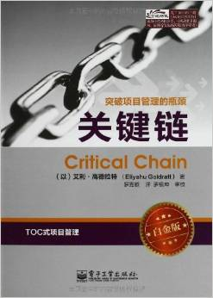
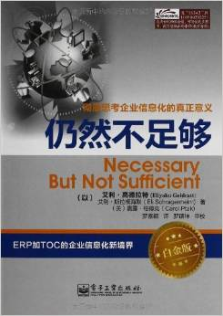

books

Slide 89
What you should learn
Just-In-Time (JIT)
Value Stream Mapping (VSM) for lean manufacturing
Theory of Constraints (TOC)

