Slide 1
AFSIM Developer Training 10 - XIO
AFRL/RQQD

Slide 2
Acronyms and Definitions
AFSIM - Advanced Framework for Simulation, Integration, and Modeling
AGL – Above Ground Level
DIS – Distributed Interactive Simulation
DTED – Digital Terrain Elevation Data
EO/IR – Electro-Optical/Infra-Red
ESM – Electronic Support Measure
FOV – Field Of View
GUI – Graphical User Interface
HLA – High Level Architecture
IEEE – Institute of Electrical & Electronics Engineers, Inc.
JTIDS – Joint Tactical Information Distribution System
MSL – Mean Sea Level
PDU – Protocol Data Unit
RCS – Radar Cross Section
SAM – Surface-to-Air Missile
SAR – Synthetic Aperture Radar
VESPA – Visual Environment for Scenario Preparation and Analysis
WKF – Warlock Framework
WSF – World Simulation Framework
dB - decibels
dBsm – decibel square meters
deg – degrees
ft – feet
GHz– GigaHertz
kts – knots
m - meters
m^2 – square meters
mw – megawatts
nm – nautical miles
s – seconds

Slide 3
Introduction
This lab focuses on using the XIO data communication interface
You will build an external flight controller application that receives platform list information from an AFSIM simulation, and transmits control packets to the simulation
The following exercise provides practice working with AFSIM XIO
Exercise 1: Registering a default Application Extension, a new Scenario Extension, and a new Simulation Extension
Exercise 2: Implementing a Simulation Extension that reads and processes new XIO messages to control selected platforms
Exercise 3: Creating an external application that communicates with an AFSIM simulation

Slide 4
Problem Statement
Subscribe to Information Published by XIO Platform List Service
Send Platform Control Information over XIO to an AFSIM Simulation
Extend AFSIM to Receive and Utilize the Data to Control Simulated Aircraft
References:
AFSIM Developers Web-based data.
AFSIM Source Codes and Visual Studio search functions.
AFSIM Documentation.

Slide 5
Learning Objectives
You gain hands-on knowledge about:
Extending the XIO interface with new data packet types
Utilizing the XIO interface to send and receive simulation data
Creating a user interface to control platforms in the simulation
Understand how to invoke input processing that is not dependent on the AFSIM simulation loader
Reinforce your skills with creating a default application extension and a plugin
Reinforce your skill with creating a simulation extension and a scenario extension

Slide 6
Prerequisites
Before working on this lab, you should:
Be familiar with WIZARD and AFSIM scripting Language
AFSIM analyst course or equivalent experience is recommended
Have available and be familiar with using Microsoft® Visual Studio 2017® or newer to compile an application
Have completed the Module “Building AFSIM with CMAKE”

Slide 7
eXternal IO Interface (XIO)
XIO is a Custom, AFSIM-Only Networked Interface
Only connects AFSIM entities with other AFSIM entities
Whereas Comms can connect to non-AFSIM, networked, entities
Useful for
Simulating Platform Parts (Sensors, Comm., etc.) in Multiple Processes
Distributed control of AFSIM platforms
Query for Information About
Tracks
Sent / received WsfMessages
Tasks
Platforms / Platform Parts
Command & Control
Controlling platforms and platform parts
Send Messages
Control Tasks
XIO

Slide 8

Focus on XIO as a Distributed Simulation Interface
Distribute Simulation of AFSIM Platforms in a Scenario Across Multiple Machines
Allows Connection to External User Interfaces
AFSIM Framework
Infrastructure
Interface
Scenario Management
Time Management
Time Management
Geospatial Data Management
Event Management
Utilities
Geospatial Data Management
Scripting
Language
Distributed Simulation Interfaces
Scenario Management
Script
Distributed Simulation Interfaces
Event Management
Plug-in
Management
Observers
Extensions
Simulation Management
Observers
Extensions
Components
Platform Components
Movers
Sensors
Weapons
Communications
Processors
Other Platform
Components
Non-Platform
Components
Sensor
Components
Weapon
Components
Comm
Components
Processor
Components
$$…$$

Slide 9
XIO Protocol Options
TCP
Guaranteed sent messages will arrive and in the same order
Messages must be sent separately to each recipient and have a larger network overhead
UDP
No guarantee of arrival or order of arrival
Lower overhead of sending a message
A single message may be sent to multiple recipients
Notes:
TCP: Transmission Control Protocol
UDP: User Datagram Protocol

Slide 10
XIO Communication Types
Commands
Usually a one-way message issuing a command or request
Can be sent reliably or unreliably
Queries
Consist of a single query message and response message
Must be sent reliably
Subscriptions
Initialized and maintained through reliable TCP messaging.
The subject of the subscription can be sent using UDP or TCP.

Slide 11
XIO Data
Commands
Delete a platform from the simulation
Changing a platform's target heading, speed, altitude, or entire route
Turning a platform part (sensor, weapon, processor, ...) on or off
Services
Platform List Service
Provides listing of platforms owned by an application as well as updates to that platform list when platforms are added or removed from the simulation
Platform Info Service
Provides information about a specific platform
Provides information about platform parts attached to that platform.
Provides information about platform part state changes
Track Service
Sends track update and track drop messages for either tracks in a platform's track manager, or from a specific sensor attached to a platform.
Simulation Sensor Service
The application models a sensor for an external platform
The sensor's tracks are optionally sent back to the requestor
Queries
Sensor re-host query
Queries an application for its ability to model a specific sensor type

Slide 12
XIO Packets
Baseline XIO Packets are Defined in WsfXIO_PacketRegistry
Each Packet Type Has a Unique Packet Id
Use of Macros Creates “Boilerplate” Code for Serialization and De-Serialization
Note: This use of the &
operator invokes an
overloaded operator&
which serializes the
data into something
that can be put in an
XIO packet
//! Packet sent from flight controller to the controlling simulation.
class FlightControlPkt : public WsfXIO_Packet
{
public:
~FlightControlPkt() noexcept override = default;
//! Use the predefined macros to define constructor, serialization, and
//! de-serialization methods.
XIO_DEFINE_PACKET(FlightControlPkt, WsfXIO_Packet, 350)
{
aBuff & mPlatformIndex & mPitchRate & mRollRate & mYawRate & mThrottle;
}
unsigned mPlatformIndex = 0;
double mPitchRate = 0; // -1 to 1
double mRollRate = 0; // -1 to 1
double mYawRate = 0; // -1 to 1
double mThrottle = 0; // 0 to 2
};
See WsfXIO_Packet
and PakPacket for
details on packet
serialization

Slide 13
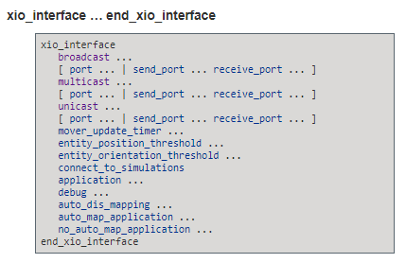
XIO Configuration
The XIO Interface shares similar network configuration parameters with the dis_interface
See Documentation for details

Slide 14
XIO Scenario
Four (Very Notional) Aircraft are Flying In this Scenario
1 Blue_Fighter_1
1 Blue_Fighter_2
1 Blue_Fighter_3
1 Blue_Fighter_4
Demonstrates the Capability of Controlling One or More of These with XIO
The WsfP6DOF_Mover is Used as the Mover of these Aircraft
We will use Warlock as our simulation executor
These four aircraft are theoretical. Their
flight characteristics are generic in nature
and do not share any operational characteristics with any real aircraft.

Slide 15
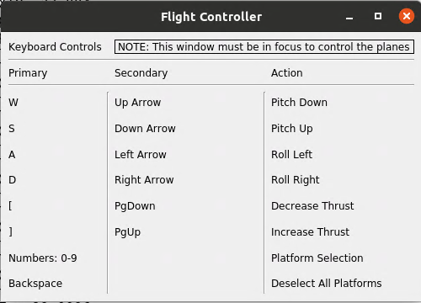
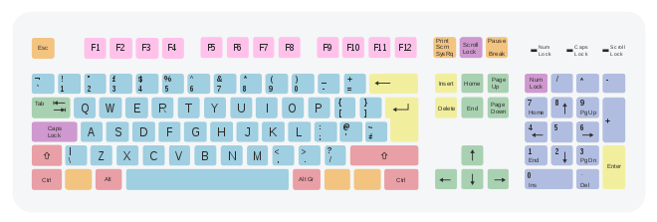

Testing
We will test the Flight Controller and XIO Connection
Give the flight controller application focus by clicking on it
The Following Keyboard Commands Control the Aircraft
Numbers 1-9: Select Platform to Control
Backspace: Deselect all platforms
Arrows or <WASD> : platform pitch, roll, rate changes
Page-Up / Page-Down or “[“ / “]”: Increase / Decrease Platform Speed

Slide 16
Getting Started (1/4)
The Following Advanced Variables are Important (check the Advanced box in cmake-gui):
SWDEV_THIRD_PARTY_PACKAGE_SOURCES
Tells CMake where to find 3rd_Party sources for things like gtest (need by mission), osg, osg_earth, qt, etc.
For AFSIM Releases, CMake expects to find the 3rd party resources in the folder:
…./swdev/dependencies/3rd_party
VTK_RESOURCES_ARCHIVE_FILENAME
Tells CMake where to find the VTK resources (needed if you build any of the visual apps: wizard, warlock, mystic).
For AFSIM Releases, CMake expects to find the VTK resources in the folder:
…./swdev/dependencies/resources

Slide 17
Getting Started (2/4)
Open run_cmake_lnx.sh if
building in Linux
Open run_cmake.bat in text editor
Change:
BUILD_WITH_wsf_p6dof to ON
BUILD_WITH_xio_exercise to ON
BUILD_WITH_warlock to ON
BUILD_WITH_WARLOCK_PLUGIN_P6dofData to ON
BUILD_WITH_WARLOCK_PLUGIN_PlatformBrowser to ON
BUILD_WITH_WARLOCK_PLUGIN_PlatformData to ON
BUILD_WITH_WARLOCK_PLUGIN_SimController to ON
BUILD_WITH_WARLOCK_PLUGIN_VisualEffects to ON
BUILD_WITH_WKF_PLUGIN_MapDisplay to ON
BUILD_WITH_WKF_PLUGIN_MapHoverInfo to ON
BUILD_WITH_WKF_PLUGIN_TetherView to ON
Run run_cmake.bat
Return to the Visual Studio solution
Run run_cmake_lnx.sh if
building in Linux
Notes:
Do not reconfigure in cmake or cmake will add options we don’t need (It will enable all the warlock plugins after we check BUILD_WITH_warlock. Instead, re-run run_cmake.bat with BUILD_WITH_warlock=TRUE.

Slide 18
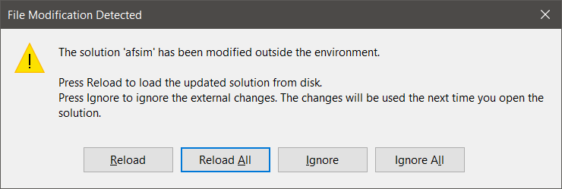
Getting Started (3/4)
If Visual Studio is already open:
Navigate to it and select Reload All when prompted.
Alternatively, open the solution file afsim.sln by:
Opening from swdev\build

Slide 19
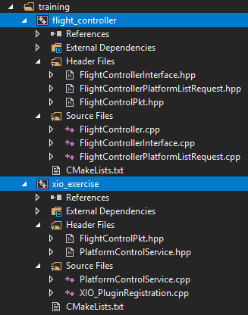
Getting Started (4/4)
This project uses the following source files:
Flight Controller App
FlightControllerPlatformListRequest.hpp
FlightControllerPlatformListRequest.cpp
FlightControllerInterface.hpp
FlightControllerInterface.cpp
FlightControlPkt.hpp
FlightController.cpp
AFSIM Extensions
PlatformControlService.hpp
PlatformControlService.cpp
XIO_PluginRegistration.cpp
Note that many solutions are possible; we have provided a solution in order to complete our training exercise in a short time period.

Slide 20
Classes Utilized by this Exercise
This exercise utilizes the following classes for AFSIM extension:
class FlightControlPkt : public WsfXIO_Packet
Defines a new type of packet that carries platform control information, including the current pitch rate, roll rate, yaw rate, and throttle value.
class PlatformControlService : public WsfSimulationExtension
Accepts FlightControlPkt packets from an external application and uses them to control platforms equipped with P6DOF movers
Sends WsfXIO_PlatformListUpdatePkt packets to inform the external application about the platforms that are selectable for control.
class RegisterPlatformController : public WsfScenarioExtension
This class waits until the simulation has been created, and then registers the PlatformControlService class as a simulation extension when it receives the SimulationCreated method call
class WsfDefaultApplicationExtension : public WsfApplicationExtention
a simple application extension with a ScenarioCreated method
Templated on a scenario extension
When ScenarioCreated is invoked, it registers the scenario extension with the scenario

Slide 21
Classes Utilized by this Exercise
This exercise utilizes the following classes for the external FlightController application:
class FlightControlPkt : public WsfXIO_Packet
Defines a new type of packet that carries platform control information, including the current pitch rate, roll rate, yaw rate, and throttle value.
Duplicated in the XIO source folder due to cmake not knowing about the flight_controller folder at XIO exercise build time (it only knows about the flight_controller folder when building the external FlightController application)
class FlightControllerWidget : public QMainWindow
Defines a Main window widget that is used to display the Flight Controller’s window on the screen
class FlightControllerPlatformListRequest : public WsfXIO_PlatformListRequest
Maintains a list of those platforms that can be selected and controlled by the application
HandlePlatormList is a callback invoked whenever a WsfXIO_PlatformListUpdatePkt is received from AFSIM
class FlightControllerInterface : public WsfScenarioExtension
Maintains the rates of change to apply to pitch, roll, and yaw when user presses keys
Method Update does most of the real work to get input from the keyboard and generating FlightControlPkt packets with the pitch, roll, and yaw values

Slide 22

XIO Packets
WsfXIO_Packet
Common to both the Simulation Extension and the Flight Controller Application
WsfXIO_HeartbeatPkt
WsfXIO_InitializePkt
WsfXIO_RequestDataPkt
FlightControllerPkt
WsfXIO_RequestPkt
We will add a new packet type for use in our AFSIM extension as well as the flight controller
WsfXIO_ResponsePkt
WsfXIO_TimeBehindPkt
WsfXIO_PlatformListUpdatePkt
WsfXIO_DeletePlatformPkt
We will make use of the existing WsfXIO_PlatformListUpdatePkt
WsfXIO_RequestTracksPkt
WsfXIO_RequestTracksPkt
WsfXIO_TrackDropPkt
WsfXIO_PlatformListPkt
WsfXIO_PlatformListPkt
$$⋮$$
There are 62 predefined packet types in XIO

Slide 23
XIO Interface Used only by the FlightController App
We only use part of the XIO interface
XIO in AFSIM utilizes:
An Application Extension
A Scenario Extension
A Simulation Extension
FlightController does not register XIO
Does not create any of the extensions
FlightController primarily uses the XIO classes shown
main creates a FlightControllerInterface
main creates a FlightControllerWidget
Ui::FlightControllerMainWindow
QMainWindow
FlightControllerWidget
We will create a new FlightControllerWidget
We will create a new FlightControllerPlatformListRequest (registers with XIO to get platform list updates every time there is a change in the list of platforms)
WsfXIO_Request
WsfXIO_PlatformListRequest
FlightControllerPlatformListRequest
0 .. N
WsfXIO_InputData
WsfXIO_RequestManager
1
WsfXIO_Interface
FlightControllerInterface
We will create a new FlightControllerInterface

Slide 24
XIO Exercises
Exercise 1
Plugin setup, extension registration, Register FlightControlPkt packet type
Register to execute ControlPlatform callback method when these packets arrive
Exercise 2
Understand selection and deselection of platforms, and complete ControlPlatform
Exercise 3
Understand FlightController Application
Implement HandlePlatformList packets
Implement Initialize
Understand use of ProcessInput in FlightController Application
Understand handling of key presses
Register FlightControlPkt and register for PlatformListUpdates

Slide 25
Exercise 1
Complete registration of default application extension, templated upon a scenario extension, and registration of a simulation extension
Observe RegisterPlatformController is a scenario extension
Observe PlatformControlService is a simulation extension
Register FlightControlPkt packet type
Register to execute PlatformControlService::ControlPlatform callback method when FlightControlPkt packets arrive

Slide 26
AFSIM Plugins & Extensions
WsfExtension
WsfScenario
WsfSimulation
WsfApplication
WsfStandardApplication
WsfSimulationExtension
WsfScenarioExtension
WsfApplicationExtension
Main application classes used
in mission/warlock
All AFSIM extensions must derive from WsfExtension:
Three predefined extension classes already exist (can be inherited from)
WsfScenarioExtension – extensions that will provide new scenario commands (requiring a new ProcessInput for those commands) will need to inherit this class
WsfSimulationExtension – extensions that will access the simulation will need to inherit this class
WsfApplicationExtension – extensions that will create new script types, or will utilize a simulation extension or scenario extension, will need to inherit this class

Slide 27
AFSIM Plugins & Extensions
WsfExtension
WsfScenario
WsfSimulation
WsfApplication
WsfStandardApplication
WsfSimulationExtension
WsfScenarioExtension
WsfApplicationExtension
Main application classes used
in mission/warlock
PlatformControlService
RegisterPlatformController
WsfDefaultApplicationExtension
Sets up the new SimulationExtension classes to work
with AFSIM
Sets up the new ScenarioExtension classes to work
with AFSIM
Sets up the new Application
Extension classes to work
with AFSIM
All AFSIM extensions must derive from WsfExtension:
Three predefined extension classes already exist (can be inherited from)
WsfScenarioExtension – extensions that will provide new scenario commands (requiring a new ProcessInput for those commands) will need to inherit this class
WsfSimulationExtension – extensions that will access the simulation will need to inherit this class
WsfApplicationExtension – extensions that will create new script types, or will utilize a simulation extension or scenario extension, will need to inherit this class

Slide 28
Extensions
Applications, Scenarios, and Simulations can all be “Extended”
Application Extensions are owned by the Application
Represent optional capabilities that can be added to an application.
Used if you need new script types (sensors, weapons, components, movers)
This is the entry point to registering all extensions in AFSIM
An application extension is required if you are going to create a scenario extension or a simulation extension
We also need an application extension if
We are creating new scripts
We need to register a new plugin
We will use the default application extension, as we only need to register the scenario and simulation extensions
see the file XIO_PluginRegistration.cpp

Slide 29
XIO Exercise 1 – Review 1 XIO_PluginRegistration.cpp
Become familiar with WsfPluginVersion and WsfPluginSetup
WsfPluginSetup registers a WsfDefaultApplicationExtension
WsfDefaultApplicationExtension::ScenarioCreated, when executed, registers a RegisterPlatformController Scenario Extension
This object loading scheme should start to look familiar!
extern "C"
{
//! This method is called to check the plugin version and compiler type.
//! If values do not match the plugin will not load.
XIO_EXERCISE_EXPORT void WsfPluginVersion(UtPluginVersion& aVersion)
{
aVersion = UtPluginVersion(WSF_PLUGIN_API_MAJOR_VERSION,
WSF_PLUGIN_API_MINOR_VERSION,
WSF_PLUGIN_API_COMPILER_STRING);
}
//! This method is called to register the plugin with the application.
XIO_EXERCISE_EXPORT void WsfPluginSetup(WsfApplication& aApplication)
{
// Make an application extension that creates a scenario extension for every scenario.
aApplication.RegisterExtension("platform_controller_registration",
ut::make_unique<WsfDefaultApplicationExtension<RegisterPlatformController>>());
aApplication.ExtensionDepends("platform_controller_registration", "wsf_p6dof", true);
}
}
Note that the WsfDefaultApplicationExtension is templated
upon RegisterPlatformController (a scenario extension)

Slide 30
Application Extensions
To extend an Application, you must create a class that inherits class WsfApplicationExtension
class myAppExtension: public WsfApplicationExtension { … }
You should override the following members:
AddedToApplication: to receive notification that extension was added to the application – often used to register additional script class and methods, etc.
ScenarioCreated: called at end of Scenario constructor in order to receive notification from the application that the scenario was created – useful to register an Scenario extension if needed
SimulationCreated: called from the Simulation’s Initialize method in order to receive notification from the application that the simulation was created – useful to register an Simulation extension if needed
ProcessCommandLine: called from WsfApplication::ProcessCommandLine method to examine current argument and process it if necessary
PrintGrammar: prints out the extended grammar recognized by the extension
ProcessCommandLineCommands: called by WsfApplication’s ProcessCommandLineCommands to allow the extension to process/handle any commands it needs to recognize

Slide 31
XIO Exercise Application Extension
To extend an Application, you must create a class that inherits class WsfApplicationExtension
We will use WsfDefaultApplicationExtension which will register the scenario extension
class WsfDefaultApplicationExtension: public WsfApplicationExtension { … }
This class overrides the following members for an ApplicationExtension:
ScenarioCreated: called at end of Scenario constructor in order to receive notification from the application that the scenario was created – useful to register a Scenario extension if needed
This class is templated on a WsfScenarioExtension (RegisterPlatformController is derived from this class)
When the ScenarioCreated method is executed by the WsfScenario constructor, our RegisterPlatformController class is registered with the scenario as a scenario extension

Slide 32
Scenario Extensions
Scenarios can all be “Extended” as well
Scenario Extensions are owned by the Scenario
Represent optional types that can be added to a scenario.
Used if you need new types (components, observers, comms)
An application extension is required if you are going to create a scenario extension (or a simulation extension – covered later)

Slide 33
Scenario Extensions
To extend a Scenario, you must create a class that inherits class WsfScenarioExtension
class myScenarioExtension: public WsfScenarioExtension
You can override:
AddedToScenario: to receive notification that extension was added to the scenario – often used to register additional component type objects and factories
ProcessInput: processes any scenario input commands that must be recognized by the extension
FileLoaded: notifies extension that a file has been loaded into the scenario
Complete: called from WsfScenario::LoadComplete – notifies extension that all scenario input has been processed
Complete2: called after all extensions have had their Complete method invoked
SimulationCreated: called from WsfSimulation::Initialize – useful if a scenario extension needs an associated simulation extension – this method can register the simulation extension
AlwaysCreate: determines if the extension is optional or required

Slide 34
XIO Exercise Scenario Extension
To extend a Scenario, you must create a class that inherits class WsfScenarioExtension
class RegisterPlatformController: public WsfScenarioExtension
We will override:
SimulationCreated: called from WsfSimulation::Initialize – useful if a scenario extension needs an associated simulation extension – this method can register the simulation extension

Slide 35
Simulation Extensions
Simulations can all be “Extended” as well
Simulation Extensions are owned by the Simulation
Allow access to the simulation features.
Used if you need access to the simulation itself(observers, comms, xio)
An application extension is required if you are going to create a simulation extension (and you may need a scenario extension as well)
We need a simulation extension if
We need to know when platforms are added or deleted
We need to access parts of the simulation to control platforms

Slide 36
Simulation Extensions
To extend a Simulation, you must create a class that inherits class WsfSimulationExtension
class mySimulationExtension: public WsfSimulationExtension
You must override:
AddedToSimulation: called from WsfSimulation::RegisterExtension
Initialize: called form WsfSimulation::Initialize – useful to perform extension initialization
PrepareExtension: called from WsfSimulation::Initialize (called when a simulation is initialized) and from WsfSimulation::PrepareSimulation (called when a simulation is reloaded)
PendingStart: simulation has just entered pending start state, allows extension to add additional platforms or other entities
Start: called from WsfSimulation::Start – another opportunity to add additional platforms or other entities
Complete: called from WsfSimulation::Complete – allows extension to release resources (files, sockets, etc.) that were allocated by Initialize or PrepareExtension

Slide 37
XIO Exercise Simulation Extension
To extend a Simulation, you must create a class that inherits class WsfSimulationExtension
class PlatformControlService: public WsfSimulationExtension
We will override:
Start: called from WsfSimulation::Initialize – useful to inform extensions that the simulation is starting

Slide 38
XIO Exercise 1 – Task 1 XIO_PluginRegistration.cpp
Complete RegisterPlatformController::SimulationCreated
Use the simulation object parameter to register an extension
Name this extension platform_controller
Provide a new instance of PlatformControlService as a parameter (make a unique_ptr to it)
Remember, SimulationCreated is executed by the simulation object’s constructor, just after it has been instantiated

Slide 39
XIO Exercise 1 – Task 1 Solution XIO_PluginRegistration.cpp
class RegisterPlatformController : public WsfScenarioExtension
{
public:
~RegisterPlatformController() noexcept override = default;
void SimulationCreated(WsfSimulation& aSimulation) override
{
// EXERCISE 1 TASK 1
// Use the simulation object to register an extension
// Name this extension "platform_controller"
// Provide a new instance of PlatformControlService as a parameter
aSimulation.RegisterExtension("platform_controller",
ut::make_unique<PlatformControlService>());
}
};

Slide 40
XIO Exercise 1 – Review 2 PlatformControlService.hpp
Inspect PlatformControlService.hpp:
Notice that start overrides a WsfSimulationExtension method
Notice that ControlPlatform takes a packet which contains control information
Notice the private helper methods:
SelectPlatform: used when changing the platform being controlled
DeselectPlatform: used when changing the platform being controlled
Notice the private member variables:
mCallbacks: the list of callback functions this class has registered for
mXIO_Ptr: a simple pointer to the XIO interface
mControlledPlatformIndex: the index of the platform that is currently being controlled by received packets

Slide 41
XIO Exercise 1 – Review 2 PlatformControlService.hpp
class PlatformControlService : public WsfSimulationExtension
{
public:
//! Constructor
PlatformControlService();
//! Virtual destructor
~PlatformControlService() noexcept override = default;
//! Callback Function
void ControlPlatform(PakPacket& aPacket);
void Start() override;
private:
void SelectPlatform(const WsfPlatform* aPlatformPtr);
void DeselectPlatform(const WsfPlatform* aPlatformPtr);
//! The callback holder to maintain list of subscriptions made by this class
UtCallbackHolder mCallbacks;
//! Maintain a pointer to the xio interface.
//! This is guaranteed to be valid throughout the simulation.
WsfXIO_Interface* mXIO_Ptr;
//! The platform we are currently controlling
unsigned int mControlledPlatformIndex;
};

Slide 42
XIO Exercise 1 – Task 2 PlatformControlService.cpp
From Within PlatformControlService::Start Method:
Task 2a: Use the XIO Interface (i.e., the mXIO_Ptr) to register the new packet type (FlightControlPkt) so that it is recognized
Invoke the method RegisterPacket
The first argument is the string “FlightControlPkt”
The second argument is a pointer to a new FlightControlPkt
Task 2b: Subscribe to be notified when a new Flight Control packet is received
Use mXIO_Ptr->Connect
Similar syntax to WsfObserver subscriptions
Takes arguments of:
the packet id to which we want to subscribe (FlightControlPkt::cPACKET_ID)
a function pointer to be called to operate on the packet (ControlPlatform)
this

Slide 43
XIO Exercise 1 – Task 2 Solution PlatformControlService.cpp
The ID of the packet of interest
void PlatformControlService::Start()
{
mXIO_Ptr = WsfXIO_Extension::Find(GetSimulation());
// If the xio interface was not configured the pointer will be zero.
if (mXIO_Ptr != nullptr)
{
// EXERCISE 1 TASK 2a
// Register our new packet type
mXIO_Ptr->RegisterPacket("FlightControlPkt", new FlightControlPkt());
// EXERCISE 1 TASK 2b
// Subscribe to be notified when a new Flight Control packet is received.
mCallbacks += mXIO_Ptr->Connect(FlightControlPkt::cPACKET_ID,
&PlatformControlService::ControlPlatform,
this);
}
...
}
The Function to be called to
operate on the packet
The instance that will operate
on the packet

Slide 44
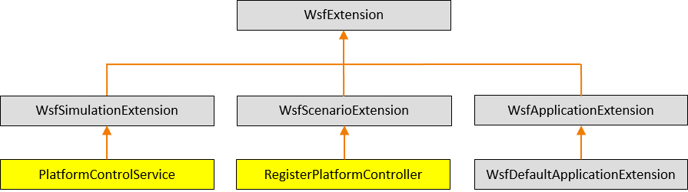
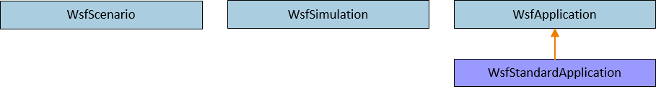
AFSIM Plugins & Extensions AFSIM mission startup sequence
First, mission creates a WsfStandardApplication named app
mission::main()
unique_ptr<WsfDefaultApplicationExtension<RegisterPlatformController>>
WsfStandardApplication: app
WsfStandardApplication::WsfStandardApplication()
XIO_PluginRegistration.cpp:WsfPluginSetup()
WsfPluginSetup()
RegisterExtension(“platform_controller_registration”, ut::make_unique<WsfDefaultApplicationExtension<RegisterPlatformController>>())
AddedToApplication()
The WsfStandardApplication constructor utilizes the plugin manager to find and load all plugins (including those in the training folders -- because of the cmake option WSF_ADD_EXTENSION_PATH)
For each plugin found, executes WsfPluginSetup (note: this causes our XIO exercise plugin’s WsfPluginSetup function to execute)
This causes our xio exercise’s WsfDefaultApplicationExtension to be created and registered with app
RegisterExtension then invokes the WsfApplicationExtension::AddedToApplication()
Note: WsfDefaultApplicationExtension does not override AddedToApplication, so this notification is essentially ignored

Slide 45

AFSIM Plugins & Extensions AFSIM mission startup sequence
mission::main()
unique_ptr<WsfDefaultApplicationExtension<…>>
WsfStandardApplication: app
RegisterExtension(…)
RegisterExtension(…)
$$⋮$$
RegisterExtension(…)
Mission then registers all of the necessary predefined extensions with app

Slide 46
AFSIM Plugins & Extensions AFSIM mission startup sequence
mission::main()
unique_ptr<RegisterPlatformController>
unique_ptr<WsfDefaultApplicationExtension<…>>
WsfScenario: scenario
WsfStandardApplication: app
WsfScenario::WsfScenario(app)
ScenarioCreated(…)
ScenarioCreated(…)
scenario.RegisterExtension(“platform_controller_registration”,
ut::make_unique<SignalCommRegistration>())
This is not the actual line of code executed, but this is what that code is equivalent to
AddedToApplication(…)
Mission then creates the scenario and invokes the WsfScenario constructor: WsfScenario scenario(app);
This constructor invokes the WsfApplication::ScenarioCreated method
This, in turn, invokes ScenarioCreated for all registered application extensions (including WsfDefaultApplicationExtension::ScenarioCreated)
This, in turn, creates the RegisterPlatformController, and registers it with scenario
RegisterExtension then invokes RegisterPlatformController::AddedToScenario
Note: RegisterPlatformController does not override AddedToApplication so this notification is essentially ignored

Slide 47
AFSIM Plugins & Extensions
mission::main()
unique_ptr<RegisterPlatformController>
unique_ptr<WsfDefaultApplicationExtension<…>>
WsfScenario: scenario
WsfStandardApplication: app
WsfStandardApplication::ProcessInputFiles()
WsfScenario::LoadFromFile(…)
ProcessInput(…)
ProcessInput(…)
Mission invokes app.WsfStandardApplication::ProcessInputFiles()
which invokes WsfScenario::LoadFromFile()
For each command in input,
Invoke each of the core classes’ ProcessInput() methods
Invoke each registered scenario extension’s ProcessInput()
RegisterPlatformController does not override ProcessInput, so this extension does not handle any new commands

Slide 48
AFSIM Plugins & Extensions
mission::main()
unique_ptr<RegisterPlatformController>
unique_ptr<WsfDefaultApplicationExtension<…>>
WsfScenario: scenario
WsfStandardApplication: app
WsfStandardApplication::ProcessInputFiles()
WsfScenario::LoadFromFile(…)
Complete(…)
WsfScenario::CompleteLoad(…)
Complete2(…)
Mission invokes app.WsfStandardApplication::ProcessInputFiles()
which, invokes WsfScenario::LoadFromFile()
and then invokes WsfScenario::CompleteLoad()
Invokes each scenario extension’s Complete()
Then invokes each scenario extension’s Complete2()

Slide 49
AFSIM Plugins & Extensions
mission::main()
unique_ptr<RegisterPlatformController>
unique_ptr<WsfDefaultApplicationExtension<…>>
WsfScenario: scenario
unique_ptr<WsfSimulation>: simPtr
WsfStandardApplication: app
WsfStandardApplication::CreateSimulation()
WsfSimulation::WsfSimulation()
Mission creates the Simulation by executing:
std::unique_ptr<WsfSimulation> simPtr =
app.CreateSimulation(scenario, …);
CreateSimulation invokes the WsfSimulation object’s constructor (with scenario as argument)

Slide 50
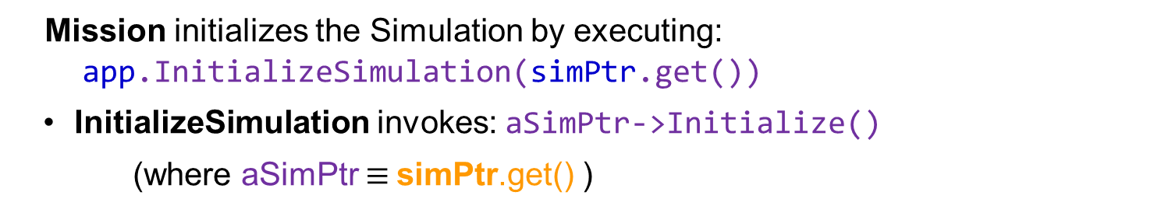
AFSIM Plugins & Extensions
mission::main()
unique_ptr<RegisterPlatformController>
unique_ptr<WsfDefaultApplicationExtension<…>>
WsfScenario: scenario
unique_ptr<WsfSimulation>: SimPtr
WsfStandardApplication: app
WsfStandardApplication::InitializeSimulation()
WsfSimulation::Initialize()
Mission initializes the Simulation by executing:
app.InitializeSimulation(simPtr.get())
InitializeSimulation invokes: aSimPtr->Initialize()
(where aSimPtr $≡$simPtr.get() )

Slide 51
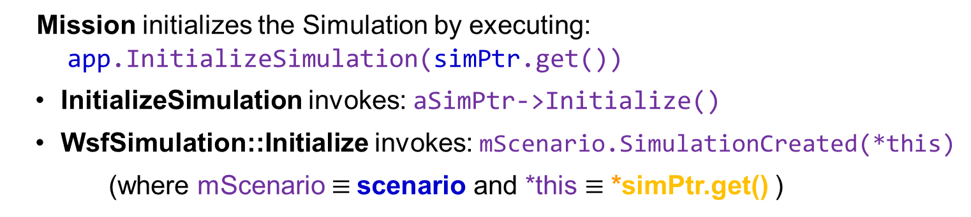
AFSIM Plugins & Extensions
mission::main()
unique_ptr<RegisterPlatformController>
unique_ptr<WsfDefaultApplicationExtension<…>>
WsfScenario: scenario
unique_ptr<WsfSimulation>: SimPtr
WsfStandardApplication: app
WsfStandardApplication::InitializeSimulation()
WsfScenario::SimulationCreated()
WsfSimulation::Initialize()
Mission initializes the Simulation by executing:
app.InitializeSimulation(simPtr.get())
InitializeSimulation invokes: aSimPtr->Initialize()
WsfSimulation::Initialize invokes: mScenario.SimulationCreated(*this)
(where mScenario $≡$scenario and *this $≡$ *simPtr.get() )

Slide 52
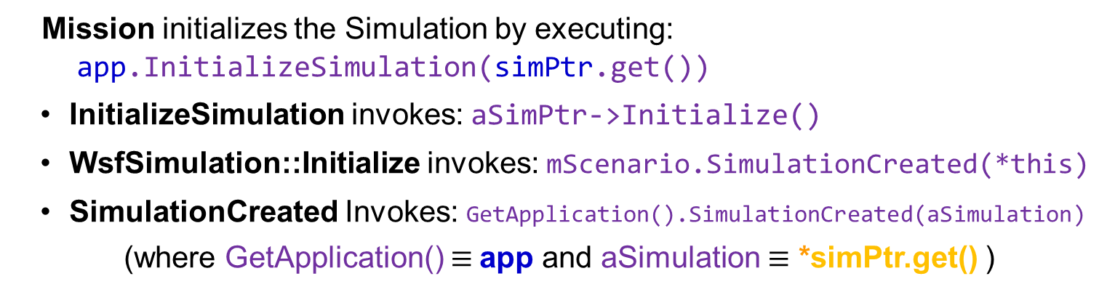
AFSIM Plugins & Extensions
mission::main()
unique_ptr<RegisterPlatformController>
unique_ptr<WsfDefaultApplicationExtension<…>>
WsfScenario: scenario
unique_ptr<WsfSimulation>: SimPtr
WsfStandardApplication: app
WsfStandardApplication::InitializeSimulation()
WsfScenario::SimulationCreated()
WsfSimulation::Initialize()
WsfApplication::SimulationCreated()
Mission initializes the Simulation by executing:
app.InitializeSimulation(simPtr.get())
InitializeSimulation invokes: aSimPtr->Initialize()
WsfSimulation::Initialize invokes: mScenario.SimulationCreated(*this)
SimulationCreated Invokes: GetApplication().SimulationCreated(aSimulation)
(where GetApplication() $≡$app and aSimulation $≡$ *simPtr.get() )

Slide 53
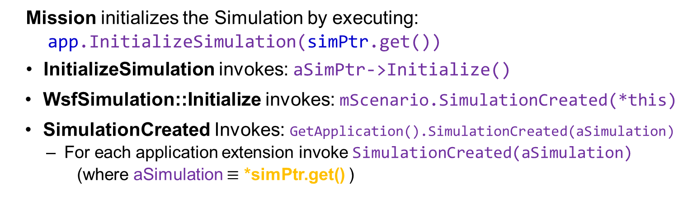
AFSIM Plugins & Extensions
mission::main()
unique_ptr<RegisterPlatformController>
unique_ptr<WsfDefaultApplicationExtension<…>>
WsfScenario: scenario
unique_ptr<WsfSimulation>: SimPtr
WsfStandardApplication: app
WsfStandardApplication::InitializeSimulation()
WsfScenario::SimulationCreated()
WsfSimulation::Initialize()
WsfApplication::SimulationCreated()
Mission initializes the Simulation by executing:
app.InitializeSimulation(simPtr.get())
InitializeSimulation invokes: aSimPtr->Initialize()
WsfSimulation::Initialize invokes: mScenario.SimulationCreated(*this)
SimulationCreated Invokes: GetApplication().SimulationCreated(aSimulation)
For each application extension invoke SimulationCreated(aSimulation)
(where aSimulation $≡$ *simPtr.get() )

Slide 54
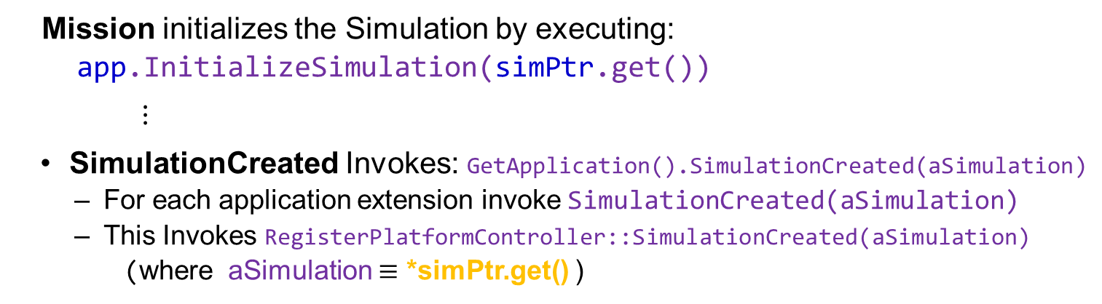
AFSIM Plugins & Extensions
mission::main()
unique_ptr<RegisterPlatformController>
unique_ptr<WsfDefaultApplicationExtension<…>>
WsfScenario: scenario
unique_ptr<WsfSimulation>: SimPtr
WsfStandardApplication: app
WsfStandardApplication::InitializeSimulation()
WsfScenario::SimulationCreated()
WsfSimulation::Initialize()
WsfApplication::SimulationCreated()
RegisterPlatformController::SimulationCreated()
Mission initializes the Simulation by executing:
app.InitializeSimulation(simPtr.get())
$⋮$
SimulationCreated Invokes: GetApplication().SimulationCreated(aSimulation)
For each application extension invoke SimulationCreated(aSimulation)
This Invokes RegisterPlatformController::SimulationCreated(aSimulation)
(where aSimulation $≡$ *simPtr.get() )

Slide 55
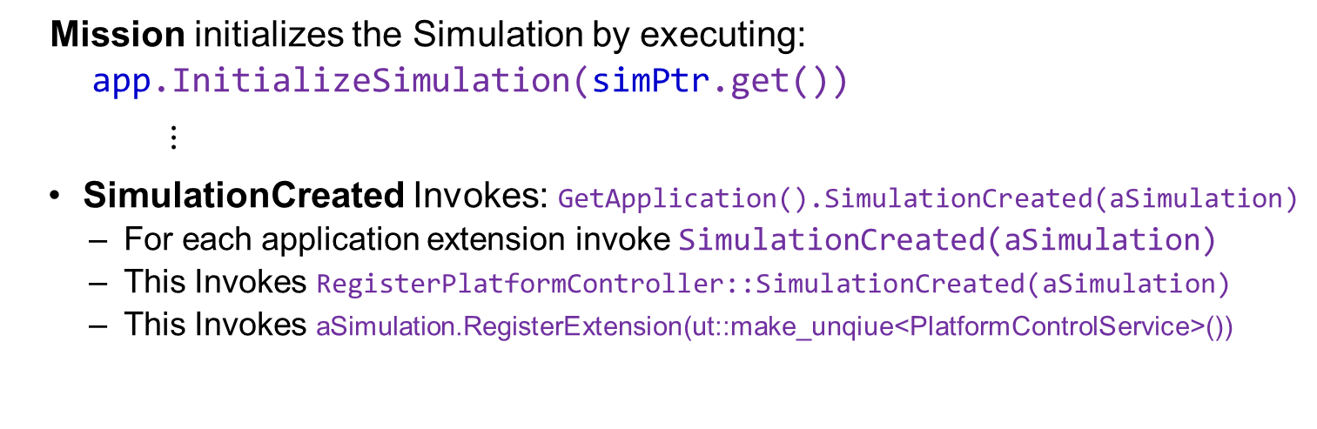
AFSIM Plugins & Extensions
unique_ptr<PlatformControlService>
mission::main()
unique_ptr<RegisterPlatformController>
unique_ptr<WsfDefaultApplicationExtension<…>>
WsfScenario: scenario
unique_ptr<WsfSimulation>: SimPtr
WsfStandardApplication: app
WsfStandardApplication::InitializeSimulation()
WsfScenario::SimulationCreated()
WsfSimulation::Initialize()
WsfApplication::SimulationCreated()
RegisterPlatformController::SimulationCreated()
WsfSimulation::RegisterExtension()
PlatformControlService::AddedToSimulation()
Mission initializes the Simulation by executing:
app.InitializeSimulation(simPtr.get())
$⋮$
SimulationCreated Invokes: GetApplication().SimulationCreated(aSimulation)
For each application extension invoke SimulationCreated(aSimulation)
This Invokes RegisterPlatformController::SimulationCreated(aSimulation)
This Invokes aSimulation.RegisterExtension(ut::make_unqiue<PlatformControlService>())
This, in turn, creates the PlatformControlService object,
and registers it with simPtr
– Finally, RegisterExtension invokes PlatfromControlService::AddedToApplication,
which is not overriden and has no effect
(where aSimulation $≡$ *simPtr.get()

Slide 56
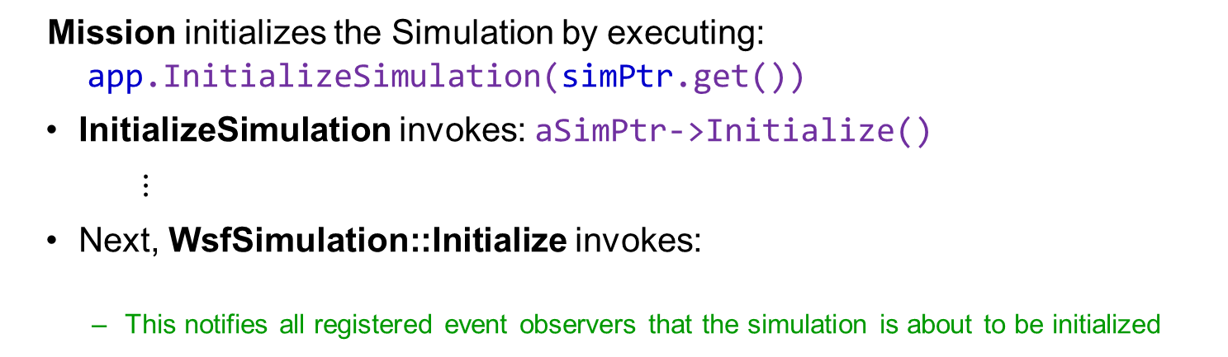
AFSIM Plugins & Extensions
unique_ptr<PlatformControlService>
mission::main()
unique_ptr<RegisterPlatformController>
unique_ptr<WsfDefaultApplicationExtension<…>>
WsfScenario: scenario
unique_ptr<WsfSimulation>: SimPtr
WsfStandardApplication: app
WsfStandardApplication::InitializeSimulation()
WsfSimulation::Initialize()
WsfObserver::SimulationInitializing()
Mission initializes the Simulation by executing:
app.InitializeSimulation(simPtr.get())
InitializeSimulation invokes: aSimPtr->Initialize()
$⋮$
Next, WsfSimulation::Initialize invokes:
This notifies all registered event observers that the simulation is about to be initialized
WsfObserver::SimulationInitializing(this)
Note: the PlatformControlService class does not override this method, hence we do nothing with the notification

Slide 57
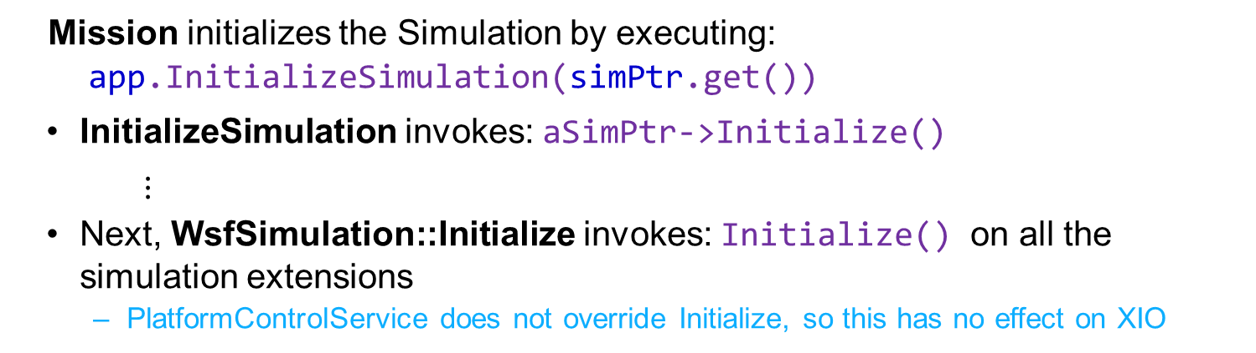
AFSIM Plugins & Extensions
unique_ptr<PlatformControlService>
mission::main()
unique_ptr<RegisterPlatformController>
unique_ptr<WsfDefaultApplicationExtension<…>>
WsfScenario: scenario
unique_ptr<WsfSimulation>: SimPtr
WsfStandardApplication: app
WsfStandardApplication::InitializeSimulation()
WsfSimulation::Initialize()
WsfSimulationExtension::Initialize()
Mission initializes the Simulation by executing:
app.InitializeSimulation(simPtr.get())
InitializeSimulation invokes: aSimPtr->Initialize()
$⋮$
Next, WsfSimulation::Initialize invokes: Initialize() on all the simulation extensions
PlatformControlService does not override Initialize, so this has no effect on XIO

Slide 58
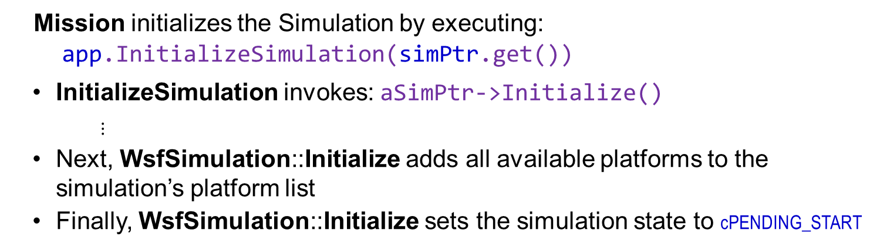
AFSIM Plugins & Extensions
unique_ptr<PlatformControlService>
mission::main()
unique_ptr<RegisterPlatformController>
unique_ptr<WsfDefaultApplicationExtension<…>>
WsfScenario: scenario
unique_ptr<WsfSimulation>: SimPtr
WsfStandardApplication: app
WsfStandardApplication::InitializeSimulation()
WsfSimulation::Initialize()
Mission initializes the Simulation by executing:
app.InitializeSimulation(simPtr.get())
InitializeSimulation invokes: aSimPtr->Initialize()
$⋮$
Next, WsfSimulation::Initialize adds all available platforms to the simulation’s platform list
Finally, WsfSimulation::Initialize sets the simulation state to cPENDING_START

Slide 59
AFSIM Plugins & Extensions
unique_ptr<PlatformControlService>
mission::main()
unique_ptr<RegisterPlatformController>
unique_ptr<WsfDefaultApplicationExtension<…>>
WsfScenario: scenario
unique_ptr<WsfSimulation>: SimPtr
WsfStandardApplication: app
WsfStandardApplication::RunEventLoop()
WsfSimulation::Start()
PlatformControlService::Start()
Mission runs the Simulation by executing:
app.RunEventLoop(simPtr.get(), options)
RunEventLoop invokes: aSimPtr->Start()
WsfSimulation::Start
For each simulation extension invoke Start()
Invokes PlatformControlService::Start()
Sets up XIO connection callbacks to handle incoming packets

Slide 60
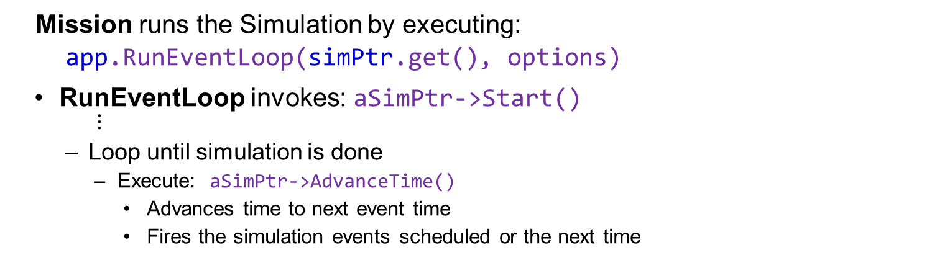
AFSIM Plugins & Extensions
unique_ptr<PlatformControlService>
mission::main()
unique_ptr<RegisterPlatformController>
unique_ptr<WsfDefaultApplicationExtension<…>>
WsfScenario: scenario
unique_ptr<WsfSimulation>: SimPtr
WsfStandardApplication: app
WsfStandardApplication::RunEventLoop()
WsfSimulation::Start()
Mission runs the Simulation by executing:
app.RunEventLoop(simPtr.get(), options)
RunEventLoop invokes: aSimPtr->Start()
$⋮$
Loop until simulation is done
Execute: aSimPtr->AdvanceTime()
Advances time to next event time
Fires the simulation events scheduled or the next time

Slide 61
Exercise 2
Handling FlightControlPkt packets
Understand selection and deselection of platforms, and complete PlatformControlService::ControlPlatform
Understand how PlatformControlService::Start turns on the autopilot for all platforms when the simulation starts
Understand PlatformControlService::SelectPlatform
Understand PlatformControlService::DeselectPlatform
Understand PlatformControlService::ControlPlatform and how it handles keystrokes encoded in the FlightControlPkt
Complete PlatformControlService::ControlPlatform logic for directly controlling the selected platform

Slide 62
XIO Exercise 2 – Review 1 PlatformControlService.cpp
Inspect PlatformControlService::Start Method:
Notice the for loop at the end
Ensures autopilot is turned on for all platform’s 6-dof movers
void PlatformControlService::Start()
{
...
// Make sure the autopilot is initially turned on for all 6-dof movers
for (unsigned i = 0; i < GetSimulation().GetPlatformCount(); ++i)
{
WsfPlatform* platformPtr = GetSimulation().GetPlatformEntry(i);
WsfP6DOF_Mover* p6DofMoverPtr = dynamic_cast<WsfP6DOF_Mover*>(platformPtr->GetMover());
if (p6DofMoverPtr != nullptr)
{
p6DofMoverPtr->ReleaseDirectControlInput();
p6DofMoverPtr->EnableAutopilot(true);
}
}
}

Slide 63
XIO Exercise 2 – Task 1 PlatformControlService.cpp
In the PlatformControlService::ControlPlatform Method:
Perform an ID Check to Verify That the Packet’s ID Corresponds with the PlatformControlPkt Packet’s ID (i.e., FlightControlPkt::cPACKET_ID).

Slide 64
XIO Exercise 2 – Task 1 Solution PlatformControlService.cpp
//! Method called by XIO to control the platform based on received packet values
//! @param aPacket The packet received by XIO and passed to this method.
void PlatformControlService::ControlPlatform(PakPacket& aPacket)
{
// EXERCISE 2 TASK 1
// Perform a check to verify that the aPacket’s ID corresponds to that of the FlightControlPkt::cPACKET_ID
if (aPacket.ID() == FlightControlPkt::cPACKET_ID)
{
...
}
}

Slide 65

XIO Exercise 2 – Review 2 PlatformControlService.cpp
In the PlatformControlService::ControlPlatform Method:
Understand the Platform Deselection Logic:
This logic is executed when the platform index in the flightControlPacket is 10 (an invalid platform index)
//! Method called by XIO to control the platform based on received packet values
//! @param aPacket The packet received by XIO and passed to this method.
void PlatformControlService::ControlPlatform(PakPacket& aPacket)
{
// EXERCISE 2 TASK 1
// Perform a check to verify that the aPacket’s ID corresponds to that of the FlightControlPkt::cPACKET_ID
if (aPacket.ID() == FlightControlPkt::cPACKET_ID)
{
FlightControlPkt flightControlPacket = static_cast<FlightControlPkt&>(aPacket);
if (flightControlPacket.mPlatformIndex == cINVALID_PLATFORM_INDEX)
{
WsfPlatform* currentPlatformPtr = GetSimulation().GetPlatformByIndex(mControlledPlatformIndex);
if (currentPlatformPtr != nullptr)
{
DeselectPlatform(currentPlatformPtr);
}
mControlledPlatformIndex = 0;
}
$⋮$

Slide 66
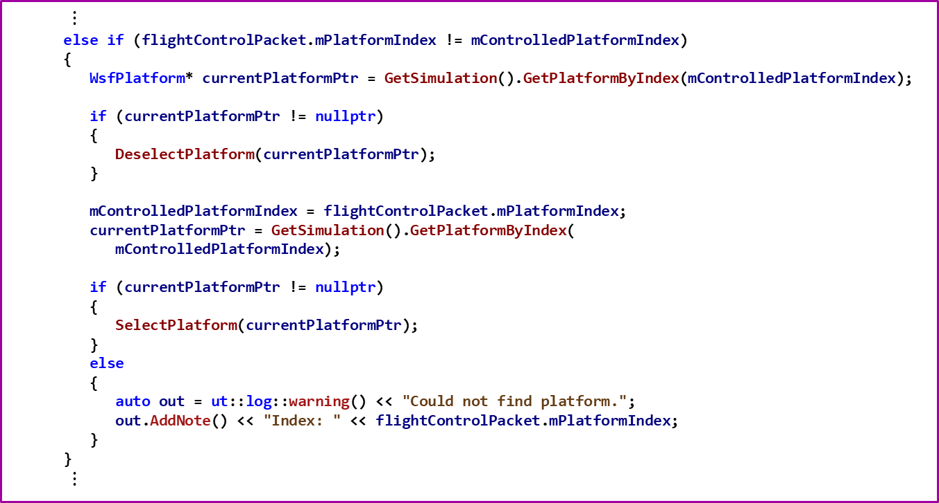
XIO Exercise 2 – Review 2 PlatformControlService.cpp
In the PlatformControlService::ControlPlatform Method:
Understand the Platform Deselection / Selection Logic:
$⋮$
else if (flightControlPacket.mPlatformIndex != mControlledPlatformIndex)
{
WsfPlatform* currentPlatformPtr = GetSimulation().GetPlatformByIndex(mControlledPlatformIndex);
if (currentPlatformPtr != nullptr)
{
DeselectPlatform(currentPlatformPtr);
}
mControlledPlatformIndex = flightControlPacket.mPlatformIndex;
currentPlatformPtr = GetSimulation().GetPlatformByIndex(
mControlledPlatformIndex);
if (currentPlatformPtr != nullptr)
{
SelectPlatform(currentPlatformPtr);
}
else
{
auto out = ut::log::warning() << "Could not find platform.";
out.AddNote() << "Index: " << flightControlPacket.mPlatformIndex;
}
}
$⋮$

Slide 67
XIO Exercise 2 – Task 2
In the PlatformControlService::ControlPlatform Method:
Use the Simulation object to get the currently selected platform
Invoke GetSimulation().GetPlatformByIndex() and pass in the platform index (stored in mControlledPlatformIndex)
Store the returned WsfPlatform pointer in a variable
Check to ensure the variable containing the WsfPlatform pointer is not a nullptr (i.e., GetPlatformByIndex found the platform)
If it is nullptr, the platform was not found (i.e., it does not exist) so do not do any of the following parts of the task
Get the mover of the currently selected platform and cast it to type WsfP6DOF_Mover
Use the WsfPlatform pointer to invoke GetMover
Dynamic_cast the returned mover to be a WsfP6DOF_Mover
Store the casted pointer in a variable of type WsfP6DOF_Mover *
Call the P6dof mover's SetDirectControlInputs method, parameterizing it with values from the flight control packet:
roll rate (FlightControlPacket.mRollRate),
pitch rate (FlightControlPacket.mPitchRate),
yaw rate (FlightControlPacket.mYawRate), and
throttle (FlightControlPacket.mThrottle)
Note: This method provides the normalized inputs that control the P6dof mover
Generate ut::log::info() output
Indicate a flight control packet was received
Output the yaw, pitch, roll, and throttle values encoded in the packet

Slide 68
XIO Exercise 2 – Task 2 Solution PlatformControlService.cpp
if (mControlledPlatformIndex != cNO_PLATFORM_SELECTED)
{
// EXERCISE 2 TASK 2
// Use the simulation object to get the currently selected platform
// Get the platform's mover and cast it to a WsfP6DOF_Mover
// Set the control inputs using values from the flight control packet
// Generate ut::log::info() output indicating a packet was received, and its yaw,
// pitch, roll, and throttle values
WsfPlatform* currentPlatformPtr = GetSimulation().GetPlatformByIndex(mControlledPlatformIndex);
if (currentPlatformPtr != nullptr)
{
WsfP6DOF_Mover* p6DofMoverPtr = dynamic_cast<WsfP6DOF_Mover*>(currentPlatformPtr->GetMover());
if (p6DofMoverPtr != nullptr)
{
p6DofMoverPtr->SetDirectControlInputs(flightControlPacket.mRollRate,
flightControlPacket.mPitchRate,
flightControlPacket.mYawRate,
flightControlPacket.mThrottle);
auto out = ut::log::info() << "Received flight control packet.";
out.AddNote() << "Yaw: " << flightControlPacket.mYawRate;
out.AddNote() << "Pitch: " << flightControlPacket.mPitchRate;
out.AddNote() << "Roll: " << flightControlPacket.mRollRate;
out.AddNote() << "Throttle: " << flightControlPacket.mThrottle;
}
}
}

Slide 69
XIO Exercise 2 – Review 3 PlatformControlService.cpp
Inspect PlatformControlService::SelectPlatform
Notice the logic to select a platform for control
Notice that autopilot is turned off on this platform
// private
void PlatformControlService::SelectPlatform(const WsfPlatform * aPlatformPtr)
{
WsfP6DOF_Mover* p6DofMoverPtr = dynamic_cast<WsfP6DOF_Mover*>(aPlatformPtr->GetMover());
if (p6DofMoverPtr != nullptr)
{
{// RAII block
auto out = ut::log::info() << "Selecting platform.";
out.AddNote() << "Platform: " << aPlatformPtr->GetName();
}
p6DofMoverPtr->EnableControls(true);
p6DofMoverPtr->EnableAutopilot(false);
p6DofMoverPtr->TakeDirectControlInput();
}
else
{
mControlledPlatformIndex = cNO_PLATFORM_SELECTED;
}
}

Slide 70
XIO Exercise 2 – Review 3 PlatformControlService.cpp
Inspect PlatformControlService::DeselectPlatform
Notice the logic to deselect a platform for control
Notice that autopilot is turned on for this platform
// private
void PlatformControlService::DeselectPlatform(const WsfPlatform * aPlatformPtr)
{
{ // RAII block
auto out = ut::log::info() << "Deselecting platform.";
out.AddNote() << "Platform: " << aPlatformPtr->GetName();
}
WsfP6DOF_Mover* p6DofMoverPtr = dynamic_cast<WsfP6DOF_Mover*>(aPlatformPtr->GetMover());
if (p6DofMoverPtr != nullptr)
{
p6DofMoverPtr->EnableControls(false);
p6DofMoverPtr->EnableAutopilot(true);
}
}

Slide 71
Exercise 3
Understand the FlightController Application
Review main function in FlightController.cpp
Understand FlightControllerWidget class
Understand FlightControllerPlatformListRequest class and WsfXIO_PacketRegistry class
Understand adding and removing of platforms in FlightControllerPlatformListRequest class list of platforms
Implement FlightControllerPlatformListRequest::HandlePlatformList to handle new platforms
Handle key presses and generate FlightControlPkt packets to send to AFSIM
Understand how key presses are handled by FlightControllerInterface::Update and FlightControllerInterface::UpdateInput
Implement FlightControllerInterface::Initialize
Understand use of FlightControllerInterface::ProcessInput in FlightController Application
Register FlightControlPkt and register for PlatformListUpdates

Slide 72
XIO Exercise 3 – Review 1
Inspect file FlightController.cpp
Notice that this is not a true AFSIM application; it is only using XIO to send and receive data with the FlightControllerInterface

Slide 73
XIO Exercise 3 – Review 1 FlightController.cpp the main function for the flight controller application program
int main(int argc, char* argv[])
{
QApplication app(argc, argv);
auto fci = ut::make_unique<FlightControllerInterface>();
auto mainWindow = ut::make_unique<FlightControllerWidget>(fci.get());
mainWindow->show();
if (argc != 2)
{
{ // RAII block
auto out = ut::log::fatal() << "Invalid arguments.";
out.AddNote() << "Usage: flight_controller <config-file>";
}
exit(0);
}
std::string inputFile = argv[1];
if (fci->Initialize(inputFile))
{
UtWallClock clock;
clock.ResetClock();
// The following in the main loop could also be threaded.
while (true)
{
QCoreApplication::processEvents();
fci->Update(clock.GetClock());
UtSleep::Sleep(0.01); // execute approximately 100 times a second
}
}
return app.exec();
}
Inspect FlightController.cpp
Notice main function
Separate app from AFSIM
Notice creation of a FlightControllerInterface
Does most of the work
Notice creation of a FlightControllerWidget
Shows main window
Notice invocation of Initialize
Invokes ProcessInput to read flight controller’s data files
Notice the while loop
processEvents
Update updates sim time & handles key presses
Executes body every 1/100th of a second

Slide 74
XIO Exercise 3 – Review 2 FlightControllerWidget.hpp
class FlightControllerWidget : public QMainWindow
{
Q_OBJECT
public:
FlightControllerWidget(FlightControllerInterface* aInterface);
~FlightControllerWidget() override = default;
void keyPressEvent(QKeyEvent* aEvent) override;
void keyReleaseEvent(QKeyEvent* aEvent) override;
void showPopup();
private:
FlightControllerInterface* mInterface;
Ui::FlightControllerMainWindow mUI;
};
Inspect FlightControllerWidget.hpp
Notice this class inherits QMainWindow
This is a separate application from AFSIM
Notice member mInterface is a FlightControllerInterface
Notice member mUI is the main window for the Ui

Slide 75
XIO Exercise 3 – Review 2 FlightControllerWidget.cpp
FlightControllerWidget::FlightControllerWidget(FlightControllerInterface* aInterface)
{
mUI.setupUi(this);
mInterface = aInterface;
}
void FlightControllerWidget::keyPressEvent(QKeyEvent* aEvent)
{
int key = 0;
if (aEvent->type() == QKeyEvent::KeyPress)
{
key = aEvent->key();
mInterface->HandleKeyPress(true, key);
}
}
void FlightControllerWidget::keyReleaseEvent(QKeyEvent* aEvent)
{
if (aEvent->type() == QKeyEvent::KeyRelease)
{
}
}
Inspect FlightControllerWidget.cpp
Notice constructor
Sets up the main window for the FlightControllerWidget
Notice keyPressEvent
Handles events resulting from keypresses
Invokes FlightControllerInterface::HandleKeyPress to handle the key presses
Notice keyReleaseEvent
Handles events resulting from keyreleases
Does nothing useful

Slide 76
XIO Exercise 3 – Review 3 FlightControllerPlatformListRequest.hpp
Examine FlightControllerPlatformListRequest
Notice that it derives from WsfXIO_PlatformListRequest
The XIO implementation calls the virtual method HandlePlatformList (overridden here) for WsfXIO_PlatformListUpdatePkt packets to provide:
Platform list information
Platform Additions and Deletions
We implement the HandlePlatformList method in this derived class
In our case will store the data for use by the controller
//! Requests for an application to send its platform list information.
class FlightControllerPlatformListRequest : public WsfXIO_PlatformListRequest
{
public:
explicit FlightControllerPlatformListRequest(WsfXIO_Connection* aConnectionPtr);
~FlightControllerPlatformListRequest() noexcept override = default;
void HandlePlatformList(WsfXIO_PlatformListUpdatePkt& aPkt) override;
...
private:
static Platforms sPlatforms;
Notes:
HandlePlatformList stores the platform list in sPlatforms

Slide 77
XIO Exercise 3 – Review 4 WsfXIO_PacketRegistry.hpp
Inside WsfXIO_PacketRegistry.hpp (WSF framework), examine the WsfXIO_PlatformListUpdatePkt::PlatformData data structure:
The packet stores the platform list data as a vector of PlatformData structures
class WSF_EXPORT WsfXIO_PlatformListUpdatePkt : public WsfXIO_Packet
{
public:
XIO_DEFINE_PACKET(WsfXIO_PlatformListUpdatePkt, WsfXIO_Packet, 6)
{
aBuff& mPlatformsAdded& mPlatformsDeleted;
}
struct WSF_EXPORT PlatformData
{
template <typename T>
void Serialize(T& aBuff)
{
aBuff& mName& mSide& mIndex& mIcon& mEntityId& mIsExternallyControlled;
}
WsfStringId mName;
int mIndex;
WsfStringId mSide;
WsfStringId mIcon;
WsfXIO_EntityId mEntityId;
bool mIsExternallyControlled;
};
std::vector<PlatformData> mPlatformsAdded;
std::vector<int32_t> mPlatformsDeleted;
};
Note: This use of the &
operator invokes an
overloaded operator&
which serializes the
data into something
that can be put in a
packet

Slide 78
XIO Exercise 3 – Task 1 FlightControllerPlatformListRequest.cpp
In FlightControllerPlatformListRequest::HandlePlatformList
Print a Message That Includes the Platform’s Name and Index Every Time a Platform is Added
Parameter aPkt has a member named mPlatformAdded, which is a list of platforms to be added to the list of selectable/controllable platforms
Parameter aPkt also has a member named mPlatformDeleted, which is a list of platforms to be removed from the list of selectable/controllable platforms (see the code below this segment that you are writing)
You should iterate through the list of platforms in mPlatformAdded, and print to the ut::log::info() stream: the platform name (the mName member of the platform) and its index (the mIndex member of the platform)
class FlightControllerPlatformListRequest has a static member variable, named sPlatforms, which is a list of all the platforms currently being tracked and potentially controllable
Implement the Code that Copies Data from the Packet’s mPlatformsAdded to the Static Class Variable, sPlatforms
You can use the same platform iterator that you used to print the message in order to add that platform to sPlatforms

Slide 79

XIO Exercise 3 – Task 1 Solution FlightControllerPlatformListRequest.cpp
void FlightControllerPlatformListRequest::HandlePlatformList(WsfXIO_PlatformListUpdatePkt& aPkt)
{
// EXERCISE 3 TASK 1
// Add new platform information
// Iterate over aPkt.mPlatformsAdded using a Platforms::iterator
// Copy Platform structures from mPlatformsAdded to the Static Class Variable, sPlatforms
for (const auto& added : aPkt.mPlatformsAdded)
{
auto out = ut::log::info() << "Platform Added. ";
out.AddNote() << "Index: " << added.mIndex;
out.AddNote() << "Name: " << added.mName;
sPlatforms.push_back(added);
}
$⋮$
}

Slide 80
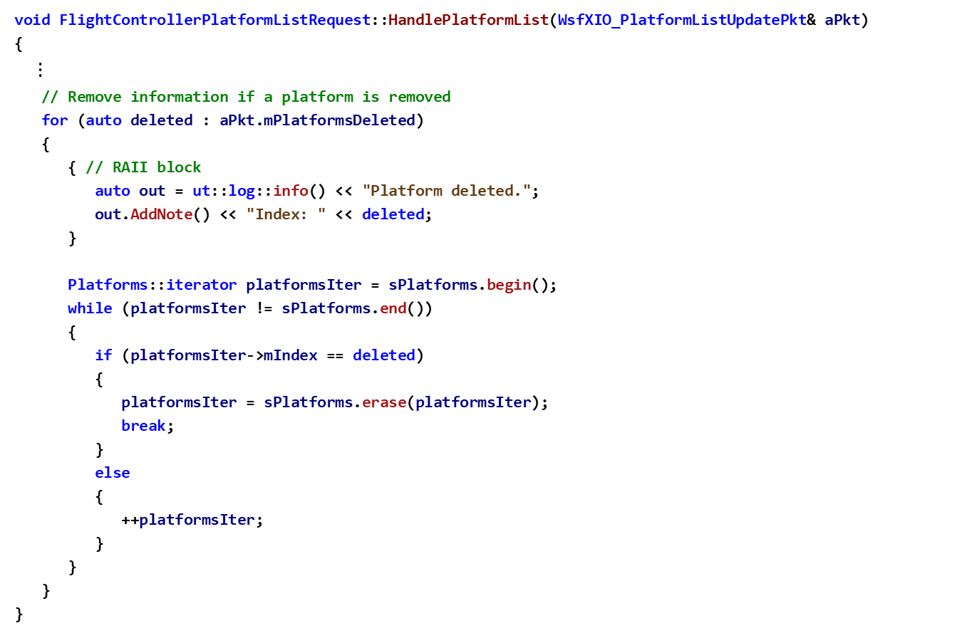
XIO Exercise 3 – Review 5 FlightControllerPlatformListRequest.cpp
void FlightControllerPlatformListRequest::HandlePlatformList(WsfXIO_PlatformListUpdatePkt& aPkt)
{
$⋮$
// Remove information if a platform is removed
for (auto deleted : aPkt.mPlatformsDeleted)
{
{ // RAII block
auto out = ut::log::info() << "Platform deleted.";
out.AddNote() << "Index: " << deleted;
}
Platforms::iterator platformsIter = sPlatforms.begin();
while (platformsIter != sPlatforms.end())
{
if (platformsIter->mIndex == deleted)
{
platformsIter = sPlatforms.erase(platformsIter);
break;
}
else
{
++platformsIter;
}
}
}
}
In HandlePlatformList
Notice the code that removes those platforms in mPlatformsDeleted from sPlatforms

Slide 81

XIO Exercise 3 – Review 6 FlightControllerInterface.cpp
AdvanceTime periodically accepts new XIO connections
and processes any pending XIO packets
//! Read input from the keyboard and send a packet if needed.
void FlightControllerInterface::Update(double aSimTime)
{
mXIO_InterfacePtr->AdvanceTime(aSimTime);
// Issue a message once per second.
if (((int)(aSimTime * 100.0) % 100) == 0)
{
auto out = ut::log::info() << "Update:";
out.AddNote() << "T=" << aSimTime;
out.AddNote() << " XIO: " << mXIO_InterfacePtr->GetSimTime();
}
HandleKeyPress(false, 0);
}
void FlightControllerInterface::HandleKeyPress(bool aKeyPress, int aKey)
{
bool hasNewInput = UpdateInput(aKeyPress, aKey);
if (hasNewInput && (mSelectedPlatformIndex != 0))
{
$⋮$
// Send a packet
FlightControlPkt pkt;
// Construct pkt based on keyboard input
$⋮$
//
mXIO_InterfacePtr->SendToAll(pkt);
}
}
Print out a message
once per second….
UpdateInput checks if
there is any input from
the keyboard
Create an XIO packet
and send it to AFSIM
PlatformControlService
Simulation Extension

Slide 82

XIO Exercise 3 – Review 7 FlightControllerInterface.cpp
//! Reads input from the keyboard and updates class attrributes.
bool FlightControllerInterface::UpdateInput(bool aKeyPress, int aKeyStroke)
{
if(aKeyPress)
{
mIgnoreNumber = 0;
if ((aKeyStroke != 0) && (aKeyStroke != -32))
{
if ((aKeyStroke == Qt::Key_Up) || (aKeyStroke == Qt::Key_W))
{
mDirection = cUP;
}
else if ((aKeyStroke == Qt::Key_Down) || (aKeyStroke == Qt::Key_S))
{
mDirection = cDOWN;
}
else if ((aKeyStroke == Qt::Key_Left) || (aKeyStroke == Qt::Key_A))
{
mDirection = cLEFT;
}
else if ((aKeyStroke == Qt::Key_Right) || (aKeyStroke == Qt::Key_D))
{
mDirection = cRIGHT;
}
$⋮$
Sets mDirection based
upon a direction key
being pressed

Slide 83

XIO Exercise 3 – Review 7 FlightControllerInterface.cpp
$⋮$
else if ((aKeyStroke == Qt::Key_PageUp) || (aKeyStroke == Qt::Key_BracketRight))
{
mThrottle += mThrottleIncrement;
const static double cMAX_THROTTLE = 2.0; // including afterburner effect
if (mThrottle > cMAX_THROTTLE)
{
mThrottle = cMAX_THROTTLE;
}
ut::log::info() << "Throttle increased to " << mThrottle;
}
else if ((aKeyStroke == Qt::Key_PageDown) || (aKeyStroke == Qt::Key_BracketLeft))
{
mThrottle -= mThrottleIncrement;
if (mThrottle < 0.0)
{
mThrottle = 0.0;
}
ut::log::info() << "Throttle reduced to " << mThrottle;
}
$⋮$
Sets mThrottle
based upon a
throttle key
being pressed

Slide 84

XIO Exercise 3 – Review 7 FlightControllerInterface.cpp
$⋮$
else if ((aKeyStroke >= Qt::Key_1) && (aKeyStroke <= Qt::Key_9))
{
mSelectedPlatformIndex = aKeyStroke - Qt::Key_1 + 1;
const FlightControllerPlatformListRequest::Platforms& platforms =
FlightControllerPlatformListRequest::GetPlatforms();
bool found = false;
for (unsigned i = 0; i < platforms.size(); ++i)
{
if (platforms[i].mIndex == mSelectedPlatformIndex)
{
mSelectedPlatform = i;
found = true;
auto out = ut::log::info() << "Selected platform.";
out.AddNote() << "Index: " << platforms[mSelectedPlatform].mIndex;
out.AddNote() << "Name: " << platforms[mSelectedPlatform].mName.GetString();
break;
}
}
if (! found)
{
auto out = ut::log::warning() << "Selected platform does not exist.";
out.AddNote() << "Platform Index: " << mSelectedPlatformIndex;
mSelectedPlatformIndex = cNO_PLATFORM_SELECTED;
}
}
$⋮$
Changes the
selected platform
based upon a
numeric key
being pressed

Slide 85

XIO Exercise 3 – Review 7 FlightControllerInterface.cpp
$⋮$
else if (aKeyStroke == Qt::Key_Backspace)
{
mSelectedPlatformIndex = cINVALID_PLATFORM_INDEX;
mSelectedPlatform = cNO_PLATFORM_SELECTED;
auto out = ut::log::info() << "All Platforms Deselected.";
}
else
{
ut::log::info() << "Key pressed: " << aKeyStroke;
}
}
}
else
{
++mIgnoreNumber;
if (mIgnoreNumber == mDebounce)
{
mDirection = cCENTER;
}
else
{
mDirection = cNONE;
}
}
bool haveNew = (mLastDirection != mDirection);
mLastDirection = mDirection;
return haveNew;
}
Sets selected platform to
an invalid value – deselects
all platforms and will cause
simulation extension to turn
autopilot on for the current
platform
Error message for key not
recognized
Handles invalid
keypress codes

Slide 86
XIO Exercise 3 – Task 2 FlightControllerInterface.cpp
In the FlightControllerInterface’s Initialize method, create the WsfXIO_Interface object by making mXIO_InterfacePtr be a unique_ptr to a new instantiation of a WsfXIO_Interface
Using the mXIO_InterfacePtr, invoke the SetApplicationName method to set the application’s name to “flight_controller”
Note: we are creating the XIO Interface in an independent application, not within an AFSIM Simulation

Slide 87
Exercise 3 – Task 2 Solution FlightControllerInterface.cpp
bool FlightControllerInterface::Initialize(const std::string& aFileName)
{
bool ok = true;
// EXERCISE 3 TASK 2
// Create the XIO Interface and set its application name.
mXIO_InterfacePtr = ut::make_unique<WsfXIO_Interface>();
mXIO_InterfacePtr->SetApplicationName("flight_controller");
...

Slide 88
XIO Exercise 3 – Review 8 FlightControllerInterface.cpp
Review FlightControllerInterface::ProcessInput
Notice the input commands handled by this method

Slide 89

XIO Exercise 3 – Review 8 FlightControllerInterface.cpp
bool FlightControllerInterface::ProcessInput(UtInput& aInput)
{
bool myCommand = true;
std::string command;
aInput.GetCommand(command);
if (command == "pitch_rate_increment")
{
aInput.ReadValue(mPitchRateIncrement);
aInput.ValueInClosedRange(mPitchRateIncrement, 0.0, 1.0);
}
else if (command == "yaw_rate_increment")
{
aInput.ReadValue(mYawRateIncrement);
aInput.ValueInClosedRange(mYawRateIncrement, 0.0, 1.0);
}
else if (command == "roll_rate_increment")
{
aInput.ReadValue(mRollRateIncrement);
aInput.ValueInClosedRange(mRollRateIncrement, 0.0, 1.0);
}
else if (command == "throttle_increment")
{
aInput.ReadValue(mThrottleIncrement);
aInput.ValueInClosedRange(mThrottleIncrement, 0.0, 1.0);
}
$⋮$
This ProcessInput method is
different from most of the others we
have seen. Since FlightController is
a separate application, ProcessInput
is not called from AFSIM’s chain of
ProcessInput calls when loading a
scenario. Rather, this ProcessInput
method is called from
FlightControllerInterface::Initialize,
when the application is setting itself
up to handle key presses

Slide 90

XIO Exercise 3 – Review 8 FlightControllerInterface.cpp
bool FlightControllerInterface::ProcessInput(UtInput& aInput)
{
bool myCommand = true;
std::string command;
aInput.GetCommand(command);
$⋮$
else if (command == "debounce")
{
aInput.ReadValue(mIgnoreNumber);
}
else if (command == "debug")
{
mDebug = true;
}
else
{
myCommand = false;
}
return myCommand;
}
Notice that if none of the commands
match, then ProcessInput fails and
returns false to the caller. No attempt
is made to invoke any other class’s
ProcessInput

Slide 91
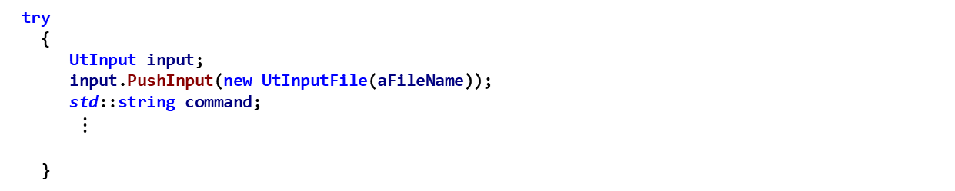
XIO Exercise 3 – Task 3 FlightControllerInterface.cpp
Understand utilizing UtInputFile and UtInput object in FlightControllerInterface::Initialize
Implement reading FlightController input
Call FlightControllerInterface::ProcessInput
If FlightControllerInterface::ProcessInput returns false, then call mXIO_InterfacePtr->ProcessInput
If neither of the previous calls to ProcessInput return true, then FlightControllerInterface::Initialize cannot process the input, so throw a UtInput::UnknownCommand exception
try
{
UtInput input;
input.PushInput(new UtInputFile(aFileName));
std::string command;
$⋮$
}
Notes:
We are processing the file we passed in as a command line argument to the flight controller (xio_interface block)

Slide 92
XIO Exercise 3 – Task 3 Solution FlightControllerInterface.cpp
try
{
UtInput input;
input.PushInput(new UtInputFile(aFileName));
std::string command;
while (input.TryReadCommand(command))
{
// EXERCISE 3 TASK 3
// Call ProcessInput and throw Ut::UnknownCommand exception if neither
// FlightControllerInterface::ProcessInput nor WsfXIO_Interface::Process
// can process it
if (ProcessInput(input))
{
}
else if (mXIO_InterfacePtr->ProcessInput(input))
{
}
else
{
throw UtInput::UnknownCommand(input);
}
}
}
Notes:
Open ProcessInput for students to see

Slide 93
XIO Exercise 3 – Task 4 FlightControllerInterface.cpp
Task 4a: In FlightControllerInterface::Initialize, use the XIO Interface to Register this New Packet Type so that it is Recognized
Invoke mXIO_InterfacePtr->RegisterPacket
The packet should be called FlightControlPkt, so make the first argument be the string "FlightControlPkt“
The second argument should be a pointer to a new FlightControlPkt
Task 4b: Use the XIO Interface’s RequestManager to Register for Platform List Updates
Invoke GetRequestManager to get the RequestManager from the mXIO_InterfacePtr pointer
Call AddRequest on the RequestManager (that was returned from the previous call) with an argument of a pointer to a new FlightControllerPlatformListRequest, where the constructor is given an argument of mXIO_InterfacePtr->GetConnections()[0]

Slide 94
XIO Exercise 3 – Task 4 Solution FlightControllerInterface.cpp
if (ok)
{
// EXERCISE 3 TASK 4a
// Use the XIO Interface to Register this New Packet Type
// The packet should be called "FlightControlPkt"
mXIO_InterfacePtr->RegisterPacket("FlightControlPkt", new FlightControlPkt());
// EXERCISE 3 TASK 4b
// Use the XIO Interface's RequestManager to Register for Platform List Updates
// Get the RequestManager from the XIO_Interface
// Call AddRequest with an argument of a FlightContollerPlatformListRequest*
mXIO_InterfacePtr->GetRequestManager().AddRequest(
new FlightControllerPlatformListRequest(mXIO_InterfacePtr->GetConnections()[0]));
}
return ok;

Slide 95
XIO Scenario
From Visual Studio:
Build both the Solution in “Release”
Build the “INSTALL” project
Find the folder named \inwork\xio\data.
Four (Very Notional) Aircraft are Flying In this Scenario
1 Blue_Fighter_1
1 Blue_Fighter_2
1 Blue_Fighter_3
1 Blue_Fighter_4
Demonstrate the Capability of Controlling One or More of These with XIO
The WsfP6DOF_Mover is Used as the Mover of these Aircraft
Until we take over control
We will use Warlock as our simulation executor
Linux: from the build directory, run:
$ cmake --build . --target all -- -j11
$ cmake --build . --target install -- -j11
These four aircraft are theoretical. Their flight
characteristics are generic in nature and do not
share any operational characteristics with any real
aircraft.

Slide 96
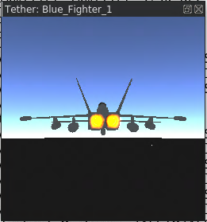
Testing
Run the run_all.bat File
This will run the controller, loading the flight_controller_config.txt input file
It will also run warlock, loading the xio_scenario.txt file.
The Controller Plug-in should be recognized and loaded automatically
Make sure to start the simulation when warlock opens
Tether to the Blue_Fighter_1 in Warlock
Select by clicking on the Blue_Fighter_1 icon
Select ctrl+shift+T to Tether
Use the mouse and scrollwheel
to optimally view the aircraft
Can also tether to other aircraft in Warlock, and
select them using the Flight Controller application

Slide 97
Testing
We will test the Flight Controller and XIO Connection
Give the flight controller application focus by clicking on it
The Following Keyboard Commands Control the Aircraft
Numbers 1-9: Select Platform to Control
Backspace: Deselect all platforms
Arrows or <WASD> : platform pitch, roll, rate changes
Page-Up / Page-Down or “[“ / “]”: Increase / Decrease Platform Speed

Slide 98
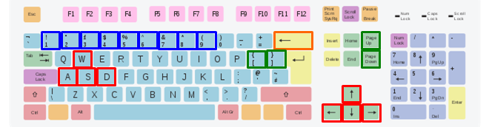
Example of Controlling Blue_Fighter_1
After Warlock and the Flight Controller start, Warlock must inform the Flight Controller about the existence of the four platforms
AFSIM Warlock with XIO exercise extensions
FlightController Application
Blue_Fighter_1 Platform p6DofMover
FlightControllerPlatformListRequest
Blue_Fighter_2 Platform p6DofMover
Blue_Fighter_3 Platform p6DofMover
Blue_Fighter_4 Platform p6DofMover
FlightControllerInterface
PlatformControlService
XIO Connection

Slide 99
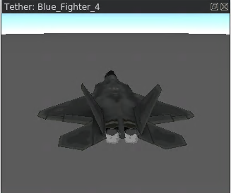
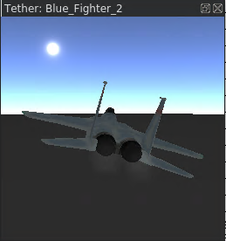
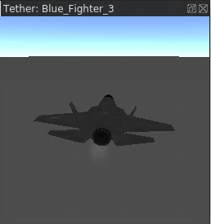
Example of Controlling Blue_Fighter_1
Now the Flight Controller Application
knows about the four platforms
AFSIM Warlock with XIO exercise extensions
FlightController Application
Blue_Fighter_1 Platform p6DofMover
FlightControllerPlatformListRequest
Blue_Fighter_2 Platform p6DofMover
1) Blue_Fighter_1
2) Blue_Fighter_2
3) Blue_Fighter_3
Blue_Fighter_3 Platform p6DofMover
4) Blue_Fighter_4
HandlePlatformList(PlatformListUpdatePkt)
Blue_Fighter_4 Platform p6DofMover
FlightControllerInterface
PlatformControlService
PlatformListUpdatePkt
PlatformListUpdatePkt
PlatformListUpdatePkt
PlatformListUpdatePkt
XIO Connection

Slide 100
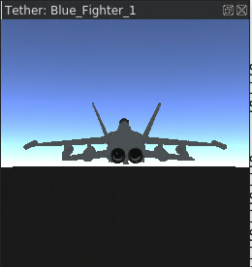
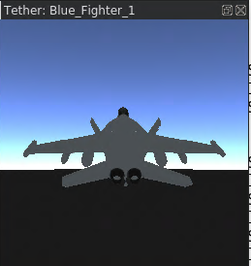
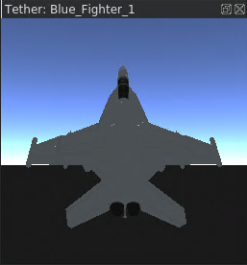

Example of Controlling Blue_Fighter_1
AFSIM Warlock with XIO exercise extensions
Now Blue_Fighter_1has been selected
FlightController Application
Blue_Fighter_1 Platform p6DofMover
FlightControllerPlatformListRequest
Blue_Fighter_2 Platform p6DofMover
1) Blue_Fighter_1
SetDirectControlInputs()
PitchRate+
2) Blue_Fighter_2
SetDirectControlInputs()
PitchRate++
3) Blue_Fighter_3
Blue_Fighter_3 Platform p6DofMover
4) Blue_Fighter_4
Blue_Fighter_4 Platform p6DofMover
FlightControllerInterface
PlatformControlService
Blue_Fighter_1 pitches upward and begins to climb
Blue_Fighter_1
pitches upward more
and begins to climb
faster
FlightControlPkt
FlightControlPkt
FlightControlPkt
XIO Connection
1 key
down-arrow (again)
down-arrow

Slide 101
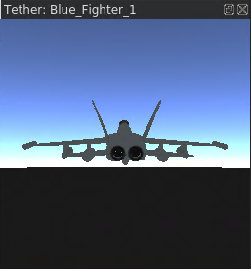
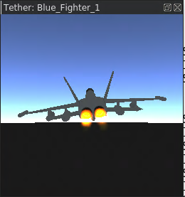
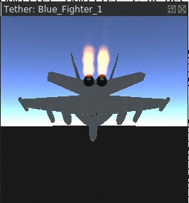
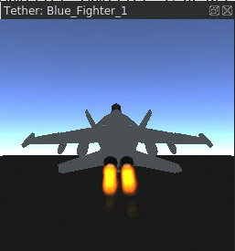
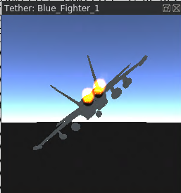
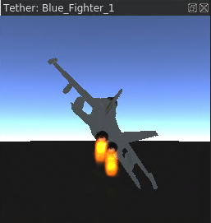
Blue_Fighter_1 Control
Level flight
Page-Up (increase thrust)
Up-Arrow (joystick forward)
Down-Arrow (joystick
backward)
Left-Arrow & Up-Arrow
Right-Arrow & Down-Arrow
Note: if you push thrust to maximum for too long, you will run out of fuel quickly and then crash

