Slide 1
AFSIM Developer Training
11 – Grammar
AFRL/RQQD

Slide 2
.ag files
Find them in ‘grammar’ subdirectory of each project.
swdev/src/core/wsf/grammar,
swdev/src/core/wsf_mil/grammar,
swdev/src/engage/grammar,
swdev/src/wsf_plugins/wsf_p6dof/grammar, …
Defines the allowed syntax for AFSIM scenario files
used by Wizard to parse
Script methods are captured automatically
Should be included in releases

Slide 3
Built-in rules
<string> - Word with non-whitespace chars
<real> - 6.214521e22
<integer> - 42
<line-string> - All text until newline
<quotable-string>
- Accepts “quote with spaces”, or <string>

Slide 4
Basic Data Types
We define a fixed list of data types: Time, Speed, Power, etc…
Uses the ‘value’ command
Everything in ‘{ … }’ defines the syntax

Slide 5
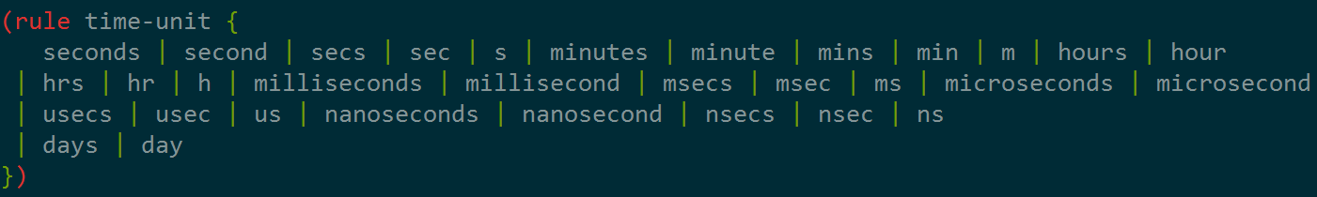
Named rules
Grammar syntax that can be referenced elsewhere
Used here:
‘|’ is the or operator

Slide 6
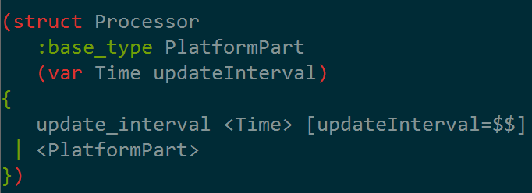
Structs
Combines definition of syntax and data structures.
Inherit from ‘PlatformPart’
Define variable ‘updateInterval’

Slide 7
Actions
Variables can be assigned when matching rules
‘[…]’ indicates actions to be taken
Actions do not have an effect on the syntax

Slide 8
Structs …
Struct rules usually call base rule

Slide 9
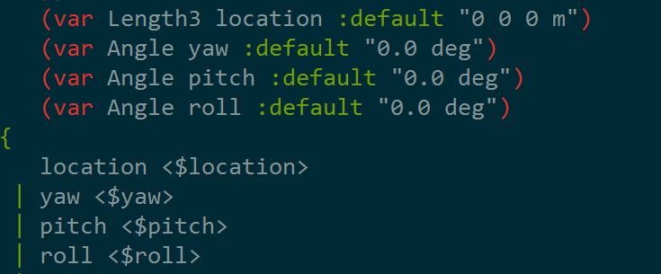
Structs…
Default values may be specified
‘<$yaw>’ will read as Angle and store in variable ‘yaw’

Slide 10

Special rules
A handful of special rules exist to provide Wizard with more information.
(name …) will read a word and associate it with something

Slide 11
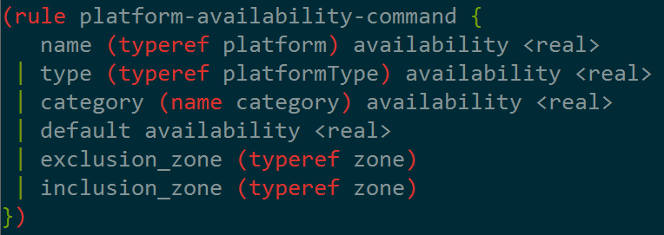
Special rules…
(typeref …) reads a word, and hints that it should be a reference to something defined elsewhere.

Slide 12
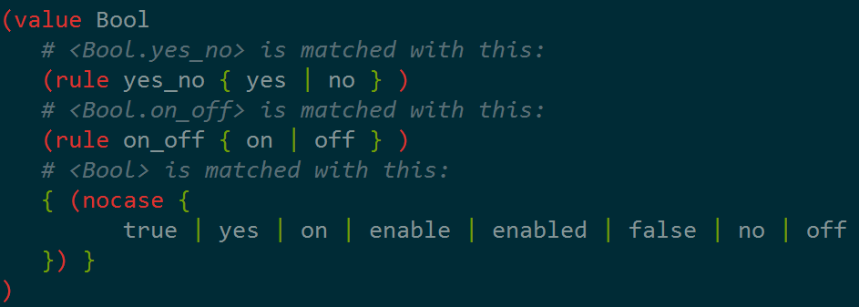
Special rules…
(nocase …) makes the contents case-insensitive

Slide 13
Nested rules…
Rules may be nested
Used like this:

Slide 14
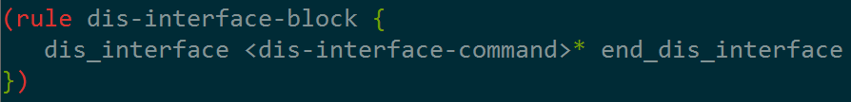
Recurrence
Zero to Many ‘*’
One to Many ‘+’
Zero or One ‘?’

Slide 15
More special rules
A symbol table is required to understand AFSIM files:
sensor MY_TYPE1 MY_TYPE2
one_m2_detect_range …
end_sensor
(load …) – Find a symbol
(new …) – Creates a new symbol
(new_replace …) – Overwrite a symbol
(delete …) – Delete a symbol

Slide 16
More special rules
(file-reference …)
(output-file-reference …)
(error …)
<ScriptBlock>
<ScriptVariables>
<ScriptFunctionBlock>
<TypeCommand>

