Slide 1
AFSIM Developer Training
12 – Building AFSIM with CMake
AFRL/RQQD
AFSIM Version 2.0

Slide 2
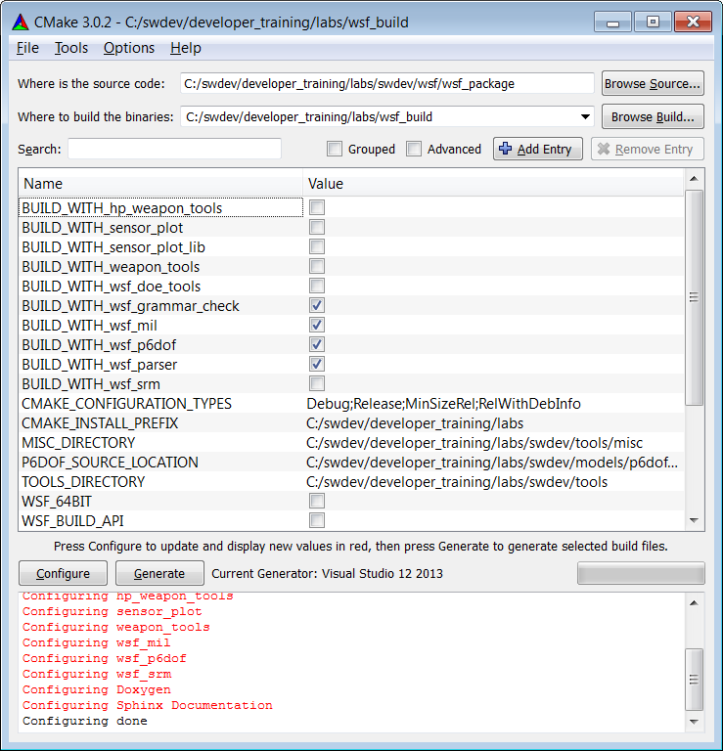
CMake Overview
AFSIM now utilizes CMake for build configuration. This presentation describes the best practices of using CMake with ASIM.
Get CMake online from http://www.cmake.org
CMake provides a tool called cmake-gui, shown to the right. This tool makes it easy to customize the AFSIM build.
(Note: This presentation is largely adapted from the AFSIM documentation page entitled “Building_WSF_with_Cmake”)

Slide 3

Out-of-Source Builds
Source Directory
Build Directory
Install Directory
Version-controlled source files
(*.cpp, *.hpp)
Transient build objects
(*.a, *.o, *.lib)
Final binaries
(*.exe, *.dll, *.so)
“Generate”
“INSTALL”
CMake files live here!
Windows: Run solution file
Linux: Make
Ready for distribution
Sometimes things go wrong in the build.
This layout allows us to safely destroy the build directory without loss of data.

Slide 4
Variables
The Following Variables are Important:
BUILD_WITH_...
Each optional projects may be enabled or disabled by toggling the associated checkboxes. The default value is determined by the availability of that module in the swdev directory.
WSF_PLUGIN_BUILD
Builds shared object or DLL libraries instead of static libraries, and enables loading of WSF plugins.
WSF_BUILD_TYPE__SECRET
This build is for a DOD target. If this box is not checked, DOD optional projects will not be included in the build.
WSF_INSTALL_DATA
Installs WSF data files along with the applications. The data files must be checked out.
WSF_INSTALL_SOURCE
Creates a 'swdev' directory in the installation folder containing the source code.
CMAKE_BUILD_TYPE Linux only.
Set to 'Release' or 'Debug'. This variable should be set when building on linux. You will need two build directories if you want to build both debug and release.

Slide 5
Targets
CMake generates multiple targets, including one for each executable and library.
Additionally, these targets are important:
INSTALL - Generates an installation directory
ALL_BUILD, ZERO_CHECK - Automatically generated by CMake for visual studio integration, ignore.
There are also a number of additional build targets for WSF. None of these are run as part of the default solution.
*_AUTO_TEST – Invokes scripts to quickly test WSF executables.
DOCUMENTATION – Build Sphinx (wiki) documentation
Installation set with WSF_INSTALL_DOCUMENTATION in CMake-GUI
DOXYGEN – Builds Doxygen source documentation
Installation set with WSF_INSTALL_DOXYGEN in CMake-GUI

Slide 6
Integrating With AFSIM’s CMake
Class examples are good places to start, but sometimes modifications to CMake will need to be made as well.
The class examples build the plugins in a separate solution file and build directory.
This simplifies the presentation.
(Potentially) only need to compile WSF core once.
However, it makes navigating/debugging the rest of the framework difficult.
Alternatively, you can place your plugin’s source directory directly in “swdev”.
With some small additions to the CMake, you’re plugin will be captured with the rest of the framework.
This provides a more unified development environment.
Desirable for feature submission to AFSIM CCB!!!

Slide 7
Integration – Using Class Examples
Frequently, users adapt the class examples for their own purposes.
Advantages:
Great place to start. Most of code is already fleshed-out.
Starting with known, working source.
Solution file simplified (for plugins).
Disadvantages:
Can’t easily navigate rest of WSF framework.
CMake is sensitive to relative folders.
Need separate WSF build directory a priori to link against.
This build directory must also match your configuration!

Slide 8
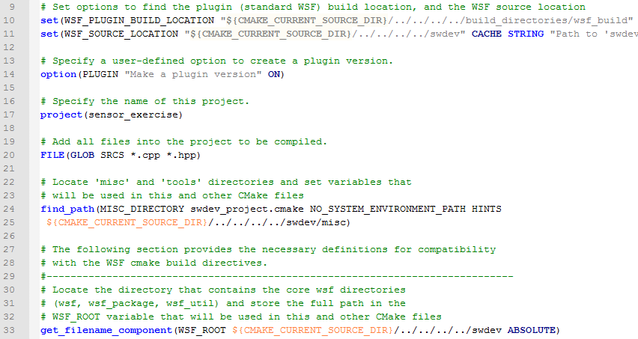
Integration – Using Class Examples
If adapting class examples, the major point is to ensure relative paths in CMake are consistent.
Don’t forget a name.

Slide 9
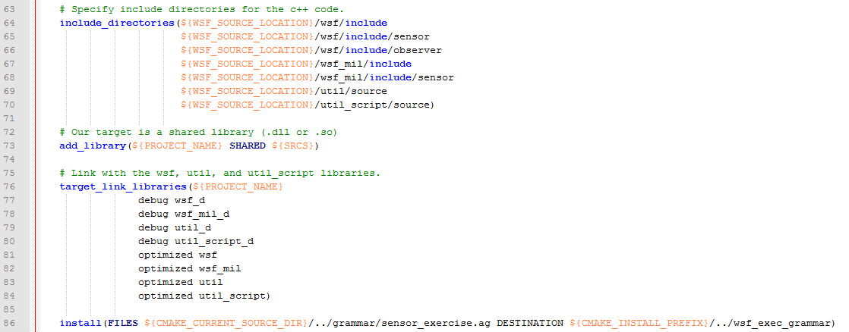
Integration – Using Class Examples
Check the paths in include_directories() and target_link_libraries()
Reference your include statements.
Any custom grammar to include?

Slide 10
Integration – Directly into “swdev”
Alternatively, you can place your plugin folder into the “swdev” folder alongside the rest of WSF source.
Advantages:
When building, plugin and framework configurations are in lock-step.
Single build directory.
If you’d like to submit this as a feature for general AFSIM distribution, CCB is MUCH more likely to accept.
Your plugin and WSF framework can be revisioned together!
Disadvantages:
More work on the CMake side.

Slide 11
Integration – Directly into “swdev”
Existing examples include “wsf_p6dof”, and “wsf_iads_c2” folders under “swdev/wsf_plugins”.
Along with main CMakeLists.txt, your folder will need to contain:
wsf_module – By existing, this file tells the greater AFSIM CMake that this folder contains a module to build. Can be empty.
wsf_cmake_extension.cmake – Sets two variables:
WSF_EXT_NAME – Name of module. This will appear as a BUILD_WITH_* flag in the CMake-GUI.
WSF_EXT_SOURCE_PATH – Relative path to your plugin’s CMakeLists.txt
Any optional disclaimer files. WSF modules have various releasability levels.

Slide 12
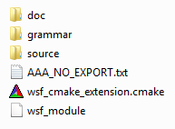
Integration – Directly into “swdev”
Example directory for a plugin ->
These are just conventions.
“doc” contains documentation.
reStructuredText (.rst) will be ingested by Sphinx*
“grammar” contains any example grammar files.
Will need to be included for install in CMakeLists.txt.
“source” contains source files and CMakeLists.txt.
Pointed to by WSF_EXT_SOURCE_PATH
*See next slide for macro to add project to Sphinx.

Slide 13
Integration – Directly into “swdev”
No need to find the rest of WSF.
You will need to call:
add_subdirectory() – on your source files
include_directories() – on your source dir and any folders not otherwise included by WSF.
target_link_libraries() – to link against any other WSF lib.
(plugin) add_library() – to indicate that a library is to be built
(app) add_executable() – to indicate that an executable is to be built.
install() – on any build targets and optional files.
Don’t forget the grammar files!

Slide 14
Integration – Directly into “swdev”
Modules within WSF should include “swdev_project.cmake”.
This file includes a number of useful macros and sets a number of flags.
Other useful macros are available in AFSIM’s CMake environment:
add_wsf_doxygen_input() – Called on source directory. Will add to folders for Doxygen to ingest.
add_wsf_sphinx_input() - Called on project directory. Will glob for *.rst files for Sphinx to process.
install_wsf_data() – If a demo scenario is included, this will add that folder to the INSTALL step if WSF_INSTALL_DATA is set.
swdev_warning_level() – Sets compiler warnings to rest of WSF build’s settings.

Slide 15
Additional Questions
afsim-help@vdl.afrl.af.mil

