Slide 1
AFSIM Developer Training
1 – Architecture Overview
AFRL/RQQD

Slide 2

To begin with …
Don’t Panic!
Things are only impossible until they’re not.
Notes:
“Don’t Panic!” The Hitchhikers Guide to the Galaxy
Image – the rabbit from Monty Python’s The Holy Grail
“Things are only impossible until they’re not.” Jean Luc Picard, Star Trek: The Next Generation

Slide 3
Acronyms and Definitions
AFSIM - Advanced Framework for Simulation, Integration, and Modeling
AGL – Above Ground Level
DIS – Distributed Interactive Simulation
DTED – Digital Terrain Elevation Data
EO/IR – Electro-Optical/Infra-Red
ESM – Electronic Support Measure
FOV – Field Of View
GUI – Graphical User Interface
HLA – High Level Architecture
IEEE – Institute of Electrical & Electronics Engineers, Inc.
JTIDS – Joint Tactical Information Distribution System
MSL – Mean Sea Level
PDU – Protocol Data Unit
RCS – Radar Cross Section
SAM – Surface-to-Air Missile
SAR – Synthetic Aperture Radar
VESPA – Visual Environment for Scenario Preparation and Analysis
WKF – Warlock Framework
WSF – World Simulation Framework
dB - decibels
dBsm – decibel square meters
deg – degrees
ft – feet
GHz– GigaHertz
kts – knots
m - meters
m^2 – square meters
mw – megawatts
nm – nautical miles
s – seconds

Slide 4
Introduction
This presentation provides an overview of the AFSIM architecture.
This training is designed to teach developers how to create mission-level simulations using the AFSIM simulation framework.
Labs are provided for the following areas:
Building AFSIM with CMAKE
Sensor
Exercise 1: Understanding AFSIM Plugins and Extensions
Exercise 2: Creating a custom AFSIM sensor
Exercise 3: Creating a custom AFSIM sensor script interface
Weapon
Exercise 1: Registering a new Application Extension
Exercise 2: Creating a custom AFSIM weapon
Mover
Exercise 1: Registering a new Application Extension
Exercise 2: Creating a custom AFSIM mover utilizing MATLAB DLLs
Exercise 3 [optional]: Compiling a MATLAB DLL
Components
Exercise 1: Registering a new Application Extension, a new Scenario Extension, and a Component Factory
Exercise 2: Creating a custom AFSIM Component
Exercise 3: Creating a ComponentFactory
Exersise 4: Creating a custom AFSIM Components script interface
Observer
Exercise 1: Creating a custom AFSIM observer with a default application extension and a new Scenario Extension
Communications
Exercise 1: Registering a default Application Extension, a new Scenario Extension, and a new Simulation Extension
Exercise 2: Implementing ProcessInput for the communication’s scenario
Exercise 3: Creating a custom AFSIM communication device and message
Exercise 4: Creating a custom AFSIM Communications script interface
eXternal IO (XIO)
Exercise 1: Registering a default Application Extension, a new Scenario Extension, and a new Simulation Extension
Exercise 2: Implementing a Simulation Extension that reads and processes new XIO messages to control selected platforms
Exercise 3: Creating an external application that communicates with an AFSIM simulation

Slide 5
Learning Objectives
You will be introduced to:
Advanced Framework for Simulation, Integration, and Modeling (AFSIM).
Gain an understanding of the course content.

Slide 6
Background
What is AFSIM?
A simulation framework developed to primarily address the mission level analysis needs of the operations research community
Why was AFSIM Developed?
Needs of the analysis community were not being met
Traditional government simulations such as SUPPRESSOR did not provide sufficient flexibility to analyze advanced concepts and technologies
Lower fidelity tools developed in Excel and VB not adequate for complex needs
Developing new analytic simulations from scratch was cost prohibitive
AFSIM provides a set of software building blocks to rapidly (weeks or months rather than years) develop sophisticated analytic simulations
What is the Current Status of AFSIM?
AFSIM is a mature simulation framework delivered to the government with unlimited rights and available to both government and industry at no cost
Includes all source code
Includes classified scenarios V&V’d to SUPPRESSOR, but which may be extended to analyze operational benefits of advanced weapon system concepts

Slide 7
AFSIM
AFSIM is:
approx. 2M lines of code (as of 1/15/2021)
Written in C++ (current releases utilize C++ 11)
Generates very efficient / performant code
Utilizes Qt for the user interface
Heavily utilizes Object-Oriented paradigm:
Encapsulation and Abstraction
Inheritance
Polymorphism
Result:
Efficient
Stable, reliable, and accurate
Provides a large assortment of components / services / analytics
It is easy to add or extend behavior
It is easy to add or extend components and services

Slide 8
Some Standard AFSIM Applications
Mission provides one way to execute main
Warlock provides another way to execute main
Wizard is a GUI that provides methods for building the scenario(s) to be executed
The scenarios are saved in the .txt files, which are loaded by mission/warlock when executed
Mystic provides a GUI for replaying a simulation using a generated .aer replay file

Slide 9
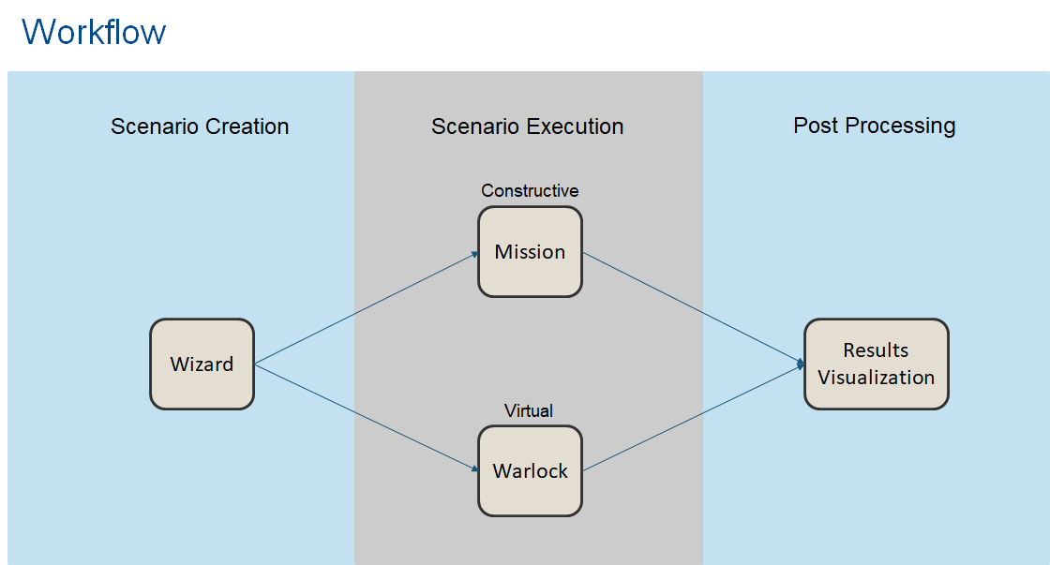






A Standard AFSIM Workflow
Scenario Creation Scenario Execution Post Processing
scenario
files
.aer
files
Mystic

Slide 10

AFSIM Architecture Overview
AFSIM Framework Provides a Common Infrastructure, Interface, and Component-Based-Architecture to Support Simulation Application Development
AFSIM Application
AFSIM Framework
Infrastructure
Interface
Scenario Management
Time Management
Time Management
Geospatial Data Management
Event Management
Utilities
Geospatial Data Management
Scripting
Language
Distributed Simulation Interfaces
Scenario Management
Script
Distributed Simulation Interfaces
Event Management
Plug-in
Management
Observers
Extensions
Simulation Management
Observers
Extensions
Components
Platform Components
Movers
Sensors
Weapons
Communications
Processors
Other Platform
Components
Non-Platform
Components
Sensor
Components
Weapon
Components
Comm
Components
Processor
Components
$$…$$

Slide 11
Utilizing AFSIM
To Utilize the AFSIM Framework in a Custom Simulation, You Must:
Create or utilize an existing simulation main loop (often utilizing AFSIM extensions)
Build new features as AFSIM plug-ins to use with an existing simulation
One will typically use “mission” (standard simulation application)
In this Course We will both Examine and Utilize a “Minimal” Simulation Main loop to Add Capabilities with Extensions, and also Build New Capabilities as AFSIM Plug-ins
AFSIM Application

Slide 12
Applications, Scenarios and Simulations
There is one AFSIM Application Per Executable
Maintains script types, plug-in manager
The Application is Composed of One or More Scenarios
Owns types factories, input, and services
Scenarios are Used to Instantiate Simulations
Owns observer interface, and types instances
One scenario per simulation
Extensions for Applications, Scenarios, and Simulations Provide the Flexibility to Add Capabilities
In practice, only one scenario per application
Usually, one simulation per scenario
AFSIM Application

Slide 13
AFSIM Infrastructure Overview
AFSIM provides capabilities for handling and supporting simulation execution and other routine computations and basic functions
Scenario Management supplies the scenario loader and object which reads all the scenario input data, and maintains the Type Lists
Simulation Management supplies the simulation loader and object
Time Management supplies the clock source
Event Management supplies a publish/subscribe capability allowing simulation observers to register for simulation events
Geospatial Data Management supplies terrain and line-of-sight data
Plug-in Management allows AFSIM to find plugins and load them into memory at run time
Utilities supply earth models, coordinate frames, math routines, etc.
Infrastructure
Scenario Management
Time Management
Time Management
Geospatial Data Management
Event Management
Utilities
Scenario Management
Geospatial Data Management
Simulation Management
Event Management
Plug-in
Management

Slide 14
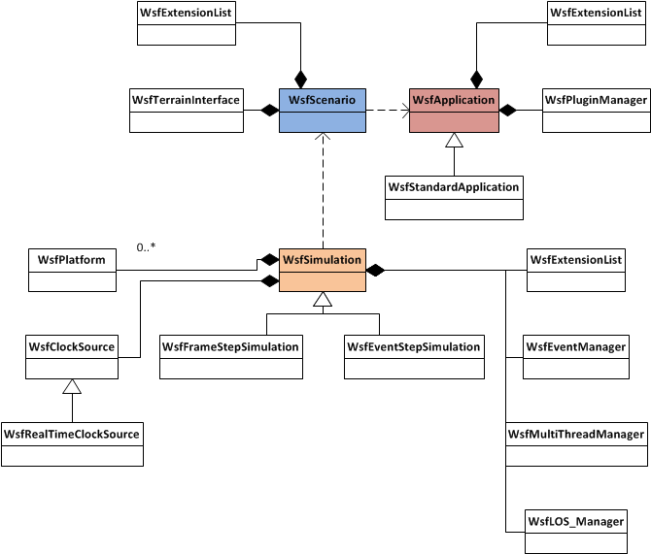
Some Simulation Architecture
The WsfScenario object contains an extension list, a terrain interface, and a list of all of the types
The WsfApplication object contains an extension list and a plugin manager
WsfObjectTypeListBaseI
0..*
The WsfSimulation object depends upon the WsfScenario object, which depends upon the WsfApplication object
WsfStandardApplication, WsfScenario, and WsfSimulation objects are instantiated by mission when it executes
The WsfSimulation object contains many objects related to managing and executing a simulation

Slide 15


The Simulation
Simulation Object is responsible for the simulation
Customized by deriving from framework-provided base classes
Event stepped or pseudo frame-stepped capable
Provides common mechanism for adding and removing platforms
Initializes and updates platforms and platform systems in a coordinated manner
Text Input
AFSIM Application
Scenario Object provides the mechanism for loading a simulation from input files
Easily extendable to allow application-specific input
Uses “Chain of Responsibility” Software Design Pattern
Different from the Wizard Parser
XIO
Scenario Object
Scenario Type Lists
DIS
Simulation
Object
HLA
Replay File
Event Output

Slide 16

Simulation Management
Scenario Type Lists provide the internal representation of user input for
Platforms
Platform parts
Signatures
Routes
Tracking Filters
EW Effects
Behavior Tree Nodes
… to name a few …
AFSIM Application
Text Input
XIO
Scenario Object
Scenario Type Lists
DIS
Simulation
Object
HLA
Replay File
Event Output
Uses Factory Software Design Pattern
“Subtypes” in User Input Stored as Different Configurations of the Same C++ Classes
Replay File has a .aer file extension

Slide 17
Time Management
Every Simulation Object Type Aggregates a Clock Source
WsfClockSource supplies methods to start, stop (pause), and reset a clock
Real-time simulations use instantiation of WsfRealTimeClockSource
Contains a wall clock object to maintain the elapsed "real" time
Retrieves system time based on the real-time clock of the computer

Slide 18
Event Management
A simulation object (WsfSimulation) creates an event manager during construction. The event manager (WsfEventManager) maintains a time-ordered queue of events. This event queue is a Standard Template Library (STL) priority_queue with each element ordered by increasing time. The time indicates when the event (WsfEvent) is to be dispatched.
The event manager provides methods to add events to the queue, peek at but not remove the next event to dispatch, pop the next event off the queue, and reset the queue back to an empty state. The interface to add an event is exercised through the simulation object AddEvent method.
An event step simulation waits for the next event by peeking at the front of the event queue. Both the event step and frame step simulation objects dispatch events during calls to the AdvanceTime method. Events are popped off the queue and their Execute method called.

Slide 19
Terrain Management
WsfTerrain class implements terrain database and query operations
Maintains static data that represents the terrain database
Query methods reference this database to get their terrain data
Note that tiles are shared between WsfTerrain objects through a reference counting mechanism. Thus, only a single instance of a specific tile will actually exist in memory.
Digital Terrain Elevation Data (DTED) is one form of terrain datasets that are cached and accessible through this class
DTED Level 0, 1, & 2 are supported
United States Geological Survey (USGS) Digital Elevation Model (DEM) data that has been reprocessed to a form that is compatible with the ESRI ArcGIS® products (http://www.esri.com)
“grid-float” or “float-grid” binary format with header

Slide 20
Plug-in Management
Allows customization through dynamically loaded plug-ins
Provides similar level of flexibility as source code modifications
Ability to version with major and minor descriptors
class WsfPluginManager
searches path defined by:
WSF_PLUGIN_PATH environment variable
"../<application_name>_plugins“ directory
Current directory of application
Registers and loads plugins that are found while searching
Performs compiler check on plug-in before registering
Ability to register nearly any kind of plug-in

Slide 21
Utilities
Utility routines serve a variety of purposes to manage and simplify manipulation of data for other AFSIM classes. AFSIM utility routines typically support areas such as:
Entity representation: location, orientation, speed/acceleration
Specialized data types and behaviors (e.g. Vectors, arrays, lists, tables, or strings.)
Mathematical manipulations (e.g. Table look-ups, vector/matrix, or geometrical calculations.)
Input, output and file management routines (e.g. Encryption and exchanging data from a variety of sources.)
Time management
Earth coordinate reference frames and atmospheric data
Simulation control mechanization (e.g. UtCallback objects, lists, and management of UtCallback objects.)
Units (Angles, Lat/Lon, Lengths, Earth calculations, Input, Math, Random numbers, Speed, Time)

Slide 22
Units
Unless otherwise noted in the documentation, AFSIM will utilize meter/kilogram/second units for all arguments and member variables.
A partial list of supported units is
Length: meters (m)
Mass: kilogram (kg)
Time: seconds (s)
Velocity: m/s
Acceleration: m/s^2
Frequency: Hertz (Hz) = 1/s
Force: Newtons (Nt) = kg-m/s^2
Power: Watts (W) = Nt-m/s
Angle: radians
Latitude: decimal degrees in the range [-90, 90]
Longitude: decimal degrees in the range [-180, 180]
Data units: bits
Data transfer rate: bits/second
The simulation loader and the input system provide the mechanism for the user to specify input values in various forms, but it always converts them to the preferred units before storing them in memory.

Slide 23
Coordinate Systems (1/2)
The 'World Coordinate System' (WCS). This is defined to be the WGS-84 coordinate system as defined in NIMA TR 8350.2 and utilized by DIS. This is a right handed system with:
The origin is at the center of the Earth.
The +X axis passes through 0N, 0E
The +Y axis passes through 0N, 90E
The +Z axis passes through 90N (the north pole).
The 'Entity Coordinate System' (ECS). This is sometimes referred to as the 'Body' coordinate system. This is a right handed system with:
The origin is at the center of the body.
The +X axis goes out the front of the body.
The +Y axis goes out the pilots right side.
The +Z axis goes out the bottom of the body.
Positive yaw is to pilots right.
Positive pitch is nose up.
Positive roll is right wing down.
A local 'North-East-Down' (NED) system. This is like the ECS except it has not been rotated by the entity orientation angles.
The origin is at the center of entity.
The +X axis is North.
The +Y axis is East.
The +Z axis is down.

Slide 24
Coordinate Systems (2/2)
The 'Earth Centered Inertial' (ECI)
This system is like WCS except it is fixed with respect to background stars instead of the Earth
To a good approximation:
The origin is at the center of the Earth
The +X axis points towards the vernal equinox (the point at which the Sun’s path crosses the Earth’s equator from south to north on the 1st day of spring [March 20th-21st])
The +Z axis is perpendicular to the mean equator on Jan. 1, 2000, 12:00 UT (approximately passing through 90N [the North Pole] at this epoch)
The +Y axis is perpendicular to the X and Z axes in a right-handed coordinate system
The 'Part Coordinate System' (PCS), represents the local coordinate system of a part attached to the entity, such as an antenna
It represents the position and orientation of this sub-part
The location of the origin and the orientation of the PCS are specified relative to the ECS of the entity (platform) to which the part is attached (described more fully in UtEntityPart)
The axis and angle conventions of the PCS are the similar to those of the ECS
The UtEntity class provides multiple ways to convert from one coordinate system to another

Slide 25
AFSIM Services Overview
AFSIM provides capabilities for handling and supporting simulation execution and other routine computations and basic functions
Extensions Supplies a generic method of adding new services and components
Observer Supplies a generic publish-subscribe service for extracting data from simulations
Script Provides the infrastructure to implement and extend the AFSIM scripting language
Distributed Simulation Interfaces applies interface standards for simulation interoperability (IEEE 1278 & 1516; DIS & HLA)
AFSIM Interface Layer
Script
Distributed Simulation Interfaces
Script
Distributed Simulation Interfaces
Observers
Extensions
Observers
Extensions

Slide 26
AFSIM Scripts
Declarations and Definitions of script methods
#define UT_DECLARE_SCRIPT_METHOD( … )
Expands to a class declaration for method argument
Inherits from class UtScriptClass::InterfaceMethod
Declares constructor and operator() for the class’s methods
#define UT_DEFINE_SCRIPT_METHOD( … )
Creates the class definition for the same “method” defined with the UT_DECLARE_SCRIPT_METHOD macro
Also, expands to a sequence of C++ statements that creates a function whose body is the defined code for the macro
This function is called from the operator() declared for the class
Once defined, this script method can be called from the scripting interface in the scenario files
Many script methods are pre-defined using these macros in the AFSIM core for mission
You can also create new script methods in your code using these macros

Slide 27
Observers
Implements the software design observer pattern in which observers can subscribe to state changes of an object and are notified by having one of their methods called.
Many different types of framework objects ‘publish’ simulation events.
List of Published Events v2.5
COMMENT
COMM_ADDED_TO_MANAGER
COMM_REMOVED_FROM_MANAGER
COMM_ADDED_TO_LOCAL
COMM_REMOVED_FROM_LOCAL
COMM_FREQUENCY_CHANGED
COMM_TURNED_OFF
COMM_TURNED_ON
CRASHED_INTO_GROUND
EXCHANGE_EVENT
EXECUTE_CALLBACK
FUEL_EVENT
LINK_ADDED_TO_MANAGER
LINK_REMOVED_FROM_MANAGER
LINK_ENABLED_ON_MANAGER
LINK_DISABLED_ON_MANAGER
LINK_ADDED_TO_LOCAL
LINK_REMOVED_FROM_LOCAL
LINK_ENABLED_ON_LOCAL
LINK_DISABLED_ON_LOCAL
LOCAL_TRACK_CORRELATION
LOCAL_TRACK_DECORRELATION
LOCAL_TRACK_DROPPED
LOCAL_TRACK_INITIATED
LOCAL_TRACK_UPDATED
MESSAGE_DELIVERY_ATTEMPT
MESSAGE_DISCARDED
MESSAGE_FAILED_ROUTING
MESSAGE_UPDATED
MESSAGE_QUEUED
MESSAGE_RECEIVED
MESSAGE_TRANSMITTED
MESSAGE_TRANSMITTED_HEARTBEAT
MESSAGE_TRANSMIT_ENDED
MOVER_UPDATED
NETWORK_ADDED
NETWORK_REMOVED
OPERATING_LEVEL_CHANGED
PLATFORM_ADDED
PLATFORM_APPEARANCE_CHANGED
PLATFORM_DELETED
PLATFORM_INITIALIZED
PLATFORM_BROKEN
PLATFORM_OMITTED
PROCESSOR_TURNED_OFF
PROCESSOR_TURNED_ON
SENSOR_DETECTION_ATTEMPT
SENSOR_DETECTION_CHANGED
SENSOR_FREQUENCY_CHANGED
SENSOR_MODE_ACTIVATED
SENSOR_MODE_DEACTIVATED
SENSOR_REQUEST_CANCELED
SENSOR_REQUEST_INITIATED
SENSOR_REQUEST_UPDATED
SENSOR_TRACK_COASTED
SENSOR_TRACK_DROPPED
SENSOR_TRACK_INITIATED
SENSOR_TRACK_UPDATED
SENSOR_TURNED_OFF
SENSOR_TURNED_ON
SIMULATION_COMPLETE
SIMULATION_INITIALIZING
SIMULATION_STARTING
STATE_ENTRY
STATE_EXIT
TANKING_EVENT
TASK_ASSIGNED
TASK_CANCELED
TASK_COMPLETED
TEAM_NAME_DEFINITION
ECLIPSE_ENTRY
ECLIPSE_EXIT
ORBITAL_MANEUVER_INITIATED
ORBITAL_MANEUVER_UPDATED
ORBITAL_MANEUVER_CANCELED
ORBITAL_MANEUVER_COMPLETED
ORBIT_DETERMINATION_INITIATED
ORBIT_DETERMINATION_UPDATED
DIRECTED_ENERGY_WEAPON_BEGIN_SHOT
DIRECTED_ENERGY_WEAPON_UPDATE_SHOT
DIRECTED_ENERGY_WEAPON_ABORT_SHOT
DIRECTED_ENERGY_WEAPON_COOLDOWN_COMPLETE
DIRECTED_ENERGY_WEAPON_END_SHOT
IMPLICIT_WEAPON_BEGIN_ENGAGEMENT
IMPLICIT_WEAPON_END_ENGAGEMENT
JAMMING_ATTEMPT
JAMMING_REQUEST_CANCELED
JAMMING_REQUEST_INITIATED
JAMMING_REQUEST_UPDATED
WEAPON_FIRE_ABORTED
WEAPON_FIRE_REQUESTED
WEAPON_FIRED
WEAPON_HIT
WEAPON_MISSED
WEAPON_MODE_ACTIVATED
WEAPON_MODE_DEACTIVATED
WEAPON_RELOAD_STARTED
WEAPON_RELOAD_ENDED
WEAPON_TERMINATED
WEAPON_TURNED_OFF
WEAPON_TURNED_ON
CYBER_ATTACK_INITIATED
CYBER_ATTACK_SUCCEEDED
CYBER_ATTACK_FAILED
CYBER_ATTACK_DETECTED
CYBER_ATTACK_RECOVERY
CYBER_SCAN_INITIATED
CYBER_SCAN_SUCCEEDED
CYBER_SCAN_FAILED
CYBER_SCAN_DETECTED

Slide 28
Distributed Simulation Interfaces
AFSIM supports several Distributed Simulation Interface standards:
Distributed Interactive Simulation (DIS) IEEE Standard 1278
Extensively Tested with Many User Features
Most “Standard” PDUs are Supported
All of DIS 5 supported
Some of DIS 6 supported
High Level Architecture (HLA)
The HLA plugin extends AFSIM to create a time managed distributed simulation which sends and receives simulation data (such as entity data) over a network.
Open Mission Systems (OMS) and Universal Command and Control Interface (UCI)
The OMS UCI plugin extends AFSIM to allow platforms to send and receive OMS/UCI messages to command and control AFSIM components (sensors, weapons, etc) over a network.
XIO is a Custom, AFSIM-Only Networked Interface
Only connects AFSIM entities with other AFSIM entities
Whereas Comms can connect to non-AFSIM, networked, entities
Useful for
Simulating Platform Parts (Sensors, Comm., etc.) in Multiple Processes
Distributed control of AFSIM platforms
Note: The DIS standards are not implemented in their entirety.

Slide 29
Extensions
Applications, Scenarios, and Simulations can all be “Extended”
Application Extensions are owned by the Application
Represent optional capabilities that can be added to an application.
Used if you need new script types (sensors, weapons, components, movers)
This is the entry point to registering all extensions in AFSIM
An application extension is required if you are going to create a scenario extension or a simulation extension
Scenario Extensions are owned by the Scenario
Needed to register new component types
Provides access to the ProcessInput chain (components, observers, comms)
A scenario extension is required if you are going to utilize the default application extension
Simulation Extensions owned by the Simulation
Necessary if you are going to access/utilize any parts of the simulation
Provide simulation-specific optional capabilities
DIS Interface, WsfDraw, Event Output, Script Observer, etc.

Slide 30
Application Extensions & Plugins
What is the purpose of a Plugin in AFSIM?
A Plugin is a external library that can be loaded into memory at run time
The main purpose of plugins is to support the creation of AFSIM extensions
Application extensions (which inherit WsfApplicationExtension)
Scenario extensions (which inherit WsfScenarioExtension)
Simulation extensions (which inherit WsfSimulationExtension)
Where are the Application Extensions located?
Application Extensions can be located almost anywhere
cmake searches a set of predefined locations for “standard” Application Extensions
cmake can be configured with other places to look for Application Extensions
ex., cmake … -DWSF_ADD_EXTENSION_PATH=<path to extension> …

Slide 31
Application Extensions & Plugins
AFSIM extensions are compiled into external dynamic link librarys (DLLs), or plugins
How does the Application Extension get registered with the Standard Application?
Every plugin must have a function named WsfPluginSetup
This function is executed right after the plugin is loaded into memory, and linked with AFSIM
The prototype for WsfPluginSetup is:
void WsfPluginSetup(WsfApplication& aApplicationPtr);
Each definition of WsfPluginSetup should:
create the Application Extension object for that library plugin, and
Invoke: aApplicationPtr->RegisterExtension( … )

Slide 32
Application Extensions & Plugins
How does AFSIM locate the plugins and load the extensions?
Using a plugin manager (WsfPluginManager, UtPluginManager), AFSIM:
searches the set of locations for dynamic library files (a .lib DLL in windows, or a .so file in Linux)
For each of these library files, the AFSIM plugin manager
Loads the library into memory
once loaded, AFSIM invokes WsfPluginSetup in that library

Slide 33
AFSIM’s Component Based Architecture
AFSIM provides capabilities for handling and supporting simulation execution and other routine computations and basic functions
Movers supplies
Sensors supplies the simulation loader and object
Weapons supplies the clock source
Communicationssupplies a publish/subscribe capability allowing simulation observers to register for simulation events
Processors supplies terrain and line-of-sight data
Other Platform Components supply earth models, coordinate frames, math routines, etc.
Non-Platform Components allows AFSIM to find plugins and load them into memory at run time
Components
Platform Components
Movers
Sensors
Weapons
Communications
Processors
Other Platform
Components
Non-Platform
Components
Sensor
Components
Weapon
Components
Comm
Components
Processor
Components
$$…$$

Slide 34
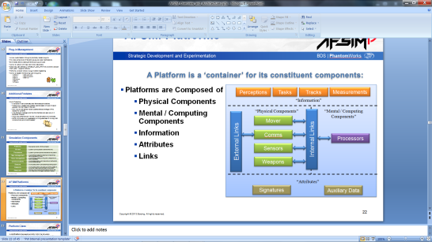
AFSIM Platforms
A Platform is the primary way to represent an entity in AFSIM
A Platform is a ‘container’ for its constituent components
Platforms are Composed of
Physical Components
Mental / Computing
Components
Information
Attributes
Links
Perceptions
Tasks
Tracks
Measurements
“Information”
“Physical Components”
Internal Links
“Mental / Computing Components”
External Links
Mover
Other Platforms
Comms
Processors
Sensors
Weapons
“Attributes”
Signatures
Auxiliary Data
Notes:
Physical and Mental components communicate via messages over internal links. Because of this system components are loosely coupled. Internal link setup is very flexible and can be arranged however the analyst desires.
A common example of using internal links is in connecting a sensor (physical component) with a track processor (computing component). With this link, the sensor transmits its measurements to the track processor using a track message. The track processor receives the track message and performs track association, track fusion, and track reporting functions, taking the new measurement from the sensor into account.
External links work like internal links but use comm. devices to communicate messages to other platforms. A common example of using external links is to use a track processor to report its tracks to other platforms by sending track messages through a comm. device over external links to the platform’s peers, subordinates, or commander.

Slide 35
Components Overview
AFSIM Enables Arbitrary Components to be Placed On Platforms
“Component-Based Architecture” (CBA)
Components can be added/removed as necessary
New components can be created
Components can themselves be platforms (think of a missile being launched from a fighter – the missile is its own platform)
Relies on Component (Object) Factories to Create and Load Components on Platforms
“PreInitialize” Method Automatically Loads Components

Slide 36
General Component Hierarchy
WsfComponent
WsfPlatformComponent 
WsfComponentList
0..
UtEntity
WsfObject
WsfPlatformComponentList 
WsfUniqueId
WsfProcessorComponent §
0..
UtEntityPart
WsfPlatformPart
WsfPlatform
WsfSinglePlatformObserver
ComponentList ‡
WsfMover
WsfArticulatedPart
WsfProcessor
WsfComm
WsfWeapon
WsfSensor
The following code segments define some useful identifiers
 using WsfPlatformComponent = WsfComponentT<WsfPlatform>
 using WsfPlatformComponentList = WsfComponentListT<WsfPlatormComponent>
§ class WsfProcessorComponent : public WsfComponentT<WsfProcessor> …
‡ using ComponentList = WsfComponentListT<WsfProcessorComponent>
Note: this is only a partial hierarchy for components in AFSIM

Slide 37
Platform Class
A WsfPlatform represents an entity (UtEntity) within the simulation.
Acts as a container for the ‘systems’ (i.e., Components – movers, comms, sensors, weapons, etc.) that define how the platform operates and behaves.
Class WsfPlatform is derived from the following:
WsfObject – A base class for objects that have a name and a type.
WsfUniqueId – Maintains a unique identifier for an object.
UtEntity – Represents the position, orientation, velocity and acceleration of an entity.

Slide 38
Platforms and Platform Indices
As platforms may be destroyed during a simulation, one must not retain a pointer to another platform
What should be retained is a 'platform name' or 'platform index'.
When a platform is added to the simulation it is assigned a unique platform index that will never be reassigned during the simulation
The platform index is not assigned until WsfSimulation::AddPlatform is called from inside WsfSimulation::Initialize
The platform index for an active platform can be retrieved by:
size_t platformIndex = platformPtr->GetIndex();
Given a platform index, the address of the associated platform can be retrieved by:
WsfPlatform* WsfSimulation::GetPlatformByIndex(size_t aIndex)
The return value will be the pointer to the platform if it still exists or nullptr if the platform has been removed from the simulation (hence, you must check that the pointer returned is not nullptr before using it to access the platform.

Slide 39
Movers
A WsfMover is a platform part that is responsible for maintaining the kinematic state (position, orientation, speed, acceleration, etc.) of the platform to which it is attached.
The mover is called by the simulation object to effect movement of platforms owned by the simulation.
Some Example Movers
Air Mover - Waypoint mover for aircraft.
Ground Mover - Waypoint mover for ground vehicles.
Guided Mover - A specialized mover that imposes a Newtonian dynamics model with specified mass properties, applied aerodynamic forces, and via steering commands issued from a guidance computer.
NORAD Space Mover - A specialized mover for earth-orbiting satellites.
Road Mover - A ground mover that moves along a road network (WsfRouteNetwork).
Surface Mover - Waypoint mover for sea-borne vehicles.
Time-Space-Position-Information (TSPI) Mover - A mover that updates position based on data for a TSPI file.

Slide 40
WsfMover Derivation
WsfComponent
WsfPlatformComponent 
WsfComponentList
0..
WsfObject
WsfPlatformComponentList 
WsfUniqueId
WsfPlatformPart
WsfPlatform
WsfMover

Slide 41
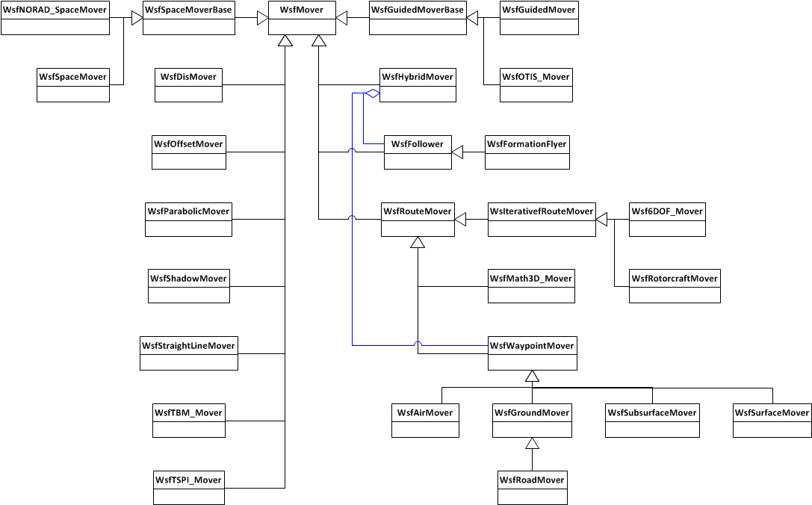
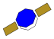
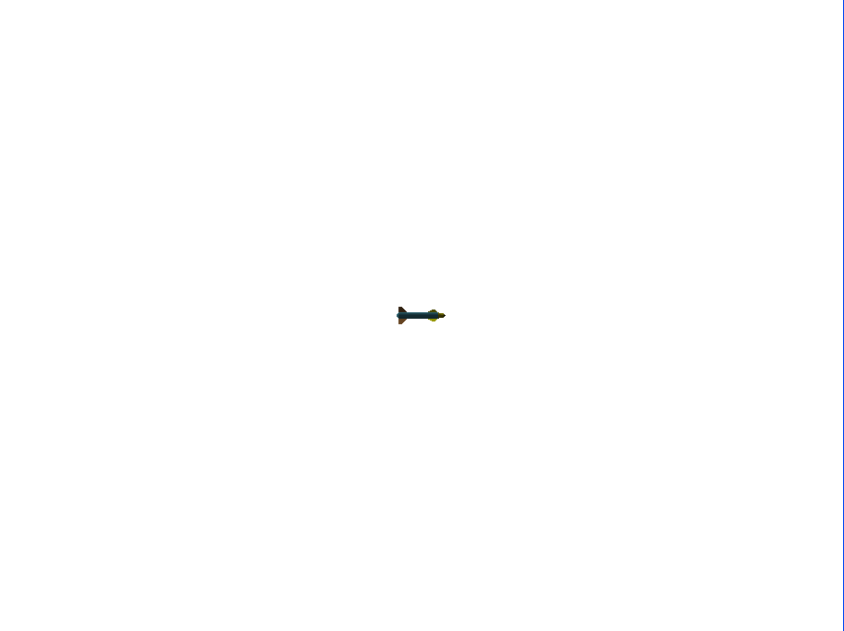
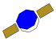
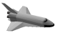
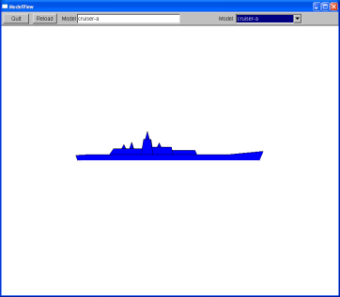

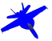
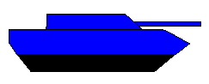
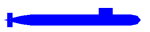

WsfMover Specialization

Slide 42
Modeling of Electromagnetic Systems
Communication, sensor, and weapon systems use a common set of classes to model electromagnetic interactions
Two-Way (Mono-static/Bi-static Radar)
WsfComm
WsfSensor
WsfWeapon
WsfComm
WsfSensor
WsfWeapon
0..n
0..n
WsfEM_Xmtr
WsfEM_Rcvr
WsfEM_Manager
WsfEM_Antenna
WsfEM_Interaction
WsfEM_Antenna
0..n
One-Way (Radio, ESM, Jammer)
0..n
WsfAntennaPattern
WsfAntennaPattern

Slide 43
Sensors
A WsfSensor Represents a Sensing System Attached to a Platform
It is an Articulated Part (WsfArticulatedPart), which is a platform part (WsfPlatformPart), which is a platform component (WsfPlatformComponent)
Often Utilizes Transmitters, Receivers, and Antennas
WsfComponent
WsfPlatformComponent 
WsfComponentList
0..
UtEntity
WsfObject
WsfPlatformComponentList 
WsfUniqueId
UtEntityPart
WsfPlatformPart
WsfPlatform
WsfSinglePlatformObserver
WsfArticulatedPart
WsfSensor
Notes:
ESM: electronic support measures

Slide 44
WsfSensor Specialization
Predefined Sensors
Acoustic - Simple passive acoustic sensor representing human hearing.
Composite – A sensor composed of other sensors.
EOIR – Baseline electro-optical or infrared sensor.
ESM - Baseline passive RADAR frequency detection sensor.
Geometric - Baseline sensor based on geometry.
IRST - Baseline infrared search-and-track sensor.
Optical - Simple electro-optical sensor.
OTH – Baseline over-the-horizon backscatter skywave RADAR sensor.
RADAR - Baseline RADAR sensor.
SAR – Baseline synthetic aperture RADAR.
Surface Wave RADAR - Surface-wave RADAR sensor.

Slide 45
Weapons
A WsfWeapon is something that is meant to prevent the operation of some other object (either permanently or temporarily).
Most weapons are ‘explicit’ weapons;
When fired, a platform is explicitly created for the weapon
Implicit weapons are not represented as platforms (e.g., Jammer, Directed Energy)

Slide 46
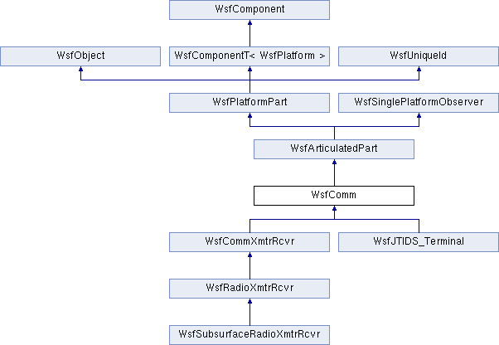
Communications
A WsfComm object provides the mechanism for platforms to communicate with each other, as well as with internal parts.
Wired or Wireless, Using Transmitters, Receivers, and Antennas
WsfComm is the base class for all communications implementations.

Slide 47
Messaging and Links
A WsfMessage is the “Unit” of Communication in AFSIM
Many derived types
Within a Platform, Messages are Passed Over “Internal Links”
Platform Components are Decoupled from One Another
Easily Set Up Communication Among Components
Among Platforms, Messages are Passed Over “External Links”
This is accomplished exclusively with Comm objects
Other Platforms
External Links
Mover
Internal Links
Processors
Comms
Sensors
Weapons

Slide 48
Processors
A WsfProcessor Implements Platform “Behavior”
Processors are invoked by:
Receiving messages from another ‘system’
A periodic call to update
Calling scripted function methods
Most Custom Processing Can Now be Accomplished Through Script Using the WsfScriptProcessor
There are Still Several Custom Processors in AFSIM Core, including
WsfTaskProcessor
WsfTrackProcessor
WsfImageProcessor
Processors

Slide 49
Component-Based Architecture
Simulation Components
Platform Components
Platform Component List
Component
(“Movers”)
Component
(“Processors”)
Component
(“Comm”)
Component
(“Sensor”)
Component
(“Weapon”)
Component
(<“XYZ”>)
Simulation Component List
Movers
Processors
Communications
Sensors
Weapons
Others
EW Interaction, DIS, XIO, etc.
Component Implementations
Component Based allows for Addition and Removal of Whole Types
Platform/Simulation Component Types are Accessed by Name or Role
Enables Component Type Addition or Removal from Simulation and Platforms
For example: Removal of Weapons and Electronic Warfare (EW) from EAR Versions with addition in ITAR only

Slide 50
WsfComponent
No Member Variables
Most Functions Require Implementations in Derived Class
Framework methods:
Clone, ProcessInput, Initialize
Other Methods
<Get/Set>Name, <Get/Set>Role, InitializationOrder
Roles define Types on Platform Components List
e.g. sensors, comms, movers, processors, weapons, etc.
WsfComponent
Wsf<type-name>Component
optional
Wsf<type-name>
WsfPlatformComponent
WsfProcessorComponent
WsfSensorComponent
Component (for Comm)
Examples:
In WsfComponent.hpp, we specialize components for platforms:
using WsfPlatformComponent = WsfComponent<WsfPlatform>
In WsfProcessorComponent.hpp, we specialize for processors:
class WsfProcessorComponent : public WsfComponentT<WsfProcessor> …
In WsfSensorComponent.hpp, we specialize for sensors:
class WsfSensorComponent : public WsfComponentT<WsfSensor> …
In WsfCommComponent.hpp, we specialize for comms:
class Component : public WsfComponentT<Comm> …

Slide 51
WsfComponentList
Provide Methods to Maintain and Manage Components
Add
Remove
Iterate
Find
FindByRole
Callbacks
Added/Deleted
Component “Role” Enumerations Defined for Each Component Type
Supports Find and FindByRole
WsfComponentList
Component and Part Type Enumerations
Part Type Enumerations
There are many component lists, such as:
WsfPlatformComponentList
ComponentList (for WsfProcessorComponent)
ComponentList (for WsfSensorComponent)
ComponentList (for comm’s Component)
WsfXioComponentList (for WsfXIO_Component)

Slide 52
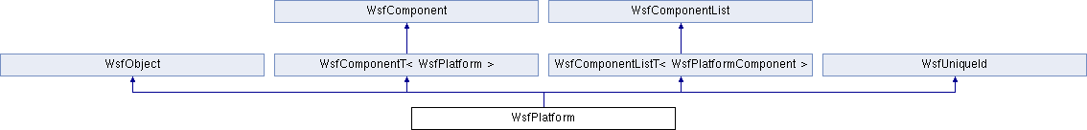
WsfPlatform Class Diagram
Derives from:
WsfComponent (Template class)
WsfComponentList (Template class)
WsfObject/WsfUniqueId
Direct access to WsfComponentList functions
Ability for a Platform to be a Component of another Platform
Composition design pattern

Slide 53
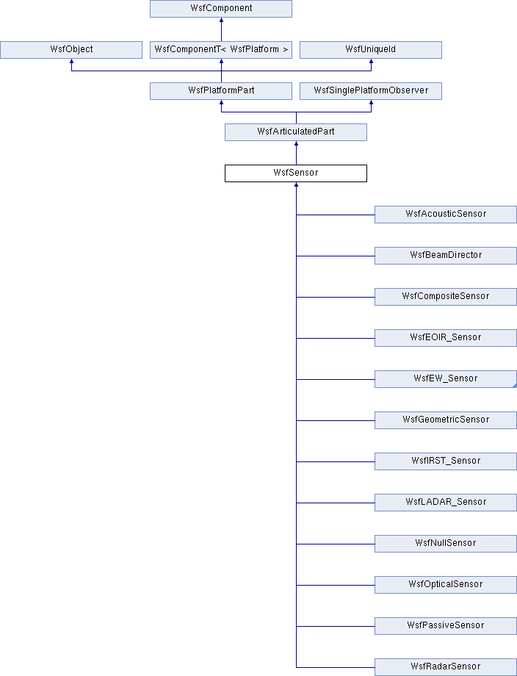
WsfSensor Component Example
Statement located in WsfSensor.hpp
- associates the value
cWSF_COMPONENT_SENSOR
(a predefined integer) with the
class WsfSensor
Declarations:
WSF_DECLARE_COMPONENT_ROLE_TYPE(WsfSensor, cWSF_COMPONENT_SENSOR)
using ComponentList = WsfComponentListT<WsfSensorComponent>;
Functions:
WsfComponent* CloneComponent() const override { return Clone(); }
const int* GetComponentRoles() const override;
void* QueryInterface(int aRole) override;
WsfObject requires overriding:
CloneComponent
Explicit cloning of components
GetComponentRoles
Returns array of the component roles associated with this class
QueryInterface
Returns a pointer to the object that has been cast as the class associated with the role passed in
Notes:
Clone() is a pure virtual function overridden for each derived type. QueryInterface checks the role and casts it to the appropriate type.

Slide 54
Additional AFSIM Infrastructure Functionality
Multi-Threading
Event Output
Task Management
Track Management
Signatures
Weapon Effects
Aux Data
Console Output

Slide 55
Multi-Threading
Multi-Threading
Available in both event-step and frame-step simulations.
Thread pool created that updates objects based on type of object passed into the thread in the pool.
Only mover and sensor object updates take advantage of this capability currently.
Line-Of-Sight manager and the DIS interface can also be run in separate threads.
Improves performance in “some” virtual simulation environments.
NOTE: Simulation run repeatability is not guaranteed if running multi-threaded.

Slide 56
Event Output
Event Output is a Time-Stamped Text File of Simulation Events
Event types are user-enabled
List of available events roughly follows the events published by WsfObserver
Readable by Event Reader
New, Custom Event Types can be Added to the Event Output
Event Output

Slide 57
Task Management
Specialized processor for sending and receiving ‘task assignments’ that are associated with tracks
Allows the user to categorize tracks using the concept of a finite state machine
The user defines a set of transition rules that define the conditions under which a transition can occur from one state to another
Each track maintains own state
T_{1,} T₃
T₂
Tracks: T₁, T₂, T₃
evaluation_interval DETECTED 1.0 sec
state DETECTED
next_state IMAGING
return (TasksReceivedFor(TRACK.TrackId(),“ID”) > 0);
end_next_state
next_state IN_ROUTE
return ((TasksReceivedFor(TRACK.TrackId(),“BDA”) > 0 ) ||
(TasksReceivedFor(TRACK.TrackId(),“STRIKE”) > 0));
end_next_state
end_state
Task
Management

Slide 58
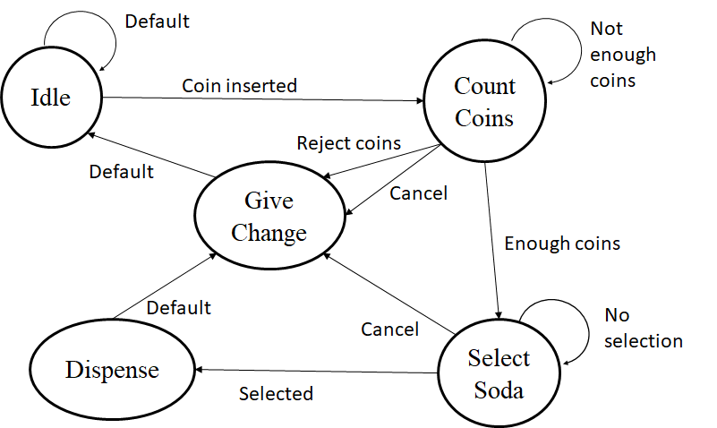
Task Management – State Machines
close
lock
State Machines have:
States
Events
Transitions
Open
Closed
Locked
open
unlock
State Machine Example – Describing Door Operation
State Machine Example – Vending Machine
Notes:
Popular example of a state machine – the vending machine. It sits in the idle state, waiting for someone to put coins in it. It then counts the coins, until 1) there are enough coins, 2) the cancel button is hit, or 3) a bad coin shows up. If there are enough coins, then it waits until a selection is made or cancel is hit. When a selection is made, then something is dispensed, and change is given. It then returns to the idle state.
If reject or cancel occurs, change is given and it returns to idle.
This is not a perfect example for AFSIM, but we will use it nonetheless.

Slide 59
Track Manager
The Track Manager is Always Available on Platforms and is Responsible for
Maintaining a track list of “local” tracks (WsfLocalTrack)
Maintaining a track list of contributing “raw” tracks (WsfTrack)
Controlling track–to-track association and fusion
Association and fusion are implemented as interchangeable “strategies” for ease of integration
Controlling track purging
Providing notifications of tracking events
Acting as a “filter center”
Track
Producers
(Sensors,
Other TMs,
Platform
Tracks,
Etc)
.
Track Manager
Fuseable Raw Tracks
(Filtered, Unfiltered, Processed)
(Associate, Fuse)
Track Association
Subscribe to Tracking
Events
Local Track List
Interested
Parties
Fuseable Raw Tracks
(Unfiltered, TM as Filter Center)
(Filter, Associate, Fuse)
Raw Track List
Track Fusion
Publish Tracking Events
Non-Fuseable Raw Tracks
(Predfined)
(N/A-[copy only])
Notes:
Track Status Indications:
cNONE, //!< There is no change, or the code is invalid.
cCREATED, //!< A local track has been created.
cUPDATED, //!< A local track has been updated.
cDROPPED, //!< A local track has been dropped.
cCORRELATED, //!< A local track has been correlated.
cDECORRELATED, //!< A local track has been decorrelated.
cCANDIDATE_TRACK_PROMOTED, //!< A "candidate" local track has been promoted to a full local track.
cRAW_TRACK_DROPPED, //!< A raw track has been dropped.
cRAW_TRACK_RECEIVED, //!< An unprocessed raw track was received.
cCURRENT_TARGET_CHANGED //!< The current target has changed.

Slide 60
Track Processor Functions
Populate the Track Manager’s Track Lists
Off-board tracks from other platforms
On-board sensor tracks
Purge Tracks
Tracks “dropped” if no update in a specified Interval
Report Tracks
Utilizes publish / subscribe service with Track Manager
Reporting options include
Batch reporting
Cyclic reporting
All tracks or only changed tracks communicated
Track Messages
Sensors
Track
Manager
Add Tracks
Track
Processor
Purge
Subscribe to Tracking Events
Publish Tracking Events
Other Platforms
Comms
Track Messages
60

Slide 61
Track Manager Tracking “Strategies”
Track Association Strategies:
Perfect
Raw tracks are associated with the truth target
Nearest Neighbor
Raw tracks are associated with another track if distance between two locations “reasonably” close in terms of covariance matrix sigmas
Cluster
Build up track associations using a clustering algorithm with covariance matrix sigmas as the discriminator for cluster membership
Truth
Useful in distributed scenarios, this algorithm matches track location to nearest truth location, if “reasonably” close
Track Fusion Strategies:
Native / “Default”
Replacement or covariance-based weighted-average
Focused on kinematic fusion
Multi-Target Tracking (MTT; from Suppressor)
See Suppressor documentation for algorithms
Categorical Data Fusion is Common and Follows Simple Rules (But May Soon Change)
Side, Type simply copied
IFF Merged according to simple hard-code rules
Aux Data are merged / replaced
Track Manager
Local Track List
Track Association
Raw Track List
Track Fusion
Notes:
Track Status Indications:
cNONE, //!< There is no change, or the code is invalid.
cCREATED, //!< A local track has been created.
cUPDATED, //!< A local track has been updated.
cDROPPED, //!< A local track has been dropped.
cCORRELATED, //!< A local track has been correlated.
cDECORRELATED, //!< A local track has been decorrelated.
cCANDIDATE_TRACK_PROMOTED, //!< A "candidate" local track has been promoted to a full local track.
cRAW_TRACK_DROPPED, //!< A raw track has been dropped.
cRAW_TRACK_RECEIVED, //!< An unprocessed raw track was received.
cCURRENT_TARGET_CHANGED //!< The current target has changed.

Slide 62
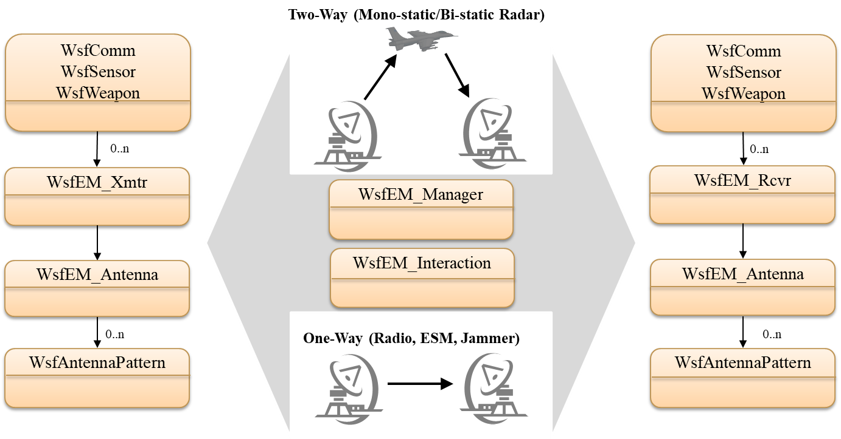
Signatures
Signatures represent platform visibility (detectability) to a sensor (radar, optical, etc.) located at some angle to the platform.
The WsfSignature object is a container for the signatures. There are several signatures currently implemented:
WsfOpticalSignature
WsfRadarSignature
WsfInfraredSignature
Signature states allow different signature tables to be used depending on the configuration of the platform.
For instance, one signature state might be represent the weapon bay doors being closed while another represents them being open
WsfSignature
WsfRadarSignature
WsfOpticalSignature
WsfInfraredSignature

Slide 63
Weapon Effects / Lethality
Weapon Effects (Lethality) Objects are Used to Determine the Effect of a Weapon on a Platform.
WsfLethality is the base class for all lethality implementations.
AFSIM provides several implementations including:
WsfCarltonLethality
WsfSphericalLethality
WsfTabulatedLethality
We will Implement a Simple Weapon Effect as Part of the AFSIM Weapons Module
uses Carlton Damage Equation
damage inversely proportional to miss distance
table lookups determine damage

Slide 64
Auxiliary Data
Auxiliary Data Allows One to Place “Extra” Data on Tracks, or Other Components, Including
Platforms
Any Platform Part (Comm, Sensor, Weapon, Mover, etc.)
Tasks
Groups
Routes
Transmitter / Receiver
Basic Types (int, bool, double, string) Predefined
Can also register arbitrary types or build up structs
Also Available Through Scripting Language
Signatures

Slide 65
Console Message Generation
ut::log::info() << “Hello World”;
Creates a stream (of type info) and generates message at same time
This stream goes out of scope immediately, send() ’ing the message
Basic Usage:
Create and write a message stream (of some type / classification).
The stream sends the message to a publisher.
Send() is called implicitly when the stream is destructed.
Send() can be called explicitly to flush a message to the stream
The publisher sends the message to all interested subscribers, including the console.
The console displays the message to the screen/window, and is followed by a newline character.
Note: while it is possible to generate console output using std::cout, you should use
the ut::log system instead, as other interested entities (like observers) can also receive
the generated output

Slide 66
Console Message Generation Message Types
Fatal
ut::log::fatal
Unrecoverable error.
Not currently used in AFSIM.
Error
ut::log::error
Recoverable error.
Denoted with *****ERROR
Warning
ut::log::warning
Warnings
Denoted with *****WARNING
Info
ut::log::info
Generic message
No star-tags applied
Debug
ut::log::debug
User-level debug message
Denoted with *****DEBUG
Developer
ut::log::developer
Developer-level debug message
Not currently used in AFSIM

Slide 67
Console Message Generation Notes
Notes can be added to a message using AddNote
Example for ut::log::info
auto out = ut::log::info() << “input command ‘foobar' is deprecated staring with AFSIM 2.6.";
out.AddNote() << aInputBlock.GetInput().GetFooBarValue();
Example for ut::log::warning
auto out = ut::log::warning() << "'subtype' definitions are not applicable for the 'default' type.";
out.AddNote() << aInputBlock.GetInput().GetLocation();
out.send();
What is a Note?
An addendum to a message containing additional information.
Items to include in a note:
Values of variables pertaining to the message
Location of an error either in code or a scenario file
Citation of documentation describing a command relating to the message
Instructions on how the user may resolve a warning or error
Notes in the console will be on a separate line and indented.
The send() method flushes the stream to output
When the variable goes out of scope, the send() method is invoked by the destructor (flushing the stream)
When the send() method is called directly, the stream is flushed

Slide 68
Coding Guidelines - Style
See the AFSIM documentation for a complete list of coding guidelines
Braces
Which enclose a block shall be placed in the same column, on separate lines directly before and after the block
Always include curly braces, even for one-line if statements or for loops
3 spaces for indentation (tabs shall not be used!)
No more, no less
3 shall be the number thou shalt count
The number of the counting shall be 3
4 shall thou not count
Neither count thou 2, excepting that thou then proceed to 3
5 is right out
Continuation lines
A continuation line shall be indented 3 spaces
* and &
The “*” and “&” operators shall appear next to the type names, followed by whitespace, in pointer and reference variable definitions
Notes:
“Then, shalt thou count to three. No more. No less. Three shalt be the number thou shalt count, and the number of the counting shall be three. Four shalt thou not count, nor either count thou two, excepting that thou then proceed to three. Five is right out.” Monty Python’s The Holy Grail

Slide 69
Coding Guidelines - Identifiers
Naming conventions
Identifiers shall use camelCase (except for when they don’t)
The names of variables shall begin with lower case letters
The names of functions, ADTs, structs, typedefs, and enumerated types shall begin with an upper case letter
Constants and enumerated values shall contain a leading, lowercase “c”
Class data member variables shall contain a leading, lowercase “m”
Function parameter names (formal arguments) shall contain a leading, lowercase “a”
Identifiers that begin with “_” or “_ _” shall not be used
Pointers shall be named with a “Ptr” suffix

Slide 70
More Guidelines
Variables
Each variable shall be declared in a separate declaration statement
Every declared variable shall be given a value before it is used
Pointer initialization
A pointer shall always be initialized to a valid value or nullptr when it is declared
Write short functions
If a function body exceeds approx. 42 LOC, consider breaking it up
Comments
All comments shall start with “//” unless necessary to support Doxygen comments
See the AFSIM documentation for a complete list of coding guidelines
The meaning of life, the universe, and everything is “42”
Notes:
‘The meaning of life, the universe, and everything is “42”’. Deep Thought Computer, Hitchhiker’s Guide to the Universe

Slide 71
Additional AFSIM Documentation
AFSIM Documentation
Location: …./BUILD/documentation/index.html
AFSIM Reference Guide: Encyclopedia of AFSIM input definitions and scripting language reference.
User / Analyst Resource
AFSIM User Manual: Standalone handbook for AFSIM users.
Doxygen: Software reference documentation generated from AFSIM source code using Doxygen*.
Software Developer Resource
Location: ..../BUILD/doxygen/index.html
* Doxygen is a documentation system for C++, C, Java, Objective-C, Python, IDL (CORBA and Microsoft flavors), Fortran, VHDL, PHP, C#, and to some extent D. Doxygen is released under the terms of the GNU General Public License and is free software. (www.doxygen.org)
Notes:
Also see software integration guide

Slide 72
Disclaimers
All representations of combat systems in the AFSIM training modules are constructed with fictional values and are intended to be generic in nature.
Representations of combat systems are solely for the purpose of teaching the operations of the AFSIM software.
Platforms, sensors, and weapons in the training sections do NOT represent any real or proposed tactical systems.
Users are expected to gather and validate their own data for analyses using AFSIM.

Slide 74
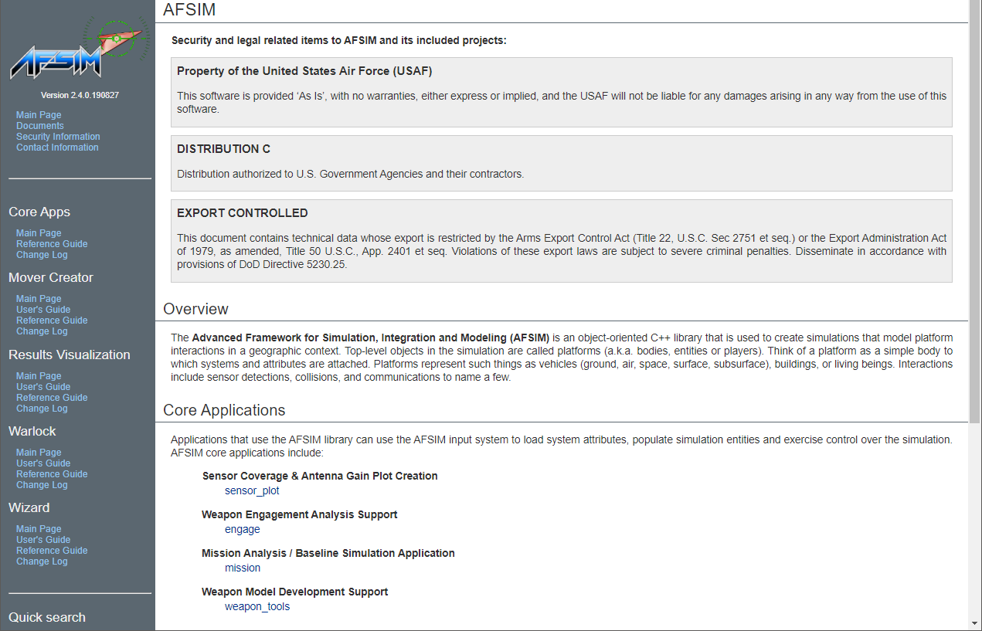
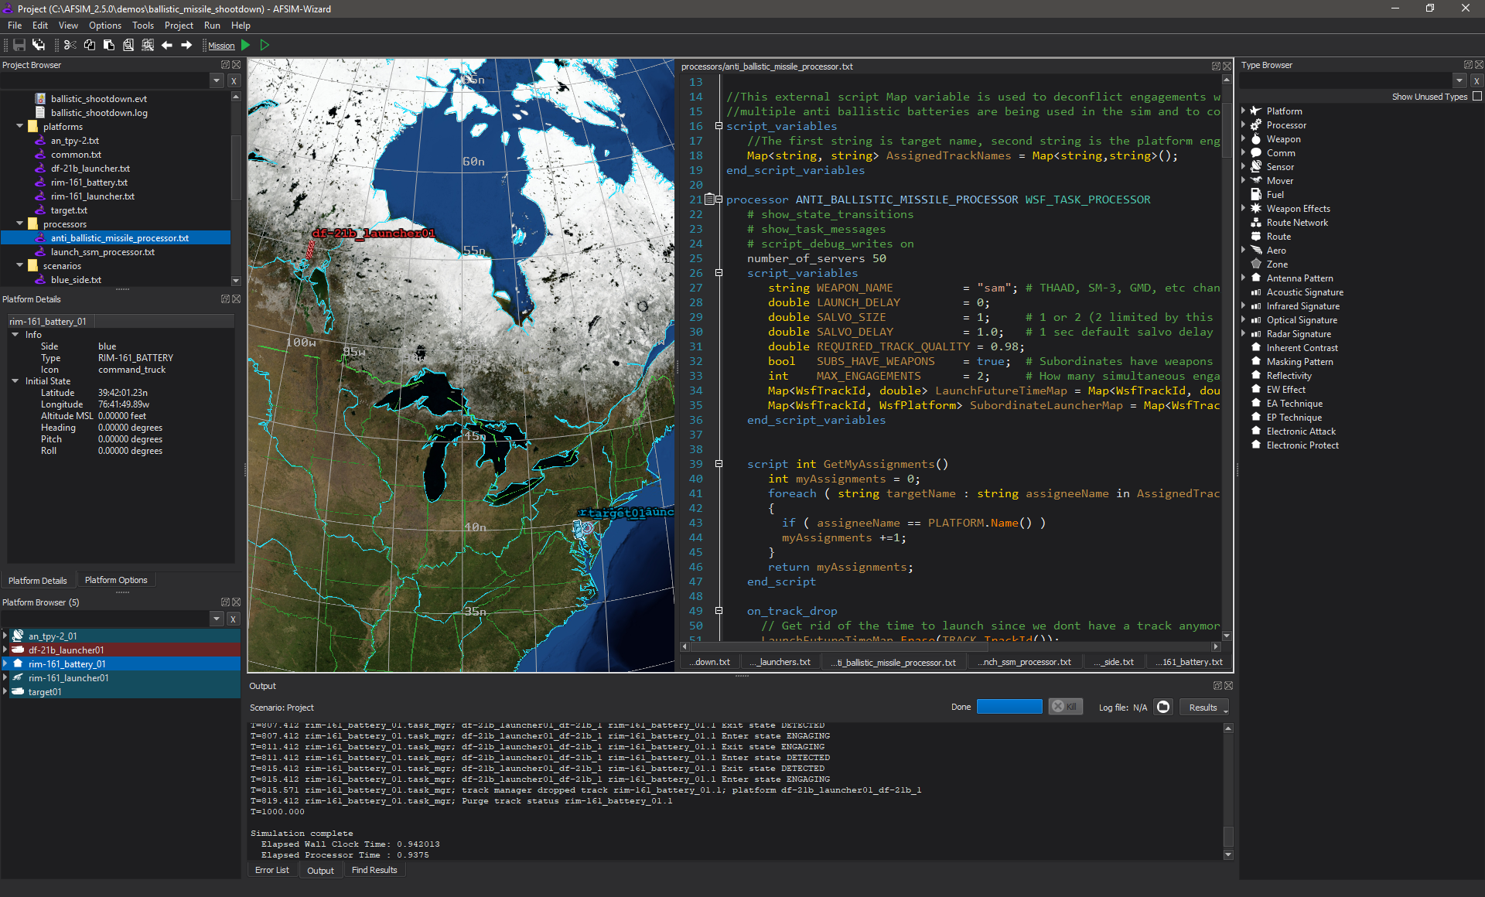
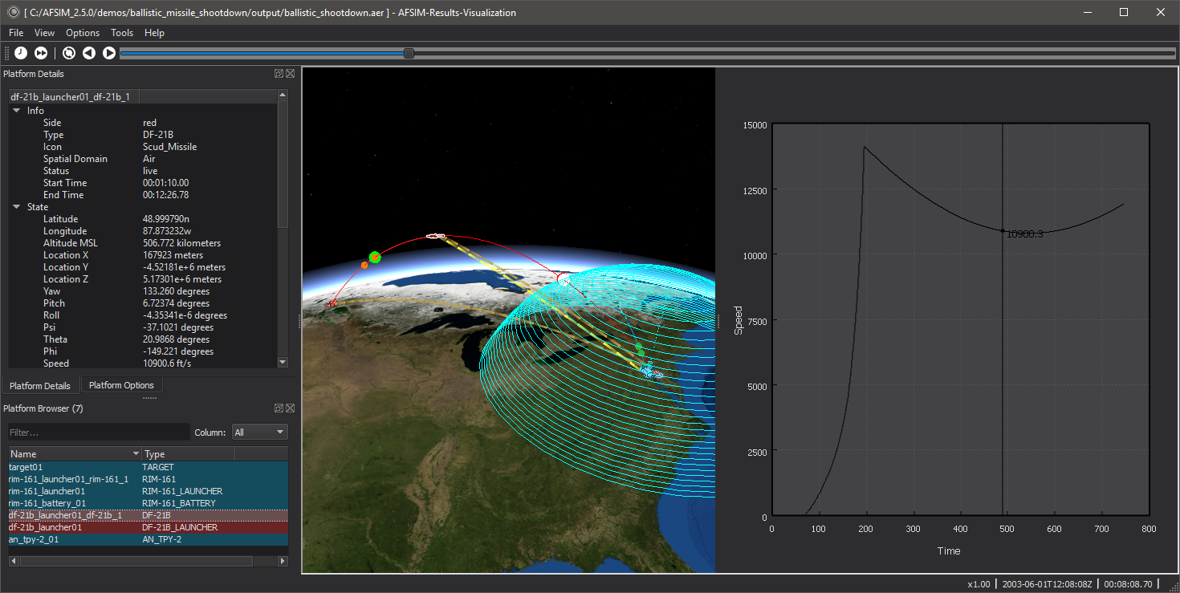
More Information / Distributions
For More Information, Consult the AFSIM Documentation
Unclassified Distributions
Request a DI2E Account (http://www.di2e.net)
Request access to the AFSIM Portal (https://dpam.di2e.net/myaccount)
Add Confluence to your application licenses (note: it may take up to an hour before access is allowed)
Download the desired release (https://confluence.di2e.net/display/AFSIM/Releases)
Classified Distributions
Contact Brian Birkmire (brian.birkmire.1@us.af.mil, 937-255-2441)
Complete ITA, contractors need to identify appropriate DD254
Gain access to SIPR Intelink AFSIM site, DVD will be mailed if SIPR access not available

Slide 75
Application-Specific Component Models
Application-specific models can be (and have been) integrated:
Written in various languages (C, C++, MATLAB®, Java, FORTRAN)
Required no change to the core framework
Integration Examples:
Custom code compiled into AFSIM application as a static library using AFSIM base classes and creating derived classes or new classes.
MATLAB® SIMULINK® models – (“Auto-Coded” to C++)
Custom code compiled as a dynamic library loaded at runtime
AFSIM Plugins
MATLAB® source code and SIMULINK® Models (Compiled .dll)
Custom communication over existing application interfaces
XIO
MATLAB® Engine API
ExtendSim OLE/COM Automation Interface

Slide 76
Additional Questions
afsim-help@vdl.afrl.af.mil

