Slide 1
AFSIM Developer Training
2 – Building AFSIM with CMake
AFRL/RQQD
AFSIM Version 2.0

Slide 2
Prerequisites
Before working on this lab, you should:
Be proficient with the C++ programming language
Understand Unified Modeling Language (UML) fundamentals
Be familiar with WIZARD and WSF scripting Language
AFSIM analyst course or equivalent experience is recommended
Have available and be familiar with using Microsoft® Visual Studio 2017® to compile an application
Be familiar with using Microsoft Windows® Explorer
Have the latest version of the WIZARD, the AFSIM Integrated Development Environment (IDE) installed. (Provided)

Slide 3
Prerequisites
Before taking this course, you should be able to demonstrate the following:
Describe and use the following C++ fundamentals
Constructors and destructors
Virtual functions
Function overloading
Operator overloading
Accessors and mutators
Single and multiple inheritance
Templates
Exception Handling
Describe and use the following Unified Modeling Language (UML) fundamentals
Class diagrams
Sequence diagrams
Aggregation associations
Composition associations
Accessors and mutators
Composite classes
Use the Microsoft Windows® environment and the Microsoft® Visual Studio 2017® or Microsoft® Visual Stuido 2019® Integrated Development Environment (IDE).

Slide 4
Lab Setup
To complete the labs in this course, you need the following:
Microsoft Windows®-based computer (7 or later)
Microsoft® Visual Studio 2017®
MATLAB® or MATLAB® Compiler Runtime (MCR) (provided)
AFSIM executable (simulation runtime executable-plug-in version)
We will be building this in the next module
AFSIM WIZARD (provided)
AFSIM MYSTIC (provided)
Python (public-domain programming language; optional)
CMake (3.8 or higher for VS 2017, 3.14 or higher for VS 2019)
The starting point for each lab is located in:
<afsim-install-folder>\training\developer\core\labs\inwork
The solution for each lab is located in:
<afsim-install-folder>\training\developer\core\labs\solution
You will work in the inwork directory.
Notes:
Note: You can also use Linux (Ubuntu, CentOS) with gcc, python, cmake, etc.

Slide 5
Preparing for Training
Before Starting, Take a Few Minutes to Set up Your Environment
Ensure that you have local admin rights.
Read/write permissions for working directories
Verify a version of Visual Studio with compilers is installed
Most recent service pack must be installed for 2017
Your instructor may have additional copies to install for this training only
Obtain a copy of the AFSIM release, containing
AFSIM software distribution, including source code
Developer training exercises and slides
Documentation for AFSIM and Development Exercises

Slide 6
Preparing for Training (cont.)
Install AFSIM to a Directory Where you have Full Read/Write Privilege
Placing on your desktop should always work.
Optionally, place a shortcut to …/3rd_party/cmake/bin/cmake-gui.exe to your desktop.
If you have installed a Release version of AFSIM, make sure that the 3rd_Party resources and the VTK resources are installed in the swdev/dependencies folder
OK! Let’s get Started!

Slide 7
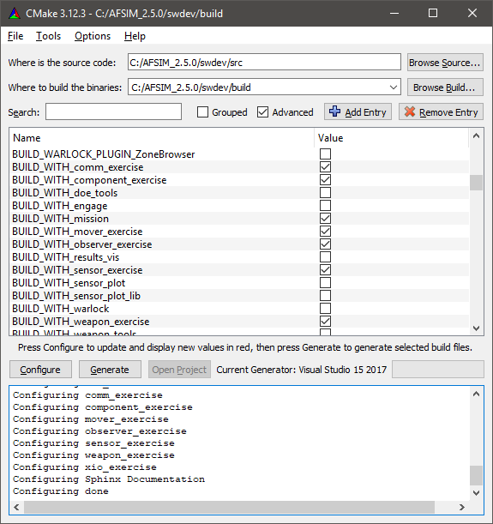
CMake Overview
AFSIM utilizes CMake for build configuration. This presentation describes the best practices of using CMake with AFSIM.
Get CMake online from http://www.cmake.org
CMake provides a tool called cmake-gui, shown to the right. This tool makes it easy to customize the AFSIM build.

Slide 8
Why Use CMake?
Earlier versions of the framework used a set of Windows Visual Studio project files and a custom Linux makefile system
Ok when new projects and files were added only infrequently
However, this is not the case for current-day AFSIM!
CMake solves the Configuration Management problem by providing the ability (in theory) to build any Windows or Linux (or other) configuration by providing a single set of configuration files
See “CMakeLists.txt files” in project directories and configuration files in “misc” directory
AFSIM’s use of CMake has since become indispensable for managing the explosion of new optional projects, executables, and plug-ins

Slide 9

Out-of-Source Builds
Source Directory
Build Directory
Install Directory
Version-controlled source files
(*.cpp, *.hpp)
Transient build objects
(*.obj, *.o)
Final binaries
(*.exe, *.dll, *.so)
“Generate”
“INSTALL”
CMake files live here!
Windows: Run solution file
Linux: Make
Ready for distribution
Sometimes things go wrong in the build.
This layout allows us to safely destroy the build directory without loss of data.

Slide 10
General Developer Folder Hierarchy
Folder | Purpose
.../afsim | The main source code folder in the repositories on Git Lab
.../afsim_shared | Additional source code for managing AFSIM related models, analyzing scenarios, generating reports, and managing certain types of communications
.../build | The build folder where all binaries are created
.../demos | The main scenarios folder
.../demos_shared | Additional scenarios
.../devtools | Git tools for pulling down AFSIM repositories
.../resources | Maps and models
.../tools | Scripts for various conversions and analysis
.../training | The training content

Slide 11
General Release Folder Hierarchy
Folder | Purpose
.../bin | The packaged versions of AFSIM executables
.../demos | The main scenarios folder
.../documentation | The main documentation folder
.../resources | Maps and models
.../swdev/build | The main AFSIM build folder
.../swdev/dependencies | The folder for placing the 3rd_party tools and vtk_resources for offline builds (w/o access to git repos)
.../swdev/resources | The folder for generated maps, models, and vtk resources
.../swdev/src | The main AFSIM source code folder
.../tools | Scripts for various conversions and analysis
.../training | The training content
Note: Everything in ../swdev/src can be found in the ../afsim_dev/afsim
folder in the developer folder structure pulled from the git repositories

Slide 12
AFSIM Source Repository Folder Hierarchy
Either: .../swdev/src or .../afsim_dev/afsim
Folder | Purpose
.../cmake | Most cmake files are here
.../core | Core source code files for mission
.../doc | .rst files for building documentation
.../engage | Analysis tool for effectiveness of weapons and vulnerability of targets
.../mission | Main source code files for Mission
.../mystic | Source code files for Mystic results visualization tool
.../sensor_plot | Tools for building sensor plots
.../tools | Tools and utilities
.../warlock | Source code files for Warlock
.../weapon_tools | Tools for generating firing tables, launch acceptable regions, and other tabulated data
.../wizard | Source code files for Wizard
.../wsf_plugins | Plugins such as Brawler, P6DOf, etc.

Slide 13
AFSIM Source Folder Hierarchy
Folder | Purpose
.../tools | In either: ../afsim/tools or ../swdev/src/tools
3rd_party-cmake | Cmake files for the 3rd Party Tools
dis | Distributed Interactive Simulation (IEEE Standard 1278)
genio | Genio library for easy setup of TCP, TCP Server, and UDP connections
misc | Miscellaneous scripts for executing tests
packetio | Packet serialization / deserialization for various packet types
tracking_filters | Filters for sensors/trackers to produce target location/velocity est.
util | Utilities for units, vectors, tables, clocks, threads, input, …
util_script | Script utilities
utilosg | Osg graphics models
utilqt | Qt related tools for building GUIs
vespatk | Tools to create and manage the Map Display
wkf | The common framework to create GUI for Wizard/Warlock/Mystic

Slide 14
AFSIM Source Folder Hierarchy
Folder | Purpose
.../core | In either: ../afsim/core or ../swdev/src/core
sensor_plot_lib | Source code to evaluate sensor characteristics and interactions
wsf | Source code for core modeling and simulation environment
wsf_cyber | Source code to implement Cyber Warfare
wsf_grammar_check | Source code for extension which checks the grammar is parsed correctly
wsf_l16 | Source code to implement the Link16 interface commands
wsf_mil | Source code to implement Weapons
wsf_mil_parser | Source for extension which parses the grammar for wsf_mil
wsf_mtt | Source code for the Multi-Target Tracker
wsf_nx | Source code for non-exportable code
wsf_parser | Source code for the AFSIM grammar parser
wsf_ripr | Source code for the Reactive Integrated Planning Architecture framework
wsf_space | Source code to for Space functionality

Slide 15
AFSIM Source Folder Hierarchy
Folder | Purpose
.../mystic | In either: ../afsim/mystic or ../swdev/src/mystic
exec | Mystic’s main function executed at run time
lib | Code for Mystic’s layout, map definitions, plugin manager, etc.
plugins | All the plugins supported by Mystic
python | Python code for running various examples
Folder | Purpose
.../warlock | In either: ../afsim/warlock or ../swdev/src/warlock
data | Scenario files for certain Warlock tests
plugins | Contains all of the Warlock plugins
warlock_core | The core code for Warlock
warlock_exec | The Warlock main function and the Warlock Application Extension

Slide 16
AFSIM Source Folder Hierarchy
Folder | Purpose
.../wizard | In either: ../afsim/wizard or ../swdev/src/wizard
exec | Mystic’s main function executed at run time
lib | Code for Mystic’s layout, map definitions, plugin manager, etc.
plugins | All the plugins supported by Mystic
python | Python code for running various examples

Slide 17
Generating Builds from CMake
CMake generates Makefiles (Linux) or Visual Studio Project Files (Windows)
Choose a Build Directory that Exists Outside of any Source Directories
Keeps build files and source files separate
Prevents source control (Git) from asking about adding build files
The Standard Directory Layout We Use is the Following:
“src” is the top-level code directory
“build” is our build directory
The dependencies directory contains the 3rd party tools and the vtk_resourcs
swdev/
/src/ - code directory
/core/
/tools/
/wizard/
…
/dependencies/
/3rd_party - directory for 3rd Party tools
/resources – directory for vtk_resources
/build/ - build directory
/build_mission/
/build_observer_exercise/
…
Notes:
You will not have a build directory yet. We are going to create this.

Slide 18
Variables
The Following Variables are Important:
BUILD_WITH_...
Each optional projects may be enabled or disabled by toggling the associated checkboxes. The default value is determined by the availability of that module in the swdev directory.
BUILD_..._PLUGIN_...
Enable/Disable a plugin. This is useful to minimize build size and for debugging
WSF_PLUGIN_BUILD
Builds shared object or DLL libraries instead of static libraries, and enables loading of WSF plugins.
WSF_INSTALL_SOURCE
Creates a 'swdev' directory in the installation folder containing the source code.
CMAKE_BUILD_TYPE (Linux only)
Set to 'Release' or 'Debug'. This variable should be set when building on Linux. You will need two build directories if you want to build both debug and release.
WSF_ADD_EXTENSION_PATH
Tells CMake where to find plugins. We will use this in the training.

Slide 19
Variables
The Following Advanced Variables are Important (check the Advanced box in cmake-gui):
SWDEV_THIRD_PARTY_PACKAGE_SOURCES
Tells CMake where to find 3rd_Party sources for things like gtest (need by mission), osg, osg_earth, qt, etc.
VTK_RESOURCES_ARCHIVE_FILENAME
Tells CMake where to find the VTK resources (needed if you build any of the visual apps: wizard, warlock, mystic).
Note: these two variables only have to be changed if you put the
3rd_party resources and/or the VTK resources in any folder other
than …/swdev/dependencies

Slide 20
Targets
CMake generates multiple targets that can be built, including one for each executable, library, and set of tests.
Additionally, these targets are important:
Windows:
RUN_TESTS - Run unit tests
INSTALL - Generates an installation directory (BUILD/wsf_install)
ALL_BUILD, ZERO_CHECK - Automatically generated by CMake for visual studio integration, ignore.
Linux:
tests – Run unit tests
install – Generates the installation directory (BUILD/wsf_install)
Common to both Platforms:
<xxxx>_AUTO_TEST – runs system integration tests for <xxxx> (<xxxx> is one of “engage”, “mission”, “sensor_plot”, “weapon_tools”)
<xxxx>_REGRESSION_TEST – runs the regression tests for <xxxx> (<xxxx> is one of “engage”, “mission”, “sensor_plot”, “weapon_tools”)
DOCUMENTATION – builds the sphinx documentation system (for users)
DOXYGEN – builds the doxygen documentation (for developers)
Notes:
The only one we’ll be using in the training is INSTALL

Slide 21
Other Issues
You will have to manually execute cmake again if new files are added
Press the 'Generate' button in cmake-gui, or
using the command-line from the build directory: $ cmake .
CMake Visual Studio
If a CMakeLists.txt file is modified, you will be prompted to reload projects:
Press 'yes to all'.
It’s a good idea to manually press 'generate' on cmake-gui after any Git update or explicit change to a CMakeLists.txt file.
CMake Linux
Just using 'make' is usually enough to update from CMake configuration changes.
Only when new files are added is an explicit call to CMake necessary.
Use “make VERBOSE=1” to troubleshoot build problems
Use “make –j” (e.g. “make -j20”) for parallel computation
Notes:
If your build fails, particularly if you see linker errors, the first thing you should try is rerunning cmake.

Slide 22
Other Issues - Linux
CMake for Linux
However, one can do the entire build on Linux using cmake
Within the swdev/build folder do:
Run cmake-gui
Make sure the source and build directories are set correctly
here we assume swdev/build is the build directory
but you can create other folders to use for builds as well – such as swdev/DEBUG or swdev/SpecialBUILD, etc.
Press the configure button and then press the generate button
From the command line, cd into the build directory swdev/build, (or afsim_dev/build if you downloaded the repositories from git lab)
If your laptop/desktop has 6 processor cores (with 2 virtual processors per core), then do the following at the command line:
$ cmake --build . --target all -- -j12
To install, run the following in the build directory:
$ cmake --build . --target install -- -j12
To run unit tests, run the following in the build directory:
$ cmake --build . --target test -- -j12
Notes:
If your build fails, particularly if you see linker errors, the first thing you should try is rerunning cmake.

Slide 23
mission
We Will Need a “Plug-in” (dll-based) Version of mission for the Labs
Mission is the Baseline AFSIM Simulation Application
Reads text files containing AFSIM commands and executes the simulation, advancing through time, moving platforms, making decisions and performing interactions between objects.
Execution modes are as follows:
Event-stepped or frame-stepped
Non-real time or real time
Purely constructive including multiple Monte Carlo Iterations
As part of a Distributed Interactive Simulation (DIS) exercise
Using CMake, AFSIM Executables like mission are built for Linux and Windows Using the Same set of Configuration Files
May also build for other platforms (not tested)!
Using CMake Also Provides Easy Configuration Management to Include or Exclude Capabilities

Slide 24
Building the Standard AFSIM Applications (1/8)
Ensure that you have downloaded the 3rd_party resources from DI2E
Ensure that you have downloaded the vtk_resources.tar.gz file from DI2E
Create the directory …/swdev/dependencies
Create the directory …/swdev/dependencies/resources
Move the 3rd_party directory into …/swdev/dependencies
Move the file vtk_resources.tar.gz into …/swdev/dependencies/resources

Slide 25
Building the Standarad AFSIM Applications (2/8)
Configuring for the first build
Navigate to: …./training/developer/core/labs
Edit the file “config.cmake"
Lines 16-18 set the CMAKE_GENERATOR variable
The choices are:
Visual Studio 2017
Visual Studio 2019, and
Unix Makefiles (Linux)
Uncomment the line for the build tool that you want to use
Comment out the lines that you don’t want to use
If you selected one of the Visual Studio generators, then uncomment line 22 for the CMAKE_GENERATOR_PLATFORM variable
If you want to build the training with a Unity build, then uncomment lines 27 and 28
The build targets are specified in lines 34-55. Change the value from FALSE to TRUE for any targets you want to build
Initially, only BUILD_WITH_mission is set to TRUE

Slide 26
Building the Standard AFSIM Applications (3a / 8)
Time for the first build! of mission!
Open a Windows cmd window
Windows commands for AFSIM Release (for AFSIM 2.2202 or higher):
Navigate to the directory: …\AFSIM-2.x.x-zzz\training\developer\core\labs
Where '2.x.x' is the version of the release and 'zzz' is any additional part of the folder name
Execute the commands:
> set scriptpath=%cd%\config.cmake
> cd inwork
> set extpath=%cd%
> cd ..\..\..\..\..\swdev\src
> set srcpath=%cd%
> cd ..
> mkdir build
> cd build
> cmake –C %scriptpath% –DWSF_ADD_EXTENSION_PATH:PATH=%extpath% –B . –S %srcpath%
this step not necessary if build directory exists
Notes:
Note: if the cmake configure fails because it can’t find MSBuild, then you may need to add the following to your PATH variable:
For Windows cmd or Windows Powershell, use:
C:\Program Files (x86)\Microsoft Visual Studio\2017\Professional\MSBuild\15.0\Bin
For Bash, use:
/c/Program Files (x86)/Microsoft Visual Studio/2017/Professional/MSBuild/15.0/Bin

Slide 27
Building the Standard AFSIM Applications (3b / 8)
Time for the first build! of mission!
Open a git-bash (Windows), terminal or xterm (Linux) window
Bash commands for AFSIM Release (for AFSIM 2.2202 or higher):
Navigate to the directory: …/AFSIM-2.x.x-zzz/training/developer/core/labs
Where '2.x.x' is the version of the release and 'zzz' is any additional part of the folder name
Execute the commands:
$ scriptpath=$PWD/config.cmake
$ cd inwork
$ extpath=$PWD
$ cd ../../../../../swdev/src
$ srcpath=$PWD
$ cd ..
$ mkdir build
$ cd build
$ cmake –C $scriptpath –DWSF_ADD_EXTENSION_PATH:PATH=$extpath –B . –S $srcpath
this step not necessary if build directory exists
Notes:
Note: if the cmake configure fails because it can’t find MSBuild, then you may need to add the following to your PATH variable:
For Windows cmd or Windows Powershell, use:
C:\Program Files (x86)\Microsoft Visual Studio\2017\Professional\MSBuild\15.0\Bin
For Bash, use:
/c/Program Files (x86)/Microsoft Visual Studio/2017/Professional/MSBuild/15.0/Bin

Slide 28
Building the Standard AFSIM Applications (4a / 8)
Time for the first build! of mission!
Open a Windows cmd window
Bash commands for AFSIM Developers:
Navigate to the directory: …/afsim_dev/training/developer/core/labs
Execute the commands:
$ set scriptpath=%cd%\config.cmake
$ cd inwork
$ set extpath=%cd%
$ cd ..\..\..\..\..\afsim
$ set srcpath=%cd%
$ cd ..\training\developer
$ mkdir build
$ cd build
$ cmake –C %scriptpath% –DWSF_ADD_EXTENSION_PATH:PATH=%extpath% –B . –S %srcpath%
this step not necessary if build directory exists

Slide 29
Building the Standard AFSIM Applications (4b / 8)
Time for the first build! of mission!
Open a git-bash (Windows), terminal or xterm (Linux) window
Bash commands for AFSIM Developers:
Navigate to the directory: …/afsim_dev/training/developer/core/labs
Execute the commands:
$ scriptpath=$PWD/config.cmake
$ cd inwork
$ extpath=$PWD
$ cd ../../../../../afsim
$ srcpath=$PWD
$ cd ../training/developer
$ mkdir build
$ cd build
$ cmake –C $scriptpath –DWSF_ADD_EXTENSION_PATH:PATH=$extpath –B . –S $srcpath
this step not necessary if build directory exists

Slide 30
Building the Standard AFSIM Applications (5/8)
The previous cmake command(s) will:
Modify the build targets to only build the mission executable
run CMake to generate a CMakeCache file
Launch the CMake GUI
Change the “Where to build the binaries” to: …/swdev/build/ (or …/afsim_dev/training/developer/build)
Verify that “Where is the source code” gets updated from the cache to: …/swdev/src/
(or …/afsim_dev/training/developer/build)

Slide 31
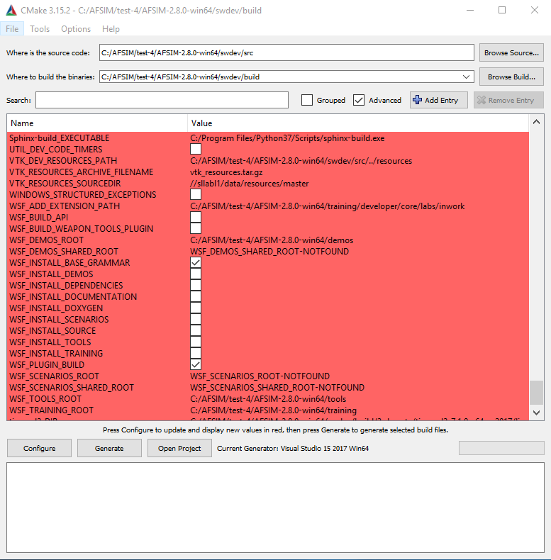
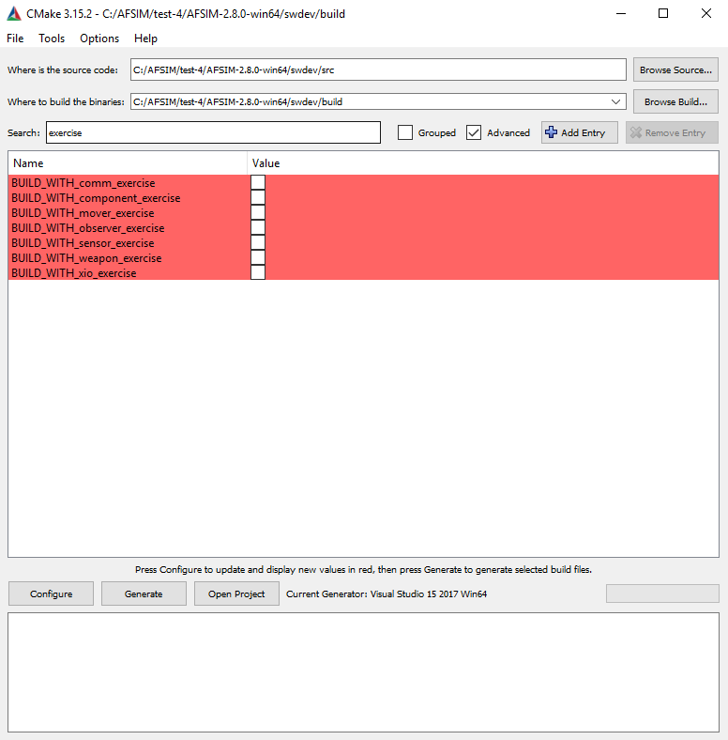
Building the Standard AFSIM Applications (6/8)
Inspect CMake options
WSF_PLUGIN_BUILD should be checked
WSF_ADD_EXTENSION_PATH should point to …/core/labs/inwork
At this point, the only build option that should be checked is BUILD_WITH_mission
Specifically, all training exercises should be unchecked
If you made any changes, Press “Configure” and then “Generate”
Notes:
WSF_ADD_EXTENSION_PATH is perhaps the most important cache variable for this training. It tells cmake to look for files in that directory called wsf_module. That tells cmake to build our plugins. For now, we are going to just build mission without any of our plugins, so all of our exercises should be unchecked to start with.
If CMake asks for a compiler, select a 64 bit version

Slide 32
Building the Standard AFSIM Applications (7/8)
Windows:
From Windows Explorer, Double-click on the “afsim.sln” solution file in “…/swdev/build/”
Alternatively, press “Open Project” button in CMake-GUI
From within Visual Studio, select the “Release” build from the pull-down menu at the top of the GUI
If you don’t do this, the default is to build in debug, which takes significantly longer to build, and truly significantly longer to execute
Build the solution in Visual Studio (this will take about 20-30 minutes)
Build->Build Solution (or F7 shortcut)
Build the INSTALL project
This will install the standard WSF application in a “bin” directory within …/build/wsf_install/bin (CMAKE_INSTALL_PREFIX)
Notes:
Make sure to select “Release”. It will build on “Debug” by default. Throughout this training, before building, always check to make sure you are building on “Release”.

Slide 33
Building the Standard AFSIM Applications (8/8)
Linux:
Use cmake-gui to ensure the CMAKE_BUILD_TYPE is correct
Ensure the variable CMAKE_BUILD_TYPE is set to ‘Release’ (Linux only)
If this variable is set to ‘debug’, cmake will build in debug, which takes significantly longer to build, and truly significantly longer to execute
Build the solution (this will take about 20-30 minutes):
From a Linux terminal (or xterm), execute the following in in the build directory (either "…/swdev/build/" or "…/afsim_dev/training/developer/build")
$ cmake –build . –target all -- -j12
Note: the –j12 option causes cmake to multi-thread the build with up to 12 simultaneous threads (the number used should be the same as the number of processors/cores in your system)
Build the ‘install’ target:
In the Linux terminal (or xterm), execute the following in the build directory
$ cmake –build . –target install -- -j12
This will install the standard WSF application in a “bin” directory within …/build/wsf_install/bin (CMAKE_INSTALL_PREFIX)

Slide 34
Notes on Building the AFSIM Training Exercises
If you want to build the exercises, you have two choices:
Run cmake-gui
Manually turn on the targets you want built,
Then click configure and generate
Modify the config.cmake file(s)
Edit the confg.cmake file in the core/labs or wkf/labs directory
Set the targets you want built to TRUE
Delete the CMakeCache.txt file in the build directory
Run the commands in the build slides (steps 1-8 of 8, slides 24-31)
Except, don’t execute the mkdir command for the build directory

Slide 36
AFSIM Developer Training
0 – Building AFSIM with CMake
Appendix
AFRL/RQQD
AFSIM Version 2.0

Slide 37
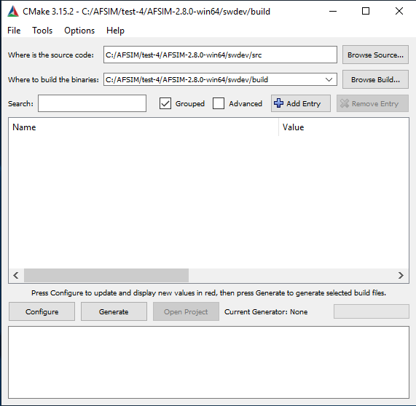
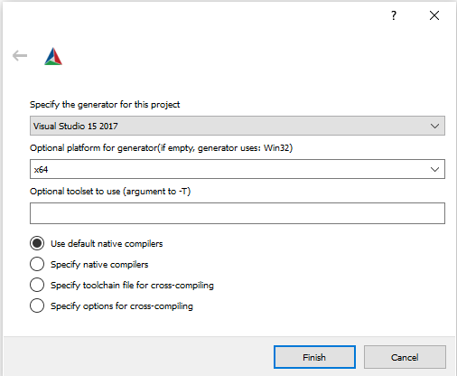
What If I Want To Build From Scratch … (1/5)
Run cmake-gui
Set the “Where is the source code” text box to the swdev/src directory
you can type in the path manually, or click on the “Browse Source …” button and navigate to the directory and click “Select Folder”
Set the “Where to build the binaries” text box to the swdev/build directory
you can type in the path manually, or click on the “Browse Build …” button and navigate to the directory and click “Select Folder”
Click on the Configure button (this will perform the initial configuration and build the cache file)
If you are asked to select a generator, select x64

Slide 38
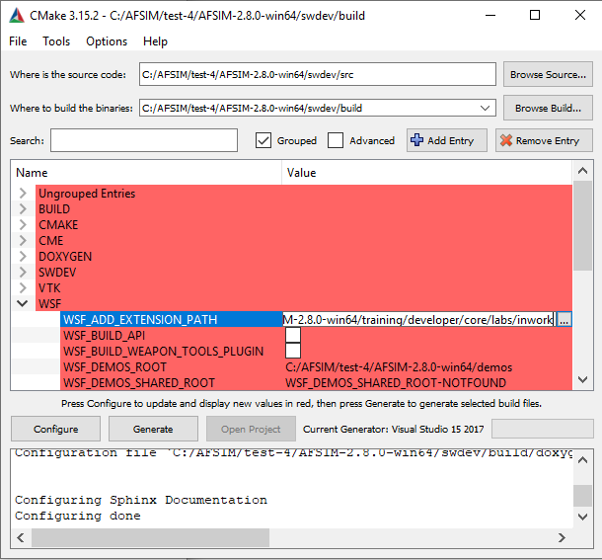
What If I Want To Build From Scratch … (2/5)
In the big white box below the search bar, navigate to the WSF group label and click the arrow “>” to the left of WSF
The first entry is WSF_ADD_EXTENSION_PATH. This variable has no value assocated with it. Click on the value column of this row, and enter the path to the training folders: “…/training/developer/core/labs/inwork”
Click on the Configure button (this will perform another configuration and rebuild the cache file – adding the exercise build variables into the configuration)

Slide 39
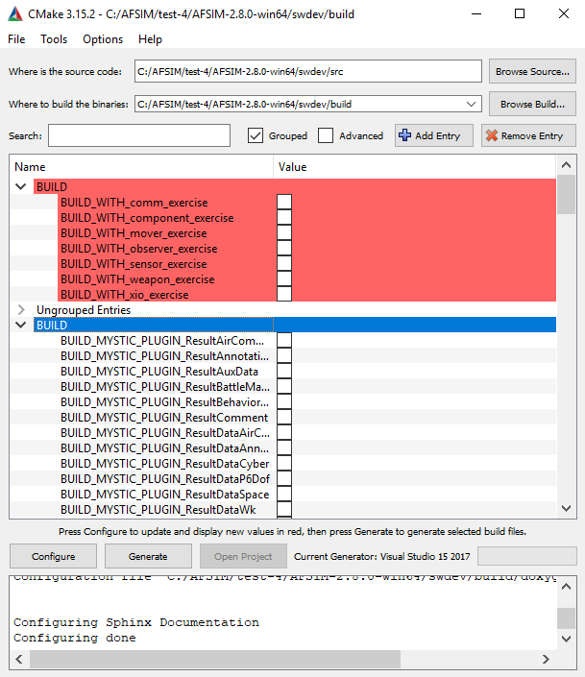
What If I Want To Build From Scratch … (3/5)
Click on the arrow “>” next to all of the BUILD group labels
There may be more than one
Manually check or uncheck all of the boxes for the build targets of interest
Click the Configure button again to set the final configuration
Click the Generate button to generate the build
Notes:
Note: unchecking the boxes manually will take a few minutes as there are approximately 175 checkboxes to uncheck

Slide 40
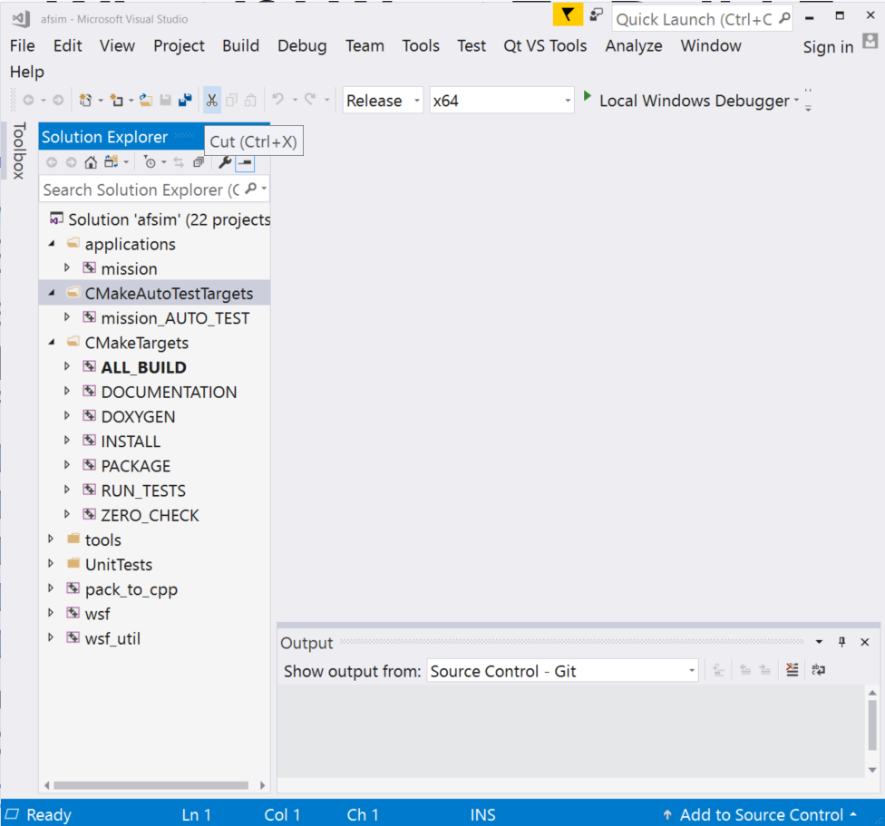
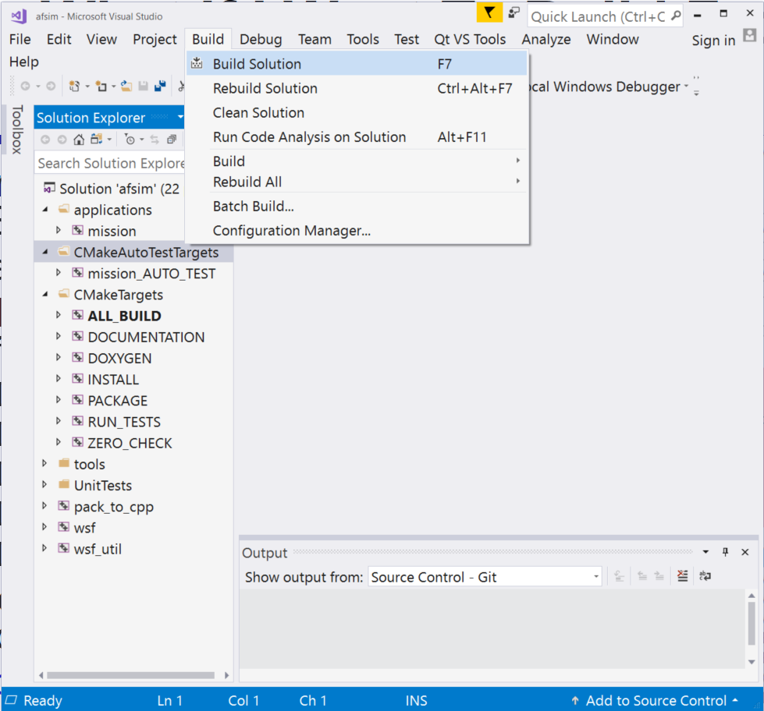
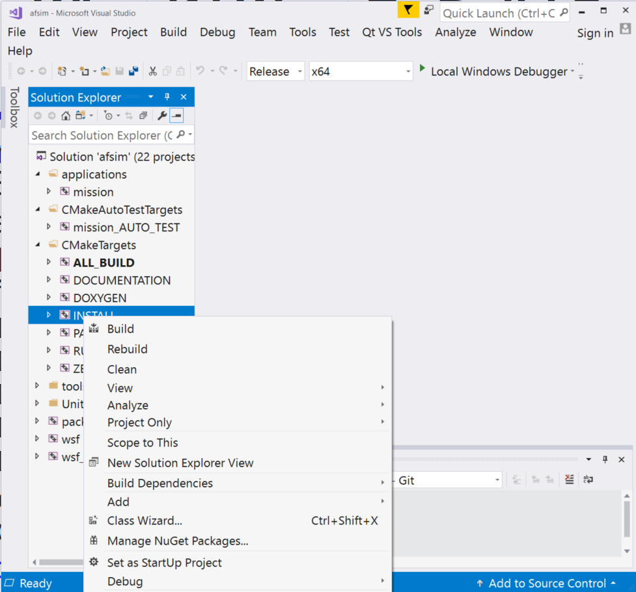
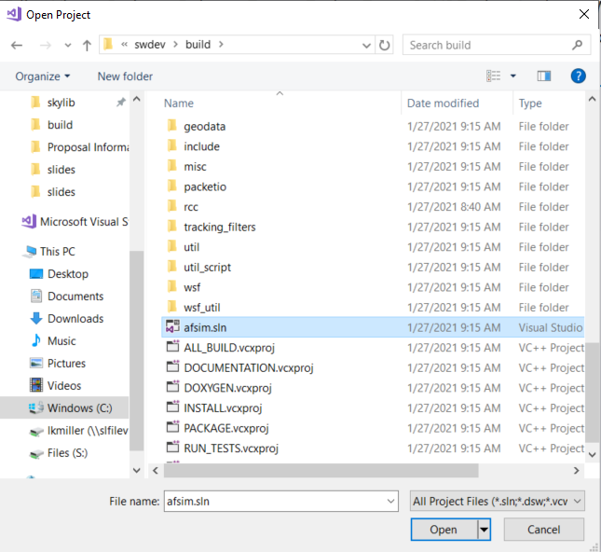
What If I Want To Build From Scratch … (4/5)
Compile the build:
In Windows:
run Visual Studio,
click File > Open > Project/Solution and in the dialog box, navigate to the directory build and double click on the file afsim.sln
Ensure the build is set to Release
Click on:
Build > Build Solution
Find the INSTALL target in the Solution Explorer, right click on INSTALL and select Build in the menu

Slide 41
What If I Want To Build From Scratch … (5/5)
Compile the build:
In a Linux terminal window:
cd into the swdev/build directory
Execute:
> cmake --build . --target all -- -j<n>,
where <n> is the number of processors in your system
Execute:
> cmake --build . --target install -- -j<n>,
where <n> is the number of processors in your system

