Slide 1
AFSIM Developer Training
4 – Sensors
AFRL/RQQD

Slide 2
Acronyms and Definitions
AFSIM - Advanced Framework for Simulation, Integration, and Modeling
AGL – Above Ground Level
DIS – Distributed Interactive Simulation
DTED – Digital Terrain Elevation Data
EO/IR – Electro-Optical/Infra-Red
ESM – Electronic Support Measure
FOV – Field Of View
GUI – Graphical User Interface
HLA – High Level Architecture
IEEE – Institute of Electrical & Electronics Engineers, Inc.
JTIDS – Joint Tactical Information Distribution System
MSL – Mean Sea Level
PDU – Protocol Data Unit
RCS – Radar Cross Section
SAM – Surface-to-Air Missile
SAR – Synthetic Aperture Radar
VESPA – Visual Environment for Scenario Preparation and Analysis
WKF – Warlock Framework
WSF – World Simulation Framework
dB - decibels
dBsm – decibel square meters
deg – degrees
ft – feet
GHz– GigaHertz
kts – knots
m - meters
m^2 – square meters
mw – megawatts
nm – nautical miles
s – seconds

Slide 3
Introduction
This lab demonstrates how to create a new AFSIM sensor
A sensor is an articulated platform part representing a sensing system
You will create a sensor requiring a tracker and a scheduler and will have multiple modes
The following exercise provides practice working with AFSIM sensors
Exercise 1: Understanding AFSIM Plugins and Extensions
Exercise 2: Creating a custom AFSIM sensor
Exercise 3: Creating a custom AFSIM sensor script interface

Slide 4
Problem Statement
Tricorders are fictional sensors used in the Star Trek television series
Create a new AFSIM sensor type called TRICORDER_SENSOR
The TRICORDER_SENSOR should:
Detect and track “Life Forms”
Identify specific types of Life Forms
Assess the health of each Life Form
References:
AFSIM Developers Web-based data.
AFSIM Source Codes and Visual Studio search functions.
AFSIM Documentation.

Slide 5
Learning Objectives
You gain hands-on knowledge about:
Creating an Application Extension
Necessary to support a new script type
Create a new type of sensor
Implementing an AttemptToDetect method for a single-moded passive sensor
Implementing an UpdateTrack method to set life form track data
Use of platform types and categories to identify life forms
Use of platform damage information as a health indicator
Creating and using a script class for the new sensor

Slide 6
Prerequisites
Before working on this lab, you should:
Be familiar with WIZARD and the AFSIM scripting Language
AFSIM analyst course or equivalent experience is recommended
Have available and be familiar with using Microsoft® Visual Studio 2017® or newer, to compile an application
Be familiar with using Microsoft Windows® Explorer
Have completed the Module “Building AFSIM with CMAKE”
Be familiar with using cmake-gui
Be familiar with executing cmake (if developing on Linux)
Note: you can perform these training exercises in Linux
but you will be much more on your own in terms of support, as many instructors are not familiar with Linux

Slide 7

Sensors in the AFSIM Framework
AFSIM includes a robust set of sensor options within the basic framework
Using the C++ architecture, developers can extend classes to create new sensors or new sensor behaviors
AFSIM Framework
Infrastructure
Interface
Scenario Management
Time Management
Time Management
Geospatial Data Management
Event Management
Utilities
Geospatial Data Management
Scripting
Language
Distributed Simulation Interfaces
Scenario Management
Script
Distributed Simulation Interfaces
Event Management
Plug-in
Management
Observers
Extensions
Simulation Management
Observers
Extensions
Components
Platform Components
Movers
Sensors
Weapons
Communications
Processors
Other Platform
Components
Non-Platform
Components
Sensor
Components
Weapon
Components
Comm
Components
Processor
Components
$$…$$

Slide 8
Sensors
A ‘sensor’ is an articulated part that detects something in the operational environment.
The basic AFSIM Class structure for WsfSensor is depicted below.
Notes:
A sensor has only one modelist. A sensor mode is associated with only one sensor. A sensor may have many modes, however.
A sensor has one scheduler and one tracker. It’s a one-to-one relationship for both of those.

Slide 9
Sensor Measurements and Tracks
Sensor Scheduler Object Controls Production of Measurements from Sensors
Standard implementation: measurements as sensing chances within the sensor’s frame time
Another implementation: predictive sensing chances in a pseudo-scan
Sensor Tracker Object for Non-Imaging Sensors
Standard Implementation: new measurements perfectly associated; “M-out-of-N” formation
Another implementation: leverage existing track-to-track algorithms
Image / Video Processor for Imaging Sensors
Converts AFSIM pseudo sensor images to tracks
Measurements
Tracks
Sensors
Track
Messages
Track
Processor
Sensor
Scheduler
Sensor
Tracker
Track
Messages
Image/Video
Processor
Image /
Video
Messages
Signatures
Aux Data
Notes:
9

Slide 10
Track Manager
The Track Manager is Always Available on Platforms and is Responsible for
Maintaining a track list of “local” tracks (WsfLocalTrack)
Maintaining a track list of contributing “raw” tracks (WsfTrack)
Controlling track–to-track association and fusion
Association and fusion are implemented as interchangeable “strategies” for ease of integration
Controlling track purging
Providing notifications of tracking events
Acting as a “filter center”
Track
Producers
(Sensors,
Other TMs,
Platform
Tracks,
Etc)
.
Track Manager
Fuseable Raw Tracks
(Filtered, Unfiltered, Processed)
(Associate, Fuse)
Track Association
Subscribe to Tracking
Events
Local Track List
Interested
Parties
Fuseable Raw Tracks
(Unfiltered, TM as Filter Center)
(Filter, Associate, Fuse)
Raw Track List
Track Fusion
Publish Tracking Events
Non-Fuseable Raw Tracks
(Predfined)
(N/A-[copy only])
Notes:
Track Status Indications:
cNONE, //!< There is no change, or the code is invalid.
cCREATED, //!< A local track has been created.
cUPDATED, //!< A local track has been updated.
cDROPPED, //!< A local track has been dropped.
cCORRELATED, //!< A local track has been correlated.
cDECORRELATED, //!< A local track has been decorrelated.
cCANDIDATE_TRACK_PROMOTED, //!< A "candidate" local track has been promoted to a full local track.
cRAW_TRACK_DROPPED, //!< A raw track has been dropped.
cRAW_TRACK_RECEIVED, //!< An unprocessed raw track was received.
cCURRENT_TARGET_CHANGED //!< The current target has changed.

Slide 11
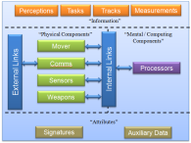
Track Processor Functions
Populate the Track Manager’s Track Lists
Off-board tracks from other platforms
On-board sensor tracks
Purge Tracks
Tracks “dropped” if no update in a specified Interval
Report Tracks
Utilizes publish / subscribe service with Track Manager
Reporting options include
Batch reporting
Cyclic reporting
All tracks or only changed tracks communicated
Track Messages
Sensors
Track
Manager
Add Tracks
Track
Processor
Purge
Subscribe to Tracking Events
Publish Tracking Events
Other Platforms
Comms
Track Messages
11

Slide 12
Track Manager Tracking “Strategies”
Track Association Strategies:
Perfect
Raw tracks are associated with the truth target
Nearest Neighbor
Raw tracks are associated with another track if distance between two locations “reasonably” close in terms of covariance matrix sigmas
Cluster
Build up track associations using a clustering algorithm with covariance matrix sigmas as the discriminator for cluster membership
Truth
Useful in distributed scenarios, this algorithm matches track location to nearest truth location, if “reasonably” close
Track Manager
Local Track List
Track Association
Raw Track List
Track Fusion
Notes:
Track Status Indications:
cNONE, //!< There is no change, or the code is invalid.
cCREATED, //!< A local track has been created.
cUPDATED, //!< A local track has been updated.
cDROPPED, //!< A local track has been dropped.
cCORRELATED, //!< A local track has been correlated.
cDECORRELATED, //!< A local track has been decorrelated.
cCANDIDATE_TRACK_PROMOTED, //!< A "candidate" local track has been promoted to a full local track.
cRAW_TRACK_DROPPED, //!< A raw track has been dropped.
cRAW_TRACK_RECEIVED, //!< An unprocessed raw track was received.
cCURRENT_TARGET_CHANGED //!< The current target has changed.

Slide 13
Track Manager Tracking “Strategies”
Track Fusion Strategies:
Native / “Default”
Replacement or covariance-based weighted-average
Focused on kinematic fusion
Multi-Target Tracking (MTT; from Suppressor)
See Suppressor documentation for algorithms
Categorical Data Fusion is Common and Follows Simple Rules (But May Soon Change)
Side, Type simply copied
IFF Merged according to simple hard-code rules
Aux Data are merged / replaced
Track Manager
Local Track List
Track Association
Raw Track List
Track Fusion
Notes:
Track Status Indications:
cNONE, //!< There is no change, or the code is invalid.
cCREATED, //!< A local track has been created.
cUPDATED, //!< A local track has been updated.
cDROPPED, //!< A local track has been dropped.
cCORRELATED, //!< A local track has been correlated.
cDECORRELATED, //!< A local track has been decorrelated.
cCANDIDATE_TRACK_PROMOTED, //!< A "candidate" local track has been promoted to a full local track.
cRAW_TRACK_DROPPED, //!< A raw track has been dropped.
cRAW_TRACK_RECEIVED, //!< An unprocessed raw track was received.
cCURRENT_TARGET_CHANGED //!< The current target has changed.

Slide 14
Sensor Exercise Extends WsfSensor Class
WsfComponent
WsfObject
WsfComponent<WsfPlatform>
WsfUniqueId
WsfPlatformPart
WsfSinglePlatformObserver
WsfArticulatedPart
You will add a new TricorderSensor class to AFSIM.
WsfSensor
WsfAcousticSensor
TricorderSensor
WsfBeamDirector
WsfCompositeSensor
WsfEOIR_Sensor
WsfEW_Sensor
WsfGeometricSensor
WsfHumanEyeSensor
WsfIRST_Sensor
WsfLADAR_Sensor
WsfNullSensor
WsfOpticalSensor
WsfPassiveSensor
WsfRadarSensor

Slide 15
TricorderMode Extends WsfSensorMode
WsfNamed
WsfMover
WsfMode
WsfMoverMode
WsfSensorMode
WsfWeapon::WeaponMode
WsfRotorCraftMover::RotorCraftMode
WsfAcousticSensor::AcousticMode
TricorderMode
WsfCompositeSensor::CompositeMode
WsfEOIR_IRST_SensorMode
You will add a new TricorderMode to AFSIM.
WsfESM_Sensor::ESM_Mode
WsfEW_SensorMode
WsfGeometricSensor::GeometricMode
WsfLADAR_Sensor::LADAR_Mode
WsfOpticalSensor::OpticalMode
WsfPassiveSensor::PassiveMode
WsfRadarSensor::RadarMode

Slide 16
Tricorder Detections
A TRICORDER_SENSOR detects Life Forms and reports the “type” of life form being detected
Detections based on inspection of user-defined target attributes
Nominal effects only
Not Physics-based
No signature tables or environmental processes
TRICORDER_SENSOR will use platform categories and platform type definitions as criteria for making detections. For this exercise:
Declare detection if platform has type of LIFE_FORM
Declare detection if platform is in category called klingon_life_form
Uses LIFE_FORM_REPORTED_TYPE for reported type in track

Slide 17
Sensor Scenario (1/2)
The input file defines five different platform types
The GROUND_FORCE_VEHICLE, LIFE_FORM, and KLINGON entries are all of type WSF_PLATFORM
The GROUND_FORCE_VEHICLE platform type is the only non-life form player in the scenario. Only the 'icon' attribute is set
The ROMULAN and VULCAN entries are derived from the LIFE_FORM platform type
The KLINGON platform type uses a platform category called klingon_life_form instead of deriving from the LIFE_FORM platform type to denote a life form
The ROMULAN, KLINGON, and VULCAN platform types use auxiliary data to identify a specific type of life form
All platforms are stationary for simplicity; none has a mover defined
Four players get created at different locations and with initial damage factors. A platform's damage factor varies from [0 .. 1]. A value of 0 indicates no damage while a value of 1 indicates the platform is 'dead'.
The platform Spock, the VULCAN, has a sensor of type TRICORDER_SENSOR. This device:
Is turned on and has two modes defined
Reports the type of life form it is tracking
Can detect life forms of type LIFE_FORM and category klingon_life_form

Slide 18
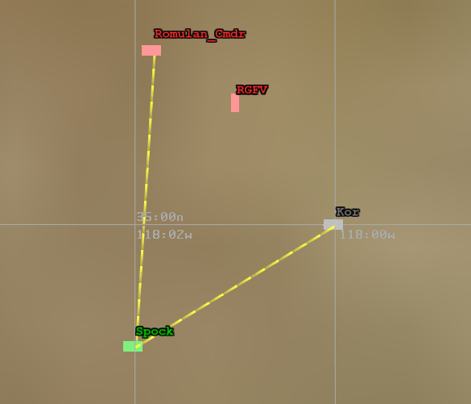
Sensor Scenario (2/2)
Two script observer methods are used to capture the SENSOR_TRACK_INITIATED and the SENSOR_TURNED_ON events. The information is sent to standard output (STDOUT)
Event data for the SENSOR_TRACK_INITIATED and the SENSOR_TURNED_ON events is also captured in the sensor_scenario.evt file
The end_time is set for 10 simulated minutes
An output file called sensor_scenario.aer captures the output from the scenario for viewing with Mystic

Slide 19
New Input Parameters
Code modifications are needed to accept:
Sensor type of TRICORDER_SENSOR and
Keyword life_form_type with an input value
Existing AFSIM methods will be used to set input values on platforms:
platform_type of LIFE_FORM
platform category of klingon_life_form
Example scenario input:
platform Spock VULCAN
add sensor tricorder TRICORDER_SENSOR
mode KLINGON
frame_time 2 s
reports_type
life_form_type klingon_life_form
end_mode
mode ALL_LIFE_FORMS
frame_time 1 s
reports_type
life_form_type LIFE_FORM
life_form_type klingon_life_form
end_mode
end_sensor
end_platform

Slide 20
Platform Detections
TRICORDER_SENSOR will detect the platform if it has a life_form_type that matches a target platform:
Type (e.g. LIFE_FORM) used to derive a platform
Category (e.g. category klingon_life_form) used to define a platform
Example input:
platform_type LIFE_FORM WSF_PLATFORM
icon human
end_platform_type
platform_type ROMULAN LIFE_FORM // Uses the LIFE_FORM type
side red
end_platform_type
platform_type KLINGON WSF_PLATFORM
icon human
side magenta
category klingon_life_form // Uses a category to denote a life form
end_platform_type

Slide 21
TricorderSensor Script Methods
In file “sensor_scenario.txt” there is a script that invokes new script methods (which we will have to define) for our new TricorderSensor
Note that these two methods utilize a new TricorderSensor script type (which we will have to create)
// Scripts used by the script observer
// These need to be defined before the script observer block
script void SensorTrackInitiated(WsfPlatform aPlatform,
WsfSensor aSensor,
WsfTrack aTrack)
writeln("*** T=", TIME_NOW, " ", aPlatform.Name(),
" has initiated a track on a ", aTrack.Type(),
" with a health of ", (aTrack.TrackQuality() * 100.0), " %");
writeln(" Mode: ", aSensor.CurrentMode());
int lifeFormCount = ((TricorderSensor)aSensor).LifeFormTypeCount();
for (int i = 0; i < lifeFormCount; i = i + 1)
{
std::string lifeFormTypeStr =((TricorderSensor)aSensor).LifeFormTypeEntry(i);
writeln(" Life Form Type: ", lifeFormTypeStr);
}
end_script

Slide 22
Getting Started (1/3)
Open CMake GUI
Ensure BUILD_WITH_mission is checked
Check it if it is not checked
Check BUILD_WITH_sensor_exercise
Press “Configure”
(Respond to any prompts asking for a compiler)
Press “Generate”

Slide 23
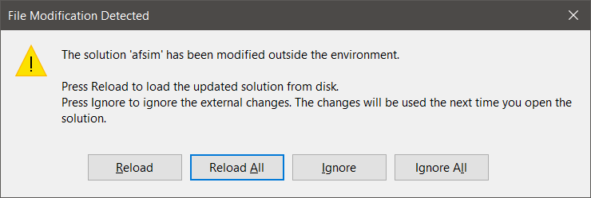
Getting Started (2/3)
If Visual Studio is already open:
Navigate to it and select Reload All when prompted.
Alternatively, open the solution file “afsim.sln” by:
Opening from “swdev\build”
Clicking “Open Project” from CMake

Slide 24
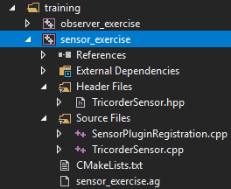
Getting Started (3/3)
This project uses the following source files:
SensorPluginRegistration.cpp
TricorderSensor.hpp
TricorderSensor.cpp
Note that many solutions are possible; we have provided a solution in order to complete our training exercise in a short time period.

Slide 25
Classes Utilized by this Exercise
This exercise utilizes the following classes:
class TricorderSensor : public WsfSensor
Creates a new type of sensor named TricorderSensor
Maintains a list (vector) of TricorderMode(s)
class TricorderMode : public WsfSensorMode
Creates a new sensor mode named TricorderMode
Maintains a list of known lifeform types
class ScriptTricorderSensorClass : public WsfScriptSensorClass
Declares and Defines the new script methods which will be available to the scenario definition
class TricorderSensorRegistration : public WsfApplicationExtension
This class is registered with the Standard Application as an Application extension
Overrides AddedToApplication, which registers the new script types class with the standard application (after the extension has been registered)
Overrides the ScenarioCreated which adds the TricorderSensor as a new sensor type (after the scenario has been created by mission/warlock)

Slide 26
Sensor Exercises
Exercise 1:
Understand how AFSIM Extensions and Plugins are integrated with AFSIM to extend existing behavior and create new functionality for mission
Exercise 2:
Implement parts of the main tricorder sensor classes (TricorderSensor and TricorderMode)
Exercise 3:
Implement parts of the related script classes that provide access to the tricorder classes from the script interface

Slide 27
Sensor Exercise 1
This exercise focuses on understanding how AFSIM Extensions and Plugins are created and registered with AFSIM
Overview of AFSIM Extensions and Plugins
Implement part of the TricorderSensorRegistration class
Understand what happens when an Application Extension is added to AFSIM

Slide 28
AFSIM Plugins & Extensions
WsfExtension
WsfScenario
WsfSimulation
WsfApplication
WsfStandardApplication
WsfSimulationExtension
WsfScenarioExtension
WsfApplicationExtension
Main application classes used
in mission/warlock
All AFSIM extensions must derive from WsfExtension:
Three predefined extension classes already exist (can be inherited from)
WsfScenarioExtension – extensions that will provide new scenario commands (requiring a new ProcessInput for those commands) will need to inherit this class
WsfSimulationExtension – extensions that will access the simulation will need to inherit this class
WsfApplicationExtension – extensions that will create new script types, or will utilize a simulation extension or scenario extension, will need to inherit this class

Slide 29
AFSIM Plugins & Extensions
WsfExtension
WsfScenario
WsfSimulation
WsfApplication
WsfStandardApplication
WsfSimulationExtension
WsfScenarioExtension
WsfApplicationExtension
Main application classes used
in mission/warlock
TricorderSensorRegistration
Sets up the new Application Extension
classes to work with AFSIM
All AFSIM extensions must derive from WsfExtension:
Three predefined extension classes already exist (can be inherited from)
WsfScenarioExtension – extensions that will provide new scenario commands (requiring a new ProcessInput for those commands) will need to inherit this class
WsfSimulationExtension – extensions that will access the simulation will need to inherit this class
WsfApplicationExtension – extensions that will create new script types, or will utilize a simulation extension or scenario extension, will need to inherit this class

Slide 30
Application Extensions & Plugins
What is the purpose of a Plugin in AFSIM?
A Plugin is a external library that can be loaded into memory at run time
The main purpose of plugins is to support the creation of AFSIM extensions
Application extensions (which inherit WsfApplicationExtension)
Scenario extensions (which inherit WsfScenarioExtension)
Simulation extensions (which inherit WsfSimulationExtension)
Where are the Application Extensions located?
Application Extensions can be located almost anywhere
cmake searches a set of predefined locations for “standard” Application Extensions
cmake can be configured with other places to look for Application Extensions
ex., cmake … -DWSF_ADD_EXTENSION_PATH=<path to extension> …

Slide 31
Application Extensions & Plugins
AFSIM extensions are compiled into external dynamic link librarys (DLLs), or plugins
How does the Application Extension get registered with the Standard Application?
Every plugin must have a function named WsfPluginSetup
This function is executed right after the plugin is loaded into memory, and linked with AFSIM
The prototype for WsfPluginSetup is:
void WsfPluginSetup(WsfApplication& aApplicationPtr);
Each definition of WsfPluginSetup should:
create the Application Extension object for that library plugin, and
Invoke: aApplicationPtr->RegisterExtension( … )

Slide 32
Application Extensions & Plugins
How does AFSIM locate the plugins and load the extensions?
Using a plugin manager (WsfPluginManager, UtPluginManager), AFSIM:
searches the predefined set of locations for dynamic library files (a .lib DLL in windows, a .so file in Linux)
For each of these library files, AFSIM:
Loads the library into memory
once loaded, AFSIM invokes WsfPluginSetup in that library

Slide 33
Sensor Exercise 1 — Review 1
Inspect SensorPluginRegistration.cpp
Review and understand WsfPluginSetup
SENSOR_EXERCISE_EXPORT void WsfPluginSetup(WsfApplication& aApplicationPtr)
{
aApplicationPtr.RegisterExtension("tricorder_sensor_registration",
ut::make_unique<TricorderSensorRegistration>());
}

Slide 34
Extensions
Applications, Scenarios, and Simulations can all be “Extended”
Application Extensions are owned by the Application
Represent optional capabilities that can be added to an application.
Used if you need new script types (sensors, weapons, components, movers)
This is the entry point to registering all extensions in AFSIM
An application extension is required if you are going to create a scenario extension or a simulation extension (covered in future exercises)

Slide 35
Application Extensions
To extend an Application, you must create a class that inherits class WsfApplicationExtension
class myAppExtension: public WsfApplicationExtension { … }
These members can be overridden, if you need them in the extension:
AddedToApplication: to receive notification that extension was added to the application – often used to register additional script class and methods, etc.
ScenarioCreated: called at end of Scenario constructor in order to receive notification from the application that the scenario was created – useful to register an Scenario extension if needed
SimulationCreated: called from the Simulation’s Initialize method in order to receive notification from the application that the simulation was created – useful to register a Simulation extension if needed
ProcessCommandLine: called from WsfApplication::ProcessCommandLine method to examine the current command line argument and process it if necessary
PrintGrammar: prints out the extended grammar recognized by the extension
ProcessCommandLineCommands: called by WsfApplication::ProcessCommandLineCommands to allow the extension to process/handle any commands it needs to recognize

Slide 36
Application Extensions
We will create an Application Extension called TricorderSensorRegistration which will register some new scripts
class TricorderSensorRegistration: public WsfApplicationExtension { … }
This class will override the following members:
AddedToApplication: to receive notification that extension was added to the application – will be used to register the class ScriptTricorderSensorClass along with a number of script methods.
ScenarioCreated: called at end of Scenario constructor in order to receive notification from the application that the scenario was created – useful to register an Scenario extension if needed – will be used to register the TricorderSensor class with the scenario as a new type of sensor

Slide 37
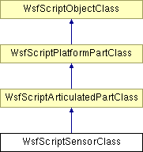
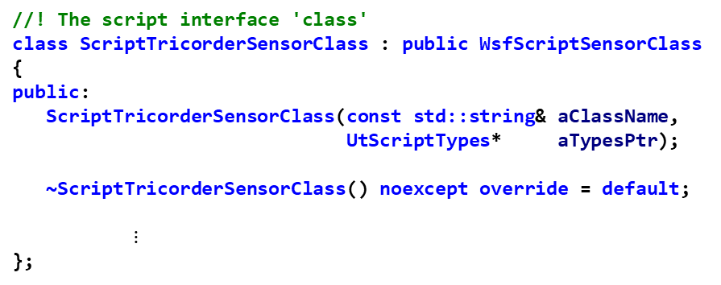
Sensor Exercise 1 — Review 2
Inspect the file TricorderSensor.hpp to become familiar with the class methods and attributes of the ScriptTricorderSensorClass class that is defined at the bottom of the file (we will add “stuff” to this class in Exercise 3)
Notice the new script sensor class ScriptTricorderSensorClass has been sub-classed from WsfScriptSensorClass (which is derived from UtScriptTypes)
Notice the constructor takes two parameters: the class name (a string) and a pointer to UtScriptTypes (which maintains a list of all the script type classes)
UtScriptTypes
//! The script interface 'class'
class ScriptTricorderSensorClass : public WsfScriptSensorClass
{
public:
ScriptTricorderSensorClass(const std::string& aClassName,
UtScriptTypes* aTypesPtr);
~ScriptTricorderSensorClass() noexcept override = default;
$⋮$
};
ScriptTricorderSensorClass

Slide 38
Sensor Exercise 1 — Task 1
In file SensorPluginRegistration.cpp:
Complete TricorderSensorRegistration::AddedToApplication()
Task 1: Register the new script class ScriptTricorderSensorClass with the UtScriptTypes class, which maintains a list of script classes derived from UtScriptTypes
Use the WsfApplication parameter object aApplication to add/register the class ScriptTricorderSensorClass to the list of script classes maintained in the UtScriptTypes list
Part 1: Invoke aApplication.GetScriptTypes() to get a pointer to the UtScriptTypes list, which is maintained in the WsfApplication class
Part 2: Using this UtScriptTypes pointer, invoke the Register() method:
UtScriptTypes::Register() takes a single input argument:
a unique_ptr to a class derived from UtScriptTypes (specifically our ScriptTricorderSensorClass class)
Note: when creating the unique_ptr<ScriptTricorderSensorClass> object, the constructor ScriptTricorderSensorClass(string, UtScriptTypes *) is invoked
You will need to pass in the name of the class (“TricorderSensor”) and a UtScriptTypes pointer, which can be obtained by invoking GetApplication()->GetScriptTypes()

Slide 39
Sensor Exercise 1 — Task 1 Solution SensorPluginRegistration.cpp
class TricorderSensorRegistration : public WsfApplicationExtension
{
public:
TricorderSensorRegistration() = default;
~TricorderSensorRegistration() noexcept override = default;
void AddedToApplication(WsfApplication& aApplication) override
{
// EXERCISE 1 TASK 1
// Use the application object parameter to add the script tricorder class
// to the script types
// Call the script class "TricorderSensor"
aApplication.GetScriptTypes()->Register(ut::make_unique<ScriptTricorderSensorClass>
("TricorderSensor", GetApplication().GetScriptTypes()));
}
void ScenarioCreated(WsfScenario& aScenario) override
{
// EXERCISE 1 TASK 2
// Use the scenario object parameter to add the TricorderSensor class to the
// list of sensor types
// Name the new sensor type "TRICORDER_SENSOR"
}
};

Slide 40
Sensor Exercise 1 — Task 2
In file SensorPluginRegistration.cpp:
Complete TricorderSensorRegistration::ScenarioCreated()
Task 2: Add the class TricorderSensor to the list of WsfSensorTypes maintained in the scenario
The WsfScenario class (the aScenario object) maintains a list of classes that implement sensor types, i.e., are derived from WsfSensor
Part1: Use the WsfScenario object aScenario to get the sensor types list by invoking: WsfSensorTypes::Get(aScenario)
Get() is a static method that does not require an object for invocation, and returns the WsfSensorTypes list stored in the aScenario object
Part2: On the WsfSensorTypes object returned, invoke the add() method
The add() method takes two arguments:
The name of the new sensor type: “TRICORDER_SENSOR”
A unique pointer to the sensor type class: unique_ptr<TricorderSensor>
Remember, creating the unique pointer invokes the TricorderSensor class constructor, which requires the scenario object aScenario as its argument

Slide 41
Sensor Exercise 1 — Task 2 Solution SensorPluginRegistration.cpp
class TricorderSensorRegistration : public WsfApplicationExtension
{
public:
TricorderSensorRegistration() = default;
~TricorderSensorRegistration() noexcept override = default;
void AddedToApplication(WsfApplication& aApplication) override
{
// EXERCISE 1 TASK 1
// Use the application object parameter to add the script tricorder class to the script types
// Call the script class "TricorderSensor"
aApplication.GetScriptTypes()->Register(ut::make_unique<ScriptTricorderSensorClass>
("TricorderSensor", GetApplication().GetScriptTypes()));
}
void ScenarioCreated(WsfScenario& aScenario) override
{
// EXERCISE 1 TASK 2
// Use the scenario object parameter to add the TricorderSensor class to the
// list of sensor types
// Name the new sensor type "TRICORDER_SENSOR“
WsfSensorTypes::Get(aScenario).Add("TRICORDER_SENSOR",
ut::make_unique<TricorderSensor>(aScenario));
}
};

Slide 42
AFSIM Plugins & Extensions AFSIM mission startup sequence
What happens when we create an Application Extension?
When and how do the plugin methods get invoked?
When do the WsfApplicationExtension methods get invoked?
When and how do the ProcessInput() and Initialize() methods get invoked?

Slide 43
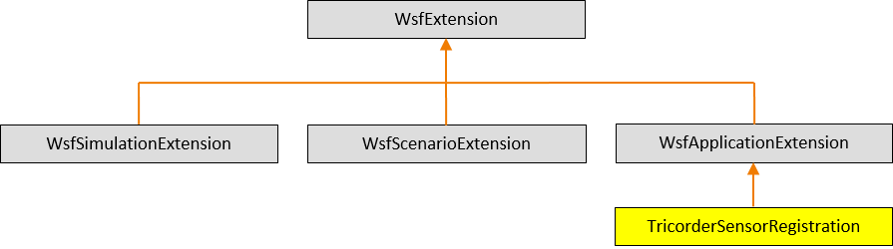
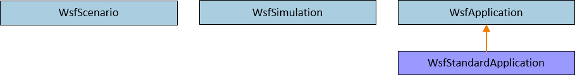
AFSIM Plugins & Extensions AFSIM mission startup sequence
First, mission creates a WsfStandardApplication named app
mission::main()
unique_ptr<TricorderSensorRegistration>
WsfStandardApplication: app
WsfStandardApplication::WsfStandardApplication()
SensorPluginRegistration.cpp:WsfPluginSetup()
WsfPluginSetup()
RegisterExtension(“tricorder_sensor_registration”, ut::make_unique<TricorderSensorRegistration>())
AddedToApplication()
The WsfStandardApplication constructor utilizes the plugin manager to find and load all plugins (including those in the training folders - because of the cmake option WSF_ADD_EXTENSION_PATH)
For each plugin found, executes WsfPluginSetup (note: this causes our sensor exercise plugin’s WsfPluginSetup function to execute)
This causes our sensor exercise’s TricorderSensorRegistration class, which is an Application Extension, to be created and registered with app
RegisterExtension then invokes WsfApplicationExtension::AddedToApplication(), which is overridden by TricorderSensorRegistration::AddedToApplication()
AddedToApplication() registers “TricorderSensor” as a new script type class

Slide 44

AFSIM Plugins & Extensions AFSIM mission startup sequence
mission::main()
unique_ptr<TricorderSensorRegistration>
WsfStandardApplication: app
RegisterExtension(…)
RegisterExtension(…)
$$⋮$$
RegisterExtension(…)
Mission then registers all of the necessary predefined extensions with app

Slide 45
AFSIM Plugins & Extensions AFSIM mission startup sequence
mission::main()
unique_ptr<TricorderSensorRegistration>
WsfScenario: scenario
WsfStandardApplication: app
WsfScenario::WsfScenario(app)
ScenarioCreated(…)
ScenarioCreated(…)
Mission then creates the scenario and invokes the WsfScenario constructor: WsfScenario scenario(app);
This constructor invokes the WsfApplication::ScenarioCreated() method
This, in turn, invokes ScenarioCreated() for all registered application extensions (including our TricorderRegistration extension)
TricorderRegistration::ScenarioCreated() creates and adds the TRICORDER_SENSOR type to the list of sensor types, so that they can have their ProcessInput() methods invoked when TRICORDER_SENSOR commands are found in the scenario files

Slide 46
AFSIM Plugins & Extensions AFSIM mission startup sequence
mission::main()
TricorderSensor
unique_ptr<TricorderSensorRegistration>
WsfScenario: scenario
WsfStandardApplication: app
WsfStandardApplication::ProcessInputFiles()
TricorderSensor::ProcessInput(…)
WsfScenario::LoadFromFile(…)
TricorderSensor::TricorderMode::ProcessInput(…)
ProcessInput(…)
Mission invokes app.WsfStandardApplication::ProcessInputFiles()
which invokes WsfScenario::LoadFromFile()
For each command in input,
Invoke each of the core classes’ ProcessInput() methods
Invokes the TricorderSensor::ProcessInput() to handle TricorderSensor commands (there are none)
Invokes the TricorderMode::ProcessInput() to handle mode commands
Invoke each registered scenario extension’s ProcessInput() – has no effect since there is no ProcessInput defined in the TricorderRegistration class
Note: a TricorderSensor object is created when a TricorderSensor block command is encountered in the scenario input files

Slide 47
AFSIM Plugins & Extensions AFSIM mission startup sequence
mission::main()
unique_ptr<TricorderSensorRegistration>
WsfScenario: scenario
WsfStandardApplication: app
WsfStandardApplication::ProcessInputFiles()
Complete(…)
WsfScenario::CompleteLoad(…)
Complete2(…)
Mission invokes app.WsfStandardApplication::ProcessInputFiles()
which, invokes WsfScenario::LoadFromFile()
and then invokes WsfScenario::CompleteLoad()
Invokes each scenario extension’s Complete()
Then invokes each scenario extension’s Complete2()
Note: None of our classes inherit WsfScenarioExtension, so no Complete or Complete2 are defined that need to be called

Slide 48
AFSIM Plugins & Extensions AFSIM mission startup sequence
mission::main()
unique_ptr<TricorderSensorRegistration>
WsfScenario: scenario
unique_ptr<WsfSimulation>: simPtr
WsfStandardApplication: app
WsfStandardApplication::CreateSimulation()
WsfSimulation::WsfSimulation()
Mission creates the Simulation by executing:
std::unique_ptr<WsfSimulation> simPtr =
app.CreateSimulation(scenario, …);
CreateSimulation invokes the WsfSimulation object’s constructor (with scenario as argument)

Slide 49
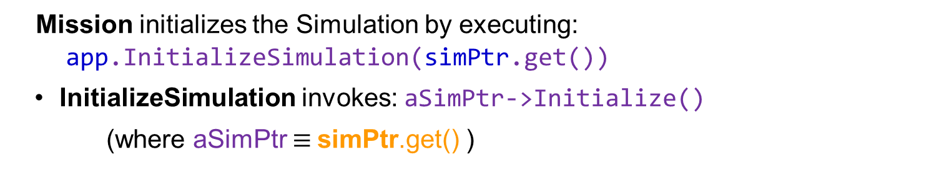
AFSIM Plugins & Extensions AFSIM mission startup sequence
mission::main()
unique_ptr<TricorderSensorRegistration>
WsfScenario: scenario
unique_ptr<WsfSimulation>: SimPtr
WsfStandardApplication: app
WsfStandardApplication::InitializeSimulation()
WsfSimulation::Initialize()
Mission initializes the Simulation by executing:
app.InitializeSimulation(simPtr.get())
InitializeSimulation invokes: aSimPtr->Initialize()
(where aSimPtr $≡$simPtr.get() )

Slide 50
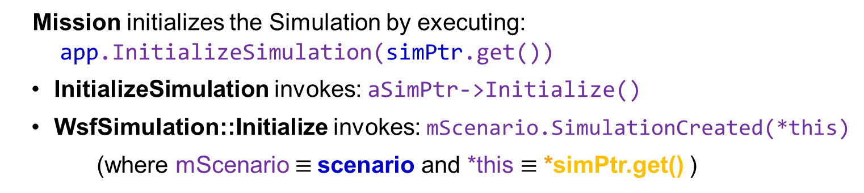
AFSIM Plugins & Extensions AFSIM mission startup sequence
mission::main()
unique_ptr<TricorderSensorRegistration>
WsfScenario: scenario
unique_ptr<WsfSimulation>: SimPtr
WsfStandardApplication: app
WsfStandardApplication::InitializeSimulation()
WsfScenario::SimulationCreated()
WsfSimulation::Initialize()
Mission initializes the Simulation by executing:
app.InitializeSimulation(simPtr.get())
InitializeSimulation invokes: aSimPtr->Initialize()
WsfSimulation::Initialize invokes: mScenario.SimulationCreated(*this)
(where mScenario $≡$scenario and *this $≡$ *simPtr.get() )

Slide 51
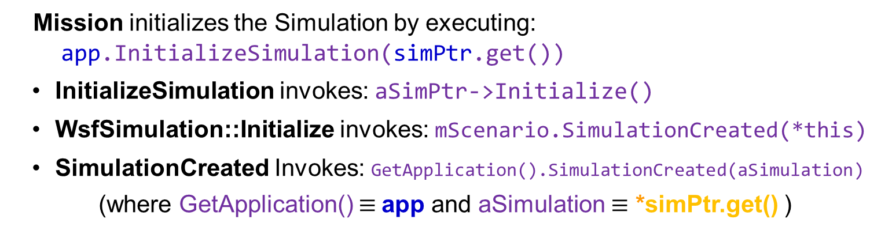
AFSIM Plugins & Extensions AFSIM mission startup sequence
mission::main()
unique_ptr<TricorderSensorRegistration>
WsfScenario: scenario
unique_ptr<WsfSimulation>: SimPtr
WsfStandardApplication: app
WsfStandardApplication::InitializeSimulation()
WsfScenario::SimulationCreated()
WsfSimulation::Initialize()
WsfApplication::SimulationCreated()
Mission initializes the Simulation by executing:
app.InitializeSimulation(simPtr.get())
InitializeSimulation invokes: aSimPtr->Initialize()
WsfSimulation::Initialize invokes: mScenario.SimulationCreated(*this)
SimulationCreated Invokes: GetApplication().SimulationCreated(aSimulation)
(where GetApplication() $≡$app and aSimulation $≡$ *simPtr.get() )

Slide 52
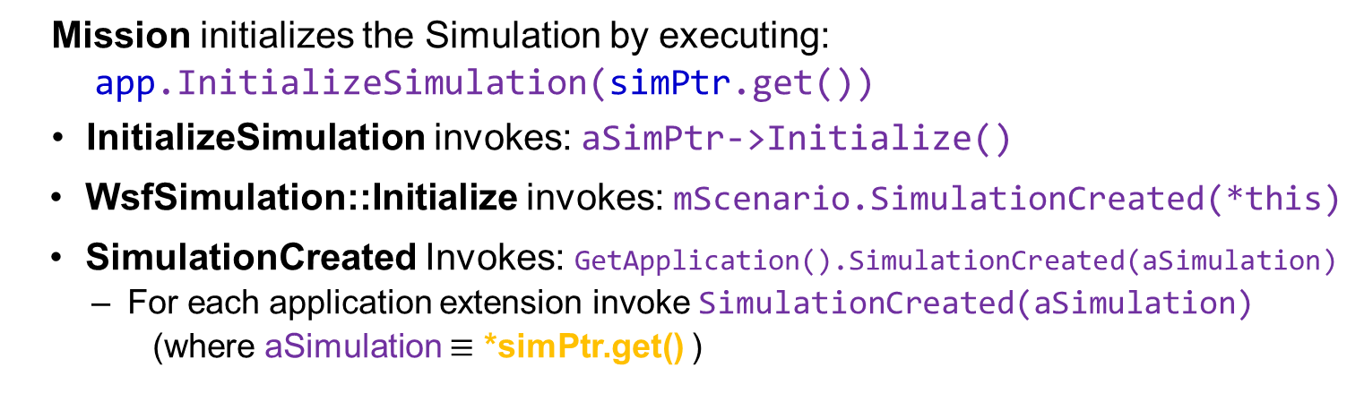
AFSIM Plugins & Extensions AFSIM mission startup sequence
mission::main()
unique_ptr<TricorderSensorRegistration>
WsfScenario: scenario
unique_ptr<WsfSimulation>: SimPtr
WsfStandardApplication: app
WsfStandardApplication::InitializeSimulation()
WsfScenario::SimulationCreated()
WsfSimulation::Initialize()
WsfApplication::SimulationCreated()
Mission initializes the Simulation by executing:
app.InitializeSimulation(simPtr.get())
InitializeSimulation invokes: aSimPtr->Initialize()
WsfSimulation::Initialize invokes: mScenario.SimulationCreated(*this)
SimulationCreated Invokes: GetApplication().SimulationCreated(aSimulation)
For each application extension invoke SimulationCreated(aSimulation)
(where aSimulation $≡$ *simPtr.get() )

Slide 53
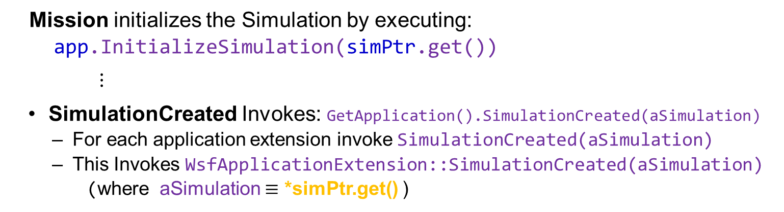
AFSIM Plugins & Extensions AFSIM mission startup sequence
mission::main()
unique_ptr<TricorderSensorRegistration>
WsfScenario: scenario
unique_ptr<WsfSimulation>: SimPtr
WsfStandardApplication: app
WsfStandardApplication::InitializeSimulation()
WsfScenario::SimulationCreated()
WsfSimulation::Initialize()
WsfApplication::SimulationCreated()
WsfApplicationExtension::SimulationCreated()
Mission initializes the Simulation by executing:
app.InitializeSimulation(simPtr.get())
$⋮$
SimulationCreated Invokes: GetApplication().SimulationCreated(aSimulation)
For each application extension invoke SimulationCreated(aSimulation)
This Invokes WsfApplicationExtension::SimulationCreated(aSimulation)
(where aSimulation $≡$ *simPtr.get() )
Note: TricorderRegistration does not override SimulationCreated, so this call has no effect

Slide 54
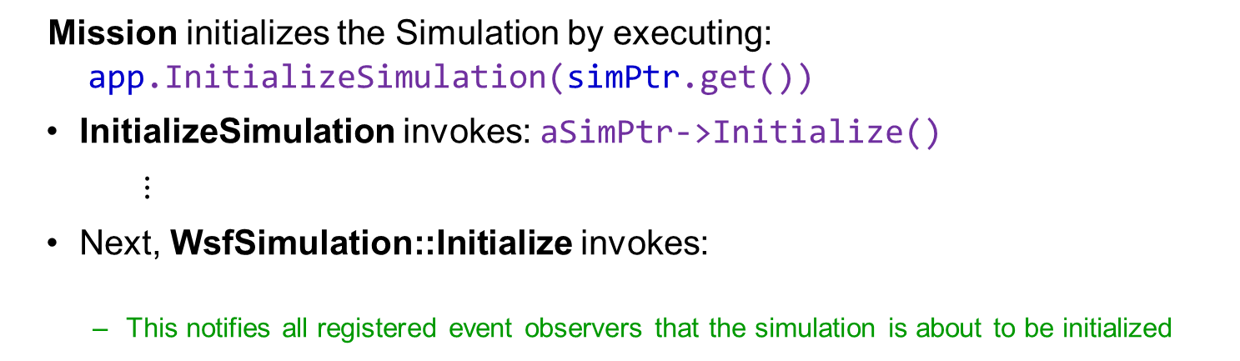
AFSIM Plugins & Extensions AFSIM mission startup sequence
mission::main()
unique_ptr<TricorderSensorRegistration>
WsfScenario: scenario
unique_ptr<WsfSimulation>: SimPtr
WsfStandardApplication: app
WsfStandardApplication::InitializeSimulation()
WsfSimulation::Initialize()
Mission initializes the Simulation by executing:
app.InitializeSimulation(simPtr.get())
InitializeSimulation invokes: aSimPtr->Initialize()
$⋮$
Next, WsfSimulation::Initialize invokes:
This notifies all registered event observers that the simulation is about to be initialized
WsfObserver::SimulationInitializing(this)
Note: we do not create any simulation observers, so the notification has no effect

Slide 55
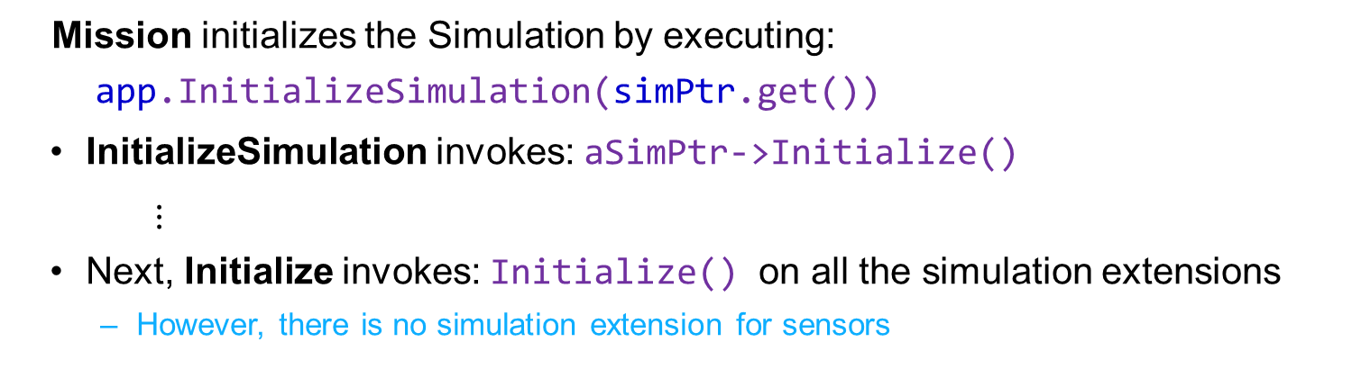
AFSIM Plugins & Extensions AFSIM mission startup sequence
mission::main()
unique_ptr<TricorderSensorRegistration>
WsfScenario: scenario
unique_ptr<WsfSimulation>: SimPtr
WsfStandardApplication: app
WsfStandardApplication::InitializeSimulation()
WsfSimulation::Initialize()
WsfSimulationExtension::Initialize()
Mission initializes the Simulation by executing:
app.InitializeSimulation(simPtr.get())
InitializeSimulation invokes: aSimPtr->Initialize()
$⋮$
Next, Initialize invokes: Initialize() on all the simulation extensions
However, there is no simulation extension for sensors

Slide 56
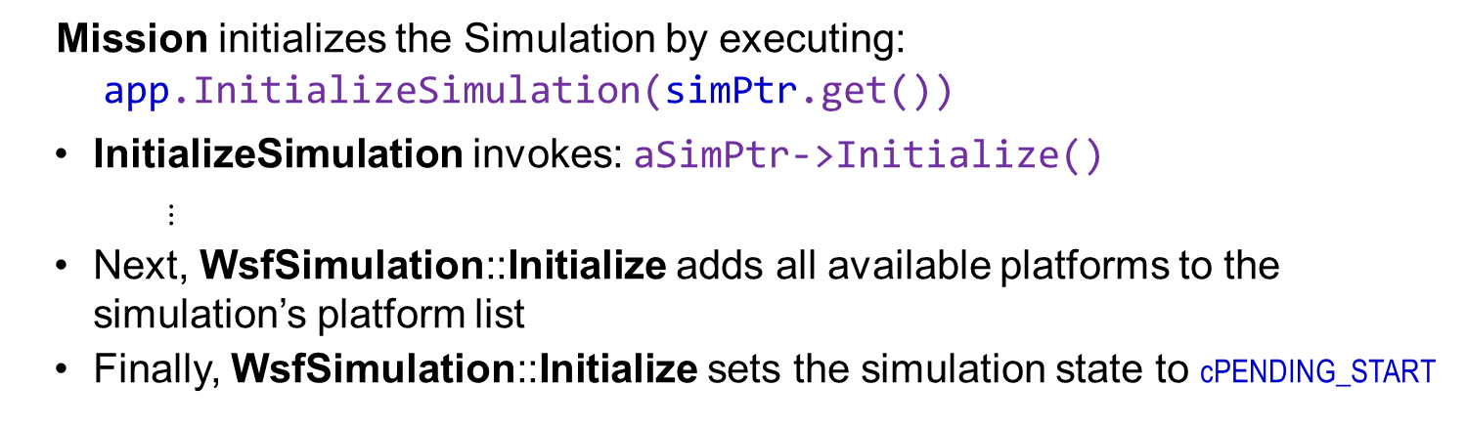
AFSIM Plugins & Extensions AFSIM mission startup sequence
mission::main()
unique_ptr<TricorderSensorRegistration>
WsfScenario: scenario
unique_ptr<WsfSimulation>: SimPtr
WsfStandardApplication: app
WsfStandardApplication::InitializeSimulation()
WsfSimulation::Initialize()
Mission initializes the Simulation by executing:
app.InitializeSimulation(simPtr.get())
InitializeSimulation invokes: aSimPtr->Initialize()
$⋮$
Next, WsfSimulation::Initialize adds all available platforms to the simulation’s platform list
Finally, WsfSimulation::Initialize sets the simulation state to cPENDING_START

Slide 57
AFSIM Plugins & Extensions
The previous animation only focuses on creating an Application Extension
In future exercises, we will create Scenario Extensions and see animations covering that process in more detail
In future exercises, we will create Simulation Extensions and see animations covering that process in more detail

Slide 58
Sensor Exercise 2
This exercise focuses on creating a new sensor (derived from WsfSensor) and a new sensor mode (derived from WsfSensorMode)
understanding the TricorderSensor class and the TricorderMode class
implementing parts of the TricorderSensor class and the TricorderMode class
Using ProcessInput to handle a TricorderSensor’s input
Using Initialize to ensure all member variables are given initial values at start of a simulation

Slide 59

Sensor Exercise 2 — Review 1
Inspect class TricorderSensor in the file TricorderSensor.hpp and note the inheritance from WsfSensor as well as the class attributes and functions assumed for our solution.
//! A standard tricorder sensor for sensing living things.
class TricorderSensor : public WsfSensor
{
public:
//! Constructor
explicit TricorderSensor(WsfScenario& aScenario);
TricorderSensor& operator=(const TricorderSensor&) = delete;
//! Virtual destructor
~TricorderSensor() noexcept override = default;
$⋮$

Slide 60
Sensor Exercise 2 — Review 1 TricorderSensor.hpp
class TricorderSensor : public WsfSensor
{
public:
...
WsfSensor* Clone() const override;
bool Initialize(double aSimTime) override;
bool ProcessInput(UtInput& aInput) override;
void Update(double aSimTime) override;
bool AttemptToDetect(double aSimTime,
WsfPlatform* aTargetPtr,
Settings& aSettings,
WsfSensorResult& aResult) override;
size_t GetLifeFormTypeCount(WsfStringId aModeNameId);
WsfStringId GetLifeFormTypeEntry(WsfStringId aModeNameId,
unsigned int aEntry);
protected:
class TricorderMode : public WsfSensorMode
{
...
};
//! The sensor-specific list of modes (not valid until Initialize is called)
//! Required by the default sensor scheduler
std::vector<TricorderMode*> mTricorderModeList;
...
//! Get the name of the script class associated with this class.
//! This is necessary for proper downcasts in the scripting language.
const char* GetScriptClassName() const override;
};
Called by the chain of
Initialize’s invoked
during simulation
initialization
Called by the chain of
ProcessInput’s invoked
during scenario load

Slide 61
Sensor Exercise 2 — Review 2
Inspect class TricorderSensorMode in the file TricorderSensor.hpp and note the inheritance from WsfSensorMode as well as the class attributes and functions assumed for our solution.

Slide 62

Sensor Exercise 2 — Review 2 TricorderSensor.hpp
class TricorderMode : public WsfSensorMode
{
public:
TricorderMode();
TricorderMode(const TricorderMode& aSrc);
TricorderMode& operator=(const TricorderMode& aSrc);
WsfMode* Clone() const override;
virtual bool Initialize(double aSimTime,
WsfSensor* aSensorPtr);
bool ProcessInput(UtInput& aInput) override;
bool AttemptToDetect(double aSimTime,
WsfPlatform* aTargetPtr,
WsfSensor::Settings& aSettings,
WsfSensorResult& aResult) override;
void UpdateTrack(double aSimTime,
WsfTrack* aTrackPtr,
WsfPlatform* aTargetPtr,
WsfSensorResult& aResult) override;
void Deselect(double aSimTime) override {}
void Select(double aSimTime) override {}
void ApplyMeasurementErrors(WsfSensor::Result& aResult) override;
double GetLifeReading(WsfPlatform* aTargetPtr);
bool IsLifeForm(WsfPlatform* aTargetPtr);
$⋮$
};
Called by the chain of
Initialize’s invoked
during simulation
initialization
Called by the chain of
ProcessInput’s invoked
during scenario load

Slide 63
Sensor Exercise 2 — Task 1 TricorderSensor.cpp
Complete the TricorderSensor’s constructor implementation by:
Task 1a: Assigning a new sensor mode list, by invoking SetModeList, parameterizing it with this sensor-specific mode template (TricorderMode).
Note: signature of SetModeList:
SetModeList(std::unique_ptr<WsfSensorModeList> aModeListPtr);
The parameter needs to be a unique pointer to a WsfSensorModeList which has been constructed with a pointer to a WsfSensorMode (i.e., a TricorderMode, which is derived from WsfSensorMode)
Task 1b: Assigning the sensor scheduler to be the default sensor scheduler
Manages target detection attempts for the sensor
Most sensors use the WsfDefaultSensorScheduler
Makes sure we get a chance to look at each target once per frame_time at a regular interval
Requires a class-unique mode list
Note: signature of SetScheduler:
SetScheduler(std::unique_ptr<WsfDefaultSensorScheduler> aSchedulerPtr);
The parameter must be a pointer to a WsfDefaultSensorScheduler, which has been constructed using the default constructor

Slide 64
Sensor Exercise 2 — Task 1 TricorderSensor.cpp
Complete the TricorderSensor’s constructor implementation by:
Task 1c: Assigning the sensor tracker to be the default sensor tracker
Maintains the sensor's track list given the sensor's detections
Most sensors use the WsfDefaultSensorTracker but sensors which don't report tracks (imaging sensors) would not set the tracker
Note: the signature of SetTracker:
SetTracker(std::unique_ptr<WsfDefaultSensorTracker>(WsfScenario&
aScenario));
The parameter is a WsfDefaultSensorTracker which is constructed with a reference to the scenario

Slide 65
Sensor Exercise 2 — Task 1 Solution TricorderSensor.cpp
TricorderSensor::TricorderSensor(WsfScenario& aScenario)
: WsfSensor(aScenario),
mTricorderModeList()
{
// Set the class of the sensor. This is a passive multi-spectral sensor
SetClass(cPASSIVE | cRADIO | cINFRARED | cVISUAL | cACOUSTIC );
// EXERCISE 2 TASK 1a
// Assign a new mode list, parameterizing it with this
// sensor-specific mode template (constructed with a new TricorderMode)
SetModeList(ut::make_unique<WsfSensorModeList>(new TricorderMode));
// EXERCISE 2 TASK 1b
// Assign the sensor scheduler to be the default sensor scheduler
SetScheduler(ut::make_unique<WsfDefaultSensorScheduler>());
// EXERCISE 2 TASK 1c
// Assign the sensor tracker to be the default sensor tracker (constructed
// with a reference to the scenario)
SetTracker(ut::make_unique<WsfDefaultSensorTracker>(aScenario));
}
The pointer to the
“new TricorderMode”
is deleted by the
WsfModeList that is
inherited by
WsfSensorModeList
Notes:
The new TricorderMode that is passed into SetModeList is inserted into an underlying WsfModeList, and is deleted by the WsfModeList destructor.

Slide 66
Sensor Exercise 2 — Review 3 TricorderSensor.cpp
In file TricorderSensor.cpp:
Review and understand:
In file WsfModeList.hpp, review and understand:
//! Initializes the Tricorder Sensor; called by WsfSimulation.
//! @param aSimTime [input] The current simulation time.
//! @return 'true' if initialization was successful.
bool TricorderSensor::Initialize(double aSimTime)
{
// Must call base class first!
bool ok = WsfSensor::Initialize(aSimTime);
// Reduce future dynamic casting by extracting derived class mode pointers.
mModeListPtr->GetDerivedModeList(mTricorderModeList);
return ok;
}
template<class T>
void GetDerivedModeList(std::vector<T>& aModeList) const
{
aModeList.resize(mModeList.size());
for (typename std::vector<WsfMode*>::size_type i = 0; i < mModeList.size(); ++i)
{
T modePtr = dynamic_cast<T>(mModeList[i]);
assert(modePtr != nullptr);
aModeList[i] = modePtr;
}
}
Notes:
GetDerivedModeList is a templated function. It loops through all the modes and dynamic_casts them to our type.

Slide 67
Sensor Exercise 2 — Review 4 TricorderSensor.cpp
In file TricorderSensor.cpp
Review and understand:
//! @param aInput [input] The input stream.
//!
//! @return 'true' if the command was recognized (and processed) or 'false'
//! if the command was not one recognized by this class.
bool TricorderSensor::ProcessInput(UtInput& aInput)
{
// Call the base class implementation
return WsfSensor::ProcessInput(aInput);
}
WsfScenario
… ProcessInput(aInput)
Notes:
WsfSensor::ProcessInput calls ProcessInput on its mode list, which calls ProcessInput on all its modes.

Slide 68
Sensor Exercise 2 — Review 5 TricorderSensor.cpp
In TricorderSensor.cpp:
Review and understand:
/! Called by the simulation object to update the Tricorder Sensor
//! @param aSimTime [input] The current simulation time.
void TricorderSensor::Update(double aSimTime)
{
// Bypass updates if not time for an update. This avoids unnecessary device updates.
// (A little slop is allowed to make sure event-driven chances occur as scheduled)
if (mNextUpdateTime <= (aSimTime + 1.0E-5))
{
WsfSensor::Update(aSimTime); // Ensure my position is current
PerformScheduledDetections(aSimTime); // Perform any required detection attempts
}
}

Slide 69
Sensor Exercise 2 — Task 2
In file TricorderSensor.hpp
Add a member variable of type WsfCategoryList to the TricorderSensor::TricorderMode class to store the life form types this mode can detect

Slide 70
Sensor Exercise 2 — Task 2 Solution TricorderSensor.hpp
class TricorderMode : public WsfSensorMode
{
public:
TricorderMode();
TricorderMode(const TricorderMode& aSrc);
TricorderMode& operator=(const TricorderMode& aSrc);
WsfMode* Clone() const override;
virtual bool Initialize(double aSimTime,
WsfSensor* aSensorPtr);
bool ProcessInput(UtInput& aInput) override;
...
double GetLifeReading(WsfPlatform* aTargetPtr);
bool IsLifeForm(WsfPlatform* aTargetPtr);
// EXERCISE 2 TASK 2
WsfCategoryList mLifeFormTypes;
};

Slide 71
Sensor Exercise 2 — Review 6 TricorderSensor.cpp
In file TricorderSensor.cpp:
Review and understand:
TricorderSensor::TricorderMode::TricorderMode()
: WsfSensorMode()
, mLifeFormTypes()
{
// Derived sensor modes should call SetCapabities(...) to register what
// they detect and report out in measurements and tracks.
SetCapabilities(cRANGE | cTYPE | cOTHER);
}
Notes:
GetDerivedModeList is a templated function. It loops through all the modes and dynamic_casts them to our type.

Slide 72
Sensor Exercise 2 — Task 3
TricorderSensor.cpp
platform Spock VULCAN
add sensor tricorder TRICORDER_SENSOR
mode KLINGON
frame_time 2 s
reports_type
life_form_type klingon_life_form
end_mode
mode ALL_LIFE_FORMS
frame_time 1 s
reports_type
life_form_type LIFE_FORM
life_form_type klingon_life_form
end_mode
end_sensor
end_platform
Example scenario input:
(see sensor_scenario.txt)
In file TricorderSensor.cpp
Task 3: Implement TricorderSensor::TricorderMode::ProcessInput to read and add the specified type to our list of detectable life forms:
The form of the command is: life_form_type <string-value>
The variable will have to be a WsfStringId and it will need to store the <string-value> that is read in from the input file by the ReadValue method
The base class, WsfSensorMode::ProcessInput, will handle standard sensor mode commands like frame_time and reports_type
command value
AFSIM examples can be found by searching source codes using references to “ReadValue”.

Slide 73
Sensor Exercise 2 — Task 3 Solution TricorderSensor.cpp
bool TricorderSensor::TricorderMode::ProcessInput(UtInput& aInput)
{
bool myCommand = true;
std::string command(aInput.GetCommand());
if (command == "life_form_type")
{
// EXERCISE 2 TASK 3
WsfStringId lifeFormType;
aInput.ReadValue(lifeFormType);
mLifeFormTypes.JoinCategory(lifeFormType);
}
else
{
myCommand = WsfSensorMode::ProcessInput(aInput);
}
return myCommand;
}
life_form_type is the only
new input command for
TricorderSensor
JoinCategory adds the
lifeFormType value to the
category list stored in
mLifeFormTypes
If the current command is not
“life_form_type”, then we need to
pass the input on to the base class
WsfSensorMode::ProcessInput
to see if it can be handled there.
Notes:
We added mLifeFormTypes (of type WsfCategoryList) in Task 2.

Slide 74
Sensor Exercise 2 — Task 4 TricorderSensor.cpp
Implement the TricorderSensor::TricorderMode::IsLifeForm method
determines if a given target (WsfPlatform) is a life form the mode can detect
Consider the target platform a life form if either:
It has the same type as any of the life form types in mLifeFormTypes, or
It has the same category as any of the life form categories in mLifeFormTypes
Note: mLifeFormTypes may be used to store both categories and platform types
Task 4a: loop over the categories returned by a call to: mLifeFormTypes.GetCategoryList()
For each category, invoke the input parameter aTargetPtr->IsA_TypeOf() method, and pass in the current category
IsA_TypeOf() returns true if the platform shares a type with the category passed in
If IsA_TypeOf() returns true, then IsLifeForm() should return true
Task 4b: invoke mLifeFormTypes.Intersects(aTargetPtr->GetCategories())
The Intersects method takes an input parameter (a list of categories) and determines if it is one of those stored in the categories for the life form type
If Intersects() returns true, then IsLifeForm() should return true

Slide 75
Sensor Exercise 2 — Task 4 Solution TricorderSensor.cpp
category is set to each of
the categories for the
LifeformType in the
category list, one after the
other
bool TricorderSensor::TricorderMode::IsLifeForm(WsfPlatform* aTargetPtr)
{
for (const auto& category : mLifeFormTypes.GetCategoryList())
{
// EXERCISE 2 TASK 4a
// Check platform type
if (aTargetPtr->IsA_TypeOf(category))
{
return true;
}
}
// EXERCISE 2 TASK 4b
// Check for category on the platform
if (mLifeFormTypes.Intersects(aTargetPtr->GetCategories()))
{
return true;
}
return false;
}
IsA_TypeOf takes an input
parameter (category) and determines if the category
is the platform’s type
Intersects takes an input
parameter (a list of
categories) and determines
if it is one of those stored in
the categories for the life
form type

Slide 76
Sensor Exercise 2 — Task 5
In file TricorderSensor.cpp:
Complete the implementation of the TricorderSensor::TricorderMode::AttemptToDetect method
You must create a bool variable named detected an set it equal to the result of invoking the TricorderSensor::TricorderMode::IsLifeForm() method from task 4 (remember the IsLifeForm() method takes as input the aTargetPtr which is one of the input parameters to AttemptToDetect)
Note: this same bool variable (detected) is used in the second if-statement below this call to check whether or not the life form was detected

Slide 77
Sensor Exercise 2 — Task 5 Solution TricorderSensor.cpp
bool TricorderSensor::TricorderMode::AttemptToDetect(double aSimTime,
WsfPlatform* aTargetPtr,
Settings& aSettings,
WsfSensorResult& aResult)
{
// EXERCISE 2 TASK 5
// Check for a life form
bool detected = IsLifeForm(aTargetPtr);
...
if (detected)
{
// Set probability of detection to 1.0; tricorder will detect all life forms
aResult.mPd = 1.0;
}
// Get the range and unit vector from the receiver to the target.
aTargetPtr->Update(aSimTime); // Ensure the target position is current
GetSensor()->GetPlatform()->GetLocationWCS(aResult.mRcvrLoc.mLocWCS);
aTargetPtr->GetLocationWCS(aResult.mTgtLoc.mLocWCS);
UtVec3d::Subtract(aResult.mRcvrToTgt.mTrueUnitVecWCS, aResult.mTgtLoc.mLocWCS, aResult.mRcvrLoc.mLocWCS);
aResult.mRcvrToTgt.mRange = UtVec3d::Normalize(aResult.mRcvrToTgt.mTrueUnitVecWCS);
// Notify observers about the sensor detection attempt
WsfSensorObserver::Get(GetSimulation()).SensorDetectionAttempt(aSimTime, GetSensor(), aTargetPtr, aResult);
return detected;
}
We define detected here
detected is used here

Slide 78
Sensor Exercise 2 — Review 7
Familiarize yourself with the WsfSensorResult class (in file WsfSensorResult.hpp [../core/wsf/source/sensor]) and review the data that we are setting in the variable aResult
At a minimum the range-to-target must be supplied or an assert will get thrown in the WsfSensorMode class in the ApplyMeasurementErrors method

Slide 79
Sensor Exercise 2 — Review 7 TricorderSensor.cpp
bool TricorderSensor::TricorderMode::AttemptToDetect(double aSimTime,
WsfPlatform* aTargetPtr,
Settings& aSettings,
WsfSensorResult& aResult)
{
bool detected = IsLifeForm(aTargetPtr);
...
if (detected)
{
// Set probability of detection to 1.0; tricorder will detect all life forms
aResult.mPd = 1.0;
}
// Get the range and unit vector from the receiver to the target.
aTargetPtr->Update(aSimTime); // Ensure the target position is current
GetSensor()->GetPlatform()->GetLocationWCS(aResult.mRcvrLoc.mLocWCS);
aTargetPtr->GetLocationWCS(aResult.mTgtLoc.mLocWCS);
UtVec3d::Subtract(aResult.mRcvrToTgt.mTrueUnitVecWCS, aResult.mTgtLoc.mLocWCS, aResult.mRcvrLoc.mLocWCS);
aResult.mRcvrToTgt.mRange = UtVec3d::Normalize(aResult.mRcvrToTgt.mTrueUnitVecWCS);
// Notify observers about the sensor detection attempt
WsfSensorObserver::Get(GetSimulation()).SensorDetectionAttempt(aSimTime, GetSensor(), aTargetPtr, aResult);
return detected;
}

Slide 80
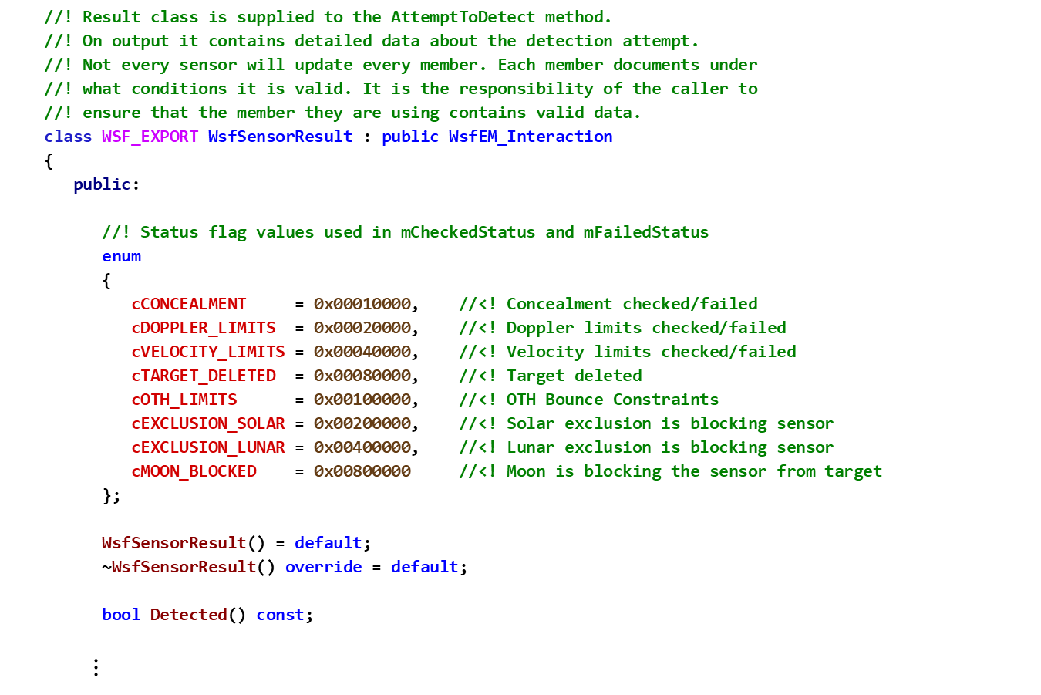
Sensor Exercise 2 — Review 7 WsfSensorResult.hpp
//! Result class is supplied to the AttemptToDetect method.
//! On output it contains detailed data about the detection attempt.
//! Not every sensor will update every member. Each member documents under
//! what conditions it is valid. It is the responsibility of the caller to
//! ensure that the member they are using contains valid data.
class WSF_EXPORT WsfSensorResult : public WsfEM_Interaction
{
public:
//! Status flag values used in mCheckedStatus and mFailedStatus
enum
{
cCONCEALMENT = 0x00010000, //<! Concealment checked/failed
cDOPPLER_LIMITS = 0x00020000, //<! Doppler limits checked/failed
cVELOCITY_LIMITS = 0x00040000, //<! Velocity limits checked/failed
cTARGET_DELETED = 0x00080000, //<! Target deleted
cOTH_LIMITS = 0x00100000, //<! OTH Bounce Constraints
cEXCLUSION_SOLAR = 0x00200000, //<! Solar exclusion is blocking sensor
cEXCLUSION_LUNAR = 0x00400000, //<! Lunar exclusion is blocking sensor
cMOON_BLOCKED = 0x00800000 //<! Moon is blocking the sensor from target
};
WsfSensorResult() = default;
~WsfSensorResult() override = default;
bool Detected() const;
$⋮$

Slide 81
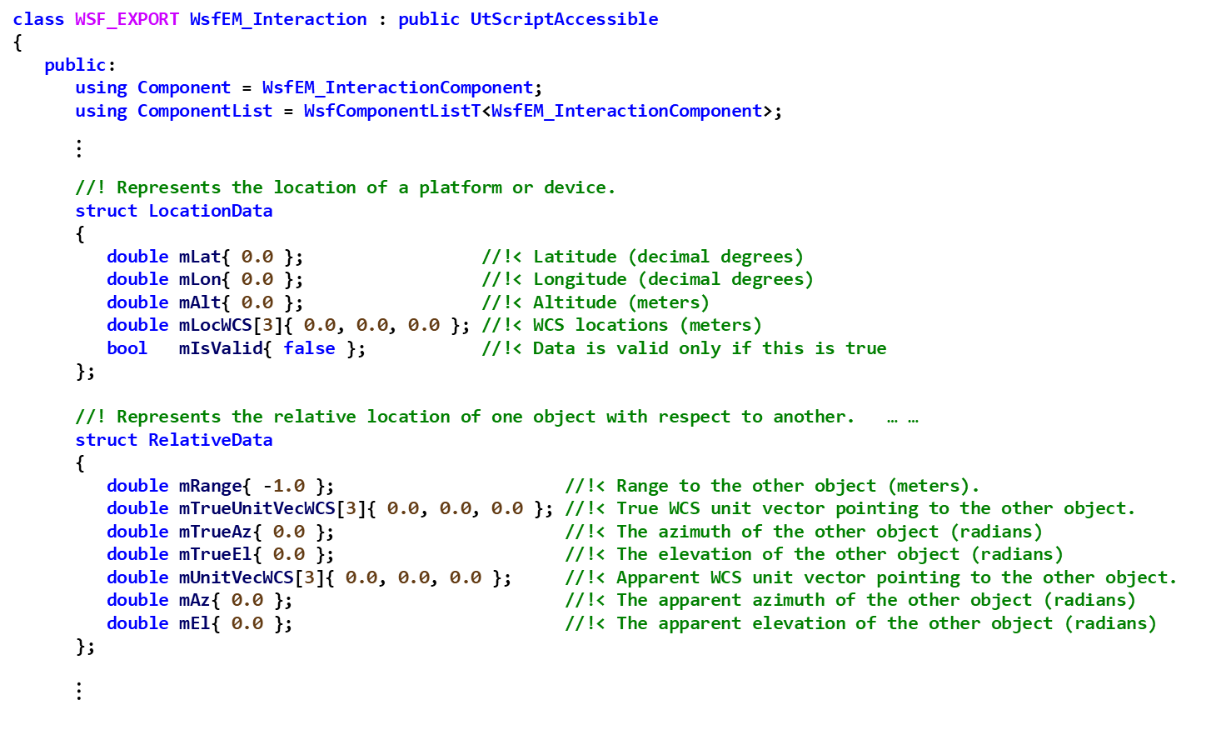
Sensor Exercise 2 — Review 7 WsfEM_Interaction.hpp
class WSF_EXPORT WsfEM_Interaction : public UtScriptAccessible
{
public:
using Component = WsfEM_InteractionComponent;
using ComponentList = WsfComponentListT<WsfEM_InteractionComponent>;
$⋮$
//! Represents the location of a platform or device.
struct LocationData
{
double mLat{ 0.0 }; //!< Latitude (decimal degrees)
double mLon{ 0.0 }; //!< Longitude (decimal degrees)
double mAlt{ 0.0 }; //!< Altitude (meters)
double mLocWCS[3]{ 0.0, 0.0, 0.0 }; //!< WCS locations (meters)
bool mIsValid{ false }; //!< Data is valid only if this is true
};
//! Represents the relative location of one object with respect to another. … …
struct RelativeData
{
double mRange{ -1.0 }; //!< Range to the other object (meters).
double mTrueUnitVecWCS[3]{ 0.0, 0.0, 0.0 }; //!< True WCS unit vector pointing to the other object.
double mTrueAz{ 0.0 }; //!< The azimuth of the other object (radians)
double mTrueEl{ 0.0 }; //!< The elevation of the other object (radians)
double mUnitVecWCS[3]{ 0.0, 0.0, 0.0 }; //!< Apparent WCS unit vector pointing to the other object.
double mAz{ 0.0 }; //!< The apparent azimuth of the other object (radians)
double mEl{ 0.0 }; //!< The apparent elevation of the other object (radians)
};
$⋮$

Slide 82

Sensor Exercise 2 — Review 7 WsfEM_Interaction.hpp
$⋮$
//! Location of the receiver.
//! @note This is valid only if the interaction involves a receiver.
LocationData mRcvrLoc;
//! Location of the target.
//! @note This is valid only if the interaction involves a target platform.
LocationData mTgtLoc;
//! Receiver-to-target relative data.
//! @note This is valid only if the interaction involves a target platform.
RelativeData mRcvrToTgt;
//! Target-to-receiver relative data.
//! @note This is valid only if the interaction involves a target platform.
RelativeData mTgtToRcvr;
$⋮$
};

Slide 83
Sensor Exercise 2 — Review 7 TricorderSensor.cpp
bool TricorderSensor::TricorderMode::AttemptToDetect(double aSimTime,
WsfPlatform* aTargetPtr,
Settings& aSettings,
WsfSensorResult& aResult)
{
bool detected = IsLifeForm(aTargetPtr);
...
if (detected)
{
// Set probability of detection to 1.0; tricorder will detect all life forms
aResult.mPd = 1.0;
}
// Get the range and unit vector from the receiver to the target.
aTargetPtr->Update(aSimTime); // Ensure the target position is current
GetSensor()->GetPlatform()->GetLocationWCS(aResult.mRcvrLoc.mLocWCS);
aTargetPtr->GetLocationWCS(aResult.mTgtLoc.mLocWCS);
UtVec3d::Subtract(aResult.mRcvrToTgt.mTrueUnitVecWCS, aResult.mTgtLoc.mLocWCS, aResult.mRcvrLoc.mLocWCS);
aResult.mRcvrToTgt.mRange = UtVec3d::Normalize(aResult.mRcvrToTgt.mTrueUnitVecWCS);
// Notify observers about the sensor detection attempt
WsfSensorObserver::Get(GetSimulation()).SensorDetectionAttempt(aSimTime, GetSensor(), aTargetPtr, aResult);
return detected;
}

Slide 84
Sensor Exercise 2 — Task 6
In file TricorderSensor.cpp
Implement the TricorderSensor::TricorderMode::GetLifeReading method
Ensure the value returned is between 0.0 and 1.0
Use the damage factor of the life form for the health reading
This can be found by invoking the platform’s GetDamageFactor method
A high damage factor represents low health reading
See the initial_damage_factor attribute in the AFSIM documentation under “platform”

Slide 85
Sensor Exercise 2 — Task 6 Solution TricorderSensor.cpp
double TricorderSensor::TricorderMode::GetLifeReading(WsfPlatform* aTargetPtr)
{
// EXERCISE 2 TASK 6
// Use the damage factor of the life form for the health reading
// Use std::min and std::max to ensure value is between 0 and 1.
return std::min(1.0, std::max(0.0, 1.0 - aTargetPtr->GetDamageFactor()));
}
This is equivalent to:
double val = 1.0 – aTargetPtr->GetDamageFactor();
if (val < 0.0) val = 0.0;
if (val > 1.0) val = 1.0;
return val;

Slide 86
Sensor Exercise 2 — Task 7
In TricorderSensor.cpp:
Complete the implementation of the TricorderSensor::TricorderMode::UpdateTrack method
If a target is determined to be detected by the processing in the AttemptToDetect method, then the sensor automatically handles creation of the WsfTrack object and this method is called to fill in new or updated track information.
Most of the information that we need to fill in the track is done by the base class implementation
Familiarize yourself with the use of the auxiliary data container attached to platforms to report the life form type
Set the WsfTrack attribute “track quality” with the life reading from GetLifeReading
A high track quality value represents a "strong" life reading

Slide 87
Sensor Exercise 2 — Task 7 Solution TricorderSensor.cpp
void TricorderSensor::TricorderMode::UpdateTrack(double aSimTime,
WsfTrack* aTrackPtr,
WsfPlatform* aTargetPtr,
WsfSensorResult& aResult)
{
// If the sensor is reporting type
if (ReportsType())
{
// Get the life form type
WsfAttributeContainer& auxDataTarget = aTargetPtr->GetAuxData();
if (auxDataTarget.AttributeExists("LIFE_FORM_REPORTED_TYPE"))
{
// Set the type data in the track
WsfStringId typeID = WsfStringId(auxDataTarget.GetString("LIFE_FORM_REPORTED_TYPE"));
aResult.mMeasurement.SetTypeId(typeID);
aResult.mMeasurement.SetTypeIdValid(true);
}
}
// Call base class' method. This will set valid measurement data (typeId) in the track.
WsfSensorMode::UpdateTrack(aSimTime, aTrackPtr, aTargetPtr, aResult);
// Set the "track quality" WsfTrack attribute with the life reading
// EXERCISE 2 TASK 7
aTrackPtr->SetTrackQuality(GetLifeReading(aTargetPtr));
}

Slide 88
Sensor Exercise 3
This exercise focuses on:
Implementing parts of the script class, ScriptTricorderSensorClass, that provides access to the TricorderSensor class from the script interface
Understanding how the C++ #defines, UT_DECLARE_SCRIPT_METHOD, and UT_DEFINE_SCRIPT_METHOD are expanded into their final class declaration and definition

Slide 89

Sensor Exercise 3 — Review 1
Inspect the file TricorderSensor.hpp to become familiar with the class methods and attributes of the ScriptTricorderSensorClass class that is defined at the bottom of the file
Remember this class is derived from class WsfScriptSensorClass
Notice the new script sensor class ScriptTricorderSensorClass has several calls to UT_DECLARE_SCRIPT_METHOD
Each of these calls creates a new class declaration within ScriptTricorderSensorClass for a class with the name of the argument that is passed in to the call
//! The script interface 'class'
class ScriptTricorderSensorClass : public WsfScriptSensorClass
{
public:
ScriptTricorderSensorClass(const std::string& aClassName,
UtScriptTypes* aTypesPtr);
~ScriptTricorderSensorClass() noexcept override = default;
UT_DECLARE_SCRIPT_METHOD(LifeFormTypeCount_1);
UT_DECLARE_SCRIPT_METHOD(LifeFormTypeCount_2);
UT_DECLARE_SCRIPT_METHOD(LifeFormTypeEntry_1);
$⋮$
};
UtScriptTypes
ScriptTricorderSensorClass

Slide 90
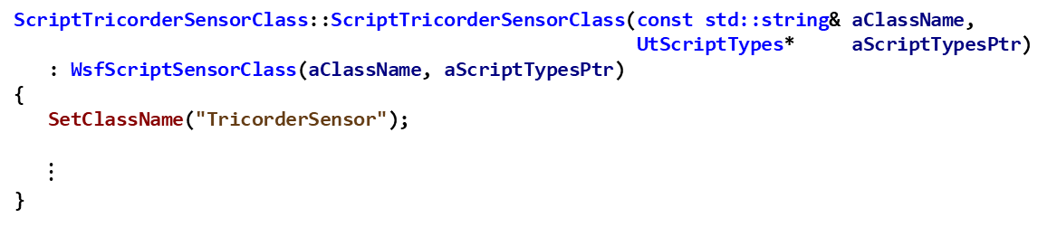
Sensor Exercise 3 — Review 2 TricorderSensor.cpp
//! Provide the name of the corresponding script class so that the
//! scripting system can implement type casting properly.
const char* TricorderSensor::GetScriptClassName() const
{
return "TricorderSensor";
}
This defines the name TricorderSensor to be the script class name for the defined script methods
ScriptTricorderSensorClass::ScriptTricorderSensorClass(const std::string& aClassName,
UtScriptTypes* aScriptTypesPtr)
: WsfScriptSensorClass(aClassName, aScriptTypesPtr)
{
SetClassName("TricorderSensor");
$⋮$
}
This sets the script class name to be TricorderSensor, the same as that defined in GetScriptClassName above

Slide 91
Sensor Exercise 3 — Review 3
Look at ScriptTricorderSensorClass implementation in TricorderSensor.cpp
Notice the constructor definition has calls to AddMethod
Notice the use of UT_DEFINE_SCRIPT_METHOD at the end of the file, where define the behavior of the scripts

Slide 92
Sensor Exercise 3 — Review 3 TricorderSensor.cpp
Review and understand:
#include "script/WsfScriptContext.hpp"
ScriptTricorderSensorClass::ScriptTricorderSensorClass(const std::string& aClassName,
UtScriptTypes* aScriptTypesPtr)
: WsfScriptSensorClass(aClassName, aScriptTypesPtr)
{
SetClassName("TricorderSensor");
AddMethod(ut::make_unique<LifeFormTypeCount_1>("LifeFormTypeCount")); // LifeFormTypeCount()
AddMethod(ut::make_unique<LifeFormTypeCount_2>("LifeFormTypeCount")); // LifeFormTypeCount(string)
AddMethod(ut::make_unique<LifeFormTypeEntry_1>("LifeFormTypeEntry")); // LifeFormTypeEntry(int)
}
The AddMethod function adds the script method with the specified name (such as LifeFormTypeEntry) to the script interface, and associates the implementation (such as class LifeFormTypeEntry_1) with that method
Note: this does not actually declare/define the script methods

Slide 93

Sensor Exercise 3 — Review 3 TricorderSensor.cpp
Review and understand:
$⋮$
// int lifeFormCount = <x>.LifeFormTypeCount();
UT_DEFINE_SCRIPT_METHOD(ScriptTricorderSensorClass, TricorderSensor, LifeFormTypeCount_1, 0, "int", "")
{ … }
// int lifeFormCount = <x>.LifeFormTypeCount(string aModeName);
UT_DEFINE_SCRIPT_METHOD(ScriptTricorderSensorClass, TricorderSensor, LifeFormTypeCount_2, 1, "int", "string")
{ … }
// int lifeFormEntry = <x>.LifeFormTypeEntry(int aEntryIndex);
UT_DEFINE_SCRIPT_METHOD(ScriptTricorderSensorClass, TricorderSensor, LifeFormTypeEntry_1, 1, "string", "int")
{ … }
// int lifeFormEntry = <x>.LifeFormTypeEntry(string aModeName, int aEntryIndex);
UT_DEFINE_SCRIPT_METHOD(ScriptTricorderSensorClass, TricorderSensor, LifeFormTypeEntry_2, 2, "string",
"string, int")
{ … }
The UT_DEFINE_SCRIPT_METHOD defines the body/implementation of a script method, and associates it with a script class declaration and definition function.

Slide 94
AFSIM Scripts
AFSIM has a fairly rich scripting interface that defines script methods that users can invoke from their entities defined from WsfPlatform, etc.
See the user training for detailed use cases for scripts
AFSIM provides a large number of predefined script methods
Developers can extend this interface by declaring and defining new script methods that can be called, and adding them to the UtScriptClass that manages the scripts
UT_DECLARE_SCRIPT_METHOD
UT_DEFINE_SCRIPT_METHOD
AddMethod
AddStaticMethod

Slide 95
Declarations of Script Methods
#define UT_DECLARE_SCRIPT_METHOD( METHOD_NAME )
Expands to a class declaration for the METHOD_NAME parameter
This new class inherits from class UtScriptClass::InterfaceMethod
Declares constructor and operator() for the class’s methods
This macro must be called from inside of a “scripting” class declaration

Slide 96
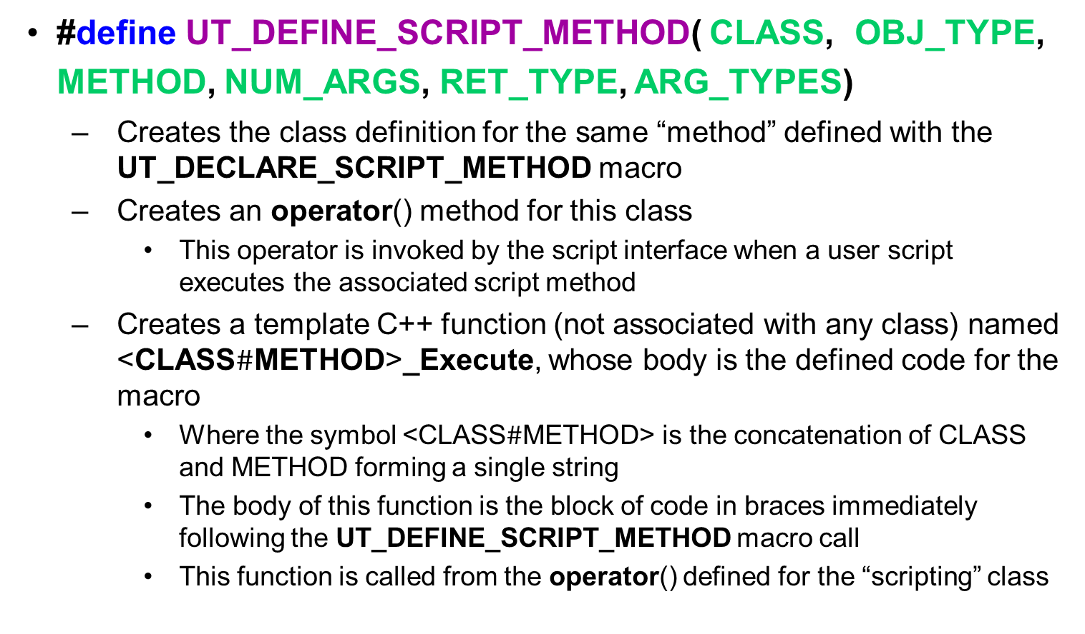
Definitions of Script Methods
#define UT_DEFINE_SCRIPT_METHOD( CLASS, OBJ_TYPE, METHOD, NUM_ARGS, RET_TYPE, ARG_TYPES)
Creates the class definition for the same “method” defined with the UT_DECLARE_SCRIPT_METHOD macro
Creates an operator() method for this class
This operator is invoked by the script interface when a user script executes the associated script method
Creates a template C++ function (not associated with any class) named <CLASS$\#$METHOD>_Execute, whose body is the defined code for the macro
Where the symbol <CLASS$\#$METHOD> is the concatenation of CLASS and METHOD forming a single string
The body of this function is the block of code in braces immediately following the UT_DEFINE_SCRIPT_METHOD macro call
This function is called from the operator() defined for the “scripting” class

Slide 97
Definitions of Script Methods
#define UT_DEFINE_SCRIPT_METHOD( CLASS, OBJ_TYPE, METHOD, NUM_ARGS, RET_TYPE, ARG_TYPES)
CLASS: the name of the “scripting” class which wraps the script method
OBJ_TYPE: the class name of the object which this script method is directly associated with
METHOD: the name of the class to implement the script method (should be the same as the METHOD_NAME argument to UT_DECLARE_SCRIPT_METHOD)
NUM_ARGS: the number of arguments the implementation METHOD requires
RET_TYPE: a string indicating the return type of the implementation METHOD
ARG_TYPES: a string indicating the types of the arguments required by the implementation METHOD

Slide 98
Registration of Script Methods
UtScriptClass::AddMethod( … )
Usually invoked as:
AddMethod(ut::make_unique<METHOD>( ScriptFunction ));
Adds the METHOD defined by the UT_DEFINE_SCRIPT_METHOD macro to the set of methods that can be called from the scripting interface
ScriptFunction is a string which identifies the name of the script function that can be called from user script
Once defined and added, this script method can be called from the user scripting interface in the scenario files by invoking the ScriptFunction with the correct number and type of parameters

Slide 99
A Standard Procedure for Creating a New Script Method
Step 1: create a new “scripting” class that inherits from one of the WsfScript<xxx>Class classes defined in the source code directory …/afsim/core/wsf/source/script
e.g., WsfScriptPlatformClass, WsfScriptPlatformPartClass, WsfScriptSensorClass, WsfScriptZoneClass, …
Ensure this class declares:
A constructor that takes two parameters:
a string which is the class name of the class that the script method will utilize/interact with
A pointer to a UtScriptTypes object
A destructor that overrides the base class destructor (it can be the default destructor)
Step 2: put calls to UT_DECLARE_SCRIPT_METHOD inside the new “scripting” class declaration, after the declaration of the destructor

Slide 100
A Standard Procedure for Creating a New Script Method
Step 3: In the “scripting” class implementation file, include the header for “script/WsfScriptContext.hpp” before any “scripting” class method definitions, and before any calls to UT_DEFINE_SCRIPT_METHOD
Step 4: Place calls to UT_DEFINE_SCRIPT_METHOD in the “scripting” class implementation file after the definition of the constructor
There should be one call to UT_DEFINE_SCRIPT_METHOD for each call to UT_DECLARE_SCRIPT_METHOD in the header file
These calls should probably be placed after the definition of the “scripting” class constructor

Slide 101
A Standard Procedure for Creating a New Script Method
Step 5: In the “scripting” class constructor definition, place calls to AddMethod.
There should be one call to AddMethod for each of the UT_DECLARE_SCRIPT_METHOD calls.
These AddMethod calls associate the script method name with the implementation object defined by the UT_DECLARE_SCRIPT_METHOD and UT_DEFINE_SCRIPT_METHOD calls

Slide 102
Sensor Exercise 3 — Task 1
In TricorderSensor.hpp:
Add a UT_DECLARE_SCRIPT_METHOD to the ScriptTricorderSensorClass that declares LifeFormTypeEntry_2 to be an implementation of a script.
Note: The UT_DECLARE_SCRIPT_METHOD generates a class declaration for the script being defined
Notice that a script method LifeFormTypeEntry_1 is already defined
By creating a method called LifeFormTypeEntry_2 we are in effect, overloading the script method LifeFormTypeEntry
For this to work correctly, we will need to provide a unique signature (different from that of LifeFormTypeEntry_1), and an implementation that uses our new TricorderSensor and TricorderMode class’ methods

Slide 103
Sensor Exercise 3 — Task 1 Solution TricorderSensor.hpp
class ScriptTricorderSensorClass : public WsfScriptSensorClass
{
public:
ScriptTricorderSensorClass(const std::string& aClassName,
UtScriptTypes* aTypesPtr);
~ScriptTricorderSensorClass() noexcept override = default;
UT_DECLARE_SCRIPT_METHOD(LifeFormTypeCount_1);
UT_DECLARE_SCRIPT_METHOD(LifeFormTypeCount_2);
UT_DECLARE_SCRIPT_METHOD(LifeFormTypeEntry_1);
// EXERCISE 3 TRAINING TASK 1
UT_DECLARE_SCRIPT_METHOD(LifeFormTypeEntry_2);
};
This creates the first
overloaded method,
called LifeFormTypeEntry.
This script method takes
one argument, an integer
that is the EntryIndex.
This creates the second
overloaded method,
called LifeFormTypeEntry.
This script method takes
two arguments, a string that is the ModeName, and an integer
that is the EntryIndex.

Slide 104
Expansion on LifeFormEntry_2
UT_DECLARE_SCRIPT_METHOD(LifeFormTypeEntry_2);
class LifeFormTypeEntry_2 : public UtScriptClass::InterfaceMethod
{
public:
LifeFormTypeEntry_2(const std::string& aName = "LifeFormTypeEntry_2");
virtual void operator() (UtScriptExecutor* aExecutorPtr,
UtScriptContext& aContext,
const UtScriptRef& aReference,
const std::vector<UtScriptData>& aVarArgs,
UtScriptData& aReturnVal);
};
Is transformed into

Slide 105
Sensor Exercise 3 — Review 4 TricorderSensor.cpp
Review and understand:
Defines the class LifeFromTypeCount_1, which defines a method that implements the script class method LifeFormTypeCount which returns an int and takes no parameters
// int lifeFormCount = <x>.LifeFormTypeCount();
UT_DEFINE_SCRIPT_METHOD(ScriptTricorderSensorClass, TricorderSensor, LifeFormTypeCount_1, 0, "int", "")
{
// Use the current mode
WsfStringId modeNameId = aObjectPtr->GetCurrentModeName();
// Get the number of life form types for this mode
int lifeFormTypeCount = static_cast<int>(aObjectPtr->GetLifeFormTypeCount(modeNameId));
// Return the count
aReturnVal.SetInt(lifeFormTypeCount);
}

Slide 106
Sensor Exercise 3 — Review 4 TricorderSensor.cpp
Review and understand:
Defines the class LifeFromTypeCount_1, which defines a method that implements the script class method LifeFormTypeCount which returns an int and takes no parameters
// int lifeFormCount = <x>.LifeFormTypeCount(string aModeName);
UT_DEFINE_SCRIPT_METHOD(ScriptTricorderSensorClass, TricorderSensor, LifeFormTypeCount_2, 1, "int",
"string")
{
// Argument 1: string aModeName
// Use the mode name provided and convert to string ID
WsfStringId modeNameId = WsfStringId(aVarArgs[0].GetString());
// Get the number of life form types for this mode
int lifeFormTypeCount = static_cast<int>(aObjectPtr->GetLifeFormTypeCount(modeNameId));
// Return the count
aReturnVal.SetInt(lifeFormTypeCount);
}

Slide 107
Sensor Exercise 3 — Review 4 TricorderSensor.cpp
// int lifeFormEntry = <x>.LifeFormTypeEntry(string aModeName, int aEntryIndex);
UT_DEFINE_SCRIPT_METHOD(ScriptTricorderSensorClass, TricorderSensor, LifeFormTypeEntry_2, 2,
"string", "string, int")
{
// Argument 1: string aModeName
// Argument 2: int aEntryIndex
// Use the mode name provided and convert to string ID
WsfStringId modeNameId = WsfStringId(aVarArgs[0].GetString());
unsigned index = (unsigned)aVarArgs[1].GetInt();
if (index >= aObjectPtr->GetLifeFormTypeCount(modeNameId))
{
// EXERCISE 3 TASK 2
}
WsfStringId lifeFormEntry = aObjectPtr->GetLifeFormTypeEntry(modeNameId, index);
if (lifeFormEntry == nullptr)
{
// EXERCISE 3 TASK 2
}
else
{
aReturnVal.SetString(lifeFormEntry.GetString());
}
}
Defines the class LifeFormTypeEntry_2, which defines a method that implements the script class method LifeFormTypeEntry which returns an int and takes no parameters

Slide 108
Sensor Exercise 3 — Task 2
LifeFormTypeEntry_1 is the first overloaded implementation of script method LifeFormTypeEntry
LifeFormTypeEntry_2 is the second overloaded implementation of script method LifeFormTypeEntry
In file TricorderSensor.cpp:
Complete the implementation of LifeFormTypeEntry_2
Task 2a: If the index returned by the call to:
aObjectPtr->GetLifeFormTypeCount(modeNameId))
is too large, then the modeNameId (a WsfStringID) was not found.
In this case, call the macro UT_SCRIPT_ABORT and pass in the string “Bad mode name”
Task 2b: If the WsfStringId returned by the call to:
aObjectPtr->GetLifeFormTypeEntry(modeNameId, index)
is a nullptr, then the index passed in was not found.
In this case, call the macro UT_SCRIPT_ABORT and pass in the string “Bad index”

Slide 109
Sensor Exercise 3 — Task 2 Solution TricorderSensor.cpp
// int lifeFormEntry = <x>.LifeFormTypeEntry(string aModeName, int aEntryIndex);
UT_DEFINE_SCRIPT_METHOD(ScriptTricorderSensorClass, TricorderSensor, LifeFormTypeEntry_2, 2,
"string", "string, int")
{
// Argument 1: string aModeName
// Argument 2: int aEntryIndex
// Use the mode name provided and convert to string ID
WsfStringId modeNameId = WsfStringId(aVarArgs[0].GetString());
unsigned index = (unsigned)aVarArgs[1].GetInt();
if (index >= aObjectPtr->GetLifeFormTypeCount(modeNameId))
{
// EXERCISE 3 TASK 2a
UT_SCRIPT_ABORT("Bad mode name");
}
WsfStringId lifeFormEntry = aObjectPtr->GetLifeFormTypeEntry(modeNameId, index);
if (lifeFormEntry == nullptr)
{
// EXERCISE 3 TASK 2b
UT_SCRIPT_ABORT("Bad index");
}
else
{
aReturnVal.SetString(lifeFormEntry.GetString());
}
}
Note: See the Appendix for a complete derivation of this preprocessor #define

Slide 110
Implicit Parameter Variables Available for Use in Script Method Definition
Each script method defined has implicit access to several variables and methods in its definition of its <xxx>_Execute function (which contains the code in the UT_DEFINE_SCRIPT_METHOD implementation block
For the LifeFormEntry_2 implementation, the Execute function is declared as:
Each of these parameters can be used within the body of the script method definition
template <class T>
void ScriptTricorderSensorClassLifeFormEntry_2_Execute(UtScriptExecutor* aExecutorPtr,
UtScriptContext& aContext,
const UtScriptRef& aReference,
T* aObjectPtr,
UtScriptClass* aObjectClassPtr,
UtScriptData& aReturnVal,
UtScriptClass* aReturnClassPtr,
const std::vector<UtScriptData>& aVarArgs,
UtScriptClass::InterfaceMethod* this);
0

Slide 111
Implicit Parameter Variables Available for Use in Script Method Definition
Parameter | Use
aExecutorPtr | Pointer to the script executor class which is calling/executing this function
aContext | The current script context (scope, environment, variables, script methods, etc.)
aReference | The current script reference (including pointers to the actual application layer object, and the UtScriptClass object that defines the class)
aObjectPtr | A pointer to the application object that is defined to be associated with the script (i.e., a TricorderSensor object in this exercise)
aObjectClassPtr | A pointer to the application object’s script type
aReturnVal, | An object to load the return value into
aReturnClassPtr | A pointer to the return object’s class type
aVarArgs | A list containing the input arguments to the script method

Slide 112
LifeFormEntry_2 Script Use of Implicit Parameter Variables
// int lifeFormEntry = <x>.LifeFormTypeEntry(string aModeName, int aEntryIndex);
UT_DEFINE_SCRIPT_METHOD(ScriptTricorderSensorClass, TricorderSensor, LifeFormTypeEntry_2, 2, "string", "string, int")
{
// Argument 1: string aModeName
// Argument 2: int aEntryIndex
// Use the mode name provided and convert to string ID
WsfStringId modeNameId = WsfStringId(aVarArgs[0].GetString());
unsigned index = (unsigned)aVarArgs[1].GetInt();
if (index >= aObjectPtr->GetLifeFormTypeCount(modeNameId))
{
UT_SCRIPT_ABORT("Bad mode name");
}
WsfStringId lifeFormEntry = aObjectPtr->GetLifeFormTypeEntry(modeNameId, index);
if (lifeFormEntry == nullptr)
{
UT_SCRIPT_ABORT("Bad index");
}
else
{
aReturnVal.SetString(lifeFormEntry.GetString());
}
}

Slide 113
Sensor Exercise 3 — Task 3
In file TricorderSensor.cpp:
In the ScriptTricorderSensorClass constructor, add an AddMethod statement to associate LifeFormTypeEntry_2 as the implementation class for the overloaded script method LifeFormTypeEntry

Slide 114
Sensor Exercise 3 — Task 3 Solution TricorderSensor.cpp
//! Provide the name of the corresponding script class so that the
//! scripting system can implement type casting properly.
const char* TricorderSensor::GetScriptClassName() const
{
return "TricorderSensor";
}
ScriptTricorderSensorClass::ScriptTricorderSensorClass(const std::string& aClassName,
UtScriptTypes* aScriptTypesPtr)
: WsfScriptSensorClass(aClassName, aScriptTypesPtr)
{
SetClassName("TricorderSensor");
AddMethod(ut::make_unique<LifeFormTypeCount_1>("LifeFormTypeCount")); // LifeFormTypeCount()
AddMethod(ut::make_unique<LifeFormTypeCount_2>("LifeFormTypeCount")); // LifeFormTypeCount(string)
AddMethod(ut::make_unique<LifeFormTypeEntry_1>("LifeFormTypeEntry")); // LifeFormTypeEntry(int)
// EXERCISE 3 TASK 3
AddMethod(ut::make_unique<LifeFormTypeEntry_2>("LifeFormTypeEntry")); // LifeFormTypeEntry(string, int)
}

Slide 115
LifeFormTypeEntry Script Method Call
// Scripts used by the script observer
// These need to be defined before the script observer block
script void SensorTrackInitiated(WsfPlatform aPlatform,
WsfSensor aSensor,
WsfTrack aTrack)
writeln("*** T=", TIME_NOW, " ", aPlatform.Name(),
" has initiated a track on a ", aTrack.Type(),
" with a health of ", (aTrack.TrackQuality() * 100.0), " %");
writeln(" Mode: ", aSensor.CurrentMode());
int lifeFormCount = ((TricorderSensor)aSensor).LifeFormTypeCount();
for (int i = 0; i < lifeFormCount; i = i + 1)
{
std::tring lifeFormTypeStr =((TricorderSensor)aSensor).LifeFormTypeEntry(i);
writeln(" Life Form Type: ", lifeFormTypeStr);
}
end_script

Slide 116
Testing (1/2)
From Visual Studio:
Build the solution in Release
Build the INSTALL project
Load the Test Scenario in WIZARD
Open WIZARD
Find the top-level scenario file named sensor_scenario.txt located in the ..\sensor\data folder. This is the input file with which we will test our program
Drag and drop sensor_scenario.txt into it
Run the selected application from WIZARD
Run the generated .aer file in Mystic
Linux: from the build directory, run:
$ cmake --build . --target all -- -j11
$ cmake --build . --target install -- -j11

Slide 117
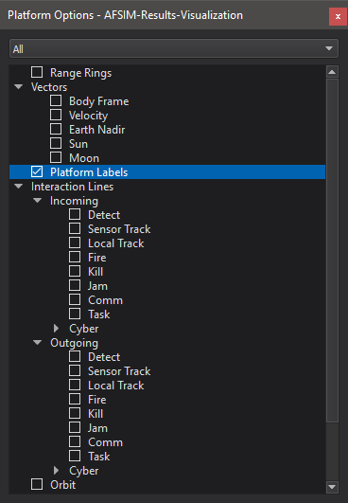
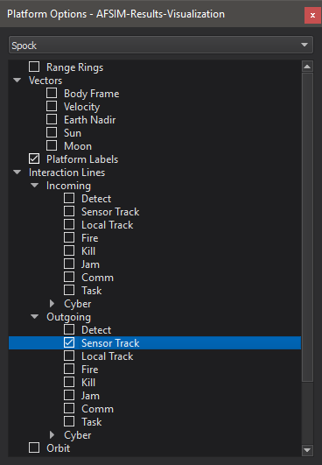
Testing (2/2)
Enable options in the “Platform Options” dock.
Platform labels (all)
Outgoing sensor tracks (Spock)
Notes:
This will allow us to see what’s going on in the scenario better.

Slide 118
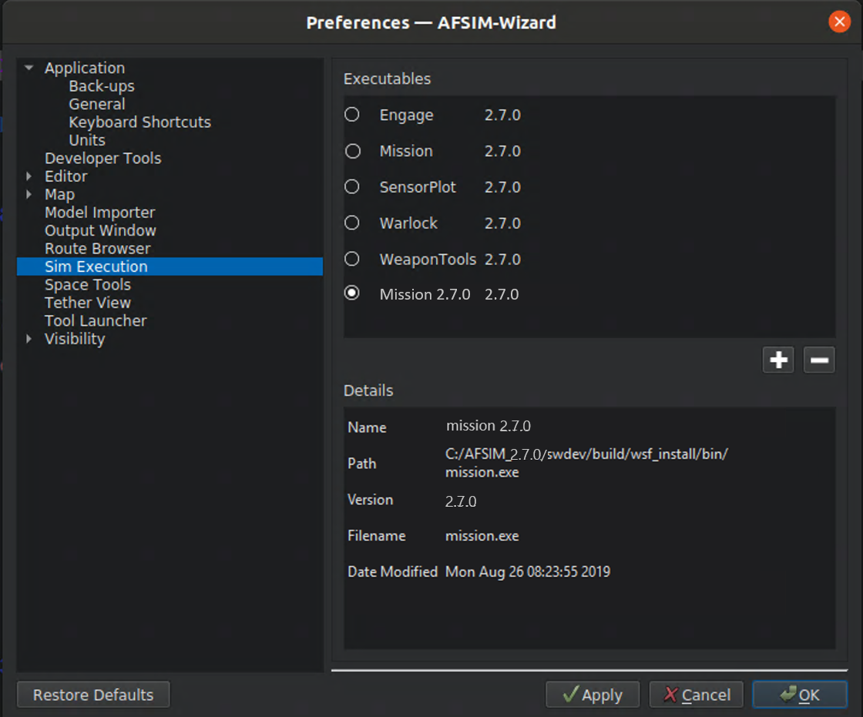
Testing (3/3)

Slide 119
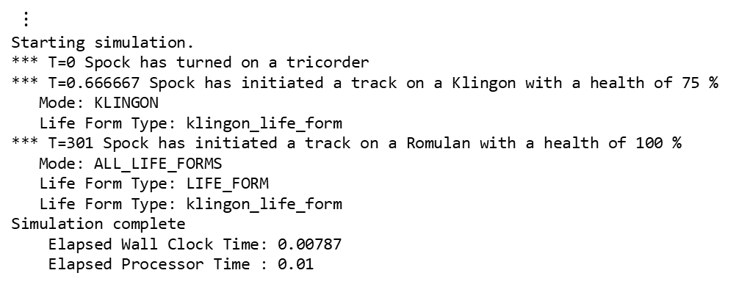
Results - Run Mystic (replay .aer file)
$⋮$
Starting simulation.
*** T=0 Spock has turned on a tricorder
*** T=0.666667 Spock has initiated a track on a Klingon with a health of 75 %
Mode: KLINGON
Life Form Type: klingon_life_form
*** T=301 Spock has initiated a track on a Romulan with a health of 100 %
Mode: ALL_LIFE_FORMS
Life Form Type: LIFE_FORM
Life Form Type: klingon_life_form
Simulation complete
Elapsed Wall Clock Time: 0.00787
Elapsed Processor Time : 0.01

Slide 121
AFSIM Developer Training
3 – Sensors Appendix
AFRL/RQQD

Slide 122
Complete Derivation of UT_DEFINE_SCRIPT_METHOD macro
The following slides in this appendix show the complete derivation of the call to the macros
UT_DEFINE_SCRIPT_METHOD(LifeFormTypeEntry_2)
and
UT_DEFINE_SCRIPT_METHOD(ScriptTricorderSensorClass,
TricorderSensor,
LifeFormTypeEntry_2,
2,
"string",
"string, int")

Slide 123
UT_DECLARE_SCRIPT_METHOD
UT_DECLARE_SCRIPT_METHOD is fairly easy to follow:
#define UT_DECLARE_SCRIPT_METHOD(METHOD_NAME) \
class METHOD_NAME : public UtScriptClass::InterfaceMethod \
{ \
public: \
METHOD_NAME(const std::string& aName = #METHOD_NAME); \
virtual void operator()(UtScriptExecutor* aExecutorPtr, \
UtScriptContext& aContext, \
const UtScriptRef& aReference, \
const std::vector<UtScriptData>& aVarArgs, \
UtScriptData& aReturnVal); \
}

Slide 124
Expansion on LifeFormEntry_2
UT_DECLARE_SCRIPT_METHOD(LifeFromEntry_2);
class LifeFormEntry_2 : public UtScriptClass::InterfaceMethod
{
public:
LifeFormEntry_2(const std::string& aName = "LifeFormEntry_2");
virtual void operator() (UtScriptExecutor* aExecutorPtr,
UtScriptContext& aContext,
const UtScriptRef& aReference,
const std::vector<UtScriptData>& aVarArgs,
UtScriptData& aReturnVal);
};
Is Transformed into

Slide 125
UT_DEFINE_SCRIPT_METHOD
Note: the code has been reordered and slightly reformatted to make it more readable
UT_DEFINE_SCRIPT_METHOD is much more complicated:
#define UT_SCRIPT_CHECK_IMP \
if (! CheckForCallErrors(aExecutorPtr, aReference, &aVarArgs, aReturnVal)) \
return;
#define UT_DEFINE_SCRIPT_METHOD(CLASS, OBJ_TYPE, METHOD, NUM_ARGS, RET_TYPE, ARG_TYPES) \
UT_DEFINE_SCRIPT_METHOD_IMP(CLASS, \
CLASS::, \
OBJ_TYPE, \
METHOD, \
NUM_ARGS, \
RET_TYPE, \
ARG_TYPES, \
UT_SCRIPT_CHECK_IMP)

Slide 126
UT_DEFINE_SCRIPT_METHOD
Note: the code has been reordered and slightly reformatted to make it more readable
UT_DEFINE_SCRIPT_METHOD is much more complicated:
#define UT_DEFINE_SCRIPT_METHOD_IMP(CLASS, SCOPE_OP, OBJ_TYPE, METHOD, NUM_ARGS, \
RET_TYPE, ARG_TYPES, CHECK_LINE) \
UT_SCRIPT_METHOD_DECL(CLASS, METHOD); \
SCOPE_OP METHOD::METHOD(const std::string& aName) \
: UtScriptClass::InterfaceMethod(aName, RET_TYPE, ARG_TYPES, NUM_ARGS) \
{ \
} \
void SCOPE_OP METHOD::operator()(UtScriptExecutor* aExecutorPtr, \
UtScriptContext& aContext, \
const UtScriptRef& aReference, \
const std::vector<UtScriptData>& aVarArgs, \
UtScriptData& aReturnVal) \
{ \
if (NUM_ARGS >= 0) \
assert(aVarArgs.size() == static_cast<size_t>(NUM_ARGS)); \
auto objPtr = aReference.GetAppObject<OBJ_TYPE>(); \
UtScriptClass* retClassPtr = GetReturnClass(); \
CHECK_LINE \
CLASS##METHOD##_Execute(aExecutorPtr, aContext, aReference, objPtr, \
mParentPtr, aReturnVal, retClassPtr, aVarArgs, this); \
} \
UT_SCRIPT_METHOD_DECL(CLASS, METHOD)

Slide 127
UT_DEFINE_SCRIPT_METHOD
Note: the code has been reordered and slightly reformatted to make it more readable
UT_DEFINE_SCRIPT_METHOD is much more complicated:
#define UT_SCRIPT_METHOD_DECL(CLASS, METHOD) \
template <class T> \
void CLASS##METHOD##_Execute(UtScriptExecutor* aExecutorPtr, \
UtScriptContext& aContext, \
const UtScriptRef& aReference, \
T* aObjectPtr, \
UtScriptClass* aObjectClassPtr, \
UtScriptData& aReturnVal, \
UtScriptClass* aReturnClassPtr, \
const std::vector<UtScriptData>& aVarArgs, \
UtScriptClass::InterfaceMethod* aInterfaceMethodPtr)
#define UT_SCRIPT_ABORT(MESSAGE_) \
aInterfaceMethodPtr->ReportCallErrors(nullptr, nullptr, &aVarArgs, aReturnVal, (MESSAGE_)); return

Slide 128
Expansion on LifeFormEntry_2 Original UT_DEFINE_SCRIPT_METHOD call
// int lifeFormEntry = <x>.LifeFormTypeEntry(string aModeName, int aEntryIndex);
UT_DEFINE_SCRIPT_METHOD(ScriptTricorderSensorClass, TricorderSensor, LifeFormTypeEntry_2, 2, "string", "string, int")
{
// Argument 1: string aModeName
// Argument 2: int aEntryIndex
// Use the mode name provided and convert to string ID
WsfStringId modeNameId = WsfStringId(aVarArgs[0].GetString());
unsigned index = (unsigned)aVarArgs[1].GetInt();
if (index >= aObjectPtr->GetLifeFormTypeCount(modeNameId))
{
UT_SCRIPT_ABORT("Bad mode name");
}
WsfStringId lifeFormEntry = aObjectPtr->GetLifeFormTypeEntry(modeNameId, index);
if (lifeFormEntry == nullptr)
{
UT_SCRIPT_ABORT("Bad index");
}
else
{
aReturnVal.SetString(lifeFormEntry.GetString());
}
}
This is the code to
be executed, when
the script method is
called
Is Transformed into:

Slide 129
Expansion on LifeFormEntry_2 Step 1: After expansion of UT_DEFINE_SCRIPT_METHOD
UT_DEFINE_SCRIPT_METHOD_IMP(ScriptTricorderSensorClass, ScriptTricorderSensorClass::, TricorderSensor, LifeFormTypeEntry_2, 2, "string", "string, int", UT_SCRIPT_CHECK_IMP)
{
// Argument 1: string aModeName
// Argument 2: int aEntryIndex
// Use the mode name provided and convert to string ID
WsfStringId modeNameId = WsfStringId(aVarArgs[0].GetString());
unsigned index = (unsigned)aVarArgs[1].GetInt();
if (index >= aObjectPtr->GetLifeFormTypeCount(modeNameId))
{
UT_SCRIPT_ABORT("Bad mode name");
}
WsfStringId lifeFormEntry = aObjectPtr->GetLifeFormTypeEntry(modeNameId, index);
if (lifeFormEntry == nullptr)
{
UT_SCRIPT_ABORT("Bad index");
}
else
{
aReturnVal.SetString(lifeFormEntry.GetString());
}
}
This is the code to
be executed, when
the script method is
called
Is Transformed into:

Slide 130
Expansion on LifeFormEntry_2 Step 2: After expansion of UT_SCRIPT_CHECK_IMP
UT_DEFINE_SCRIPT_METHOD_IMP(ScriptTricorderSensorClass, ScriptTricorderSensorClass::, TricorderSensor, LifeFormTypeEntry_2, 2, "string", "string, int",
if (! CheckForCallErrors(aExecutorPtr, aReference, &aVarArgs, aReturnVal)) return;)
{
// Argument 1: string aModeName
// Argument 2: int aEntryIndex
// Use the mode name provided and convert to string ID
WsfStringId modeNameId = WsfStringId(aVarArgs[0].GetString());
unsigned index = (unsigned)aVarArgs[1].GetInt();
if (index >= aObjectPtr->GetLifeFormTypeCount(modeNameId))
{
UT_SCRIPT_ABORT("Bad mode name");
}
WsfStringId lifeFormEntry = aObjectPtr->GetLifeFormTypeEntry(modeNameId, index);
if (lifeFormEntry == nullptr)
{
UT_SCRIPT_ABORT("Bad index");
}
else
{
aReturnVal.SetString(lifeFormEntry.GetString());
}
}
This is the code to
be executed, when
the script method is
called
Is Transformed into:

Slide 131

Expansion on LifeFormEntry_2 Step 3: After expansion of UT_DEFINE_SCRIPT_METHOD_IMP
UT_SCRIPT_METHOD_DECL(ScriptTricorderSensorClass, LifeFormTypeEntry_2);
ScriptTricorderSensorClass::LifeFormTypeEntry_2::LifeFormTypeEntry_2(const std::string& aName)
: UtScriptClass::InterfaceMethod(aName, "string", "string, int", 2)
{
}
void ScriptTricorderSensorClass::LifeFormTypeEntry_2::operator()(UtScriptExecutor* aExecutorPtr,
UtScriptContext& aContext,
const UtScriptRef& aReference,
const std::vector<UtScriptData>&
UtScriptData& aReturnVal)
{
if (2 >= 0)
assert(aVarArgs.size() == static_cast<size_t>(2));
auto objPtr = aReference.GetAppObject<TricorderSensor>();
UtScriptClass* retClassPtr = GetReturnClass();
if (! CheckForCallErrors(aExecutorPtr, aReference, &aVarArgs, aReturnVal)) return;
ScriptTricorderSensorClassLifeFormTypeEntry_2_Execute(aExecutorPtr, aContext, aReference, objPtr,
mParentPtr, aReturnVal,
retClassPtr, aVarArgs, this);
}
UT_SCRIPT_METHOD_DECL(ScriptTricorderSensorClass, LifeFormTypeEntry_2)
{
// Argument 1: string aModeName
// Argument 2: int aEntryIndex
$⋮$
}
aVarArgs,
Is Transformed into:
This is the code to
be executed, when
the script method is
called

Slide 132
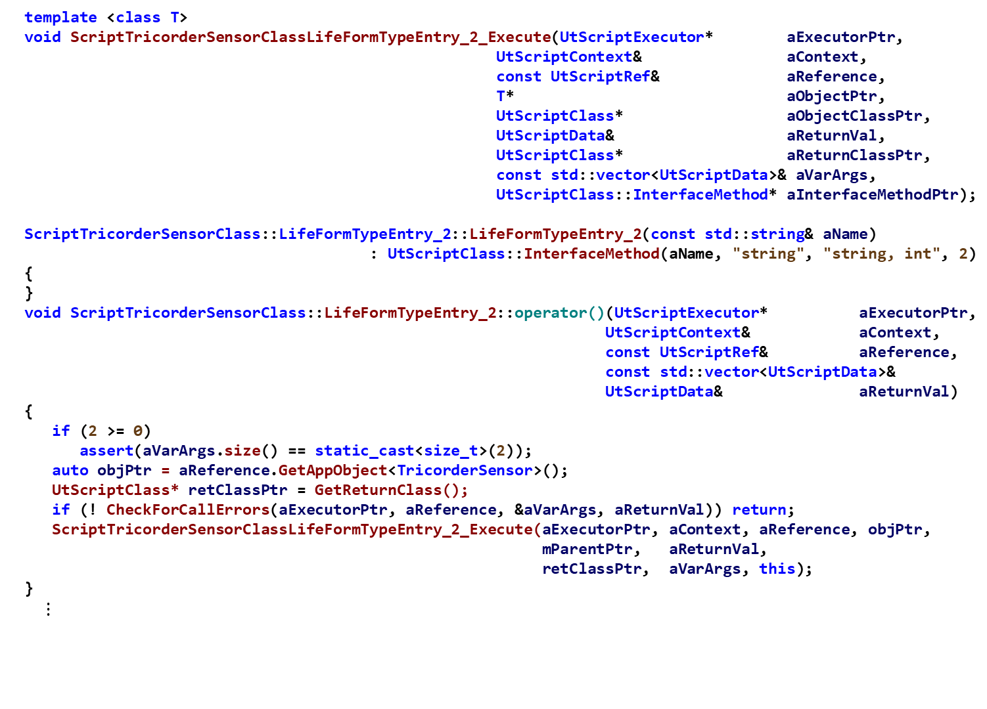
Expansion on LifeFormEntry_2 Step 4: After expansion of UT_SCRIPT_METHOD_DECL
template <class T>
void ScriptTricorderSensorClassLifeFormTypeEntry_2_Execute(UtScriptExecutor* aExecutorPtr,
UtScriptContext& aContext,
const UtScriptRef& aReference,
T* aObjectPtr,
UtScriptClass* aObjectClassPtr,
UtScriptData& aReturnVal,
UtScriptClass* aReturnClassPtr,
const std::vector<UtScriptData>& aVarArgs,
UtScriptClass::InterfaceMethod* aInterfaceMethodPtr);
ScriptTricorderSensorClass::LifeFormTypeEntry_2::LifeFormTypeEntry_2(const std::string& aName)
: UtScriptClass::InterfaceMethod(aName, "string", "string, int", 2)
{
}
void ScriptTricorderSensorClass::LifeFormTypeEntry_2::operator()(UtScriptExecutor* aExecutorPtr,
UtScriptContext& aContext,
const UtScriptRef& aReference,
const std::vector<UtScriptData>&
UtScriptData& aReturnVal)
{
if (2 >= 0)
assert(aVarArgs.size() == static_cast<size_t>(2));
auto objPtr = aReference.GetAppObject<TricorderSensor>();
UtScriptClass* retClassPtr = GetReturnClass();
if (! CheckForCallErrors(aExecutorPtr, aReference, &aVarArgs, aReturnVal)) return;
ScriptTricorderSensorClassLifeFormTypeEntry_2_Execute(aExecutorPtr, aContext, aReference, objPtr,
mParentPtr, aReturnVal,
retClassPtr, aVarArgs, this);
}
$⋮$
aVarArgs,

Slide 133

Expansion on LifeFormEntry_2 Step 4: After expansion of UT_SCRIPT_METHOD_DECL
template <class T>
void ScriptTricorderSensorClassLifeFormTypeEntry_2_Execute(UtScriptExecutor* aExecutorPtr,
UtScriptContext& aContext,
const UtScriptRef& aReference,
T* aObjectPtr,
UtScriptClass* aObjectClassPtr,
UtScriptData& aReturnVal,
UtScriptClass* aReturnClassPtr,
const std::vector<UtScriptData>& aVarArgs,
UtScriptClass::InterfaceMethod* aInterfaceMethodPtr)
{
// Argument 1: string aModeName
// Argument 2: int aEntryIndex
// Use the mode name provided and convert to string ID
WsfStringId modeNameId = WsfStringId(aVarArgs[0].GetString());
unsigned index = (unsigned)aVarArgs[1].GetInt();
if (index >= aObjectPtr->GetLifeFormTypeCount(modeNameId))
{
UT_SCRIPT_ABORT("Bad mode name");
}
$⋮$
This is the code to
be executed, when
the script method is
called

Slide 134
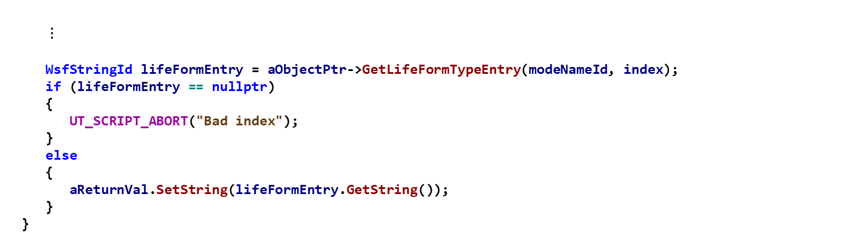
Expansion on LifeFormEntry_2 Step 4: After expansion of UT_SCRIPT_METHOD_DECL
$⋮$
WsfStringId lifeFormEntry = aObjectPtr->GetLifeFormTypeEntry(modeNameId, index);
if (lifeFormEntry == nullptr)
{
UT_SCRIPT_ABORT("Bad index");
}
else
{
aReturnVal.SetString(lifeFormEntry.GetString());
}
}
This is the code to
be executed, when
the script method is
called

Slide 135
UT_SCRIPT_ABORT
Note: the code has been reordered and slightly reformatted to make it more readable
UT_SCRIPT_ABORT is define as:
#define UT_SCRIPT_ABORT(MESSAGE_) \
aInterfaceMethodPtr->ReportCallErrors(nullptr, nullptr, &aVarArgs, aReturnVal, (MESSAGE_)); return

Slide 136

Expansion in <xxx>_Execute method Step 5: After expansion of UT_SCRIPT_ABORT
template <class T>
void ScriptTricorderSensorClassLifeFormTypeEntry_2_Execute(UtScriptExecutor* aExecutorPtr,
UtScriptContext& aContext,
const UtScriptRef& aReference,
T* aObjectPtr,
UtScriptClass* aObjectClassPtr,
UtScriptData& aReturnVal,
UtScriptClass* aReturnClassPtr,
const std::vector<UtScriptData>& aVarArgs,
UtScriptClass::InterfaceMethod* aInterfaceMethodPtr)
{
// Argument 1: string aModeName
// Argument 2: int aEntryIndex
// Use the mode name provided and convert to string ID
WsfStringId modeNameId = WsfStringId(aVarArgs[0].GetString());
unsigned index = (unsigned)aVarArgs[1].GetInt();
if (index >= aObjectPtr->GetLifeFormTypeCount(modeNameId))
{
aInterfaceMethodPtr->ReportCallErrors(nullptr, nullptr, &aVarArgs, aReturnVal, (("Bad mode name");
return;
}
$⋮$
This is the code to
be executed, when
the script is called

Slide 137
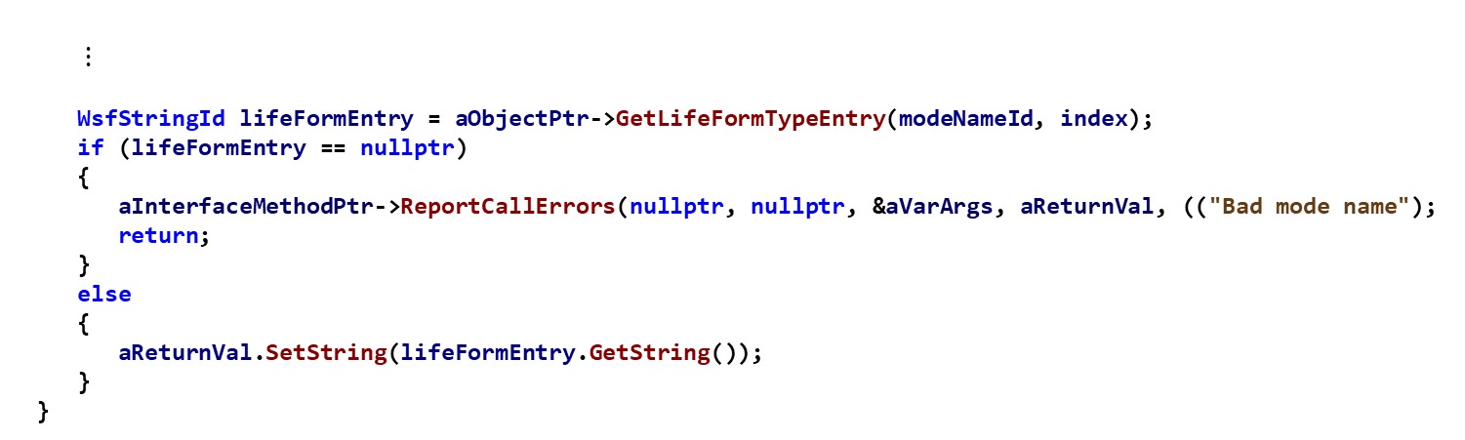
Expansion in <xxx>_Execute method Step 5: After expansion of UT_SCRIPT_ABORT
$⋮$
WsfStringId lifeFormEntry = aObjectPtr->GetLifeFormTypeEntry(modeNameId, index);
if (lifeFormEntry == nullptr)
{
aInterfaceMethodPtr->ReportCallErrors(nullptr, nullptr, &aVarArgs, aReturnVal, (("Bad mode name");
return;
}
else
{
aReturnVal.SetString(lifeFormEntry.GetString());
}
}
This is the code to
be executed, when
the script is called

