Slide 1
AFSIM Developer Training
6 – Movers
AFRL/RQQD

Slide 2
Acronyms and Definitions
AFSIM - Advanced Framework for Simulation, Integration, and Modeling
AGL – Above Ground Level
DIS – Distributed Interactive Simulation
DTED – Digital Terrain Elevation Data
EO/IR – Electro-Optical/Infra-Red
ESM – Electronic Support Measure
FOV – Field Of View
GUI – Graphical User Interface
HLA – High Level Architecture
IEEE – Institute of Electrical & Electronics Engineers, Inc.
JTIDS – Joint Tactical Information Distribution System
MSL – Mean Sea Level
PDU – Protocol Data Unit
RCS – Radar Cross Section
SAM – Surface-to-Air Missile
SAR – Synthetic Aperture Radar
VESPA – Visual Environment for Scenario Preparation and Analysis
WKF – Warlock Framework
WSF – World Simulation Framework
dB - decibels
dBsm – decibel square meters
deg – degrees
ft – feet
GHz– GigaHertz
kts – knots
m - meters
m^2 – square meters
mw – megawatts
nm – nautical miles
s – seconds

Slide 3
Introduction
This lab demonstrates how to create a new AFSIM mover.
A mover is a platform component that is responsible for maintaining the kinematic state (position, orientation, speed, acceleration, etc.) of the platform to which it is attached.
The following exercises provides practice working with AFSIM movers.
Exercise 1: Registering the AFSIM Mover
Exercise 2: Creating a custom AFSIM mover
Exercise 3 [optional]: Compiling a MATLAB shared library
Note: Unless you have MATLAB installed on
your machine, this exercise can only be completed
in MS Visual Studio running on MS Windows

Slide 4
Problem Statement
You will create a new mover type called MATLAB_BALLISTIC_MOVER
The mover represents a simple ballistic multi-staged missile
The kinematic calculations are performed using a MATLAB® dynamic-link library (DLL)
To achieve this, we will create a new plugin and a new application extension
References:
AFSIM Developers Web-based data.
AFSIM Source Codes and Visual Studio search functions.
AFSIM Documentation.

Slide 5
Learning Objectives
You gain hands-on knowledge about:
Creating new types of movers
Implementing an "Update" method for a multi-staged ballistic mover
Using the MATLAB® Compiler Runtime library utility to initialize, interact, and terminate the MATLAB-compiled DLL
Creating new script types
You reinforce your skills with creating an application extension and a plugin

Slide 6
Prerequisites
Before working on this lab, you should:
Be familiar with WIZARD and AFSIM scripting Language
AFSIM analyst course or equivalent experience is recommended
Have available and be familiar with using Microsoft® Visual Studio 2017® or newer to compile an application
Be familiar with using Microsoft Windows® Explorer
Have completed the Module “Building AFSIM with CMAKE”
Be familiar with using cmake-gui
MATLAB MCR 9.1 needs to be installed
Available for free on mathworks.com site

Slide 7

Movers in the AFSIM Framework
AFSIM includes a robust set of mover options within the basic framework
Using the C++ architecture, developers can extend classes to create new movers or new mover behaviors
AFSIM Framework
Infrastructure
Interface
Scenario Management
Time Management
Time Management
Geospatial Data Management
Event Management
Utilities
Geospatial Data Management
Scripting
Language
Distributed Simulation Interfaces
Scenario Management
Script
Distributed Simulation Interfaces
Event Management
Plug-in
Management
Observers
Extensions
Simulation Management
Observers
Extensions
Components
Platform Components
Movers
Sensors
Weapons
Communications
Processors
Other Platform
Components
Non-Platform
Components
Sensor
Components
Weapon
Components
Comm
Components
Processor
Components
$$…$$

Slide 8
How Movers Move
A 'mover' is a Platform Part that is Responsible for Maintaining the Kinematic State (Position, Orientation, Speed, Acceleration, etc) of the Platform to Which it is Attached
It is Called by the Simulation to Effect the Movement of Platforms Within a Simulation.
Integrating a New Mover is as Simple as Implementing the “Update” Method in a Derived Class
Update is called from an event when using the WsfEventStepSimulation
Update is called directly when using the WsfFrameStepSimulation

Slide 9
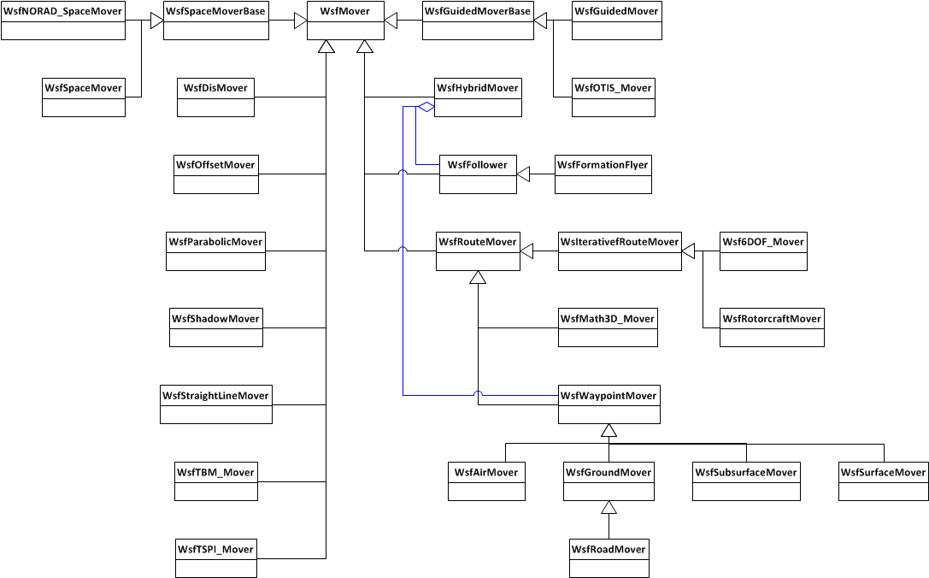
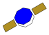
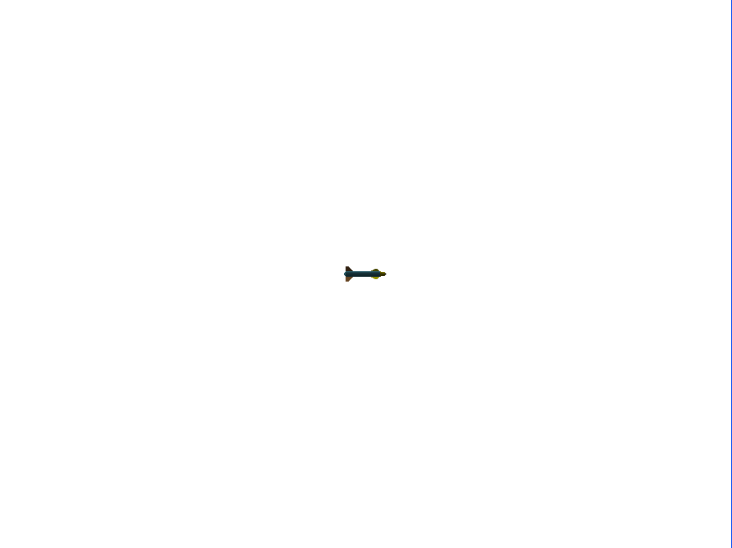
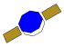
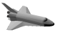
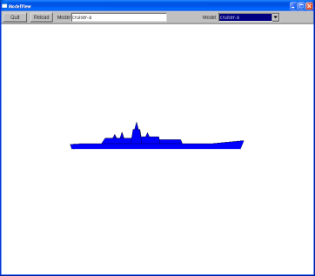

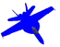
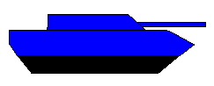
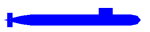

Movers

Slide 10
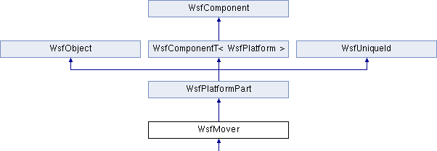
Mover Exercise Extends WsfMover Class
You will add a new MATLABBallisticMover class to AFSIM.
We will create a new class named “MATLABBalisticMover that will implement the ballistic missile’s multi-stage mover functionality
MATLABBallisticMover

Slide 11
MATLAB® Ballistic Missile Physics
A simple ballistic missile mover
Multi-staged
Launched vertically
Uses a user-defined pitch interval and dynamic pressure constraint to provide smooth pitch over during boost
Drag is only modeled during boost
Assumes constant beta (sideslip angle)
Coefficient of drag does not vary with Mach
The air density is modeled using an exponential approximation

Slide 12
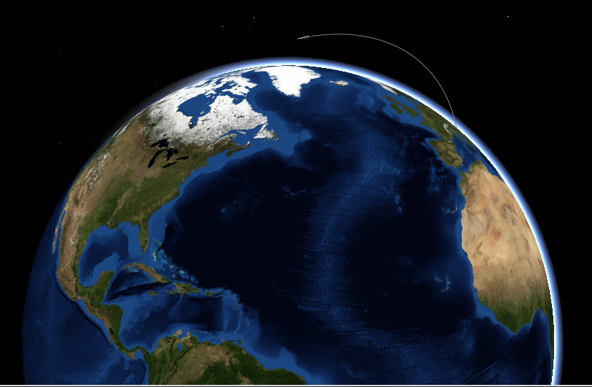
Mover Scenario
The input file declares a platform type of 'ICBM' that uses a MATLAB_BALLISTIC_MOVER
The MATLAB_BALLISTIC_MOVER is a multi-staged vehicle
The platform 'ballistic_missile-1' has a MATLAB_BALLISTIC_MOVER mover with the given initial position, heading, and pitch
The "end time" is set for 3000 simulated seconds
Note that the mover_scenario.txt specifies file mover_scenario.aer to hold data to replay the scenario using Mystic to verify operations

Slide 13
New Input Parameters
mover MATLAB_BALLISTIC_MOVER
update_interval 1 sec
stage 1
fuel_mass 27941 kg
total_mass 31343 kg
thrust 1230600 Nt
burn_time 76 sec
end_stage
stage 2
fuel_mass 8872.3 kg
total_mass 10233 kg
thrust 529290 Nt
burn_time 59 sec
end_stage
stage 3
fuel_mass 3265.9 kg
total_mass 4209.3 kg
thrust 200140 Nt
burn_time 49 sec
end_stage
drag_coeff 0.4
effective_area 2.986 meters^2
mass_payload 900 kg
maxq 650 // lb/ft^2
pitch_interval 35 sec
vertical_time 10 sec
end_mover
Example input:
Processed by method
MATLABBallisticMover::ProcessInput

Slide 14
New Input Parameters
mover MATLAB_BALLISTIC_MOVER
update_interval 1 sec
stage 1
fuel_mass 27941 kg
total_mass 31343 kg
thrust 1230600 Nt
burn_time 76 sec
end_stage
stage 2
fuel_mass 8872.3 kg
total_mass 10233 kg
thrust 529290 Nt
burn_time 59 sec
end_stage
stage 3
fuel_mass 3265.9 kg
total_mass 4209.3 kg
thrust 200140 Nt
burn_time 49 sec
end_stage
drag_coeff 0.4
effective_area 2.986 meters^2
mass_payload 900 kg
maxq 650 // lb/ft^2
pitch_interval 35 sec
vertical_time 10 sec
end_mover
Example input:
Processed by method
MATLABBallisticMover::Stage::ProcessInput

Slide 15
Getting Started (1/4)
Incorporate a MATLAB®-compiled C++ shared library into mover project
Use the MATLAB® Compiler Runtime (MCR), which is a standalone set of shared libraries supplied by MATLAB®, to enable the execution of the compiled M-files with the C++ mover project
Installing MATLAB® Compiler Runtime (MCR)
The MCR needs to be installed on the target machine that you want to run on if you do not have MATLAB® installed
You only have to install the MCR once
You Must Restart Your Computer After Installing MCR
The MCR is specific to each version of MATLAB® so ensure that when giving or receiving MATLAB®-compiled shared libraries that a correct version of the MCR is supplied (MCRInstaller.exe)
Installation of the MCR is relatively straightforward under Microsoft® Windows

Slide 16
Getting Started (2/4)
Open CMake GUI
Check BUILD_WITH_mover_exercise
Press “Configure”
(Respond to any prompts asking for a compiler)
Make sure the options for MCR_INCLUDE_LOCATION and MCR_LIBRARY_LOCATION correctly refer to the <MCR install folder>
Press “Generate”
Notes:
If you attempt to use a 64 bit compiler, cmake will complain. Make sure you are using a 32 bit compiler.

Slide 17
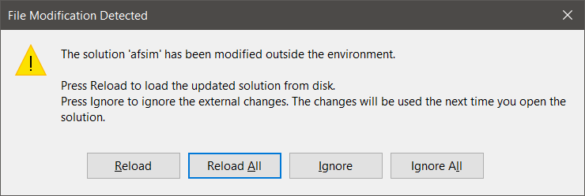
Getting Started (3/4)
If Visual Studio is already open:
Navigate to it and select Reload All when prompted.
Alternatively, open the solution file afsim.sln by:
Opening from labs\build
Clicking “Open Project” from CMake

Slide 18
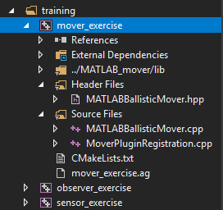
Getting Started (4/4)
This project uses the following source files:
MoverPluginRegistration.cpp
MATLABBallisticMover.hpp
MATLABBallisticMover.cpp
Note that many solutions are possible; we have provided a solution in order to complete our training exercise in a short time period.

Slide 19
Classes Utilized by this Exercise
This exercise utilizes the following classes:
class MATLABBallisticMover : public WsfMover
Creates a new type of mover
Maintains many variables related to MATLAB
Maintains many variables related to the mover
class Stage
Internal to MATLABBallisticMover
Represents one stage in a (potentially) multi-stage vehicle
Maintains FuelMass, TotalMass, Thrust, and ThrustDuration of the stage
class RegisterMATLAB_BallisticMover : public WsfApplicationExtension
This class is registered with the Standard Application as an Application extension
Overrides the ScenarioCreated which adds the MATLAB_BALLISTIC_MOVER as a new mover type (after the scenario has been created by mission/warlock)

Slide 20
Mover Exercises
Exercise 1
Complete registration of application extension
Initialize and Terminate the MATLAB library
Exercise 2
Complete the implementations of ProcessInput, Initialize, Update, and UpdatePlatform for MATLABBallisticMover
Exercise 3 (optional)
Create and Deploy the MATLAB library file

Slide 21
Exercise 1
Register the Application Extension
Initialize the MATLAB shared library when the scenario has been created
Terminate the MATLAB shared library when AFSIM terminates
Add a new mover type to the scenario of type MATLABBallisticMover

Slide 22
AFSIM Plugins & Extensions
WsfExtension
WsfScenario
WsfSimulation
WsfApplication
WsfStandardApplication
WsfSimulationExtension
WsfScenarioExtension
WsfApplicationExtension
Main application classes used
in mission/warlock
All AFSIM extensions must derive from WsfExtension:
Three predefined extension classes already exist (can be inherited from)
WsfScenarioExtension – extensions that will provide new scenario commands (requiring a new ProcessInput for those commands) will need to inherit this class
WsfSimulationExtension – extensions that will access the simulation will need to inherit this class
WsfApplicationExtension – extensions that will create new script types, or will utilize a simulation extension or scenario extension, will need to inherit this class

Slide 23
AFSIM Plugins & Extensions
WsfExtension
WsfScenario
WsfSimulation
WsfApplication
WsfStandardApplication
WsfSimulationExtension
WsfScenarioExtension
WsfApplicationExtension
Main application classes used
in mission/warlock
RegisterMATLAB_BallisticMover
Sets up the new Application Extension
classes to work with AFSIM
All AFSIM extensions must derive from WsfExtension:
Three predefined extension classes already exist (can be inherited from)
WsfScenarioExtension – extensions that will provide new scenario commands (requiring a new ProcessInput for those commands) will need to inherit this class
WsfSimulationExtension – extensions that will access the simulation will need to inherit this class
WsfApplicationExtension – extensions that will create new script types, or will utilize a simulation extension or scenario extension, will need to inherit this class

Slide 24
Extensions
Applications, Scenarios, and Simulations can all be “Extended”
Application Extensions are owned by the Application
Represent optional capabilities that can be added to an application.
Used if you need new script types (sensors, weapons, components, movers)
This is the entry point to registering all extensions in AFSIM
An application extension is required if you are going to create a scenario extension or a simulation extension
We also need an application extension if
We are creating new scripts
We need to register types with the scenario
We need the new plugin because we are creating a new type
Here we need to register the plugin with the application extension (see the file MoverPluginRegistration.cpp)

Slide 25
Mover Exercise 1 — Review 1
Review and Understand How the Plugins are set up
Look at WsfPluginSetup and note the call to RegisterExtension to register the WsfApplicationExtension (our RegisterMATLAB_BallisticMover class)
Look at WsfPluginVersion and note the call to UtPluginVersion
Same as the code in the Weapons exercise

Slide 26
Mover Exercise 1 — Review 1 MoverPluginRegistration.cpp
extern "C"
{
MOVER_EXERCISE_EXPORT void WsfPluginVersion(UtPluginVersion& aVersion)
{
aVersion = UtPluginVersion(WSF_PLUGIN_API_MAJOR_VERSION,
WSF_PLUGIN_API_MINOR_VERSION,
WSF_PLUGIN_API_COMPILER_STRING);
}
MOVER_EXERCISE_EXPORT void WsfPluginSetup(WsfApplication& aApplication)
{
aApplication.RegisterExtension("register_matlab_ballistic_mover",
ut::make_unique<RegisterMATLAB_BallisticMover>());
}
}

Slide 27
Application Extensions
To extend an Application, you must create a class that inherits class WsfApplicationExtension
class myAppExtension: public WsfApplicationExtension { … }
You should override the following members:
AddedToApplication: to receive notification that extension was added to the application – often used to register additional script class and methods, etc.
ScenarioCreated: called at end of Scenario constructor in order to receive notification from the application that the scenario was created – useful to register an Scenario extension if needed
SimulationCreated: called from the Simulation’s Initialize method in order to receive notification from the application that the simulation was created – useful to register an Simulation extension if needed
ProcessCommandLine: called from WsfApplication::ProcessCommandLine method to examine current argument and process it if necessary
PrintGrammar: prints out the extended grammar recognized by the extension
ProcessCommandLineCommands: called by WsfApplication’s ProcessCommandLineCommands to allow the extension to process/handle any commands it needs to recognize

Slide 28
Application Extensions
We will create an Application Extension called RegisterMATLAB_BallisticMover which will register some new scripts
class RegisterMATLAB_BallisticMover: public WsfApplicationExtension { … }
This class will override the following members:
ScenarioCreated: called at end of Scenario constructor in order to receive notification from the application that the scenario was created – useful to register an Scenario extension if needed

Slide 29
Mover Exercise 1 — Review 2
In file MoverPluginRegistration.cpp
In the class RegisterMATLAB_BallisticMover:
Look at ScenarioCreated and review the initialization and destruction of:
MATLAB® Compiler Runtime (MCR) instance
MATLAB generated libAFSIM_Mover shared library
Also, look at the destructor and review the destruction of and destruction of:
MATLAB generated libAFSIM_Mover shared library
MATLAB® Compiler Runtime (MCR) instance

Slide 30
Mover Exercise 1 — Review 2 MoverPluginRegistration.cpp
class RegisterMATLAB_BallisticMover : public WsfApplicationExtension
{
public:
RegisterMATLAB_BallisticMover()
{
}
~RegisterMATLAB_BallisticMover() noexcept override
{
// Clean up the Matlab Compiler Runtime.
libAFSIM_MoverTerminate();
mclTerminateApplication();
}
void ScenarioCreated(WsfScenario& aScenario) override
{
// To use a MATLAB shared library, you must initialize and terminate
// the MATLAB Compiler Runtime instance correctly.
if (!mclInitializeApplication(NULL, 0) || !libAFSIM_MoverInitialize())
{
ut::log::error << "Could not initialize MATLAB libraries!";
exit(-1);
}
// Exercise 1 Task 1
}
};

Slide 31
Mover Exercise 1 — Task 1
In the RegisterMATLAB_BallisticMover::ScenarioCreated:
Register the MATLABBallisticMover class as an application extension with the name “MATLAB_BALLISTIC_MOVER”
Using aScenario, call GetMoverTypes
Using the WsfMoverTypes object returned in the previous step, call Add, and pass in the name and a new unique_ptr to a MATLABBallisticMover object that is constructed from the scenario variable aScenario.

Slide 32
Mover Exercise 1 — Task 1 Solution MoverPluginRegistration.cpp
class RegisterMATLAB_BallisticMover : public WsfApplicationExtension
{
public:
RegisterMATLAB_BallisticMover()
{
}
~RegisterMATLAB_BallisticMover() noexcept override
{
// Clean up the Matlab Compiler Runtime.
libAFSIM_MoverTerminate();
mclTerminateApplication();
}
void ScenarioCreated(WsfScenario& aScenario) override
{
// To use a MATLAB shared library, you must initialize and terminate
// the MATLAB Compiler Runtime instance correctly.
if (!mclInitializeApplication(NULL, 0) || !libAFSIM_MoverInitialize())
{
ut::log::error << "Could not initialize MATLAB libraries!";
exit(-1);
}
// Exercise 1 Task 1
aScenario.GetMoverTypes().Add("MATLAB_BALLISTIC_MOVER",
ut::make_unique<MATLABBallisticMover>(aScenario));
}
};

Slide 33
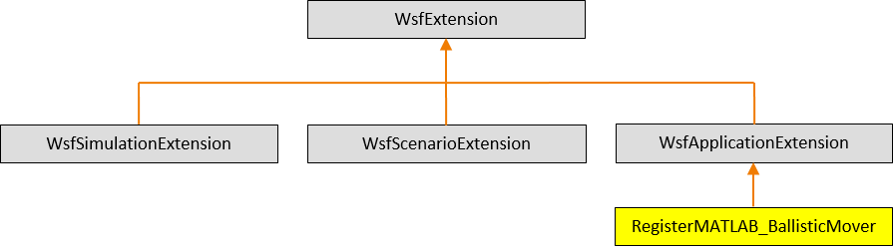
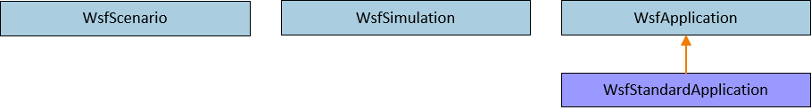
AFSIM Plugins & Extensions AFSIM mission startup sequence
First, mission creates a WsfStandardApplication named app
mission::main()
unique_ptr<RegisterMATLAB_BallisticMover>
WsfStandardApplication: app
WsfStandardApplication::WsfStandardApplication()
MoverPluginRegistration.cpp:WsfPluginSetup()
WsfPluginSetup()
RegisterExtension(“register_matlab_ballistic_mover”, ut::make_unique<RegisterMATLAB_BallisticMover>())
AddedToApplication()
The WsfStandardApplication constructor utilizes the plugin manager to find and load all plugins (including those in the training folders - because of the cmake option WSF_ADD_EXTENSION_PATH)
For each plugin found, executes WsfPluginSetup (note: this causes our mover exercise plugin’s WsfPluginSetup function to execute)
This causes our mover exercise’s RegisterMATLAB_BallisticMover class, which is an Application Extension, to be created and registered with app
RegisterExtension then invokes WsfApplicationExtension::AddedToApplication(),
Note: RegisterMATLAB_BallisticMover does not override AddedToApplication, hence this notification has no effect

Slide 34

AFSIM Plugins & Extensions AFSIM mission startup sequence
mission::main()
unique_ptr<RegisterMATLAB_BallisticMover>
WsfStandardApplication: app
RegisterExtension(…)
RegisterExtension(…)
$$⋮$$
RegisterExtension(…)
Mission then registers all of the necessary predefined extensions with app

Slide 35
AFSIM Plugins & Extensions AFSIM mission startup sequence
mission::main()
unique_ptr<RegisterMATLAB_BallisticMover>
WsfScenario: scenario
WsfStandardApplication: app
WsfScenario::WsfScenario(app)
ScenarioCreated(…)
ScenarioCreated(…)
Mission then creates the scenario and invokes the WsfScenario constructor: WsfScenario scenario(app);
This constructor invokes the WsfApplication::ScenarioCreated() method
This, in turn, invokes ScenarioCreated() for all registered application extensions (including our RegisterMATLAB_BallisticMover extension)
RegisterMATLAB_BallisticMover::ScenarioCreated() creates and adds the MATLABBallisticMover type to the list of mover types, so that they can have their ProcessInput() methods invoked when MATLAB_BALLISTIC_MOVER commands are found in the scenario files

Slide 36
AFSIM Plugins & Extensions AFSIM mission startup sequence
mission::main()
MATLABBallisticMover
unique_ptr<RegisterMATLAB_BallisticMover>
WsfScenario: scenario
WsfStandardApplication: app
WsfStandardApplication::ProcessInputFiles()
MATLABBallisticMover::ProcessInput(…)
WsfScenario::LoadFromFile(…)
ProcessInput(…)
Mission invokes app.WsfStandardApplication::ProcessInputFiles()
which invokes WsfScenario::LoadFromFile()
For each command in input,
Invoke each of the core classes’ ProcessInput() methods
Invokes the MATLABBallisticMover::ProcessInput() to handle MATLABBallisticMover commands
Invoke each registered scenario extension’s ProcessInput() – has no effect since there is no Scenario extension defined for MATLABBallisticMover
Note: a MATLABBallisticMover object is created when a MATLABBallisticMover block command is encountered in the scenario input files

Slide 37
AFSIM Plugins & Extensions AFSIM mission startup sequence
mission::main()
unique_ptr<RegisterMATLAB_BallisticMover>
WsfScenario: scenario
WsfStandardApplication: app
WsfStandardApplication::ProcessInputFiles()
Complete(…)
WsfScenario::CompleteLoad(…)
Complete2(…)
Mission invokes app.WsfStandardApplication::ProcessInputFiles()
which, invokes WsfScenario::LoadFromFile()
and then invokes WsfScenario::CompleteLoad()
Invokes each scenario extension’s Complete()
Then invokes each scenario extension’s Complete2()
Note: None of our classes inherit WsfScenarioExtension, so no Complete or Complete2 are defined that need to be called

Slide 38
AFSIM Plugins & Extensions AFSIM mission startup sequence
mission::main()
unique_ptr<RegisterMATLAB_BallisticMover>
WsfScenario: scenario
unique_ptr<WsfSimulation>: simPtr
WsfStandardApplication: app
WsfStandardApplication::CreateSimulation()
WsfSimulation::WsfSimulation()
Mission creates the Simulation by executing:
std::unique_ptr<WsfSimulation> simPtr =
app.CreateSimulation(scenario, …);
CreateSimulation invokes the WsfSimulation object’s constructor (with scenario as argument)

Slide 39
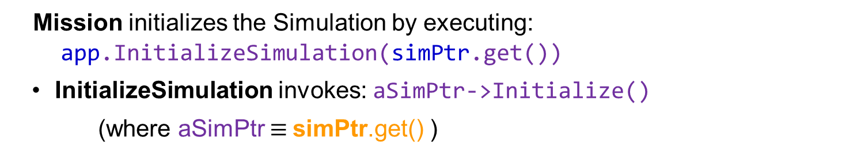
AFSIM Plugins & Extensions AFSIM mission startup sequence
mission::main()
unique_ptr<RegisterMATLAB_BallisticMover>
WsfScenario: scenario
unique_ptr<WsfSimulation>: SimPtr
WsfStandardApplication: app
WsfStandardApplication::InitializeSimulation()
WsfSimulation::Initialize()
Mission initializes the Simulation by executing:
app.InitializeSimulation(simPtr.get())
InitializeSimulation invokes: aSimPtr->Initialize()
(where aSimPtr $≡$simPtr.get() )

Slide 40
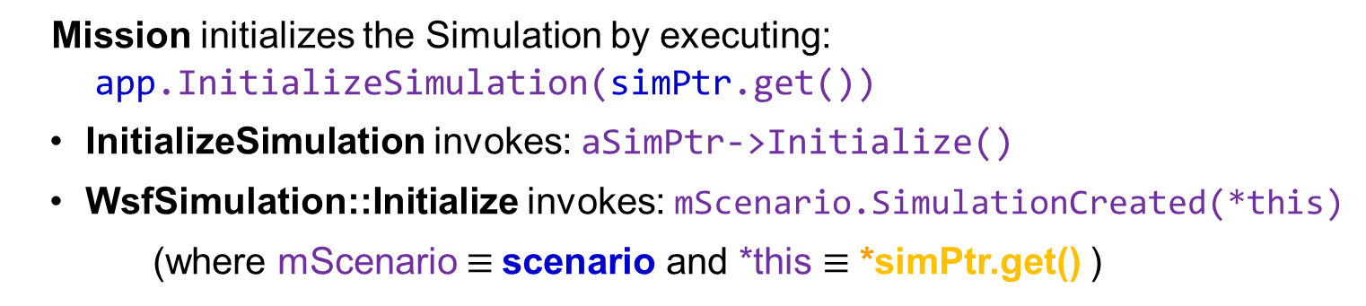
AFSIM Plugins & Extensions AFSIM mission startup sequence
mission::main()
unique_ptr<RegisterMATLAB_BallisticMover>
WsfScenario: scenario
unique_ptr<WsfSimulation>: SimPtr
WsfStandardApplication: app
WsfStandardApplication::InitializeSimulation()
WsfScenario::SimulationCreated()
WsfSimulation::Initialize()
Mission initializes the Simulation by executing:
app.InitializeSimulation(simPtr.get())
InitializeSimulation invokes: aSimPtr->Initialize()
WsfSimulation::Initialize invokes: mScenario.SimulationCreated(*this)
(where mScenario $≡$scenario and *this $≡$ *simPtr.get() )

Slide 41
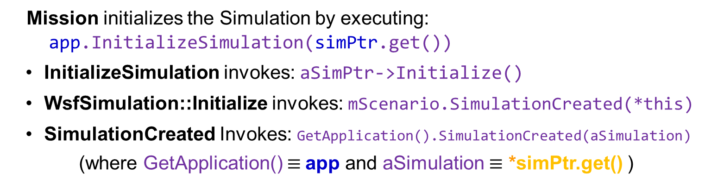
AFSIM Plugins & Extensions AFSIM mission startup sequence
mission::main()
unique_ptr<RegisterMATLAB_BallisticMover>
WsfScenario: scenario
unique_ptr<WsfSimulation>: SimPtr
WsfStandardApplication: app
WsfStandardApplication::InitializeSimulation()
WsfScenario::SimulationCreated()
WsfSimulation::Initialize()
WsfApplication::SimulationCreated()
Mission initializes the Simulation by executing:
app.InitializeSimulation(simPtr.get())
InitializeSimulation invokes: aSimPtr->Initialize()
WsfSimulation::Initialize invokes: mScenario.SimulationCreated(*this)
SimulationCreated Invokes: GetApplication().SimulationCreated(aSimulation)
(where GetApplication() $≡$app and aSimulation $≡$ *simPtr.get() )

Slide 42
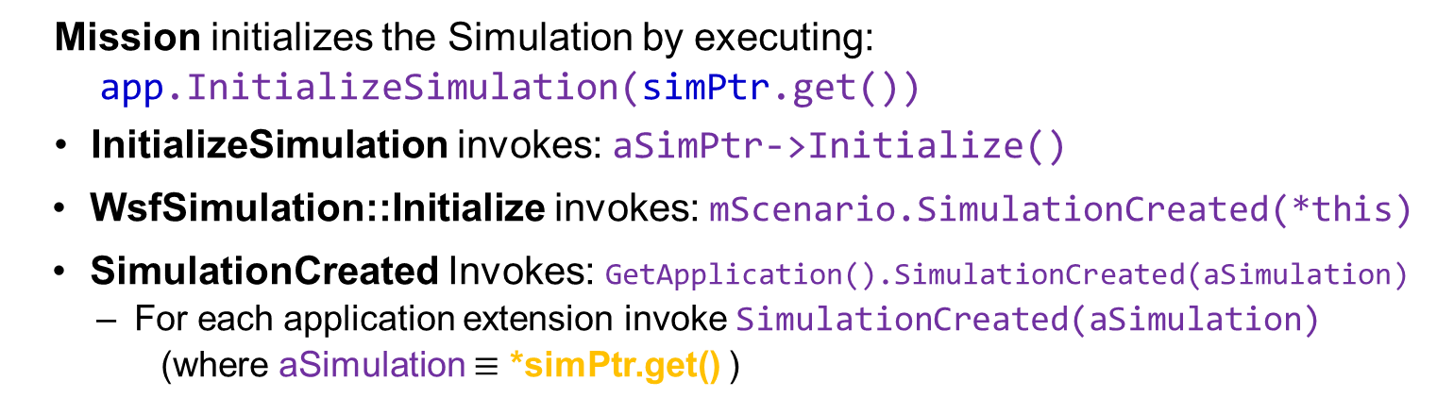
AFSIM Plugins & Extensions AFSIM mission startup sequence
mission::main()
unique_ptr<RegisterMATLAB_BallisticMover>
WsfScenario: scenario
unique_ptr<WsfSimulation>: SimPtr
WsfStandardApplication: app
WsfStandardApplication::InitializeSimulation()
WsfScenario::SimulationCreated()
WsfSimulation::Initialize()
WsfApplication::SimulationCreated()
Mission initializes the Simulation by executing:
app.InitializeSimulation(simPtr.get())
InitializeSimulation invokes: aSimPtr->Initialize()
WsfSimulation::Initialize invokes: mScenario.SimulationCreated(*this)
SimulationCreated Invokes: GetApplication().SimulationCreated(aSimulation)
For each application extension invoke SimulationCreated(aSimulation)
(where aSimulation $≡$ *simPtr.get() )

Slide 43
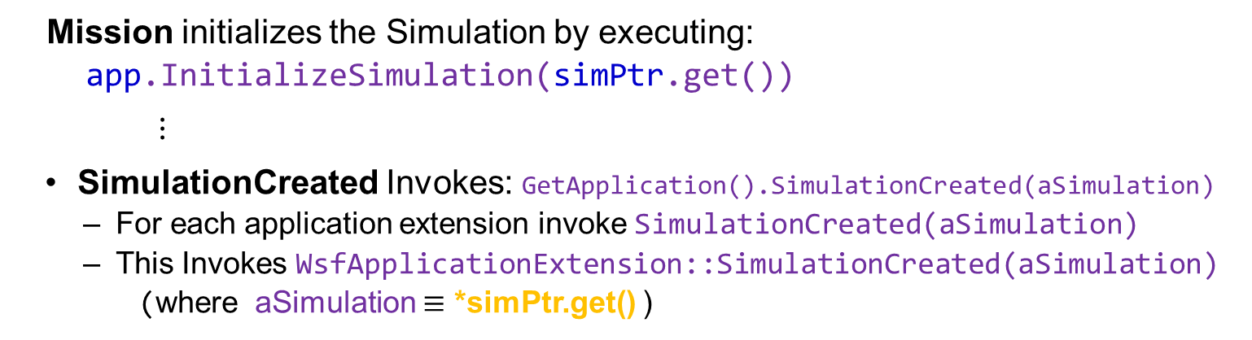
AFSIM Plugins & Extensions AFSIM mission startup sequence
mission::main()
unique_ptr<RegisterMATLAB_BallisticMover>
WsfScenario: scenario
unique_ptr<WsfSimulation>: SimPtr
WsfStandardApplication: app
WsfStandardApplication::InitializeSimulation()
WsfScenario::SimulationCreated()
WsfSimulation::Initialize()
WsfApplication::SimulationCreated()
WsfApplicationExtension::SimulationCreated()
Mission initializes the Simulation by executing:
app.InitializeSimulation(simPtr.get())
$⋮$
SimulationCreated Invokes: GetApplication().SimulationCreated(aSimulation)
For each application extension invoke SimulationCreated(aSimulation)
This Invokes WsfApplicationExtension::SimulationCreated(aSimulation)
(where aSimulation $≡$ *simPtr.get() )
Note: RegisterMATLAB_BallisticMover does not override SimulationCreated, so this call has no effect

Slide 44
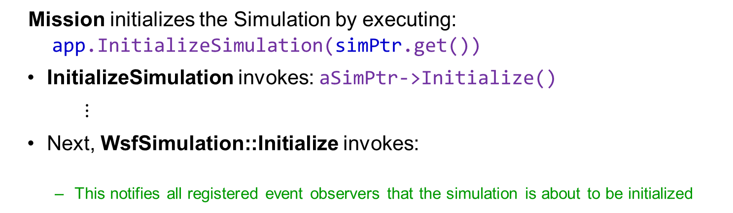
AFSIM Plugins & Extensions AFSIM mission startup sequence
mission::main()
unique_ptr<RegisterMATLAB_BallisticMover>
WsfScenario: scenario
unique_ptr<WsfSimulation>: SimPtr
WsfStandardApplication: app
WsfStandardApplication::InitializeSimulation()
WsfSimulation::Initialize()
Mission initializes the Simulation by executing:
app.InitializeSimulation(simPtr.get())
InitializeSimulation invokes: aSimPtr->Initialize()
$⋮$
Next, WsfSimulation::Initialize invokes:
This notifies all registered event observers that the simulation is about to be initialized
WsfObserver::SimulationInitializing(this)
Note: we do not create any simulation observers, so the notification has no effect

Slide 45
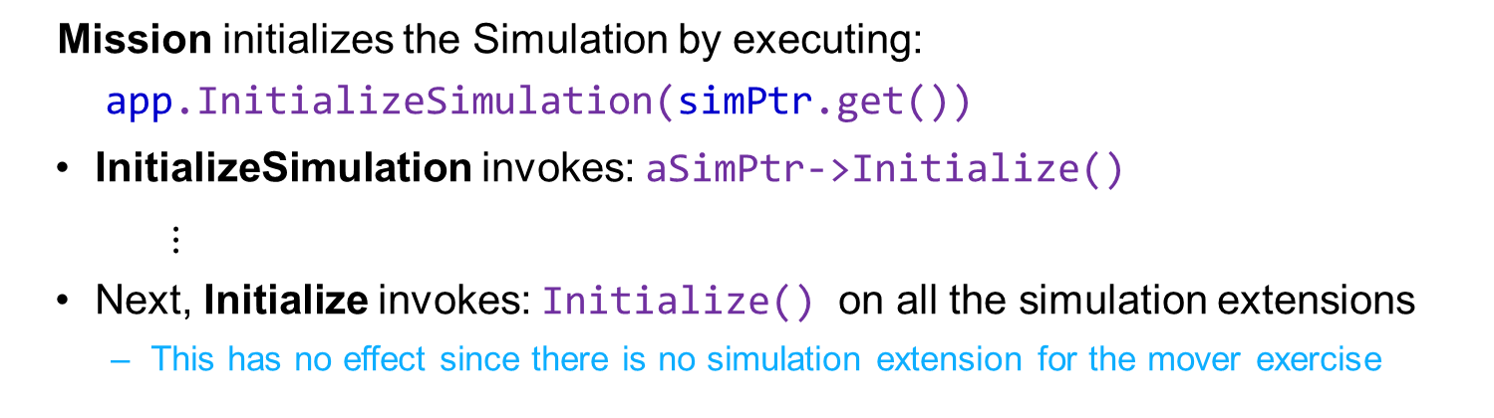
AFSIM Plugins & Extensions AFSIM mission startup sequence
mission::main()
unique_ptr<RegisterMATLAB_BallisticMover>
WsfScenario: scenario
unique_ptr<WsfSimulation>: SimPtr
WsfStandardApplication: app
WsfStandardApplication::InitializeSimulation()
WsfSimulation::Initialize()
WsfSimulationExtension::Initialize()
Mission initializes the Simulation by executing:
app.InitializeSimulation(simPtr.get())
InitializeSimulation invokes: aSimPtr->Initialize()
$⋮$
Next, Initialize invokes: Initialize() on all the simulation extensions
This has no effect since there is no simulation extension for the mover exercise

Slide 46
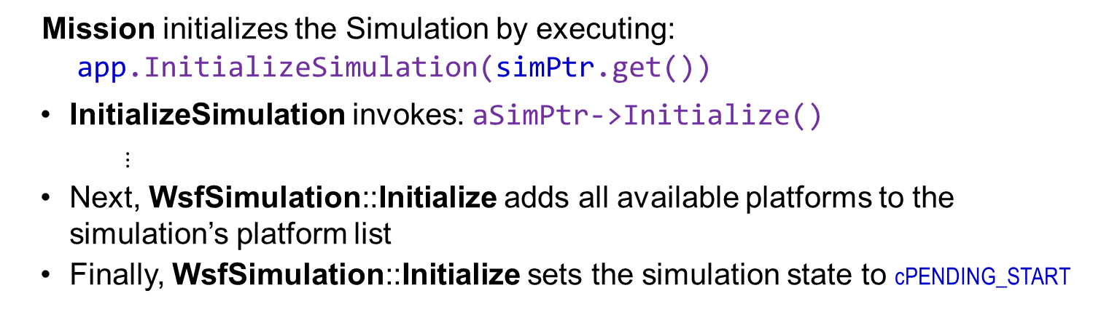
AFSIM Plugins & Extensions AFSIM mission startup sequence
mission::main()
unique_ptr<RegisterMATLAB_BallisticMover>
WsfScenario: scenario
unique_ptr<WsfSimulation>: SimPtr
WsfStandardApplication: app
WsfStandardApplication::InitializeSimulation()
WsfSimulation::Initialize()
Mission initializes the Simulation by executing:
app.InitializeSimulation(simPtr.get())
InitializeSimulation invokes: aSimPtr->Initialize()
$⋮$
Next, WsfSimulation::Initialize adds all available platforms to the simulation’s platform list
Finally, WsfSimulation::Initialize sets the simulation state to cPENDING_START

Slide 47
Exercise 2
Complete the implementations of MATLABBallisticMover::ProcessInput and MATLABBallisticMover::Stage::ProcessInput
Understand implementation of MATLABBallisticMover::GetBoosterParams
Complete the implementation of MATLABBallisticMover::Initialize
Complete the implementation of MATLABBallisticMover::Update
Complete the implementation of MATLABBallisticMover::UpdatePlatform

Slide 48

Mover Exercise 2 — Review 1
Inspect file MATLABBallisticMover.hpp and note the inheritance from WsfMover as well as the class attributes and functions assumed for our solution.
Review the member variables.
The mwarray class is a MATLAB® generated class that is used to pass input/output arguments to the MATLAB® Compiler generated C++ interface
// Input to MATLAB functions
mwArray mwInputLLA;
mwArray mwInputOrientation;
mwArray mwInputTime;
mwArray mwInputBoosterParams;
$⋮$
// Output from MATLAB functions
mwArray mwHitGroundTime;
mwArray mwState;

Slide 49
Mover Exercise 2 — Task 1
Complete implementation of the MATLABBallisticMover class constructor inside MATLABBallisticMover.cpp
Each of the mwarray classes needs to be sized on construction.
Add a line to construct the mwInputOrientation member variable
The mwInputOrientation constructor takes four elements:
the number of rows,
the number of columns,
the data type of the matrix, and
the complexity of the matrix (See MATLAB® for more information)
Our mwInputOrientation member variable will have 3 rows, 1 column, be of type mxDOUBLE_CLASS, and have a complexity type of mxREAL

Slide 50
Mover Exercise 2 — Task 1 Solution MATLABBallisticMover.cpp
MATLABBallisticMover::MATLABBallisticMover(WsfScenario& aScenario)
: WsfMover(aScenario),
mwInputLLA(3, 1, mxDOUBLE_CLASS, mxREAL),
// EXERCISE 2 TASK 1
mwInputOrientation(3, 1, mxDOUBLE_CLASS, mxREAL),
mwInputTime(1, 1, mxDOUBLE_CLASS, mxREAL),
mwInputBoosterParams(cBOOSTER_PARAMS_SIZE, 1, mxDOUBLE_CLASS, mxREAL),
mInputAlt(0.0),
mInputAltAGL(false),
mStageList(),
mExplicitStageUsed(false),
mImplicitStageUsed(false),
mCd0(0.0),
mReferenceArea(0.0),
mMassPayload(0.0),
mMaxq(0.0),
mPitchInterval(1.0),
mVerticalTime(0.0),
mwHitGroundTime(1, 1, mxDOUBLE_CLASS, mxREAL),
mwState(cSTATE_VECTOR_SIZE, 1, mxDOUBLE_CLASS, mxREAL)
{
...
}

Slide 51
Mover Exercise 2 — Review 2
Inspect the libAFSIM_Mover.h and review the extern methods declared at the bottom of the file. Each of these two methods will be called at various points in the MATLABBallisticMover class.
These correspond to the InitializeMover (InitializeMover.m) and UpdateMover (UpdateMover.m) MATLAB functions
extern LIB_libAFSIM_Mover_CPP_API void MW_CALL_CONV InitializeMover(int nargout,
mwArray& state,
const mwArray& inLLA,
const mwArray& inBoosterParams);
extern LIB_libAFSIM_Mover_CPP_API void MW_CALL_CONV UpdateMover(int nargout,
mwArray& state,
mwArray& hit_ground_time,
const mwArray& t,
const mwArray& x,
const mwArray& inLLA,
const mwArray& inOrientation,
const mwArray& inBoosterParams);
Notes:
Arguments to these functions are mwArrays

Slide 52
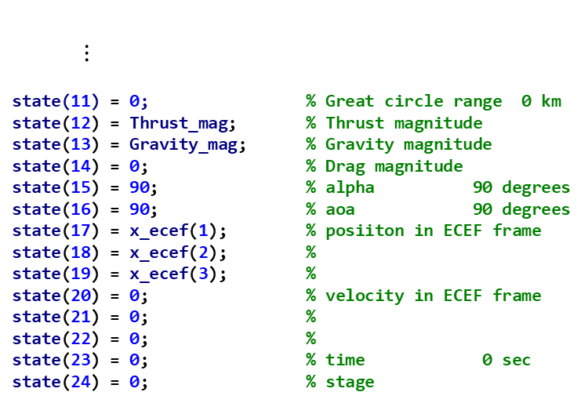
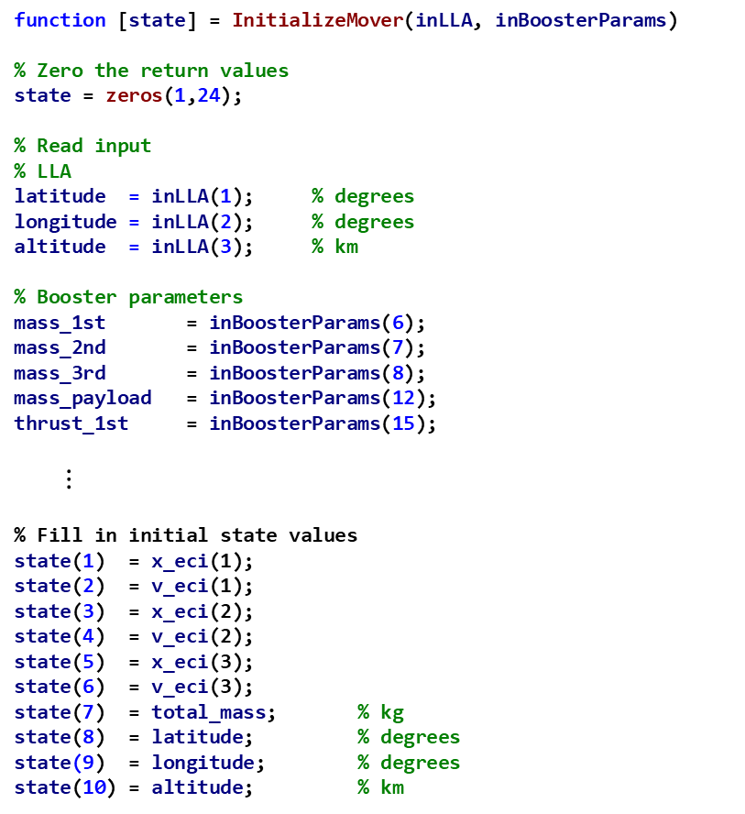
Mover Exercise 2 – Review 3 MATLAB function InitializeMover - file InitializeMover.m
function [state] = InitializeMover(inLLA, inBoosterParams)
% Zero the return values
state = zeros(1,24);
% Read input
% LLA
latitude = inLLA(1); % degrees
longitude = inLLA(2); % degrees
altitude = inLLA(3); % km
% Booster parameters
mass_1st = inBoosterParams(6);
mass_2nd = inBoosterParams(7);
mass_3rd = inBoosterParams(8);
mass_payload = inBoosterParams(12);
thrust_1st = inBoosterParams(15);
$⋮$
% Fill in initial state values
state(1) = x_eci(1);
state(2) = v_eci(1);
state(3) = x_eci(2);
state(4) = v_eci(2);
state(5) = x_eci(3);
state(6) = v_eci(3);
state(7) = total_mass; % kg
state(8) = latitude; % degrees
state(9) = longitude; % degrees
state(10) = altitude; % km
$⋮$
state(11) = 0; % Great circle range 0 km
state(12) = Thrust_mag; % Thrust magnitude
state(13) = Gravity_mag; % Gravity magnitude
state(14) = 0; % Drag magnitude
state(15) = 90; % alpha 90 degrees
state(16) = 90; % aoa 90 degrees
state(17) = x_ecef(1); % posiiton in ECEF frame
state(18) = x_ecef(2); %
state(19) = x_ecef(3); %
state(20) = 0; % velocity in ECEF frame
state(21) = 0; %
state(22) = 0; %
state(23) = 0; % time 0 sec
state(24) = 0; % stage

Slide 53
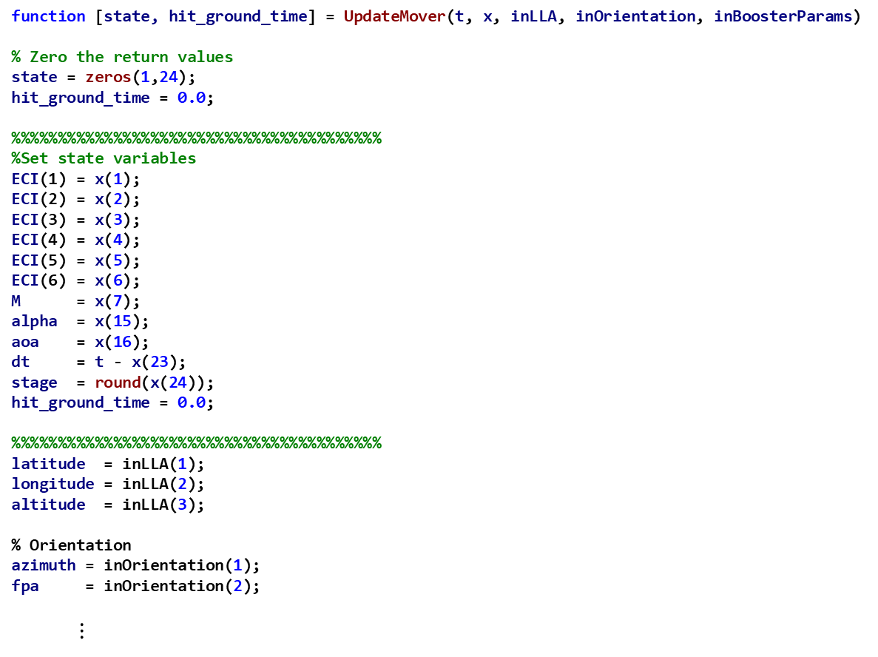
Mover Exercise 2 – Review 4 MATLAB function UpdateMover - file UpdateMover.m
function [state, hit_ground_time] = UpdateMover(t, x, inLLA, inOrientation, inBoosterParams)
% Zero the return values
state = zeros(1,24);
hit_ground_time = 0.0;
%%%%%%%%%%%%%%%%%%%%%%%%%%%%%%%%%%%%%%%%
%Set state variables
ECI(1) = x(1);
ECI(2) = x(2);
ECI(3) = x(3);
ECI(4) = x(4);
ECI(5) = x(5);
ECI(6) = x(6);
M = x(7);
alpha = x(15);
aoa = x(16);
dt = t - x(23);
stage = round(x(24));
hit_ground_time = 0.0;
%%%%%%%%%%%%%%%%%%%%%%%%%%%%%%%%%%%%%%%%
latitude = inLLA(1);
longitude = inLLA(2);
altitude = inLLA(3);
% Orientation
azimuth = inOrientation(1);
fpa = inOrientation(2);
$⋮$

Slide 54
Mover Exercise 2 — Task 2
Implement MATLABBallisticMover::ProcessInput to read:
mass_payload
pitch_interval
The attribute mass_payload has units of mass and a value greater than 0.0
The attribute pitch_interval has units of time and a value greater than or equal to 1.0
Each of these inputs should be stored in the corresponding MATLABBallisticMover class member variables
AFSIM examples can be found by searching source codes using references to “ReadValue” and “ReadValueOfType”.

Slide 55
Mover Exercise 2 — Task 2 Solution MATLABBallisticMover.cpp
bool MATLABBallisticMover::ProcessInput(UtInput& aInput)
{
...
else if (command == "mass_payload")
{
// EXERCISE 2 TASK 2a
aInput.ReadValueOfType(mMassPayload, UtInput::cMASS);
aInput.ValueGreater(mMassPayload, 0.0);
}
else if (command == "pitch_interval")
{
// EXERCISE 2 TASK 2b
aInput.ReadValueOfType(mPitchInterval, UtInput::cTIME);
aInput.ValueGreaterOrEqual(mPitchInterval, 1.0);
}
AFSIM examples can be found by searching source codes using references to “ReadValue” and “ReadValueOfType”.

Slide 56
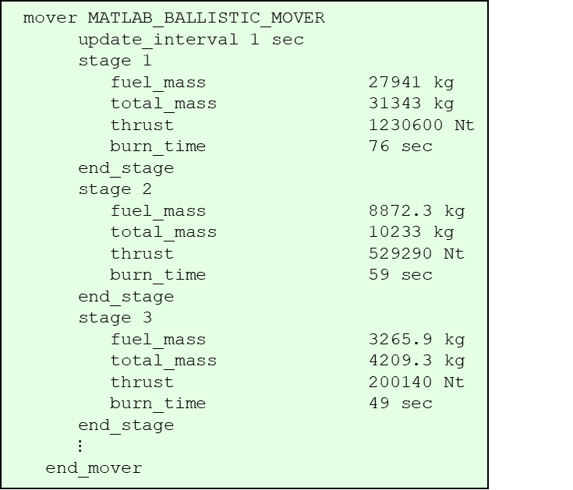
Mover Exercise 2 — Review 5 MATLABBallisticMover.cpp
bool MATLABBallisticMover::ProcessInput(UtInput& aInput)
{
// Set the default value
bool myCommand(true);
std::string command(aInput.GetCommand());
if ((! mExplicitStageUsed) &&
mStageList[0].ProcessInput(aInput))
{
mImplicitStageUsed = true;
}
else if ((! mImplicitStageUsed) &&
(command == "stage"))
{
UtInputBlock inputBlock(aInput);
int stageNumber;
aInput.ReadValue(stageNumber);
aInput.ValueInClosedRange(static_cast<double>(stageNumber),
1.0,
static_cast<double>(mStageList.size() + 1));
if (stageNumber > ut::cast_to_int(mStageList.size()))
{
mStageList.push_back(Stage());
}
while (inputBlock.ReadCommand())
{
if (! mStageList[stageNumber - 1].ProcessInput(aInput))
{
throw UtInput::UnknownCommand(aInput);
}
}
mExplicitStageUsed = true;
}
Note: variable mStageList is an array of type
MATLABBallisticMover::Stage. For each stage command found in the input, this code results in the Stage::ProcessInput method being invoked to
handle the stage’s input
mover MATLAB_BALLISTIC_MOVER
update_interval 1 sec
stage 1
fuel_mass 27941 kg
total_mass 31343 kg
thrust 1230600 Nt
burn_time 76 sec
end_stage
stage 2
fuel_mass 8872.3 kg
total_mass 10233 kg
thrust 529290 Nt
burn_time 59 sec
end_stage
stage 3
fuel_mass 3265.9 kg
total_mass 4209.3 kg
thrust 200140 Nt
burn_time 49 sec
end_stage
$⋮$
end_mover

Slide 57

Mover Exercise 2 — Review 5 MATLABBallisticMover.cpp
$⋮$
else if ((command == "zero_lift_cd") ||
(command == "drag_coeff"))
{
$⋮$
}
$⋮$
else if (command == "vertical_time")
{
$⋮$
}
else
{
myCommand = WsfMover::ProcessInput(aInput);
}
return myCommand;
mover MATLAB_BALLISTIC_MOVER
update_interval 1 sec
stage 1
fuel_mass 27941 kg
total_mass 31343 kg
thrust 1230600 Nt
burn_time 76 sec
end_stage
stage 2
fuel_mass 8872.3 kg
total_mass 10233 kg
thrust 529290 Nt
burn_time 59 sec
end_stage
stage 3
fuel_mass 3265.9 kg
total_mass 4209.3 kg
thrust 200140 Nt
burn_time 49 sec
end_stage
drag_coeff 0.4
effective_area 2.986 meters^2
mass_payload 900 kg
maxq 650 // lb/ft^2
pitch_interval 35 sec
vertical_time 10 sec
end_mover

Slide 58
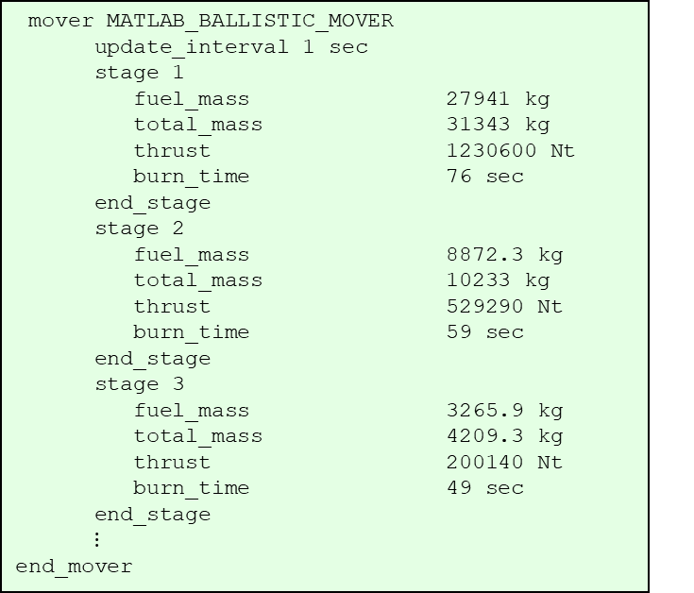
Mover Exercise 2 — Review 6 MATLABBallisticMover.cpp
bool MATLABBallisticMover::Stage::ProcessInput(UtInput& aInput)
{
bool myCommand(true);
std::string command(aInput.GetCommand());
if ((command == "total_mass") ||
(command == "launch_mass"))
{
aInput.ReadValueOfType(mTotalMass, UtInput::cMASS);
aInput.ValueGreater(mTotalMass, 0.0);
}
else if (command == "fuel_mass")
{
aInput.ReadValueOfType(mFuelMass, UtInput::cMASS);
aInput.ValueGreater(mFuelMass, 0.0);
}
else if (command == "thrust")
{
aInput.ReadValueOfType(mThrust, UtInput::cFORCE);
aInput.ValueGreater(mThrust, 0.0);
}
else if ((command == "thrust_duration") ||
(command == "burn_time"))
{
aInput.ReadValueOfType(mThrustDuration, UtInput::cTIME);
aInput.ValueGreaterOrEqual(mThrustDuration, 0.0);
}
else
{
myCommand = false;
}
return myCommand;
}
mover MATLAB_BALLISTIC_MOVER
update_interval 1 sec
stage 1
fuel_mass 27941 kg
total_mass 31343 kg
thrust 1230600 Nt
burn_time 76 sec
end_stage
stage 2
fuel_mass 8872.3 kg
total_mass 10233 kg
thrust 529290 Nt
burn_time 59 sec
end_stage
stage 3
fuel_mass 3265.9 kg
total_mass 4209.3 kg
thrust 200140 Nt
burn_time 49 sec
end_stage
$⋮$
end_mover

Slide 59
Mover Exercise 2 — Task 3
Implement MATLABBallisticMover::Stage::ProcessInput to read:
total_mass, and
launch_mass
The attribute total_mass / launch_mass has units of mass and a value greater than 0.0
This input should be stored in the corresponding MATLABBallisticMover class member variable mTotalMass
These are synonyms for each other and should
result in the same code being executed
AFSIM examples can be found by searching source codes using references to “ReadValue” and “ReadValueOfType”.

Slide 60
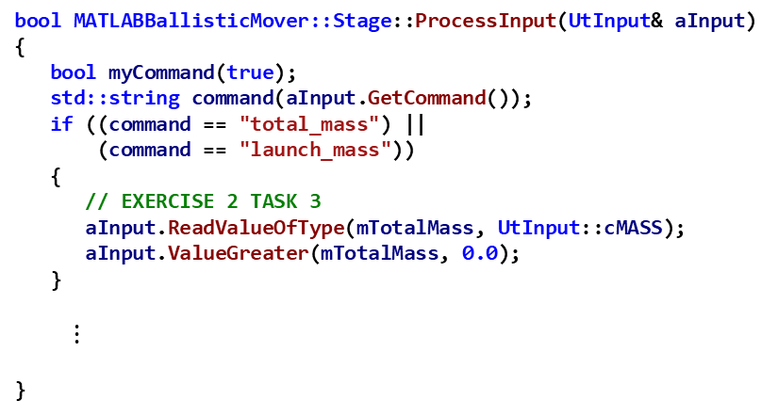
Mover Exercise 2 — Task 3 Solution MATLABBallisticMover.cpp
bool MATLABBallisticMover::Stage::ProcessInput(UtInput& aInput)
{
bool myCommand(true);
std::string command(aInput.GetCommand());
if ((command == "total_mass") ||
(command == "launch_mass"))
{
// EXERCISE 2 TASK 3
aInput.ReadValueOfType(mTotalMass, UtInput::cMASS);
aInput.ValueGreater(mTotalMass, 0.0);
}
$⋮$
}

Slide 61
Mover Exercise 2 — Review 7 MATLABBallisticMover.cpp
Review and understand:
void MATLABBallisticMover::GetBoosterParams()
{
// Initialize the booster parameters to zero
double dBooster[cBOOSTER_PARAMS_SIZE] = {0.0};
...
// Get the stage data; stop at 3 stages
int nStages(mStageList.size());
if (nStages > 3)
{
nStages = 3;
}
for(int i = 0; i < nStages; ++i)
{
// burn_time
dBooster[nBurnTimeIndex + i] = mStageList[i].mThrustDuration;
// total_mass
dBooster[nTotalMass + i] = mStageList[i].mTotalMass;
// fuel_mass
dBooster[nFuelMass + i] = mStageList[i].mFuelMass;
// thrust
dBooster[nThrust + i] = mStageList[i].mThrust;
}
...
}
Note: dBooster is a 1D array that is indexed
like a 2D array where nBurnIndex, nTotalMass,
nFuelMass, and nThrust are column numbers,
and i is a row number

Slide 62
Mover Exercise 2 — Review 8 MATLABBallisticMover.cpp
Inspect MATLABBallisticMover::Initialize and understand the code to:
Fill the arrays mwInputLLA and mwInputBoosterParams using calls to the GetInitialAltitude and GetBoosterParams methods, respectively

Slide 63

Mover Exercise 2 — Review 8 MATLABBallisticMover.cpp
bool MATLABBallisticMover::Initialize(double aSimTime)
{
// Get the altitude
GetInitialAltitude();
// Get the booster parameters
GetBoosterParams();
// EXERCISE 2 TASK 4
// Call the MATLAB to initialize
// PLACE YOUR CODE HERE
// EXERCISE 2 TASK 5
// Set orientation
// Initialize the base class
return WsfMover::Initialize(aSimTime);
}
void MATLABBallisticMover::GetInitialAltitude()
{
double dLLA[3] = {0.0};
mwInputLLA.GetData(dLLA, 3);
if (mInputAltAGL)
{
float terrainHeight;
wsf::Terrain terrain(GetPlatform()->GetTerrain());
terrain.GetElevInterp(dLLA[0], dLLA[1], terrainHeight);
dLLA[2] += terrainHeight;
}
mwInputLLA.SetData(dLLA, 3);
}
void MATLABBallisticMover::GetBoosterParams()
{
// Initialize the booster parameters to zero
double dBooster[cBOOSTER_PARAMS_SIZE] = {0.0};
// Starting locations within the dBooster array
int nBurnTimeIndex(0);
int nTotalMass(5);
int nFuelMass(8);
int nThrust(14);
$⋮$
// vert_time
dBooster[17] = mVerticalTime;
// Set the data in the MATLAB array
mwInputBoosterParams.SetData(dBooster, cBOOSTER_PARAMS_SIZE);
}

Slide 64
Mover Exercise 2 — Task 4
In file MATLABBallisticMover.cpp
Task 4: Initialize the MATLAB® mover
Call the InitializeMover method in the libAFSIM_Mover interface.
This method takes four arguments:
the number of output arguments,
the output mwarray for holding the state,
the input mwarray containing the initial latitude, longitude, and altitude, and
the input mwarray containing the booster parameters.

Slide 65
Mover Exercise 2 — Task 4 Solution MATLABBallisticMover.cpp
bool MATLABBallisticMover::Initialize(double aSimTime)
{
// Get the altitude
GetInitialAltitude();
// Get the booster parameters
GetBoosterParams();
// EXERCISE 2 TASK 4
// Call the MATLAB to initialize
InitializeMover(1, mwState, // output
mwInputLLA, // input
mwInputBoosterParams);
// EXERCISE 2 TASK 5
// Set orientation
// Initialize the base class
return WsfMover::Initialize(aSimTime);
}

Slide 66
Mover Exercise 2 — Task 5
In file MATLABBallisticMover.cpp
Task 5: Complete MATLABBallisticMover::Initialize:
Get the input orientation from the matlab library and use it to set the heading
Set the platform’s initial orientation to the input heading (in radians) and 90 degrees pitch angle (in radians).
Steps:
Create an array of size 3 of double named dInputOrientation, and initialize its elements to 0.0
Invoke mwInputOrientation.GetData() and pass in arguments of 1) the array dInputOrientation, and 2) the size of the array
Define and set heading to element 0 of the dInputOrientation array converted to radians (multiply by UtMath::cRAD_PER_DEG)
Define and set pitch to UtMath::cRAD_PER_DEG (90 degrees in radians)
Call GetPlatform(), and on the platform returned, call SetOrientationNED(), and pass in the heading, pitch, and 0.0 (for the roll of the platform)

Slide 67
Mover Exercise 2 — Task 5 Solution MATLABBallisticMover.cpp
bool MATLABBallisticMover::Initialize(double aSimTime)
{
// Get the altitude
GetInitialAltitude();
// Get the booster parameters
GetBoosterParams();
// EXERCISE 2 TASK 4
// Call the MATLAB to initialize
InitializeMover(1, mwState, // output
mwInputLLA, // input
mwInputBoosterParams);
// EXERCISE 2 TASK 5
// Set orientation
double dInputOrientation[3] = {0.0};
mwInputOrientation.GetData(dInputOrientation, 3);
double heading = dInputOrientation[0] * UtMath::cRAD_PER_DEG;
double pitch = UtMath::cPI_OVER_2;
GetPlatform()->SetOrientationNED(heading, pitch, 0.0);
// Initialize the base class
return WsfMover::Initialize(aSimTime);
}

Slide 68
Mover Exercise 2 — Task 6
In file MATLABBallisticMover.cpp
Implement MATLABBallisticMover::Update
Call the UpdateMover method in the libAFSIM_Mover interface.
The UpdateMover method takes eight arguments:
the number of output arguments,
the output mwarray for holding the state,
the output mwarray for holding the time the mover hit the ground,
the input mwarray containing the current simulation time,
the input mwarray containing the current state,
the mwarray containing the initial latitude, longitude, and altitude,
the mwarray containing the initial orientation, and
the input mwarray containing the booster parameters.
Once the update is performed the data is used to update the platform location, velocity, orientation, etc.
If the mover has hit the ground the platform is deleted

Slide 69
Mover Exercise 2 — Task 6 Solution MATLABBallisticMover.cpp
void MATLABBallisticMover::Update(double aSimTime)
{
if ((aSimTime - mLastUpdateTime) > mUpdateTimeTolerance)
{
// Set the input parameter - time
mwInputTime.SetData(&aSimTime, 1);
// EXERCISE 2 TASK 6
// -- call MATLAB update function
UpdateMover(2, mwState, mwHitGroundTime, // output
mwInputTime, // input
mwState,
mwInputLLA,
mwInputOrientation,
mwInputBoosterParams);
}
// Update the platform location, velocity, orientation, etc.
UpdatePlatform(aSimTime);
...
// Call base class implementation last
WsfMover::Update(aSimTime);
}

Slide 70
Mover Exercise 2 — Task 7
In file MATLABBallisticMover.cpp
Implement MATLABBallisticMover::UpdatePlatform
This method takes the data returned from the MATLAB® mover in the mwarray called mwState and sets the corresponding data in the AFSIM platform
The description of mwState member variable is found in the comments of the MATLABBallisticMover.hpp file
The mwState.GetData method extracts its data and stores it in an array (which we will call dState)
Elements 0, 2, and 4 contain the three components of an ECI location
Elements 1, 3, and 5, contain the three components of an ECI velocity
Task 7:
Create a double array of size 3, which can hold the ECI velocity components
Extract the ECI velocity values from mwState (which are stored in dState[1], dState[3], and dState[5]), and fill in this array for the ECI velocity with the elements of dState[1], dState[3], and dState[5], respectively
set the ECI velocity of the platform by calling the method GetPlatform()->SetVelocityECI(), and passing in the array containing the ECI velocity

Slide 71
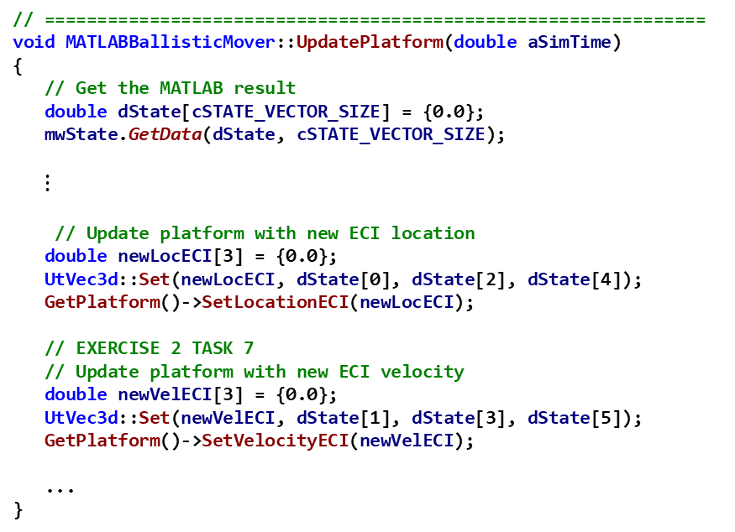
Mover Exercise 2 — Task 7 Solution MATLABBallisticMover.cpp
// ===============================================================
void MATLABBallisticMover::UpdatePlatform(double aSimTime)
{
// Get the MATLAB result
double dState[cSTATE_VECTOR_SIZE] = {0.0};
mwState.GetData(dState, cSTATE_VECTOR_SIZE);
$⋮$
// Update platform with new ECI location
double newLocECI[3] = {0.0};
UtVec3d::Set(newLocECI, dState[0], dState[2], dState[4]);
GetPlatform()->SetLocationECI(newLocECI);
// EXERCISE 2 TASK 7
// Update platform with new ECI velocity
double newVelECI[3] = {0.0};
UtVec3d::Set(newVelECI, dState[1], dState[3], dState[5]);
GetPlatform()->SetVelocityECI(newVelECI);
...
}

Slide 72
Exercise 3
Open MATLAB files in MATLAB
Understand the makelib.m file
Create the MATLAB library file
Deploy the MATLAB library file

Slide 73
Mover Exercise 3 * [optional]
Requires installation of MATLAB®
You will create a MATLAB®-compiled C++ shared library for incorporation into the mover project (Refer to MATLAB® for more information)

Slide 74
[optional] Mover Exercise 3* - Task 1
Requires installation of MATLAB®
Compiling MATLAB® M files – Task 1
Open the MATLAB® application.
Change the "Current Directory" by browsing to the inwork\mover\MATLAB_mover directory. All the M-files in that directory should now be visible in the MATLAB application.

Slide 75
[optional] Mover Exercise 3* - Task 2
Requires installation of MATLAB®
Compiling MATLAB® M files – Task 2
Double-click on the makelib.m file. This will open the file in the MATLAB® Editor.
Review and understand the contents of the file (MATLAB commands).
cmdFlags = {...
% '-v'; % verbose
'-N'; % clear MATLAB path
'-W';'cpplib:libAFSIM_Mover'; % create C++ library wrapper named libAFSIM_Mover
'-T';'link:lib'; % link library
'-d';'./lib'; % output directory
};
mFiles = {...
'InitializeMover.m';
'UpdateMover.m';
};
mcc(cmdFlags{:}, mFiles{:});

Slide 76
[optional] Mover Exercise 3* - Task 3
Requires installation of MATLAB®
Compiling MATLAB® M files – Task 3
In the MATLAB® command window, type "makelib" to create the C++ shared library. This will take a few minutes.
Use Windows Explorer to locate the inwork\mover\MATLAB_mover directory to see the files generated from the compilation step.
Move the libAFSIM_Mover.dll file into the inwork\mover\data directory.

Slide 77
[optional] Mover Exercise 3* - Task 4
Requires installation of MATLAB®
Deploying the shared library
To distribute the shared library created with the MATLAB® compiler create a package that includes the following files:
MCRInstaller.exe (Located in the <MCR install folder>\toolbox\compiler\deploy)
libAFSIM_Mover.h
libAFSIM_Mover.lib
libAFSIM_Mover.dll
Note the readme.txt file generated during the compilation step and resident in the inwork\mover\MATLAB_mover directory contains useful information on deployment.

Slide 78
Testing
From Visual Studio:
Build the solution in Release
Build the INSTALL project
Load the Test Scenario into WIZARD
Open WIZARD
Find the top-level scenario file named mover_scenario.txt located in the ..\mover\data folder. This is the input file with which we will test our program
Drag and drop mover_scenario.txt into WIZARD
Run the selected application from WIZARD
Run the generated mover_scenario.aer in Mystic
Linux: from the build directory, run:
$ cmake --build . --target all -- -j11
$ cmake --build . --target install -- -j11
Notes:
It will take a while for it to load in wizard.

Slide 79
Results

