Slide 1
AFSIM Developer Training
7 – Components
AFRL/RQQD

Slide 2
Acronyms and Definitions
AFSIM - Advanced Framework for Simulation, Integration, and Modeling
AGL – Above Ground Level
DIS – Distributed Interactive Simulation
DTED – Digital Terrain Elevation Data
EO/IR – Electro-Optical/Infra-Red
ESM – Electronic Support Measure
FOV – Field Of View
GUI – Graphical User Interface
HLA – High Level Architecture
IEEE – Institute of Electrical & Electronics Engineers, Inc.
JTIDS – Joint Tactical Information Distribution System
MSL – Mean Sea Level
PDU – Protocol Data Unit
RCS – Radar Cross Section
SAM – Surface-to-Air Missile
SAR – Synthetic Aperture Radar
VESPA – Visual Environment for Scenario Preparation and Analysis
WKF – Warlock Framework
WSF – World Simulation Framework
dB - decibels
dBsm – decibel square meters
deg – degrees
ft – feet
GHz– GigaHertz
kts – knots
m - meters
m^2 – square meters
mw – megawatts
nm – nautical miles
s – seconds

Slide 3
Introduction
This lab focuses on understanding AFSIM Components and Component Extensions
You will build a new AFSIM component class that is not one of the ‘standard’ components, learn how to configure instances of components with component factories, process custom input, and access them on the platform
You will build a new AFSIM component extension that provides additional functionality of an existing component without having to extend existing component classes.
You will see how to extend existing AFSIM script classes to add additional functions without modifying core code.
The following exercises provides practice working with AFSIM components.
Exercise 1: Registering a new Application Extension, a new Scenario Extension, and a Component Factory
Exercise 2: Creating a custom AFSIM Component
Exercise 3: Creating a ComponentFactory
Exersise 4: Creating a custom AFSIM Components script interface

Slide 4
Problem Statement
Affect Sensor Detections in a Cyber Exploit to Drop Sensor Tracks
Create a New Component Called Shields, That is Inserted Onto a Platform and Does not Need to Use Aux Data
Create a Simple New Component Called Latinum, Representing a Commodity That Can be Transferred Between Platforms
Expose the Shield Component to the Script Interface as a Script Shields Object that can be Queried
Extend the Existing WsfPlatform Script Class to Return a Shields Script Object

Slide 5
Learning Objectives
Understand how to Create New Components and Component Extensions
Understand Options for Creating Component Factories and Injecting them with the Component’s Input Processing
Understand how to Inject Components Without using Input
Understand how to Extend Existing Script Classes to Include new Methods, without Modifying Core Code
Reinforce your skills with creating an application extension and a plugin
Understand how to create a new scenario extension

Slide 6
Prerequisites
Before working on this lab, you should:
Be familiar with WIZARD and AFSIM scripting Language
AFSIM analyst course or equivalent experience is recommended
Have available and be familiar with using Microsoft® Visual Studio 2017® or newer to compile an application
Be familiar with using Microsoft Windows® Explorer
Have completed the Module “Building AFSIM with CMAKE”
Be familiar with using cmake-gui
Be familiar with executing cmake (if developing on Linux)

Slide 7
Component-Based Architecture
Simulation Components
Platform Components
Platform Component List
Component
(“Movers”)
Component
(“Processors”)
Component
(“Comm”)
Component
(“Sensor”)
Component
(“Weapon”)
Component
(<“XYZ”>)
Simulation Component List
Movers
Processors
Communications
Sensors
Weapons
Others
EW Interaction, DIS, XIO, etc.
Component Implementations
Component Based allows for Addition and Removal of Whole Types
Platform/Simulation Component Types are Accessed by Name or Role
Enables Component Type Addition or Removal from Simulation and Platforms
For example: Removal of Weapons and Electronic Warfare (EW) from EAR Versions with addition in ITAR only

Slide 8

Components in the AFSIM Framework
AFSIM Enables Arbitrary Components to be Placed On Platforms and Platform Components (like Sensors)
“Component-Based Architecture” (CBA)
AFSIM Framework
Infrastructure
Interface
Scenario Management
Time Management
Time Management
Geospatial Data Management
Event Management
Utilities
Geospatial Data Management
Scripting
Language
Distributed Simulation Interfaces
Scenario Management
Script
Distributed Simulation Interfaces
Event Management
Plug-in
Management
Observers
Extensions
Simulation Management
Observers
Extensions
Components
Platform Components
Movers
Sensors
Weapons
Communications
Processors
Other Platform
Components
Non-Platform
Components
Sensor
Components
Weapon
Components
Comm
Components
Processor
Components
$$…$$

Slide 9
Components Overview
AFSIM Enables Arbitrary Components to be Placed On Platforms
“Component-Based Architecture” (CBA)
Relies on Component (Object) Factories to Create and Load Components on Platforms
“PreInitialize” Method Automatically Loads Components

Slide 10
Types Factories
Most New Component Types Will Implement an Associated Component Factory
The Component Factory will create new components based upon their types
Four Main Types of Component Factories:
Named / Editable
Ex. Processor, Sensor, Comm
Un-Named / Editable
Ex. Mover
Named / Un-Editable
Allowed; perhaps not needed
Un-Named / Un-Editable
Ex. Signature, Intersection Mesh
Note that for platform components, these are defined outside platform definitions and referenced by type only on the platform
See ComponentFactory and aScenario.RegisterComponentFactory Implementations for Some of the Above Types

Slide 11
“Pre-Initialize”
PreInitialize is called by WsfPlatform::Initialize Prior to Actually Initializing the Components on a Platform
i.e.; calling Initialize and Initialize2 for each component
PreInitialize Allows Components to Add other Components
If a component should be added, but is not declared anywhere else in the input stream, it should be inserted using PreInitialize
A component may examine the component list and add components, but it must not assume anything about the actual state of the component
…It has not been initialized yet!

Slide 12
Component Scenario
This Scenario Consists of Two Platforms Orbiting Earth
The Starship Enterprise, which carries bars of “gold-pressed latinum” (the only remaining currency of the 24th century)
The Ferengi Ship
(The “Ferengi” are a fictional merchant race of questionable ethics)
The Ferengi Ship Approaches the Enterprise and Attempts to Steal the Latinum
The Ferengi Execute a Plan in Which They:
Launch a cyber attack over a comm device
As a result, the Enterprise drops track on (can no longer target) the Ferengi Ship
Launch a second cyber attack that forces the Enterprise to “drop” (turn off) its shields
Once These Cyber Attacks are Successfully Accomplished, the Ferengi can Steal the Latinum

Slide 13
Component Scenario (cont.)
The Enterprise has a New Component: Shields
Initial Energy and Power Restoration are Inputs
We do not directly use this feature to “draw down” shields in this scenario
Definition as a Platform Part allows us to drop / turn them off
Other possibilities available
Notice how the shields are defined outside of the platform definition and are only defined by type on the platform (not in a block)
This is because we set up the Shields component factory as “Un-Editable”
The Enterprise definition also contains a definition for a latinum quantity
The Enterprise and Ferengi Ships are Placed in “Standard Orbit”
Feature of WSF_SPACE_MOVER to easily place satellites in orbit
Specify lat / lon / alt and heading to place into a circular orbit
The Start Date is Set to jul 27 2369

Slide 14
Component Scenario (cont.)
The Enterprise also has an input on the sensor to create a cyber_effect of track_drop
This input leads to creation of a CyberSensorEffect Instance that is added to the sensor.
An “unsecure comm” Device on the Enterprise Receives Commands by the Ferengi to Begin Cyber Exploits
First the command is sent to activate the sensor cyber effect to drop track (SimTime = 30s)
Triggers the effect in CyberSensorEffect
Makes targeting impossible
In Mystic, there is a red track icon visualization that disappears
Then the command to drop shields is sent (SimTime = 40s)
This command is directed at the new Shields component
Allows the Ferengi to “appropriate” the latinum
In Mystic, there is a green line visualization to indicate the latinum transport / transfer

Slide 15
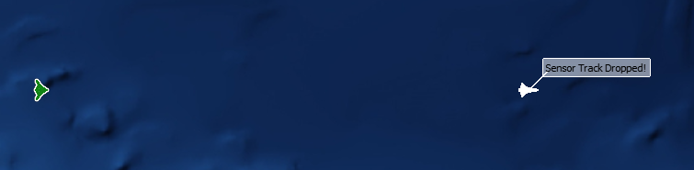
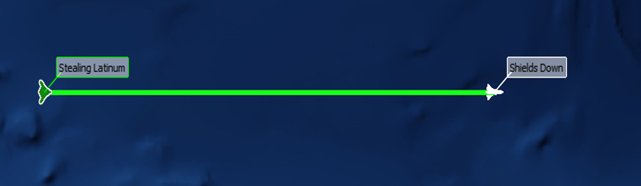
Component Scenario (cont.)
Result of forcing sensor track to drop
Result of forcing shields to drop

Slide 16
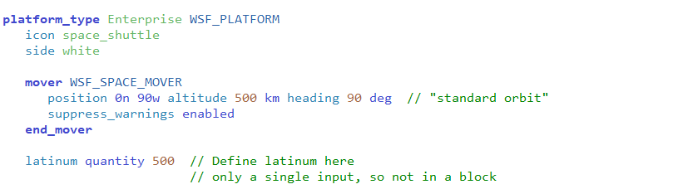
Component Input Processing
Note that ProcessInput is Called for All Components Inserted onto a Platform, and for Component Extensions Inserted onto Sensors, Comms, and Processors
For example, the latinum component is defined and inserted as follows:
In this Example There is Only one Possible Input, quantity
It is not defined in a (latinum … end_latinum) block
However, if There is More Than One Input, It Should be Defined in a Block
This makes the input easier to parse

Slide 17
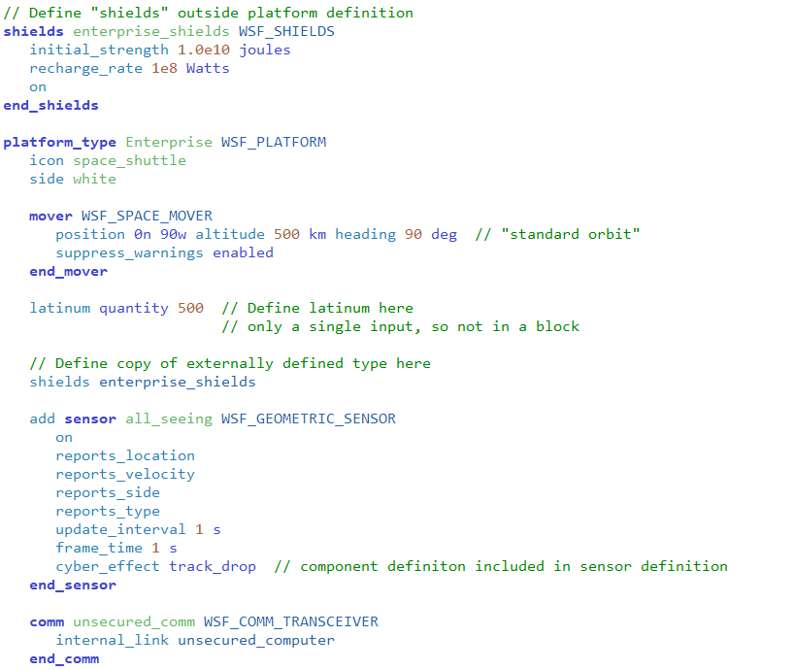
Scenario file
Defines what shields is
Creates shields
Creates sensor
Adds cyber_effect
component to the sensor
Creates comm

Slide 18
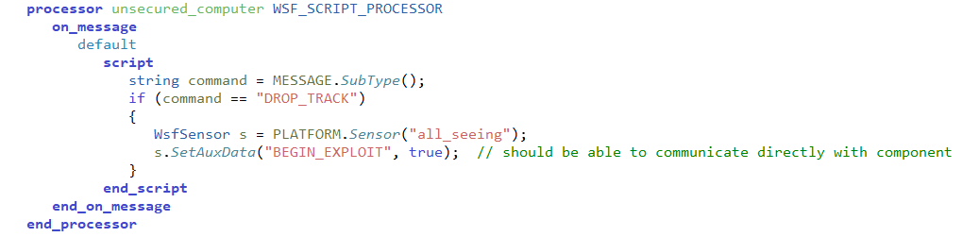
Scenario file
Creates processor to handle “Drop_Track”
messages arriving on comm
$$⋮$$
Creates platform enterprise

Slide 19
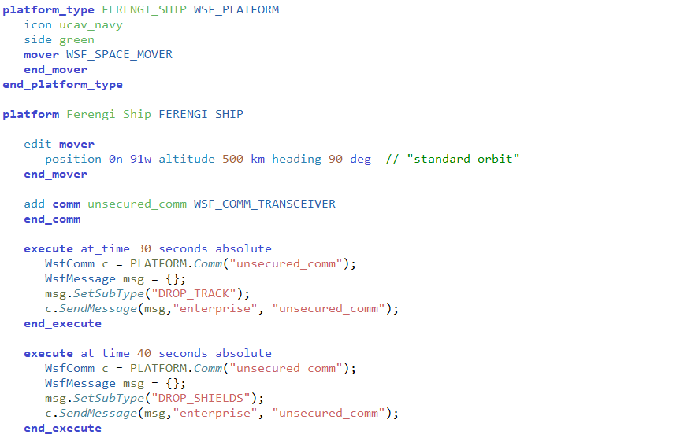

Scenario file
Defines what FERENGI_SHIP is
Creates platform Ferengi_Ship
Adds comm to Ferengi_Ship
Issues “Drop_Track” message at 30s
Issues “Drop_Shields” message at 40s
$⋮$

Slide 20
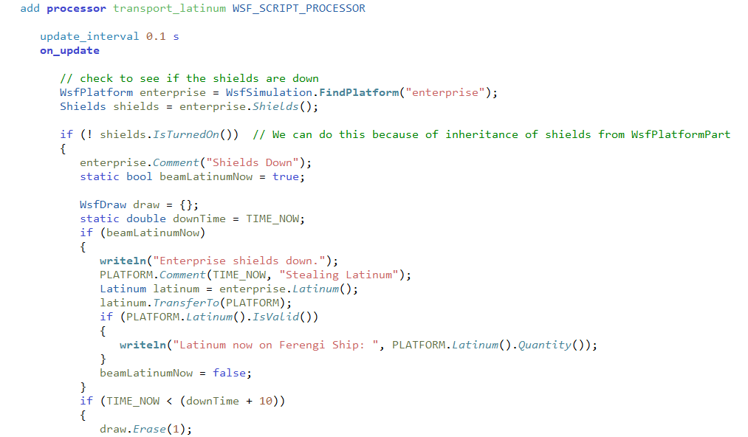

Scenario file
Creates processor to steal the latinum
Checks if enterprise shields are down
Steal the latinum
$⋮$
$⋮$
Draw line between the ships if shields
are not down

Slide 21
General Component Heirarchy
Note: this is only a partial hierarchy for components in AFSIM
WsfComponent
WsfPlatformComponent 
WsfComponentList
0..
UtEntity
WsfObject
WsfPlatformComponentList 
WsfUniqueId
WsfProcessorComponent §
0..
UtEntityPart
WsfPlatformPart
WsfPlatform
WsfSinglePlatformObserver
ComponentList ‡
WsfMover
WsfArticulatedPart
WsfProcessor
WsfComm
WsfWeapon
WsfSensor
The following code segments define some useful identifiers
 using WsfPlatformComponent = WsfComponentT<WsfPlatform>
 using WsfPlatformComponentList = WsfComponentListT<WsfPlatormComponent>
§ class WsfProcessorComponent : public WsfComponentT<WsfProcessor> …
‡ using ComponentList = WsfComponentListT<WsfProcessorComponent>

Slide 22
General Component Heirarchy
Note: this is only a partial hierarchy for components in AFSIM
WsfComponent
WsfComponentT<typename>
LatinumComponent
WsfPlatformComponent 
WsfComponentList
0..
UtEntity
WsfObject
WsfPlatformComponentList 
WsfUniqueId
WsfProcessorComponent §
0..
UtEntityPart
WsfPlatformPart
WsfPlatform
WsfSinglePlatformObserver
ComponentList ‡
WsfMover
WsfArticulatedPart
WsfProcessor
WsfSensorComponent ♦
0..
WsfComm
WsfWeapon
WsfSensor
WsfSensorComponentList ♪
CyberSensorEffect
The following code segments define some useful identifiers
 using WsfPlatformComponent = WsfComponentT<WsfPlatform>
 using WsfPlatformComponentList = WsfComponentListT<WsfPlatormComponent>
§ class WsfProcessorComponent : public WsfComponentT<WsfProcessor> …
‡ using ComponentList = WsfComponentListT<WsfProcessorComponent>
♦ class WsfSensorComponent : public WsfComponentT<WsfSensor>
♪ using ComponentList = WsfComponentListT<WsfSensorComponent>
ShieldComponent
1
This exercise adds three new
components:
SheildComponent
CyberSensorEffect
LatinumComponent

Slide 23
Getting Started (1/3)
Open CMake GUI
Check BUILD_WITH_component_exercise
Check BUILD_WITH_wsf_space
Check BUILD_WITH_wsf_mil
Press “Configure”
(Respond to any prompts asking for a compiler)
Press “Generate”

Slide 24
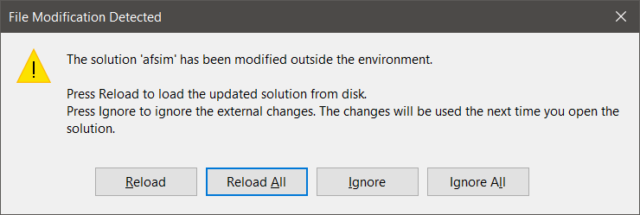
Getting Started (2/3)
If Visual Studio is already open:
Navigate to it and select Reload All when prompted.
Alternatively, open the solution file “afsim.sln” by:
Opening from “swdev\build”
Clicking “Open Project” from CMake

Slide 25
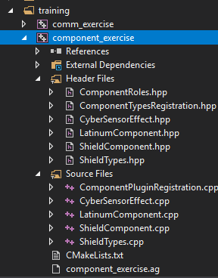
Getting Started (3/3)
This project uses the following source files:
ComponentPluginRegistration.cpp
ComponentTypesRegistration.hpp
CyberSensorEffect.hpp
CyberSensorEffect.cpp
ShieldComponent.hpp
ShieldComponent.cpp
ShieldTypes.hpp
ShieldTypes.cpp
LatinumComponent.hpp
LatinumComponent.cpp
ComponentRoles.hpp

Slide 26
Classes Utilized by this Exercise
In files ShieldComponent.hpp and ShieldComponent.cpp:
class ShieldComponent : public WsfPlatformPart
Creates and registers a new type of platform part with a role of cWSF_COMPONENT_SHIELDS
Maintains Strength, RechargeRate, UpdateInterval, etc.
class WsfScriptShieldComponentClass : public WsfScriptPlatformPartClass
Defines a script named Strength for use in the scenario input file scripts
In files ShieldTypes.hpp and ShieldTypes.cpp
class ShieldTypes : public WsfObjectTypeList<ShieldComponent>
Registers the ShieldTypes’ ShieldComponentFactory with the scenario so that platforms can have components that are of type ShieldComponent which are created by a shields … end_shields command block
class ShieldComponentFactory : public WsfComponentFactory<WsfPlatform>
Extends WsfComponentFactory<WsfPlatform> for SheildTypes and overrides methods ProcessAddorEditCommand and ProcessDeleteCommand to load/delete a ShieldComponent as platform component

Slide 27
Classes Utilized by this Exercise
In files LatinumComponent.hpp and LatinumComponent.cpp:
class LatinumComponent : public WsfPlatformComponent, …
Creates and registers a new platform component with a role of cWSF_COMPONENT_LATINUM
class WsfScriptLatinumComponentClass : public UtScriptClass
Defines a script named Quantity (returns the number of bars of LatinumComponent) for use in the scenario input files
Defines a script named TransferTo (transfers the LatinumComponent to the receiver, i.e., Ferengi ship) for use in the scenario input file scripts
class LatinumComponentFactory : public WsfComponentFactory<WsfPlatform>
Creates a LatinumComponent object and implements the ProcessInput method to read in the latinum command for this object
class LatinumTypes : public WsfObjectTypeList<LatinumComponent>
Defines the type list for LatinumComponents and registers the LatinumComponentFactory for LatinumComponent for the latinum command

Slide 28
Classes Utilized by this Exercise
In files CyberSensorEffect.hpp and CyberSensorEffect.cpp
class CyberSensorEffect : public WsfSensorComponent
Creates a new sensor component with a role of cWSF_COMPONENT_CYBER_SENSOR_EFFECT
Implements the Electronic Warfare (EW) component that is attached to all sensor systems (will allow the Ferengi to impair/defeat the Enterprise’s sensors)
class CyberSensorComponentFactory : public WsfComponentFactory<WsfSensor>
Creates a CyberSensorEffectObject and implements the ProcessInput method to read in the cyber_effect … end_cyber_effect commands for this object

Slide 29
Classes Utilized by this Exercise
In file ComponentTypesRegistration.hpp:
class ComponentTypesRegistration : public WsfScenarioExtension
This class is registered with the Scenario as a Scenario extension
Overrides AddedToScenario, which registers the new ShieldComponent type with the scenario, and adds the LatinumTypes type to the scenario
In file ComponentPluginRegistration.cpp:
class RegisterShieldComponent : public WsfApplicationExtension
Overrides AddedToApplication, which registers the new ShieldComponent script type, registers the ShieldComponent script methods, and registers the LatinumComponent script methods
Overrides the ScenarioCreated which registers the new ShieldComponent type with the scenario, and adds the LatinumTypes type to the scenario (after the scenario has been created by mission/warlock)
Registered with the StandardApplication by WsfPluginSetup

Slide 30
Component Exercises
Exercise 1
Complete registration of application extension, scenario extension, and component factory
Understand other component factories
Exercise 2
Understand, and complete the implementation of, the new platform and sensor components
Exercise 3
Understand component factory classes’ ProcessInput methods
Complete CyberSensorEffect’s ProcessInput and TrackerAllowTracking methods
Exercise 4
Understand, and complete the implementation of, the script classes

Slide 31
Exercise 1
Complete registration of application extension
Complete registration of scenario extension
Complete registration of the script methods
Complete registration of CyberSensorEffect component factory
Understand other component factories (ShieldTypes and LatinumComponent)

Slide 32
AFSIM Plugins & Extensions
WsfExtension
WsfScenario
WsfSimulation
WsfApplication
WsfStandardApplication
WsfSimulationExtension
WsfScenarioExtension
WsfApplicationExtension
Main application classes used
in mission/warlock
All AFSIM extensions must derive from WsfExtension:
Three predefined extension classes already exist (can be inherited from)
WsfScenarioExtension – extensions that will provide new scenario commands (requiring a new ProcessInput for those commands) will need to inherit this class
WsfSimulationExtension – extensions that will access the simulation will need to inherit this class
WsfApplicationExtension – extensions that will create new script types, or will utilize a simulation extension or scenario extension, will need to inherit this class

Slide 33
AFSIM Plugins & Extensions
WsfExtension
WsfScenario
WsfSimulation
WsfApplication
WsfStandardApplication
WsfSimulationExtension
WsfScenarioExtension
WsfApplicationExtension
Main application classes used
in mission/warlock
ComponentTypesRegistration
RegisterShieldComponent
Sets up the new Scenario
Extension classes to work
with AFSIM
Sets up the new Application
Extension classes to work
with AFSIM
All AFSIM extensions must derive from WsfExtension:
Three predefined extension classes already exist (can be inherited from)
WsfScenarioExtension – extensions that will provide new scenario commands (requiring a new ProcessInput for those commands) will need to inherit this class
WsfSimulationExtension – extensions that will access the simulation will need to inherit this class
WsfApplicationExtension – extensions that will create new script types, or will utilize a simulation extension or scenario extension, will need to inherit this class

Slide 34
Extensions
Applications, Scenarios, and Simulations can all be “Extended”
Application Extensions are owned by the Application
Represent optional capabilities that can be added to an application.
Used if you need new script types (sensors, weapons, components, movers)
This is the entry point to registering all extensions in AFSIM
An application extension is required if you are going to create a scenario extension or a simulation extension
We also need an application extension if
We are creating new scripts
We need to register a new plugin
We need the new plugin because we are creating a new type
Here we need to register the plugin with the application extension (see the file RegisterShieldComponent in ComponentPluginRegistration.cpp)

Slide 35
Component Exercise 1 — Review 1
In file ComponentPluginRegistration.cpp:
Review and Understand How the Plugins are set up
Look at WsfPluginSetup and note the call to RegisterExtension to register the WsfApplicationExtension (our RegisterShieldComponent class)
Look at WsfPluginVersion and note the call to UtPluginVersion
Same as the code in the Weapons and Movers exercises

Slide 36
Component Exercise 1 — Review 1 ComponentPluginRegistration.cpp
extern "C"
{
COMPONENT_EXERCISE_EXPORT void WsfPluginVersion(UtPluginVersion& aVersion)
{
aVersion = UtPluginVersion(WSF_PLUGIN_API_MAJOR_VERSION,
WSF_PLUGIN_API_MINOR_VERSION,
WSF_PLUGIN_API_COMPILER_STRING);
}
COMPONENT_EXERCISE_EXPORT void WsfPluginSetup(WsfApplication& aApplication)
{
aApplication.RegisterExtension("register_shield_component",
ut::make_unique<RegisterShieldComponent>());
}
}
This registers the application extension
RegisterShieldComponent with the application

Slide 37
Application Extensions
To extend an Application, you must create a class that inherits class WsfApplicationExtension
class myAppExtension: public WsfApplicationExtension { … }
You should override the following members:
AddedToApplication: to receive notification that extension was added to the application – often used to register additional script class and methods, etc.
ScenarioCreated: called at end of Scenario constructor in order to receive notification from the application that the scenario was created – useful to register an Scenario extension if needed
SimulationCreated: called from the Simulation’s Initialize method in order to receive notification from the application that the simulation was created – useful to register an Simulation extension if needed
ProcessCommandLine: called from WsfApplication::ProcessCommandLine method to examine current argument and process it if necessary
PrintGrammar: prints out the extended grammar recognized by the extension
ProcessCommandLineCommands: called by WsfApplication’s ProcessCommandLineCommands to allow the extension to process/handle any commands it needs to recognize

Slide 38
Application Extensions
We will create an Application Extension called RegisterShieldComponent which will register some new scripts
class RegisterShieldComponent: public WsfApplicationExtension { … }
This class will override the following members:
AddedToApplication: to receive notification that extension was added to the application – often used to register additional script class and methods, etc.
ScenarioCreated: called at end of Scenario constructor in order to receive notification from the application that the scenario was created – useful to register an Scenario extension if needed.
Note: this time, you will have to complete both the AddedToApplication
method, and the ScenarioCreated method.

Slide 39
Component Exercise 1 — Task 1 ComponentPluginRegistration.cpp
The application’s RegisterExtension method calls the WsfApplicationExtension::AddedToApplication method, which invokes the application extension’s AddedToApplication methods
In file ComponentPluginRegistration.cpp, complete method RegisterShieldComponent::AddedToApplication
Task 1a: Invoke the ShieldComponent::RegisterScriptTypes method to register the shield component's script type(s)
The format of RegisterScriptTypes is:
static void RegisterScriptTypes(UtScriptTypes&);
The input argument should be a dereferenced pointer for the pointer returned by a call to the aApplication.GetScriptTypes() method
Task 1b: Invoke the ShieldComponent::RegisterScriptMethods method to register the shield component's script method(s)
The format of RegisterScriptTypes is:
static void RegisterScriptMethods(UtScriptTypes&);
The input argument should be a dereferenced pointer for the pointer returned by a call to the aApplication.GetScriptTypes() method

Slide 40
Component Exercise 1 — Task 1 Solution ComponentPluginRegistration.cpp
class RegisterShieldComponent : public WsfApplicationExtension
{
public:
RegisterShieldComponent() = default;
void AddedToApplication(WsfApplication& aApplication) override
{
// EXERCISE 1 TASK 1a
// Use the application object to register the shield component's script type(s)
ShieldComponent::RegisterScriptTypes(*aApplication.GetScriptTypes());
// EXERCISE 1 TASK 1b
// Use the application object to register the "Shields" accessor that extends the WsfPlatform script type.
ShieldComponent::RegisterScriptMethods(*aApplication.GetScriptTypes());
// Use the application object to register the latinum component's script type(s)
LatinumComponent::RegisterScriptTypes(*aApplication.GetScriptTypes());
// Use the application object to register the "Latinum" accessor that extends WsfPlatform
LatinumComponent::RegisterScriptMethods(*aApplication.GetScriptTypes());
}
...
};
Note that AddedToApplication also calls RegisterScriptTypes
and RegisterScriptMethods for LatinumComponent

Slide 41
Component Exercise 1 — Task 2 ComponentPluginRegistration.cpp
In file ComponentPluginRegistration.cpp, implement RegisterShieldComponent::ScenarioCreated for the Application Extension
Use the scenario object’s RegisterExtension method to register our new scenario extension (ComponentTypesRegistration)
The format of RegisterExtension is:
void RegisterExtension(const std::string&, std::unique_ptr<WsfScenarioExtension>());
The first parameter is the name of the extension, which is “shield_types”
The second parameter is the type of extension, which is a scenario extension
The second parameter should be a unique_ptr created with ut::make_unique<ComponentTypesRegistration>()
Notes:
The WsfScenario constructor calls WsfApplication::ScenarioCreated, which then calls WsfApplicationExtension::ScenarioCreated for each of the application extensions registered with AFSIM

Slide 42
Component Exercise 1 — Task 2 Solution ComponentPluginRegistration.cpp
class RegisterShieldComponent : public WsfApplicationExtension
{
public:
...
void ScenarioCreated(WsfScenario& aScenario) override
{
// EXERCISE 1 TASK 2
// Register the scenario extension that allows us to reference the new type lists.
// Use the scenario object to register an extension called "shield_types",
// of type ComponentTypesRegistration().
aScenario.RegisterExtension("shield_types", ut::make_unique<ComponentTypesRegistration>());
// EXERCISE 1 TASK 3
// Call the CyberSensorEffect's static method RegisterComponentFactory.
}
};

Slide 43
Component Exercise 1 — Task 3 ComponentPluginRegistration.cpp
In file ComponentPluginRegistration.cpp, complete RegisterShieldComponent::ScenarioCreated for the Application Extension
Call the CyberSensorEffect’s method RegisterComponentFactory
The format of RegisterComponentFactory is:
static void RegisterComponentFactory(WsfScenario&);
Pass in the aScenario object as the argument
This will register the CyberSensorEffect’s CyberSensorComponentFactory class with the scenario

Slide 44
Component Exercise 1 — Task 3 Solution ComponentPluginRegistration.cpp
class RegisterShieldComponent : public WsfApplicationExtension
{
public:
...
void ScenarioCreated(WsfScenario& aScenario) override
{
// EXERCISE 1 TASK 2
// Register the scenario extension that allows us to reference the new type lists.
// Use the scenario object to register an extension called "shield_types",
// of type ComponentTypesRegistration().
aScenario.RegisterExtension("shield_types", ut::make_unique<ComponentTypesRegistration>());
// EXERCISE 1 TASK 3
// Call the CyberSensorEffect's static method RegisterComponentFactory.
CyberSensorEffect::RegisterComponentFactory(aScenario);
}
};

Slide 45

Component Exercise 1 – Review 2 CyberSensorEffect.hpp / CyberSensorEffect.cpp
Examine the CyberSensorEffect class
Notice the implementation of RegisterComponentFactory
//! The EW component that will be attached to all sensor systems.
class CyberSensorEffect : public WsfSensorComponent
{
public:
enum Type
{
cUNDEFINED,
cTRACK_PULLOFF,
cTRACK_DROP
};
static void RegisterComponentFactory(WsfScenario& aScenario);
static CyberSensorEffect* Find(const WsfSensor& aSensor);
static CyberSensorEffect* FindOrCreate(WsfSensor& aSensor);
CyberSensorEffect();
CyberSensorEffect(const CyberSensorEffect& aSrc);
CyberSensorEffect& operator=(const CyberSensorEffect& aSrc);
~CyberSensorEffect() noexcept override = default;
$⋮$
};
//! Register the component factory that handles input for this component.
void CyberSensorEffect::RegisterComponentFactory(WsfScenario& aScenario)
{
aScenario.RegisterComponentFactory(ut::make_unique<CyberSensorComponentFactory>());
}

Slide 46

Component Exercise 1 – Review 3 CyberSensorEffect.cpp
Examine CyberSensorComponentFactory in CyberSensorEffect.cpp
Notice the implementation of ProcessInput
Handles the cyber_effect sensor command and finds the existing CyberSensorEffect object, or creates a new one if necessary, to implement this component and process its commands
class CyberSensorComponentFactory : public WsfComponentFactory<WsfSensor>
{
public:
bool ProcessAddOrEditCommand(UtInput& aInput, WsfSensor& aParent, bool aIsAdding) override
{
// No add or edit commands to process
return false;
}
bool ProcessInput(UtInput& aInput, WsfSensor& aParent) override
{
std::string command;
aInput.GetCommand(command);
bool myCommand = false;
if (command == "cyber_effect")
{
CyberSensorEffect* cbePtr = CyberSensorEffect::FindOrCreate(aParent);
$⋮$
}
return myCommand;
}
};
This is the component
factory class responsible
for creating a
CyberSensorEffect object
when the scenario sees a
cyber_effect command in
the scenario input files

Slide 47
Extensions
Scenarios can all be “Extended” as well
Scenario Extensions are owned by the Scenario
Represent optional types that can be added to a scenario.
Used if you need new types (components, observers, comms)
An application extension is required if you are going to create a scenario extension (or a simulation extension – covered later)
We also need an scenario extension if
We are creating global level ProcessInput methods (for our types)

Slide 48
Scenario Extensions
To extend a Scenario, you must create a class that inherits class WsfScenarioExtension
class myScenarioExtension: public WsfScenarioExtension
You must override:
AddedToScenario: to receive notification that extension was added to the scenario – often used to register additional component type objects and factories
ProcessInput: processes any scenario input commands that must be recognized by the extension
FileLoaded: notifies extension that a file has been loaded into the scenario
Complete: called from WsfScenario::LoadComplete – notifies extension that all scenario input has been processed
Complete2: called after all extensions have had their Complete method invoked
SimulationCreated: called from WsfSimulation::Initialize – useful if a scenario extension needs an associated simulation extension – this method can register the simulation extension
AlwaysCreate: determines if the extension is optional or required

Slide 49
Scenario Extensions
To extend a Scenario, you must create a class that inherits class WsfScenarioExtension
class ComponentTypesRegistration: public WsfScenarioExtension
You must override:
AddedToScenario: to receive notification that extension was added to the scenario – often used to register additional component type objects and factories

Slide 50
Component Exercise 1 – Review 4 ComponentTypesRegistration.hpp
In file ComponentTypesRegistration.hpp, inspect the registration of the new component types with the scenario
AddedToScenario is responsible for adding the new ShieldTypes component type and the new LatinumComponent component type to the scenario
AddedToScenario is called by
the scenario’s RegisterExtension
Method, which was called by the
application extension’s
ScenarioCreated method
class ComponentTypesRegistration : public WsfScenarioExtension
{
public:
ComponentTypesRegistration() = default;
void AddedToScenario() override
{
// Register our custom type lists with the scenario.
// Shields
mShieldTypesIndex = GetScenario().GetTypeLists().size();
auto mShieldTypesPtr = ut::make_unique<ShieldTypes>(GetScenario());
GetScenario().AddTypeList(std::move(mShieldTypesPtr));
// Latinum
// Note we do not need to access the type list for latinum as we are only
// using it to process input and add instances to the platform.
GetScenario().AddTypeList(ut::make_unique<LatinumTypes>(GetScenario()));
}
ShieldTypes& GetShieldTypes() const
{return *static_cast<ShieldTypes*>(GetScenario().GetTypeLists().at(mShieldTypesIndex)); }
private:
size_t mShieldTypesIndex;
};

Slide 51
Component Exercise 1 – Review 5 ShieldTypes.hpp
Examine the ShieldTypes class constructor
Notice that it registers the ShieldComponentFactory (defined in ShieldTypes.cpp) with the scenario
Notice that it adds the WSF_SHIELDS as a command that can be created in the scenario, and registers the SheildComponent class for that type
class ShieldTypes : public WsfObjectTypeList<ShieldComponent>
{
public:
static ShieldTypes& Get(WsfScenario& aScenario);
static const ShieldTypes& Get(const WsfScenario& aScenario);
explicit ShieldTypes(WsfScenario& aScenario);
};
ShieldTypes::ShieldTypes(WsfScenario& aScenario)
: WsfObjectTypeList<ShieldComponent>(aScenario, cREDEFINITION_ALLOWED, "shields")
{
aScenario.RegisterComponentFactory(ut::make_unique<ShieldComponentFactory>()); // Allows for definition
// inside platform, platform_type blocks.
Add("WSF_SHIELDS", ut::make_unique<ShieldComponent>(aScenario)); // Dummy type "WSF_SHIELDS"
// explicitly referenced in the input.
}

Slide 52
Component Exercise 1 – Review 6 LatinumTypes.hpp
Examine the LatinumTypes class constructor
Notice that it registers the LatinumComponentFactory (defined in LatinumComponent.cpp) with the scenario
class LatinumTypes : public WsfObjectTypeList<LatinumComponent>
{
public:
explicit LatinumTypes(WsfScenario& aScenario);
};
LatinumTypes::LatinumTypes(WsfScenario& aScenario)
: WsfObjectTypeList<LatinumComponent>(aScenario, cREDEFINITION_ALLOWED, "latinum")
{
SetSingularBaseType();
aScenario.RegisterComponentFactory(ut::make_unique<LatinumComponentFactory>()); // Allows for definition
// inside platform, platform_type blocks.
}

Slide 53
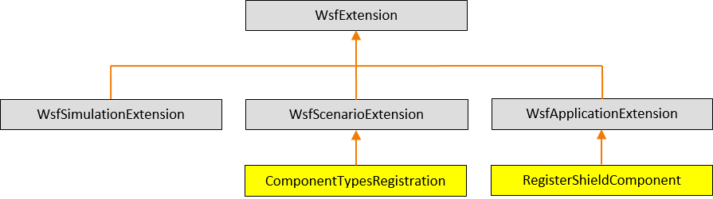
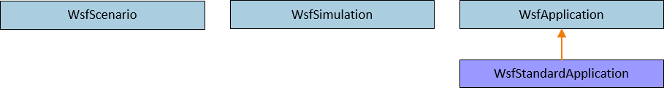
AFSIM Plugins & Extensions AFSIM mission startup sequence
First, mission creates a WsfStandardApplication named app
mission::main()
unique_ptr<RegisterShieldComponent>
WsfStandardApplication: app
WsfStandardApplication::WsfStandardApplication()
ComponentPluginRegistration.cpp:WsfPluginSetup()
WsfPluginSetup()
RegisterExtension(“register_shield_component”, ut::make_unique<RegisterShieldComponent>())
AddedToApplication()
The WsfStandardApplication constructor utilizes the plugin manager to find and load all plugins (including those in the training folders -- because of the cmake option WSF_ADD_EXTENSION_PATH)
For each plugin found, executes WsfPluginSetup (note: this causes our component exercise plugin’s WsfPluginSetup function to execute)
This causes our component exercise’s RegisterShieldComponent application extension to be created and registered with app
RegisterExtension then invokes the WsfApplicationExtension::AddedToApplication() which is overridden by RegisterShieldComponent::AddedToApplication()
AddedToApplication registers the script types & methods for ShieldComponent and LatinumComponent

Slide 54

AFSIM Plugins & Extensions AFSIM mission startup sequence
mission::main()
unique_ptr<RegisterShieldComponent>
WsfStandardApplication: app
RegisterExtension(…)
RegisterExtension(…)
$$⋮$$
RegisterExtension(…)
Mission then registers all of the necessary predefined extensions with app

Slide 55
AFSIM Plugins & Extensions AFSIM mission startup sequence
mission::main()
unique_ptr<ComponentTypesRegistration>
unique_ptr<RegisterShieldComponent>
WsfScenario: scenario
WsfStandardApplication: app
WsfScenario::WsfScenario(app)
ScenarioCreated(…)
ScenarioCreated(…)
scenario.RegisterExtension(“shield_types”,
ut::make_unique<ComponentTypesRegistration>())
This is not the actual line of code executed, but this is what that code is equivalent to
AddedToScenario(…)
Mission then creates the scenario and invokes the WsfScenario constructor: WsfScenario scenario(app);
This constructor invokes the WsfApplication::ScenarioCreated method
This, in turn, invokes ScenarioCreated for all registered application extensions (including RegisterShieldComponent::ScenarioCreated)
This, in turn, creates the ComponentTypesRegistration, and registers it with scenario
RegisterExtension then invokes ComponentTypesRegistration::AddedToScenario
ComponentTypesRegistation::AddedToScenario adds ShieldTypes and LatinumTypes as new scenario types

Slide 56
AFSIM Plugins & Extensions AFSIM mission startup sequence
mission::main()
unique_ptr<ComponentTypesRegistration>
unique_ptr<RegisterShieldComponent>
WsfScenario: scenario
WsfStandardApplication: app
WsfScenario::WsfScenario(app)
ScenarioCreated(…)
ScenarioCreated(…)
scenario.RegisterExtension(“shield_types”,
ut::make_unique<ComponentTypesRegistration>())
This is not the actual line of code executed, but this is what that code is equivalent to
AddedToScenario(…)
When ComponentTypesRegistration::AddedToScenario executes:
It creates a ShieldTypes object,
the ShieldTypes constructor invokes the ShieldTypes::RegisterComponentFactory method to register the ShieldComponentFactory with the scenario
This enables the scenario to create a ShieldComponent object when processing the scenario’s input files
Then it creates the LatinumTypes object,
the LatinumTypes constructor invokes the LatinumTypes::RegisterComponentFactory method to register the LatinumComponentFactory with the scenario
This enables the scenario to create a LatinumComponent object when processing the scenario’s input files

Slide 57
AFSIM Plugins & Extensions AFSIM mission startup sequence
CyberSensorComponentFactory
Sets values
CyberSensorEffect
mission::main()
unique_ptr<ComponentTypesRegistration>
unique_ptr<RegisterShieldComponent>
WsfScenario: scenario
WsfStandardApplication: app
WsfStandardApplication::ProcessInputFiles()
WsfScenario::LoadFromFile(…)
ProcessInput(…)
Mission invokes app.WsfStandardApplication::ProcessInputFiles()
which invokes WsfScenario::LoadFromFile()
For each command in input,
Invoke each of the core classes’ ProcessInput() methods (including those for registered components and types)
when processing a cyber_effect sensor command – core finds the CyberSensorComponentFactory for a CyberSensorEffect object
Invokes CyberSensorComponentFactory::ProcessInput()
Creates a CyberSensorEffect object as a sensor component (for the associated sensor)
reads in the track_drop, track_pulloff, and exploit_delay commands

Slide 58
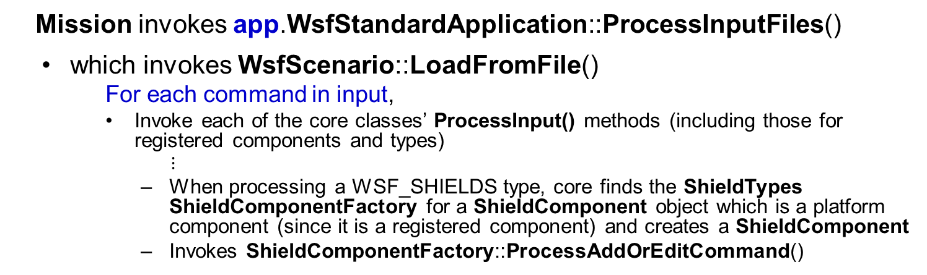
AFSIM Plugins & Extensions AFSIM mission startup sequence
ShieldComponentFactory
CyberSensorComponentFactory
ShieldComponent
CyberSensorEffect
mission::main()
unique_ptr<ComponentTypesRegistration>
unique_ptr<RegisterShieldComponent>
WsfScenario: scenario
WsfStandardApplication: app
WsfStandardApplication::ProcessInputFiles()
WsfScenario::LoadFromFile(…)
ProcessAddOrEditCommand(…)
ProcessInput(…)
Mission invokes app.WsfStandardApplication::ProcessInputFiles()
which invokes WsfScenario::LoadFromFile()
For each command in input,
Invoke each of the core classes’ ProcessInput() methods (including those for registered components and types)
$⋮$
When processing a WSF_SHIELDS type, core finds the ShieldTypes ShieldComponentFactory for a ShieldComponent object which is a platform component (since it is a registered component) and creates a ShieldComponent
Invokes ShieldComponentFactory::ProcessAddOrEditCommand()
Leads to invocation of ShieldComponent::ProcessInput() for shields commands
Notes:
The ShieldTypes’ ShieldComponentFactory::ProcessAddOrEditCommand method invokes the ShieldTypes types.LoadUnnamedComponentWithoutEdit method

Slide 59
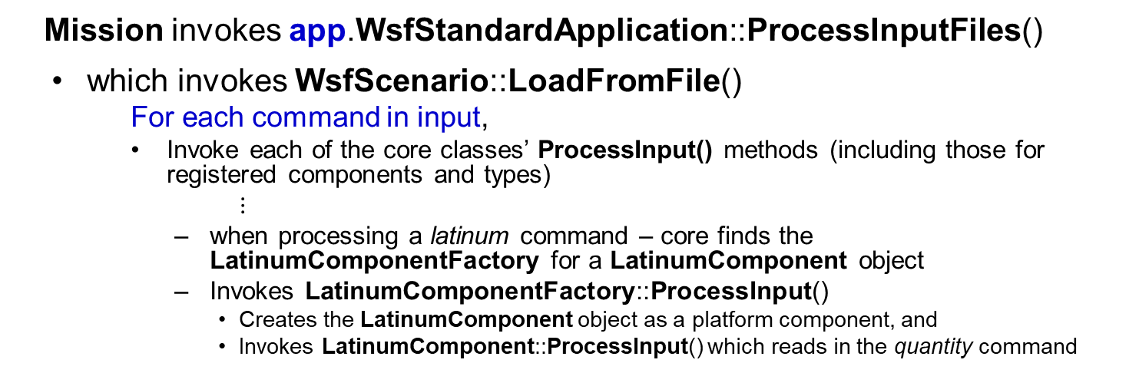
AFSIM Plugins & Extensions AFSIM mission startup sequence
ShieldComponentFactory
CyberSensorComponentFactory
LatinumComponentFactory
LatinumComponent
ShieldComponent
CyberSensorEffect
mission::main()
unique_ptr<ComponentTypesRegistration>
unique_ptr<RegisterShieldComponent>
WsfScenario: scenario
WsfStandardApplication: app
WsfStandardApplication::ProcessInputFiles()
WsfScenario::LoadFromFile(…)
ProcessInput(…)
ProcessInput(…)
Mission invokes app.WsfStandardApplication::ProcessInputFiles()
which invokes WsfScenario::LoadFromFile()
For each command in input,
Invoke each of the core classes’ ProcessInput() methods (including those for registered components and types)
$⋮$
when processing a latinum command – core finds the LatinumComponentFactory for a LatinumComponent object
Invokes LatinumComponentFactory::ProcessInput()
Creates the LatinumComponent object as a platform component, and
Invokes LatinumComponent::ProcessInput() which reads in the quantity command

Slide 60
AFSIM Plugins & Extensions AFSIM mission startup sequence
mission::main()
unique_ptr<ComponentTypesRegistration>
unique_ptr<RegisterShieldComponent>
WsfScenario: scenario
WsfStandardApplication: app
WsfStandardApplication::ProcessInputFiles()
WsfScenario::LoadFromFile(…)
ProcessInput(…)
Mission invokes app.WsfStandardApplication::ProcessInputFiles()
which invokes WsfScenario::LoadFromFile()
For each command in input,
Invoke each of the core classes’ ProcessInput() methods
Invoke each registered scenario extension’s ProcessInput()
Invokes WsfScenarioExtension::ProcessInput() for ComponentTypesRegistration
ComponentTypesRegistration does not override this method, so this has no effect

Slide 61
AFSIM Plugins & Extensions AFSIM mission startup sequence
mission::main()
unique_ptr<ComponentTypesRegistration>
unique_ptr<RegisterShieldComponent>
WsfScenario: scenario
WsfStandardApplication: app
WsfStandardApplication::ProcessInputFiles()
WsfScenario::LoadFromFile(…)
ProcessInput(…)
WsfScenario::CompleteLoad(…)
Complete(…)
Complete2(…)
Mission invokes app.WsfStandardApplication::ProcessInputFiles()
which, invokes WsfScenario::LoadFromFile()
and then invokes WsfScenario::CompleteLoad()
Invokes each scenario extension’s Complete()
Then invokes each scenario extension’s Complete2()

Slide 62
AFSIM Plugins & Extensions AFSIM mission startup sequence
mission::main()
unique_ptr<ComponentTypesRegistration>
unique_ptr<RegisterShieldComponent>
WsfScenario: scenario
unique_ptr<WsfSimulation>: simPtr
WsfStandardApplication: app
WsfStandardApplication::CreateSimulation()
WsfSimulation::WsfSimulation()
Mission creates the Simulation by executing:
std::unique_ptr<WsfSimulation> simPtr =
app.CreateSimulation(scenario, …);
CreateSimulation invokes the WsfSimulation object’s constructor (with scenario as argument)

Slide 63
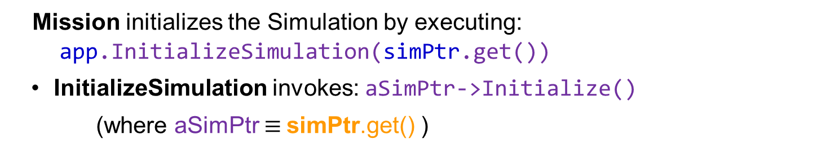
AFSIM Plugins & Extensions AFSIM mission startup sequence
mission::main()
unique_ptr<ComponentTypesRegistration>
unique_ptr<RegisterShieldComponent>
WsfScenario: scenario
unique_ptr<WsfSimulation>: SimPtr
WsfStandardApplication: app
WsfStandardApplication::InitializeSimulation()
WsfSimulation::Initialize()
Mission initializes the Simulation by executing:
app.InitializeSimulation(simPtr.get())
InitializeSimulation invokes: aSimPtr->Initialize()
(where aSimPtr $≡$simPtr.get() )

Slide 64
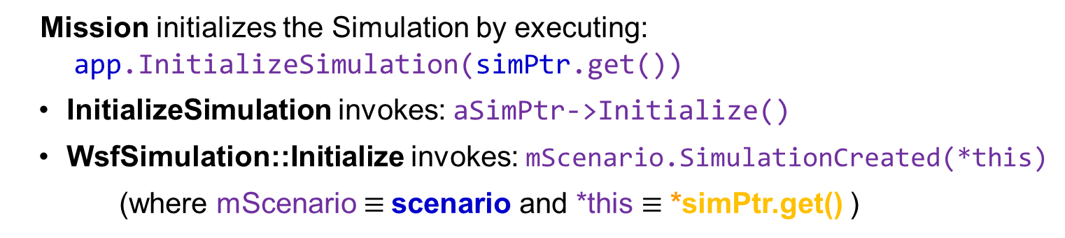
AFSIM Plugins & Extensions AFSIM mission startup sequence
mission::main()
unique_ptr<ComponentTypesRegistration>
unique_ptr<RegisterShieldComponent>
WsfScenario: scenario
unique_ptr<WsfSimulation>: SimPtr
WsfStandardApplication: app
WsfStandardApplication::InitializeSimulation()
WsfScenario::SimulationCreated()
WsfSimulation::Initialize()
Mission initializes the Simulation by executing:
app.InitializeSimulation(simPtr.get())
InitializeSimulation invokes: aSimPtr->Initialize()
WsfSimulation::Initialize invokes: mScenario.SimulationCreated(*this)
(where mScenario $≡$scenario and *this $≡$ *simPtr.get() )

Slide 65
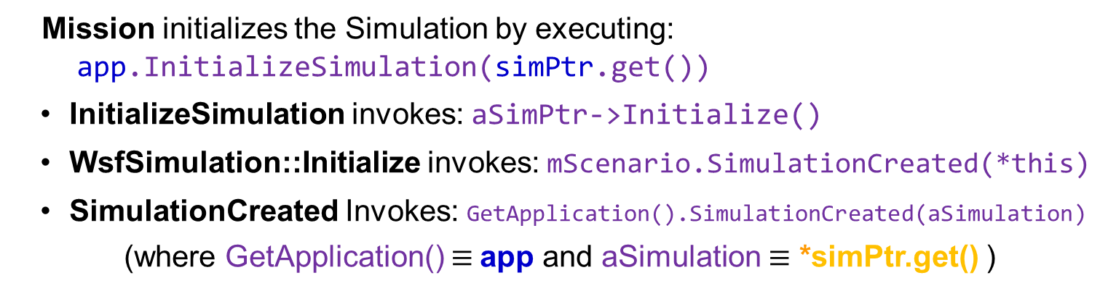
AFSIM Plugins & Extensions AFSIM mission startup sequence
mission::main()
unique_ptr<ComponentTypesRegistration>
unique_ptr<RegisterShieldComponent>
WsfScenario: scenario
unique_ptr<WsfSimulation>: SimPtr
WsfStandardApplication: app
WsfStandardApplication::InitializeSimulation()
WsfScenario::SimulationCreated()
WsfSimulation::Initialize()
WsfApplication::SimulationCreated()
Mission initializes the Simulation by executing:
app.InitializeSimulation(simPtr.get())
InitializeSimulation invokes: aSimPtr->Initialize()
WsfSimulation::Initialize invokes: mScenario.SimulationCreated(*this)
SimulationCreated Invokes: GetApplication().SimulationCreated(aSimulation)
(where GetApplication() $≡$app and aSimulation $≡$ *simPtr.get() )

Slide 66
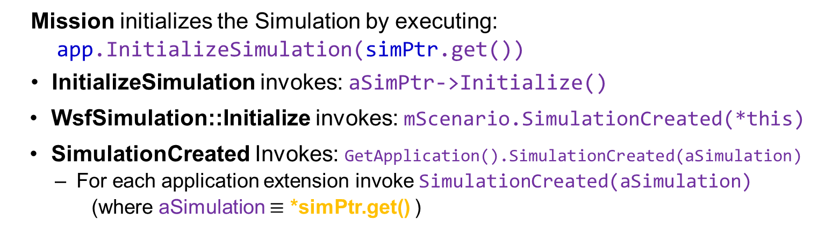
AFSIM Plugins & Extensions AFSIM mission startup sequence
mission::main()
unique_ptr<ComponentTypesRegistration>
unique_ptr<RegisterShieldComponent>
WsfScenario: scenario
unique_ptr<WsfSimulation>: SimPtr
WsfStandardApplication: app
WsfStandardApplication::InitializeSimulation()
WsfScenario::SimulationCreated()
WsfSimulation::Initialize()
WsfApplication::SimulationCreated()
Mission initializes the Simulation by executing:
app.InitializeSimulation(simPtr.get())
InitializeSimulation invokes: aSimPtr->Initialize()
WsfSimulation::Initialize invokes: mScenario.SimulationCreated(*this)
SimulationCreated Invokes: GetApplication().SimulationCreated(aSimulation)
For each application extension invoke SimulationCreated(aSimulation)
(where aSimulation $≡$ *simPtr.get() )

Slide 67
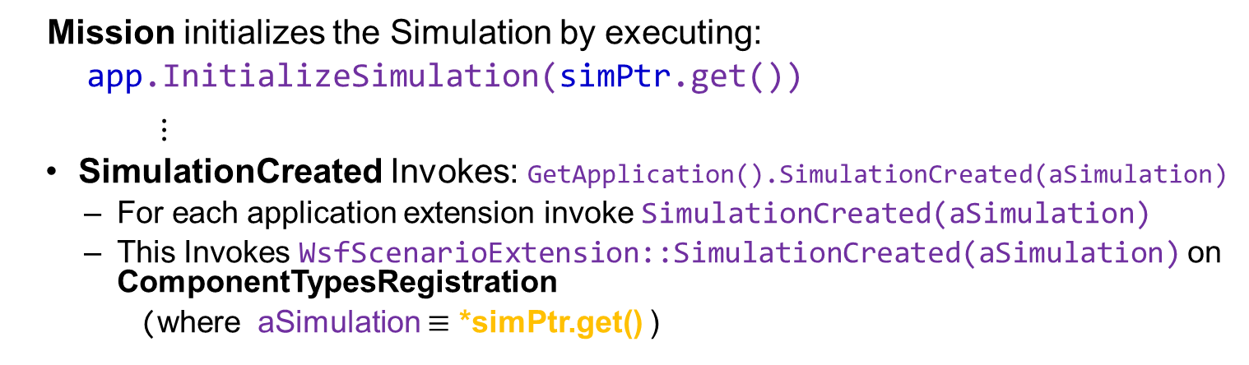
AFSIM Plugins & Extensions AFSIM mission startup sequence
mission::main()
unique_ptr<ComponentTypesRegistration>
unique_ptr<RegisterShieldComponent>
WsfScenario: scenario
unique_ptr<WsfSimulation>: SimPtr
WsfStandardApplication: app
WsfStandardApplication::InitializeSimulation()
WsfScenario::SimulationCreated()
WsfSimulation::Initialize()
WsfApplication::SimulationCreated()
ComponentTypesRegistration::SimulationCreated()
Mission initializes the Simulation by executing:
app.InitializeSimulation(simPtr.get())
$⋮$
SimulationCreated Invokes: GetApplication().SimulationCreated(aSimulation)
For each application extension invoke SimulationCreated(aSimulation)
This Invokes WsfScenarioExtension::SimulationCreated(aSimulation) on ComponentTypesRegistration
(where aSimulation $≡$ *simPtr.get() )
Note: ComponentTypesRegistration does not override SimulationCreated, so this call has no effect

Slide 68
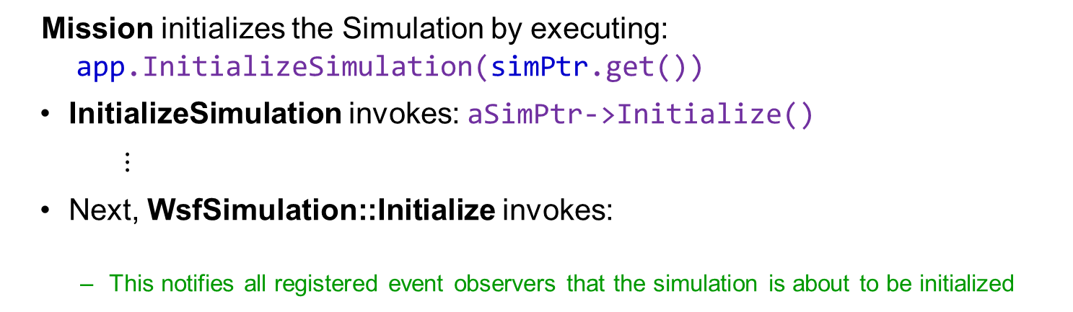
AFSIM Plugins & Extensions AFSIM mission startup sequence
mission::main()
unique_ptr<ComponentTypesRegistration>
unique_ptr<RegisterShieldComponent>
WsfScenario: scenario
unique_ptr<WsfSimulation>: SimPtr
WsfStandardApplication: app
WsfStandardApplication::InitializeSimulation()
WsfSimulation::Initialize()
WsfObserver::SimulationInitializing()
Mission initializes the Simulation by executing:
app.InitializeSimulation(simPtr.get())
InitializeSimulation invokes: aSimPtr->Initialize()
$⋮$
Next, WsfSimulation::Initialize invokes:
This notifies all registered event observers that the simulation is about to be initialized
WsfObserver::SimulationInitializing(this)
Note: the Interfaced class does not override this method, hence we do nothing with the notification

Slide 69
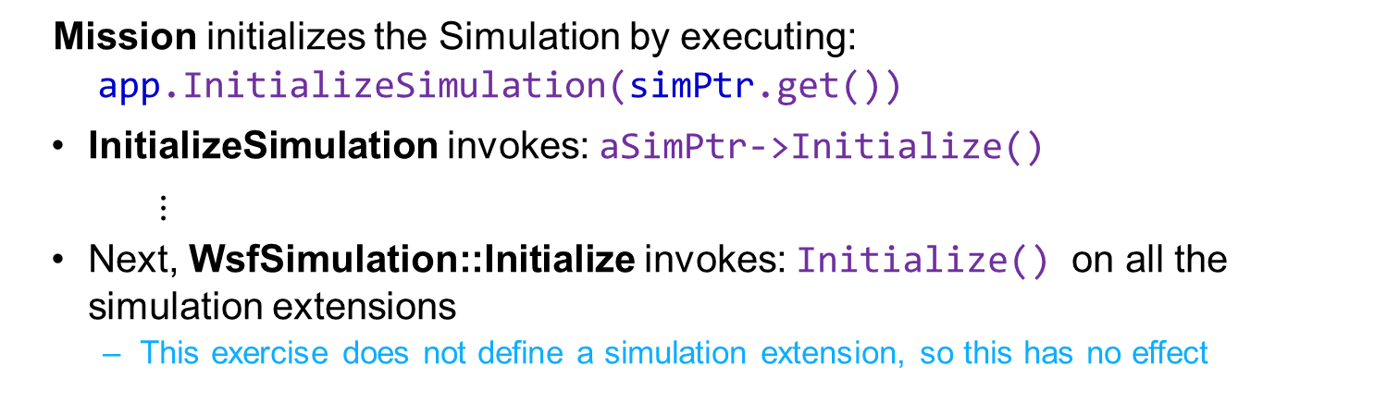
AFSIM Plugins & Extensions AFSIM mission startup sequence
mission::main()
unique_ptr<ComponentTypesRegistration>
unique_ptr<RegisterShieldComponent>
WsfScenario: scenario
unique_ptr<WsfSimulation>: SimPtr
WsfStandardApplication: app
WsfStandardApplication::InitializeSimulation()
WsfSimulation::Initialize()
WsfSimulationExtension::Initialize()
Mission initializes the Simulation by executing:
app.InitializeSimulation(simPtr.get())
InitializeSimulation invokes: aSimPtr->Initialize()
$⋮$
Next, WsfSimulation::Initialize invokes: Initialize() on all the simulation extensions
This exercise does not define a simulation extension, so this has no effect

Slide 70
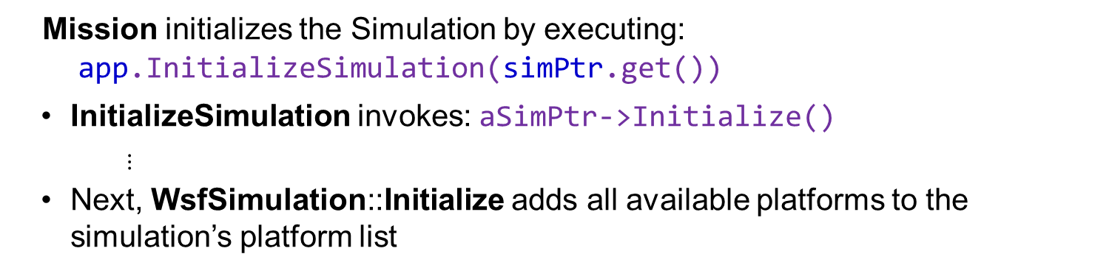
AFSIM Plugins & Extensions AFSIM mission startup sequence
mission::main()
unique_ptr<ComponentTypesRegistration>
unique_ptr<RegisterShieldComponent>
WsfScenario: scenario
unique_ptr<WsfSimulation>: SimPtr
WsfStandardApplication: app
WsfStandardApplication::InitializeSimulation()
WsfSimulation::Initialize()
Mission initializes the Simulation by executing:
app.InitializeSimulation(simPtr.get())
InitializeSimulation invokes: aSimPtr->Initialize()
$⋮$
Next, WsfSimulation::Initialize adds all available platforms to the simulation’s platform list

Slide 71
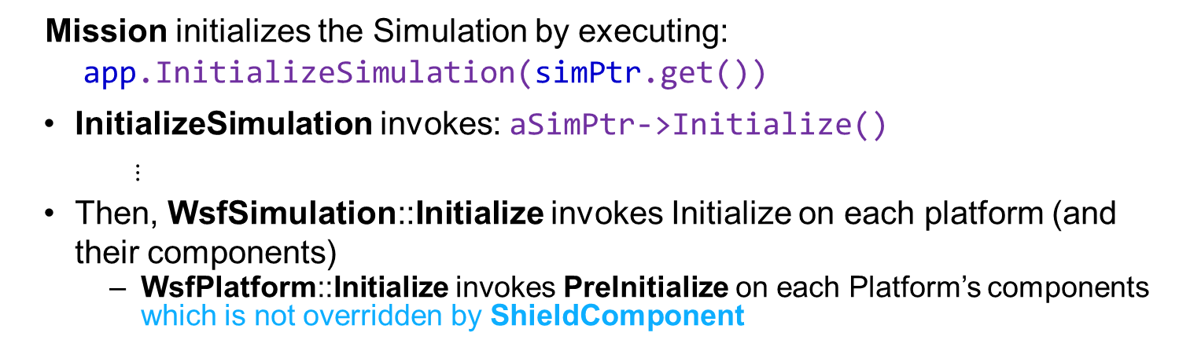
AFSIM Plugins & Extensions AFSIM mission startup sequence
mission::main()
unique_ptr<ComponentTypesRegistration>
unique_ptr<RegisterShieldComponent>
WsfScenario: scenario
unique_ptr<WsfSimulation>: SimPtr
WsfStandardApplication: app
WsfStandardApplication::InitializeSimulation()
WsfSimulation::Initialize()
Mission initializes the Simulation by executing:
app.InitializeSimulation(simPtr.get())
InitializeSimulation invokes: aSimPtr->Initialize()
$⋮$
Then, WsfSimulation::Initialize invokes Initialize on each platform (and their components)
WsfPlatform::Initialize invokes PreInitialize on each Platform’s components which is not overridden by ShieldComponent

Slide 72
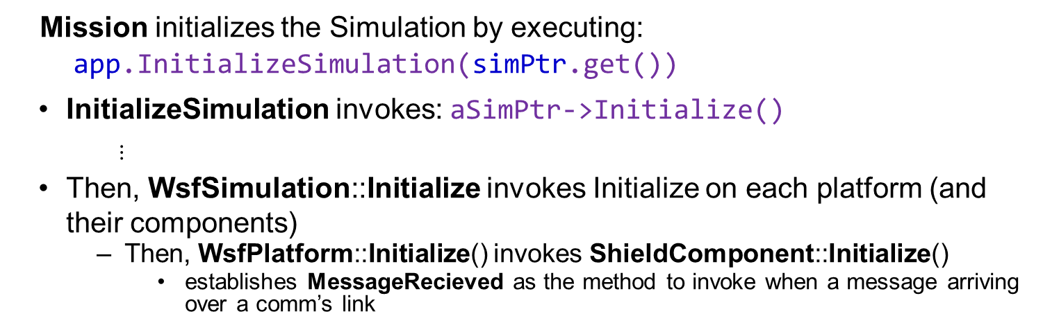
AFSIM Plugins & Extensions AFSIM mission startup sequence
ShieldComponent
mission::main()
unique_ptr<ComponentTypesRegistration>
unique_ptr<RegisterShieldComponent>
WsfScenario: scenario
unique_ptr<WsfSimulation>: SimPtr
WsfStandardApplication: app
WsfStandardApplication::InitializeSimulation()
WsfSimulation::Initialize()
ShieldComponent::Initialize()
Mission initializes the Simulation by executing:
app.InitializeSimulation(simPtr.get())
InitializeSimulation invokes: aSimPtr->Initialize()
$⋮$
Then, WsfSimulation::Initialize invokes Initialize on each platform (and their components)
Then, WsfPlatform::Initialize() invokes ShieldComponent::Initialize()
establishes MessageRecieved as the method to invoke when a message arriving over a comm’s link

Slide 73
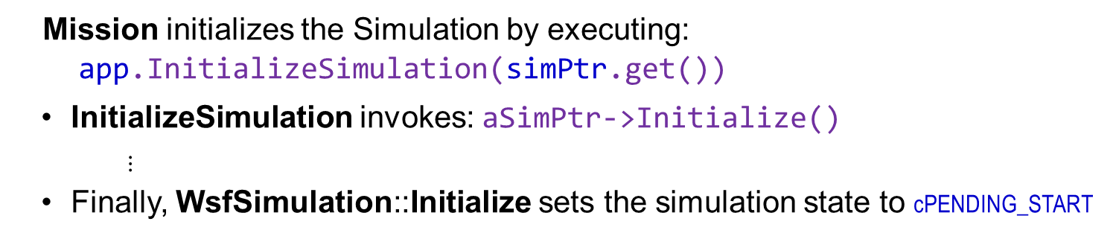
AFSIM Plugins & Extensions AFSIM mission startup sequence
mission::main()
unique_ptr<ComponentTypesRegistration>
unique_ptr<RegisterShieldComponent>
WsfScenario: scenario
unique_ptr<WsfSimulation>: SimPtr
WsfStandardApplication: app
WsfStandardApplication::InitializeSimulation()
WsfSimulation::Initialize()
Mission initializes the Simulation by executing:
app.InitializeSimulation(simPtr.get())
InitializeSimulation invokes: aSimPtr->Initialize()
$⋮$
Finally, WsfSimulation::Initialize sets the simulation state to cPENDING_START

Slide 74
AFSIM Plugins & Extensions AFSIM mission startup sequence
mission::main()
unique_ptr<ComponentTypesRegistration>
unique_ptr<RegisterShieldComponent>
WsfScenario: scenario
unique_ptr<WsfSimulation>: SimPtr
WsfStandardApplication: app
WsfStandardApplication::RunEventLoop()
WsfSimulation::Start()
WsfSimulationExtension::Start()
Mission runs the Simulation by executing:
app.RunEventLoop(simPtr.get(), options)
RunEventLoop invokes: aSimPtr->Start()
WsfSimulation::Start
For each simulation extension invoke Start()
This exercise does not have a simulation extension, so this has no effect

Slide 75
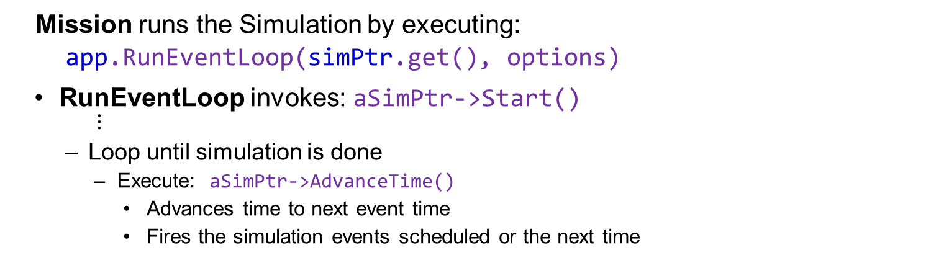
AFSIM Plugins & Extensions AFSIM mission startup sequence
mission::main()
unique_ptr<ComponentTypesRegistration>
unique_ptr<RegisterShieldComponent>
WsfScenario: scenario
unique_ptr<WsfSimulation>: SimPtr
WsfStandardApplication: app
WsfStandardApplication::RunEventLoop()
WsfSimulation::Start()
Mission runs the Simulation by executing:
app.RunEventLoop(simPtr.get(), options)
RunEventLoop invokes: aSimPtr->Start()
$⋮$
Loop until simulation is done
Execute: aSimPtr->AdvanceTime()
Advances time to next event time
Fires the simulation events scheduled or the next time

Slide 76
Exercise 2
Understand component roles
Understand WsfSensorComponent, WsfPlatformPart, and WsfArticulatedPart
Understand purpose of GetComponentRoles and QueryInterface

Slide 77
Component Roles
Roles generally define services or other types on simulation component lists.
Roles generally define types on the platform components list e.g. sensors, comms, movers, processors, etc.
Furthermore, component role enumerations are defined for each component and part type at a global and sometimes local level to support FindComponentByRole functionality in the component lists.
Each project that requires additional roles adds to the global component roles enumerations within its own project.
This addition of roles in a global context does require de-confliction amongst the multiple projects adding roles in a global context.

Slide 78

Component Exercise 2 — Review 1
Examine ComponentRoles.hpp
Component Roles must have a Unique Number to Distinguish it From Other Component Roles
See WsfComponentRoles.hpp for predefined roles
Roles are used by WsfComponentList
See WsfComponent::QueryInterfaceT for how to query a component’s role for validity
enum
{
cWSF_COMPONENT_SHIELDS = 1234567,
cWSF_COMPONENT_LATINUM = 1234568,
cWSF_COMPONENT_CYBER_SENSOR_EFFECT = 654321
};
These component roles are added to the list of component roles defined in WsfComponentRoles.hpp
enum
{
cWSF_COMPONENT_PLATFORM = 1,
cWSF_COMPONENT_PLATFORM_PART = 2,
cWSF_COMPONENT_ARTICULATED_PART = 3,
cWSF_COMPONENT_MOVER = 4,
$⋮$
cWSF_COMPONENT_SENSOR = 9,
$⋮$
};
There are many component
roles pre-defined in WsfComponentRoles.hpp

Slide 79
Component Exercise 2 — Review 2
In file CyberSensorEffect.hpp, notice that class CyberSensorEffect inherits WsfSensorComponent, which is a component of a sensor, which is a component of a platform
In file ShieldComponent.hpp, notice that class ShieldComponent inherits from WsfPlatformPart,which inherits from WsfPlatformComponent, which is a component of a platform
In file LatinumComponent.hpp, notice that class LatinumComponent inherits from WsfPlatformComponent, which is a component of a platform
class CyberSensorEffect : public WsfSensorComponent
{
...
};
class ShieldComponent : public WsfPlatformPart
{
...
};
class LatinumComponent : public WsfPlatformComponent,
public WsfObject
{
...
};

Slide 80
Component Exercise 2 — Review 3
ShieldTypes and LatinumTypes are full blown types, and hence can be used to create ShieldComponent’s and LatinumComponent’s
In file ShieldTypes.hpp, notice that class ShieldTypes inherits from WsfObjectTypeList<ShieldComponent>, and is hence a full blown type list for ShieldTypes, which is added to the scenario’s type lists
In file LatinumComponent.hpp, notice that class LatinumTypes inherits from WsfObjectTypeList<LatinumComponent>, and is hence a full blown type list for LatinumTypes, which is added to the scenario’s type lists
class ShieldTypes : public WsfObjectTypeList<ShieldComponent>
{
...
};
class LatinumTypes : public WsfObjectTypeList<LatinumComponent>
{
...
};

Slide 81
Types and Components
 using WsfPlatformComponent = WsfComponentT<WsfPlatform>
 using WsfPlatformComponentList = WsfComponentListT<WsfPlatormComponent>
§ class WsfProcessorComponent : public WsfComponentT<WsfProcessor> …
‡ using ComponentList = WsfComponentListT<WsfProcessorComponent>
♦ class WsfSensorComponent : public WsfComponentT<WsfSensor>
♪ using ComponentList = WsfComponentListT<WsfSensorComponent>
WsfComponent
WsfComponentT<typename>
LatinumComponent
WsfPlatformComponent 
WsfComponentList
0..
UtEntity
WsfObject
WsfPlatformComponentList 
WsfUniqueId
WsfProcessorComponent §
0..
UtEntityPart
WsfPlatformPart
WsfPlatform
WsfSinglePlatformObserver
ComponentList ‡
WsfMover
WsfArticulatedPart
WsfProcessor
WsfSensorComponent ♦
0..
WsfComm
WsfWeapon
WsfSensor
WsfSensorComponentList ♪
CyberSensorEffect
LatinumTypes is a new type used to create a LatinumComponent for a platform when the scenario command indicates it should be created
1
ShieldComponent
LatinumComponentFactory::ProcessInput(…)
LatinumComponent::FindOrCreate(…)
ShieldComponentFactory::ProcessAddOrEditCommand(…)
WsfObjectTypeList<ShieldComponent>::LoadUnnamedComponentWithoutEdit(…)
ShieldTypes is a new type used to create a
ShieldComponent for a platform when the scenario command indicates it should be created
mAllTypeLists
std::vector<std::unique_ptr<WsfObjectTypeListBaseI>>
WsfObjectTypeListBaseI
WsfObjectTypeListBaseI
WsfObjectTypeListBaseI
…
WsfObjectTypeListBaseI
WsfObjectTypeListBaseI
WsfObjectTypeListBase
WsfObjectTypeListBase
WsfObjectTypeListBase
…
WsfObjectTypeListBase
WsfObjectTypeListBase
WsfMoverTypes
WsfPlatformTypes
WsfSensorTypes
…
ShieldTypes
LatinumTypes
ShieldComponent
LatinumComponent

Slide 82
Types and Components
 using WsfPlatformComponent = WsfComponentT<WsfPlatform>
 using WsfPlatformComponentList = WsfComponentListT<WsfPlatormComponent>
§ class WsfProcessorComponent : public WsfComponentT<WsfProcessor> …
‡ using ComponentList = WsfComponentListT<WsfProcessorComponent>
♦ class WsfSensorComponent : public WsfComponentT<WsfSensor>
♪ using ComponentList = WsfComponentListT<WsfSensorComponent>
WsfComponent
WsfComponentT<typename>
LatinumComponent
WsfPlatformComponent 
WsfComponentList
0..
UtEntity
WsfObject
WsfPlatformComponentList 
WsfUniqueId
WsfProcessorComponent §
0..
UtEntityPart
WsfPlatformPart
WsfPlatform
WsfSinglePlatformObserver
ComponentList ‡
WsfMover
WsfArticulatedPart
WsfProcessor
WsfSensorComponent ♦
0..
WsfComm
WsfWeapon
WsfSensor
WsfSensorComponentList ♪
CyberSensorEffect
1
ShieldComponent
The “enterprise” platform contains a component list
CyberSensorEffect is a sensor component (not a type) and CyberSensorComponentFactory is registered with the scenario
CyberSensorEffect is created by the “all_seeing” WsfSensor after it is added to the platform and invokes CyberSensorComponentFactory::ProcessInput
ProcessInput then creates a new CyberSensorEffect object, inserts it into the sensor’s component list, and handles its scenario commands
WsfPlatform “enterprise”
WsfPlatformComponentList
WsfMover
Shields
Latinum
…
WsfSensor “all_seeing”
WsfSensorComponentList
CyberSensorEffect
Notes:
The “enterprise” WsfPlatform is a WsfPlatformComponentList (it inherits WsfPlatformComponentList)
The “enterprise” component list contains a mover component, a shields component, a latinum component, a sensor component, etc.
The “all_seeing” sensor contains a CyberSensorEffect sensor component

Slide 83
Component Exercise 2 — Task 1
Since the three classes, CyberSensorEffect, ShieldComponent, and LatinumComponent are all components, we must declare them as components
Task 1a: Use the WSF_DECLARE_COMPONENT_ROLE_TYPE macro to register the shield component defined in ComponentRoles.hpp
The WSF_DECLARE_COMPONENT_ROLE_TYPE macro takes as input:
the name of the class (ShieldComponent), and
the component role number (cWSF_COMPONENT_SHIELDS)
Place the macro call immediately after the ShieldComponent class declaration
Task 1b: Similarly, register the type for LatinumComponent
Task 1c: Similarly, register the type for CyberSensorEffect

Slide 84
Component Exercise 2 — Task 1 Solution
File: ShieldComponent.hpp
class ShieldComponent : public WsfPlatformPart
{
...
};
class WsfScriptShieldComponentClass : public WsfScriptPlatformPartClass { … };
// EXERCISE 2 TASK 1a
// Register the shield component type using macro defined in WsfComponentRoles.hpp
WSF_DECLARE_COMPONENT_ROLE_TYPE(ShieldComponent, cWSF_COMPONENT_SHIELDS)
File: LatinumComponent.hpp
class LatinumComponent : public WsfPlatformComponent,
public WsfObject
{
...
};
class WsfScriptLatinumComponentClass : public UtScriptClass { … };
class LatinumTypes : public WsfObjectTypeList<LatinumComponent> { … };
// EXERCISE 2 TASK 1b
// Register the latinum component type using macro defined in WsfComponentRoles.hpp
WSF_DECLARE_COMPONENT_ROLE_TYPE(LatinumComponent, cWSF_COMPONENT_LATINUM)
File: CyberSensorEffect.hpp
class CyberSensorEffect : public WsfSensorComponent
{
...
};
// EXERCISE 2 TASK 1c
// Register the sensor cyber effect component type using macro defined in WsfComponentRoles.hpp
WSF_DECLARE_COMPONENT_ROLE_TYPE(CyberSensorEffect, cWSF_COMPONENT_CYBER_SENSOR_EFFECT)

Slide 85
Component Exercise 2 — Review 4
Inspect and Understand these methods from WsfComponentRoles.hpp
template <class T>
struct WsfComponentRole
{
template <class U> struct always_false : std::false_type {};
static_assert(always_false<T>::value, "Type has no component role registered. Use the WSF_DECLARE_COMPONENT_ROLE_TYPE macro to register the type.");
};
#define WSF_DECLARE_COMPONENT_ROLE_TYPE(TYPE, ROLE) \
template <> \
struct WsfComponentRole<TYPE> : std::integral_constant<int, ROLE> \
{ \
static_assert(std::is_base_of<WsfComponent, TYPE>::value, "Cannot register component role for type that does not derive from WsfComponent"); \
static_assert(value > 0, "Component role must be > 0"); \
};
template <class T>
struct cCOMPONENT_ROLE
{
constexpr operator int() const noexcept {return WsfComponentRole<T>::value; }
};
Defines a compile time
integer constant with
a value of ROLE
used here
Notes:
Understand

Slide 86

Component Exercise 2 — Review 5
Inspect and Understand this interface in WsfComponent.hpp
class WSF_EXPORT WsfComponent
{
public:
virtual ~WsfComponent() = default;
$⋮$
virtual WsfComponent* CloneComponent() const = 0;
$⋮$
virtual WsfStringId GetComponentName() const = 0;
$⋮$
virtual const int* GetComponentRoles() const = 0;
$⋮$
virtual void* QueryInterface(int aRole) = 0;
$⋮$
virtual int GetComponentInitializationOrder() const { return 0; }
$⋮$
template <typename T>
bool QueryInterfaceT(T*& aRolePtr)
{
aRolePtr = static_cast<T*>(QueryInterface(cCOMPONENT_ROLE<T>()));
return aRolePtr != nullptr;
}
$⋮$
bool ComponentHasRole(int aRole) { return QueryInterface(aRole) != nullptr; }
$⋮$
virtual bool PreInitialize(double aSimTime);
virtual bool Initialize(double aSimTime);
virtual bool Initialize2(double aSimTime);
virtual void PreInput();
virtual bool ProcessInput(UtInput& aInput);
Note: QueryInterface returns a void *
(a pointer with no type)
The actual type that the return pointer refers to is determined by the value of aRole
The pointer returned should be cast as the type identified by aRole before it is returned
Notes:
Understand

Slide 87
QueryInterface method
The QueryInterface method is a required virtual function that allows for roles to be queried.
It requires the GetComponentRoles method to also be defined so that a role can be looked up to see if it is valid for the given component
In this exercise, QueryInterface is utilized by the component’s component factory’s ProcessInput method to either find an existing component of that type on the platform, or create a new component of that type on the platform if one does not yet exist

Slide 88

Component Exercise 2 — Review 6
Inspect and Understand these methods from WsfComponent.hpp
template <typename PARENT_TYPE>
class WsfComponentT : public WsfComponent
{
public:
typedef PARENT_TYPE ParentType;
WsfComponentT()
: mParentPtr(nullptr)
{}
WsfComponentT(const WsfComponentT& /* aSrc */)
: mParentPtr(nullptr)
{}
WsfComponentT& operator=(const WsfComponentT& /* aSrc */)
{
mParentPtr = nullptr;
return *this;
}
~WsfComponentT() override = default;
$⋮$
virtual void ComponentParentChanged(ParentType* aParentPtr) { }
$⋮$
ParentType* GetComponentParent() const { return mParentPtr; }
$⋮$
This class’s job is to keep track
of the component’s parent object
Notes:
Understand

Slide 89
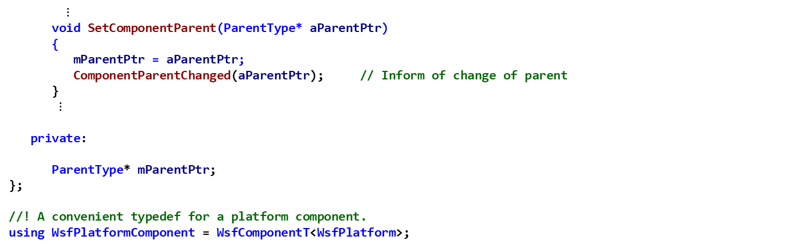
Component Exercise 2 — Review 6
Inspect and Understand these methods from WsfComponent.hpp
$⋮$
void SetComponentParent(ParentType* aParentPtr)
{
mParentPtr = aParentPtr;
ComponentParentChanged(aParentPtr); // Inform of change of parent
}
$⋮$
private:
ParentType* mParentPtr;
};
//! A convenient typedef for a platform component.
using WsfPlatformComponent = WsfComponentT<WsfPlatform>;
This class’s job is to keep track
of the component’s parent object
This statement creates a definition whereby a platform
can itself be a platform component
Notes:
Understand

Slide 90
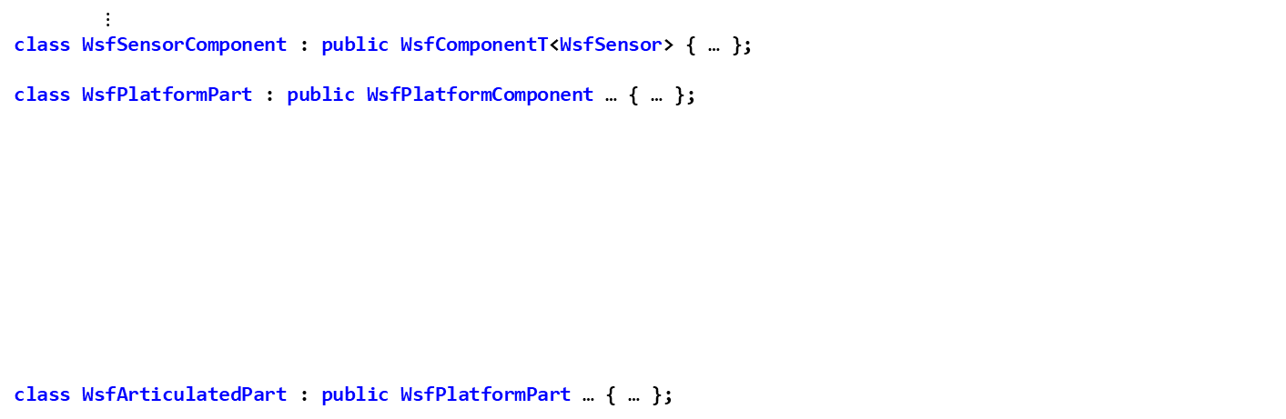
Component Exercise 2 — Review 7
Inspect and Understand these other core classes
$⋮$
class WsfSensorComponent : public WsfComponentT<WsfSensor> { … };
class WsfPlatformPart : public WsfPlatformComponent … { … };
class WsfArticulatedPart : public WsfPlatformPart … { … };
Defines WsfSensorComponent to
be a component of WsfSensor
Defines WsfPlatformPart to be a WsfPlatformComponent
(i.e., a component of a platform)
Defines WsfArticulatedPart to be an extension of
WsfPlatformPart
Notes:
Understand

Slide 91
Component Exercise 2 — Review 8 CyberSensorEffect.cpp
Inspect and Understand these methods from CyberSensorEffect.cpp
WsfComponent* CyberSensorEffect::CloneComponent() const
{
return new CyberSensorEffect(*this);
}
WsfStringId CyberSensorEffect::GetComponentName() const
{
static WsfStringId id = "WSF_CYBER_SENSOR_EFFECT";
return id;
}
Notes:
Understand

Slide 92
Component Exercise 2 — Task 2 CyberSensorEffect.cpp
Complete CyberSensorEffect::GetComponentRoles
Define the set of roles as a static array of int.
Initialize this array to consist of:
'this' component role (cWSF_COMPONENT_CYBER_SENSOR_EFFECT),
sensor (cWSF_COMPONENT_SENSOR),
and the null component (cWSF_COMPONENT_NULL)

Slide 93
Component Exercise 2 — Task 2 Solution CyberSensorEffect.cpp
const int* CyberSensorEffect::GetComponentRoles() const
{
// EXERCISE 2 TASK 2
// Define the set of roles as a static array of ints.
// Initialize this array to consist of 'this' component role
// (cWSF_COMPONENT_CYBER_SENSOR_EFFECT), sensor (cWSF_COMPONENT_SENSOR),
// and the null component (cWSF_COMPONENT_NULL).
static int roles[] = { cWSF_COMPONENT_CYBER_SENSOR_EFFECT,
cWSF_COMPONENT_SENSOR,
cWSF_COMPONENT_NULL };
return roles;
}
Notes:
Understand

Slide 94
QueryInterface Usage
QueryInterface is a pure virtual method in WsfComponent
It must be overriden in any class that directly inherits WsfComponent (or else you will get a compile error)
However, it really should be overridden (it is practically a requirement) in any derived class
Hence, since CyberSensorEffect inherits WsfSensorComponent which inherits WsfComponent, it should override QueryInterface
QueryInterface should return a pointer to the object to which it belongs
This pointer should be cast as the type of object indicated by the value of the aRole integer that is passed in as an argument

Slide 95
Component Exercise 2 — Task 3 CyberSensorEffect.cpp
Task 3: Complete CyberSensorEffect::QueryInterface
QueryInterface should return a pointer to the current object (i.e., this), which is of the type specified in the parameter aRole
Return a properly cast pointer according to the given role in aRole
A role of cWSF_COMPONENT_CYBER_SENSOR_EFFECT means you should return 'this'
A role of cWSF_COMPONENT_SENSOR means you should return 'this' which has been static_cast as a WsfSensorComponent*
If the given role in aRole is not one supported by GetComponentRoles, or if it is cWSF_COMPONENT_NULL, return zero (nullptr).

Slide 96
Component Exercise 2 — Task 3 Solution CyberSensorEffect.cpp
void* CyberSensorEffect::QueryInterface(int aRole)
{
// EXERCISE 2 TASK 3
// Return a properly cast pointer according to the given role.
// If the given role is not one supported by GetCompoenntRoles
// (or if it is cWSF_COMPONENT_NULL), return zero.
if (aRole == cWSF_COMPONENT_CYBER_SENSOR_EFFECT)
{
return this;
}
if (aRole == cWSF_COMPONENT_SENSOR)
{
return (static_cast<WsfSensorComponent*>( this));
}
return nullptr;
}
Notes:
Understand

Slide 97
Component Exercise 2 — Review 9 CyberSensorEffect.cpp
Inspect and Understand these methods from CyberSensorEffect.cpp
// =================================================================================================
//! Find the instance of this component attached to the specified sensor.
CyberSensorEffect* CyberSensorEffect::Find(const WsfSensor& aParent)
{
CyberSensorEffect* componentPtr(nullptr);
aParent.GetComponents().FindByRole<CyberSensorEffect>(componentPtr);
return componentPtr;
}
// =================================================================================================
//! Find the instance of this component attached to the specified processor,
//! and create it if it doesn't exist.
CyberSensorEffect* CyberSensorEffect::FindOrCreate(WsfSensor& aParent)
{
CyberSensorEffect* componentPtr = Find(aParent);
if (componentPtr == nullptr)
{
componentPtr = new CyberSensorEffect;
aParent.GetComponents().AddComponent(componentPtr);
}
return componentPtr;
}
Note: if a component is in the sensor’s component list, then FindByRole will lead to invocation
of QueryInterface on that component
Notes:
These are static methods
Note: CyberSensorEffect::QueryInterface is not actually ever invoked during the execution of the simulation by mission, as FindByRole is never executed on the sensor’s component list after the CyberSensorEffect object has been created and added as a component to the sensor.
CyberSensorEffect’s job is to provide a TrackerAllowTracking method that will return false when the Ferengi ship is taking advantage of the exploit in order to allow them to steal the Latinum.

Slide 98
Scenario file
The script method Sensor must find the
“all_seeing” sensor (which searches the
platform’s component list, invoking
QueryInterface on each of the components,
until a WsfSensor is found which has a
name of “all_seeing”)
$$⋮$$
The script method Sensor only scans the
platform’s component list, and not the
WsfSensor component list. Hence, it does not
invoke the CyberSensorEffect::QueryInterface
method.
However, we should still define the
CyberSensorEffect::QueryInterface method, as it
could be possible that some other function or script
method could end up scanning the sensor’s
component list.

Slide 99
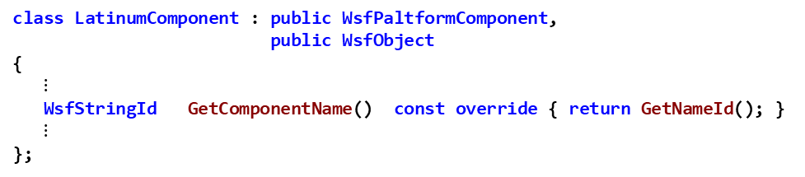
Component Exercise 2 — Review 10 LatinumComponent.hpp and LatinumComponent.cpp
Inspect / Understand these methods from class LatinumComponent
class LatinumComponent : public WsfPaltformComponent,
public WsfObject
{
$⋮$
WsfStringId GetComponentName() const override { return GetNameId(); }
$⋮$
};
// virtual
WsfComponent* LatinumComponent::CloneComponent() const
{
return new LatinumComponent(*this);
}

Slide 100
Component Exercise 2 — Task 4 LatinumComponent.cpp
Complete LatinumComponent::GetComponentRoles
Define the set of roles as a static array of int.
Initialize this array to consist of:
'this' component role (cWSF_COMPONENT_LATINUM),
and the null component (cWSF_COMPONENT_NULL)

Slide 101
Component Exercise 2 — Task 4 Solution LatinumComponent.cpp
const int * LatinumComponent::GetComponentRoles() const
{
// EXERCISE 2 TASK 4
// Define the set of roles as a static array of ints.
// Initialize this array to consist of 'this' component role
// (cWSF_COMPONENT_LATINUM), and the null component (cWSF_COMPONENT_NULL).
static const int roles[] = { cWSF_COMPONENT_LATINUM,
cWSF_COMPONENT_NULL
};
return roles;
}

Slide 102
Component Exercise 2 — Task 5 LatinumComponent.cpp
QueryInterface should return a pointer to the current object (i.e., this), which is of the type specified in the parameter aRole (this may have to be cast to the correct type before returning it), or nullptr if the object is not any of the types supported by GetComponentRoles
Task 5: Complete LatinumComponent::QueryInterface
Return a properly cast pointer according to the given role
A role of cWSF_COMPONENT_LATINUM means you should return 'this'
If the given role is not one supported by GetComponentRoles, i.e., if it is not cWSF_COMPONENT_LATINUM, return zero (nullptr).

Slide 103
Component Exercise 2 — Task 5 Solution LatinumComponent.cpp
// virtual
void* LatinumComponent::QueryInterface(int aRole)
{
// EXERCISE 2 TASK 5
// Return a properly cast pointer according to the given role.
// If the given role is not one supported by GetComponentRoles
// (or if it is cWSF_COMPONENT_NULL), return zero.
if (aRole == cWSF_COMPONENT_LATINUM)
{
return this;
}
return nullptr;
}

Slide 104
QueryInterface Usage
LatinumComponent::QueryInterface is invoked multiple times throughout the execution of the simulation
Once the LatinumComponent has been created and added to the “enterprise” platform, any attempt to find a platform component will scan the platform’s component list,
This invokes QueryInterface on each component (including on the LatinumComponent) in the list to see if it is the one being searched for
This occurs when ProcessInput is adding new components to the list and must first scan the list to see if there is already a component of that type
It also occurs when the LatinumComponent script method “Latinum” is executed, as it must find the component and return a pointer to it.

Slide 105
Component Exercise 2 — Review 11 LatinumComponent.cpp
Inspect and Understand these methods from LatinumComponent.cpp
// =================================================================================================
//! Find the instance of this component attached to the specified sensor.
LatinumComponent* LatinumComponent ::Find(const WsfPlatform& aParent)
{
// Exercise 2 Review 4 (understand)
LatinumComponent* componentPtr = nullptr;
aParent.GetComponents().FindByRole<LatinumComponent>(componentPtr);
return componentPtr;
}
// =================================================================================================
//! Find the instance of this component attached to the specified processor,
//! and create it if it doesn't exist.
LatinumComponent* LatinumComponent::FindOrCreate(WsfPlatform& aParent)
{
// Exercise 2 Review 4 understand
LatinumComponent* componentPtr = Find(aParent);
if (componentPtr == nullptr)
{
componentPtr = new LatinumComponent();
aParent.AddComponent(componentPtr);
}
return componentPtr;
}
Note: if a component is in the platform’s component list, then FindByRole will lead to invocation
of QueryInterface on that component
Notes:
Static methods

Slide 106
Creating the LatinumComponent using FindOrCreate
LatinumComponentFactory
WsfPlatform& aParent (the enterprise)
WsfComponentList
LatinumComponent
…
LatinumComponent
ProcessInput(…)
FindOrCreate(…)
QueryInterface(…)
Find(…)
FindByRole invokes QueryInterface
on each component in the
component list to see if it is of the correct type
FindByRole(…)
new LatinumComponent(…)
AddComponent(…)
FindByRole does not find a LatinumComponent on
the platform, so FindOrCreate creates a
new LatinumComponent
ProcessInput(…)

Slide 107
Scenario file
The script method Latinum must find the
“latinum” component (which searches the
platform’s component list, invoking
QueryInterface on each of the components,
until a LatinumComponent is found)
$⋮$
$⋮$

Slide 108
When script interface invokes the Latinum script method
The Latinum script method was added
to the WsfPlatform object, so
aObjectPtr points to the “enterprise”
WsfPlatform object
WsfPlatform& aObjectPtr (the enterprise)
WsfPlatform script Execute function for Latinum method
WsfComponentList
…
LatinumComponent
Latinum(…)
aObjectPtr->GetComponent<LatinumComponent>(…)
QueryInterface(…)
GetComponent calls FindComponentByRoleP,
which invokes QueryInterface on each component in the
component list to see if it is of the correct type
When FindComponentByRoleP finds the
LatinumComponent on the platform, it returns a pointer
to that component, which GetComponent then returns to
the Latinum script method
The Latinum script method then returns this pointer to
the caller of the script method

Slide 109
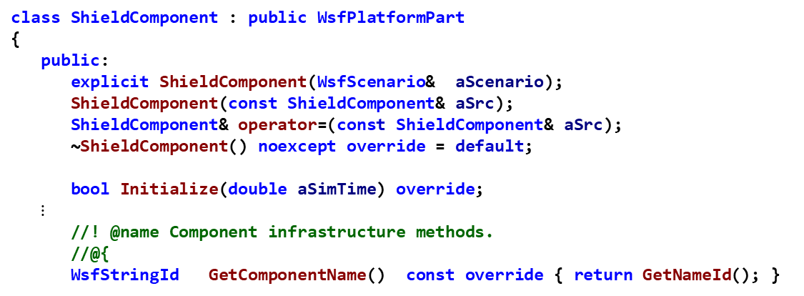
Component Exercise 2 — Review 12 ShieldComponent.hpp
Examine ShieldComponent.hpp
Notice ShieldComponent derives from WsfPlatformPart, a Platform Component Type
ShieldComponent is already a Component
ShieldComponent inherits WsfPlatformPart functionality
TurnOn, TurnOff, Degradation, etc.
Notice the implementation of GetComponentName
class ShieldComponent : public WsfPlatformPart
{
public:
explicit ShieldComponent(WsfScenario& aScenario);
ShieldComponent(const ShieldComponent& aSrc);
ShieldComponent& operator=(const ShieldComponent& aSrc);
~ShieldComponent() noexcept override = default;
bool Initialize(double aSimTime) override;
$⋮$
//! @name Component infrastructure methods.
//@{
WsfStringId GetComponentName() const override { return GetNameId(); }

Slide 110

Component Exercise 2 — Review 13 ShieldComponent.cpp
Examine ShieldComponent.cpp
Notice that the WsfPlatformPart constructor takes the component role as an argument
ShieldComponent::ShieldComponent(WsfScenario& aScenario)
: WsfPlatformPart(aScenario, cCOMPONENT_ROLE<ShieldComponent>()),
mUpdateInterval(-1.0),
mInitialStrength(0.0),
mRechargeRate(0.0),
mStrength(0.0),
mLastUpdateTime(0.0)
{
SetName("shields");
}
$⋮$
// virtual
WsfComponent* ShieldComponent::CloneComponent() const
{
return new ShieldComponent(*this);
}

Slide 111
Component Exercise 2 — Task 6 ShieldComponent.cpp
Complete ShieldComponent::GetComponentRoles
Define the set of roles as a static array of int.
Initialize this array to consist of:
'this' component role (cWSF_COMPONENT_SHIELDS),
platform part (cWSF_PLATFORM_PART),
and the null component (cWSF_COMPONENT_NULL)

Slide 112
Component Exercise 2 — Task 6 Solution ShieldComponent.cpp
const int* ShieldComponent::GetComponentRoles() const
{
// EXERCISE 2 TASK 6
// Define the set of roles as a static array of ints.
// Initialize this array to consist of 'this' component role
// (cWSF_COMPONENT_SHIELDS), platform part (cWSF_COMPONENT_PLATFORM_PART),
// and the null component (cWSF_COMPONENT_NULL).
static const int roles[] = { cWSF_COMPONENT_SHIELDS,
cWSF_COMPONENT_PLATFORM_PART,
cWSF_COMPONENT_NULL
};
return roles;
}

Slide 113
Component Exercise 2 — Task 7 ShieldComponent.cpp
Task 3: Complete ShieldComponent::QueryInterface
QueryInterface should return a pointer to the current object (i.e., this), which is of the type specified in the parameter aRole
Return a properly cast pointer according to the given role
A role of cWSF_COMPONENT_SHIELDS means you should return 'this'
A role of cWSF_PLATFORM_PART means you should return 'this' which has been static_cast as a WsfPlatformPart*
If the given role is not one supported by GetComponentRoles, or if it is cWSF_COMPONENT_NULL, return zero (nullptr).

Slide 114
Component Exercise 2 — Task 7 Solution ShieldComponent.cpp
void* ShieldComponent::QueryInterface(int aRole)
{
// EXERCISE 2 TASK 7
// Return a properly cast pointer according to the given role.
// If the given role is not one supported by GetCompoenntRoles
// (or if it is cWSF_COMPONENT_NULL), return zero.
if (aRole == cWSF_COMPONENT_SHIELDS)
{
return this;
}
else if (aRole == cWSF_COMPONENT_PLATFORM_PART)
{
return (static_cast<WsfPlatformPart*>(this));
}
return nullptr;
}

Slide 115
QueryInterface Usage
ShieldComponent::QueryInterface is invoked multiple times throughout the execution of the simulation
Once the ShieldComponent has been created and added to the “enterprise” platform, any attempt to find a platform component will scan the platform’s component list,
This invokes QueryInterface on each component (including on the ShieldComponent) in the list to see if it is the one being searched for
This also occurs when the ShieldComponent script method “Shields” is executed, as it must find the component and return a pointer to it.

Slide 116
Scenario file
The script method Shields must find the
“shields” component (which searches the
platform’s component list, invoking
QueryInterface on each of the components,
until a ShieldComponent is found)
$⋮$
$⋮$

Slide 117
When script interface invokes the Shields script method
The Shields script method was added
to the WsfPlatform object, so
aObjectPtr points to the “enterprise”
WsfPlatform object
WsfPlatform& aObjectPtr (the enterprise)
WsfPlatform script Execute function for Latinum method
WsfComponentList
…
ShieldComponent
Shields(…)
aObjectPtr->GetComponent<ShieldComponent>(…)
QueryInterface(…)
GetComponent calls FindComponentByRoleP,
which invokes QueryInterface on each component in the
component list to see if it is of the correct type
When FindComponentByRoleP finds the
ShieldComponent on the platform, it returns a pointer
to that component, which GetComponent then returns to
the Shields script method
The Shield script method then returns this pointer to
the caller of the script method

Slide 118
Exercise 3
Understand component factory classes’ ProcessInput methods
Complete CyberSensorEffect’s ProcessInput and TrackerAllowTracking methods

Slide 119
Component Exercise 3 — Review 1
In CyberSensorEffect.cpp, examine the CyberSensorComponentFactory Class
This factory allows us to create and configure CyberSensorEffect instances directly on sensor type input definitions
Examine the ProcessInput Method
Understand how the FindOrCreate method from Review 6 is used to populate the CyberSensorEffect Pointer
Notes:
LatinumComponent; CyberSensorEffect ProcessInput function calls FindOrCreate

Slide 120
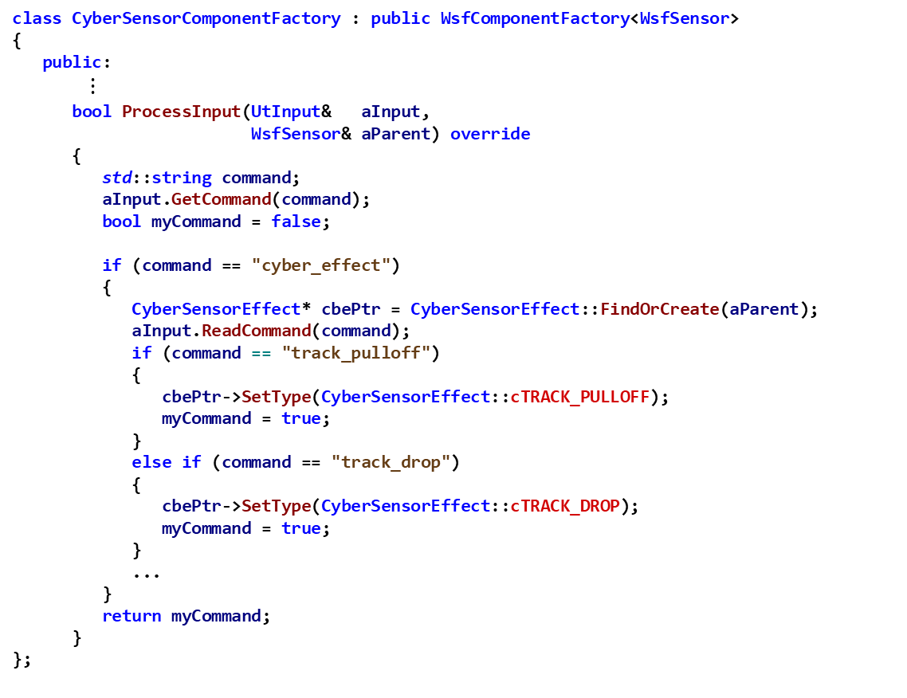
Component Exercise 3 — Review 1 CyberSensorEffect.cpp
class CyberSensorComponentFactory : public WsfComponentFactory<WsfSensor>
{
public:
$⋮$
bool ProcessInput(UtInput& aInput,
WsfSensor& aParent) override
{
std::string command;
aInput.GetCommand(command);
bool myCommand = false;
if (command == "cyber_effect")
{
CyberSensorEffect* cbePtr = CyberSensorEffect::FindOrCreate(aParent);
aInput.ReadCommand(command);
if (command == "track_pulloff")
{
cbePtr->SetType(CyberSensorEffect::cTRACK_PULLOFF);
myCommand = true;
}
else if (command == "track_drop")
{
cbePtr->SetType(CyberSensorEffect::cTRACK_DROP);
myCommand = true;
}
...
}
return myCommand;
}
};
Notes:
LatinumComponent; CyberSensorEffect ProcessInput function calls FindOrCreate

Slide 121
Component Exercise 3 — Task 1 CyberSensorEffect.cpp
Complete CyberSensorComponentFactory::ProcessInput in CyberSensorEffect.cpp
For the exploit_delay command, create a variable, which is a double, to hold the delay time
Invoke aInput.ReadValueOfType to read the delay value
The format of ReadValueOfType is:
template<typename T>
void ReadValueOfType(T& aValue,
ValueType aValueType)
The first parameter should be the variable you created
The second argument should be UtInput::cTIME to indicate that the value being read is a time value
Using the CyberSensorEffect pointer cbePtr, invoke CyberSensorEffect::SetExploitDelay, and pass in the variable in which you stored the exploit delay time
Notes:
LatinumComponent; CyberSensorEffect ProcessInput function calls FindOrCreate

Slide 122
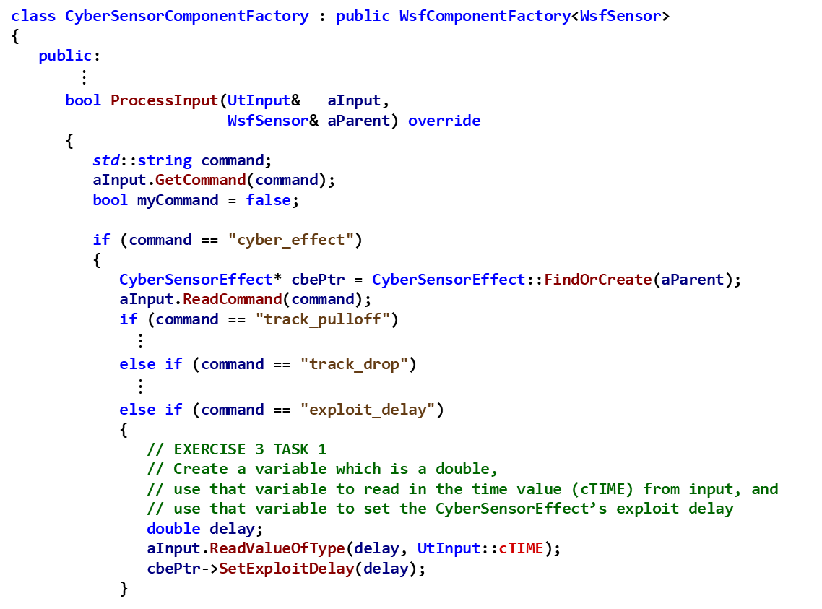
Component Exercise 3 — Task 1 Solution CyberSensorEffect.cpp
class CyberSensorComponentFactory : public WsfComponentFactory<WsfSensor>
{
public:
$⋮$
bool ProcessInput(UtInput& aInput,
WsfSensor& aParent) override
{
std::string command;
aInput.GetCommand(command);
bool myCommand = false;
if (command == "cyber_effect")
{
CyberSensorEffect* cbePtr = CyberSensorEffect::FindOrCreate(aParent);
aInput.ReadCommand(command);
if (command == "track_pulloff")
$⋮$
else if (command == "track_drop")
$⋮$
else if (command == "exploit_delay")
{
// EXERCISE 3 TASK 1
// Create a variable which is a double,
// use that variable to read in the time value (cTIME) from input, and
// use that variable to set the CyberSensorEffect’s exploit delay
double delay;
aInput.ReadValueOfType(delay, UtInput::cTIME);
cbePtr->SetExploitDelay(delay);
}
Notes:
LatinumComponent; CyberSensorEffect ProcessInput function calls FindOrCreate

Slide 123
Component Exercise 3 — Task 2 CyberSensorEffect.cpp
Complete the CyberSensorEffect::TrackerAllowTracking Implementation
This Method is called by the Sensor Tracker to determine whether to drop track
Signals that the tracker should not allow tracking if the sensor has received the command to begin the exploit
Task 2:
Check the value of the compound conditional that:
A) Checks to see that the exploit is not already occurring
i.e., check to see if mExploitTime is less than zero
B) AND also Checks to see that the sensor's aux data attribute exists (called BEGIN_EXPLOIT)
Invoke GetSensor()->GetAuxData().AttributeExists("BEGIN_EXPLOIT")) which returns a bool
If the compound conditional is true, set the exploit time (mExploitTime) to be the current simulation time (mSimTime) plus the exploit delay time (mExploitDelayTime).
Otherwise, do nothing

Slide 124
Component Exercise 3 — Task 2 Solution CyberSensorEffect.cpp
bool CyberSensorEffect::TrackerAllowTracking(double aSimTime,
const TrackerSettings& aSettings,
const WsfTrackId& aRequestId,
size_t aObjectId,
WsfTrack* aTrackPtr,
WsfSensorResult& aResult)
{
// If we've received a message
// EXERCISE 3 TASK 2
// Signal that the tracker should not allow tracking if the sensor has received the command to begin the exploit
// Check to see that the exploit is not already occurring (mExploitTime less than zero)
// And check to see that the sensor's aux data attribute exists, called "BEGIN_EXPLOIT"
// If so, set the exploit time to be the current sim time plus the exploit delay time (mExploitDelayTime).
if ((mExploitTime < 0.0) &&
GetSensor()->GetAuxData().AttributeExists("BEGIN_EXPLOIT"))
{
mExploitTime = aSimTime + mExploitDelay;
}
return (aSimTime >= mExploitTime);
}

Slide 125
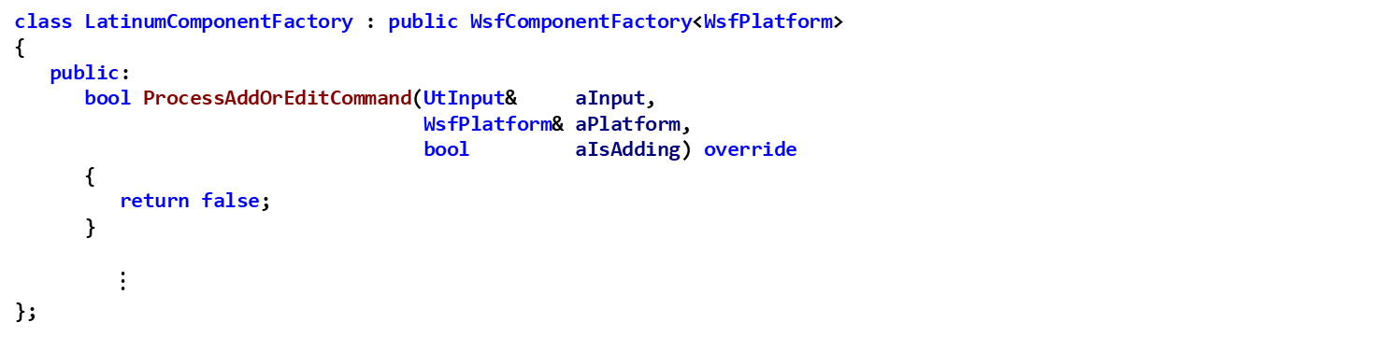
Component Exercise 3 — Review 2 LatinumComponent.cpp
Understand the LatinumComponent component factory in LatinumComponent.cpp
The ProcessAddOrEditCommand method handles creation or (optional) editing of components on a platform
In this case it returns false (for failure to add/edit the component)
class LatinumComponentFactory : public WsfComponentFactory<WsfPlatform>
{
public:
bool ProcessAddOrEditCommand(UtInput& aInput,
WsfPlatform& aPlatform,
bool aIsAdding) override
{
return false;
}
$⋮$
};

Slide 126

Component Exercise 3 — Review 2 LatinumComponent.cpp
Understand the LatinumComponent component factory in LatinumComponent.cpp
The ProcessInput method handles the latinum command in input
class LatinumComponentFactory : public WsfComponentFactory<WsfPlatform>
{
public:
$⋮$
bool ProcessInput(UtInput& aInput,
WsfPlatform& aParent) override
{
std::string command;
aInput.GetCommand(command);
bool myCommand = false;
if (command == "latinum")
{
LatinumComponent* lPtr = LatinumComponent::FindOrCreate(aParent);
aInput.ReadCommand(command);
myCommand = lPtr->ProcessInput(aInput);
if (! myCommand)
{
throw UtInput::BadValue(aInput);
}
}
return myCommand;
}
};
Note: the component factory’s
ProcessInput method invokes the
LatinumComponent::ProcessInput
Method to handle the quantity
command in the scenario files

Slide 127
Component Exercise 3 — Review 3 ShieldTypes.cpp
Understand the ShieldComponent component factory in ShieldTypes.cpp
The ProcessAddOrEditCommand method handles creation or (optional) editing of components on a platform
In this case it is an unnamed component that we cannot edit
The ProcessDeleteCommand method handles corresponding component deletion directives
class ShieldComponentFactory : public WsfComponentFactory<WsfPlatform>
{
public:
bool ProcessAddOrEditCommand(UtInput& aInput,
WsfPlatform& aPlatform,
bool aIsAdding) override
{
ShieldTypes& types(ShieldTypes::Get(GetScenario()));
return types.LoadUnnamedComponentWithoutEdit(aInput, aPlatform, aIsAdding, cWSF_COMPONENT_SHIELDS);
}
bool ProcessDeleteCommand(UtInput& aInput,
WsfPlatform& aPlatform) override
{
ShieldTypes& types(ShieldTypes::Get(GetScenario()));
return types.DeleteUnnamedComponent(aInput, aPlatform, cWSF_COMPONENT_SHIELDS);
}
};

Slide 128
Component Exercise 3 — Review 4 ShieldComponent.cpp
Examine the ShieldComponent::MessageReceived method
Notice that if the message subtype is DROP_SHIELDS, this method turns off the Shields platform part
void ShieldComponent::MessageReceived(double aSimTime,
wsf::comm::Comm* aXmtrPtr,
wsf::comm::Comm* aRcvrPtr,
const WsfMessage& aMessage,
wsf::comm::Result& aResult)
{
std::string type = aMessage.GetSubType();
if (type == "DROP_SHIELDS")
{
{ // RAII block
auto out = ut::log::info() << "Turning off shield component.";
out.AddNote() << "T = " << aSimTime;
out.AddNote() << "Platform: " << GetPlatform()->GetName();
out.AddNote() << "Shield: " << GetName();
}
GetPlatform()->GetSimulation()->TurnPartOff(aSimTime, this);
}
}

Slide 129
Exercise 4
In this exercise, the several classes have associated Script…Classes with defined methods by which users can access/modify certain values related to the components
LatinumComponent has the associated WsfScriptLatinumComponentClass with defined methods:
Quantity: returns the amount of Latinum stored in the component
TransferTo: transfers the Latinum from one platform to another
ShieldComponent has the associated WsfScriptShieldComponentClass with defined methods
Strength: returns the current strength value of the platforms shields
The CyberSensorEffect component does not have an associated script class or methods which can access its values
Two script methods are added to platforms
Latinum: returns a pointer to the platform’s latinum
Shields: returns a pointer to the platform’s shields

Slide 130
Component Exercise 4 — Review 1 ShieldComponent.hpp
Understand the WsfScriptShieldComponentClass class declaration in ShieldComponent.hpp
Notice the class inherits WsfScriptPlatformPartClass
Notice the declaration of the Strength script method, which creates the class Strength with a constructor and operator()
See the Sensor Exercise for details about UT_DECLARE_SCRIPT_METHOD
class WsfScriptShieldComponentClass : public WsfScriptPlatformPartClass
{
public:
bool WsfScriptShieldComponentClass(const std::string& aScriptName,
UtScriptTypes* aScriptTypesPtr);
UT_DECLARE_SCRIPT_METHOD(Strength);
};

Slide 131
Component Exercise 4 — Review 2 ShieldComponent.cpp
Understand the WsfScriptShieldComponentClass class definition in ShieldComponent.cpp
Notice the constructor sets the class name to “Shields”
Notice the constructor adds the method Strength to the scripting interface (makes it invocable from user script code)
Notice the definition of the Strength script method, which defines the class Strength with a constructor and operator()
See the Sensor Exercise for details about UT_DEFINE_SCRIPT_METHOD
WsfScriptShieldComponentClass::WsfScriptShieldComponentClass(const std::string & aClassName,
UtScriptTypes* aScriptTypesPtr)
: WsfScriptPlatformPartClass(aClassName, aScriptTypesPtr)
{
SetClassName("Shields");
AddMethod(ut::make_unique<Strength>());
}
UT_DEFINE_SCRIPT_METHOD(WsfScriptShieldComponentClass, ShieldComponent, Strength, 0, "double", "")
{
aReturnVal.SetDouble(aObjectPtr->GetStrength());
}
Invokes ShieldComponent::GetStrength

Slide 132
Component Exercise 4 — Review 3 ShieldComponent.cpp
Understand the call to UT_DEFINE_SCRIPT_METHOD_EXT
Creates a new method, called shields, and defines it to be part of the WsfPlatform class definition in ShieldComponent.cpp
This method gets a pointer to the platform’s shields (it will be a nullptr if the platform does not have shields component defined) and returns that pointer to the script method’s caller
The Macro UT_DEFINE_SCRIPT_METHOD_EXT is used to define methods for existing script classes
Useful to expose script capabilities for additional, add-on functionality
Example: Wsf_mil providing “military-specific” capabilities for Wsf
Notice that UT_DECLARE_SCRIPT_METHOD and AddMethod are not needed
UT_DEFINE_SCRIPT_METHOD_EXT(WsfPlatform, Shields, 0, "Shields", "")
{
// Note the following will only return a valid pointer if the platform has a "shields" component.
ShieldComponent* ppPtr = aObjectPtr->template GetComponent<ShieldComponent>();
aReturnVal.SetPointer(new UtScriptRef(ppPtr, aReturnClassPtr));
}

Slide 133
Component Exercise 4 — Review 4 ShieldComponent.cpp
Examine the ShieldComponent::RegisterScriptMethods and ShieldComponent::RegisterScriptTypes in ShieldComponent.cpp
Notice that RegisterScriptMethods adds the method Shields to WsfPlatform (allows method Shields to be invoked on platforms to get a pointer to it’s shields – if the platform has shields)
Notice that RegisterScriptTypes registers class WsfScriptShieldComponentClass as the implementation for the method Shields
void ShieldComponent::RegisterScriptMethods(UtScriptTypes & aScriptTypes)
{
aScriptTypes.AddClassMethod("WsfPlatform", ut::make_unique<Shields>());
}
void ShieldComponent::RegisterScriptTypes(UtScriptTypes& aScriptTypes)
{
aScriptTypes.Register(ut::make_unique<WsfScriptShieldComponentClass>("Shields", &aScriptTypes));
}

Slide 134
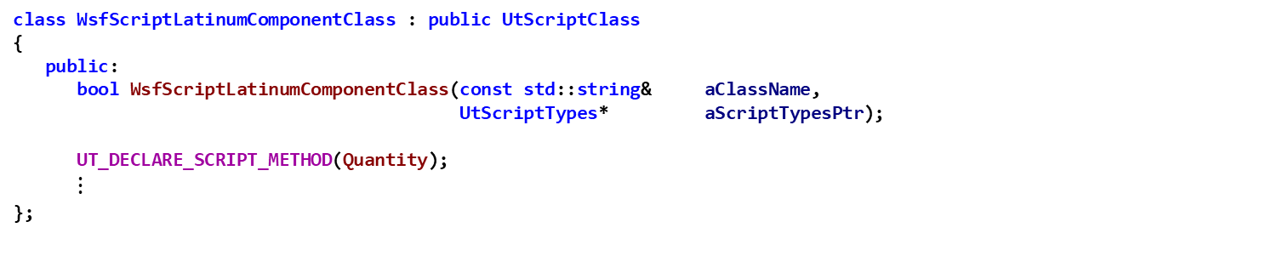
Component Exercise 4 — Review 5 LatinumComponent.hpp
Understand the WsfScriptLatinumComponentClass class declaration in LatinumComponent.hpp
Notice the class inherits UtScriptClass
Notice the declaration of the Quantity script method, which creates the class Quantity with a constructor and operator()
See the Sensor Exercise for details about UT_DECLARE_SCRIPT_METHOD
class WsfScriptLatinumComponentClass : public UtScriptClass
{
public:
bool WsfScriptLatinumComponentClass(const std::string& aClassName,
UtScriptTypes* aScriptTypesPtr);
UT_DECLARE_SCRIPT_METHOD(Quantity);
$⋮$
};

Slide 135
Component Exercise 4 — Task 1 LatinumComponent.hpp
Add a UT_DECLARE_SCRIPT_METHOD to the ScriptLatinumComponentClass that declares TransferTo to be an implementation of a script method.
See the Sensor Exercise for details about UT_DECLARE_SCRIPT_METHOD

Slide 136
Component Exercise 4 — Task 1 Solution LatinumComponent.hpp
class WsfScriptLatinumComponentClass : public UtScriptClass
{
public:
bool WsfScriptLatinumComponentClass(const std::string& aClassName,
UtScriptTypes* aScriptTypesPtr);
UT_DECLARE_SCRIPT_METHOD(Quantity);
// EXERCISE 4 TASK 1
UT_DECLARE_SCRIPT_METHOD(TransferTo);
};

Slide 137
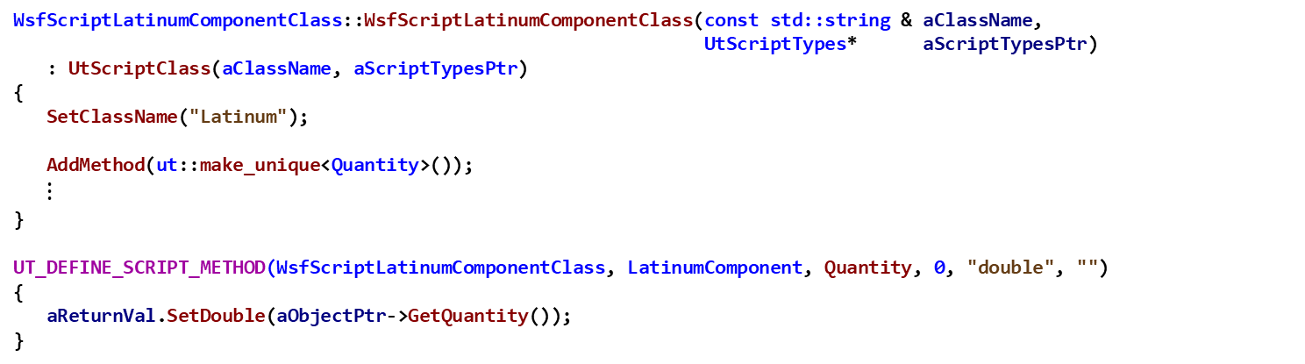
Component Exercise 4 — Review 6 LatinumComponent.cpp
Understand the WsfScriptLatinumComponentClass class definition in LatinumComponent.cpp
Notice the constructor sets the class name to “Latinum”
Notice the constructor adds the method Quantity to the scripting interface (makes it invocable from user script code)
Notice the definition of the Quantity script method, which defines the class Quantity with a constructor and operator()
See the Sensor Exercise for details about UT_DEFINE_SCRIPT_METHOD
WsfScriptLatinumComponentClass::WsfScriptLatinumComponentClass(const std::string & aClassName,
UtScriptTypes* aScriptTypesPtr)
: UtScriptClass(aClassName, aScriptTypesPtr)
{
SetClassName("Latinum");
AddMethod(ut::make_unique<Quantity>());
$⋮$
}
UT_DEFINE_SCRIPT_METHOD(WsfScriptLatinumComponentClass, LatinumComponent, Quantity, 0, "double", "")
{
aReturnVal.SetDouble(aObjectPtr->GetQuantity());
}
Invokes LatinumComponent::GetQuantity

Slide 138
Sensor Exercise 4 — Task 2
In file LatinumComponent.cpp:
In the ScriptLatinumComponentClass constructor, add an AddMethod statement to associate TransferTo as the implementation class for the overloaded script method TransferTo

Slide 139
Component Exercise 4 — Task 2 Solution LatinumComponent.cpp
WsfScriptLatinumComponentClass::WsfScriptLatinumComponentClass(const std::string & aClassName,
UtScriptTypes* aScriptTypesPtr)
: UtScriptClass(aClassName, aScriptTypesPtr)
{
SetClassName("Latinum");
AddMethod(ut::make_unique<Quantity>());
// EXERCISE 4 TASK 2
AddMethod(ut::make_unique<TransferTo>());
}

Slide 140
Component Exercise 4 — Task 3 LatinumComponent.cpp
In file LatinumComponent.cpp, complete the TransferTo Script Method of the LatinumComponent Script Class
Task 3a: Get the Parent Platform using GetComponentParent
This method is a member of the object pointed to by aObjectPtr pointer (the variable aObjectPtr is defined by the macro – and is available for you to use)
The type returned by GetComponentParent is a WsfPlatform* - you should store this in a variable
Task 3b: Clone the component
Invoke aObjectPtr->Clone() to create a clone
dynamic_cast the clone to be a LatinumComponent*
Store the casted pointer in a variable of type LatinumComponent*
Task 3c: Remove the existing component from the parent
Invoke the method RemoveComponent (passing the aObjectPtr) for the object pointed to by the pointer stored in the variable from part 1 above
Task 3d: Add the cloned component to the receiver platform
The receiver platform is pointed to by the variable receiverPlatformPtr
Invoke the AddComponent method with an argument that is the casted pointer variable from part 2

Slide 141
Component Exercise 4 — Task 3 Solution LatinumComponent.cpp
UT_DEFINE_SCRIPT_METHOD(WsfScriptLatinumComponentClass, LatinumComponent, TransferTo, 1, "void", "WsfPlatform")
{
WsfPlatform* receiverPlatformPtr = static_cast<WsfPlatform*>(aVarArgs[0].GetPointer()->GetAppObject());
// EXERCISE 4 Task 3a
// Get this component's parent platform (use GetComponentParent).
WsfPlatform* componentParent = aObjectPtr->GetComponentParent();
// EXERCISE 4 Task 3b
// Clone this component, casting it to the correct object type.
LatinumComponent* xferPtr = dynamic_cast<LatinumComponent*>(aObjectPtr->Clone());
// EXERCISE 4 Task 3c
// Remove the component from the existing component's parent platform (use RemoveComponent).
componentParent->RemoveComponent(aObjectPtr);
// EXERCISE 4 Task 3d
// Add the cloned component to the receiver platform (use AddComponent).
receiverPlatformPtr->AddComponent(xferPtr);
}

Slide 142
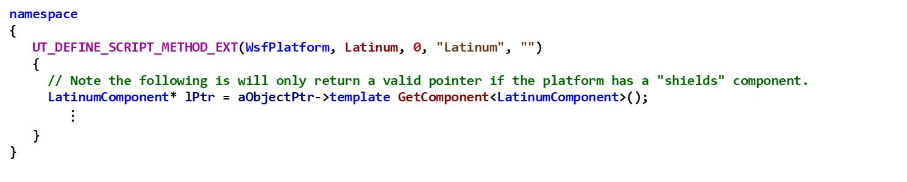
Component Exercise 4 — Review 7 LatinumComponent.cpp
Understand the WsfScriptLatinumComponentClass class definition in LatinumComponent.cpp
Notice the definition of the Latinum script method, which defines the class Latinum with a constructor and operator()
UT_DEFINE_SCRIPT_METHOD_EXT adds this script method to the WsfPlatform, which already has a scripting class defined for it
Notice the implementation creates a pointer to a LatinumComponent which points to the component returned by the GetComponent method which has been template specialized on a LatinumComponent type
namespace
{
UT_DEFINE_SCRIPT_METHOD_EXT(WsfPlatform, Latinum, 0, "Latinum", "")
{
// Note the following is will only return a valid pointer if the platform has a "shields" component.
LatinumComponent* lPtr = aObjectPtr->template GetComponent<LatinumComponent>();
$⋮$
}
}

Slide 143
Component Exercise 4 — Task 4 LatinumComponent.cpp
The Macro UT_DEFINE_SCRIPT_METHOD_EXT is used to define methods for existing script classes
Useful to expose script capabilities for additional, add-on functionality
Example: Wsf_mil providing “military-specific” capabilities for Wsf
Notice that UT_DECLARE_SCRIPT_METHOD and AddMethod are not needed when extending the script interface for existing script classes
Task 4: In LatinumComponent.cpp, complete the implementation of UT_DEFINE_SCRIPT_METHOD_EXT
Notice the definition of the Latinum script method, which defines the class Latinum with a constructor and operator()
UT_DEFINE_SCRIPT_METHOD_EXT does two things:
defines the body of the script method for the Latinum method
adds this script method to the WsfPlatform, which already has a scripting class
The implementation of the Latinum script method (as defined in this macro) should return a pointer to the LatinumComponent (the previous statement just retrieved a pointer to this LatinumComponent and stored it in lptr)
This pointer needs to be placed into the return value aReturnVal by invoking aReturnVal.SetPointer and passing in a newly created UtScriptRef object that is constructed with the pointer lptr and the pointer aReturnClassPtr

Slide 144
Component Exercise 4 — Task 4 Solution LatinumComponent.cpp
namespace
{
UT_DEFINE_SCRIPT_METHOD_EXT(WsfPlatform, Latinum, 0, "Latinum", "")
{
// Note this script method will only return a valid pointer if the platform has a "Latinum" component.
LatinumComponent* lPtr = aObjectPtr->template GetComponent<LatinumComponent>();
// EXERCISE 4 TASK 4
// invoke aReturnVal.SetPointer to set the return value to be the pointer to the LatinumComponent
// the argument to SetPointer is a new UtScriptRef which is constructed with the pointer lptr
// and the variable aReturnClassPtr
aReturnVal.SetPointer(new UtScriptRef(lPtr, aReturnClassPtr));
}
}

Slide 145
Component Exercise 4 — Review 8 LatinumComponent.cpp
Examine the LatinumComponent::RegisterScriptMethods and LatinumComponent::RegisterScriptTypes in LatinumComponent.cpp
Notice that RegisterScriptMethods adds the method Latinum to WsfPlatform (allows method Latinum to be invoked on platforms to get a pointer to it’s Latinum – if the platform has Latinum defined)
Notice that RegisterScriptTypes registers class WsfScriptLatinumComponentClass as the implementation for the method Latinum
void LatinumComponent::RegisterScriptMethods(UtScriptTypes & aScriptTypes)
{
aScriptTypes.AddClassMethod("WsfPlatform", ut::make_unique<Latinum>());
}
void LatinumComponent::RegisterScriptTypes(UtScriptTypes& aScriptTypes)
{
aScriptTypes.Register(ut::make_unique<WsfScriptLatinumComponentClass>("Latinum", &aScriptTypes));
}

Slide 146
Testing (1/2)
From Visual Studio,
Build the solution in Release
Build the “INSTALL” project
Load the Test Scenario into WIZARD
Open WIZARD
Find the top-level scenario file named component_scenario.txt located in the ..\component\data folder. This is the input file with which we will test our program
Drag and drop component_scenario.txt into it
Linux: from the build directory, run:
$ cmake --build . --target all -- -j11
$ cmake --build . --target install -- -j11

Slide 147

Testing (2/2)
Run the selected application from Wizard
(Press Play)
Open the component_scenario.aer file in Mystic

Slide 148
Results
Result of forcing sensor track to drop
Result of forcing shields to drop

Slide 149
Summary: What did all of the code do?
Created and registered the extensions
the RegisterShieldComponent application extension
the ComponentTypesRegistration scenario extension
Created and registered the CyberSensorEffect sensor component’s CyberSensorComponentFactory
Created the LatinumTypes type and had it register the LatinumComponent LatinumComponentFactory
Create the ShieldTypes type, and had its constructor
register the WSF_SHIELDS scenario type, and
register the ShieldComponent’s ShieldComponentFactory
Implemented the methods and identifiers for the different component roles
Defined the component role values in ComponentRoles.hpp
Implemented methods GetComponentName, CloneComponent, GetComponentRoles, QueryInterface
Implemented the platform components
LatinumComponent
ShieldComponent
Implement the sensor component
CyberSensorEffect
Implement the ProcessInput methods for the three components

Slide 150
Summary: What did all of the code do?
Implemented the Find and FindOrCreate methods for both the LatinumComponent and the CyberSensorEffect component classes
Implemented the virtual TrackerAllowTracking method for the CyberSensorEffect component to allow the exploit
Implemented the ShieldComponent::MessageReceived method which enables the exploit
Defined the WsfPlatform script methods Latinum and Shields
Registered the script types for “Latinum” and registered the script methods for the Latinum method
Registered the script types for “Shields” and registered the script methods for the Shields method
Implemented the WsfScript…Class classes for ShieldComponent and LatinumComponent
WsfScriptShieldComponentClass
Declare the Quantity method
Declare the TransferTo method
AddMethod for Quantity
AddMethod for TransferTo
WsfScriptLatinumComponentClass
Declare the Strength method
AddMethod for Strength
Defined the Strength, Quantity, and TransferTo script methods

