Slide 1
AFSIM Developer Training
8 – Observers
AFRL/RQQD

Slide 2
Acronyms and Definitions
AFSIM - Advanced Framework for Simulation, Integration, and Modeling
AGL – Above Ground Level
DIS – Distributed Interactive Simulation
DTED – Digital Terrain Elevation Data
EO/IR – Electro-Optical/Infra-Red
ESM – Electronic Support Measure
FOV – Field Of View
GUI – Graphical User Interface
HLA – High Level Architecture
IEEE – Institute of Electrical & Electronics Engineers, Inc.
JTIDS – Joint Tactical Information Distribution System
MSL – Mean Sea Level
PDU – Protocol Data Unit
RCS – Radar Cross Section
SAM – Surface-to-Air Missile
SAR – Synthetic Aperture Radar
VESPA – Visual Environment for Scenario Preparation and Analysis
WKF – Warlock Framework
WSF – World Simulation Framework
dB - decibels
dBsm – decibel square meters
deg – degrees
ft – feet
GHz– GigaHertz
kts – knots
m - meters
m^2 – square meters
mw – megawatts
nm – nautical miles
s – seconds

Slide 3
Introduction
This lab focuses on using AFSIM observers to extract data from an AFSIM simulation
You build a new C++ AFSIM observer class that observes interactions and forward selected data to a networked application
The following exercise provides practice working with AFSIM observers
Exercise 1: Creating a custom AFSIM observer with a default application extension and a new Scenario Extension
Notes:
This is an alternative way to do simple observers.
This is not the model we will be following.

Slide 4
Problem Statement
Subscribe to selected AFSIM observer callbacks
Send information over a UDP socket to a remote application
References:
AFSIM Developers Web-based data.
AFSIM Source Codes and Visual Studio search functions.
AFSIM Documentation.

Slide 5
Learning Objectives
You gain hands-on knowledge about:
Initializing a new observer class and reading input data files
Opening a socket to send data to a remote application
Inserting callbacks to capture interactions for the purpose of triggering functions that will process and forward data
Building the observer class as an AFSIM plug-in and loading the plug-in into an AFSIM application
Create a default application extension and new plugin
Create a new simulation extension
You reinforce your skills with a scenario extension

Slide 6
Prerequisites
Before working on this lab, you should:
Be familiar with WIZARD and AFSIM scripting Language
AFSIM analyst course or equivalent experience is recommended
Have available and be familiar with using Microsoft® Visual Studio 2017® or newer to compile an application
Be familiar with using Microsoft Windows® Explorer
Have completed the Module “Building AFSIM with CMAKE”
Be familiar with using cmake-gui

Slide 7

Observers Within the Framework
AFSIM includes observers within the basic framework
Using callback utilities, developers can subscribe to published events to capture desired interactions for analyses or displays
AFSIM Framework
Infrastructure
Interface
Scenario Management
Time Management
Time Management
Geospatial Data Management
Event Management
Utilities
Geospatial Data Management
Scripting
Language
Distributed Simulation Interfaces
Scenario Management
Script
Distributed Simulation Interfaces
Event Management
Plug-in
Management
Observers
Extensions
Simulation Management
Observers
Extensions
Components
Platform Components
Movers
Sensors
Weapons
Communications
Processors
Other Platform
Components
Non-Platform
Components
Sensor
Components
Weapon
Components
Comm
Components
Processor
Components
$$…$$
Observer Supplies a generic publish-subscribe interface for extracting data from simulations

Slide 8
Observer
Observer concept allows notification of certain events without having to modify the core software that is issuing the event
Observers are typically used for data collection and logging
Publisher “pushes” all commonly needed data through use of specific publication function signatures
See UtCallback
New Observer
(Subscriber)
// Performs user specific
// actions.
Subscribe to publisher
WsfObserver
(Publisher)
// Has set of built-in
// published events.
Publication when event happens
// Process event as needed

Slide 9
WsfObserver
Callbacks Exist Within the WsfObserver Namespce
Categories for Major Classes of Events (Platform, Sensor, Weapon, Comm, etc.)
Receive notification of significant events occuring within the simulation by subscribing to events
Events are publishers to which others can subscribe
List of Published Events v2.5
COMMENT
COMM_ADDED_TO_MANAGER
COMM_REMOVED_FROM_MANAGER
COMM_ADDED_TO_LOCAL
COMM_REMOVED_FROM_LOCAL
COMM_FREQUENCY_CHANGED
COMM_TURNED_OFF
COMM_TURNED_ON
CRASHED_INTO_GROUND
EXCHANGE_EVENT
EXECUTE_CALLBACK
FUEL_EVENT
LINK_ADDED_TO_MANAGER
LINK_REMOVED_FROM_MANAGER
LINK_ENABLED_ON_MANAGER
LINK_DISABLED_ON_MANAGER
LINK_ADDED_TO_LOCAL
LINK_REMOVED_FROM_LOCAL
LINK_ENABLED_ON_LOCAL
LINK_DISABLED_ON_LOCAL
LOCAL_TRACK_CORRELATION
LOCAL_TRACK_DECORRELATION
LOCAL_TRACK_DROPPED
LOCAL_TRACK_INITIATED
LOCAL_TRACK_UPDATED
MESSAGE_DELIVERY_ATTEMPT
MESSAGE_DISCARDED
MESSAGE_FAILED_ROUTING
MESSAGE_UPDATED
MESSAGE_QUEUED
MESSAGE_RECEIVED
MESSAGE_TRANSMITTED
MESSAGE_TRANSMITTED_HEARTBEAT
MESSAGE_TRANSMIT_ENDED
MOVER_UPDATED
NETWORK_ADDED
NETWORK_REMOVED
OPERATING_LEVEL_CHANGED
PLATFORM_ADDED
PLATFORM_APPEARANCE_CHANGED
PLATFORM_DELETED
PLATFORM_INITIALIZED
PLATFORM_BROKEN
PLATFORM_OMITTED
PROCESSOR_TURNED_OFF
PROCESSOR_TURNED_ON
SENSOR_DETECTION_ATTEMPT
SENSOR_DETECTION_CHANGED
SENSOR_FREQUENCY_CHANGED
SENSOR_MODE_ACTIVATED
SENSOR_MODE_DEACTIVATED
SENSOR_REQUEST_CANCELED
SENSOR_REQUEST_INITIATED
SENSOR_REQUEST_UPDATED
SENSOR_TRACK_COASTED
SENSOR_TRACK_DROPPED
SENSOR_TRACK_INITIATED
SENSOR_TRACK_UPDATED
SENSOR_TURNED_OFF
SENSOR_TURNED_ON
SIMULATION_COMPLETE
SIMULATION_INITIALIZING
SIMULATION_STARTING
STATE_ENTRY
STATE_EXIT
TANKING_EVENT
TASK_ASSIGNED
TASK_CANCELED
TASK_COMPLETED
TEAM_NAME_DEFINITION
ECLIPSE_ENTRY
ECLIPSE_EXIT
ORBITAL_MANEUVER_INITIATED
ORBITAL_MANEUVER_UPDATED
ORBITAL_MANEUVER_CANCELED
ORBITAL_MANEUVER_COMPLETED
ORBIT_DETERMINATION_INITIATED
ORBIT_DETERMINATION_UPDATED
DIRECTED_ENERGY_WEAPON_BEGIN_SHOT
DIRECTED_ENERGY_WEAPON_UPDATE_SHOT
DIRECTED_ENERGY_WEAPON_ABORT_SHOT
DIRECTED_ENERGY_WEAPON_COOLDOWN_COMPLETE
DIRECTED_ENERGY_WEAPON_END_SHOT
IMPLICIT_WEAPON_BEGIN_ENGAGEMENT
IMPLICIT_WEAPON_END_ENGAGEMENT
JAMMING_ATTEMPT
JAMMING_REQUEST_CANCELED
JAMMING_REQUEST_INITIATED
JAMMING_REQUEST_UPDATED
WEAPON_FIRE_ABORTED
WEAPON_FIRE_REQUESTED
WEAPON_FIRED
WEAPON_HIT
WEAPON_MISSED
WEAPON_MODE_ACTIVATED
WEAPON_MODE_DEACTIVATED
WEAPON_RELOAD_STARTED
WEAPON_RELOAD_ENDED
WEAPON_TERMINATED
WEAPON_TURNED_OFF
WEAPON_TURNED_ON
CYBER_ATTACK_INITIATED
CYBER_ATTACK_SUCCEEDED
CYBER_ATTACK_FAILED
CYBER_ATTACK_DETECTED
CYBER_ATTACK_RECOVERY
CYBER_SCAN_INITIATED
CYBER_SCAN_SUCCEEDED
CYBER_SCAN_FAILED
CYBER_SCAN_DETECTED
Notes:
More have been added since 2.1. Such as in XIO when a simulation falls behind (WsfObserver::SimulationTimeBehind)

Slide 10
Simple Observers Example (for observers that are part of AFSIM application/extensions)
Suppose you define a class which needs to be notified if a specific platform is deleted
A callback method can be invoked when a platform is deleted.
To achieve this, your class must
Inherit class WsfSinglePlatformObserver
Provide a definition for virtual methods OnPlatformDeleting and OnPlatformDeleted, which overrides the ones defined in WsfSinglePlatformObserver
Register your class to get the callback:
invoke the platform’s AttachObserver method (with a pointer to the object to be notified)
class myclass : public WsfSinglePlatformObserver, …
{
 void OnPlatformDeleted(double aSimTime, WsfPlatform* aPlatformPtr) override;
void OnPlatformDeleting(double aSimTime, WsfPlatform* aPlatformPtr) override;
void OnPlatformUpdated(double aSimTime, WsfPlatform* aPlatformPtr) override;

void RegisterAsObserver(WsfPlatform* platformPtr)
{
platformPtr->AttachObserver(this);
}
};
Notes:
This isn’t the model for this exercise, but this an alternative way to do a simple observer which only has access to a small subset of events.

Slide 11
Extensible Observer Architecture
Challenge for the AFSIM Component-Based Architecture (AFSIM version 2.0+)
Make Observers Extensible
Give “Add-on” Observers the Same Interface as “Core” Observers
All Observers are Owned by a Simulation Object
A simulation object needs to be provided when subscribing
“Core” Observers are Attributes of the Simulation Object
Add-on Observers are Accessed through Simulation Extensions
Example is the WsfWeaponObserver
Attribute of the “WsfMil” simulation extension

Slide 12
Example Subscription
// code example
class UDP_Observer
{
...
private:
void SensorTrackUpdated(double aSimTime,
WsfSensor* aSensorPtr,
const WsfTrack* aTrackPtr);
...
UtCallbackHolder mCallbacks;
...
};
// Usually, make subscriptions in constructor or initialization routine.
// Our exercise will use initialization routine in order to ensure that
// we have successful socket connection prior to making subscriptions.
mCallbacks.Add(WsfObserver::SensorTrackUpdated(&GetSimulation()).Connect(
&UDP_Observer::SensorTrackUpdated, this));
// \endcode example
Notes:
Our new observer is subscribing to the WsfObserver::SensorTrackUpdated. When the WsfObserver::SensorTrackUpdated is invoked, UDP_Observer::SensorTrackUpdated function will get called. This connection is stored in the UtCallbackHolder.

Slide 13
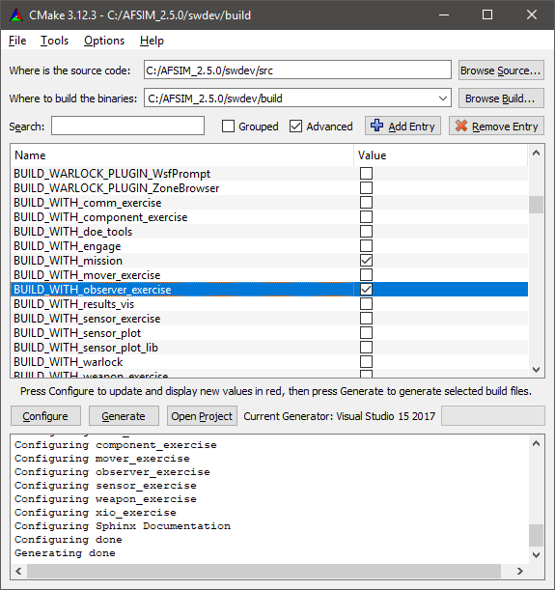
Getting Started (1/3)
Open CMake GUI
Check BUILD_WITH_observer_exercise
Press “Configure”
(Respond to any prompts asking for a compiler)
Press “Generate”
Notes:
Plugin Option:
These are the steps AFSIM uses to load a plugin (make interaction diagram todo):
WsfPluginManager::LoadPlugins calls RegisterPluginType; This is where the types are specified that afsim can handle.
RegisterPluginType calls CreateObject
CreateObject calls aRegistration.CreateObject(…)
aRegistration.CreateObject invokes the passed function pointer to the plugin’s Create method.
Plugin’s create method calls plugin object’s constructor.

Slide 14
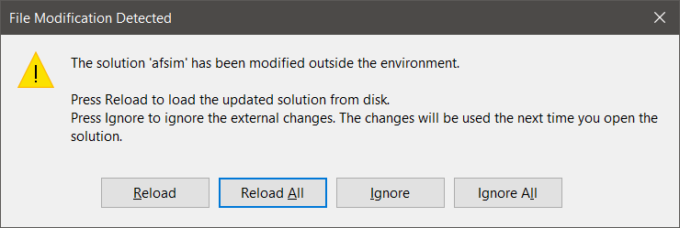
Getting Started (2/3)
If Visual Studio is already open:
Navigate to it and select Reload All when prompted.
Alternatively, open the solution file afsim.sln by:
Opening from swdev\build
Clicking Open Project from CMake

Slide 15
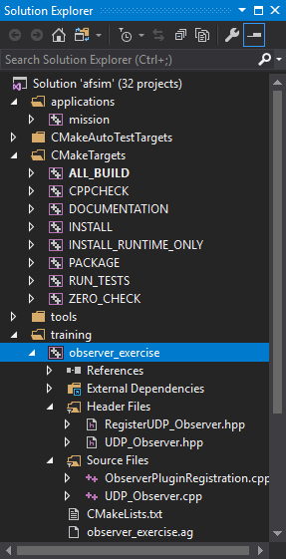
Getting Started (3/3)
This project uses the following source files:
ObserverPluginRegistration.cpp
RegisterUDP_Observer.hpp
UDP_Observer.hpp
UDP_Observer.cpp
Notes:
Our observer will not compile as it is. There are missing pieces that we need to fill in.

Slide 16
Classes Utilized by this Exercise
This exercise utilizes the following classes:
class UDP_Observer : public WsfSimulationExtension
Registers for simulation events using WsfObserver
Outputs observed events over a UDP socket to an external application
class RegisterUDP_Observer : public WsfScenarioExtension
Creates and registers UDP_Observer as a simulation extension
When this scenario extension’s RegisterUDP_Observer::ProcessInput is invoked, simply calls the UDP_Observer::ProcessInput
Registered with the scenario by WsfPluginSetup
class WsfDefaultApplicationExtension : public WsfApplicationExtention
a simple application extension with a ScenarioCreated method
Templated on a scenario extension
When ScenarioCreated is invoked, it registers the scenario extension with the scenario

Slide 17
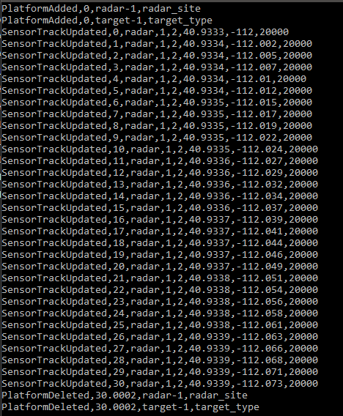
Observer Scenario
UDP_Observer’s generated output:
Builds a ground site with a radar sensor that generates tracks
Builds one air target for the ground site to detect
Uses a udp_observer block that is unique to this AFSIM application
Sends messages through the network to a receiver
A separate application (receiver.exe) extracts messages and displays them on screen
The end time is set to 10 seconds

Slide 18
UDP_Observer Input Parameters
UDP_Observer has the following attributes:
port – Port for the UDP connection
address – IP address or hostname of computer with remote application to read UDP_Observer’s messages
Example input:
udp_observer
port 19240
address localhost
end_udp_observer

Slide 19
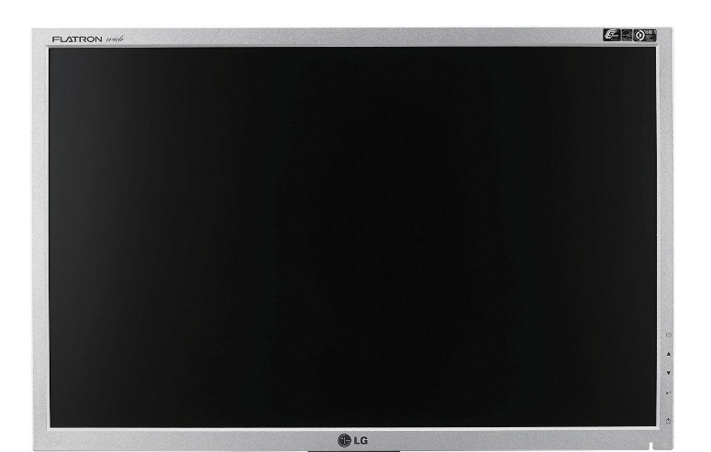
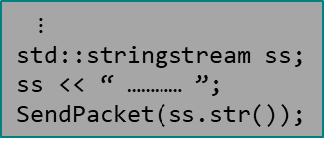
Observer Scenario
PlatformAdded, 0, radar_1, radar_site
PlatformAdded, 0, target_1, target_type
UDP_Observer and WsfObserver live inside the AFSIM application
UDP_Observer subscribes to the WsfObserver publisher for 4 events
When an event occurs, the publisher notifies UDP_Observer
UDP_Observer callback method creates a message, and invokes SendPacket
udp packets flow through network to separate application (receiver.exe)
receiver.exe (or receiver.py) is a separate application outside of AFSIM
Receives packets, extracts the message, and ships it to the screen for displaying
receiver.exe
AFSIM
Event: radar_1 platform added to simulation
Event: target_1 platform added to simulation
// Receives messages
// from the UDP network
// connection and displays
// them on the screen
Subscribe to publisher for events:
- WsfObserver::PlatformAdded,
- WsfObserver::PlatformDeleted,
- WsfObserver::SensorTrackUpdated,
- WsfObserver::SensorTrackInitiated
AFSIM notifies WsfObserver
invokes WsfObserver::PlatformAdded
UDP_Observer
(Subscriber)
// Performs user specific
// actions whenever notified
// that subscribed events
// occurred.
WsfObserver
(Publisher)
// Has set of built-in
// published events, including:
// WsfObserver::PlatformAdded
// WsfObserver::PlatformDeleted
// WsfObserver::SensorTrackInitiated
// WsfObserver::SensorTrackUpdated
Extract message
message
message
Notification that subscribed
event happened (i.e., platform
added)
Invokes callback to
UDP_Observer::PlatformAdded
$⋮$
std::stringstream ss;
ss << “ ………… ”;
SendPacket(ss.str());
UDP packet
UDP packet
UDP packet
UDP packet
UDP Network Connection

Slide 20
Observer Exercise
For this exercise, you will need to modify
UDP_Observer.cpp
ObserverPluginRegistration.cpp
RegisterUDP_Observer.hpp

Slide 21
AFSIM Plugins & Extensions
WsfExtension
WsfScenario
WsfSimulation
WsfApplication
WsfStandardApplication
WsfSimulationExtension
WsfScenarioExtension
WsfApplicationExtension
Main application classes used
in mission/warlock
All AFSIM extensions must derive from WsfExtension:
Three predefined extension classes already exist (can be inherited from)
WsfScenarioExtension – extensions that will provide new scenario commands (requiring a new ProcessInput for those commands) will need to inherit this class
WsfSimulationExtension – extensions that will access the simulation will need to inherit this class
WsfApplicationExtension – extensions that will create new script types, or will utilize a simulation extension or scenario extension, will need to inherit this class

Slide 22
AFSIM Plugins & Extensions
WsfExtension
WsfScenario
WsfSimulation
WsfApplication
WsfStandardApplication
WsfSimulationExtension
WsfScenarioExtension
WsfApplicationExtension
Main application classes used
in mission/warlock
UDP_Observer
RegisterUDP_Observer
WsfDefaultApplicationExtension
Sets up the new SimulationExtension classes to work
with AFSIM
Sets up the new ScenarioExtension classes to work
with AFSIM
Sets up the new Application
Extension classes to work
with AFSIM
All AFSIM extensions must derive from WsfExtension:
Three predefined extension classes already exist (can be inherited from)
WsfScenarioExtension – extensions that will provide new scenario commands (requiring a new ProcessInput for those commands) will need to inherit this class
WsfSimulationExtension – extensions that will access the simulation will need to inherit this class
WsfApplicationExtension – extensions that will create new script types, or will utilize a simulation extension or scenario extension, will need to inherit this class

Slide 23
Extensions
Applications, Scenarios, and Simulations can all be “Extended”
Application Extensions are owned by the Application
Represent optional capabilities that can be added to an application.
Used if you need new script types (sensors, weapons, components, movers)
This is the entry point to registering all extensions in AFSIM
An application extension is required if you are going to create a scenario extension or a simulation extension
We also need an application extension if
We are creating new scripts
In this exercise, we need an application extension in order to create and register a scenario extension and a simulation extension
To register the application extension, we need a new plugin
see the file ObserverPluginRegistration.cpp

Slide 24
Observer Exercise — Task 1
In ObserverPluginRegistration.cpp
Complete the WsfPluginVersion Method
Set the version by invoking UtPluginVersion and passing in three arguments
The first two arguments should be the two macros defined in WsfPlugin.hpp (in …/swdev/src/core/wsf/source or in …/afsim_dev/afsim/core/wsf/source), for the major version number and the minor version number, in that order
The third argument should be the static constant for the compiler string defined in WsfPlugin.hpp
Notes:
At this point, we should be able to build with no errors. Again, make sure you are building on Release.

Slide 25
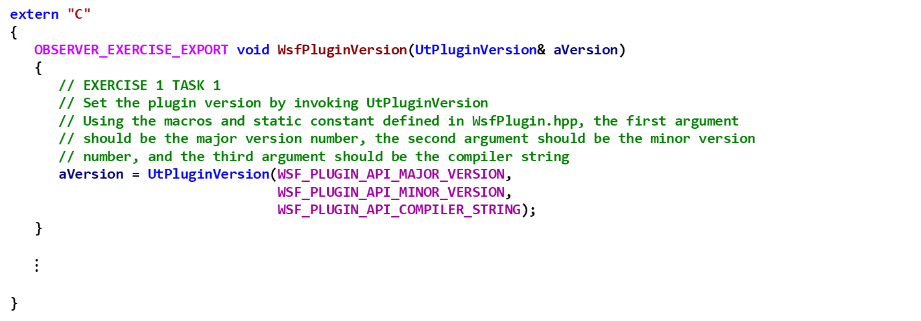
Observer Exercise — Task 1 Solution ObserverPluginRegistration.cpp
extern "C"
{
OBSERVER_EXERCISE_EXPORT void WsfPluginVersion(UtPluginVersion& aVersion)
{
// EXERCISE 1 TASK 1
// Set the plugin version by invoking UtPluginVersion
// Using the macros and static constant defined in WsfPlugin.hpp, the first argument
// should be the major version number, the second argument should be the minor version
// number, and the third argument should be the compiler string
aVersion = UtPluginVersion(WSF_PLUGIN_API_MAJOR_VERSION,
WSF_PLUGIN_API_MINOR_VERSION,
WSF_PLUGIN_API_COMPILER_STRING);
}
$⋮$
}

Slide 26
Application Extensions
To extend an Application, you must create a class that inherits class WsfApplicationExtension
class myAppExtension: public WsfApplicationExtension { … }
You should override the following members:
AddedToApplication: to receive notification that extension was added to the application – often used to register additional script class and methods, etc.
ScenarioCreated: called at end of Scenario constructor in order to receive notification from the application that the scenario was created – useful to register an Scenario extension if needed
SimulationCreated: called from the Simulation’s Initialize method in order to receive notification from the application that the simulation was created – useful to register an Simulation extension if needed
ProcessCommandLine: called from WsfApplication::ProcessCommandLine method to examine current argument and process it if necessary
PrintGrammar: prints out the extended grammar recognized by the extension
ProcessCommandLineCommands: called by WsfApplication’s ProcessCommandLineCommands to allow the extension to process/handle any commands it needs to recognize

Slide 27
Application Extensions
To extend an Application, you must create a class that inherits class WsfApplicationExtension
We will use WsfDefaultApplicationExtension which will register the scenario extension
class WsfDefaultApplicationExtension: public WsfApplicationExtension { … }
This class overrides the following members for an ApplicationExtension:
ScenarioCreated: called at end of Scenario constructor in order to receive notification from the application that the scenario was created – useful to register a Scenario extension if needed
This class is templated on a ScenarioExtension, and hence, when instantiated, a class derived from ScenarioExtension must be provided for the template
When the WsfDefaultApplicationExtension::ScenarioCreated method is executed by the WsfScenario constructor, it performs the registration of the RegisterUDP_Observer scenario extension with the scenario
hence, we do not have to write the code to do this.

Slide 28
Observer Exercise – Task 2
In file ObserverPluginRegistration.cpp
Complete WsfPluginSetup
Register a WsfDefaultApplicationExtension with the application aApplication
The name of the extension should be “register_udp_observer”
Instantiate a unique_ptr to a WsfDefaultApplicationExtension that has been templated upon the scenario extension RegisterUDP_Observer

Slide 29
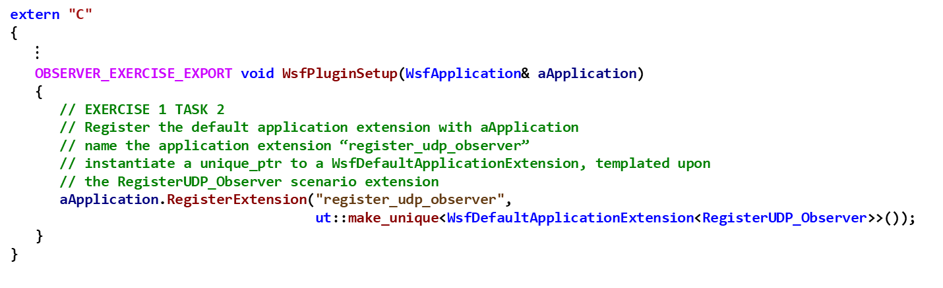
Observer Exercise – Task 2 Solution ObserverPluginRegistration.cpp
extern "C"
{
$⋮$
OBSERVER_EXERCISE_EXPORT void WsfPluginSetup(WsfApplication& aApplication)
{
// EXERCISE 1 TASK 2
// Register the default application extension with aApplication
// name the application extension “register_udp_observer”
// instantiate a unique_ptr to a WsfDefaultApplicationExtension, templated upon
// the RegisterUDP_Observer scenario extension
aApplication.RegisterExtension("register_udp_observer",
ut::make_unique<WsfDefaultApplicationExtension<RegisterUDP_Observer>>());
}
}
Note: when we register the application extension WsfDefaultApplicationExtension, we are also registering the RegisterUDP_Observer scenario extension
Notes:
When the constructor for the WsfDefaultApplicationExtension is executed, it performs the scenario extension registration.

Slide 30
Scenario Extensions
Scenarios can all be “Extended” as well
Scenario Extensions are owned by the Scenario
Represent optional types that can be added to a scenario.
Used if you need new types (components, observers, comms)
An application extension is required if you are going to create a scenario extension (or a simulation extension – covered later)
We also need an scenario extension if
We are creating simulation level commands

Slide 31
Scenario Extensions
To extend a Scenario, you must create a class that inherits class WsfScenarioExtension
class myScenarioExtension: public WsfScenarioExtension
You can override:
AddedToScenario: to receive notification that extension was added to the scenario – often used to register additional component type objects and factories
ProcessInput: processes any scenario input commands that must be recognized by the extension
FileLoaded: notifies extension that a file has been loaded into the scenario
Complete: called from WsfScenario::LoadComplete – notifies extension that all scenario input has been processed
Complete2: called after all extensions have had their Complete method invoked
SimulationCreated: called from WsfSimulation::Initialize – useful if a scenario extension needs an associated simulation extension – this method can register the simulation extension
AlwaysCreate: determines if the extension is optional or required

Slide 32
Observer Exercise Scenario Extension
To extend a Scenario, you must create a class that inherits class WsfScenarioExtension
class RegisterUDP_Observer: public WsfScenarioExtension
We will override:
SimulationCreated: called from WsfSimulation::Initialize – useful if a scenario extension needs an associated simulation extension – this method can register the simulation extension
ProcessInput: processes any scenario input commands that must be recognized by the extension
Note: The RegisterUDP_Observer scenario extension is already registered with the scenario by the WsfDefaultApplicationExtension, so we do not have to write code to do it ourselves

Slide 33
Observer Exercise — Task 3
In file RegisterUDP_Observer.hpp, complete the code for the RegisterUDP_Observer::SimulationCreated method
Task 3: Implement the SimulationCreated Method
Call the Simulation’s RegisterExtension method
Pass in the string “udp_observer” as first argument
Pass in ut::make_unique<UDP_Observer>(mPrototype) as the second argument (note: mPrototype is a UDP_Observer, and hence is a WsfSimulationExtension)
This will register mPrototype, which is a UDP_Observer (which is derived from WsfSimulationExtension), with the simulation

Slide 34
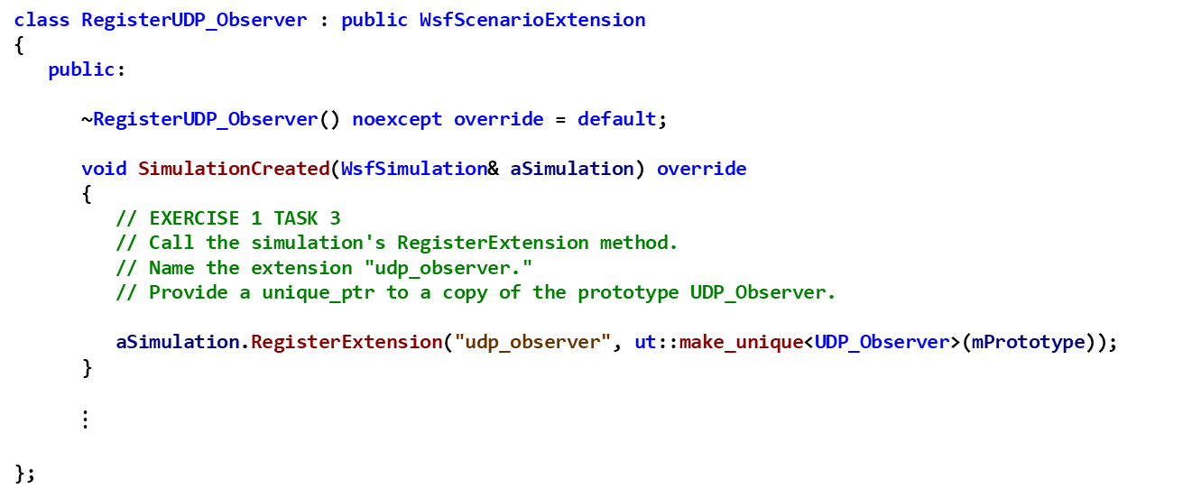
Observer Exercise — Task 3 Solution RegisterUDP_Observer.hpp
class RegisterUDP_Observer : public WsfScenarioExtension
{
public:
~RegisterUDP_Observer() noexcept override = default;
void SimulationCreated(WsfSimulation& aSimulation) override
{
// EXERCISE 1 TASK 3
// Call the simulation's RegisterExtension method.
// Name the extension "udp_observer."
// Provide a unique_ptr to a copy of the prototype UDP_Observer.
aSimulation.RegisterExtension("udp_observer", ut::make_unique<UDP_Observer>(mPrototype));
}
$⋮$
};

Slide 35
Simulation Extensions
Simulations can all be “Extended” as well
Simulation Extensions are owned by the Simulation
Allow access to the simulation features.
Used if you need access to the simulation itself(observers, comms, xio)
An application extension is required if you are going to create a simulation extension (and you may need a scenario extension as well)
We need a simulation extension if
We need to know when platforms are added or deleted, and when sensor tracks are initialized or updated

Slide 36
Simulation Extensions
To extend a Simulation, you must create a class that inherits class WsfScenarioExtension
class mySimulationExtension: public WsfSimulationExtension
You must override:
AddedToSimulation: called from WsfSimulation::RegisterExtension
Initialize: called form WsfSimulation::Initialize – useful to perform extension initialization
PrepareExtension: called from WsfSimulation::Initialize (called when a simulation is initialized) and from WsfSimulation::PrepareSimulation (called when a simulation is reloaded)
PendingStart: simulation has just entered pending start state, allows extension to add additional platforms or other entities
Start: called from WsfSimulation::Start – another opportunity to add additional platforms or other entities
Complete: called from WsfSimulation::Complete – allows extension to release resources (files, sockets, etc.) that were allocated by Initialize or PrepareExtension

Slide 37
Simulation Extensions
To extend a Simulation, you must create a class that inherits class WsfScenarioExtension
class UDP_Observer: public WsfSimulationExtension
You must override:
Initialize: called form WsfSimulation::Initialize – useful to perform extension initialization

Slide 38
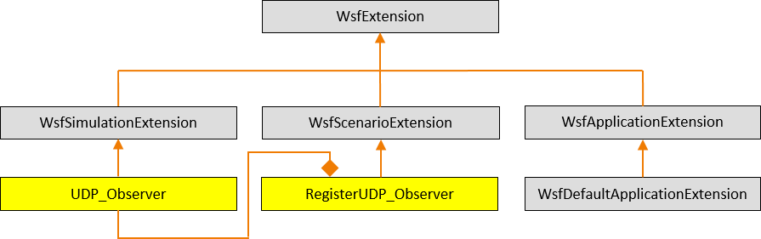
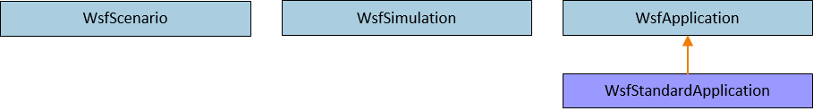
AFSIM Plugins & Extensions AFSIM mission startup sequence
Note: RegisterUDP_Observer contains
a member variable mPrototype
which is a UDP_Observer
First, mission creates a WsfStandardApplication named app
mPrototype
mission::main()
unique_ptr<WsfDefaultApplicationExtension<RegisterUDP_observer>>
WsfStandardApplication: app
WsfStandardApplication::WsfStandardApplication()
ObserverPluginRegistration.cpp:WsfPluginSetup()
WsfPluginSetup()
RegisterExtension(“register_udp_observer”, ut::make_unique<WsfDefaultApplicationExtension<RegisterUDP_Observer>>())
AddedToApplication()
The WsfStandardApplication constructor utilizes the plugin manager to find and load all plugins (including those in the training folders -- because of the cmake option WSF_ADD_EXTENSION_PATH)
For each plugin found, executes WsfPluginSetup (note: this causes our observer exercise plugin’s WsfPluginSetup function to execute)
This causes our observer exercise’s WsfDefaultApplicationExtension to be created and registered with app
RegisterExtension then invokes the WsfApplicationExtension::AddedToApplication()
Note: Neither the Default Application Extension nor the RegisterUDP_Observer class override AddedToApplication, so this notification is essentially ignored
Notes:
AFSIM mission startup sequence (warlock is similar but more complicated):
Create a WsfStandardApplication named app
Executes WsfStandardApplication::WsfStandardApplication constructor
Utilizes the plugin manager to find and load all plugins
Including those in the training folders (because of the cmake otption WSF_ADD_EXTENSION_PATH established when you ran the run_cmake.bat (run_cmake_lnx.sh) script
For each plugin, executes WsfPluginSetup (note: this causes our observer exercise plugin’s WsfPluginSetup function to execute)
This causes our observer exercise’s Default Application Extension (really a WsfScenarioExtension to be registered with app

Slide 39

AFSIM Plugins & Extensions AFSIM mission startup sequence
mission::main()
unique_ptr<WsfDefaultApplicationExtension<…>>
WsfStandardApplication: app
RegisterExtension(…)
RegisterExtension(…)
$$⋮$$
RegisterExtension(…)
Mission then registers all of the necessary predefined extensions with app
Notes:
AFSIM mission startup sequence (warlock is similar but more complicated):
Registers all of the necessary predefined extensions with app

Slide 40
AFSIM Plugins & Extensions AFSIM mission startup sequence
mission::main()
unique_ptr<RegisterUDP_Observer>
unique_ptr<WsfDefaultApplicationExtension<…>>
WsfScenario: scenario
WsfStandardApplication: app
WsfScenario::WsfScenario(app)
ScenarioCreated(…)
ScenarioCreated(…)
scenario.RegisterExtension(“register_udp_observer”,
ut::make_unique<RegisterUDP_Observer>())
This is not the actual line of code executed, but this is what that code is equivalent to
Mission then creates the scenario and invokes the WsfScenario constructor: WsfScenario scenario(app);
This constructor invokes the WsfApplication::ScenarioCreated method
This, in turn, invokes ScenarioCreated for all registered application extensions (including WsfDefaultApplicationExtension::ScenarioCreated)
This, in turn, creates the RegisterUDP_Observer, and registers it with scenario
Notes:
AFSIM mission startup sequence (warlock is similar but more complicated):
Creates the scenario
Invokes the WsfScenario constructor with app: WsfScenario scenario(app);
This constructor invokes the WsfApplication::ScenarioCreated method
This, in turn, invokes ScenarioCreated for all registered application extensions (including our default application extension)

Slide 41
AFSIM Plugins & Extensions AFSIM mission startup sequence
mission::main()
unique_ptr<RegisterUDP_Observer>
unique_ptr<WsfDefaultApplicationExtension<…>>
WsfScenario: scenario
WsfStandardApplication: app
WsfStandardApplication::ProcessInputFiles()
WsfScenario::LoadFromFile(…)
ProcessInput(…)
ProcessInput(…)
Mission invokes app.WsfStandardApplication::ProcessInputFiles()
which invokes WsfScenario::LoadFromFile()
For each command in input,
Invoke each of the core classes’ ProcessInput() methods
Invoke each registered scenario extension’s ProcessInput()
Invokes RegisterUDP_Observer::ProcessInput()
Invokes the UDP_Observer::ProcessInput()
Notes:
AFSIM mission startup sequence (warlock is similar but more complicated):
Invokes WsfStandardApplication::ProcessInputFiles()
Invokes WsfScenario::LoadFromFile()
Invokes WsfScenario::LoadFromStreamP()
For each command in input,
Invokes WsfScenario::ProcessExtensionInput()
For each registered extension,
Invokes RegisterUDP_Observer::ProcessInput()
Invokes the UDP_Observer::ProcessInput()
Note: the chain of ProcessInput calls is halted as soon as one of them returns true, indicating that the command has been “handled” by that ProcessInput method

Slide 42
AFSIM Plugins & Extensions AFSIM mission startup sequence
mission::main()
unique_ptr<RegisterUDP_Observer>
unique_ptr<WsfDefaultApplicationExtension<…>>
WsfScenario: scenario
WsfStandardApplication: app
WsfStandardApplication::ProcessInputFiles()
WsfScenario::LoadFromFile(…)
Complete(…)
WsfScenario::CompleteLoad(…)
Complete2(…)
Mission invokes app.WsfStandardApplication::ProcessInputFiles()
which, invokes WsfScenario::LoadFromFile()
and then invokes WsfScenario::CompleteLoad()
Invokes each extension’s Complete()
Then invokes each extension’s Complete2()
Notes:
AFSIM mission startup sequence (warlock is similar but more complicated):
Invokes WsfStandardApplication::ProcessInputFiles()
And then invokes WsfScenario::CompleteLoad()
Invokes each extension’s Complete()
Invokes each extension’s Complete2()

Slide 43
AFSIM Plugins & Extensions AFSIM mission startup sequence
mission::main()
unique_ptr<RegisterUDP_Observer>
unique_ptr<WsfDefaultApplicationExtension<…>>
WsfScenario: scenario
unique_ptr<WsfSimulation>: simPtr
WsfStandardApplication: app
WsfStandardApplication::CreateSimulation()
WsfSimulation::WsfSimulation()
Mission creates the Simulation by executing:
std::unique_ptr<WsfSimulation> simPtr =
app.CreateSimulation(scenario, …);
CreateSimulation invokes the WsfSimulation object’s constructor (with scenario as argument)
Notes:
AFSIM mission startup sequence (warlock is similar but more complicated):
Create the Simulation
Invokes:
std::unique_ptr<WsfSimulation> simPtr = app.CreateSimulation(scenario, …);
creates a unique pointer to a WsfSimulation object
Invokes the WsfSimulation object’s constructor (passing in scenario as an argument)
Returns the unique_ptr which is then assigned to SimPtr

Slide 44
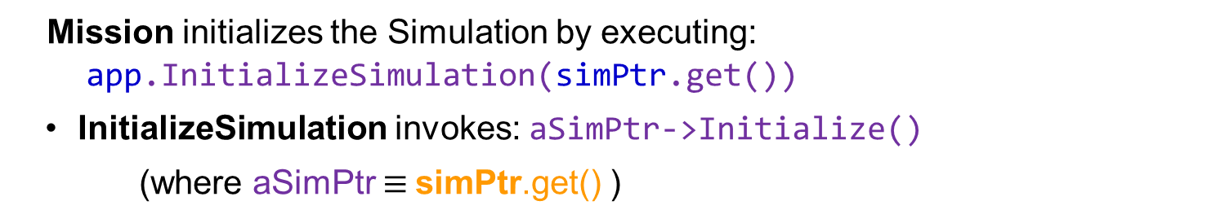
AFSIM Plugins & Extensions AFSIM mission startup sequence
mission::main()
unique_ptr<RegisterUDP_Observer>
unique_ptr<WsfDefaultApplicationExtension<…>>
WsfScenario: scenario
unique_ptr<WsfSimulation>: SimPtr
WsfStandardApplication: app
WsfStandardApplication::InitializeSimulation()
WsfSimulation::Initialize()
Mission initializes the Simulation by executing:
app.InitializeSimulation(simPtr.get())
InitializeSimulation invokes: aSimPtr->Initialize()
(where aSimPtr $≡$simPtr.get() )
Notes:
AFSIM mission startup sequence (warlock is similar but more complicated):
Initialize the Simulation
Invokes: app.InitializeSimulation(simPtr.get())
Invokes aSimPtr->Initialize() (where aSimPtr $≡$simPtr.get() )
Invokes the mScenario.SimulationCreated(*this)
(where mScenario $≡$scenario and *this $≡$ *simPtr.get())
Invokes GetApplication().SimulationCreated(aSimulation)
where GetApplication() $≡$app and aSimulation $≡$ *simPtr.get()
For each application extension, invoke SimulationCreated(aSimulation)
where aSimulation $≡$ *simPtr.get()
Invokes RegisterUDP_Observer::SimulationCreated(aSimulation) where aSimulation $≡$ *simPtr.get()
Invokes aSimulation.RegisterExtension(ut::make_unqiue<UDP_Observer>(mPrototype) where where aSimulation $≡$ *simPtr.get(), and mPrototype is a UDP_Observer

Slide 45
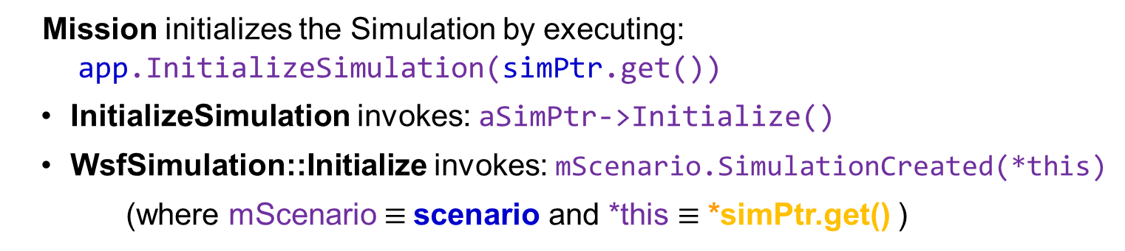
AFSIM Plugins & Extensions AFSIM mission startup sequence
mission::main()
unique_ptr<RegisterUDP_Observer>
unique_ptr<WsfDefaultApplicationExtension<…>>
WsfScenario: scenario
unique_ptr<WsfSimulation>: SimPtr
WsfStandardApplication: app
WsfStandardApplication::InitializeSimulation()
WsfScenario::SimulationCreated()
WsfSimulation::Initialize()
Mission initializes the Simulation by executing:
app.InitializeSimulation(simPtr.get())
InitializeSimulation invokes: aSimPtr->Initialize()
WsfSimulation::Initialize invokes: mScenario.SimulationCreated(*this)
(where mScenario $≡$scenario and *this $≡$ *simPtr.get() )
Notes:
AFSIM mission startup sequence (warlock is similar but more complicated):
Initialize the Simulation
Invokes: app.InitializeSimulation(simPtr.get())
Invokes aSimPtr->Initialize() (where aSimPtr $≡$simPtr.get() )
Invokes the mScenario.SimulationCreated(*this)
(where mScenario $≡$scenario and *this $≡$ *simPtr.get())
Invokes GetApplication().SimulationCreated(aSimulation)
where GetApplication() $≡$app and aSimulation $≡$ *simPtr.get()
For each application extension, invoke SimulationCreated(aSimulation)
where aSimulation $≡$ *simPtr.get()
Invokes RegisterUDP_Observer::SimulationCreated(aSimulation) where aSimulation $≡$ *simPtr.get()
Invokes aSimulation.RegisterExtension(ut::make_unqiue<UDP_Observer>(mPrototype) where where aSimulation $≡$ *simPtr.get(), and mPrototype is a UDP_Observer

Slide 46
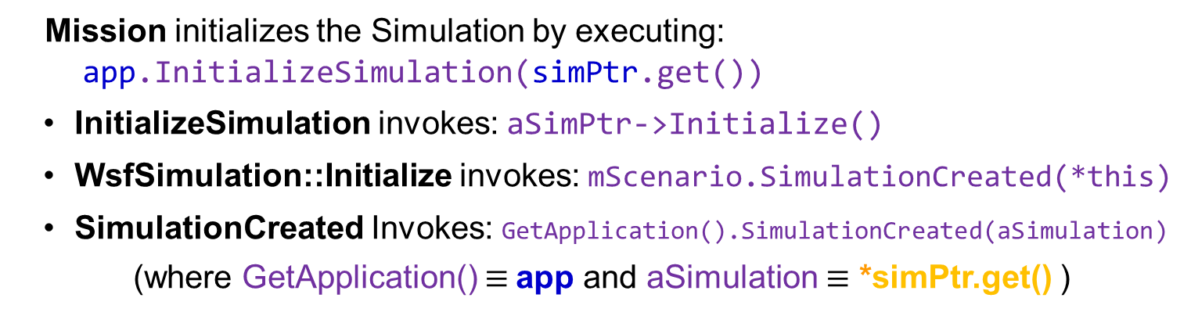
AFSIM Plugins & Extensions AFSIM mission startup sequence
mission::main()
unique_ptr<RegisterUDP_Observer>
unique_ptr<WsfDefaultApplicationExtension<…>>
WsfScenario: scenario
unique_ptr<WsfSimulation>: SimPtr
WsfStandardApplication: app
WsfStandardApplication::InitializeSimulation()
WsfScenario::SimulationCreated()
WsfSimulation::Initialize()
WsfApplication::SimulationCreated()
Mission initializes the Simulation by executing:
app.InitializeSimulation(simPtr.get())
InitializeSimulation invokes: aSimPtr->Initialize()
WsfSimulation::Initialize invokes: mScenario.SimulationCreated(*this)
SimulationCreated Invokes: GetApplication().SimulationCreated(aSimulation)
(where GetApplication() $≡$app and aSimulation $≡$ *simPtr.get() )
Notes:
AFSIM mission startup sequence (warlock is similar but more complicated):
Initialize the Simulation
Invokes: app.InitializeSimulation(simPtr.get())
Invokes aSimPtr->Initialize() (where aSimPtr $≡$simPtr.get() )
Invokes the mScenario.SimulationCreated(*this)
(where mScenario $≡$scenario and *this $≡$ *simPtr.get())
Invokes GetApplication().SimulationCreated(aSimulation)
where GetApplication() $≡$app and aSimulation $≡$ *simPtr.get()
For each application extension, invoke SimulationCreated(aSimulation)
where aSimulation $≡$ *simPtr.get()
Invokes RegisterUDP_Observer::SimulationCreated(aSimulation) where aSimulation $≡$ *simPtr.get()
Invokes aSimulation.RegisterExtension(ut::make_unqiue<UDP_Observer>(mPrototype) where where aSimulation $≡$ *simPtr.get(), and mPrototype is a UDP_Observer

Slide 47
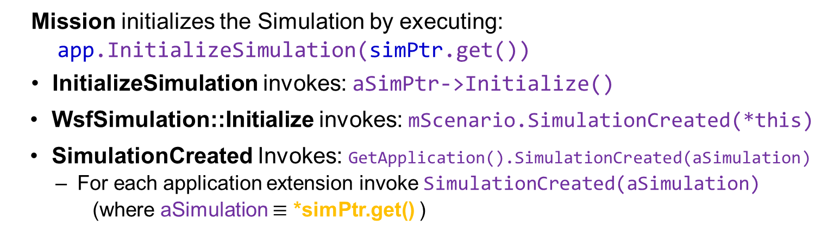
AFSIM Plugins & Extensions AFSIM mission startup sequence
mission::main()
unique_ptr<RegisterUDP_Observer>
unique_ptr<WsfDefaultApplicationExtension<…>>
WsfScenario: scenario
unique_ptr<WsfSimulation>: SimPtr
WsfStandardApplication: app
WsfStandardApplication::InitializeSimulation()
WsfScenario::SimulationCreated()
WsfSimulation::Initialize()
WsfApplication::SimulationCreated()
Mission initializes the Simulation by executing:
app.InitializeSimulation(simPtr.get())
InitializeSimulation invokes: aSimPtr->Initialize()
WsfSimulation::Initialize invokes: mScenario.SimulationCreated(*this)
SimulationCreated Invokes: GetApplication().SimulationCreated(aSimulation)
For each application extension invoke SimulationCreated(aSimulation)
(where aSimulation $≡$ *simPtr.get() )
Notes:
AFSIM mission startup sequence (warlock is similar but more complicated):
Initialize the Simulation
Invokes: app.InitializeSimulation(simPtr.get())
Invokes aSimPtr->Initialize() (where aSimPtr $≡$simPtr.get() )
Invokes the mScenario.SimulationCreated(*this)
(where mScenario $≡$scenario and *this $≡$ *simPtr.get())
Invokes GetApplication().SimulationCreated(aSimulation)
where GetApplication() $≡$app and aSimulation $≡$ *simPtr.get()
For each application extension, invoke SimulationCreated(aSimulation)
where aSimulation $≡$ *simPtr.get()
Invokes RegisterUDP_Observer::SimulationCreated(aSimulation) where aSimulation $≡$ *simPtr.get()
Invokes aSimulation.RegisterExtension(ut::make_unqiue<UDP_Observer>(mPrototype) where where aSimulation $≡$ *simPtr.get(), and mPrototype is a UDP_Observer

Slide 48
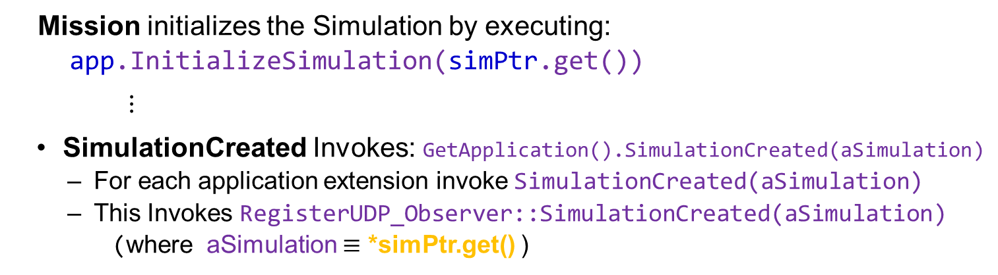
AFSIM Plugins & Extensions AFSIM mission startup sequence
mission::main()
unique_ptr<RegisterUDP_Observer>
unique_ptr<WsfDefaultApplicationExtension<…>>
WsfScenario: scenario
unique_ptr<WsfSimulation>: SimPtr
WsfStandardApplication: app
WsfStandardApplication::InitializeSimulation()
WsfScenario::SimulationCreated()
WsfSimulation::Initialize()
WsfApplication::SimulationCreated()
RegisterUDP_Observer::SimulationCreated()
Mission initializes the Simulation by executing:
app.InitializeSimulation(simPtr.get())
$⋮$
SimulationCreated Invokes: GetApplication().SimulationCreated(aSimulation)
For each application extension invoke SimulationCreated(aSimulation)
This Invokes RegisterUDP_Observer::SimulationCreated(aSimulation)
(where aSimulation $≡$ *simPtr.get() )
Notes:
AFSIM mission startup sequence (warlock is similar but more complicated):
Initialize the Simulation
Invokes: app.InitializeSimulation(simPtr.get())
Invokes aSimPtr->Initialize() (where aSimPtr $≡$simPtr.get() )
Invokes the mScenario.SimulationCreated(*this)
(where mScenario $≡$scenario and *this $≡$ *simPtr.get())
Invokes GetApplication().SimulationCreated(aSimulation)
where GetApplication() $≡$app and aSimulation $≡$ *simPtr.get()
For each application extension, invoke SimulationCreated(aSimulation)
where aSimulation $≡$ *simPtr.get()
Invokes RegisterUDP_Observer::SimulationCreated(aSimulation) where aSimulation $≡$ *simPtr.get()
Invokes aSimulation.RegisterExtension(ut::make_unqiue<UDP_Observer>(mPrototype) where where aSimulation $≡$ *simPtr.get(), and mPrototype is a UDP_Observer

Slide 49
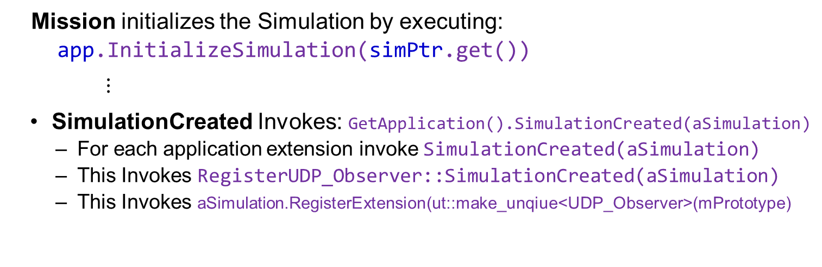
AFSIM Plugins & Extensions AFSIM mission startup sequence
mission::main()
unique_ptr<RegisterUDP_Observer>
unique_ptr<WsfDefaultApplicationExtension<…>>
WsfScenario: scenario
unique_ptr<WsfSimulation>: SimPtr
WsfStandardApplication: app
WsfStandardApplication::InitializeSimulation()
WsfScenario::SimulationCreated()
WsfSimulation::Initialize()
WsfApplication::SimulationCreated()
RegisterUDP_Observer::SimulationCreated()
WsfSimulation::RegisterExtension()
Mission initializes the Simulation by executing:
app.InitializeSimulation(simPtr.get())
$⋮$
SimulationCreated Invokes: GetApplication().SimulationCreated(aSimulation)
For each application extension invoke SimulationCreated(aSimulation)
This Invokes RegisterUDP_Observer::SimulationCreated(aSimulation)
This Invokes aSimulation.RegisterExtension(ut::make_unqiue<UDP_Observer>(mPrototype)
(where aSimulation $≡$ *simPtr.get(), and mPrototype is the UDP_Observer)
Notes:
AFSIM mission startup sequence (warlock is similar but more complicated):
Initialize the Simulation
Invokes: app.InitializeSimulation(simPtr.get())
Invokes aSimPtr->Initialize() (where aSimPtr $≡$simPtr.get() )
Invokes the mScenario.SimulationCreated(*this)
(where mScenario $≡$scenario and *this $≡$ *simPtr.get())
Invokes GetApplication().SimulationCreated(aSimulation)
where GetApplication() $≡$app and aSimulation $≡$ *simPtr.get()
For each application extension, invoke SimulationCreated(aSimulation)
where aSimulation $≡$ *simPtr.get()
Invokes RegisterUDP_Observer::SimulationCreated(aSimulation) where aSimulation $≡$ *simPtr.get()
Invokes aSimulation.RegisterExtension(ut::make_unqiue<UDP_Observer>(mPrototype) where where aSimulation $≡$ *simPtr.get(), and mPrototype is a UDP_Observer

Slide 50
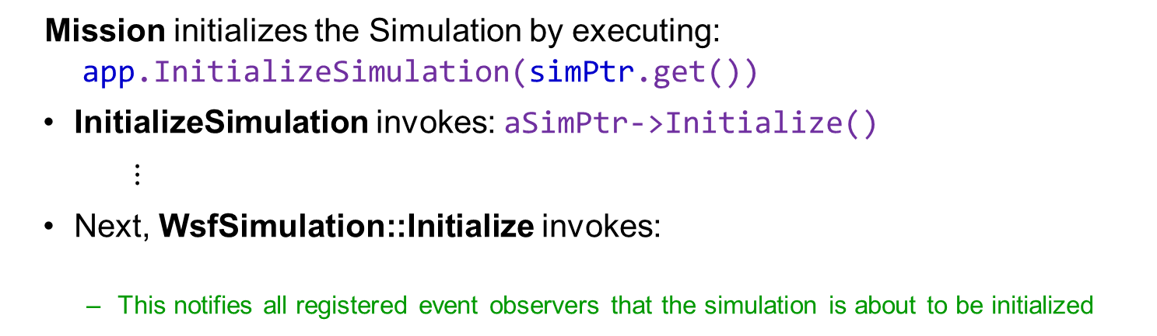
AFSIM Plugins & Extensions AFSIM mission startup sequence
mission::main()
unique_ptr<RegisterUDP_Observer>
unique_ptr<WsfDefaultApplicationExtension<…>>
WsfScenario: scenario
unique_ptr<WsfSimulation>: SimPtr
WsfStandardApplication: app
WsfStandardApplication::InitializeSimulation()
WsfSimulation::Initialize()
WsfObserver::SimulationInitializing()
Mission initializes the Simulation by executing:
app.InitializeSimulation(simPtr.get())
InitializeSimulation invokes: aSimPtr->Initialize()
$⋮$
Next, WsfSimulation::Initialize invokes:
This notifies all registered event observers that the simulation is about to be initialized
WsfObserver::SimulationInitializing(this)
Note: the UDP_Observer class does not override this method, hence we do nothing with the notification
Notes:
AFSIM mission startup sequence (warlock is similar but more complicated):
Initialize the Simulation
- Next invoke Wsf::Observer::SimulationInitializing

Slide 51
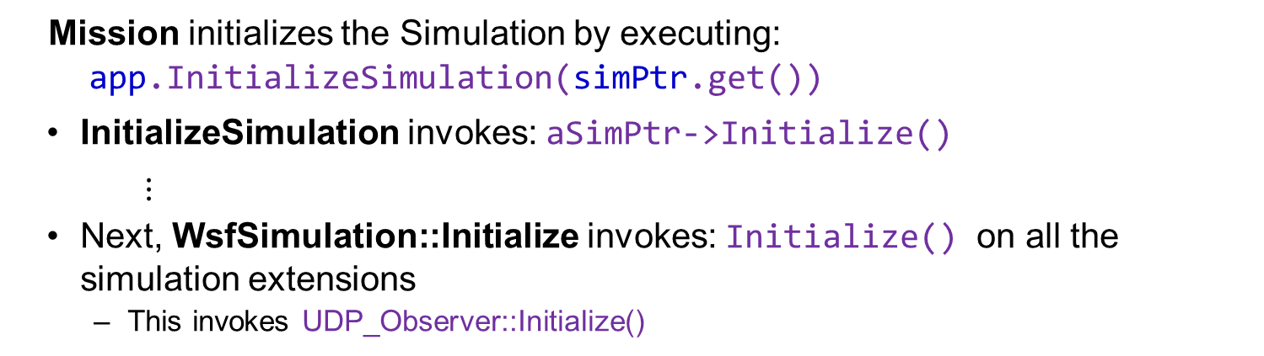
AFSIM Plugins & Extensions AFSIM mission startup sequence
mission::main()
unique_ptr<RegisterUDP_Observer>
unique_ptr<WsfDefaultApplicationExtension<…>>
WsfScenario: scenario
unique_ptr<WsfSimulation>: SimPtr
WsfStandardApplication: app
WsfStandardApplication::InitializeSimulation()
WsfSimulation::Initialize()
UDP_Observer::Initialize()
Mission initializes the Simulation by executing:
app.InitializeSimulation(simPtr.get())
InitializeSimulation invokes: aSimPtr->Initialize()
$⋮$
Next, WsfSimulation::Initialize invokes: Initialize() on all the simulation extensions
This invokes UDP_Observer::Initialize()
Notes:
AFSIM mission startup sequence (warlock is similar but more complicated):
Initialize the Simulation
- Next invoke Initialize on all the simulation extensions
- Next invoke UDP_Observer::Initialize

Slide 52
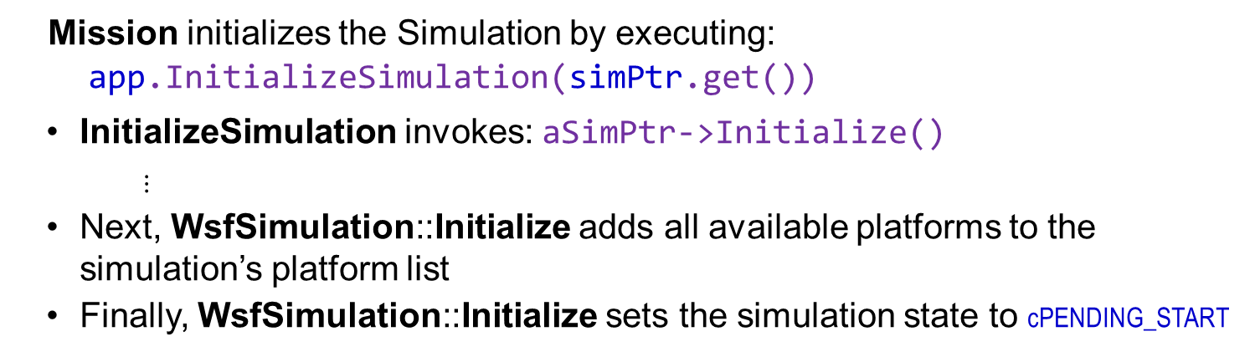
AFSIM Plugins & Extensions AFSIM mission startup sequence
mission::main()
unique_ptr<RegisterUDP_Observer>
unique_ptr<WsfDefaultApplicationExtension<…>>
WsfScenario: scenario
unique_ptr<WsfSimulation>: SimPtr
WsfStandardApplication: app
WsfStandardApplication::InitializeSimulation()
WsfSimulation::Initialize()
Mission initializes the Simulation by executing:
app.InitializeSimulation(simPtr.get())
InitializeSimulation invokes: aSimPtr->Initialize()
$⋮$
Next, WsfSimulation::Initialize adds all available platforms to the simulation’s platform list
Finally, WsfSimulation::Initialize sets the simulation state to cPENDING_START
Notes:
AFSIM mission startup sequence (warlock is similar but more complicated):
Initialize the Simulation
Next create all the available platforms
Finally set simulation state to cPENDING_START

Slide 53
ProcessInput Call Sequence
For Scenario Extensions, ProcessInput methods are also called as a result of loading the scenario
ProcessInput is a virtual method in WsfScenarioExtension which executes polymorphically (starting with the most derived object’s ProcessInput method – i.e., RegisterUDP_Observer)
WsfScenario
RegisterUDP_Observer
(the scenario extension)
UDP_Observer
(the simulation extension)
… ProcessInput(aInput)
ProcessInput(aInput)
ProcessInput(aInput)

Slide 54
Observer Exercise — Task 4 RegisterUDP_Observer.hpp
In file RegisterUDP_Observer.hpp, complete the code for RegisterUDP_Observer Scenario Extension
Task 4: Implement the ProcessInput Method
Call the Prototype’s (i.e., the member variable mPrototype) ProcessInput method
pass in aInput as the argument
Provides access to the input stream to configure a prototype UDP_Observer
Return the bool result of the call to mPrototype.ProcessInput to the caller of RegisterUDP_Observer::ProcessInput

Slide 55
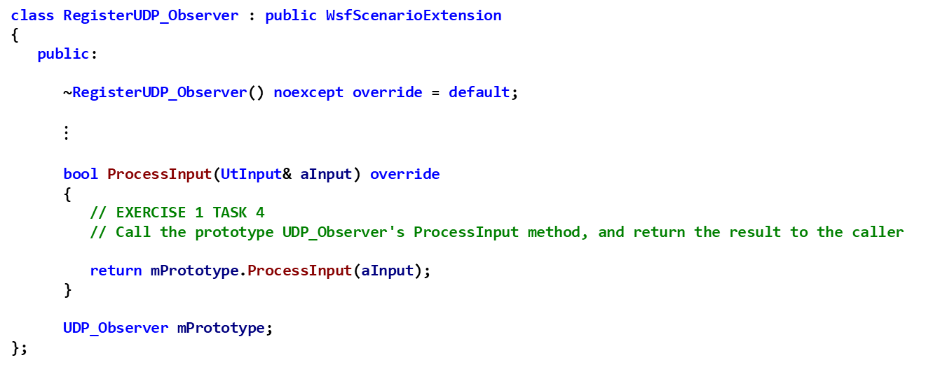
Observer Exercise — Task 4 Solution RegisterUDP_Observer.hpp
class RegisterUDP_Observer : public WsfScenarioExtension
{
public:
~RegisterUDP_Observer() noexcept override = default;
$⋮$
bool ProcessInput(UtInput& aInput) override
{
// EXERCISE 1 TASK 4
// Call the prototype UDP_Observer's ProcessInput method, and return the result to the caller
return mPrototype.ProcessInput(aInput);
}
UDP_Observer mPrototype;
};

Slide 56
Observer Exercise – Review 1
Inspect file UDP_Observer.hpp and note the class attributes and functions assumed for our solution
Notice that it derives from WsfSimulationExtension
Initialize is an overridden virtual method, and is automatically called by the simulation for each extension
A non-virtual ProcessInput must be defined and invoked by the Scenario Extension
Three private member methods provided to serve as callbacks to be invoked when subscribed observer events occur
PlatformAdded
PlatformDeleted
SensorTrackUpdated,

Slide 57
Observer Exercise – Review 1 UDP_Observer.hpp
class UDP_Observer : public WsfSimulationExtension
{
public:
//! Constructor
UDP_Observer();
UDP_Observer(const UDP_Observer& aSrc);
UDP_Observer& operator=(const UDP_Observer& aSrc);
//! Virtual destructor
~UDP_Observer() noexcept override;
bool Initialize() override;
bool ProcessInput(UtInput& aInput);
private:
void PlatformAdded(double aSimTime,
WsfPlatform* aPlatformPtr);
//! PlatformDeleted prototype is provided as a
// sample for the exercise
void PlatformDeleted(double aSimTime,
WsfPlatform* aPlatformPtr);
//! SensorTrackUpdated prototype is provided as a
// sample for the exercise
void SensorTrackUpdated(double aSimTime,
WsfSensor* aSensorPtr,
const WsfTrack* aTrackPtr);
void Disconnect();
void SendPacket(const std::string& aMessage);
//! The port to send data on, default is 14421
int mPort;
//! The address to send to. No default address.
// Check mAddress at Initialize(); Disconnect if
// not loaded by ProcessInput()
std::string mAddress;
//! The callback holder to maintain list of
// subscriptions made by this class
UtCallbackHolder mCallbacks;
//! Provides and configures the UDP socket
GenUDP_Connection* mConnectionPtr;
};

Slide 58
Observer Exercise — Task 5
For each simulation extension, the simulation invokes the Initialize method
Complete the UDP_Observer::Initialize implementation
Create a new GenUDP_Connection:
Create a pointer to a new GenUDP_Connection using new operator
Assign the GenUDP_Connection pointer to the class member mConnectionPtr
Initialize the GenUDP_Connection using it’s Init() method (pass in the mAddress and mPort member variables)
Refer to header file GenUDP_Connection.hpp in the genio project of the Visual Studio solution for correct syntax

Slide 59
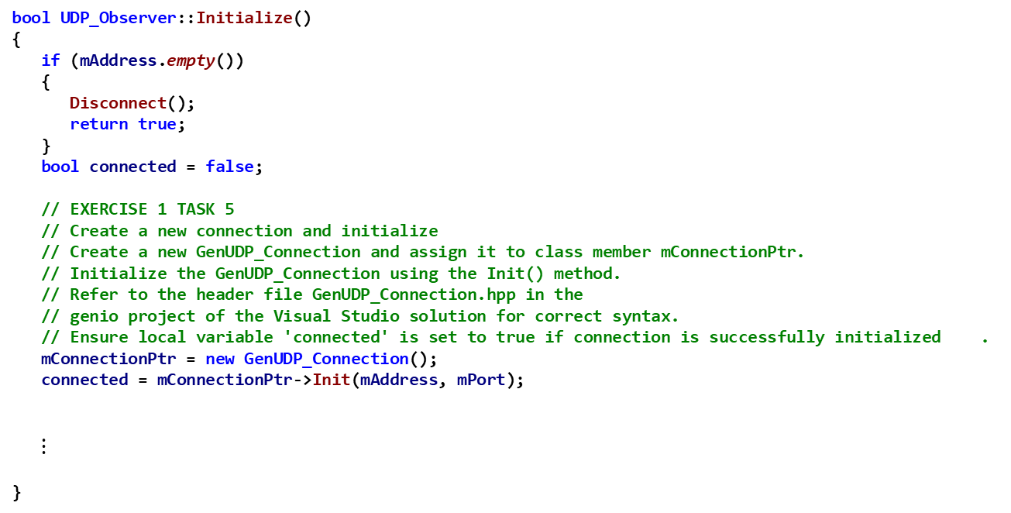
Observer Exercise — Task 5 Solution UDP_Observer.cpp
bool UDP_Observer::Initialize()
{
if (mAddress.empty())
{
Disconnect();
return true;
}
bool connected = false;
// EXERCISE 1 TASK 5
// Create a new connection and initialize
// Create a new GenUDP_Connection and assign it to class member mConnectionPtr.
// Initialize the GenUDP_Connection using the Init() method.
// Refer to the header file GenUDP_Connection.hpp in the
// genio project of the Visual Studio solution for correct syntax.
// Ensure local variable 'connected' is set to true if connection is successfully initialized .
mConnectionPtr = new GenUDP_Connection();
connected = mConnectionPtr->Init(mAddress, mPort);
$⋮$
}
Notes:
receiver.exe is a separate application that has to be run in addition to executing AFSIM (mission/warlock …)

Slide 60
Observer Exercise — Review 2
For each simulation extension, the simulation invokes the Initialize method
Inspect the subscription to additional WsfObserver events:
SensorTrackUpdated, and SensorTrackInitiated,
We will eventually write these UDP_Observer functions to respond to any subscribed callbacks
The local member variable mCallbacks is used to hold added subscriptions for WsfObserver callbacks
Note: Initialize returns true if the GenUDP_Connection class successfully initialized, otherwise it returns false

Slide 61
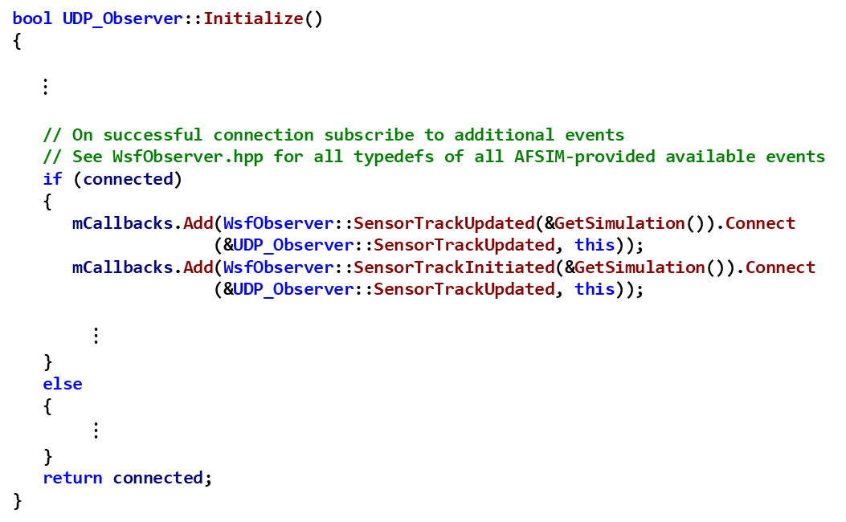
Observer Exercise — Review 2 UDP_Observer.cpp
bool UDP_Observer::Initialize()
{
$⋮$
// On successful connection subscribe to additional events
// See WsfObserver.hpp for all typedefs of all AFSIM-provided available events
if (connected)
{
mCallbacks.Add(WsfObserver::SensorTrackUpdated(&GetSimulation()).Connect
(&UDP_Observer::SensorTrackUpdated, this));
mCallbacks.Add(WsfObserver::SensorTrackInitiated(&GetSimulation()).Connect
(&UDP_Observer::SensorTrackUpdated, this));
$⋮$
}
else
{
$⋮$
}
return connected;
}
Notes:
receiver.exe is a separate application that has to be run in addition to executing AFSIM (mission/warlock …)

Slide 62
Observer Exercise — Task 6
In file UDP_Observer.cpp:
Task 6a: Similar to how the SensorTrackUpdated and SensorTrackInitiated methods were connected as callbacks to the WsfObserver events of the same names, write a statement that does the same kind of thing for the method PlatformAdded
Task 6b: Similar to how the SensorTrackUpdated and SensorTrackInitiated methods were connected as callbacks to the WsfObserver events of the same names, write a statement that does the same kind of thing for the method PlatformDeleted

Slide 63
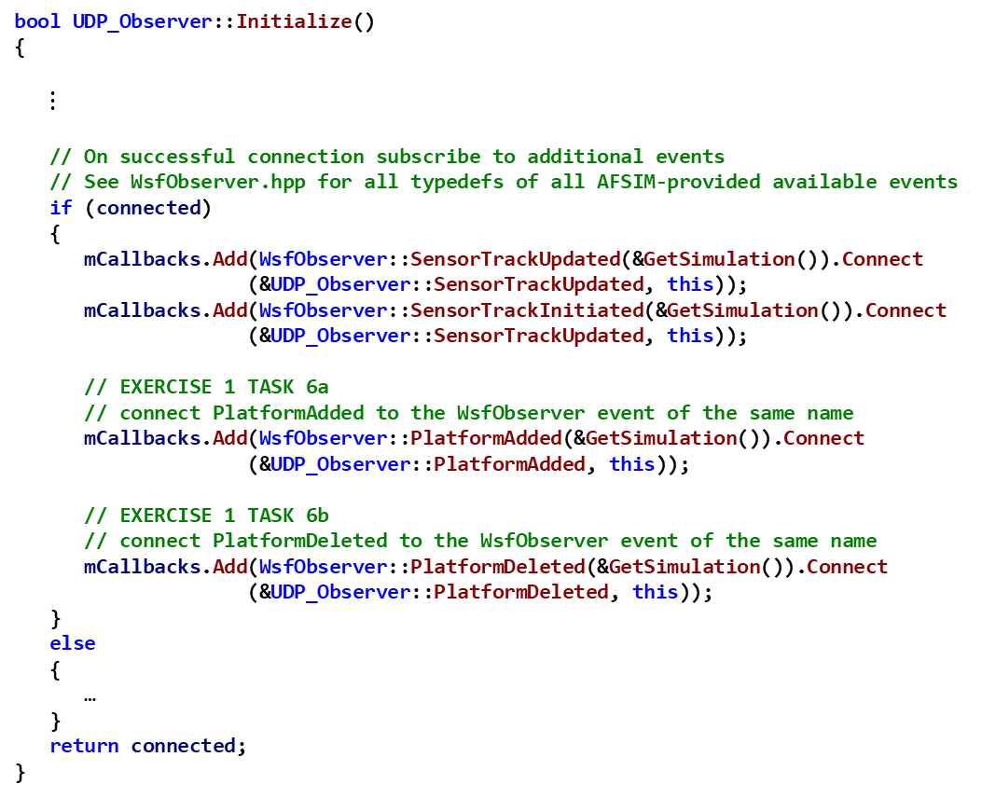
Observer Exercise — Task 6 Solution UDP_Observer.cpp
bool UDP_Observer::Initialize()
{
$⋮$
// On successful connection subscribe to additional events
// See WsfObserver.hpp for all typedefs of all AFSIM-provided available events
if (connected)
{
mCallbacks.Add(WsfObserver::SensorTrackUpdated(&GetSimulation()).Connect
(&UDP_Observer::SensorTrackUpdated, this));
mCallbacks.Add(WsfObserver::SensorTrackInitiated(&GetSimulation()).Connect
(&UDP_Observer::SensorTrackUpdated, this));
// EXERCISE 1 TASK 6a
// connect PlatformAdded to the WsfObserver event of the same name
mCallbacks.Add(WsfObserver::PlatformAdded(&GetSimulation()).Connect
(&UDP_Observer::PlatformAdded, this));
// EXERCISE 1 TASK 6b
// connect PlatformDeleted to the WsfObserver event of the same name
mCallbacks.Add(WsfObserver::PlatformDeleted(&GetSimulation()).Connect
(&UDP_Observer::PlatformDeleted, this));
}
else
{
…
}
return connected;
}
Notes:
receiver.exe is a separate application that has to be run in addition to executing AFSIM (mission/warlock …)

Slide 64
UDP_Observer Implementation of ProcessInput
In this exercise, we choose to defer the processing of the scenario’s input to the simulation extension UDP_Observer class
Hence we declare and define a non-virtual, non-overriding, ProcessInput method in UDP_Observer, and have the scenario extension call this method to handle the input commands

Slide 65
Observer Exercise — Task 7
In file UDP_Observer.hpp, process the UDP_Observer's keywords from the scenario input file and assign the values to appropriate members of the UDP_Observer class:
Task 7: Need to process the block for: udp_observer and end_udp_observer
Finish the if statement that looks for the initial udp_observer block identifier
AFSIM examples can be found by searching source codes using references to “ReadCommand”.

Slide 66
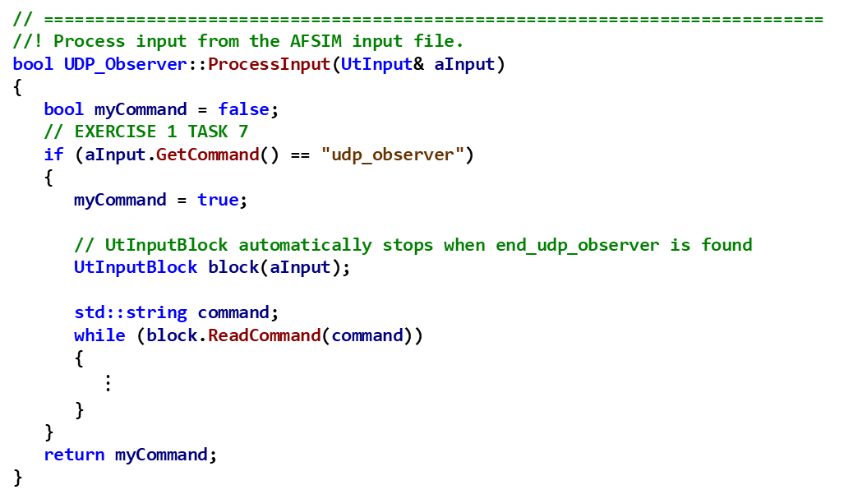
Observer Exercise — Task 7 Solution UDP_Observer.cpp
// ============================================================================
//! Process input from the AFSIM input file.
bool UDP_Observer::ProcessInput(UtInput& aInput)
{
bool myCommand = false;
// EXERCISE 1 TASK 7
if (aInput.GetCommand() == "udp_observer")
{
myCommand = true;
// UtInputBlock automatically stops when end_udp_observer is found
UtInputBlock block(aInput);
std::string command;
while (block.ReadCommand(command))
{
$⋮$
}
}
return myCommand;
}

Slide 67
Observer Exercise — Task 8
In file UDP_Observer.hpp, process the UDP_Observer's keywords from the scenario input file and assign the values to appropriate members of the UDP_Observer class:
Task 8a Need to process the input values for command port
Invoke aInput.ReadValue and pass in the member variable mPort
Task 8b: Need to process the input values for command address
Invoke aInput.ReadValue and pass in the member variable mAddress
AFSIM examples can be found by searching source codes using references to “ReadCommand”.

Slide 68
Observer Exercise — Task 8 Solution UDP_Observer.cpp
bool UDP_Observer::ProcessInput(UtInput& aInput)
{
bool myCommand = false;
// EXERCISE 1 TASK 6
if (aInput.GetCommand() == "udp_observer")
{
myCommand = true;
// UtInputBlock automatically stops when end_udp_observer is found
UtInputBlock block(aInput);
std::string command;
while (block.ReadCommand(command))
{
// EXERCISE 1 TASK 8a
if (command == "port")
{
aInput.ReadValue(mPort);
}
// EXERCISE 1 TASK 8b
else if (command == "address")
{
aInput.ReadValue(mAddress);
}
else
{
throw UtInput::UnknownCommand(aInput);
}
}
}
return myCommand;
}

Slide 69
Observer Exercise — Task 9
Task 9a: Complete the UDP_Observer::PlatformAdded implementation
Inspect WsfPlatform.hpp and the base class WsfObject.hpp
Note the methods GetName and GetType
Create a string of the form: “PlatformAdded, <time>, <name>, <type>”
where <time> is the simulation time parameter, <name> is the platform’s name (from GetName), and <type> is the platform’s type (from GetType)
Use the aPlatformPtr argument to access selected methods and capture data (such as the platform’s name and type) and write it to the string
Send the string with the selected data to the UDP_Observer::SendPacket function that has been provided as part of the UDP_Observer class
Task 9b: Similarly, complete the UDP_Observer::PlatformDeleted method
Task 9c: Similarly, complete the SensorTrackUpdated methods
But also print information about the aTrackPtr’s TargetIndex (GetTargetIndex),
and also print the platforms latitude, longitude, and altitude
These are given values by invoking aTrackPtr->GetLocationLLA(lat, lon, alt)
Note: If you use a std::stringstream to hold the data, then SendPacket would be called with a syntax such as: SendPacket(ss.str());
This task can be solved in many ways. A common method for a similar task can be found in the file named WsfScriptPlatformClass.cpp where method WsfScriptPlatformClass::ToString uses a local variable named "ss" of type std::stringstream.

Slide 70
Observer Exercise — Task 9 Solution UDP_Observer.cpp
void UDP_Observer::PlatformAdded(double aSimTime,
WsfPlatform* aPlatformPtr)
{
// EXERCISE 1 TASK 9a
stringstream ss;
ss << "PlatformAdded," << aSimTime
<< ',' << aPlatformPtr->GetName()
<< ',' << aPlatformPtr->GetType();
SendPacket(ss.str());
}
void UDP_Observer::PlatformDeleted(double aSimTime,
WsfPlatform* aPlatformPtr)
{
// EXERCISE 1 TASK 9b
stringstream ss;
ss << "PlatformDeleted," << aSimTime
<< ',' << aPlatformPtr->GetName()
<< ',' << aPlatformPtr->GetType();
SendPacket(ss.str());
}
void UDP_Observer::SensorTrackUpdated(double aSimTime,
WsfSensor* aSensorPtr,
const WsfTrack* aTrackPtr)
{
// EXERCISE 1 TASK 9c
stringstream ss;
double lat, lon, alt;
aTrackPtr->GetLocationLLA(lat, lon, alt);
ss << "SensorTrackUpdated," << aSimTime
<< ',' << aSensorPtr->GetName()
<< ',' << aSensorPtr->GetPlatform()->GetIndex()
<< ',' << aTrackPtr->GetTargetIndex()
<< ',' << lat
<< ',' << lon
<< ',' << alt;
SendPacket(ss.str());
}

Slide 71
Observer Exercise — Review 3 UDP_Observer.cpp
Review and understand:
// ============================================================================
////! Destroy the socket, and disconnect from all callbacks.
void UDP_Observer::Disconnect()
{
delete mConnectionPtr;
mConnectionPtr = nullptr;
// It is good practice to disconnect from callbacks you don't need to
// reduce overhead.
mCallbacks.Clear();
}
// ============================================================================
//! Send a UDP packet given a packet type ID and a buffer of data
void UDP_Observer::SendPacket(const std::string& aMessage)
{
int bytesWritten = mConnectionPtr->SendBuffer(aMessage.c_str(), aMessage.length() + 1);
if (bytesWritten < 0)
{
ut::log::error() << "Socket error: " << GenSocketManager::GetLastError();
Disconnect();
}
}

Slide 72
Observer Scenario
PlatformAdded, 0, radar_1, radar_site
PlatformAdded, 0, target_1, target_type
UDP_Observer and WsfObserver live inside the AFSIM application
UDP_Observer subscribes to the WsfObserver publisher for 4 events
When an event occurs, the publisher notifies UDP_Observer
UDP_Observer callback method creates a message, and invokes SendPacket
udp packets flow through network to separate application (receiver.exe)
receiver.exe (or receiver.py) is a separate application outside of AFSIM
Receives packets, extracts the message, and ships it to the screen for displaying
receiver.exe
AFSIM
Event: radar_1 platform added to simulation
Event: target_1 platform added to simulation
// Receives messages
// from the UDP network
// connection and displays
// them on the screen
Subscribe to publisher for events:
- WsfObserver::PlatformAdded,
- WsfObserver::PlatformDeleted,
- WsfObserver::SensorTrackUpdated,
- WsfObserver::SensorTrackInitiated
AFSIM notifies WsfObserver
invokes WsfObserver::PlatformAdded
UDP_Observer
(Subscriber)
// Performs user specific
// actions whenever notified
// that subscribed events
// occurred.
WsfObserver
(Publisher)
// Has set of built-in
// published events, including:
// WsfObserver::PlatformAdded
// WsfObserver::PlatformDeleted
// WsfObserver::SensorTrackInitiated
// WsfObserver::SensorTrackUpdated
Extract message
message
message
Notification that subscribed
event happened (i.e., platform
added)
Invokes callback to
UDP_Observer::PlatformAdded
$⋮$
std::stringstream ss;
ss << “ ………… ”;
SendPacket(ss.str());
UDP packet
UDP packet
UDP packet
UDP packet
UDP Network Connection

Slide 73
Testing (1/3)
From Visual Studio:
Build the solution in Release
Build the INSTALL project
Load the Test Scenario in WIZARD
Open WIZARD (provided in /bin/)
Find the top-level scenario file named observer_scenario.txt located in the training\developer\core\labs\inwork\observer\data folder. This is the input file with which we will test our program
Drag and drop observer_scenario.txt into it
Linux: from the build directory, run:
$ cmake --build . --target all -- -j11
$ cmake --build . --target install -- -j11
Notes:
At this point, your “udp_observer” block will not be syntactically highlighted. This is because it is not in the default grammar. We will need to select the correct application from the application manager. We have a grammar file for the observer_exercise in bin/mission_grammar/

Slide 74
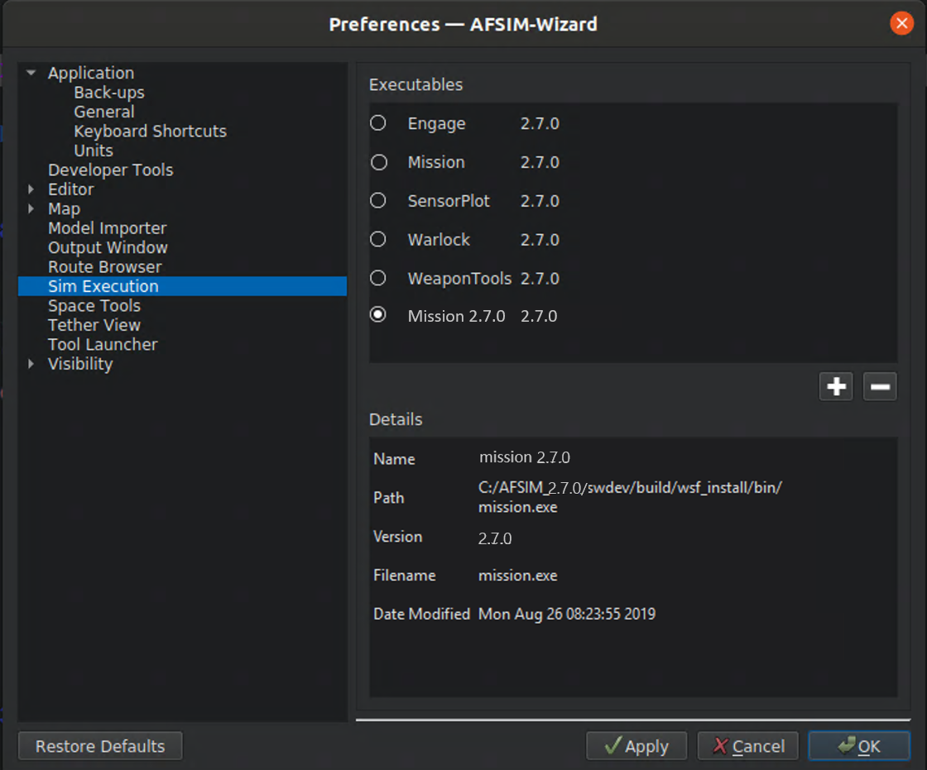
Testing (2/3)

Slide 75

Testing (3/3)
Set up and Run the Receiver Application
Receives data sent from UDP_Observer and displays the messages on STDOUT
There are two options:
Execute a Python script named "receiver.py“:
Run the provided “receiver” application, built from the WSF core library, genio:
Run the selected application from WIZARD
(Press Play)
Command line window (..\observer)
python receiver.py
Command line window (..\observer)
receiver/bin/receiver.exe
Notes:
PlatformAdded,0,radar-1,radar_site
PlatformAdded,0,target-1,target_type
SensorTrackUpdated,0,radar,1,2,40.9333,-112,20000
SensorTrackUpdated,1,radar,1,2,40.9334,-112.002,20000
SensorTrackUpdated,2,radar,1,2,40.9334,-112.005,20000
SensorTrackUpdated,3,radar,1,2,40.9334,-112.007,20000
SensorTrackUpdated,4,radar,1,2,40.9334,-112.01,20000
SensorTrackUpdated,5,radar,1,2,40.9334,-112.012,20000
SensorTrackUpdated,6,radar,1,2,40.9335,-112.015,20000
SensorTrackUpdated,7,radar,1,2,40.9335,-112.017,20000
SensorTrackUpdated,8,radar,1,2,40.9335,-112.019,20000
SensorTrackUpdated,9,radar,1,2,40.9335,-112.022,20000
SensorTrackUpdated,10,radar,1,2,40.9335,-112.024,20000
PlatformDeleted,10.001,radar-1,radar_site
PlatformDeleted,10.001,target-1,target_type

Slide 76
Results
Notes:
receiver.exe output should look like this.

