Slide 1
AFSIM Developer Training
9 – Communications
AFRL/RQQD

Slide 2
Acronyms and Definitions
AFSIM - Advanced Framework for Simulation, Integration, and Modeling
AGL – Above Ground Level
DIS – Distributed Interactive Simulation
DTED – Digital Terrain Elevation Data
EO/IR – Electro-Optical/Infra-Red
ESM – Electronic Support Measure
FOV – Field Of View
GUI – Graphical User Interface
HLA – High Level Architecture
IEEE – Institute of Electrical & Electronics Engineers, Inc.
JTIDS – Joint Tactical Information Distribution System
MSL – Mean Sea Level
PDU – Protocol Data Unit
RCS – Radar Cross Section
SAM – Surface-to-Air Missile
SAR – Synthetic Aperture Radar
VESPA – Visual Environment for Scenario Preparation and Analysis
WKF – Warlock Framework
WSF – World Simulation Framework
dB - decibels
dBsm – decibel square meters
deg – degrees
ft – feet
GHz– GigaHertz
kts – knots
m - meters
m^2 – square meters
mw – megawatts
nm – nautical miles
s – seconds

Slide 3
Introduction
This lab demonstrates how to create a new AFSIM communication device and a new AFSIM message
Additionally, the Distributed Interactive Simulation (DIS) interface will be used to send the new message using a DIS Signal Protocol Data Unit (PDU)
An AFSIM communication device is a platform component that provides the means to send messages (WsfMessage) between platforms
The following exercise provides practice working with AFSIM communications
Exercise 1: Registering a default Application Extension, a new Scenario Extension, and a new Simulation Extension
Exercise 2: Implementing ProcessInput for the communication’s scenario
Exercise 2: Creating a custom AFSIM communication device and message
Exercise 3: Creating a custom AFSIM Communications script interface

Slide 4
Problem Statement
Create a new communication device type called SIGNAL_COMM and a new message class called LocationMessage
The SIGNAL_COMM should:
Be able to send all the core message types including the new LocationMessage
Whenever a new LocationMessage is sent by the SIGNAL_COMM device, the message will also be sent over the DIS interface using a Signal PDU containing the contents of the LocationMessage
Other DIS-enabled simulations can read Location Messages
References:
AFSIM Developers Web-based data.
AFSIM Source Codes and Visual Studio search functions.
AFSIM Documentation.

Slide 5
Learning Objectives
You gain hands-on knowledge about:
Creating new types of communication devices and messages
Implementing the send and receive methods for a new communication device
Packing and unpacking a DIS Signal PDU with custom data
Reinforce your skills with creating a default application extension and a plugin
The new script types are registered by the scenario extension
Reinforce your skill with creating a simulation extension and a scenario extension
Understand how to extend existing script classes to include new methods, without modifying core code

Slide 6
Prerequisites
Before working on this lab, you should:
Be familiar with Wizard and the AFSIM scripting Language
AFSIM analyst course or equivalent experience is recommended
Have available and be familiar with using Microsoft® Visual Studio 2017® or newer to compile an application
Be familiar with using Microsoft Windows® Explorer
Have the latest version of Mystic installed
Mystic is an interactive software environment for analyzing AFSIM results.

Slide 7

Communications in the AFSIM Framework
AFSIM includes a robust set of communication and message options within the basic framework
Using the C++ architecture, developers can extend classes to create new communication devices and new messages
AFSIM Framework
Infrastructure
Interface
Scenario Management
Time Management
Time Management
Geospatial Data Management
Event Management
Utilities
Geospatial Data Management
Scripting
Language
Distributed Simulation Interfaces
Scenario Management
Script
Distributed Simulation Interfaces
Event Management
Plug-in
Management
Observers
Extensions
Simulation Management
Observers
Extensions
Components
Platform Components
Movers
Sensors
Weapons
Communications
Processors
Other Platform
Components
Non-Platform
Components
Sensor
Components
Weapon
Components
Comm
Components
Processor
Components
$$…$$

Slide 8
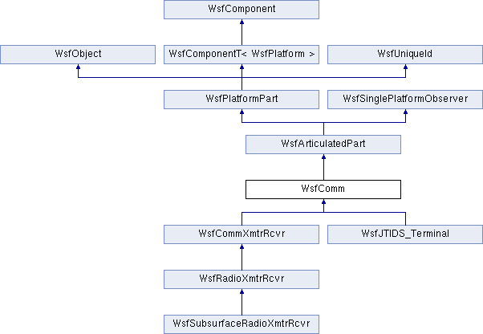
Comm Exercise Extends WsfComm Class
Add a new SignalComm class to AFSIM.
SignalComm

Slide 9
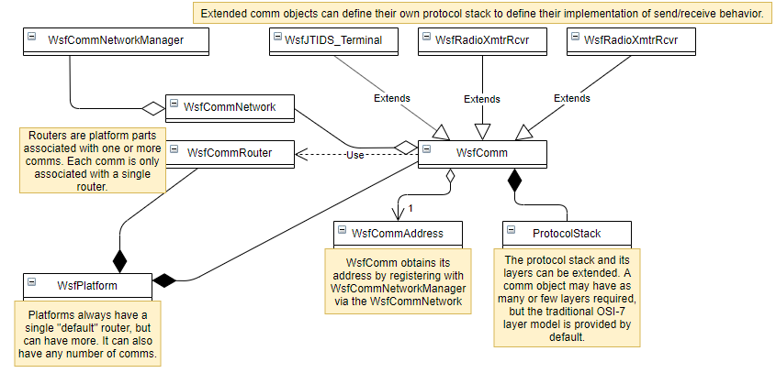
Detailed AFSIM Comm Classes

Slide 10
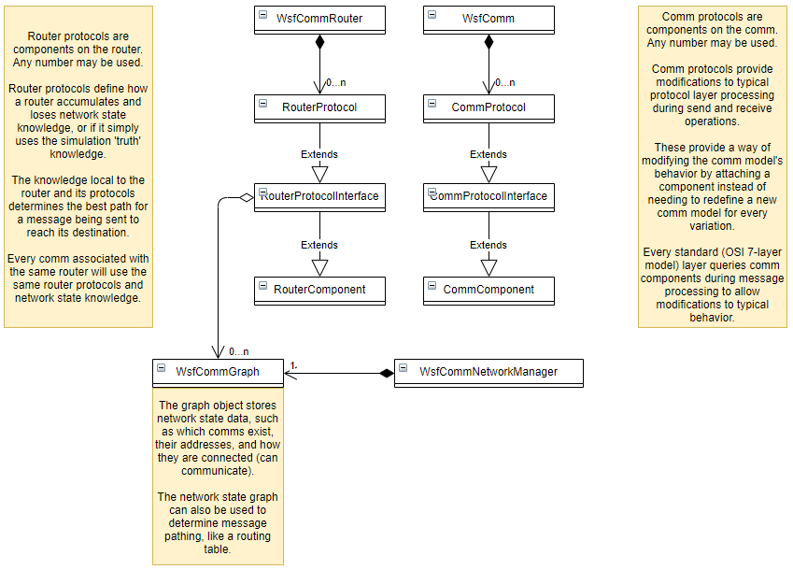
Detailed AFSIM Comm Classes

Slide 11
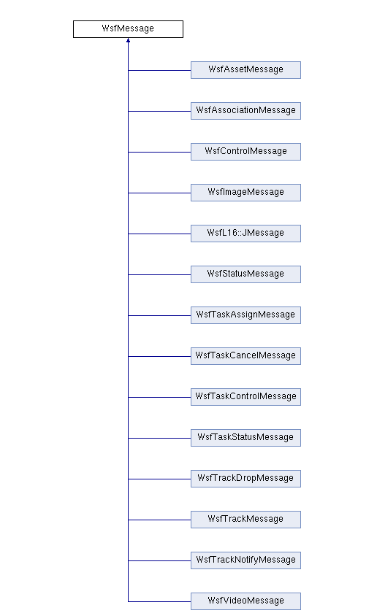
Comm Exercise Extends WsfMessage
LocationMessage
Add a new LocationMessage class to AFSIM

Slide 12
AFSIM Plugins & Extensions
WsfExtension
WsfScenario
WsfSimulation
WsfApplication
WsfStandardApplication
WsfSimulationExtension
WsfScenarioExtension
WsfApplicationExtension
CommLab::Interface
SignalCommRegistration
WsfDefaultApplicationExtension
AFSIM extensions must derive from WsfExtension:
WsfScenarioExtension – extensions that will provide new scenario commands (requiring a new ProcessInput for those commands) will need to inherit this class
WsfSimulationExtension – extensions that will access the simulation will need to inherit this class
WsfApplicationExtension – extensions that will create new script types, or will utilize a simulation extension or scenario extension, will need to inherit this class

Slide 13
New Input Parameters
Code modifications are needed to accept:
Keyword source_track_number_offset with an input value
Existing AFSIM methods will be used to set other comm input values
Example input:
comm comm-net SIGNAL_COMM
source_track_number 100
end_comm

Slide 14
Comm Scenario
Inspect the comm_types.txt file and observe the following:
The platform_type called COMM_PLATFORM carries the SIGNAL_COMM (BLUE_COMM) communication device
COMM_PLATFORM
SIGNAL_COMM
BLUE_COMM
comm BLUE_COMM SIGNAL_COMM
debug
end_comm
platform_type COMM_PLATFORM WSF_PLATFORM
comm comm-net BLUE_COMM
internal_link msg_processor
end_comm
processor msg_processor WSF_SCRIPT_PROCESSOR
end_processor
end_platform_type

Slide 15
Comm Scenario
Inspect the comm_scenario1.txt file and observe the following:
The blue_commander platform sends out a WsfControlMessage every 5 seconds to all subordinates
File: comm_scenario1.txt
platform blue_commander CMDR
side blue
commander SELF
position 39:39:12n 123:08:00w altitude 0 ft agl
execute at_interval_of 5 s
WsfControlMessage cntrlMsg = WsfControlMessage();
cntrlMsg.SetFunction("I COMMAND YOU");
PLATFORM.Comm("comm-net").SendMessageToSubordinates("", cntrlMsg);
end_execute
end_platform

Slide 16
Comm Scenario
Inspect the comm_scenario1.txt file and observe the following:
The blue_commander platform has an on_message block to write a message when a LOCATION_MESSAGE is received from his subordinates
File: comm_scenario1.txt
File: comm_types.txt
platform_type CMDR COMM_PLATFORM
icon cmd_post
edit processor msg_processor
// --- * --- * ---
script void ProcessMessage(LocationMessage aMsg)
writeln("Message received of type: ", aMsg.Type());
writeln("Received a Location Message from ", aMsg.Originator());
end_script
on_message type LOCATION_MESSAGE
script
ProcessMessage((LocationMessage) MESSAGE);
end_script
end_on_message
platform blue_commander CMDR
side blue
commander SELF
position 39:39:12n 123:08:00w altitude 0 ft agl
execute at_interval_of 5 s
WsfControlMessage cntrlMsg = WsfControlMessage();
cntrlMsg.SetFunction("I COMMAND YOU");
PLATFORM.Comm("comm-net").SendMessageToSubordinates("", cntrlMsg);
end_execute
end_platform

Slide 17
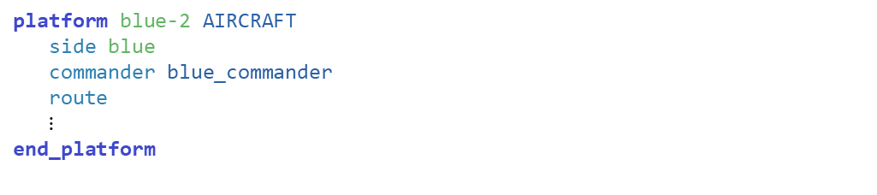
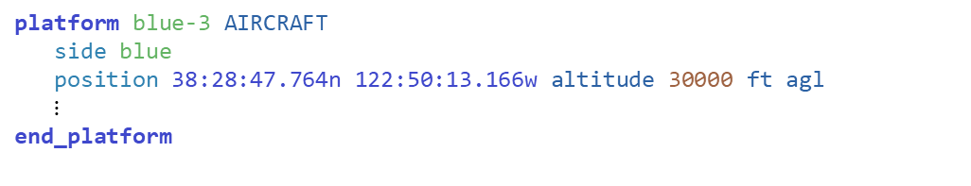
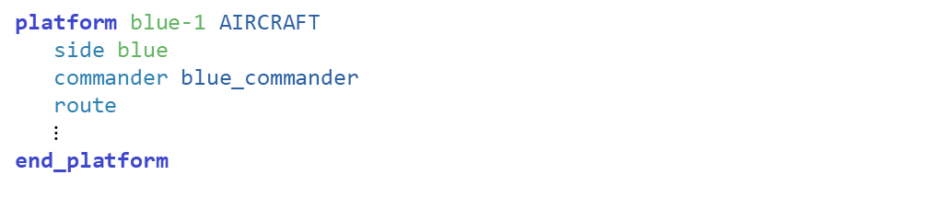

Comm Scenario
Inspect the comm_scenario1.txt file and observe the following:
The blue-1, blue-2, and blue-3 platforms send out a LocationMessage every 5 seconds to commander
File: comm_scenario1.txt
File: comm_types.txt
platform blue-1 AIRCRAFT
side blue
commander blue_commander
route
$⋮$
end_platform
platform_type SUBORDINATE COMM_PLATFORM
$⋮$
execute at_interval_of 5 s
// Send location
LocationMessage msg = LocationMessage();
PLATFORM.Comm("comm-net“).SendMessageToCommander(msg);
end_execute
$⋮$
end_platform_type
platform_type AIRCRAFT SUBORDINATE
icon fighter
mover WSF_AIR_MOVER
end_mover
end_platform_type
platform blue-2 AIRCRAFT
side blue
commander blue_commander
route
$⋮$
end_platform
platform blue-3 AIRCRAFT
side blue
position 38:28:47.764n 122:50:13.166w altitude 30000 ft agl
$⋮$
end_platform

Slide 18

Comm Scenario
Inspect the comm_scenario1.txt file and observe the following:
These platforms have an on_message block to respond to a WsfControlMessage
File: comm_scenario1.txt
File: comm_types.txt
platform blue-1 AIRCRAFT
side blue
commander blue_commander
route
$⋮$
end_platform
platform_type SUBORDINATE COMM_PLATFORM
$⋮$
edit processor msg_processor
// --- * --- * ---
script void ProcessMessage(WsfControlMessage aMsg)
// Send status
WsfStatusMessage statusMsg = WsfStatusMessage();
statusMsg.SetStatus("OK");
PLATFORM.Comm("comm-net").SendMessageToCommander("",
statusMsg);
end_script
on_message
type WSF_CONTROL_MESSAGE
script ProcessMessage((WsfControlMessage) MESSAGE);
end_script
end_on_message
end_processor
platform blue-2 AIRCRAFT
side blue
commander blue_commander
route
$⋮$
end_platform
platform blue-3 AIRCRAFT
side blue
position 38:28:47.764n 122:50:13.166w altitude 30000 ft agl
$⋮$
end_platform

Slide 19
Messages Generated
“I COMMAND YOU” control messages
are sent out every 5 sec.
are only sent to subordinates
platforms that have commander blue_commander (blue-1 & blue-2)
“OK” control messages are immediately sent back to the commander
blue_2
WSF_CONTROL_MESSAGE
“I COMMAND YOU”
WSF_CONTROL_MESSAGE
“OK”
Simulation instance 1
(running comm_scenario1.txt)
blue_1
WSF_CONTROL_MESSAGE
“OK”
WSF_CONTROL_MESSAGE
“I COMMAND YOU”
blue_commander
Simulation instance 2
(running comm_scenario2.txt)
blue_3
isr_1

Slide 20

Comm Scenario
Inspect the comm_scenario2.txt file
A platform ISR-1 receives SIGNAL_COMM messages from platforms in comm_scenario1 and uses WsfDraw to display these locations as icons in Mystic
Although we demonstrate this in an AFSIM simulation, another simulation could also receive and, decode, and display these locations
File: comm_scenario2.txt
platform isr-1 COMM_PLATFORM
$⋮$
add processor internal_generation msg_processor
update_interval 5.0 seconds
internal_link msg_processor
on_update
// Send location
LocationMessage msg = LocationMessage();
SendMessage(msg);
end_on_update
end_processor
$⋮$

Slide 21

Comm Scenario
Inspect the comm_scenario2.txt file
ISR-1 also demonstrates sending a location message over internal links for display with WsfDraw
File: comm_scenario2.txt
platform isr-1 COMM_PLATFORM
$⋮$
edit processor msg_processor
on_message type LOCATION_MESSAGE
script
LocationMessage msg = (LocationMessage)MESSAGE;
WsfDraw draw = WsfDraw();
draw.Erase(msg.SourceTrackNumber());
draw.SetId(msg.SourceTrackNumber());
draw.SetDuration(20.0);
$⋮$
draw.End();
end_script
end_on_message
end_processor
$⋮$

Slide 22
Messages Generated
Location messages
are sent out every 5 sec.
are only sent to platform’s commander
blue-1 sends to blue_commander
blue-2 sends to blue_commander
blue-3 sends messages, but they go to nobody (no commander)
isr-1 sends messages, but they go to nobody(no commander)
isr-1 scans comm-net for ALL Location messages
For each one received, it draws the platform at that location
blue_2
LOCATION_MESSAGE
(lat, lon, alt, course, speed)
Simulation instance 1
(running comm_scenario1.txt)
blue_1
LOCATION_MESSAGE
(lat, lon, alt, course, speed)
blue_commander
???
Simulation instance 2
(running comm_scenario2.txt)
LOCATION_MESSAGE
(lat, lon, alt, course, speed)
blue_3
isr_1
LOCATION_MESSAGE
(lat, lon, alt, course, speed)
???

Slide 23
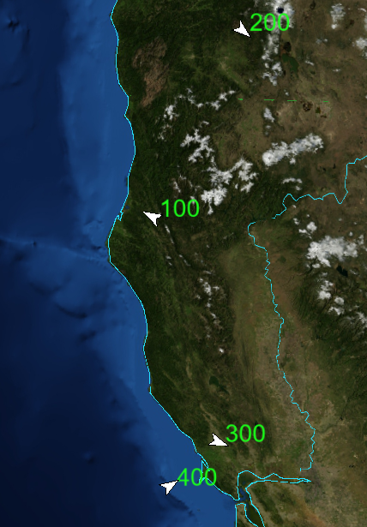
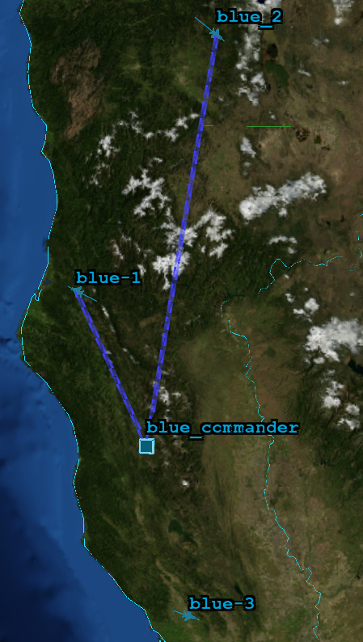
Comm Scenario
T = 0
Queued message for transmission.
T = 2.96422
Comm: blue_commander.comm-net
Message: 35 (dest 0.1.0.2; size 0)
Scheduled transmission event.
T = 2.96422
Comm: blue_commander.comm-net
Message: 35 (dest 0.1.0.2; size 0)
Queued message for transmission.
T = 2.96422
Comm: blue_commander.comm-net
Message: 35 (dest 0.1.0.3; size 0)
Scheduled transmission event.
T = 2.96422
Comm: blue_commander.comm-net
Message: 35 (dest 0.1.0.3; size 0)
Comm has started transmission of message.
T = 2.96422
Comm: blue_commander.comm-net
Message: 35 (dest 0.1.0.2; size 0)
Message transmission completed.
T = 2.96422
Comm: blue_commander.comm-net
Message: 35 (dest 0.1.0.2; size 0)
Comm has started transmission of message.
T = 2.96422
Comm: blue_commander.comm-net
Message: 35 (dest 0.1.0.3; size 0)
Message transmission completed.
T = 2.96422
Comm: blue_commander.comm-net
Message: 35 (dest 0.1.0.3; size 0)
Comm receiving message.
T = 2.96464
Comm: blue-1.comm-net
Message: 35 (dest 0.1.0.2; size 0)
blue_2
blue_1
blue_commander
blue_3
isr-1

Slide 24
Getting Started (1/3)
Open CMake GUI
Check BUILD_WITH_comm_exercise
Press “Configure”
(Respond to any prompts asking for a compiler)
Press “Generate”

Slide 25
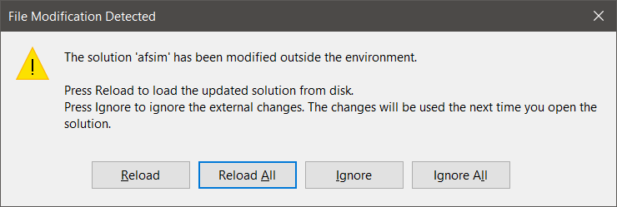
Getting Started (2/3)
If Visual Studio is already open:
Navigate to it and select Reload All when prompted.
Alternatively, open the solution file afsim.sln by:
Opening from swdev\build
Clicking “Open Project” from CMake

Slide 26
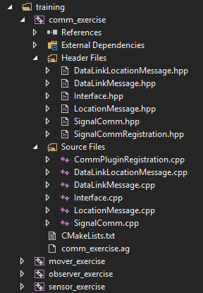
Getting Started (3/3)
This project uses the following 12 source files:
CommPluginRegistration.cpp
DataLinkMessage.hpp
DataLinkMessage.cpp
DataLinkLocationMessage.hpp
DataLinkLocationMessage.cpp
Interface.hpp
Interface.cpp
LocationMessage.hpp
LocationMessage.cpp
SignalComm.hpp
SignalComm.cpp
SignalCommRegistration.hpp
Note that many solutions are possible; we have provided a solution in order to complete our training exercise in a short time period.

Slide 27
Classes Utilized by this Exercise
This exercise utilizes the following classes:
class DataLink::Message
Defines a “Link Layer” message header
Lives in namespace DataLink
class DataLink::LocationMessage : public DataLink::Message
Defines a “Link Layer” message to encode the elements of a LocationMessage (see below)
The inherited DataLink::Message incorporates a header into the message
Lives in namespace DataLink
class WsfControlMessage : public WsfMessage
Utilized by our scenario scripts
Allows commanders (those with subordinates) to send out “I CONTROL YOU” messages
Already defined in the core script interface
class WsfStatusMessage : public WsfMessage
Utilized by our scenario scripts
Allows subordinates (those platforms with a commander) to respond with “OK” messages
Already defined in the core script interface
class LocationMessage : public WsfMessage
Creates a new type of high level message to encode a platform’s location data

Slide 28
Classes Utilized by this Exercise
This exercise utilizes the following classes:
class ScriptLocationMessageClass : public WsfScriptMessageClass
Declares and Defines the new script methods which will be available to the scenario definition for sending and receiving the new LocationMessage(s)
class SignalComm : public wsf::comm::Comm
Defines a Comm device that triggers the sending / receiving of DIS signal PDUs which encode messages
class CommLab::Interface : public WsfSimulationExtension
Primarily servers as an interface to the DIS communications protocol for sending and receiving messages
Lives in namespace CommLab
class SignalCommRegistration : public WsfScenarioExtension
Defines three methods:
AddedToScenario: adds the new SignalComm comm type to the scenario
Adds the new ScriptLocationMessageClass to the application’s script types
ProcessInput: simply invokes the CommLab::Interface::ProcessInput to handle scenario commands
SimulationCrated: registers the CommLab::Interface simulation extension with the simulation
class WsfDefaultApplicationExtension : public WsfApplicationExtention
a simple application extension with a ScenarioCreated method
Templated on a scenario extension
When ScenarioCreated is invoked, it registers the scenario extension with the scenario

Slide 29
Communications Exercises
Exercise 1
Complete registration of a default application extension, with a scenario extension
Exercise 2
Complete scenario extension ProcessInput and Interface::ProcessInput
Exercise 3
Understand, and complete the implementation of class methods that handle sending, receiving, and processing messages
Exercise 4
Understand and complete code for new script methods

Slide 30
Exercise 1
Complete registration of a default application extension, which is templated upon a scenario extension

Slide 31
AFSIM Plugins & Extensions
WsfExtension
WsfScenario
WsfSimulation
WsfApplication
WsfStandardApplication
WsfSimulationExtension
WsfScenarioExtension
WsfApplicationExtension
Main application classes used
in mission/warlock
All AFSIM extensions must derive from WsfExtension:
Three predefined extension classes already exist (can be inherited from)
WsfScenarioExtension – extensions that will provide new scenario commands (requiring a new ProcessInput for those commands) will need to inherit this class
WsfSimulationExtension – extensions that will access the simulation will need to inherit this class
WsfApplicationExtension – extensions that will create new script types, or will utilize a simulation extension or scenario extension, will need to inherit this class

Slide 32
AFSIM Plugins & Extensions
WsfExtension
WsfScenario
WsfSimulation
WsfApplication
WsfStandardApplication
WsfSimulationExtension
WsfScenarioExtension
WsfApplicationExtension
Main application classes used
in mission/warlock
CommLab::Interface
SignalCommRegistration
WsfDefaultApplicationExtension
Sets up the new SimulationExtension classes to work
with AFSIM
Sets up the new ScenarioExtension classes to work
with AFSIM
Sets up the new Application
Extension classes to work
with AFSIM
All AFSIM extensions must derive from WsfExtension:
Three predefined extension classes already exist (can be inherited from)
WsfScenarioExtension – extensions that will provide new scenario commands (requiring a new ProcessInput for those commands) will need to inherit this class
WsfSimulationExtension – extensions that will access the simulation will need to inherit this class
WsfApplicationExtension – extensions that will create new script types, or will utilize a simulation extension or scenario extension, will need to inherit this class

Slide 33
Extensions
Applications, Scenarios, and Simulations can all be “Extended”
Application Extensions are owned by the Application
Represent optional capabilities that can be added to an application.
Used if you need new script types (sensors, weapons, components, movers)
This is the entry point to registering all extensions in AFSIM
An application extension is required if you are going to create a scenario extension or a simulation extension
We need a new plugin because we need to register the default application extension
see the file CommPluginRegistration.cpp

Slide 34
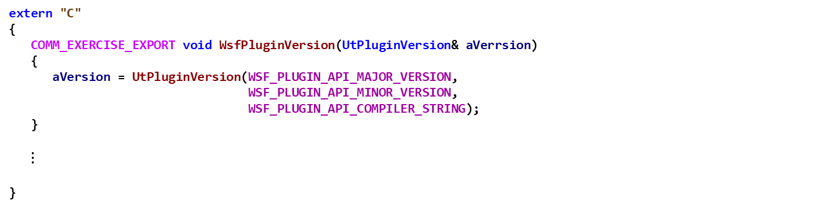
Comm Exercise 1 — Review 1 CommPluginRegistration.cpp
In CommPluginRegistration.cpp, review WsfPluginVersion
extern "C"
{
COMM_EXERCISE_EXPORT void WsfPluginVersion(UtPluginVersion& aVerrsion)
{
aVersion = UtPluginVersion(WSF_PLUGIN_API_MAJOR_VERSION,
WSF_PLUGIN_API_MINOR_VERSION,
WSF_PLUGIN_API_COMPILER_STRING);
}
$⋮$
}

Slide 35
Comm Exercise 1 — Task 1
Complete WsfPluginSetup
Invoke aApplication.RegisterExtension
The first argument should be the name of the application extenstion, which is “signal_comm_registration”
The second argument should be a newly created unique_ptr to a WsfDefaultApplicationExtension templated on our scenario extension SignalCommRegistration

Slide 36
Comm Exercise 1 — Task 1 Solution CommPluginRegistration.cpp
extern "C"
{
COMM_EXERCISE_EXPORT void WsfPluginVersion(UtPluginVersion& aVerrsion)
{
aVersion = UtPluginVersion(WSF_PLUGIN_API_MAJOR_VERSION,
WSF_PLUGIN_API_MINOR_VERSION,
WSF_PLUGIN_API_COMPILER_STRING);
}
COMM_EXERCISE_EXPORT void WsfPluginSetup(WsfApplication& aApplication)
{
// EXERCISE 1 TASK 1
// Invoke aApplication’s RegiserExtension method
// The first argument is the name of the application extension
// The second argument is a newly created unique_ptr to a default application extension
// that is templated upon a scenario extension (the SignalCommRegisration class)
aApplication.RegisterExtension("signal_comm_registration",
ut::make_unique<WsfDefaultApplicationExtension<SignalCommRegistration>>());
}
}
Note: when we register the application extension WsfDefaultApplicationExtension, we are also registering the SignalCommRegistration scenario extension

Slide 37
Application Extensions
To extend an Application, you must create a class that inherits class WsfApplicationExtension
class myAppExtension: public WsfApplicationExtension { … }
You should override the following members:
AddedToApplication: to receive notification that extension was added to the application – often used to register additional script class and methods, etc.
ScenarioCreated: called at end of Scenario constructor in order to receive notification from the application that the scenario was created – useful to register an Scenario extension if needed
SimulationCreated: called from the Simulation’s Initialize method in order to receive notification from the application that the simulation was created – useful to register an Simulation extension if needed
ProcessCommandLine: called from WsfApplication::ProcessCommandLine method to examine current argument and process it if necessary
PrintGrammar: prints out the extended grammar recognized by the extension
ProcessCommandLineCommands: called by WsfApplication’s ProcessCommandLineCommands to allow the extension to process/handle any commands it needs to recognize

Slide 38
Application Extensions
To extend an Application, you must create a class that inherits class WsfApplicationExtension
We will use WsfDefaultApplicationExtension which will register the scenario extension
class WsfDefaultApplicationExtension: public WsfApplicationExtension { … }
This class overrides the following members for an ApplicationExtension:
ScenarioCreated: called at end of Scenario constructor in order to receive notification from the application that the scenario was created – useful to register a Scenario extension if needed
This class is templated on a WsfScenarioExtension (SignalCommRegistration is derived from this class)
When the WsfDefaultApplicationExtension::ScenarioCreated method is executed by the WsfScenaro constructor, it performs the registration of the SignalCommRegistration scenario extension with the scenario

Slide 39
Scenario Extensions
Scenarios can all be “Extended” as well
Scenario Extensions are owned by the Scenario
Represent optional types that can be added to a scenario.
Used if you need new types (components, observers, comms)
An application extension is required if you are going to create a scenario extension (or a simulation extension – covered later)
We also need an scenario extension if
We are creating simulation level commands

Slide 40
Scenario Extensions
To extend a Scenario, you must create a class that inherits class WsfScenarioExtension
class myScenarioExtension: public WsfScenarioExtension
You can override:
AddedToScenario: to receive notification that extension was added to the scenario – often used to register additional component type objects and factories
ProcessInput: processes any scenario input commands that must be recognized by the extension
FileLoaded: notifies extension that a file has been loaded into the scenario
Complete: called from WsfScenario::LoadComplete – notifies extension that all scenario input has been processed
Complete2: called after all extensions have had their Complete method invoked
SimulationCreated: called from WsfSimulation::Initialize – useful if a scenario extension needs an associated simulation extension – this method can register the simulation extension
AlwaysCreate: determines if the extension is optional or required

Slide 41
Observer Exercise Scenario Extension
To extend a Scenario, you must create a class that inherits class WsfScenarioExtension
class SignalCommRegistration: public WsfScenarioExtension
We will override:
AddedToScenario: to receive notification that extension was added to the scenario – often used to register additional component type objects and factories
SimulationCreated: called from WsfSimulation::Initialize – useful if a scenario extension needs an associated simulation extension – this method can register the simulation extension
ProcessInput: processes any scenario input commands that must be recognized by the extension

Slide 42
Comm Exercise 1 — Review 2
Look at the definition of SignalCommRegistration::AddedToScenario
Note that AddedToScenario is is executed by WsfScenarioExtension::RegisterExtension to notify the extension that it can now do things that require the scenario to exist, such as register new types, etc.
AddedToScenario does the following:
registers the new SignalComm comm type with the scenario
Registers the new script type ScriptLocationMessageClass with the scenario

Slide 43
Comm Exercise 1 — Review 2 SignalCommRegistration.hpp
class SignalCommRegistration : public WsfScenarioExtension
{
public:
...
void AddedToScenario() override
{
// Add the new comm type.
auto signalCommPtr = ut::make_unique<wsf::comm::SignalComm>(GetScenario());
GetScenario().GetCommTypes().Add(wsf::comm::SignalComm::GetSignalCommClassId(), std::move(signalCommPtr));
// Add the script classes to the script manager
GetScenario().GetApplication().GetScriptTypes()->Register(ut::make_unique<ScriptLocationMessageClass> ("LocationMessage", GetScenario().GetApplication().GetScriptTypes()));
}
...
};

Slide 44
Comm Exercise 1 — Review 3
Note the member variable mPrototypeInterface is a CommLab::Interface simulation extension object
mPrototypeInterface is a prototype simulation extension which is used when then scenario is reading the input files
This object exists at the time that ProcessInput is called by the scenario, whereas the unique_ptr to a newly created simulation extension (created in SimulationCreated) does not exist yet
When the simulation is created, a unique pointer to newly instantiated CommLab::Interface is created, and the members of mPrototypeInterface are copied over to it

Slide 45
Comm Exercise 1 — Review 3 SignalCommRegistration.hpp
class SignalCommRegistration : public WsfScenarioExtension
{
public:
...
void SimulationCreated(WsfSimulation& aSim) override
{
// create a new CommLab::Interface simulation extension
auto InterfacePtr = ut::make_unique<CommLab::Interface>();
// use the prototype to initialize member variables in the new Interface
// have to copy members, since ProcessInput was already called on mPrototypeInterface
// only have to copy two members, since the others are not yet changed from default
InterfacePtr->SetDebugEnabled(mPrototypeInterface.GetDebugEnabled());
InterfacePtr->SetPrintMessages(mPrototypeInterface.GetPrintMessages());
// register the new extension
aSim.RegisterExtension("comm_lab_interface", std::move(InterfacePtr));
}
private:
CommLab::Interface mPrototypeInterface;
};

Slide 46
Extensions
Simulations can all be “Extended” as well
Simulation Extensions are owned by the Simulation
Allow access to the simulation features.
Used if you need access to the simulation itself(observers, comms, xio)
An application extension is required if you are going to create a simulation extension (and you may need a scenario extension as well)
We need a simulation extension if
We need to know when platforms are added or deleted, and when sensor tracks are initialized or updated

Slide 47
Simulation Extensions
To extend a Simulation, you must create a class that inherits class WsfScenarioExtension
class mySimulationExtension: public WsfSimulationExtension
You must override:
AddedToSimulation: called from WsfSimulation::RegisterExtension
Initialize: called form WsfSimulation::Initialize – useful to perform extension initialization
PrepareExtension: called from WsfSimulation::Initialize (called when a simulation is initialized) and from WsfSimulation::PrepareSimulation (called when a simulation is reloaded)
PendingStart: simulation has just entered pending start state, allows extension to add additional platforms or other entities
Start: called from WsfSimulation::Start – another opportunity to add additional platforms or other entities
Complete: called from WsfSimulation::Complete – allows extension to release resources (files, sockets, etc.) that were allocated by Initialize or PrepareExtension

Slide 48
Simulation Extensions
To extend a Simulation, you must create a class that inherits class WsfScenarioExtension
class Interface: public WsfSimulationExtension
You must override:
Initialize: called form WsfSimulation::Initialize – useful to perform extension initialization
Start: called form WsfSimulation::Initialize – useful to inform extensions that the simulation is starting

Slide 49
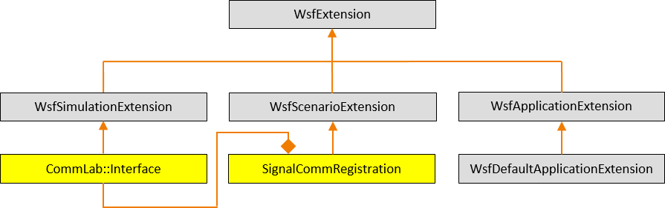
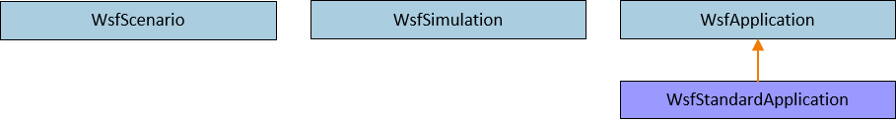
AFSIM Plugins & Extensions AFSIM mission startup sequence
Note: SignalCommRegistration contains
a member variable
mPrototypeInterface
which is a Comm::Interface
First, mission creates a WsfStandardApplication named app
mPrototypeInterface
mission::main()
unique_ptr<WsfDefaultApplicationExtension<SignalCommRegistration>>
WsfStandardApplication: app
WsfStandardApplication::WsfStandardApplication()
CommPluginRegistration.cpp:WsfPluginSetup()
WsfPluginSetup()
RegisterExtension(“signal_comm_registration”, ut::make_unique<WsfDefaultApplicationExtension<SignalCommRegistration>>())
AddedToApplication()
The WsfStandardApplication constructor utilizes the plugin manager to find and load all plugins (including those in the training folders -- because of the cmake option WSF_ADD_EXTENSION_PATH)
For each plugin found, executes WsfPluginSetup (note: this causes our communication exercise plugin’s WsfPluginSetup function to execute)
This causes our comm exercise’s WsfDefaultApplicationExtension to be created and registered with app
RegisterExtension then invokes the WsfApplicationExtension::AddedToApplication()
Note: WsfDefaultApplicationExtension does not override AddedToApplication, so this notification is essentially ignored

Slide 50

AFSIM Plugins & Extensions AFSIM mission startup sequence
mission::main()
unique_ptr<WsfDefaultApplicationExtension<…>>
WsfStandardApplication: app
RegisterExtension(…)
RegisterExtension(…)
$$⋮$$
RegisterExtension(…)
Mission then registers all of the necessary predefined extensions with app

Slide 51
AFSIM Plugins & Extensions AFSIM mission startup sequence
mission::main()
unique_ptr<SignalCommRegistration>
unique_ptr<WsfDefaultApplicationExtension<…>>
WsfScenario: scenario
WsfStandardApplication: app
WsfScenario::WsfScenario(app)
ScenarioCreated(…)
ScenarioCreated(…)
scenario.RegisterExtension(“signal_comm_registration”,
ut::make_unique<SignalCommRegistration>())
This is not the actual line of code executed, but this is what that code is equivalent to
AddedToApplication(…)
Mission then creates the scenario and invokes the WsfScenario constructor: WsfScenario scenario(app);
This constructor invokes the WsfApplication::ScenarioCreated method
This, in turn, invokes ScenarioCreated for all registered application extensions (including WsfDefaultApplicationExtension::ScenarioCreated)
This, in turn, creates the SignalCommRegistration, and registers it with scenario
RegisterExtension then invokes SignalCommRegistration::AddedToScenario
SignalCommRegistration::AddedToScenario registers the ScriptLocationMessageClass class with the script types manager

Slide 52
AFSIM Plugins & Extensions AFSIM mission startup sequence
mission::main()
unique_ptr<SignalCommRegistration>
unique_ptr<WsfDefaultApplicationExtension<…>>
WsfScenario: scenario
WsfStandardApplication: app
WsfStandardApplication::ProcessInputFiles()
WsfScenario::LoadFromFile(…)
ProcessInput(…)
ProcessInput(…)
Mission invokes app.WsfStandardApplication::ProcessInputFiles()
which invokes WsfScenario::LoadFromFile()
For each command in input,
Invoke each of the core classes’ ProcessInput() methods
Invoke each registered scenario extension’s ProcessInput()
Invokes SignalCommRegistration::ProcessInput()
Invokes the CommLab::Interface::ProcessInput()

Slide 53
AFSIM Plugins & Extensions AFSIM mission startup sequence
mission::main()
unique_ptr<SignalCommRegistration>
unique_ptr<WsfDefaultApplicationExtension<…>>
WsfScenario: scenario
WsfStandardApplication: app
WsfStandardApplication::ProcessInputFiles()
WsfScenario::LoadFromFile(…)
Complete(…)
WsfScenario::CompleteLoad(…)
Complete2(…)
Mission invokes app.WsfStandardApplication::ProcessInputFiles()
which, invokes WsfScenario::LoadFromFile()
and then invokes WsfScenario::CompleteLoad()
Invokes each scenario extension’s Complete()
Then invokes each scenario extension’s Complete2()

Slide 54
AFSIM Plugins & Extensions AFSIM mission startup sequence
mission::main()
unique_ptr<SignalCommRegistration>
unique_ptr<WsfDefaultApplicationExtension<…>>
WsfScenario: scenario
unique_ptr<WsfSimulation>: simPtr
WsfStandardApplication: app
WsfStandardApplication::CreateSimulation()
WsfSimulation::WsfSimulation()
Mission creates the Simulation by executing:
std::unique_ptr<WsfSimulation> simPtr =
app.CreateSimulation(scenario, …);
CreateSimulation invokes the WsfSimulation object’s constructor (with scenario as argument)

Slide 55
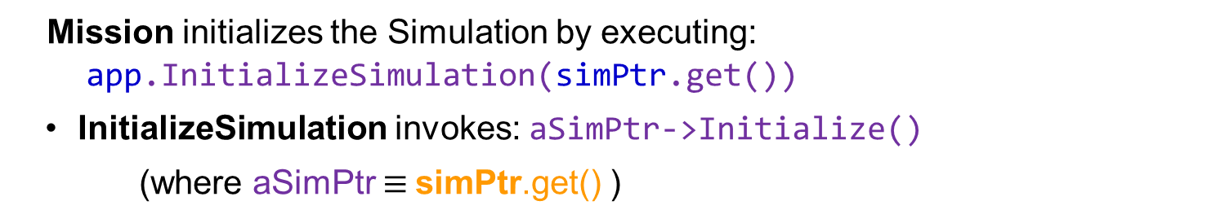
AFSIM Plugins & Extensions AFSIM mission startup sequence
mission::main()
unique_ptr<SignalCommRegistration>
unique_ptr<WsfDefaultApplicationExtension<…>>
WsfScenario: scenario
unique_ptr<WsfSimulation>: SimPtr
WsfStandardApplication: app
WsfStandardApplication::InitializeSimulation()
WsfSimulation::Initialize()
Mission initializes the Simulation by executing:
app.InitializeSimulation(simPtr.get())
InitializeSimulation invokes: aSimPtr->Initialize()
(where aSimPtr $≡$simPtr.get() )

Slide 56
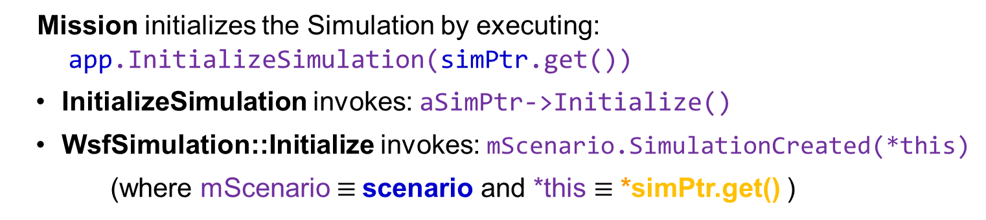
AFSIM Plugins & Extensions AFSIM mission startup sequence
mission::main()
unique_ptr<SignalCommRegistration>
unique_ptr<WsfDefaultApplicationExtension<…>>
WsfScenario: scenario
unique_ptr<WsfSimulation>: SimPtr
WsfStandardApplication: app
WsfStandardApplication::InitializeSimulation()
WsfScenario::SimulationCreated()
WsfSimulation::Initialize()
Mission initializes the Simulation by executing:
app.InitializeSimulation(simPtr.get())
InitializeSimulation invokes: aSimPtr->Initialize()
WsfSimulation::Initialize invokes: mScenario.SimulationCreated(*this)
(where mScenario $≡$scenario and *this $≡$ *simPtr.get() )

Slide 57
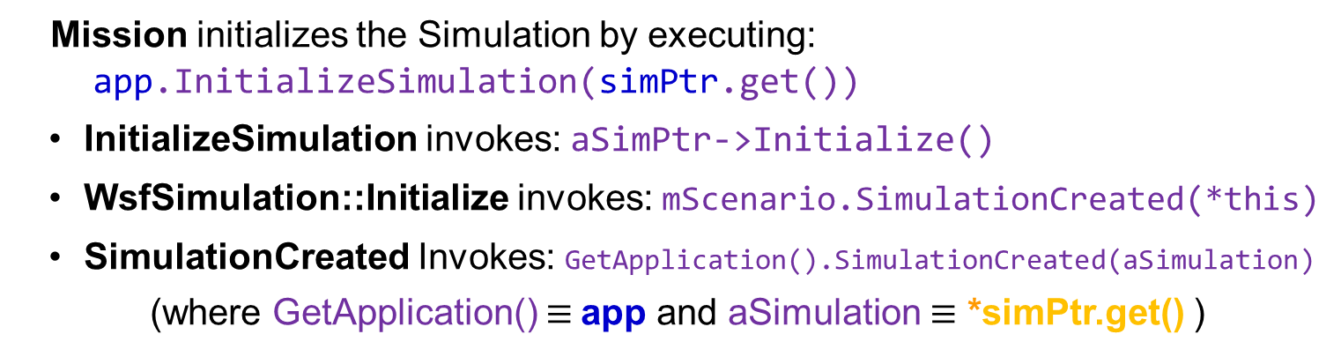
AFSIM Plugins & Extensions AFSIM mission startup sequence
mission::main()
unique_ptr<SignalCommRegistration>
unique_ptr<WsfDefaultApplicationExtension<…>>
WsfScenario: scenario
unique_ptr<WsfSimulation>: SimPtr
WsfStandardApplication: app
WsfStandardApplication::InitializeSimulation()
WsfScenario::SimulationCreated()
WsfSimulation::Initialize()
WsfApplication::SimulationCreated()
Mission initializes the Simulation by executing:
app.InitializeSimulation(simPtr.get())
InitializeSimulation invokes: aSimPtr->Initialize()
WsfSimulation::Initialize invokes: mScenario.SimulationCreated(*this)
SimulationCreated Invokes: GetApplication().SimulationCreated(aSimulation)
(where GetApplication() $≡$app and aSimulation $≡$ *simPtr.get() )

Slide 58
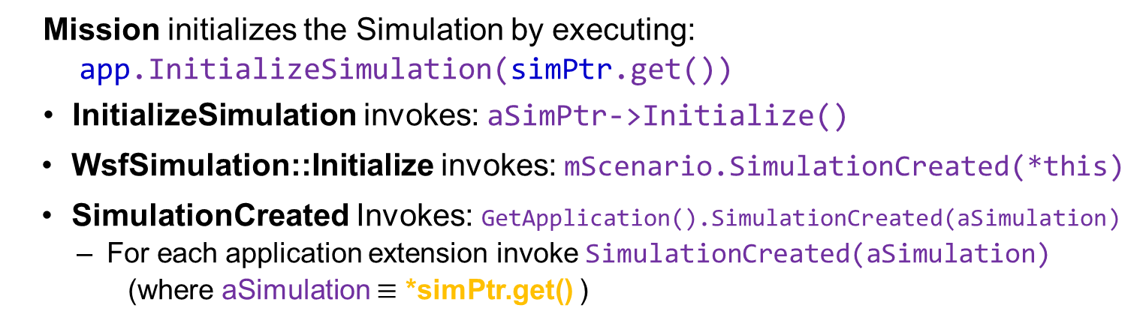
AFSIM Plugins & Extensions AFSIM mission startup sequence
mission::main()
unique_ptr<SignalCommRegistration>
unique_ptr<WsfDefaultApplicationExtension<…>>
WsfScenario: scenario
unique_ptr<WsfSimulation>: SimPtr
WsfStandardApplication: app
WsfStandardApplication::InitializeSimulation()
WsfScenario::SimulationCreated()
WsfSimulation::Initialize()
WsfApplication::SimulationCreated()
Mission initializes the Simulation by executing:
app.InitializeSimulation(simPtr.get())
InitializeSimulation invokes: aSimPtr->Initialize()
WsfSimulation::Initialize invokes: mScenario.SimulationCreated(*this)
SimulationCreated Invokes: GetApplication().SimulationCreated(aSimulation)
For each application extension invoke SimulationCreated(aSimulation)
(where aSimulation $≡$ *simPtr.get() )

Slide 59
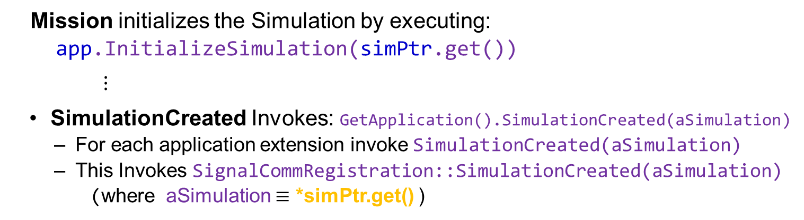
AFSIM Plugins & Extensions AFSIM mission startup sequence
mission::main()
unique_ptr<SignalCommRegistration>
unique_ptr<WsfDefaultApplicationExtension<…>>
WsfScenario: scenario
unique_ptr<WsfSimulation>: SimPtr
WsfStandardApplication: app
WsfStandardApplication::InitializeSimulation()
WsfScenario::SimulationCreated()
WsfSimulation::Initialize()
WsfApplication::SimulationCreated()
SignalCommRegistration::SimulationCreated()
Mission initializes the Simulation by executing:
app.InitializeSimulation(simPtr.get())
$⋮$
SimulationCreated Invokes: GetApplication().SimulationCreated(aSimulation)
For each application extension invoke SimulationCreated(aSimulation)
This Invokes SignalCommRegistration::SimulationCreated(aSimulation)
(where aSimulation $≡$ *simPtr.get() )

Slide 60
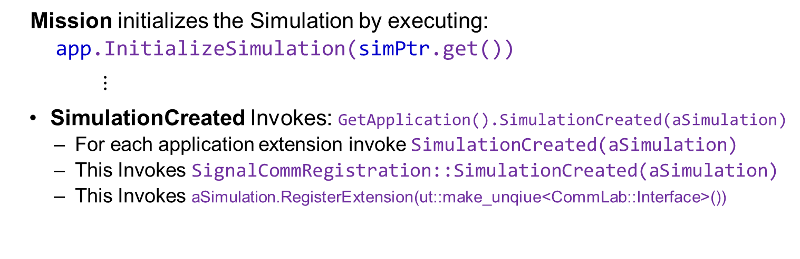
AFSIM Plugins & Extensions AFSIM mission startup sequence
mission::main()
unique_ptr<SignalCommRegistration>
unique_ptr<WsfDefaultApplicationExtension<…>>
WsfScenario: scenario
unique_ptr<WsfSimulation>: SimPtr
WsfStandardApplication: app
WsfStandardApplication::InitializeSimulation()
WsfScenario::SimulationCreated()
WsfSimulation::Initialize()
WsfApplication::SimulationCreated()
SignalCommRegistration::SimulationCreated()
WsfSimulation::RegisterExtension()
Mission initializes the Simulation by executing:
app.InitializeSimulation(simPtr.get())
$⋮$
SimulationCreated Invokes: GetApplication().SimulationCreated(aSimulation)
For each application extension invoke SimulationCreated(aSimulation)
This Invokes SignalCommRegistration::SimulationCreated(aSimulation)
This Invokes aSimulation.RegisterExtension(ut::make_unqiue<CommLab::Interface>())
(where aSimulation $≡$ *simPtr.get()

Slide 61
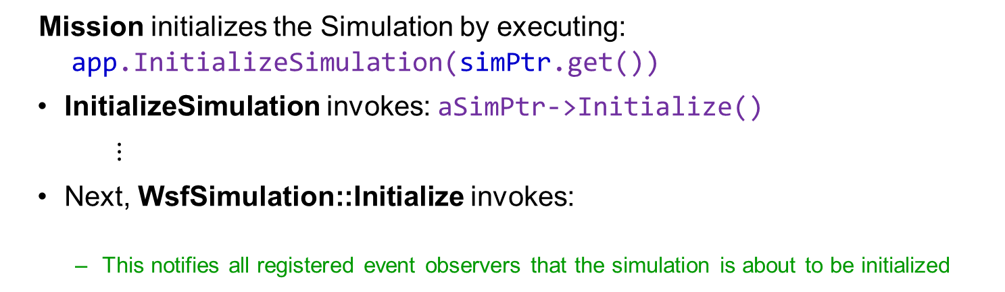
AFSIM Plugins & Extensions AFSIM mission startup sequence
mission::main()
unique_ptr<SignalCommRegistration>
unique_ptr<WsfDefaultApplicationExtension<…>>
WsfScenario: scenario
unique_ptr<WsfSimulation>: SimPtr
WsfStandardApplication: app
WsfStandardApplication::InitializeSimulation()
WsfSimulation::Initialize()
WsfObserver::SimulationInitializing()
Mission initializes the Simulation by executing:
app.InitializeSimulation(simPtr.get())
InitializeSimulation invokes: aSimPtr->Initialize()
$⋮$
Next, WsfSimulation::Initialize invokes:
This notifies all registered event observers that the simulation is about to be initialized
WsfObserver::SimulationInitializing(this)
Note: the Interfaced class does not override this method, hence we do nothing with the notification

Slide 62
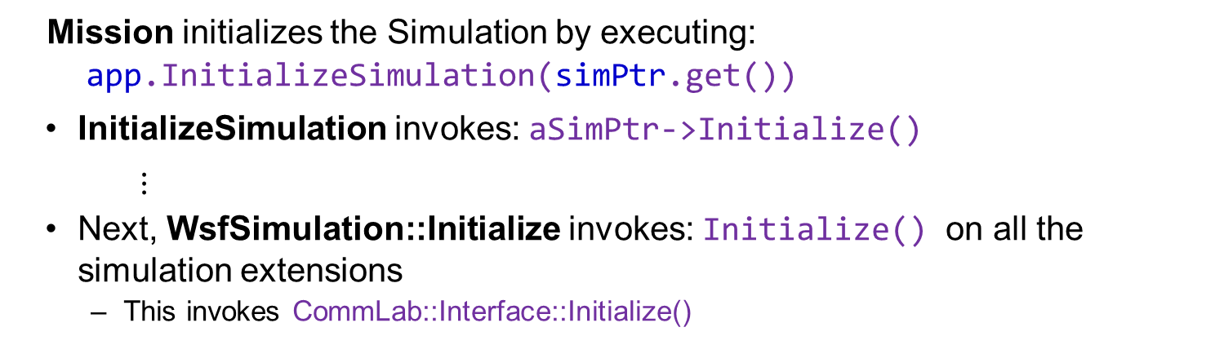
AFSIM Plugins & Extensions AFSIM mission startup sequence
mission::main()
unique_ptr<SignalCommRegistration>
unique_ptr<WsfDefaultApplicationExtension<…>>
WsfScenario: scenario
unique_ptr<WsfSimulation>: SimPtr
WsfStandardApplication: app
WsfStandardApplication::InitializeSimulation()
WsfSimulation::Initialize()
CommLab::Interface::Initialize()
Mission initializes the Simulation by executing:
app.InitializeSimulation(simPtr.get())
InitializeSimulation invokes: aSimPtr->Initialize()
$⋮$
Next, WsfSimulation::Initialize invokes: Initialize() on all the simulation extensions
This invokes CommLab::Interface::Initialize()

Slide 63
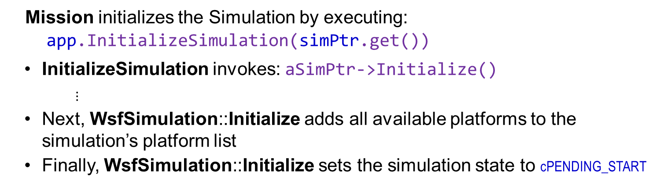
AFSIM Plugins & Extensions AFSIM mission startup sequence
mission::main()
unique_ptr<SignalCommRegistration>
unique_ptr<WsfDefaultApplicationExtension<…>>
WsfScenario: scenario
unique_ptr<WsfSimulation>: SimPtr
WsfStandardApplication: app
WsfStandardApplication::InitializeSimulation()
WsfSimulation::Initialize()
Mission initializes the Simulation by executing:
app.InitializeSimulation(simPtr.get())
InitializeSimulation invokes: aSimPtr->Initialize()
$⋮$
Next, WsfSimulation::Initialize adds all available platforms to the simulation’s platform list
Finally, WsfSimulation::Initialize sets the simulation state to cPENDING_START

Slide 64
AFSIM Plugins & Extensions AFSIM mission startup sequence
mission::main()
unique_ptr<SignalCommRegistration>
unique_ptr<WsfDefaultApplicationExtension<…>>
WsfScenario: scenario
unique_ptr<WsfSimulation>: SimPtr
WsfStandardApplication: app
WsfStandardApplication::RunEventLoop()
WsfSimulation::Start()
CommLab::Interface::Start()
Mission runs the Simulation by executing:
app.RunEventLoop(simPtr.get(), options)
RunEventLoop invokes: aSimPtr->Start()
WsfSimulation::Start
For each simulation extension invoke Start()
Invokes CommLab::Interface::Start()
Sets up the low level DIS Interface for communications

Slide 65
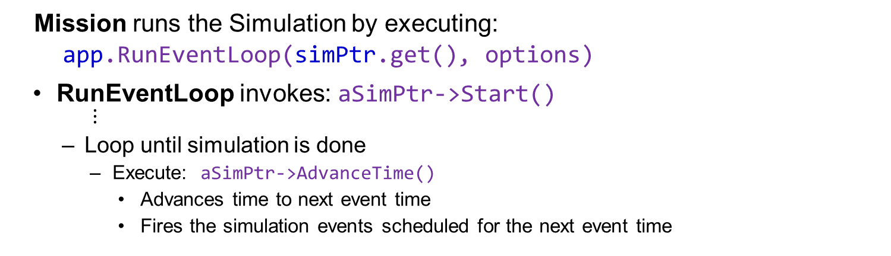
AFSIM Plugins & Extensions AFSIM mission startup sequence
mission::main()
unique_ptr<SignalCommRegistration>
unique_ptr<WsfDefaultApplicationExtension<…>>
WsfScenario: scenario
unique_ptr<WsfSimulation>: SimPtr
WsfStandardApplication: app
WsfStandardApplication::RunEventLoop()
WsfSimulation::Start()
Mission runs the Simulation by executing:
app.RunEventLoop(simPtr.get(), options)
RunEventLoop invokes: aSimPtr->Start()
$⋮$
Loop until simulation is done
Execute: aSimPtr->AdvanceTime()
Advances time to next event time
Fires the simulation events scheduled for the next event time

Slide 66
Exercise 2
Complete scenario extension SignalCommRegistration::ProcessInput
Complete Interface::ProcessInput
Review Interface simulation extension’s Initialize and Start methods

Slide 67
Comm Exercise 2 — Task 1
Complete the SignalCommRegistration::ProcessInput method by calling the prototype CommLab::Interface’s ProcessInput method:
Use the member variable mPrototypeInterface to invoke ProcessInput
Be sure to return the result of the call to mPrototypeInterface’s ProcessInput to the caller of SignalCommRegistration::ProcessInput

Slide 68
Comm Exercise 2 — Task 1 Solution SignalCommRegistration.hpp
class SignalCommRegistration : public WsfScenarioExtension
{
public:
SignalCommRegistration() = default;
bool ProcessInput(UtInput& aInput) override
{
// EXERCISE 2 TASK 1
//! Call the CommLab::Interface prototype's ProcessInput method.
return mPrototypeInterface.ProcessInput(aInput);
}
...
private:
CommLab::Interface mPrototypeInterface;
};

Slide 69
Comm Exercise 2 — Review 1
Inspect the CommLab::Interface class to become familiar with the class methods and attributes.
CommLab::Interface will be implemented as a WsfSimulationExtension
The Initialize method is automatically called by the simulation
ProcessInput is called by the scenario through the SignalCommRegistration object
HandleSignalPDU method is a callback method
The SendMessage method is called when a SignalComm communication device is sending a message

Slide 70

Comm Exercise 2 — Review 1 Interface.hpp
class Interface : public WsfSimulationExtension
{
public:
//! Constructor
Interface();
//! Virtual destructor
~Interface() noexcept override = default;
bool Initialize() override;
bool ProcessInput(UtInput& aInput);
void Start() override;
void SendMessage(double aSimTime,
WsfPlatform* aSenderPlatformPtr,
int aSourceTrackNumberOffset,
const WsfMessage* aMessagePtr);
//! Determine if debugging is enabled.
bool DebugEnabled() const { return mDebugEnabled; }
using LocationMessageReceivedCallback = UtCallbackListN<void(double, DataLink::LocationMessage*)>;
static LocationMessageReceivedCallback LocationMessageReceived;
$⋮$
private:
void HandleSignalPDU(WsfDisInterface* aInterfacePtr, const WsfDisSignal& aPdu);
UtCallbackHolder mCallbacks;
WsfDisInterface* mDisPtr;
bool mDebugEnabled;
bool mPrintMessages;
};

Slide 71
Comm Exercise 2 — Task 2
In Interface.cpp, complete CommLab::Interface::ProcessInput method
Task 2a: Write an if statement that will check if the variable cmd contains the string “print_messages”, and if true, sets the member mPrintMessages to true.
Task 2b: Write an else if statement that will check if the variable cmd contains the string debug, and if true, sets the member mDebugEnabled to true.

Slide 72
Comm Exercise 2 — Task 2 Solution Interface.cpp
bool Interface::ProcessInput(UtInput& aInput)
{
bool myCommand = false;
std::string cmd;
if ("comm_lab_interface" == aInput.GetCommand())
{
myCommand = true;
UtInputBlock block(aInput);
while (block.ReadCommand(cmd))
{
// EXERCISE 2 TASK 2a
// Write if statement to check if cmd contains “print_messages” and if true,
// sets mPrintMessages to true
if (cmd == "print_messages")
{
mPrintMessages = true;
}
// EXERCISE 2 TASK 2b
// Write else if statement to check if cmd contains “debug” and if true,
// sets mDebug to true
else if (cmd == "debug")
{
mDebugEnabled = true;
}
else
{
throw UtInput::BadValue(aInput);
}
}
}
return myCommand;
}
Notes:
In Interface::Start, we ask the simulation for the extension called “dis_interface”. This gives us a WsfSimulationExtension, which we cast to a WsfDisInterface.
In Interface::Initialize, we register for a callback. This callback gets triggered when a dis signal is received by the AFSIM Dis Interface. When this happens, we want to process it in Interface::HandleSignalPDU

Slide 73
Comm Exercise 2 — Review 2
In Interface.cpp, inspect the CommLab::Interface::Initialize method and CommLab::Interface::Start method
Note that Initialize adds a callback to HandleSignalPDU to the list of callbacks stored in mCallbacks
Note that start sets the member mDisPtr to point to the WsfDisInterface simulation extension

Slide 74
Comm Exercise 2 — Review 2 Interface.cpp
Review and understand:
void Interface::Start()
{
// Get the DIS interface
mDisPtr = dynamic_cast<WsfDisInterface*>(&GetSimulation().GetExtension("dis_interface"));
}
bool Interface::Initialize()
{
mCallbacks += WsfObserver::DisSignalReceived(&GetSimulation()).Connect(&Interface::HandleSignalPDU, this);
return true;
}
Notes:
In Interface::Start, we ask the simulation for the extension called “dis_interface”. This gives us a WsfSimulationExtension, which we cast to a WsfDisInterface.
In Interface::Initialize, we register for a callback. This callback gets triggered when a dis signal is received by the AFSIM Dis Interface. When this happens, we want to process it in Interface::HandleSignalPDU

Slide 75
Exercise 3
Add member variables to class LocationMessage
Add Accessor/Mutator methods to class LocationMessage
Finish LocationMessage constructor
Complete SignalComm::Receive
Complete SignalComm::Send
Complete Interface::SendMessage
Complete Interface::HandleSignalPDU

Slide 76
Comm Exercise 3 — Review 1
Review and understand the DataLink::Message class
This class creates a datalink layer header for the LocationMessage data
This class utilizes GenIO to serialize and de-serialize our data

Slide 77

Comm Exercise 3 — Review 1 DataLinkMessage.hpp
class Message
{
public:
// This method reads enough of the input stream to
// determine the type of Message being read. It then creates the proper Message
// type from a factory class. Once the Message is generated,
// it is populated with the data from the input stream.
//
// The caller owns the returned Message and is responsible for its destruction.
static Message* Create(GenI& aGenI);
Message() = delete;
Message(const UtCalendar& aCurrentTime,
unsigned short aSourceTrackNumber);
explicit Message(GenI& aGenI);
virtual ~Message() noexcept = default;
enum Type
{
cUNDEFINED = 0,
cLOCATION = 1,
cNUM_MESSAGE_TYPES = 2
};
$⋮$

Slide 78

Comm Exercise 3 — Review 1 DataLinkMessage.hpp
class Message
{
public:
$⋮$
// Input/output
virtual void Get(GenI& aGenI);
virtual void Put(GenO& aGenO) const;
virtual unsigned GetSize() const;
virtual int GetType() const { return cUNDEFINED; }
virtual const std::string& GetName() const;
virtual void TestData() const; // Test Message for bad or questionable data
// The following are simply the data and so are public
// Message header
unsigned short mSourceTrackNumber; // The originator of the message
unsigned short mSize; // total number of bytes in the Message
unsigned char mType; // Message type enumeration
unsigned char mHour; // 0-24 UT
unsigned char mMin; // 0-60
unsigned char mSec; // 0-60
};

Slide 79
Comm Exercise 3 — Review 2
Review and understand the DataLink::LocationMessage class
This class creates a datalink layer message for the LocationMessage class data
This class also utilizes GenIO to serialize and de-serialize our data

Slide 80
Comm Exercise 3 — Review 2 DataLinkLocationMessage.hpp
class LocationMessage : public Message
{
public:
LocationMessage() = delete;
LocationMessage(const UtCalendar& aCurrentTime,
unsigned short aSourceTrackNumber);
LocationMessage(const Message& aMessage,
GenI& aGenI);
~LocationMessage() noexcept override = default;
double mLatitude;
double mLongitude;
double mAltitude;
double mCourse;
double mSpeed;
unsigned GetSize() const override;
int GetType() const override { return Message::cLOCATION; }
const std::string& GetName() const override;
void Get(GenI& aGenI) override;
void Put(GenO& aGenO) const override;
protected:
virtual void GetMemberData(GenI& aGenI);
};

Slide 81
Comm Exercise 3 — Review 3
WsfControlMessage.hpp and WsfStatusMessage.hpp already declare two types of messages used in this exercise
WsfControlMessage: utilized by platforms that are commanders to send the “I COMMAND YOU” messages
WsfStatusMessage: utilized by subordinates (those platforms with a commander) to send the “OK” messages back in response
This exercise adds a new type of message called LocationMessage
Inspect the LocationMessage.hpp file to become familiar with the class methods and attributes. Notice the new message type LocationMessage has been sub-classed from WsfMessage.

Slide 82
Comm Exercise 3 — Review 3 LocationMessage.hpp
class LocationMessage : public WsfMessage
{
public:
LocationMessage();
...
int GetSourceTrackNumber() const { return mSourceTrackNumber; }
void SetSourceTrackNumber(int aSourceTrackId) { mSourceTrackNumber = aSourceTrackId; }
double GetLatitude() const { return mLatitude; }
void SetLatitude(double aLatitude) { mLatitude = aLatitude; }
...
double GetAltitude() const { return mAltitude; }
void SetAltitude(double aAltitude) { mAltitude = aAltitude; }
...
const char* GetScriptClassName() const override;
private:
int mSourceTrackNumber;
double mLatitude;
double mLongitude;
double mAltitude;
...
};

Slide 83
Comm Exercise 3 — Task 1
Add private member variables to the LocationMessage class to store the following:
The platform’s course (a double)
The platform’s speed (a double)

Slide 84
Comm Exercise 3 — Task 1 Solution LocationMessage.hpp
class LocationMessage : public WsfMessage
{
public:
LocationMessage();
...
private:
int mSourceTrackNumber;
double mLatitude;
double mLongitude;
double mAltitude;
// EXERCISE 3 TASK 1
double mCourse;
double mSpeed;
};

Slide 85
Comm Exercise 3 — Task 2
Task 2: Provide public accessor and mutator functions similar in syntax to the other member variable’s accessors/mutators. These functions should be named:
GetCourse
SetCourse
GetSpeed
SetSpeed

Slide 86
Comm Exercise 3 — Task 2 Solution LocationMessage.hpp
class LocationMessage : public WsfMessage
{
public:
LocationMessage();
...
// EXERCISE 3 TASK 2
double GetCourse() const { return mCourse; }
void SetCourse(double aCourse) { mCourse = aCourse; }
double GetSpeed() const { return mSpeed; }
void SetSpeed(double aSpeed) { mSpeed = aSpeed; }
const char* GetScriptClassName() const override;
private:
int mSourceTrackNumber;
double mLatitude;
double mLongitude;
double mAltitude;
// EXERCISE 3 TASK 1
double mCourse;
double mSpeed;
};

Slide 87
Comm Exercise 3 — Task 3
Complete the LocationMessage class constructor implementation:
Task 3a: Add the new member variables defined in the previous step to the constructor member initialization list and provide appropriate default values
Task 3b: In the body of the constructor, set the message data using information from the originator of the message
location (mLatitiude, mLongitude, mAltitude),
course (which can obtained from the velocity by using atan2)
Get the velocity
Create a double array, velNED, of size 3, initialized to all 0.0s
Invoke aPlatformPtr->GetVelocityNED(velNED)
Invoke atan2(velNED[1], velNED[0]) and set the course equal to the result
and speed
Invoke aPlatformPtr->GetSpeed() and set the speed equal to the result

Slide 88
Comm Exercise 3 — Task 3 Solution LocationMessage.cpp
LocationMessage::LocationMessage(WsfPlatform* aPlatformPtr)
: WsfMessage(GetTypeId(), nullptr, aPlatformPtr),
mSourceTrackNumber(0),
mLatitude(0.0),
mLongitude(0.0),
mAltitude(0.0),
// EXERCISE 3 TASK 3a
mCourse(0.0),
mSpeed(0.0)
{
// Set the source track number
mSourceTrackNumber = aPlatformPtr->GetAuxData().GetInt("SOURCE_TRACK_NUMBER");
// EXERCISE 3 TASK 3b
// Get location
aPlatformPtr->GetLocationLLA(mLatitude, mLongitude, mAltitude);
// Get course
double velNED[3] = { 0.0 };
aPlatformPtr->GetVelocityNED(velNED);
mCourse = atan2(velNED[1], velNED[0]);
// Get speed
mSpeed = aPlatformPtr->GetSpeed();
}

Slide 89
Comm Exercise 3 — Review 4
Inspect the SignalComm.hpp file to become familiar with the class methods and attributes. Notice the new communication device type SignalComm has been sub-classed from wsf::comm::Comm.

Slide 90
Comm Exercise 3 — Review 4 SignalComm.hpp
class SignalComm : public wsf::comm::Comm
{
public:
//! Constructor
explicit SignalComm(WsfScenario& aScenario);
SignalComm& operator=(const SignalComm&) = delete;
//! Virtual destructor
~SignalComm() noexcept override = default;
//! Get the class ID associated with the object (poor man's RTTI).
//! @return Returns the associated class ID.
static WsfStringId GetSignalCommClassId();
//! @name Framework methods
//@{
wsf::comm::Comm* Clone() const override;
bool ProcessInput(UtInput& aInput) override;
bool Initialize(double aSimTime) override;
//@}
unsigned int GetSourceTrackNumber() const { return mSourceTrackNumber; }
CommLab::Interface* GetInterface() const { return mInterfacePtr; }
bool Receive(double aSimTime, wsf::comm::Comm* aCommPtr, wsf::comm::Message& aMessage) override;
bool Send(double aSimTime, std::unique_ptr<WsfMessage> aMessagePtr, const Address& aAddress) override;

Slide 91
Comm Exercise 3 — Review 4 SignalComm.hpp
void LocationMessageReceived(double aSimTime,
DataLink::LocationMessage* aLocMsgPtr);
const char* GetScriptClassName() const override;
protected:
//! Copy Constructor; used by clone
SignalComm(const SignalComm& aSrc) = default;
private:
unsigned int mSourceTrackNumber; //! Like a link-16 source identifier
CommLab::Interface* mInterfacePtr;
UtCallbackHolder mCallbacks;
};

Slide 92
Comm Exercise 3 — Task 4
Implement SignalComm::Receive
This method is called when a communication device is receiving a message
Task 4a: Pass the message to the protocol stack
Invoke mProtocolStack.Receive(aSimTime, aCommPtr, aMessage);
Receive returns a bool, store this bool in the variable messageReceived
Task 4b: Using the owning simulation object accessor, notify observers that a message has been received
Invoking WsfObserver::MessageRecieved will generate the callbacks to the registered observers
This is invoked as:
WsfObserver::MessageReceived(GetSimulation())(aSimTime, aCommPtr, this,
*aMessage.SourceMessage(), aMessage.GetResult());
Task 4c: Send the message on to any on-board recipients
Invoke the base class WsfPlatformPart::Send_Message method
The arguments are
the simulation time, and
the aMessage parameter’s source message (obtained by invoking aMessage.SourceMessage()

Slide 93
Comm Exercise 3 — Task 4 Solution SignalComm.cpp
bool SignalComm::Receive(double aSimTime, Comm* aCommPtr, Message& aMessage)
{
...
bool messageReceived = false;
// Perform a comm filter check
if (Component::Receive(*this, aSimTime, aCommPtr, aMessage))
{
// EXERCISE 3 TASK 4a
// Pass the message to the stack to see if it can be processed
messageReceived = mProtocolStack.Receive(aSimTime, aCommPtr, aMessage);
if (messageReceived)
{
// EXERCISE 3 TASK 4b
// Using the owning simulation object accessor,
// Notify simulation observers that a message has been received
WsfObserver::MessageReceived(GetSimulation())(aSimTime, aCommPtr, this,
*aMessage.SourceMessage(), aMessage.GetResult());
// EXERCISE 3 TASK 4c
// Forward the message to any on-board recipients (internal links)
SendMessage(aSimTime, *aMessage.SourceMessage());
}
//! Only throw a notification of message discarded if the message was intended for us and failed.
if (!messageReceived && aMessage.SourceMessage()->GetDstAddr() == GetAddress())
{
// This message is specifically for a protocol stack failure
WsfObserver::MessageDiscarded(GetSimulation())(aSimTime, aCommPtr,
*aMessage.SourceMessage(), "layer_receive_failure");
}
}
return messageReceived;
}

Slide 94
Comm Exercise 3 — Task 5
Implement SignalComm::Send
Note that this method is overridden from the base class wsf::comm::Comm
We are not going to queue or route the message; when a message is sent it is immediately received
Task 5a: Using the owning simulation accessor, notify observers that a message has been transmitted
This is done as follows:
WsfObserver::MessageTransmitted(GetSimulation())(aSimTime,this, *message.SourceMessage());
Task 5b: Pass the message to the protocol stack, by executing:
mProtocolStack.Send(aSimTime, message);
Task 5c: Using the CommLab::Interface attribute, send the message over DIS, by executing:
mInterfacePtr->SendMessage(aSimTime, GetPlatform(),
mSourceTrackNumber, message.SourceMessage());

Slide 95
Comm Exercise 3 — Task 5 Solution SignalComm.cpp
bool SignalComm::Send(double aSimTime, std::unique_ptr<WsfMessage> aMessagePtr,
const Address& aAddress)
{
...
// Perform a comm filter check
if (Component::Send(*this, aSimTime, *aMessagePtr, aAddress))
{
//! This object is only valid in the scope of this method call, and will
//! deallocate upon returning. If any object (layer, event, etc.) in the
//! stack call chain requires an extended lifetime of this object, it is
//! their responsibility to create such an object and manage it.
Message message(std::move(aMessagePtr));
message.SourceMessage()->SetDstAddr(aAddress);
message.SourceMessage()->SetSrcAddr(GetAddress());
// Use properties from the message table
GetScenario().GetMessageTable()->SetMessageProp(GetTypeId(), *message.SourceMessage());
// EXERCISE 3 TASK 5a
// Using the owning simulation accessor, notify observers that a message has been transmitted
WsfObserver::MessageTransmitted(GetSimulation())(aSimTime, this, *message.SourceMessage());
// EXERCISE 3 TASK 5b
// Using our comm's protocol stack, send the message
messageSent = mProtocolStack.Send(aSimTime, message);
// EXERCISE 3 TASK 5c
// Using the CommLab::Interface attribute, send the message over DIS
mInterfacePtr->SendMessage(aSimTime, GetPlatform(), mSourceTrackNumber, message.SourceMessage());
}
return messageSent;
}

Slide 96
Comm Exercise 3 — Task 6
Implement CommLab::Interface::SendMessage
This method gets called by a couple of classes in our exercise
The SignalComm::Send method calls this method when a message of any type is being sent
Use an if statement to ignore any non-LocationMessage types.
Use the LocationMessage::GetTypeId method to retrieve the LocationMessage’s type id,
Use aMessage::GetType to retrieve the message type stored in the message
Check and compare the type against the type id, and if they are not the same, then simply return from this method

Slide 97
Comm Exercise 3 — Task 6 Solution Interface.cpp
void Interface::SendMessage(double aSimTime,
WsfPlatform* aSenderPlatformPtr,
int aSourceTrackNumberOffset,
const WsfMessage* aMessagePtr)
{
// EXERCISE 3 TASK 6a
// Check for quick return if this message type is not a LocationMessage.
if (aMessagePtr->GetType() != LocationMessage::GetTypeId())
{
return;
}
...

Slide 98
Comm Exercise 3 — Task 7
Notice the creation of a variable dlMsg of type DataLink::LocationMessage
Task 7a: Pack up header and data into the DIS Signal PDU
create a GenMemIO object as the send buffer
the constructor takes two arguments:
type GenBuf::Native, and
size of the message (use dlMsg.GetSize, which returns number of bytes in message)
Use the dlMsg message’s Put method to pack the data into the buffer
Put takes a single argument which is the GenMemIo buffer
Task 7b: Set the user data in the Signal PDU
Invoke signalPduPtr->SetUserData
Parameterize with the buffer’s contents (buffer.GetBuffer) and size of the message in bits (use dlMsg.GetSize and convert to number of bits)
Task 7c: Send using the DIS interface
Using the pointer mDisPtr, invoke the interface’s PutPdu method
Pass in the sim time (aSimTime), and the unique_ptr signalPduPtr that is moved to the PutPdu method

Slide 99

Comm Exercise 3 — Task 7 Solution Interface.cpp
void Interface::SendMessage(double aSimTime,
WsfPlatform* aSenderPlatformPtr,
int aSourceTrackNumberOffset,
const WsfMessage* aMessagePtr)
{
...
if (mDisPtr != nullptr)
{
...
const LocationMessage* msgPtr = dynamic_cast<const LocationMessage*>(aMessagePtr);
if(msgPtr != nullptr)
{
$⋮$
DataLink::LocationMessage dlMsg(currentTime, sourceTrackOffset);
dlMsg.mSourceTrackNumber = msgPtr->GetSourceTrackNumber();
dlMsg.mLatitude = msgPtr->GetLatitude(); dlMsg.mLongitude = msgPtr->GetLongitude();
dlMsg.mAltitude = msgPtr->GetAltitude();
dlMsg.mCourse = msgPtr->GetCourse();
dlMsg.mSpeed = msgPtr->GetSpeed();
$⋮$
// EXERCISE 3 TASK 7a
GenMemIO buffer(GenBuf::Native, dlMsg.GetSize());
dlMsg.Put(buffer);
// EXERCISE 3 TASK 7b
signalPduPtr->SetUserData(buffer.GetBuffer(), dlMsg.GetSize() * 8);
// EXERCISE 3 TASK 7c
mDisPtr->PutPdu(aSimTime, std::move(signalPduPtr));
}

Slide 100
Comm Exercise 3 — Task 8
Implement CommLab::Interface:::HandleSignalPDU
This method is called when a Signal PDU is received by the DIS interface class
Task 8a: Process Signal PDUs only from a data link of type WsfDisSignal::EtGenericIP
Use the PDU’s GetTDLType to check against this value
Unpack the DataLink::LocationMessage object from the DIS Signal PDU.
Task 8b: Use a GenMemIO object that accesses the data buffer from the DIS Signal PDU
Parameterize with:
the signal data (call the signalData.data method),
size of the buffer (dataLength)
type (with type GenBuf::Native)
and length of the data in the buffer (also dataLength)
Task 8c: Utilize the DataLink::Message::Create factory method to read the DataLink::LocationMessge from the buffer
Pass in the buffer into the Create method
The return value is DataLink::Message* pointer and should be stored in a variable of that type (note: this variable must be named msgPtr, as this variable is used in later code that is provided for you)

Slide 101
Comm Exercise 3 — Task 8 Solution Interface.cpp
void Interface::HandleSignalPDU(WsfDisInterface* aInterfacePtr, const WsfDisSignal& aPdu)
{
// EXERCISE 3 TASK 8a
// Use the PDUs GetTDLType() to check that it is of type
// WsfDisSignal::EtGenericIP, and if so return
if (aPdu.GetTDLType() != WsfDisSignal::EtGenericIP)
{
return;
}
if (mDisPtr != nullptr) // Must be configured with optional DIS interface
{
...
// EXERCISE 3 TASK 8b
// Use a GenMemIO object that accesses the data buffer from the DIS Signal PDU
// Parameterize with the signal data, type with type GenBuf::Native and length of the data
GenMemIO buffer(signalData.data(), dataLength, GenBuf::Native, dataLength);
// EXERCISE 3 TASK 8c
// Utilize the DataLink::Message::Create factory method to read the
// DataLink::LocationMessage from the buffer
DataLink::Message* msgPtr = DataLink::Message::Create(buffer);
...
}
}

Slide 102
Exercise 4
Add UT_DECLARE_SCRIPT_METHOD macros to the ScriptLocationMessageClass for the new script methods Course and Speed
Add UT_DEFINE_SCRIPT_METHOD macros to LocationMessage.cpp for the new script methods Course and Speed
Add AddMethod calls to the ScriptLocationMessageClas constructor for the new script methods Course and Speed

Slide 103
Comm Exercise 4 — Review 1 LocationMessage.hpp
Inspect the LocationMessage.hpp file to become familiar with the class methods and attributes of the ScriptLocationMessageClass class that is defined at the bottom of the file
Notice the new script message class ScriptLocationMessageClass has been sub-classed from WsfScriptMessageClass
class ScriptLocationMessageClass : public WsfScriptMessageClass
{
public:
ScriptLocationMessageClass(const std::string& aClassName,
UtScriptTypes* aScriptTypePtr);
void* Create(const UtScriptContext& aContext) override;
void* Clone(void* aObjectPtr) override;
void Destroy(void* aObjectPtr) override;
UT_DECLARE_SCRIPT_METHOD(SourceTrackNumber);
UT_DECLARE_SCRIPT_METHOD(Latitude);
UT_DECLARE_SCRIPT_METHOD(Longitude);
UT_DECLARE_SCRIPT_METHOD(Altitude);
};

Slide 104
Comm Exercise 4 — Task 1
Declarations of script methods
#define UT_DECLARE_SCRIPT_METHOD( … )
Expands to a class declaration for method argument
Inherits from class UtScriptClass::InterfaceMethod
Declares constructor and operator() for the class’s methods
Task 1: Add a UT_DECLARE_SCRIPT_METHOD to the ScriptLocationMessageClass that declares a script called Course and another script called Speed. These methods allow access of the message contents in script.

Slide 105
Comm Exercise 4 — Task 1 Solution LocationMessage.hpp
class ScriptLocationMessageClass : public WsfScriptMessageClass
{
public:
ScriptLocationMessageClass(const std::string& aClassName,
UtScriptTypes* aScriptTypePtr);
void* Create(const UtScriptContext& aContext) override;
void* Clone(void* aObjectPtr) override;
void Destroy(void* aObjectPtr) override;
UT_DECLARE_SCRIPT_METHOD(SourceTrackNumber);
UT_DECLARE_SCRIPT_METHOD(Latitude);
UT_DECLARE_SCRIPT_METHOD(Longitude);
UT_DECLARE_SCRIPT_METHOD(Altitude);
// EXERCISE 4 TASK 1
UT_DECLARE_SCRIPT_METHOD(Course);
UT_DECLARE_SCRIPT_METHOD(Speed);
};

Slide 106
Comm Exercise 4 — Task 2
In LocationMessage.cpp, complete the implementation of the ScriptLocationMessageClass constructor
Add calls to AddMethod for the Course and Speed script methods (similar to those for SourceTrackNumber, Latitude, Longitude, and Altitutde)

Slide 107
Comm Exercise 4 — Task 2 Solution LocationMessage.cpp
ScriptLocationMessageClass::ScriptLocationMessageClass(const std::string& aClassName,
UtScriptTypes* aScriptTypesPtr)
: WsfScriptMessageClass(aClassName, aScriptTypesPtr)
{
SetClassName("LocationMessage");
mConstructible = true;
mCloneable = true;
AddMethod(ut::make_unique<SourceTrackNumber>());
AddMethod(ut::make_unique<Latitude>());
AddMethod(ut::make_unique<Longitude>());
AddMethod(ut::make_unique<Altitude>());
// EXERCISE 4 TASK 2
// add calls to AddMethod for the script methods Course and Speed
AddMethod(ut::make_unique<Course>());
AddMethod(ut::make_unique<Speed>());
}

Slide 108
Comm Exercise 4 — Task 3
Definitions of script methods
#define UT_DEFINE_SCRIPT_METHOD( … )
Creates the class definition for the same “method” defined with the UT_DECLARE_SCRIPT_METHOD macro
Also, expands to a sequence of C++ statements that creates a function whose body is the defined code for the macro
This function is called from the operator() declared for the class
Once defined, this script method can be called from the scripting interface in the scenario files
Task 3: Complete the implementation of the Course and Speed script methods at the bottom of the LocationMessage.cpp file.
Remember, you must invoked the macro UT_DEFINE_SCRIPT_METHOD
UT_DEFINE_SCRIPT_METHOD( … ) takes the following input arguments:
Class: the class derived from UtScriptClass
Obj_Type: the type of the application object
Method: the name of the script
Num_Args: the number of input arguments
Ret_Type: a string indicating the type of the return value
Arg_Types: a string with a comma separated set of types indicating the types of each of the input arguments (if there are no input arguments, this string should be the empty string)

Slide 109
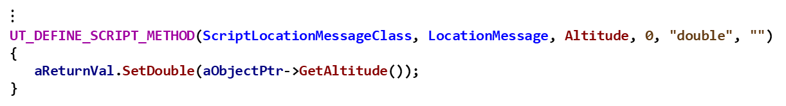
Comm Exercise 4 — Task 3 Solution LocationMessage.cpp
$⋮$
UT_DEFINE_SCRIPT_METHOD(ScriptLocationMessageClass, LocationMessage, Altitude, 0, "double", "")
{
aReturnVal.SetDouble(aObjectPtr->GetAltitude());
}
// EXERCISE 4 TASK 3a
UT_DEFINE_SCRIPT_METHOD(ScriptLocationMessageClass, LocationMessage, Course, 0, "double", "")
{
aReturnVal.SetDouble(aObjectPtr->GetCourse() * UtMath::cDEG_PER_RAD);
}
// EXERCISE 4 TASK 3b
UT_DEFINE_SCRIPT_METHOD(ScriptLocationMessageClass, LocationMessage, Speed, 0, "double", "")
{
aReturnVal.SetDouble(aObjectPtr->GetSpeed());
}

Slide 110
Testing
In Visual Studio
Build the solution in release
Build the INSTALL Project
In ..\comm\data, inspect then run the run_all.bat file
Linux: from the build directory, run:
$ cmake --build . --target all -- -j11
$ cmake --build . --target install -- -j11

Slide 111
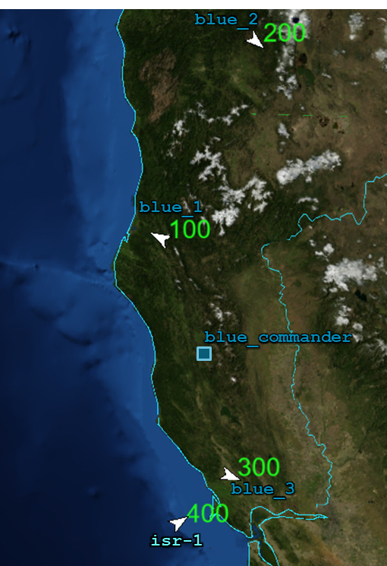

Testing
The program should be tested with two scenario files named comm_scenario1.txt and comm_scenario2.txt located in the “..\comm\data” folder (we will not be using the Wizard for this test).

Slide 112
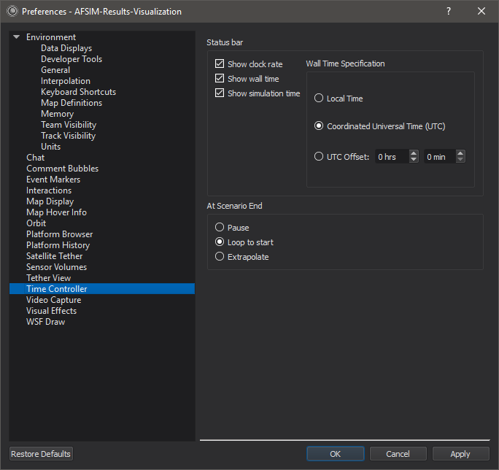
Testing
Mystic will start from the run_all.bat file.
Since the application is viewing a file that is being updated in real-time, it would be best to configure it for this purpose.
In the preferences, set the “At Scenario End” option to “Extrapolate”
Now Mystic will extrapolate when it is played beyond the latest received data from the simulation.

