Slide 1
AFSIM Developer Training
2 – Introduction to WKF
AFRL/RQQD

Slide 2
Acronyms and Definitions
AFSIM - Advanced Framework for Simulation, Integration, and Modeling
AGL – Above Ground Level
DIS – Distributed Interactive Simulation
DTED – Digital Terrain Elevation Data
EO/IR – electro-optical/infra-red
ESM – electronic support measure
FOV – field of view
GUI – graphical user interface
HLA – High Level Architecture
ID – identification
IEEE – Institute of Electrical & Electronics Engineers, Inc.
JTIDS – Joint Tactical Information Distribution System
MSL – Mean Sea Level
OS – Operating System
PC – Personal Computer
PDU – Protocol Data Unit
RCS – radar cross section
SAM – surface-to-air missile
SAR – synthetic aperture radar
VESPA – Visual Environment for Scenario Preparation and Analysis
WSF – World Simulation Framework
dB - decibels
dBsm – decibel square meters
deg – degrees
ft – feet
GHz– GigaHertz
kts – knots
m - meters
m^2 – square meters
mw – megawatts
nm – nautical miles
s – seconds

Slide 3
Introduction
This lab focuses on extending AFSIM-Wizard using the common framework (WKF) written to support all AFSIM visual applications (Wizard, Warlock, and Mystic)
You will build a new C++ WKF based plugin that creates a dock widget to display data and creates an attachment to be displayed on the central map display

Slide 4
Problem Statement
Extend the Wizard application to provide new functionality
Create new visualizations to display on the map
References:
AFSIM Developers Web-based data.
AFSIM Source Codes and Visual Studio search functions.
AFSIM Documentation.

Slide 5
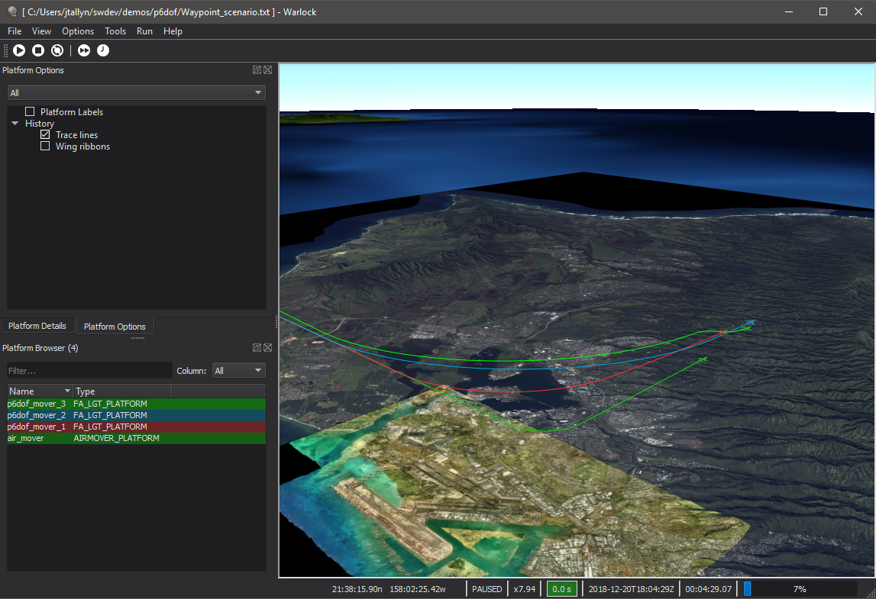
Learning Objectives
You gain hands-on knowledge about:
What WKF and VTK are, and how to use them
How to create a plugin to extend Wizard
How to create attachments and add them to platforms

Slide 6
What is VTK?
Vespa Toolkit
It is the framework that VESPA (legacy tool) was build upon
Used to create and manage the Map Display and the objects displayed within
Located under the tools directory in the directory named “vespatk”

Slide 7
Concepts of VTK
Attachment: a visual element in the scene that is associated with an Entity and Viewer
Entity: representation of a platform within the Scenario which contains a set of elements called Attachments
Environment: contains viewers and scenarios, manages scenario time, and provides access to the application’s factory
Overlay: used to display visual elements in a Viewer that are not associated with an Entity
Scenario: a container of the set of entities loaded in the application
Viewer: controls the visible scene, it is a container of attachments and Overlays

Slide 8
What is WKF?
Warlock Framework (WKF)
Common application code that leverages Qt and VTK to provide core application functionality along with support for Map Displays
This framework was created initially to support development of Warlock, and was later used to create Results Visualization (now called Mystic)
In AFSIM 2.4, Wizard was converted to use WKF
WKF supports extensions via its plugin interface
These plugins can be common to all three applications or restricted to just a single application

Slide 9
What is in WKF?
Core code to create the GUI and supporting functions
This code is used by all WKF applications
Located in tools/wkf/core
Common code that may be used by WKF applications
Contains classes that are not instantiated from within WKF but are commonly used by plugins of different applications
Helps with code reuse on plugins
Located in tools/wkf/common
Plugins that are common to all WKF applications
Located in tools/wkf/plugins

Slide 10
Environment Classes
There are two Environment Classes within WKF:
wkf::Environment (wkfEnv) : provides access to MainWindow, Preferences, Directory paths, user selection, and more.
This is the most commonly used Environment class.
wkf::VtkEnvironment (vaEnv) : extends vespa::VaEnvironment
Plugins use this to access to the Standard Viewer and Standard Scenario

Slide 11
Standard Scenario
The Standard Scenario is the Scenario object that has been registered with the VtkEnvironment class.
The Standard Scenario is of type wkf::Scenario which derives from vespa::VaScenario
The Scenario gives access to Platforms, Attachments can then be added to the Platforms
wkf::Scenario* scenario = vaEnv.GetStandardScenario();
if (scenario != nullptr)
{
//Do Stuff
}
The Standard Scenario may be nullptr, so check against nullptr prior to using the Standard Scenario.

Slide 12
Standard Viewer
The Standard Viewer is the Viewer object that has been registered with the VtkEnvironment class.
The Standard Viewer is of type vespa::VaViewer
Currently the MapDisplay plugin registers this.
Other plugins can change the Standard Viewer if desired but only one Viewer can be designated as the Standard Viewer at a time.
Plugins can add Overlays to the Viewer or control the Camera
if (vaEnv.GetStandardViewer() != nullptr)
{
vaEnv.GetStandardViewer()->AddOverlay(layer);
}
The Standard Viewer may be nullptr, so check against nullptr prior to using the Standard Viewer.

Slide 13
WKF Plugin Interface
wkf::Plugin is an abstract base class that the visual applications inherit for their Plugin classes.
Provides registration interface to plugin manager
Provides methods for interacting with the GUI
Some plugins are common among all WKF applications:
MapDisplay, MapHoverInfo, TetherView, and more

Slide 14
WKF_PLUGIN_DEFINE_SYMBOLS
All plugins must export the necessary symbols to register with the WKF plugin manager
A convenient macro is provided in WkfPlugin.hpp:
WKF_PLUGIN_DEFINE_SYMBOLS(PLUGIN_CLASS, PLUGIN_NAME, DESCRIPTION, TAGS, ...)
Usually placed at the top of the cpp of the Plugin Class
PLUGIN_CLASS : The class name for the Plugin.
PLUGIN_NAME : The pretty name for the plugin as it will appear within the GUI
DESCRIPTION : Description of what the Plugin’s function is
TAGS : A list of bar (‘|’) separated tags used to determine which WKF applications can load the plugin
IE: Warlock will load Plugins with the tag of “all” or “warlock”
OPTIONAL … : Boolean flag indicates whether the plugin is loaded by default (if no value is specified, the plugin will be loaded)

Slide 15
Select wkf::Plugin Virtual Methods
GetPreferencesWidgets() – Returns a list of PrefWidget’s to be displayed in the Preferences dialog
GetActions() – Returns a list of Action’s that the user can bind to keyboard shortcuts in the Preferences dialog
BuildPlatformContextMenu() – Allows a plugin to add items to the context (right-click) menu requested on a platform
GetPlatformData() – Allows a plugin to provide data about the selected platform, whenever the platform selection changes, to be displayed in the Platform Data dialog
RegisterOption() & RegisterOptionGroup() – Define options to appear in the Platform Options dialog. Commonly called within the constructor of a plugin.
LoadSettings() & SaveSettings() – These functions are invoked to allow a plugin to save/load preference data upon user request. SaveSettings is also called when the application exits.
GuiUpdate() – Invoked at a regular rate to allow Plugins to update their displays
Notes:
Not an exhaustive list

Slide 16
CMake for Plugins
Creating a CMakeLists.txt file for a WKF plugin is very simple. WKF has abstracted the required CMake configuration into a single macro that can be called.
Most WKF plugins’ CMakeLists.txt file looks like: plugin_cmakelists_template(MapHoverInfo tools/wkf
LIBRARIES wkf wkf_common)
Some plugins will have additional 3rd party includes:
plugin_cmakelists_template(MapDisplay tools/wkf
THIRD_PARTY_INCLUDE_DIRS osg
LIBRARIES wkf wkf_common)

Slide 17
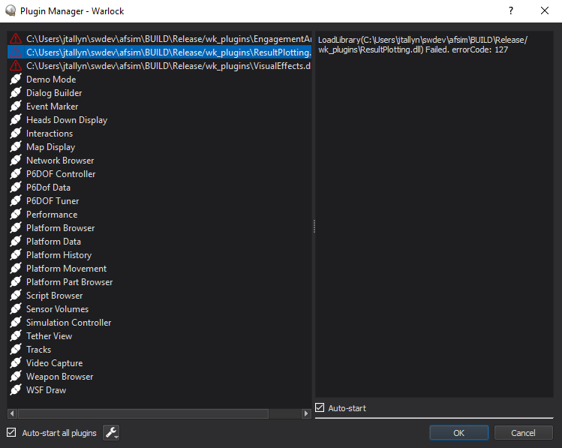
Plugin Manager Dialog
It is not necessary to interact with the WKF plugin manager when creating a plugin. All interactions with the plugin manager are done by the base classes.
Plugin Manager Dialog can be accessed through the menu Options->Plugin Manager...
Displays errors encountered when loading plugins
Can disable auto-starting of plugins. This can be useful when debugging issues with plugins.
Displays description of each plugin

Slide 18
Entity Selection
Platform Selection is handled by wkf::Environment
Methods to modify selection
PlatformSelectionChanged() signal : sent when selection changed
PlatformOfInterestChanged() signal : sent when the platform of interest changes
Platform of Interest is the most recently selected Platform.
This is helpful for displays that do not support multi-select. If your plugin does not support multi-select, then use Platform of Interest.
This allows for better optimization of updates for GUIs
Currently, only the Platform Browser and Map Display plugins modify platform selection

Slide 19
Platform-contextual Dialogs
WKF has two standard dialogs that populate based on the platform selection, to which all plugins can contribute.
Platform Options : Displays boolean options for the selected platform(s), such as the ability to hide/show tracelines
Register options within the constructor of your plugin using the RegisterOption() or RegisterOptionGroup() methods.
Platform Data : Displays data about the platform of interest
Override the GetPlatformData() method and return the list of QTreeWidgetItem’s.
For values that have units, use wkf::UnitTreeWidgetItem which will be discussed more later when we discuss Preferences

Slide 20
Configurations
A configuration is a snapshot of all Preference selections, along with what plugins are loaded, what windows are visible and their positions and sizes.
WKF allows a user to save, load, and import configurations
Window geometry and visibility are automatically saved.
Preferences are saved and loaded via Save/LoadSettings implemented by overriding the functions in wkf::Plugin.
No additional work is required to support configurations.
Configurations can be Saved/Loaded via the File menu
A Configuration file can be specified via the command line using the –cf or –icf options
More about Configurations later, when we discuss Preferences in the Warlock Training presentation.

Slide 21
wkf::MainWindow
The WKF application main window is accessed through wkf::Environment::GetMainWindow()
Methods:
Add menus and GetMenuByName
Add a dialog to the Tools menu
Add DockWidgets
An action to toggle visibility will automatically be added to the View menu
Show a message on the status bar, or access the status bar
Get the central widget (see next slide)

Slide 22
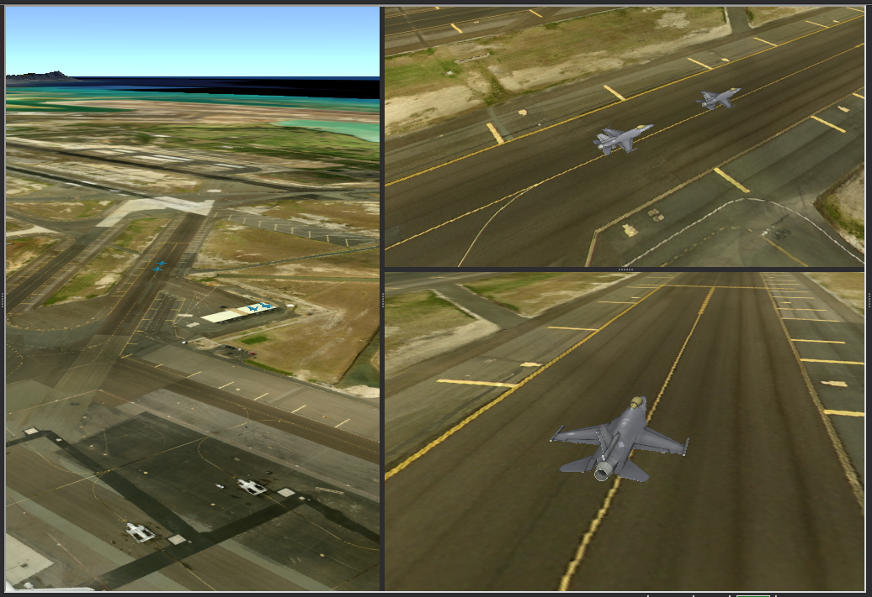
wkf::CentralDisplayWidget
CentralDisplayWidget exists in the center of the MainWindow.
Allows multiple widgets to be displayed in various configurations
wkf::DockWidget’s context menu allows users to move widgets within the central widget and to remove them.

Slide 23
wkf::DockWidget vs QDockWidget
wkf::DockWidget derives from QDockWidget and adds functionality to support interacting with the CentralDisplayWidget.
Functions to support moving to/from central widget
Functions to build the context menu
Saves additional state information into the settings file
Only wkf::DockWidget’s can be added to CentralDisplayWidget, not QDockWidget’s
Recommended to use QDockWidget unless you specifically want your DockWidget to be dockable in the central widget
Hint: Hold ctrl when moving Dock Widgets to prevent them from docking.
Notes:
Majority of dock widgets are QDockWidgets

Slide 24
PluginUiPointer
You may see PluginUiPointer<T> used instead of QPointer<T> in the source code for the visual applications
QPointer is a guarded pointer
PluginUiPointer wraps QPointer and provides memory management which will delete T in its destructor
PluginUiPointer is not required to be used, QPointer can be used instead, just remember to delete the data() in QPointer

Slide 25
WkfPlatform Warning
The Map Display uses WkfPlatform (Not to be confused with WsfPlatform) which derives from VaEntity which is part of VTK.
Attachments may be added to a WkfPlatform from any plugin
Use classes that derive from VaAttachment
WkfPlatform will take ownership of any attachments added to it, and will delete them when the WkfPlatform is deleted.
Examples: Routes, Wing Ribbons, and Platform Model

Slide 26
Attachment Examples
To Create an Attachment:
To Access an attachment:
vespa::make_attachment<wkf::AttachmentRangeRing>(
*platform, vaEnv.GetStandardViewer(), "range_ring");
auto ring = platform->FindAttachment("range_ring");
if (ring != nullptr)
{
//do stuff
}

Slide 27
Menu & Status Bars
The application menu bar and status bar can be accessed through the wkf::MainWindow class.
While it is possible to call any methods inherited from QMainWindow, it is best to use the methods provided in the wkf::MainWindow class:
AddMenu(), GetMenuByName(), AddDialogToToolMenu(), addToolBar(), addDockWidget(), ShowStatusMessage()
These functions handle common interactions plugins have with the MenuBar and StatusBar.
One exception to this is if you want to add a widget to the StatusBar
See SimController plugin for an example of how to handle this.

Slide 28
Exercise Objectives
Create a simple plugin for Wizard
This will be a generic plugin so Warlock and Mystic will also be able to load this plugin
Create a QDockWidget that will say “Hello World”
Add an action to the View menu to display the QDockWidget
When the selected platforms change
Add an Attachment to every selected platform
Remove the attachment from platforms that are no longer selected
Learn to use the Plugin Manager to verify the plugin loaded properly and to see error messages if it did not.

Slide 29
Configuring WKF Training
Edit the file: training/developer/wkf/labs/config.cmake
Ensure the correct Generator is uncommented out
If you are using Visual Studio, be sure the CMAKE_GENERATOR_PLATFORM is uncommented
Uncomment the two lines for Unity builds, if you wish to build using Unity

Slide 30
Configuring WKF Training
In the file: training/developer/wkf/labs/config.cmake
Ensure the following build targets are set to TRUE
BUILD_WKF_PLUGIN_WKF_Training
BUILD_WITH_mission
BUILD_WITH_wizard
BUILD_WITH_wsf_mil
BUILD_WITH_wsf_p6dof
BUILD_WITH_wsf_parser
BUILD_WITH_wsf_space
BUILD_WIZARD_PLUGIN_WizMapAnnotation
BUILD_WIZARD_PLUGIN_WizMysticLauncher
BUILD_WIZARD_PLUGIN_WizPlatformBrowser
BUILD_WIZARD_PLUGIN_WizPlatformData
BUILD_WIZARD_PLUGIN_WizSimulationManager
BUILD_WIZARD_PLUGIN_WizSpaceTools
BUILD_WIZARD_PLUGIN_WizTypeBrowser
BUILD_WIZARD_PLUGIN_WizUnitConversion
BUILD_WIZARD_PLUGIN_WizZoneEditor
BUILD_WKF_PLUGIN_MapDisplay
BUILD_WKF_PLUGIN_MapHoverInfo
BUILD_WKF_PLUGIN_TetherView

Slide 31
Configuring WKF Training (cmd shell)
In a cmd window (Windows):
cd into the main AFSIM folder (contains the training folder)
Execute the following commands:
> cd training\developer\wkf\labs
> scriptpath=%cd%\config.cmake
> cd inwork
> extpath=%cd%
If working in an AFSIM release, execute:
> cd ..\..\..\..\..\swdev\src
Otherwise, execute:
> cd ..\..\..\..\..\afsim
Finally, execute:
> set srcpath=%cd%
> cd ..\build
> rm CMakeCache.txt
> cmake –C %scriptpath% –DWSF_ADD_EXTENSION_PATH:PATH=%extpath% –B . –S %srcpath%

Slide 32
Configuring WKF Training (bash shell)
In a bash shell (git bash in Windows or bash in Linux):
cd into the main AFSIM folder (contains the training folder)
Execute the following commands;
$ cd training/developer/wkf/labs
$ scriptpath=$PWD/config.cmake
$ cd inwork
$ extpath=$PWD
If working in an AFSIM release, execute:
$ cd ../../../../../swdev/src
Otherwise, execute:
$ cd ../../../../../afsim
Finally, execute:
$ srcpath=$PWD
$ cd ../build
$ rm CMakeCache.txt
$ cmake –C $scriptpath –DWSF_ADD_EXTENSION_PATH:PATH=$extpath –B . –S $srcpath

Slide 33
Exercise 1 – Task 1 TrainingPlugin.hpp and TrainingPlugin.cpp
In file TrainingPlugin.hpp, create a class named “Plugin” that derives from wkf::Plugin
In file TrainingPlugin.cpp, call a macro function WKF_PLUGIN_DEFINE_SYMBOLS in the implementation file of the Plugin class
This is a macro that exports the necessary symbols for the PluginManager
WKF_PLUGIN_DEFINE_SYMBOLS has the following format:
#define WKF_PLUGIN_DEFINE_SYMBOLS(PLUGIN_CLASS, PLUGIN_NAME, PLUGIN_DESCRIPTION, PLUGIN_TAGS, …)
This macro takes the following arguments
PLUGIN_CLASS: the c++ class name
PLUGIN_NAME: the name of the plugin for display to users
PLUGIN_DESCRIPTION: a description of the plugin
PLUGIN_TAGS: defines which applications will use/load the plugin
… : an optional boolean specifying whether to load plugin by default

Slide 34
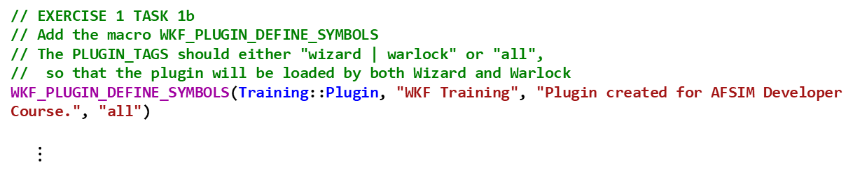
Solution – Exercise 1 Task 1 TrainingPlugin.hpp and TrainingPlugin.cpp
TrainingPlugin.hpp
// EXERCISE 1 TASK 1a
// Derive a new class Plugin from wkf::Plugin
class Plugin : public wkf::Plugin
{
public:
Plugin(const QString& aPluginName,
const size_t aUniqueId);
~Plugin() override = default;
private:
//! Adds range rings to all newly selected platforms.
//! Removes range rings from all unselected platforms.
//! @param aSelected This is a list of newly selected platforms.
//! @param aUnselected This is a list of newly unselected platforms.
void SelectionChanged(const wkf::PlatformList& aSelected,
const wkf::PlatformList& aUnselected);
};
TrainingPlugin.cpp
// EXERCISE 1 TASK 1b
// Add the macro WKF_PLUGIN_DEFINE_SYMBOLS
// The PLUGIN_TAGS should either "wizard | warlock" or "all",
// so that the plugin will be loaded by both Wizard and Warlock
WKF_PLUGIN_DEFINE_SYMBOLS(Training::Plugin, "WKF Training", "Plugin created for AFSIM Developer Course.", "all")
$⋮$

Slide 35
Exercise 1 – Task 2 TrainingPlugin.cpp
In the constructor for the Plugin class:
Task 2a: Access the Main Window from the Environment class
Create a wkf::MainWindow pointer that points to the window returned by a call to wkfEnv::GetMainWindow()
Task 2b: Construct a DockWidget and add the DockWidget to the Main Window
Use the pointer from 2a to invoke AddDockWidget
The first argument should be: Qt::RightDockWidgetArea
The second argument should be a pointer to a new DockWidget
https://doc.qt.io/qt-5/qmainwindow.html#addDockWidget

Slide 36

Solution – Exercise 1 Task 2 TrainingPlugin.cpp
WKF_PLUGIN_DEFINE_SYMBOLS(Training::Plugin, "WKF Training", "Plugin created for AFSIM Developer Course.", "all")
Training::Plugin::Plugin(const QString& aPluginName,
const size_t aUniqueId)
: wkf::Plugin(aPluginName, aUniqueId)
{
// EXERCISE 1 TASK 2a
// Get wkf::MainWindow pointer from WkfEnvironment
wkf::MainWindow* mainWindowPtr = wkfEnv.GetMainWindow();
// EXERCISE 1 TASK 2b
// Add mDockWidget to the Main Window,
// this will also add the action to toggle the visibility of the DockWidget to the View menu
mainWindowPtr->addDockWidget(Qt::RightDockWidgetArea, new DockWidget());
$⋮$

Slide 37
Exercise 1 – Task 3 TrainingDockWidget.ui
Add a QLabel to the DockWidget using QtDesigner
Open TrainingDockWidget.ui
developer\wkf\labs\inwork\1_WKF_Training\ui
Designer.exe is located in the 3rd party package for Qt
afsim\tools\3rd_party\qt-5.9.7-x86-vs2017\bin
If Designer fails to open, you may need to add a qt.conf file to the bin directory
In Designer, Add a QLabel to the DockWidget and change the text to “Hello World”
Qt’s User Interface Compiler (uic) will convert the UI file into source code
https://doc.qt.io/qt-5/uic.html

Slide 38
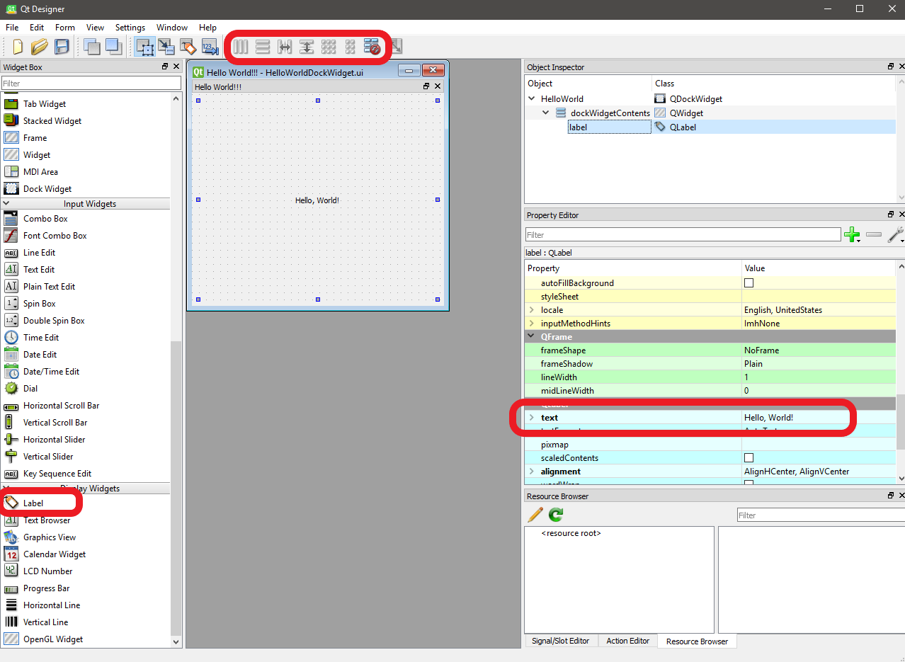
Solution – Exercise 1 Task 3 TrainingDockWidget.ui in QtDesigner

Slide 39
Exercise 1 – Task 4
Add the UI to the DockWidget
Task 4a: In file TrainingDockWidget.hpp, include the generated file that Qt’s UIC made from the UI file
Task 4b: In file TrainingDockWidget.hpp, add a class member variable for the UI
Should be of type Ui::WKF_Training
Task 4c: In TrainingDockWidget.cpp, make sure to call setupUi() on the variable from part 4b in the constructor of DockWidget

Slide 40
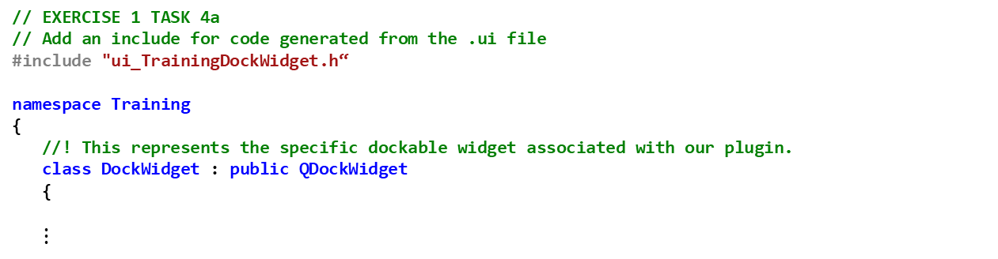
Solution – Exercise 1 Task 4
TrainingDockWidget.hpp
// EXERCISE 1 TASK 4a
// Add an include for code generated from the .ui file
#include "ui_TrainingDockWidget.h“
namespace Training
{
//! This represents the specific dockable widget associated with our plugin.
class DockWidget : public QDockWidget
{
$⋮$
private:
// EXERCISE 1 TASK 4b
// Declare a member variable for the UI element defined in "ui_TrainingDockWidget.h"
Ui::WKF_Training mUI;
};
}
TrainingDockWidget.cpp
Training::DockWidget::DockWidget(QWidget* aParent,
Qt::WindowFlags aWindowFlags)
: QDockWidget(aParent, aWindowFlags)
{
// EXERCISE 1 TASK 4c
// Call setupUI(this) on the UI member variable.
// If setupUI is not called, the UI will be blank
mUI.setupUi(this);
}

Slide 41
Testing
From Windows Visual Studio:
Build the solution in “Release”
Build the “INSTALL” project
From Linux, execute the following commands in the build directory:
$ cmake --build . --target all -- -j12
$ cmake --build . --target install -- -j12
Load the Test Scenario in WIZARD
Located at: training\developer\wkf\labs\data\wkf_training_scenario.txt
Verify the “Hello World!!!” action is in the View menu
Verify the “Hello World!!!” dock widget has a text string saying “Hello World”

Slide 42
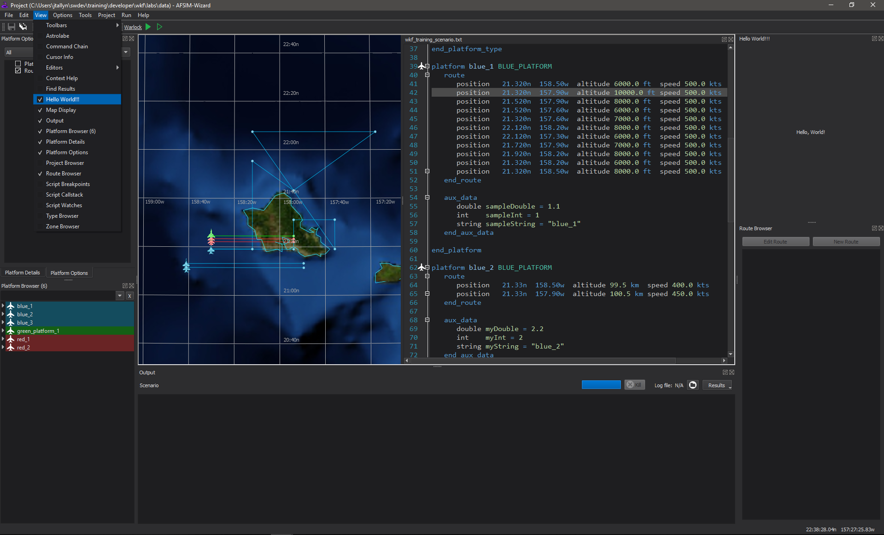
Testing

Slide 43
Exercise 2 – Task 1 TrainingPlugin.cpp
Create a connection between the WkfEnvironment’s PlatformSelectionChanged() signal and the Training::Plugin’s SelectionChanged() function
This will cause Plugin::SelectionChanged() to be called any time the set of selected Platforms changes
Use the following overload of connect:
QObject::connect(
const QObject *sender,
PointerToMemberFunction signal,
const QObject *receiver,
PointerToMemberFunction method,
Qt::ConnectionType type = Qt::AutoConnection)
Should be: &wkfEnv
Should be: &wkf::Environment::PlatformSelectionChanged
Should be: this
Should be: &Training::Plugin::SelectionChanged
Should be left as using the default value
Qt’s Signal and Slot documentation
https://doc.qt.io/qt-5/signalsandslots.html

Slide 44
Solution – Exercise 2 Task 1 TrainingPlugin.cpp
WKF_PLUGIN_DEFINE_SYMBOLS(Training::Plugin, "WKF Training", "Plugin created for AFSIM Developer Course.", "all")
Training::Plugin::Plugin(const QString& aPluginName,
const size_t aUniqueId)
: wkf::Plugin(aPluginName, aUniqueId)
{
// EXERCISE 1 TASK 2a
// Get wkf::MainWindow pointer from WkfEnvironment
wkf::MainWindow* mainWindowPtr = wkfEnv.GetMainWindow();
// EXERCISE 1 TASK 2b
// Add mDockWidget to the Main Window,
// this will also add the action to toggle the visibility of the DockWidget to the View menu
mainWindowPtr->addDockWidget(Qt::RightDockWidgetArea, new DockWidget());
//EXERCISE 2 TASK 1
// Add a connect statement that connects RangeRing::Plugin::SelectionChanged
// to the wkf::Environment::PlatformSelectionChanged signal
connect(&wkfEnv, &wkf::Environment::PlatformSelectionChanged,
this, &Training::Plugin::SelectionChanged);
}

Slide 45
Exercise 2 – Task 2 TrainingPlugin.cpp
Range Ring attachments are defined in the file WkfAttachmentRangeRing.hpp (already included)
Within Plugin::SelectionChanged()
Task 2a: Add a Range Ring attachment to each selected platform
Use vespa::make_attachment<>() defined in VaUtils.hpp (already included) to create the attachment
This should be templated upon a wkf::AttachmentRangeRing
The constructor takes three arguments:
Parent: which is the platform
Viewer: which is the Standard Viewer
Obtained from invoking vaEnv::GetStandardViewer
Unique Name: name the attachment "range_ring"

Slide 46
Solution – Exercise Task 2 TrainingPlugin.cpp
void Training::Plugin::SelectionChanged(const wkf::PlatformList& aSelected,
const wkf::PlatformList& aUnselected)
{
for (auto platform : aSelected)
{
//EXERCISE 2 TASK 2a
// First check to see if an attachment named "range_ring" is on the platform
// If the attachment does not exist, create an attachment using vespa::make_attachment
// The attachment constructor takes three arguments:
// 1. Parent: which the the platform
// 2. Viewer: which is the Standard Viewer
// 3. Unique Name: name the attachment "range_ring"
if (platform->FindAttachment("range_ring") == nullptr)
{
vespa::make_attachment<wkf::AttachmentRangeRing>(*platform, vaEnv.GetStandardViewer(), "range_ring");
}
}
for (auto platform : aUnselected)
{
//EXERCISE 2 TASK 2b
// Find the attachment on the platform with the name "range_ring"
// Remove the attachment from the platform using the attachment's GetUniqueId()
}
}

Slide 47
Exercise – Task 2 TrainingPlugin.cpp
Task 2b: Remove the Range Ring attachment from each platform that is no longer selected
Use the platform’s FindAttachment method to find an attachment with the name “range_ring”
If one is returned, i.e., the returned value is not a nullptr, then remove it from the platform using the platform’s RemoveAttachment method

Slide 48
Solution – Exercise 2 Task 2 TrainingPlugin.cpp
void Training::Plugin::SelectionChanged(const wkf::PlatformList& aSelected,
const wkf::PlatformList& aUnselected)
{
for (auto platform : aSelected)
{
//EXERCISE 2 TASK 2a
// First check to see if an attachment named "range_ring" is on the platform
// If the attachment does not exist, create an attachment using vespa::make_attachment
// The attachment constructor takes three arguments:
// 1. Parent: which the the platform
// 2. Viewer: which is the Standard Viewer
// 3. Unique Name: name the attachment "range_ring"
if (platform->FindAttachment("range_ring") == nullptr)
{
vespa::make_attachment<wkf::AttachmentRangeRing>(*platform, vaEnv.GetStandardViewer(), "range_ring");
}
}
for (auto platform : aUnselected)
{
//EXERCISE 2 TASK 2b
// Find the attachment on the platform with the name "range_ring"
// Remove the attachment from the platform using the attachment's GetUniqueId()
auto ring = platform->FindAttachment("range_ring");
if (ring != nullptr)
{
platform->RemoveAttachment(ring->GetUniqueId());
}
}
}

Slide 49
Testing
From Windows Visual Studio:
Build the solution in “Release”
Build the “INSTALL” project
From Linux, execute the following commands in the build directory:
$ cmake --build . --target all -- -j12
$ cmake --build . --target install -- -j12
Load the Test Scenario in WIZARD
Located at: training\developer\wkf\labs\data\wkf_training_scenario.txt
Change the selected platform via the Map Display or the Platform Browser
You can select multiple platforms using ctrl or shift on the Platform Browser

Slide 50
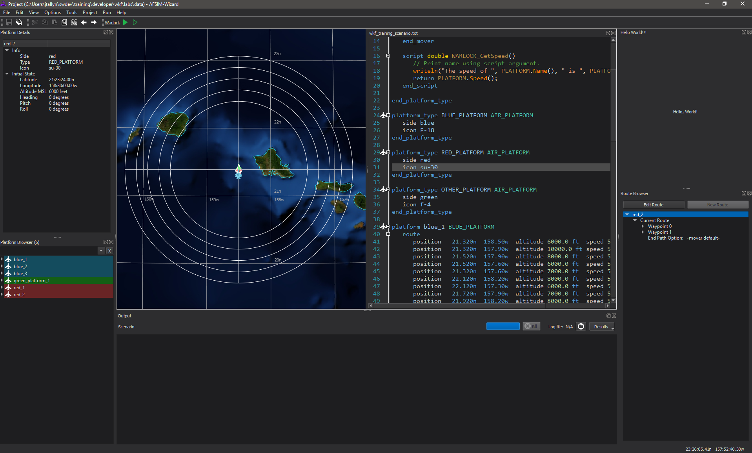
Testing

