Slide 1
AFSIM Developer Training
3 - Warlock
AFRL/RQQD

Slide 2
Acronyms and Definitions
AFSIM - Advanced Framework for Simulation, Integration, and Modeling
AGL – Above Ground Level
DIS – Distributed Interactive Simulation
DTED – Digital Terrain Elevation Data
EO/IR – electro-optical/infra-red
ESM – electronic support measure
FOV – field of view
GUI – graphical user interface
HLA – High Level Architecture
ID – identification
IEEE – Institute of Electrical & Electronics Engineers, Inc.
JTIDS – Joint Tactical Information Distribution System
MSL – Mean Sea Level
OS – Operating System
PC – Personal Computer
PDU – Protocol Data Unit
RCS – radar cross section
SAM – surface-to-air missile
SAR – synthetic aperture radar
VESPA – Visual Environment for Scenario Preparation and Analysis
WSF – World Simulation Framework
dB - decibels
dBsm – decibel square meters
deg – degrees
ft – feet
GHz– GigaHertz
kts – knots
m - meters
m^2 – square meters
mw – megawatts
nm – nautical miles
s – seconds

Slide 3
Introduction
This lab focuses on extending Warlock
You will write a plugin that
Gets data from the simulation
Displays the data to the user
Allows the user to change the heading of the selected platform
You will also connect to the Preference system to
provide hotkeys for the heading actions
provide display options for your plugin

Slide 4
Problem Statement
Extend the Warlock application to provide new functionality
Display data not currently shown in Warlock to the user and allow the user to control the simulation in ways not currently implemented.
References:
AFSIM Developers Web-based data.
AFSIM Source Codes and Visual Studio search functions.
AFSIM Documentation.

Slide 5
Learning Objectives
You gain hands-on knowledge about:
How to create a plugin to extend Warlock
How to connect to the simulation to retrieve data
How to control the simulation
How to connect to settings in Preferences

Slide 6
Warlock
Warlock extends WKF to create an Operator-In-The-Loop (OITL) application
Code is located within the Warlock directory with the following subdirectories:
Plugins: Where Warlock specific plugins go
the general purpose plugins like Map Display are in the WKF/plugins directory
Warlock_core: The library built for Warlock
Warlock_exec: Small directory that contains the main loop
Data: a directory of non-essential stuff that is mostly used for testing
you can safely ignore this directory as nothing in it is used to build or run Warlock

Slide 7
Warlock & Plugins
Warlock can load many different types of plugins:
Warlock will load AFSIM plugins from the wsf_plugins or mission_plugins directory
This allows a scenario that works in Mission to be executed in Warlock too
Warlock will load plugins from the wkf_plugins directory which contains common plugins across all three applications (warlock, wizard, and mystic??)
Warlock will load plugins from the warlock_plugins directory which contains plugins that are only for Warlock

Slide 8
warlock::Environment
Warlock adds one more Environment class, warlock::Environment (simEnv) which is used to access objects that handle simulation data
Plugins can use the Warlock Environment class to access the PlatformManager or the ScriptSimInterface
Access to the simEnv is restricted to the simulation thread only
Access of simEnv on the GUI thread will lead to an exception
The three Environment classes within Warlock can be accessed using the simEnv, wkfEnv, and vaEnv macros

Slide 9
warlock::Plugin
Warlock has a Plugin class that extends wkf::Plugin
Template argument is the SimInterface the plugin will use
Adds the virtual method GetPlotUpdater() which is used to support plotting data on graphs

Slide 10
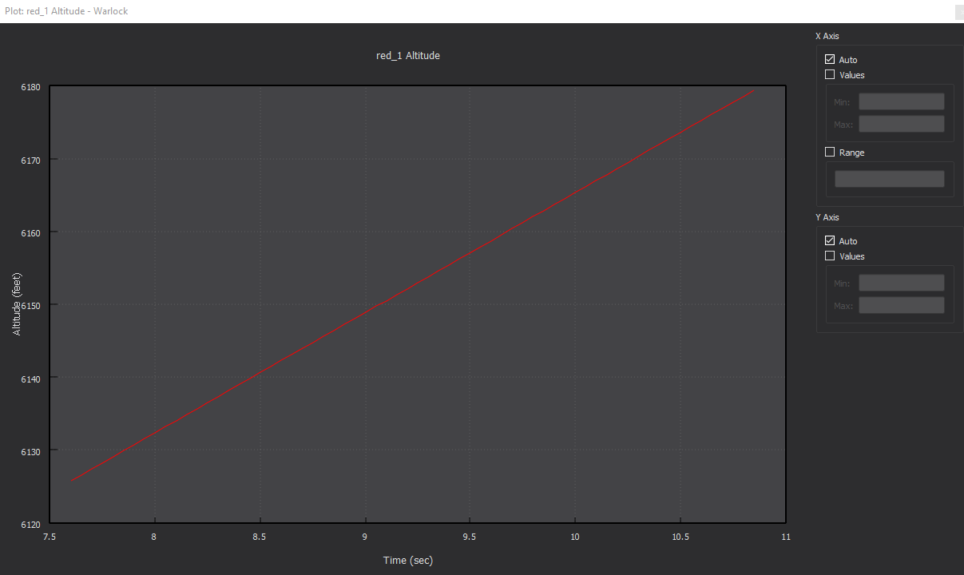
Plotting and Updaters
wkf::PlottingWidget
Derives from wkf::DockWidget, and contains a UtQtGL2DPlot
Provides a default context menu for some common actions
warlock::PlottingWidget
Derives from wkf::PlottingWidget and uses a list of PlotUpdater’s
PlotUpdater is a class designed to fetch data from a WsfSimulation object
When a user launches a plot from Platform Data display, the plugin that provided that TreeWidgetItem has its GetPlotUpdater method called.
If this method does not return a valid Updater, the plot will not update data

Slide 11
Run Manager
The warlock::RunManager is responsible for loading the AFSIM input files, creating a WsfScenario, and managing the thread spawned to run the simulation
It also stores the list of recent scenarios.
Plugins rarely need to access the RunManager but a few do:
DemoMode: On GuiSimulationComplete() it will call LoadScenario() with the most recent scenario.
SimController: Calls LoadScenario() based on user actions

Slide 12
SimInterface
The SimInterface class is the only way to get access to simulation data and thus almost every Warlock Plugin will have one.
Provides thread-safe communication when using SimEvents and SimCommands
Has many virtual methods already connected to simulation events such as PlatformAdded and SimulationStarting.
To use these methods simply override them

Slide 13
SimInterface
Periodic Functions
WallClockRead and SimClockRead
Single-Shot (non-periodic) Functions
All other public virtual functions such as PlatformAdded()
SetEnabled(false) will disable the calls to periodic functions reducing the amount of computation time a plugin requires.
Single-Shot functions will still be called.
Commands will be not be processed until after Enabled is set to true
It is a good idea to disable the SimInterface when periodic updates are not required, such as all displays are closed or hidden.
Notes:
Tuner is disabled until corresponding tuner dialog is opened

Slide 14
SimEvents
SimEvents are messages that are sent from the simulation thread to the GUI thread by calling method SimInterfaceT::AddSimEvent
SimInterfaceT is a class template whose template argument is the user-defined Event type
Each plugin will define its own SimEvent interface with its own Event type(s)
Each SimEvent should have a Process function that dictates how the event is handled on the GUI thread.
Call SimInterfaceT::ProcessEvents() periodically from the GUI thread
Usually done in the Plugin::GuiUpdate() method
Compiler error will occur if arguments to ProcessEvents do not match signature of the SimEvent’s Process method

Slide 15

SimEvent Example
In file SimControllerSimEvents.hpp
class SimControllerEvent : public warlock::SimEvent
{
public:
SimControllerEvent(bool aRecurring = false)
: warlock::SimEvent(aRecurring) {}
virtual void Process(SimControllerDataContainer& aState) = 0;
};
$⋮$
class SimStartingEvent : public SimControllerEvent
{
public:
SimStartingEvent(bool aPaused)
: SimControllerEvent(false)
, mPaused(aPaused) {}
void Process(SimControllerDataContainer& aState) override;
private:
bool mPaused;
const std::string mStateString;
};

Slide 16
SimEvent Example
In file SimControllerSimInterface.cpp
// Add a SimEvent to a SimInterface example
void WkSimController::SimInterface::SimulationStarting(const WsfSimulation& aSimulation)
{
AddSimEvent(ut::make_unique<SimStartingEvent>(aSimulation.IsExternallyStarted()));
}
In file SimControllerSimEvents.cpp
// SimEvent::Process example implementation
void WkSimController::SimStartingEvent::Process(SimControllerDataContainer& aState)
{
aState.SetStarting(mPaused);
}
In file SimControllerPlugin.cpp
// Make sure to call ProcessEvents at a regular interval to read data
void WkSimController::Plugin::GuiUpdate()
{
mInterfacePtr->ProcessEvents(mSimulationState);
mStatusWidgetPtr->Update();
}

Slide 17
Recurring SimEvents
The base class for SimEvents (warlock::SimEvent) has a Boolean argument that can be passed in the constructor named aRecurring.
This indicates if the SimEvent is a recurring message
Warlock will only process the most recent SimEvent of a given type, if the SimEvent is marked recurring
This reduces processing spent on stale data
Very useful when running at multiples of real-time
If you do not use recurring events (when appropriate), it is possible to get into a situation where the Sim thread is generating SimEvents faster than the Gui thread is processing the SimEvents, which will deadlock Warlock

Slide 18
SimCommands
SimCommands are similar to SimEvents except they are messages from the GUI thread to the simulation thread
The SimCommand base class is defined in WkSimInterface.hpp
Process(WsfSimulation&) is a pure virtual function, that gives the SimCommand access to the simulation
Call AddSimCommand to send a SimCommand
SimCommands will have Process() called on them automatically
Process() can be called on wall clock or simulation clock depending on constructor argument

Slide 19
SimCommand Example
In file SimControllerSimCommands.hpp
class SimCommand : public warlock::SimCommand
{
public:
SimCommand()
: warlock::SimCommand(true) {} //Execute these Commands on WallClock timer
protected:
static void SendXIO_Command(WsfSimulation& aSimulation,
WsfXIO_SimTimeCommandPkt::CommandType aType,
double aValue = 0.0);
};
class PauseCommand : public SimCommand
{
public:
PauseCommand(bool aSendDIS)
: SimCommand()
, mSendDIS(aSendDIS) {}
void Process(WsfSimulation& aSimulation) override;
private:
bool mSendDIS;
};

Slide 20
SimCommand Example
In file SimControllerSimCommands.cpp
// SimCommand::Process example implementation
void WkSimController::PauseCommand::Process(WsfSimulation& aSimulation)
{
if (mSendDIS)
{
WsfDisInterface* dis = WsfDisInterface::Find(aSimulation);
if (dis != nullptr)
{
auto pdu = ut::make_unique<WsfDisStopFreeze>(dis);
pdu->SetReason(DisEnum::Control::Reason::RECESS);
dis->PutPdu(aSimulation.GetSimTime(), std::move(pdu));
}
}
SendXIO_Command(aSimulation, WsfXIO_SimTimeCommandPkt::cPAUSE);
aSimulation.Pause();
}
In file SimControllerToolbar.cpp
// Adding a SimCommand to a SimInterface example
mSimInterfacePtr->AddSimCommand(ut::make_unique<PauseCommand>(mSendDIS_PDUs));

Slide 21
Processing SimCommands
SimCommand’s Process() function is automatically called for you, based on the Boolean value of aUseWallClock passed into warlock::SimCommand
aUseWallClock == true : Indicates that this SimCommand should be processed when the Wall Clock advances
aUseWallClock == false : Indicates that this SimCommand should be processed when the Sim Clock advances
Most SimCommands should use the Sim Clock, but any SimCommand you want to process while the Simulation is paused, needs to be handled on the Wall Clock

Slide 22
SimEvents from a SimCommand
Some SimCommands may create responses from the simulation thread that need to be sent back to the GUI thread. This can be done in one of two ways:
Connect to a callback that gets triggered when the SimCommand executes (e.g. WsfPlatformObserver::PlatformDeleted when removing a platform), then sending a SimEvent back to the GUI
If no callback exists, you can create the SimEvent within the SimCommand::Process() function
In file SimControllerSimEvents.cpp
void WkPlatformMovement::LocalRouteRequestCommand::Process(WsfSimulation& aSimulation)
{
wkf::RouteBrowserInterface::RouteInfo info = FindLocalRouteInfo(aSimulation, mPlatformName);
if (mResponseEventType == ROUTE_SELECT)
{
AddSimEvent(ut::make_unique<RouteSelectEvent>(info));
}
else if (mResponseEventType == ROUTE_DIALOG)
{
AddSimEvent(ut::make_unique<RouteDialogEvent>(info));
}
}

Slide 23
SimEvents from a SimCommand
In file PlatformMovementSimCommands.cpp
void WkPlatformMovement::LocalRouteRequestCommand::Process(WsfSimulation& aSimulation)
{
if (mResponseEventType == ROUTE)
{
WsfPlatform* platform = aSimulation.GetPlatformByName(mPlatformName);
if (platform)
{
WsfMover* mover = platform->GetMover();
if (mover)
{
const WsfRoute* route = mover->GetRoute();
if (route != nullptr)
{
AddSimEvent(ut::make_unique<RouteEvent>(platform->GetIndex(),
mPlatformName,
route));
}
}
}
}
else if (!mPlatformName.empty())
{
wkf::RouteBrowserInterface::RouteInfo info = FindLocalRouteInfo(aSimulation, mPlatformName);
if (mResponseEventType == ROUTE_SELECT)
{
AddSimEvent(ut::make_unique<RouteSelectEvent>(info));
}
else if (mResponseEventType == ROUTE_DIALOG)
{
AddSimEvent(ut::make_unique<RouteDialogEvent>(info));
}
}
}

Slide 24
WsfEvents in SimCommands
When processing a SimCommand that requires additional processing to happen in the future, create a WsfEvent and add the event to the WsfSimulation’s event queue.
In file SimControllerSimCommands.cpp
void WkSimController::AdvanceToTimeCommand::Process(WsfSimulation& aSimulation)
{
...
aSimulation.AddEvent(ut::make_unique<WsfOneShotEvent>(mSimTime, [=, &aSimulation]()
{
aSimulation.SetRealtime(simTime, true);
// Need to call resume due to the real-time clock being deleted and re-created,
// and the new clock potentially expecting a Resume() command.
pause ? aSimulation.Pause() : aSimulation.Resume();
}));
aSimulation.SetRealtime(aSimulation.GetSimTime(), false);
}
Do not create additional SimCommands from another SimCommand as this leads to bad programming practices

Slide 25
ScriptSimInterface
ScriptSimInterface is a specialized SimInterface to handle interaction with AFSIM scripts.
Get global and platform script information
Execute both global and platform scripts
Can be accessed from Warlock Environment
simEnv.GetScriptSimInterface()
Do not create your own instantiation of this class, all plugins that need access to script information can use the same instantiation (through std::shared_ptr)
Used by the DialogBuilder and ScriptBrowser plugins

Slide 26
Sending DIS & XIO Messages
DIS and XIO messages can be sent from Warlock plugins (from the Simulation thread)

Slide 27


Sending DIS & XIO Messages
In file SimControllerSimCommands.cpp
void WkSimController::SimCommand::SendXIO_Command(WsfSimulation& aSimulation,
WsfXIO_SimTimeCommandPkt::CommandType aType,
double aValue /*= 0.0*/)
{
WsfXIO_Interface* xio = WsfXIO_Extension::Find(aSimulation);
if (xio)
{
WsfXIO_SimTimeCommandPkt pkt;
pkt.mCommandType = aType;
pkt.mSimTime = aValue;
for (auto connection : xio->GetReliableConnections())
{
connection->Send(pkt);
}
}
$⋮$
}
void WkSimController::PauseCommand::Process(WsfSimulation& aSimulation)
{
if (mSimDIS)
{
WsfDisInterface* dis = WsfDisInterface::Find(aSimulation);
if (dis != nullptr)
{
auto pdu = ut::make_unique<WsfDisStopFreeze>(dis);
pdu->SetReason(DisEnum::Control::Reason::RECESS);
dis->PutPdu(aSimulation.GetSimTime(), std::move(pdu));
}
$⋮$

Slide 28
Thread Safety
Warlock works by launching AFSIM on a separate thread. This means thread safety has to be considered when communicating with the simulation.
Use mutexes to lock critical sections of code.
This is typically done when reading/writing member data of the SimInterface class that can be accessed from both threads.
Lock only critical sections.
Avoid holding onto the lock longer than necessary as it affects performance.
SimInterface provides a QMutex to lock data
Use SimEvents and SimCommands to reduce and potentially remove the need to mutex lock within your plugin
Within Warlock the two threads are commonly referred to as the GUI (or Main) Thread and the Sim Thread.

Slide 29
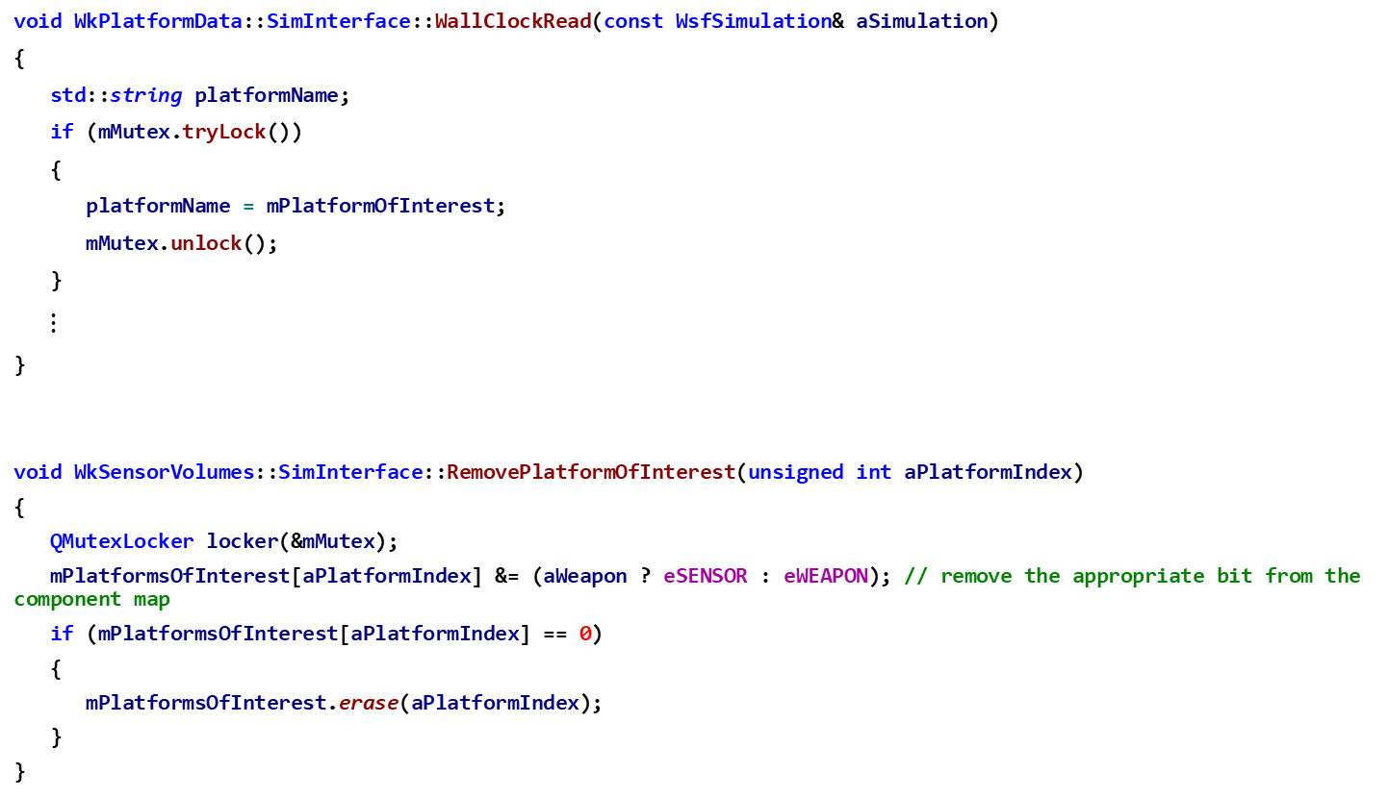
Mutex Locking Examples
In file PlatformDataSimInterface.cpp
void WkPlatformData::SimInterface::WallClockRead(const WsfSimulation& aSimulation)
{
std::string platformName;
if (mMutex.tryLock())
{
platformName = mPlatformOfInterest;
mMutex.unlock();
}
$⋮$
}
void WkSensorVolumes::SimInterface::RemovePlatformOfInterest(unsigned int aPlatformIndex)
{
QMutexLocker locker(&mMutex);
mPlatformsOfInterest[aPlatformIndex] &= (aWeapon ? eSENSOR : eWEAPON); // remove the appropriate bit from the component map
if (mPlatformsOfInterest[aPlatformIndex] == 0)
{
mPlatformsOfInterest.erase(aPlatformIndex);
}
}
Use tryLock() because it is not critical that we update this frame since this is a periodic call.
Store platformName in a local variable and release the mutex to reduce the impact of the critical section.
In file SensorVolumesSimInterface.cpp
lock() or use of QMutexLocker will block until the mutex is available before allowing processing to continue. This should be used on all events that are non-periodic.

Slide 30
Deadlocking
Incorrect usage of a mutex can lead to deadlock.
This happens when a mutex is not released, and another portion of code is waiting for the mutex to be released so that it can lock it.
Make sure to release the mutex lock anytime you lock the mutex.
QMutexLocker is a helper class that provides scoped locking
Locks the mutex in its constructor and will unlock when the QMutexLocker goes out of scope (in its destructor).
https://doc.qt.io/qt-5/qmutexlocker.html

Slide 31
Conditions for Deadlock
Review of multi-threaded programming issues:
Four Necessary and Sufficient Conditions for Deadlock
Mutual Exclusion
The resource involved must be unshareable
Hold and Wait (or partial allocation)
Threads must hold the resources they have already been allocated while waiting for other (requested) resources
No Preemption
Threads must not have resources taken away from them while that resource is being used
Resource waiting or Circular Wait
A circular chain of threads, with each holding resources which are currently being requested by the next thread in the chain
All four conditions must exist for a deadlock to actually occur
This is easy to achieve in Warlock since there is only one thread executing the simulation code, and thus acquiring locks/mutexes

Slide 32
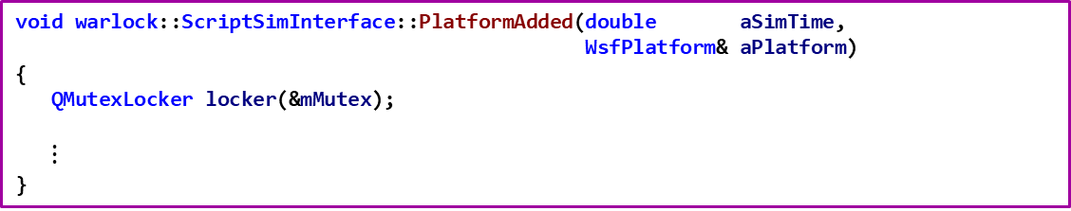
Common Deadlocking Issues
It is common to have a function connected to the PlatformAdded() callback within a SimInterface. This function will usually lock a mutex within it.
When executing a Script or Platform::Update() call, a new Platform may be created (which invokes a callback to PlatformAdded).
This means if the mutex is locked when you execute a Script or call Platform::Update, your code will Deadlock.
In file WkScriptSimInterface.cpp
void warlock::ScriptSimInterface::PlatformAdded(double aSimTime,
WsfPlatform& aPlatform)
{
QMutexLocker locker(&mMutex);
$⋮$
}
This can potentially lead to a deadlock. If the method/function
that added the platform to the simulation already holds a lock
on mMutex, then when the callback to PlatformAdded gets
invoked, it will deadlock when trying to acquire the lock.

Slide 33
Common Deadlocking Issues
The previous slide describes a situation where a thread has a lock on a resource, and then attempts to re-acquire that same resource that it is already holding
The thread is involved in a circular wait condition with itself

Slide 34
Queueable Message Object
wkf::QueueableMessageObject wraps QMessageBox with built-in functionality to queue itself on the GUI’s event loop when called from the simulation thread.
Allows developer to display warnings and errors to the user without concerning themselves with threading issues.
wkf::QueueableMessageObject::DisplayQueuedMessage(
QMessageBox::Warning, "Script Error", “Insert Warning Message Here");

Slide 35
Note:
The next few slides describe Configurations and Preferences.
Even though this is the Warlock Training Slides, accessing and using Configurations and Preferences is common between Warlock, Wizard, and Mystic

Slide 36
Configurations
A configuration is a snapshot of all Preference selections, along with what plugins are loaded, what windows are visible and their positions and sizes.
Warlock allows a user to save, load, and import configurations
Window geometry and whether dialogs created within a plugin are shown, is automatically saved.
Preferences are saved and loaded via Save/LoadSettings implemented by overriding the functions in wkf::Plugin.
No additional work is required to support configurations.

Slide 37
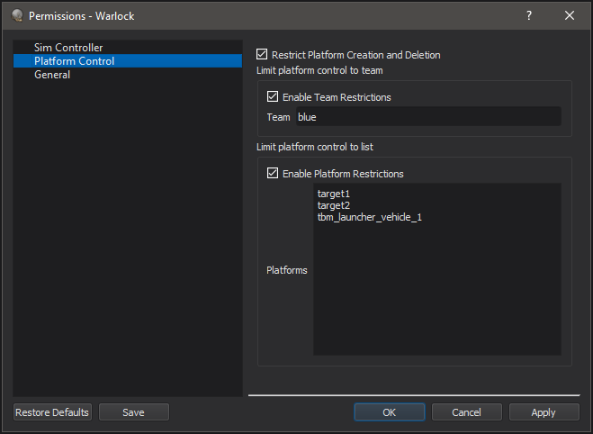
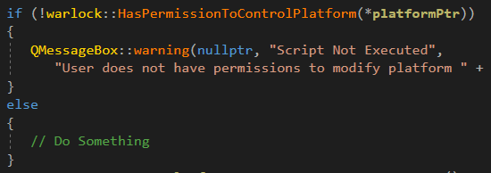
Permissions
Prior to creating, removing , or modifying a Platform, check to see if the user has permission.
Call the following functions (WkPermissions.hpp):
warlock::HasPermissionToControlPlatform()
warlock::HasPermissionToCreateOrRemovePlatforms()

Slide 38
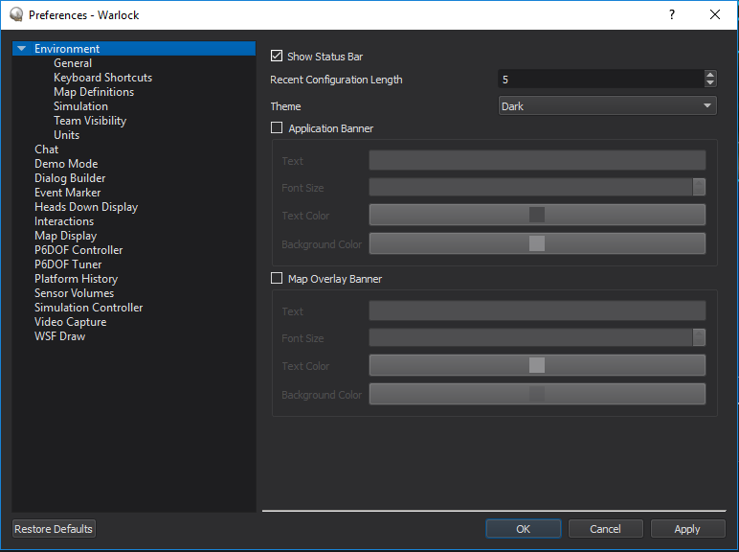
Preferences
Common to all WKF applications
The Preferences dialog provides a few application standard options under ‘Environment’
Specify which maps to load
Define keyboard shortcuts
Change default units
Plugins can add their own options
Define a PrefObject to contain data
Define a PrefWidget to display data
Override GetPreferencesWidgets()
in your Plugin Class

Slide 39
PrefObject & PrefWidget
PrefObject handles the reading and writing of options to and from a file.
When options are changed, the class emits a signal to notify subscribers of the change (including corresponding PrefWidget to update its display).
PrefWidget handles the display of options
Is interface to a plugin’s preferences inside the Preferences dialog
A plugin’s PrefWidget will derive from the PrefWidgetT class template, with the PrefObject as template argument
Should only interact with its PrefObject
No class should get information directly from PrefWidget, but instead get information from the PrefObject.
Do not emit signals from PrefWidget

Slide 40
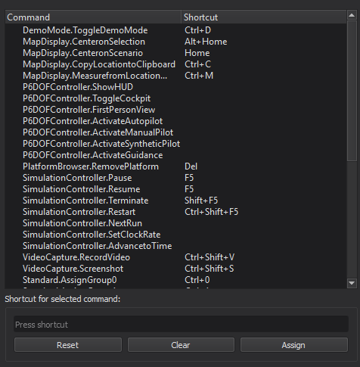
Key Bindings & wkf::Action
To add actions to Keyboard Shortcuts page in Preferences dialog, override GetActions() in your plugin class.
Return list of wkf::Action
wkf::Action derives from QAction
Has a default key sequence
Allows user to rebind the key sequence
Allows user to revert to the default
User modifications to key sequences will be saved, no additional work in plugin required.

Slide 41
Units
The Units page controls what units Warlock should use for displaying different value types.
Using these units within a plugin is easy
WkfUnitTypes.hpp defines items for displaying values within trees and tables, already integrated with the Unit preferences.
The items will automatically convert units, and update when default units are changed by the user
Simply declare the type of item:
mSpeed = new wkf::SpeedTreeWidgetItem(aParentItem, "Speed: ");
Make sure to use Unit Items when applicable - having units displayed that don’t match the rest of the application looks terrible.

Slide 42
warlock::net::Network
The warlock::net::Network is a Warlock-to-Warlock multicast network interface that approximates distributed signals and slots.
Access with wkEnv.GetNetwork();

Slide 43
Network Examples
Using DerivePacket<DemoPacket> adds machinery required for calling the correct callbacks.
// Defining a packet type.
using namespace warlock::net;
struct DemoPacket : DerivePacket<DemoPacket>
{
QString PacketType() const override { return "DemoPacket"; }
Field<PlatformId> mPlatform{ this, "platform" };
Field<Int32> mData{ this, "data" };
};
// Sending a packet.
DemoPacket pkt;
pkt.mPlatform->SetPlatform(platformPtr);
pkt.mData->Set(value);
bool success = wkEnv.GetNetwork().Publish(pkt);
// Defining a callback.
void Plugin::OnPacketReceived(const DemoPacket& aPacket)
{
warlock::Platform* platform = aPacket.mPlatform->GetPlatform();
int value = aPacket.mData->Get();
if (platform != nullptr)
{ ... }
}
// Subscribing to DemoPacket.
wkEnv.GetNetwork().RegisterPacket<DemoPacket>();
mCallbacks += wkEnv.GetNetwork().Subscribe<DemoPacket>(&Plugin::OnPacketReceived, this);
By adding Fields, data serialization and deserialization is handled automatically.
Field types include Boolean, Int32, Float32, Float64, String, Color, PlatformId, List<T>, and custom objects.
The subscription callback must be added to a UtCallbackHolder.

Slide 44
Structure of a Warlock Plugin
The common components of a plugin are:
Plugin Class (required)
PrefObject & PrefWidget
SimInterface
SimEvents
SimCommands
Display Widget such as DockWidget or Dialogs
DataContainer to store information from simulation
PlotUpdaters
Types file to define custom data types

Slide 45
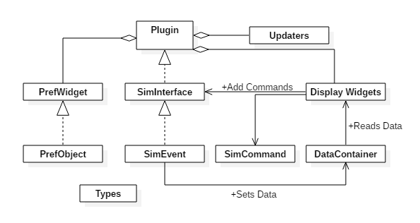
Warlock Plugin Diagram
Notes:
PrefWidget has PrefObject as a templated type. Warlock plugin has SimInterface as its template type. SimInterface has SimEvent as a template type

Slide 46
Plugin Examples
Many plugins exist in Warlock and can be used for reference.
Some good plugins to use as examples are:
DemoMode, because it is a very simple plugin
SimController, because it interacts with the simulation both to read data, and control the simulation
PlatformData, because it shows how to use Updaters and write data to the contextual dialogs

Slide 47
Exercises
Create a Warlock plugin that:
Gets the position & heading information for the selected platform and display them in a DockWidget
Provides button in the DockWidget to turn the selected platform and provide hotkeys for these actions.
Create a Preference Widget that allows the user to configure the information shown on the DockWidget

Slide 48
Configuring Warlock Training
In the file: training/developer/wkf/labs/config.cmake
Ensure the following build targets are set to TRUE
BUILD_WARLOCK_PLUGIN_WarlockTraining
BUILD_WITH_warlock
BUILD_WITH_wsf_mil
BUILD_WITH_wsf_p6dof
BUILD_WITH_wsf_parser
BUILD_WITH_wsf_space
BUILD_WARLOCK_PLUGIN_P6dofController
BUILD_WARLOCK_PLUGIN_P6dofData
BUILD_WARLOCK_PLUGIN_PlatformBrowser
BUILD_WARLOCK_PLUGIN_PlatformData
BUILD_WARLOCK_PLUGIN_SimController
BUILD_WARLOCK_PLUGIN_VisualEffects
BUILD_WIZARD_PLUGIN_WizMapAnnotation
BUILD_WKF_PLUGIN_MapDisplay
BUILD_WKF_PLUGIN_MapHoverInfo
BUILD_WKF_PLUGIN_TetherView

Slide 49
Configuring Warlock Training (cmd shell)
In a cmd window (Windows):
cd into the main AFSIM folder (contains the training folder)
Execute the following commands:
> cd training\developer\wkf\labs
> scriptpath=%cd%\config.cmake
> cd inwork
> extpath=%cd%
If working in an AFSIM release, execute:
> cd ..\..\..\..\..\swdev\src
Otherwise, execute:
> cd ..\..\..\..\..\afsim
Finally, execute:
> set srcpath=%cd%
> cd ..\build
> rm CMakeCache.txt
> cmake –C %scriptpath% –DWSF_ADD_EXTENSION_PATH:PATH=%extpath% –B . –S %srcpath%

Slide 50
Configuring Warlock Training (bash shell)
In a bash shell (git bash in Windows or bash in Linux):
cd into the main AFSIM folder (contains the training folder)
Execute the following commands;
$ cd training/developer/wkf/labs
$ scriptpath=$PWD/config.cmake
$ cd inwork
$ extpath=$PWD
If working in an AFSIM release, execute:
$ cd ../../../../../swdev/src
Otherwise, execute:
$ cd ../../../../../afsim
Finally, execute:
$ srcpath=$PWD
$ cd ../build
$ rm CMakeCache.txt
$ cmake –C $scriptpath –DWSF_ADD_EXTENSION_PATH:PATH=$extpath –B . –S $srcpath

Slide 51
Exercise 1 Review 1 Types.hpp
Inspect Types.hpp
Notice that struct PlatformData contains four member variables corresponding to a platforms latitude, longitude, altitude, and heading
namespace WarlockTraining
{
struct PlatformData
{
double mLatitude = 0;
double mLongitude = 0;
double mAltitude = 0;
double mHeading = 0;
};
}

Slide 52
Exercise 1 Review 2 SimInterface.hpp
Inspect SimInterace.hpp
Notice that SimInterface inherits from warlock::SimInterfaceT<EventBase>
namespace WarlockTraining
{
//! This represents the specific simulation interface we are creating.
//! Inheriting from warlock::SimInterfaceT<T> tells the class what type of
//! event the interface creates.
class SimInterface : public warlock::SimInterfaceT<EventBase>
{
Q_OBJECT
public:
SimInterface(const QString& aPluginName);
//! Creates an UpdateEvent.
//! This function will be updated every time the simulation clock updates.
//! @param aSimulation This is the simulation whose clock updated.
void SimulationClockRead(const WsfSimulation& aSimulation) override;
};
}

Slide 53

Exercise 1 Review 3 Plugin.hpp
In Plugin.hpp, notice the 3 methods and the 4 member variables
$⋮$
class Plugin : public warlock::PluginT<WarlockTraining::SimInterface>
{
public:
Plugin(const QString& aPluginName,
const size_t aUniqueId);
~Plugin() override = default;
//! Called periodically to update the GUI.
void GuiUpdate() override;
//! Returns a list of the preferences widgets that this plugin provides.
//! @note Without this function, the PrefWidget for this plugin will not appear in the Preferences menu.
QList<wkf::PrefWidget*> GetPreferencesWidgets() const override;
//! Returns a list of the actions that this plugin provides.
//! @note Without this function, the actions for this plugin will do nothing.
QList<wkf::Action*> GetActions() const override;
private:
//! The container of Data of this plugin
DataContainer mDataContainer;
//! The preferences widget to display.
PluginUiPointer<PrefWidget> mPrefWidget;
//! The DockWidget that displays information
PluginUiPointer<DockWidget> mDockWidget;
//! The actions that this plugin uses.
QList<wkf::Action*> mActions;
};

Slide 54

Exercise 1 Review 4 SimEvents.hpp
In SimEvents.hpp,
notice the class EventBase and the class UpdateEvent
Notice the Process method in each class
$⋮$
class EventBase : public warlock::SimEvent
{
public:
EventBase(bool aRecurring)
: warlock::SimEvent(aRecurring) {}
//! All event types should have a Process function. The arguments can vary depending on need.
virtual void Process(DataContainer& aDataContainer) = 0;
};
//! This is an event that represents the clock updating.
class UpdateEvent : public EventBase
{
public:
UpdateEvent(const std::map<std::string, PlatformData>& aData);
//! Processes the event by updating the DockWidget's display.
void Process(DataContainer& aDataContainer) override;
private:
//! Data about all platforms' position and heading.
std::map<std::string, PlatformData> mData;
};

Slide 55
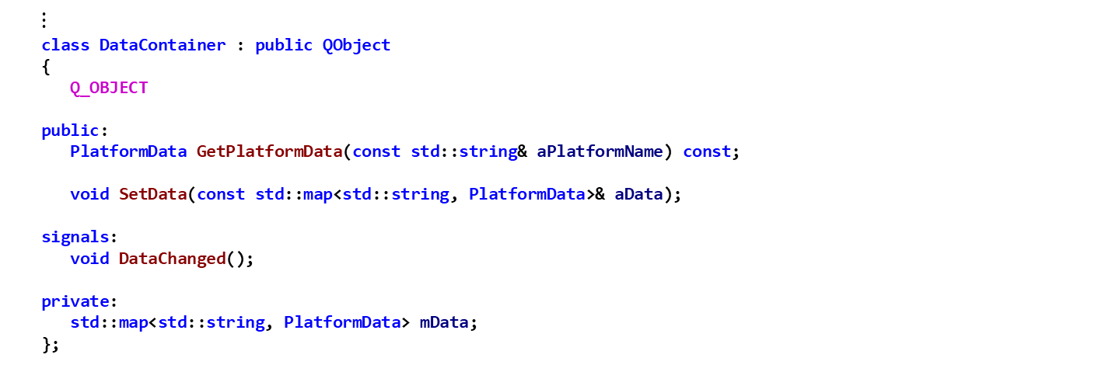
Exercise 1 Review 5 DataContainer.hpp
In DataContainer.hpp,
notice the class methods
Notice the Qt signal DataChanged
Notice the private member variable
$⋮$
class DataContainer : public QObject
{
Q_OBJECT
public:
PlatformData GetPlatformData(const std::string& aPlatformName) const;
void SetData(const std::map<std::string, PlatformData>& aData);
signals:
void DataChanged();
private:
std::map<std::string, PlatformData> mData;
};

Slide 56
Exercise 1 – Task 1
Get the Position and Heading information from platforms in the Simulation
Create an UpdateEvent in the WarlockTraining::SimInterface::SimulationClockRead method in SimInterface.cpp
Invoke AddSimEvent with an argument that is a new unique_ptr to an UpdateEvent that is constructed with the std::map PlatformData from above
Implement WarlockTraining::UpdateEvent::Process in SimEvents.cpp
Invoke aDataContainer’s SetData method and pass in mData
For the WarlockTraining::DataContainer::SetData method, store the data in the DataContainer and notify subscribers of the changes in DataContainer.cpp
Call ProcessEvents() on the SimInterface in the WarlockTraining::Plugin::GuiUpdate method in Plugin.cpp
The argument to ProcessEvents is the Plugin class’ DataContainer member

Slide 57
Solution – Exercise 1 Task 1.a SimInterface.cpp
void WarlockTraining::SimInterface::SimulationClockRead(const WsfSimulation& aSimulation)
{
std::map<std::string, PlatformData> platformData;
// For each platform, add its information to dataForEvent.
for(std::size_t i = 0; i < aSimulation.GetPlatformCount(); i++)
{
WsfPlatform* platform = aSimulation.GetPlatformEntry(i);
if (platform)
{
PlatformData& dataBeingRead = platformData[platform->GetName()];
//Get the position information for the platform
platform->GetLocationLLA(dataBeingRead.mLatitude,
dataBeingRead.mLongitude,
dataBeingRead.mAltitude);
//Dummy variables for in-out parameters.
double pitch, roll;
//Get the heading information for the platform
platform->GetOrientationNED(dataBeingRead.mHeading, pitch, roll);
}
}
// EXERCISE 1 TASK 1a
// Create the UpdateEvent and then add it to the SimInterface
// note: std::make_unique can't be used until c++14,
// since AFSIM is c++11 we have to use ut::make_unique instead.
AddSimEvent(ut::make_unique<UpdateEvent>(platformData));
}

Slide 58
Solution – Exercise 1 Task 1.b, 1.c, 1.d
SimEvents.cpp
void WarlockTraining::UpdateEvent::Process(DataContainer& aDataContainer)
{
// EXERCISE 1 TASK 1b
// Add mData to the DataContainer
aDataContainer.SetData(mData);
}
DataContainer.cpp
void WarlockTraining::DataContainer::SetData(const std::map<std::string, PlatformData>& aData)
{
// EXERCISE 1 TASK 1c
// Store aData and emit the DataChanged() signal
mData = aData;
emit DataChanged();
}
Plugin.cpp
void WarlockTraining::Plugin::GuiUpdate()
{
// EXERCISE 1 TASK 1d
// Call ProcessEvents on the SimInterface so that we can process the SimEvents we have created
// Remember the argument to ProcessEvents is the DataContainer
mInterfacePtr->ProcessEvents(mDataContainer);
}

Slide 59
Exercise 1 – Review 6
Inspect DockWidget.hpp
Notice: TurnToHeading, PlatformOfInterestChanged, PreferencesChanged, and UpdateDisplay are the slots (targets) of signals that are established in DockWidget.cpp
Notice the member variables:
mPlatformOfInterest
mSimInterface
mDataContainer
mUI

Slide 60
Exercise 1 Review 6 DockWidget.hpp
namespace WarlockTraining
{
//! This represents the specific dockable widget associated with our plugin.
class DockWidget : public QDockWidget
{
// This line is required for Qt signals to be properly emitted from this class.
Q_OBJECT
public:
DockWidget(SimInterface& aSimInterface,
DataContainer& aDataContainer,
PrefObject* aPrefObject,
Qt::WindowFlags aWindowFlags = Qt::WindowFlags());
void TurnToHeading(double aHeading);
private:
void PlatformOfInterestChanged(wkf::Platform* aPlatform);
void PreferencesChanged(const PrefData& aPrefData);
void UpdateDisplay();
std::string mPlatformOfInterest;
SimInterface& mSimInterface;
DataContainer& mDataContainer;
//! This contains all of the components that will appear on the screen.
//! The Ui::WarlockTraining class is generated from the file "SimListenerDockWidget.ui".
//! Its name comes from the "objectName" field.
Ui::WarlockTraining mUI;
};
}

Slide 61
Exercise 1 – Task 2
Display the Position and Heading information for the Platform of Interest on the DockWidget
In DockWidget.cpp
connect the DataContainer’s DataChanged signal to the DockWidget’s UpdateDisplay method
Connect the wkf::Environment’s PlatformOfInterestChanged signal to the DockWidget’s PlatformOfInterestchanged method
Update the displays to show the data that was received from the DataContainer
Invoke SetValue on each LineEdit member of mUI for latitude, longitude, altitude, and heading

Slide 62
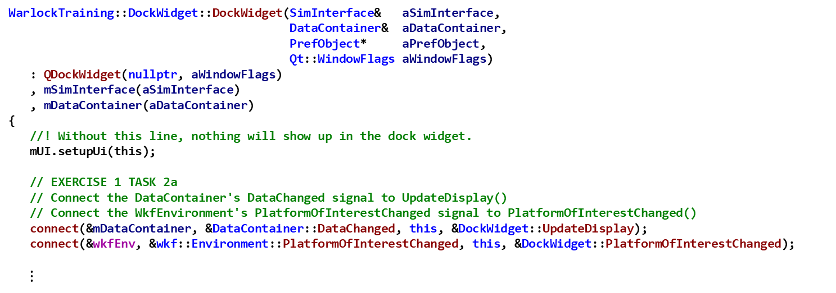
Solution – Exercise 1 Task 2 DockWidget.cpp
WarlockTraining::DockWidget::DockWidget(SimInterface& aSimInterface,
DataContainer& aDataContainer,
PrefObject* aPrefObject,
Qt::WindowFlags aWindowFlags)
: QDockWidget(nullptr, aWindowFlags)
, mSimInterface(aSimInterface)
, mDataContainer(aDataContainer)
{
//! Without this line, nothing will show up in the dock widget.
mUI.setupUi(this);
// EXERCISE 1 TASK 2a
// Connect the DataContainer's DataChanged signal to UpdateDisplay()
// Connect the WkfEnvironment's PlatformOfInterestChanged signal to PlatformOfInterestChanged()
connect(&mDataContainer, &DataContainer::DataChanged, this, &DockWidget::UpdateDisplay);
connect(&wkfEnv, &wkf::Environment::PlatformOfInterestChanged, this, &DockWidget::PlatformOfInterestChanged);
$⋮$
void WarlockTraining::DockWidget::UpdateDisplay()
{
//Get the data for the platform of interest from the DataContainer
PlatformData data = mDataContainer.GetPlatformData(mPlatformOfInterest);
mUI.nameOutput->setText(QString::fromStdString(mPlatformOfInterest));
// EXERCISE 1 TASK 2b
// Using the PlatformData, set the value to display in the latitude, longitude, altitude, and heading LineEdits
mUI.latitudeLineEdit->SetValue(data.mLatitude);
mUI.longitudeLineEdit->SetValue(data.mLongitude);
mUI.altitudeLineEdit->SetValue(data.mAltitude);
mUI.headingLineEdit->SetValue(data.mHeading);
}

Slide 63
Exercise 1 – Task 3
In DockWidget.cpp, implement logic that sends a TurnCommand when one of the four buttons (north, east, south, west) is clicked.
Connect the four buttons’ clicked() signal to call TurnToHeading() with the correct value as the heading (north is 0 deg, east is 90 deg, south is 180 deg, and west is 270 deg)
In TurnToHeading, create a TurnCommand and add it to the SimInterface
Invoke AddSimCommand with an argument that is a new unique_pointer to a TurnCommand, constructed with the variables mPlatformOfInterest, and aHeading

Slide 64
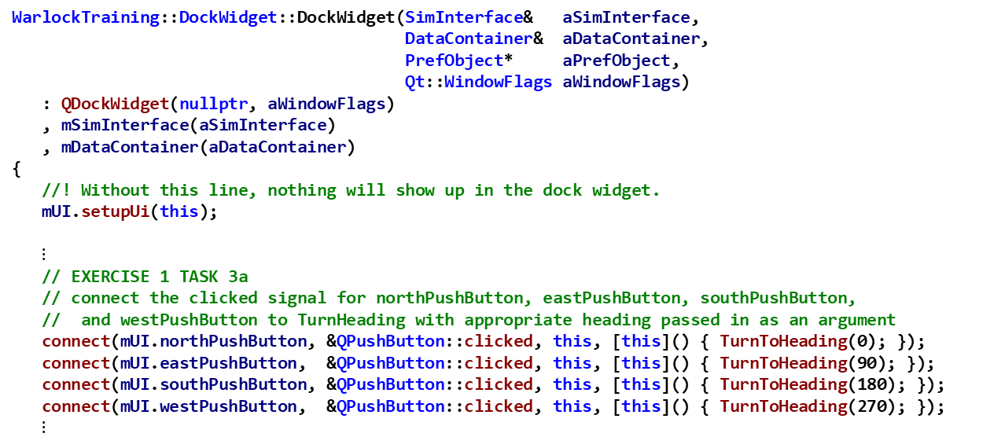
Solution – Exercise 1 Task 3 DockWidget.cpp
WarlockTraining::DockWidget::DockWidget(SimInterface& aSimInterface,
DataContainer& aDataContainer,
PrefObject* aPrefObject,
Qt::WindowFlags aWindowFlags)
: QDockWidget(nullptr, aWindowFlags)
, mSimInterface(aSimInterface)
, mDataContainer(aDataContainer)
{
//! Without this line, nothing will show up in the dock widget.
mUI.setupUi(this);
$⋮$
// EXERCISE 1 TASK 3a
// connect the clicked signal for northPushButton, eastPushButton, southPushButton,
// and westPushButton to TurnHeading with appropriate heading passed in as an argument
connect(mUI.northPushButton, &QPushButton::clicked, this, [this]() { TurnToHeading(0); });
connect(mUI.eastPushButton, &QPushButton::clicked, this, [this]() { TurnToHeading(90); });
connect(mUI.southPushButton, &QPushButton::clicked, this, [this]() { TurnToHeading(180); });
connect(mUI.westPushButton, &QPushButton::clicked, this, [this]() { TurnToHeading(270); });
$⋮$
void WarlockTraining::DockWidget::TurnToHeading(double aHeading)
{
// EXERCISE 1 TASK 3b
// Create the TurnCommand (arguments should the platform of interest and the desired heading)
// and then add it to the SimInterface
// note: std::make_unique can't be used until c++14,
// since AFSIM is c++11 we have to use ut::make_unique instead.
mSimInterface.AddSimCommand(ut::make_unique<TurnCommand>(mPlatformOfInterest, aHeading));
}

Slide 65
Exercise 1 Review 7 SimCommands.hpp
In SimCommands.hpp,
notice the class TurnCommand is the only SimCommand in this file
Notice the Process method and the mHeading and mPlatformName member variables
class TurnCommand : public warlock::SimCommand
{
public:
TurnCommand(const std::string& aPlatformName,
double aHeading);
~TurnCommand() override = default;
//! Processes the command by changing the heading of the platform in question.
//! @param aSimulation This is the simulation to modify.
void Process(WsfSimulation& aSimulation) override;
private:
//! This is the direction to turn to.
double mHeading;
//! This is the name of the platform to be modified.
std::string mPlatformName;
};

Slide 66
Exercise 1 – Task 4
Implement TurnCommand::Process() so that the selected platform will turn to the specified heading
Using the mover, invoke TurnToHeading and pass in the arguments:
The current simulation time from GetSimTime()
The heading mHeading converted to radians
An acceleration of 0, and
WsfPath::cTURN_DIR_SHORTEST

Slide 67
Solution – Exercise 1 Task 4 SimCommands.cpp
void WarlockTraining::TurnCommand::Process(WsfSimulation& aSimulation)
{
WsfPlatform* platform = aSimulation.GetPlatformByName(mPlatformName);
if (platform)
{
WsfMover* mover = platform->GetMover();
if (mover)
{
// EXERCISE 1 TASK 4
// Command the mover to turn to the specified Heading
mover->TurnToHeading(aSimulation.GetSimTime(), //< When to turn
mHeading * UtMath::cRAD_PER_DEG, //< Where to turn to
0, //< Acceleration. 0 = use default
WsfPath::cTURN_DIR_SHORTEST); //< Direction to turn (left/right)
}
}
}

Slide 68
Testing
At this point you should be able to run Warlock and see the selected platform’s information display in the Warlock Training DockWidget and be able to control the selected platform via the buttons
From Windows Visual Studio:
Build the solution in “Release”
Build the “INSTALL” project
From Linux, execute the following commands in the build directory:
$ cmake --build . --target all -- -j12
$ cmake --build . --target install -- -j12
Run the Test Scenario in Warlock
Run warlock.exe
Load the Test Scenario, located at: training\developer\wkf\labs\data\wkf_training_scenario.txt

Slide 69
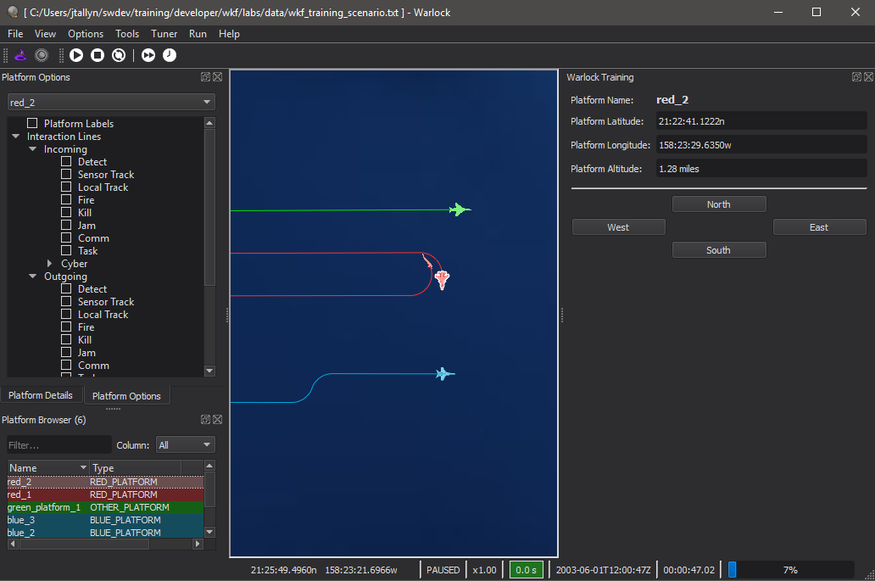
Testing

Slide 70
Exercise 2 – Task 1 Plugin.cpp
Connect the plugin to the Preferences system
Override GetPreferencesWidget() and return the QList of the PrefWidget member
Override GetActions() and return the QList of wkf::Actions which is stored in member variable mActions

Slide 71
Solution – Exercise 2 Task 1 Plugin.cpp
QList<wkf::PrefWidget*> WarlockTraining::Plugin::GetPreferencesWidgets() const
{
// EXERCISE 2 TASK 1a
// return a QList that contains the PrefWidget.
// This will add the widget to the Preferences display.
return { mPrefWidget };
}
QList<wkf::Action*> WarlockTraining::Plugin::GetActions() const
{
// EXERCISE 2 TASK 1b
// return the QList of Actions. This will add the actions to the Preferences' KeyBinding menu.
return mActions;
}

Slide 72
Exercise 2 - Review 1
Inspect the PrefObject class in PrefObject.hpp and PrefObject.cpp
This class handles the reading and writing of Preference data to the Settings.ini file
This class notifies subscribers of changes to Preference data
This class handles the user updating the Preferences data via the PrefWidget that is displayed in the Preferences Dialog

Slide 73

Exercise 2 - Review 1 PrefObject.hpp
namespace WarlockTraining
{
//! This represents the data that the preferences widget modifies.
//! @note A default constructed PrefData is used for the default preferences.
//! Use default member initializers (as used here), and/or a default constructor.
struct PrefData
{
bool mDisplayAltitude = true;
bool mDisplayHeading = true;
};
//! This provides an interface to load, save, and apply changes to the preferences.
//! Inheriting from wkf::PrefObjectT<T> tells the class what type of data it is dealing with.
class PrefObject : public wkf::PrefObjectT<PrefData>
{
// This line is required for Qt signals to be properly emitted from this class.
Q_OBJECT
public:
static constexpr const char* cNAME = "WarlockTrainingPreferences";
PrefObject(QObject* aParent = nullptr);
~PrefObject() override = default;
//! Applies changes to the PrefData to the rest of the application.
//! Called internally AFTER SetPreferenceDataP().
void Apply() override;
$⋮$

Slide 74

Exercise 2 - Review 1 PrefObject.hpp
$⋮$ //! Sets the current preferences.
//! If applying changes to every preference would cause a significant delay,
//! this function is where flags can be set to indicate which preferences need re-applied.
//! @param aPrefData This is the new preferences.
void SetPreferenceDataP(const PrefData& aPrefData) override;
//! Reads the current preferences from a file.
//! @param aSettings This is the interface to the file where preference data is stored.
//! @returns The settings read.
PrefData ReadSettings(QSettings& aSettings) const override;
//! Saves the current preferences to a file.
//! @param aSettings This is the interface to the file where preference data is stored.
void SaveSettingsP(QSettings& aSettings) const override;
signals:
//! Used by Apply() to only update the display when the preferences have actually changed.
//! @param aPreferences This is the current preferences.
//! @note In practice, one could have multiple such functions to update each non-trivial setting.
void Changed(const PrefData& aPreferences);
private:
//! Represents whether the preferences have changed.
bool mPreferencesChanged = false;
};
}
Q_DECLARE_METATYPE(WarlockTraining::PrefData)

Slide 75

Exercise 2 - Review 1 PrefObject.cpp
WarlockTraining::PrefObject::PrefObject(QObject* aParent /*= 0*/)
: wkf::PrefObjectT<PrefData>(aParent, "WarlockTraining")
{}
void WarlockTraining::PrefObject::Apply()
{
// If Preferences have changed, we need to notify subscribers
if (mPreferencesChanged)
{
emit Changed(mCurrentPrefs);
mPreferencesChanged = false;
}
}
void WarlockTraining::PrefObject::SetPreferenceDataP(const PrefData& aPrefData)
{
// Check to see if the new value for the preferences are different than the current values
// If so, updated the mPreferencesChanged flag
if (mCurrentPrefs.mDisplayAltitude != aPrefData.mDisplayAltitude ||
mCurrentPrefs.mDisplayHeading != aPrefData.mDisplayHeading)
{
mPreferencesChanged = true;
mCurrentPrefs = aPrefData;
}
}
$⋮$
Emit generates a signal to a connected slot

Slide 76

Exercise 2 - Review 1 PrefObject.cpp
$⋮$
WarlockTraining::PrefData WarlockTraining::PrefObject::ReadSettings(QSettings& aSettings) const
{
PrefData pData;
//Read the settings from the QSettings file
pData.mDisplayAltitude = aSettings.value("showAltitude", mDefaultPrefs.mDisplayAltitude).toBool();
pData.mDisplayHeading = aSettings.value("showHeading", mDefaultPrefs.mDisplayHeading).toBool();
return pData;
}
void WarlockTraining::PrefObject::SaveSettingsP(QSettings& aSettings) const
{
//Write the settings to the QSettings file
aSettings.setValue("showAltitude", mCurrentPrefs.mDisplayAltitude);
aSettings.setValue("showHeading", mCurrentPrefs.mDisplayHeading);
}

Slide 77
Exercise 2 - Review 2 PrefWidget.hpp
namespace WarlockTraining
{
//! This represents the specific preferences widget associated with our plugin.
//! Inheriting from wkf::PrefWidgetT<T> tells the class what type of PrefObject it is dealing with.
class PrefWidget : public wkf::PrefWidgetT<PrefObject>
{
public:
explicit PrefWidget(QWidget* aParent = nullptr);
private:
Ui::WarlockTrainingPrefs mUI;
//! Updates the widget with the current preferences.
//! @param aPrefData This is the current preferences.
void ReadPreferenceData(const PrefData& aPrefData) override;
//! Writes the preferences shown in the widget to the current preferences.
//! @param aPrefData This is the current preferences.
void WritePreferenceData(PrefData& aPrefData) override;
};
}

Slide 78
Exercise 2 – Task 2 PrefWidget.cpp
Display the current Preference data to the user, and allow the user to change the data
In PrefWidget.cpp update the checkbox to have the same state as the PrefData
The mUI member variable contains is a class that contains members altitudeCheckBox and headingCheckBox
Invoke the setChecked method on those two members and pass in aPrefData.mDisplayAltitude and aPrefData.mDisplayAltitude, respectively
Read the state of the checkboxes and update the PrefData which is sent to the PrefObject
Invoke the IsChecked method on those same two members, and use the results to set the two members of mUI

Slide 79
Solution – Exercise 2 Task 2 PrefWidget.cpp
void WarlockTraining::PrefWidget::ReadPreferenceData(const PrefData& aPrefData)
{
// EXERCISE 2 TASK 2a
// Call setChecked() on altitudeCheckBox & headingCheckBox using the data in aPrefData
mUI.altitudeCheckBox->setChecked(aPrefData.mDisplayAltitude);
mUI.headingCheckBox->setChecked(aPrefData.mDisplayHeading);
}
void WarlockTraining::PrefWidget::WritePreferenceData(PrefData& aPrefData)
{
// EXERCISE 2 TASK 2b
// Set aPrefData based on the altitude and heading checkBoxes
aPrefData.mDisplayAltitude = mUI.altitudeCheckBox->isChecked();
aPrefData.mDisplayHeading = mUI.headingCheckBox->isChecked();
}

Slide 80
Exercise 2 – Task 3
In DockWidget.cpp update the displays based on the user Preferences
Connect the PrefObject parameter’s Changed signal to the DockWidget’s PreferencesChanged function
Update the visibility of the labels and line edits for altitude and heading to match the PrefData parameter’s mDisplayAltitude and mDisplayHeading members

Slide 81
Solution – Exercise 2 Task 3a DockWidget.cpp
WarlockTraining::DockWidget::DockWidget(SimInterface& aSimInterface,
DataContainer& aDataContainer,
PrefObject* aPrefObject,
Qt::WindowFlags aWindowFlags)
: QDockWidget(nullptr, aWindowFlags)
, mSimInterface(aSimInterface)
, mDataContainer(aDataContainer)
{
//! Without this line, nothing will show up in the dock widget.
mUI.setupUi(this);
// EXERCISE 1 TASK 2a
// Connect the DataContainer's DataChanged signal to UpdateDisplay()
// Connect the WkfEnvironment's PlatformOfInterestChanged signal to PlatformOfInterestChanged()
connect(&mDataContainer, &DataContainer::DataChanged, this, &DockWidget::UpdateDisplay);
connect(&wkfEnv, &wkf::Environment::PlatformOfInterestChanged, this, &DockWidget::PlatformOfInterestChanged);
// EXERCISE 2 TASK 3a
// Connect the PrefObject's Changed() signal to PreferencesChanged()
connect(aPrefObject, &WarlockTraining::PrefObject::Changed, this, &DockWidget::PreferencesChanged);
// EXERCISE 1 TASK 3a
// connect the clicked signal for northPushButton, eastPushButton, southPushButton, and westPushButton
// to TurnHeading with appropriate heading passed in as an argument
connect(mUI.northPushButton, &QPushButton::clicked, this, [this]() { TurnToHeading(0); });
connect(mUI.eastPushButton, &QPushButton::clicked, this, [this]() { TurnToHeading(90); });
connect(mUI.southPushButton, &QPushButton::clicked, this, [this]() { TurnToHeading(180); });
connect(mUI.westPushButton, &QPushButton::clicked, this, [this]() { TurnToHeading(270); });
}

Slide 82
Solution – Exercise 2 Task 3b DockWidget.cpp
void WarlockTraining::DockWidget::PreferencesChanged(const PrefData& aPrefData)
{
// EXERCISE 2 TASK 3b
// Hide/Show the altitude/heading labels & lineEdits based on the user selection in Preferences.
mUI.altitudeLabel->setVisible(aPrefData.mDisplayAltitude);
mUI.altitudeLineEdit->setVisible(aPrefData.mDisplayAltitude);
mUI.headingLabel->setVisible(aPrefData.mDisplayHeading);
mUI.headingLineEdit->setVisible(aPrefData.mDisplayHeading);
}

Slide 83
Testing
You should be able to rebind the actions that control the aircraft movement in the Keyboard Shortcuts menu in Preferences
You should be able to toggle the displays for altitude and heading using the Warlock Training menu in Preferences
From Windows Visual Studio:
Build the solution in “Release”
Build the “INSTALL” project
From Linux, execute the following commands in the build directory:
$ cmake --build . --target all -- -j12
$ cmake --build . --target install -- -j12
Run the Test Scenario in Warlock
Run warlock.exe
Load the Test Scenario, located at: training\developer\wkf\labs\data\wkf_training_scenario.txt

Slide 84
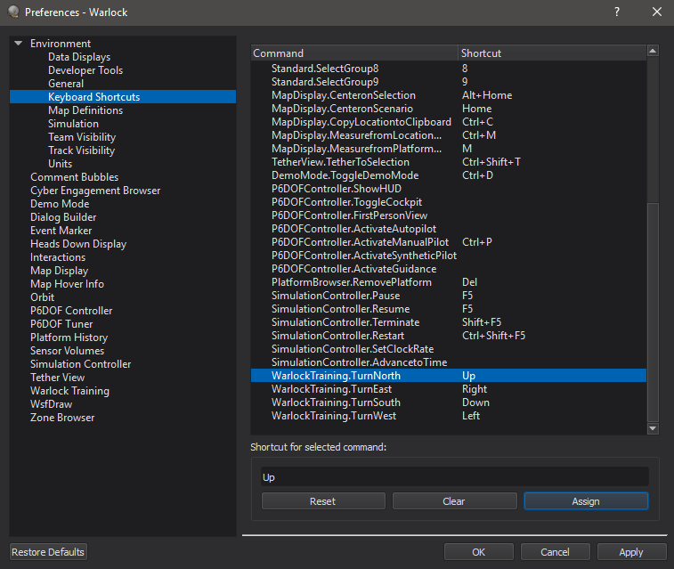
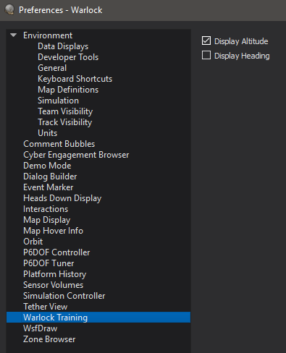
Testing

