Slide 1
K-means Algorithm
Yunyoung Choi(22100748)
Jongmu Lee(21800569)
Seonu Kim(21800090)

Slide 2



K means is often used in our real life!
Recommendation systems
Customer segmentation

Slide 3
Outline
Toy problem using K means algorithm
Distributing 8 sample points onto the South Korea territory using the K-means algorithm
Identifying a proper number of vertiports

Slide 4
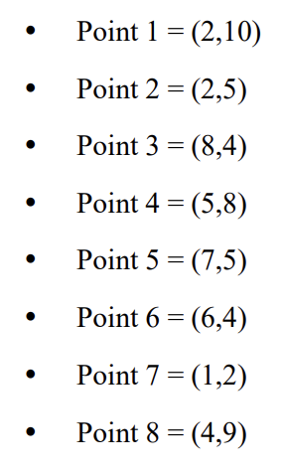
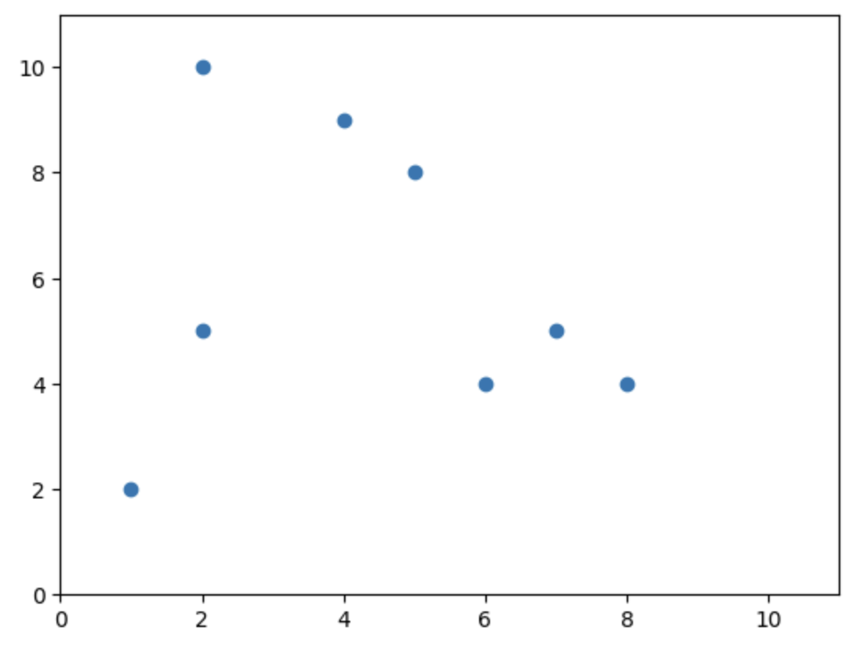
Initial points

Slide 5
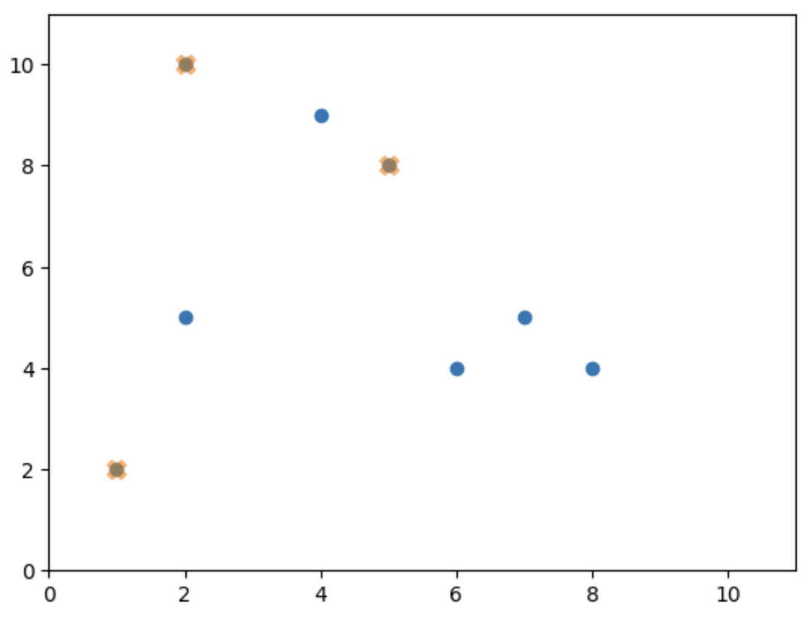
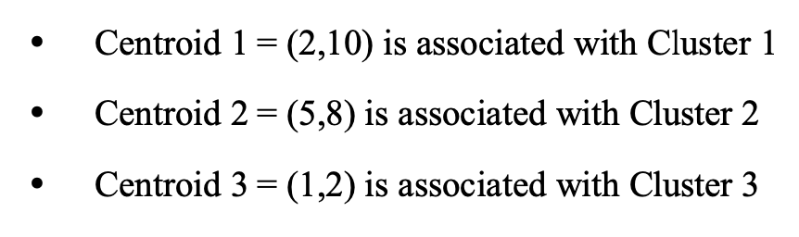
Initial centroid points

Slide 6
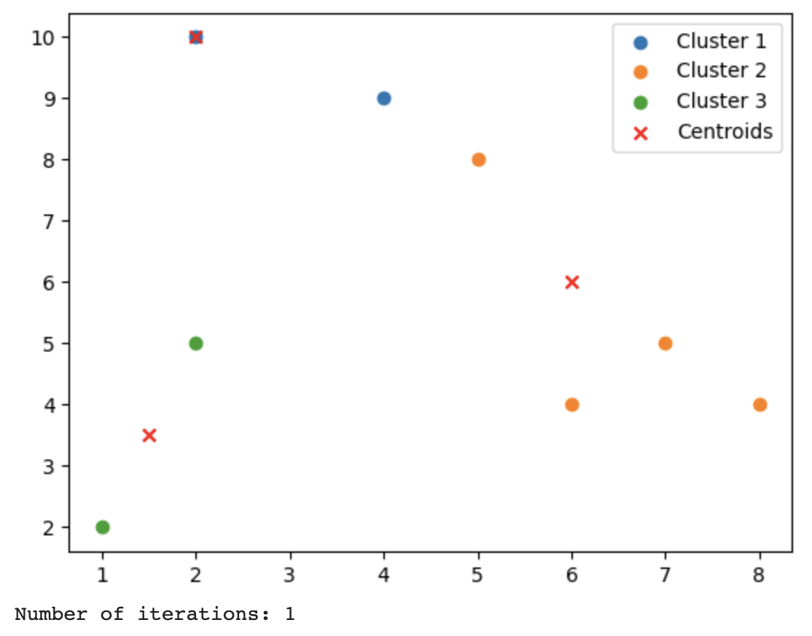
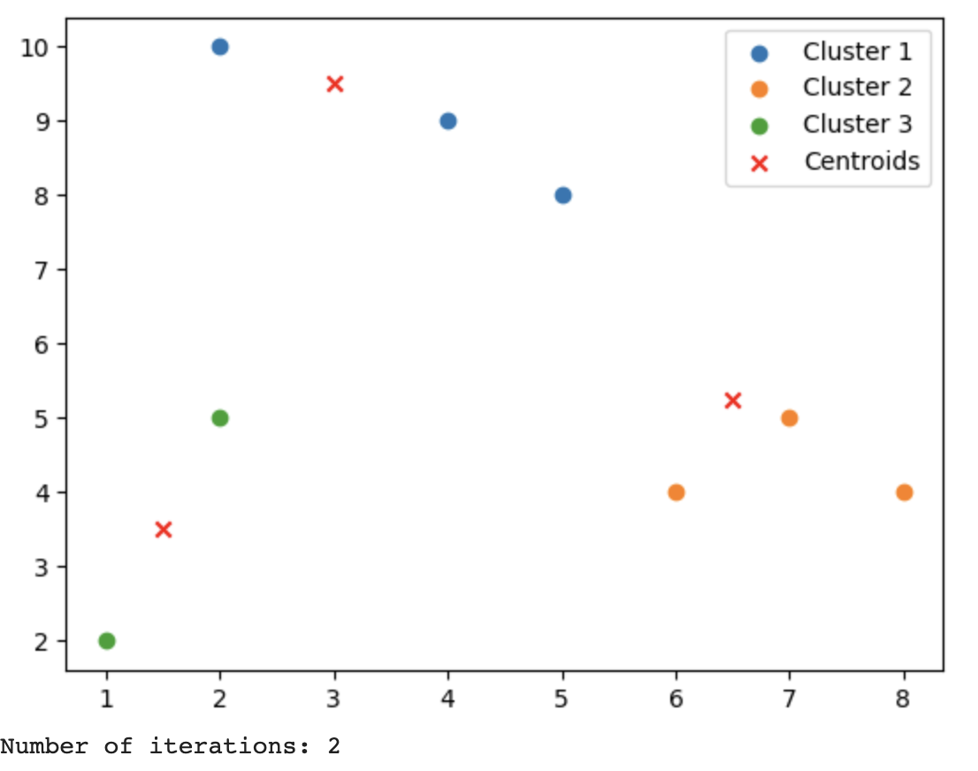
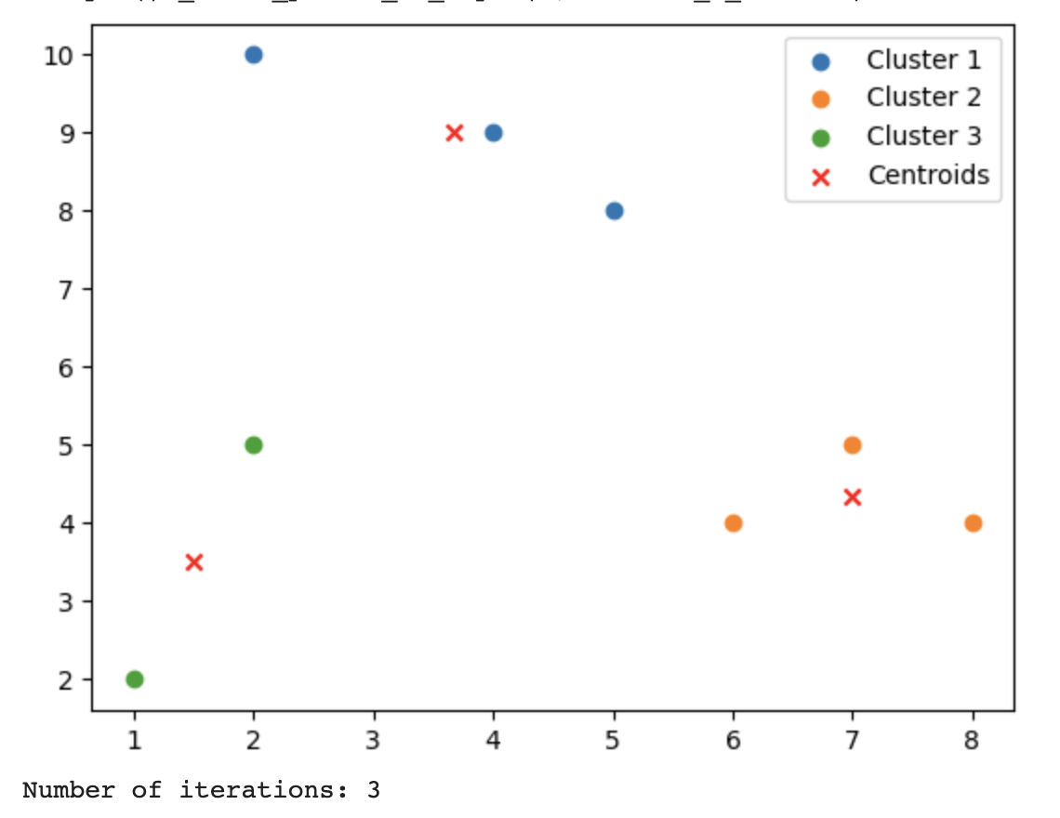
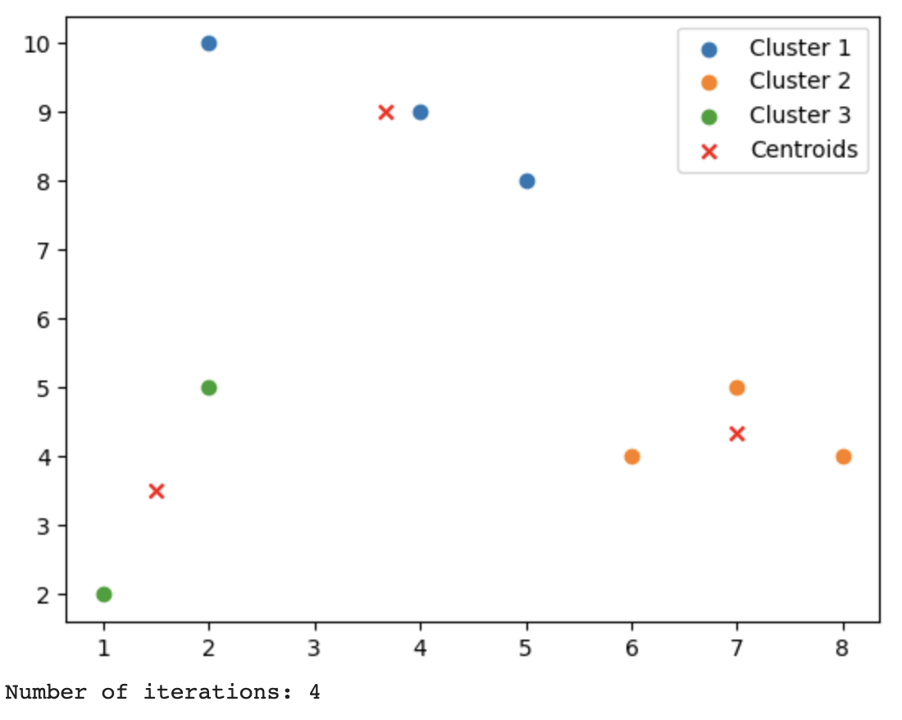
Changes of centroid points per iteration
almost
no change…

Slide 7
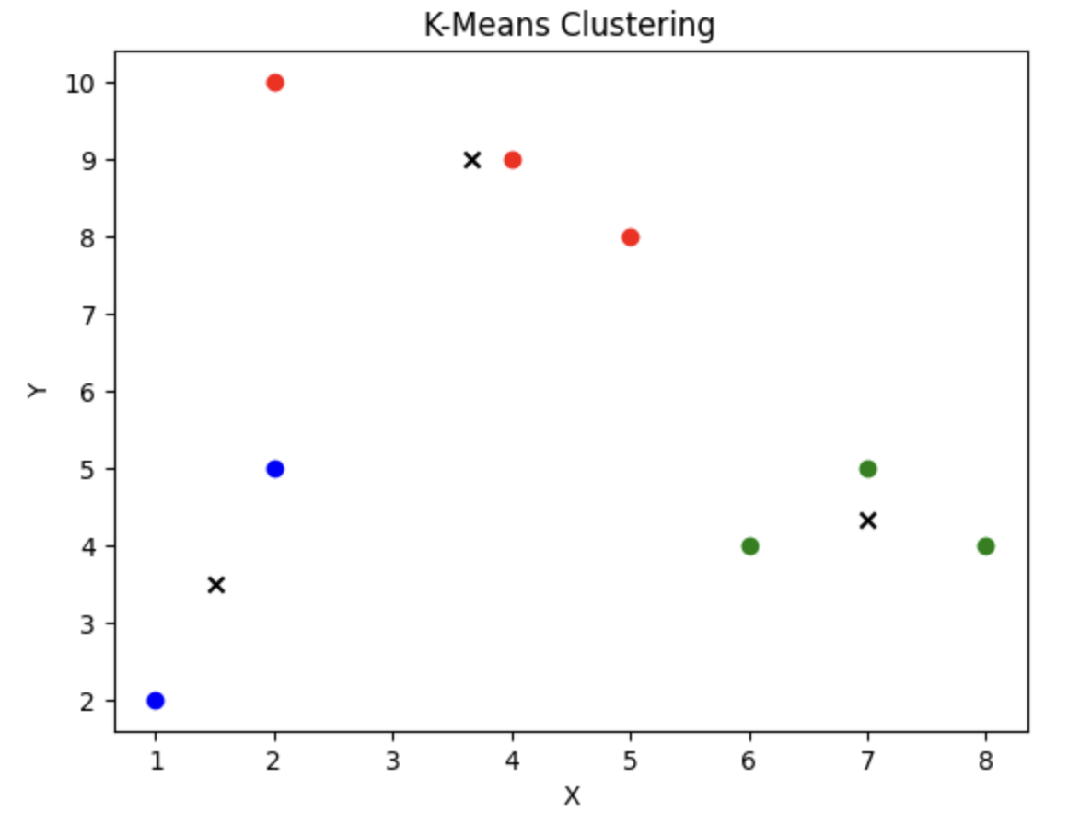
Clustering results and stopping criterions
How many iterations are needed to complete the clustering task?
: 4 iterations are needed
What is your team’s strategy to stop the iterations?
stopping criteria: max_iterations=50
convergence criteria: ‘tolerance=0.0001’
tolerance: threshold for centroid updates
<clustering results>
Notes:
If the maximum change in centroid positions between iterations is less than or equal to the tolerance value, the algorithm considers it converged and stops iterating.

Slide 8
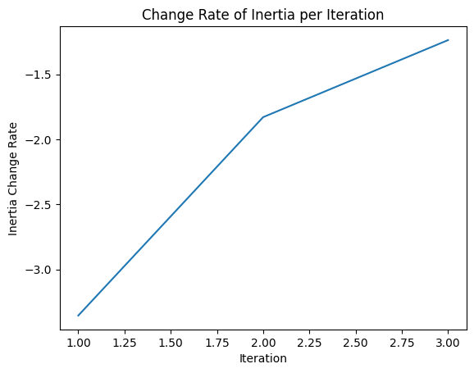
Change Rate of Inertia per Iteration

Slide 9
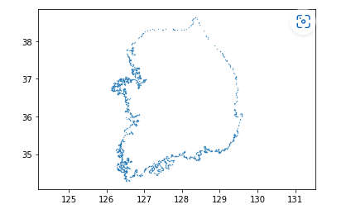
Open-ended problem

Slide 10
Optimal N
We choose
Silhouette score method

Slide 11
Silhouette score
a = The average distance between a data point and other data points which is same cluster.
b = The average distance between a data point and all other data points which is nearest neighboring cluster.
Silhouette score = (b-a) / Max(a,b)
Score range is -1 to 1
If the score is close to 1 : good clustering result
If the score is close to -1 : bad clustering result

Slide 12
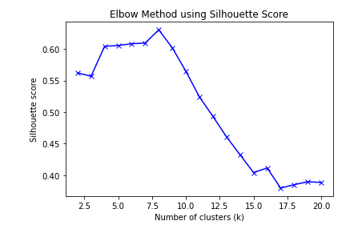
Open-ended problem

Slide 13
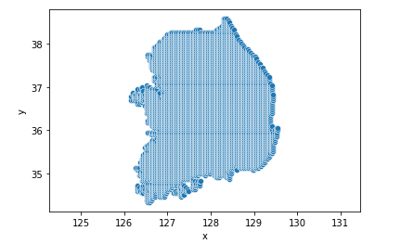
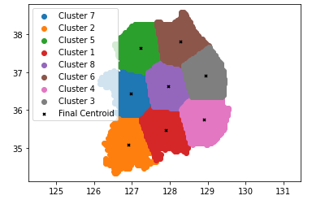
Open-ended problem

Slide 14
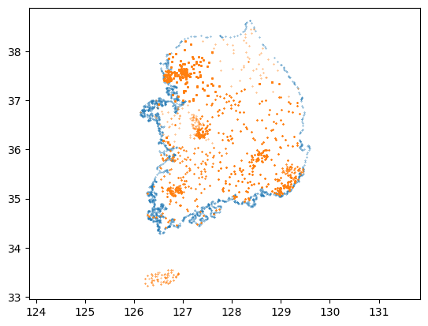
Real-world problem

Slide 15
Government allows 17 vertiport = N of cluster(K) is 17

Slide 16
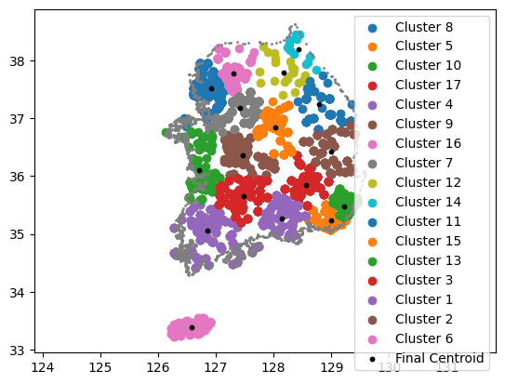
Result of clustering of the candidates

Slide 17
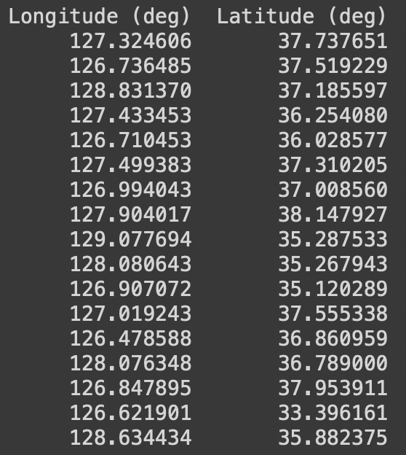
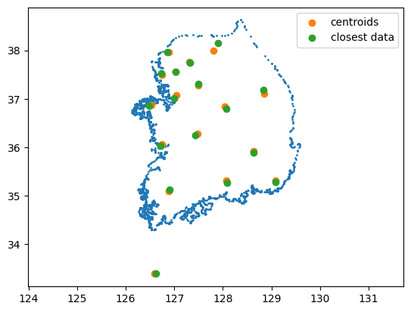
Final vertiport location

Slide 18
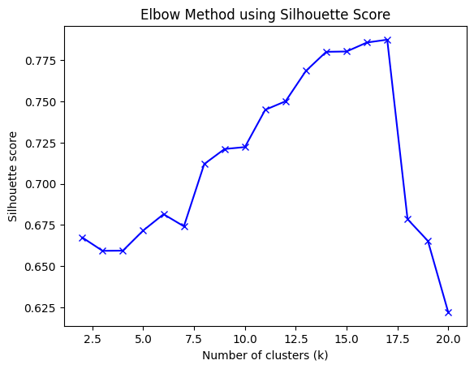
Defining optimal K by using Silhouette score method

Slide 19
Citation
K-means algorithm convergence criterion : IBM(https://www.ibm.com/docs/en/spss-statistics/beta?topic=analysis-k-means-cluster-convergence-criteria)
elbow method and elbow method visualization : ChatGPT
Concept of silhouette score : Scikit learn(https://scikit-learn.org/stable/auto_examples/cluster/plot_kmeans_silhouette_analysis.html)
Visualization of silhouette score : ChatGPT

Slide 20
Thank you!

