Slide 1
A WORLD BUILT FOR ADVENTURE
Pokémon:
A World Built
for Adventure
Partners, discoveries, and choices around every path.

Slide 2

THE WORLD OF POKÉMON
Pokémon are creatures with surprising powers
They come in many shapes, sizes, habitats, and personalities.
Some live in the wild, while others live alongside people in towns and cities.

Slide 3
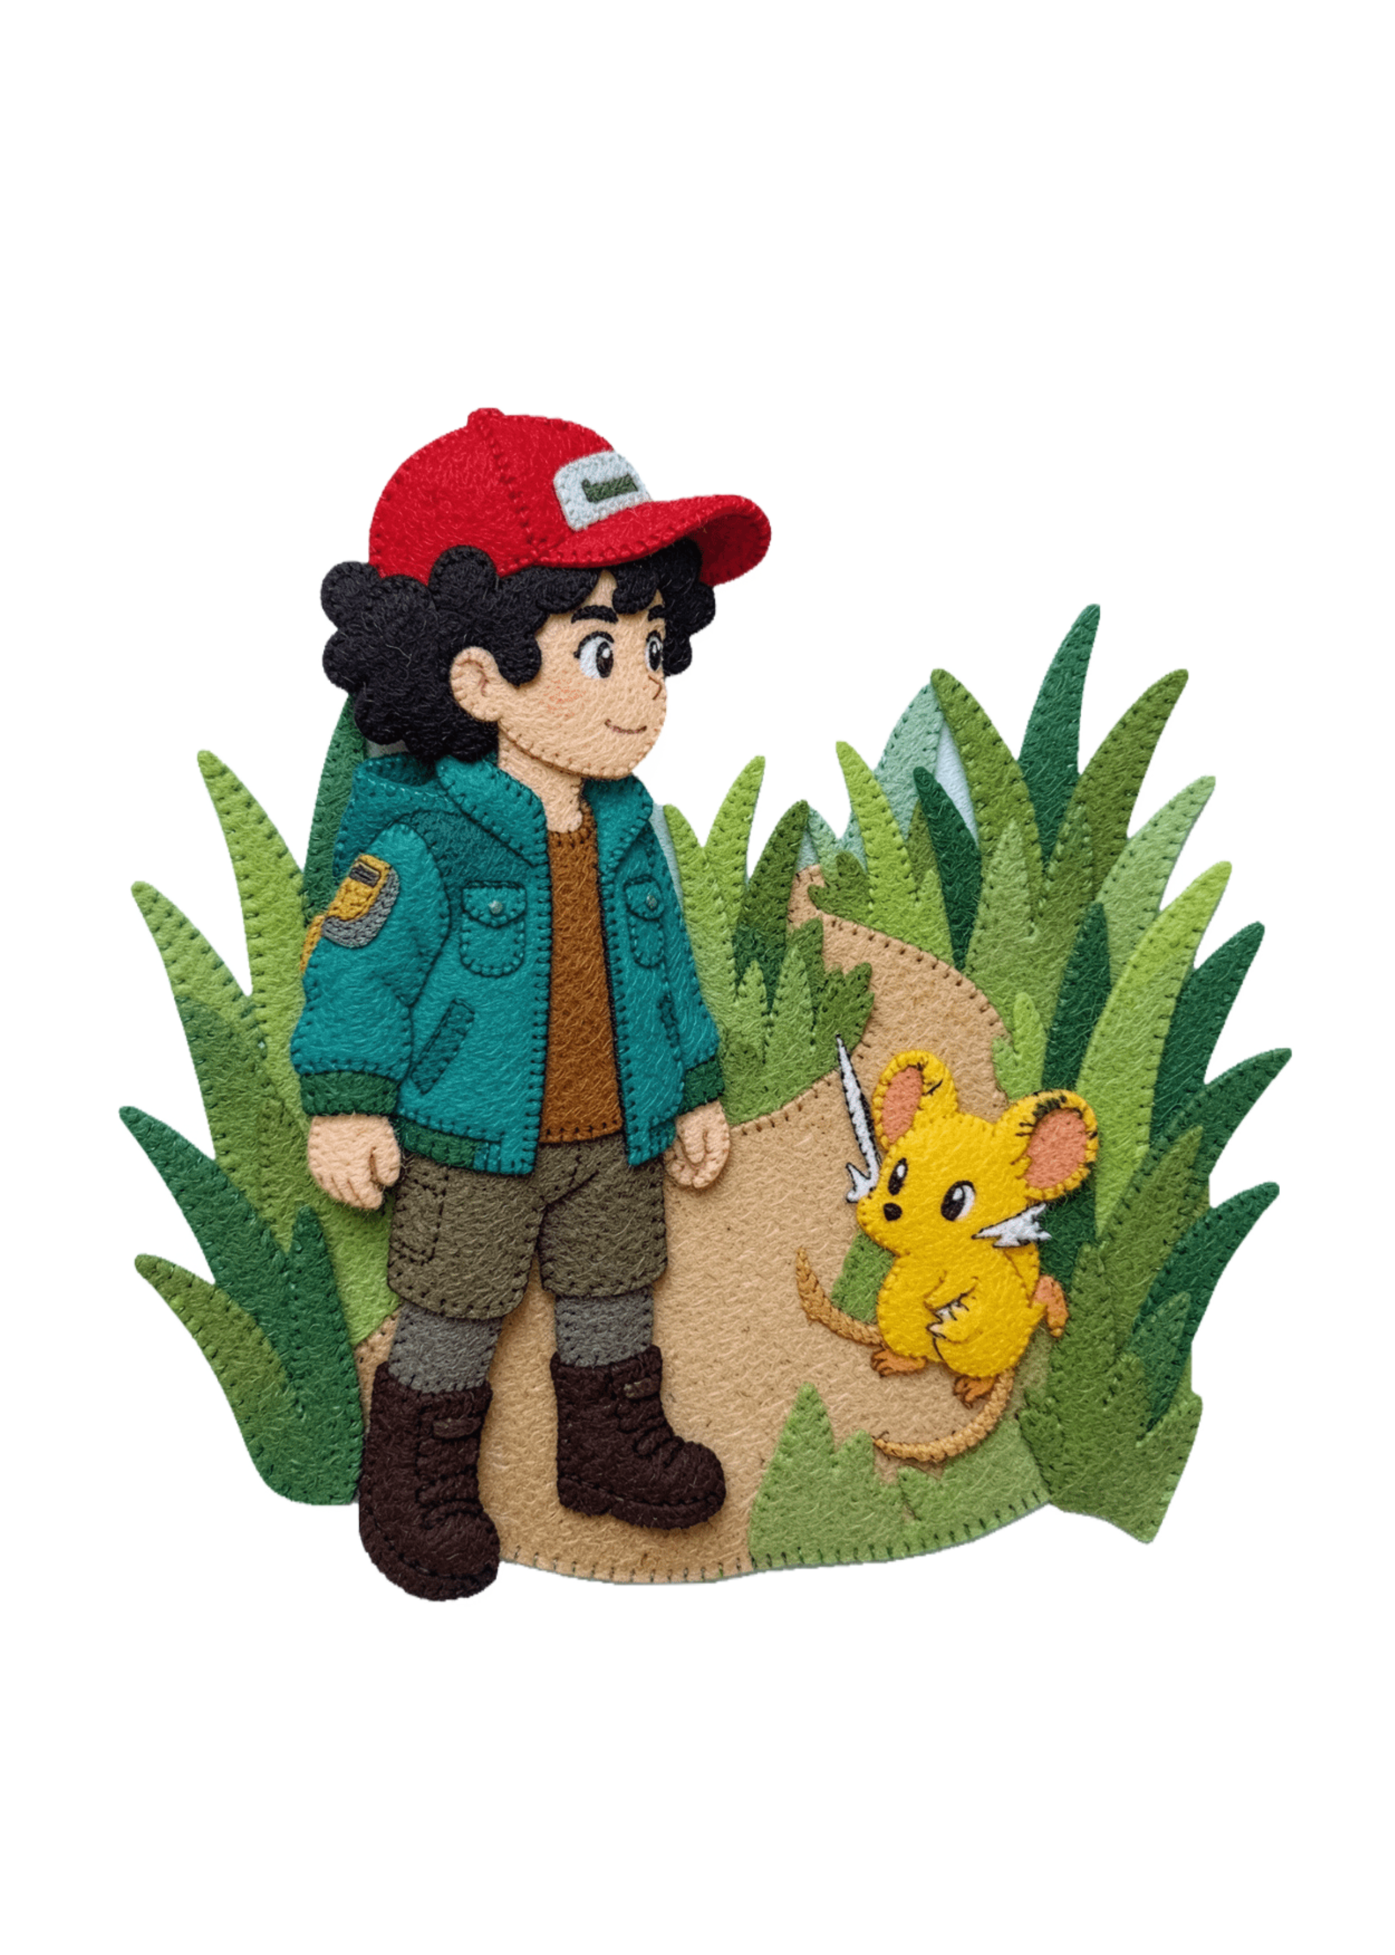
YOUR FIRST QUEST
Every adventure starts with a partner
01
02
03
Choose a partner
Explore
Keep learning
Travel through towns, routes, and wild places.
A Pokémon joins you for the journey.
Meet people, discover Pokémon, and learn as you go.

Slide 4

A SIMPLE WAY TO READ THE WORLD
Types help explain what Pokémon can do
Fire
Water
Pokémon can have one or two of 18 types, including Fire, Water, Grass, Electric, and Fairy.
Types create strengths and weaknesses, so different matchups call for different choices.
strong against Grass
strong against Fire
Grass
Electric
strong against Water
watch the matchup
Fairy
one more possibility

Slide 5



TEAMWORK IN MOTION
A great team mixes different strengths
Different abilities
Think ahead
Find your style
Build a team with different abilities, types, and personalities.
The strongest-looking Pokémon is not always best for the moment.
Try, learn, switch, and discover which partners fit you.

Slide 6



DISCOVERY BECOMES A QUEST
The Pokédex turns discovery into a quest
Notice
Understand
Keep exploring
Finding Pokémon is part of the journey, not just a checklist.
Each new discovery adds to your understanding of the world.
Collecting gives every route a reason to continue.

Slide 7



THE FUN IS IN THE NEXT CHOICE
Battles are about choices, not just power
Choose a move
Match types
Adapt
Switch plans when the next move changes.
Pick an action that fits the moment.
Use strengths and watch for weaknesses.
A battle asks you to notice what is happening, then decide what to try next.
And outside battles: trading, battling, and sharing the hobby can help fans make new friends.

Slide 8
THE FIRST STEP IS A QUESTION
Your Pokémon journey starts with curiosity
Pick a partner, ask questions, explore a new place, and see which Pokémon become part of your story.

