Slide 1
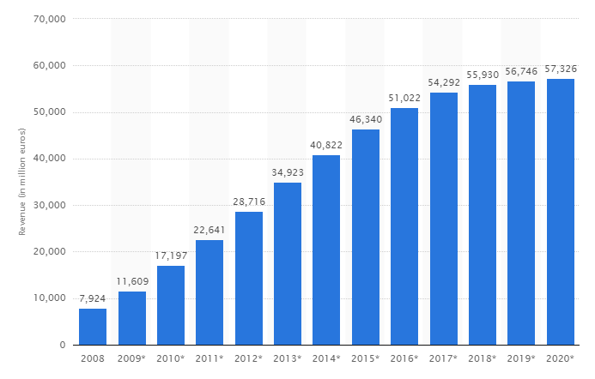




















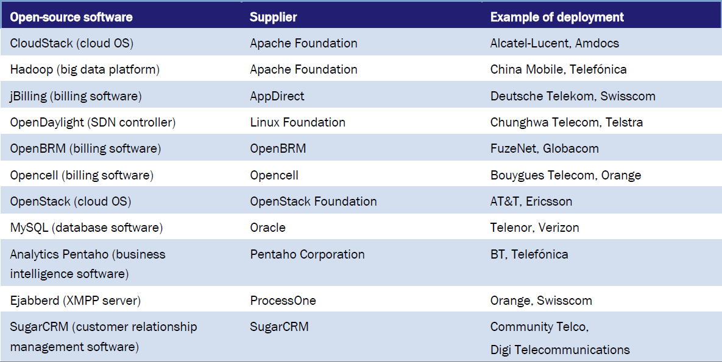
open source software
Overview: revenues, key players and Telcos
Fields of
Key companies & key foundations
Revenue forecast
(million Euro, worldwide)¹
49 %
OS-Software
@ Telcos/CSPs²
Statements
  Revenues based on OS-Software are expected to continuously rise in the upcoming years, up to a volume of around 58 billion Euros in 2020 (worldwide)
  Key players include software companies like Intel, Epson, IBM, Transcend and Oracle as well as OS-foundations incl. Apache, Linux, OSI and Openstack (in which “usual suspects” like IBM also support)
  With regards to Telcos and CSPs², adoption of free and OS-Software is already underway and expected to be mainstream by 2020
  Key issue for Telcos’ infrastructure solutions: the long-term support - with an emphasis on performance, reliability and security
¹ Source: Statista
² CSP = communication service provider, as of Sep 2016
Sources: Analysys Mason, RCR Wireless, Statista, Wiseguyreports
Source: Patentsight
- confidential -

