Slide 1

Topic "Online Store and Blog"

Slide 2
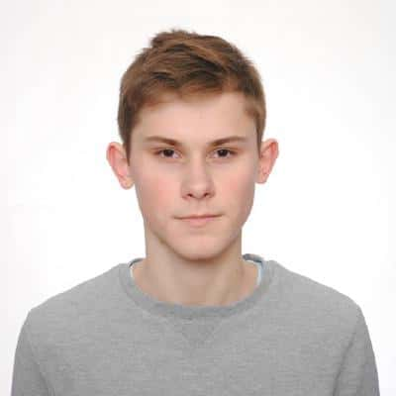
ABOUT ME
Hi, I am a web developer from Kiev. During my childhood I wanted to become an athlete, but then I bought a computer and somehow my first dream failed. Since then, many lines of code have popped up. I am very motivated, and I like to learn and improve my knowledge
CONTACT WITH ME
+38(099)-669-93-45
mail@slavapleshkov.com
t.me/slavapleshkov
github.com/slava-pleshkov
linkedin.com/in/slavapleshkov
twitter.com/slavapleshkov
SKILLS
PHP
JavaScript
GraphQL
REST API
Laravel
Eloquent ORM
Blade
Yii2 Framework
Active Record
Composer
MySQL
Memcache
Git
Apache
Nginx
Ubuntu
Slava Pleshkov
Back-end Developer
EDUCATIONS
Software development
KISIT SHEI "KNEU named after V. Hetman"
August 2016 – June 2020
PROJECTS
club.metro.ua
espreso.tv
atem-shop.com.ua
dental.iorder.com.ua

Slide 3
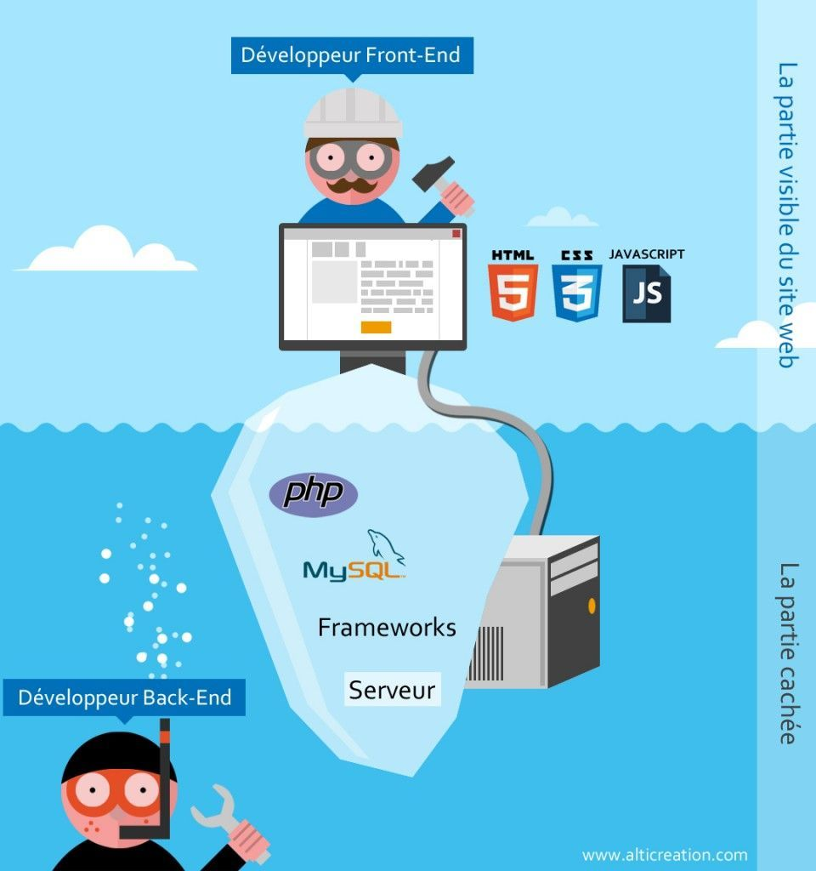
Back-end and Front-end

Slide 4









Used technologies
Front and: HTML5, SCSS, JavaScript, jQuery, Bootstrap, Font Awesome, Webpack, Yarn
Back-end: PHP, Laravel, Eloquent ORM, Blade, Composer, Redis, PostgreSQL, Stripe

Slide 5
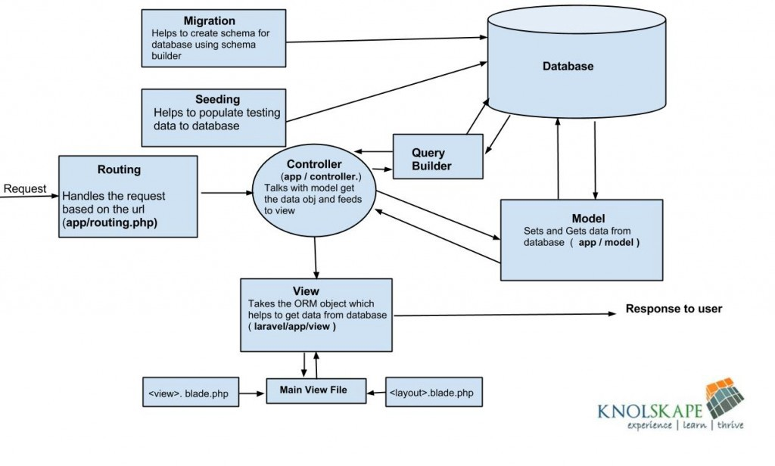
Diagram of Laravel architecture

Slide 6
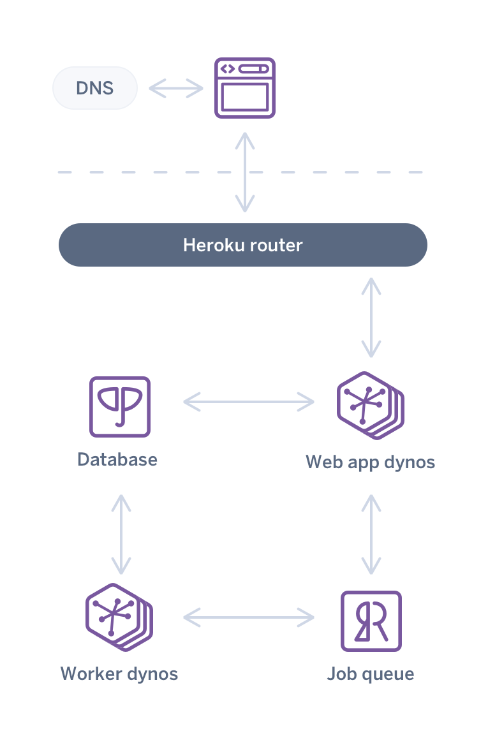
Heroku architecture

Slide 7

E-shop

Slide 8
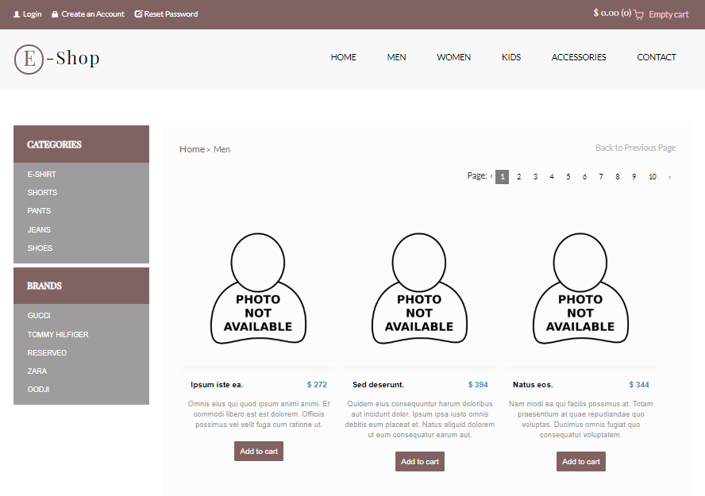

Slide 9
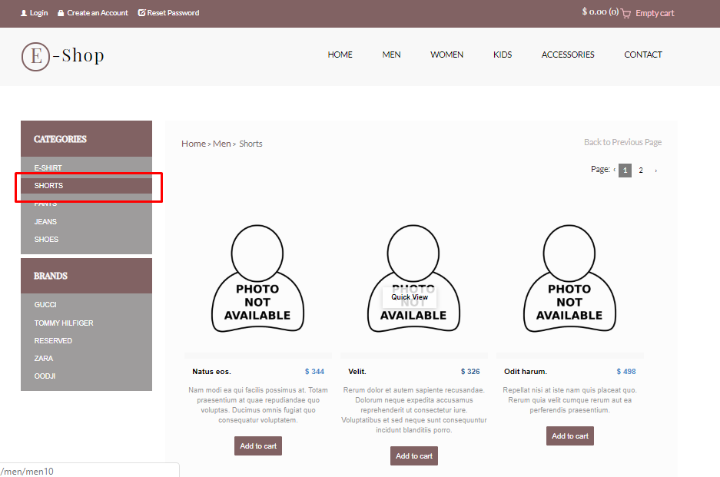
Categories

Slide 10
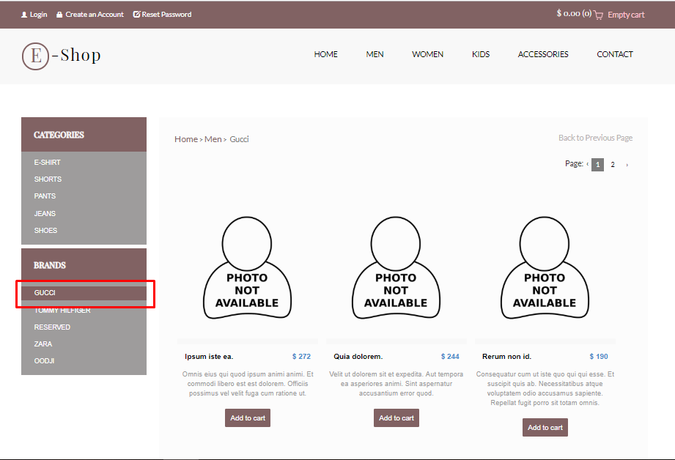
Brands

Slide 11
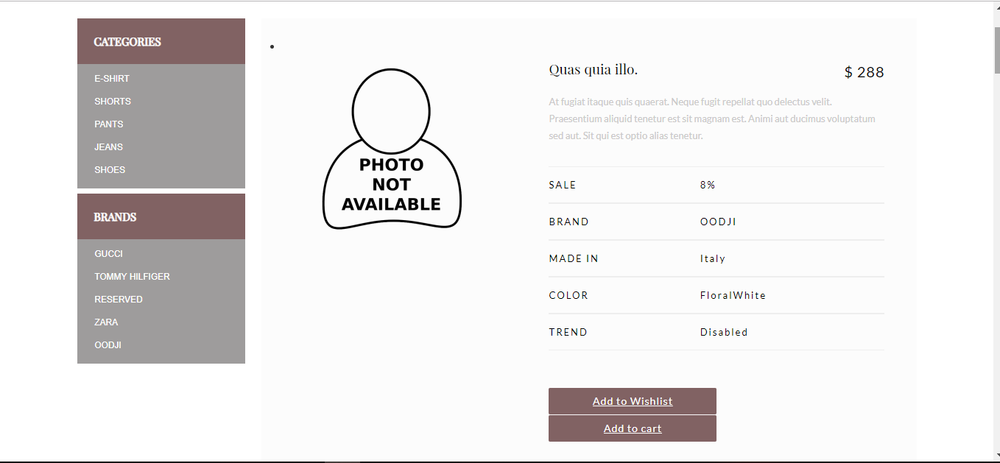
View

Slide 12
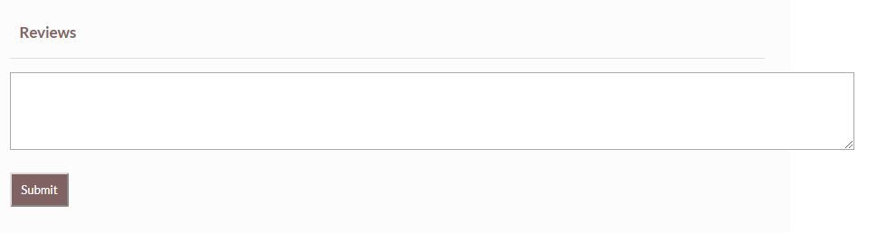
Reviews

Slide 13
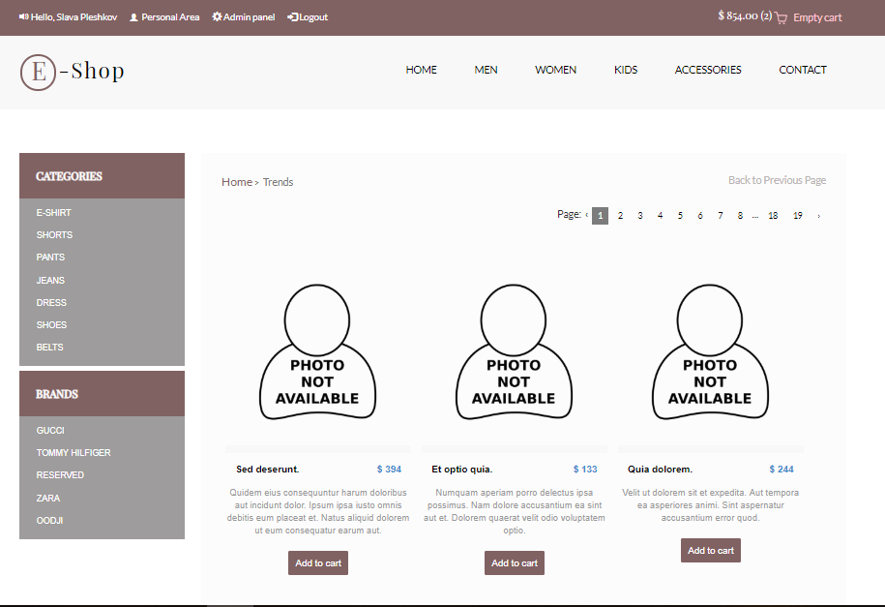
Trends

Slide 14
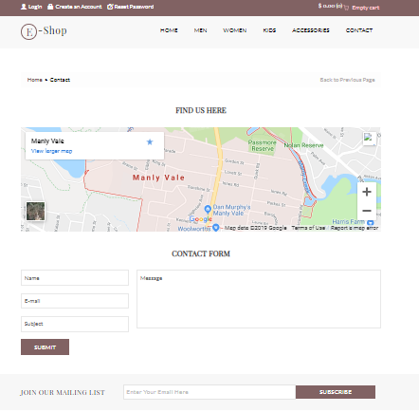
Contact

Slide 15
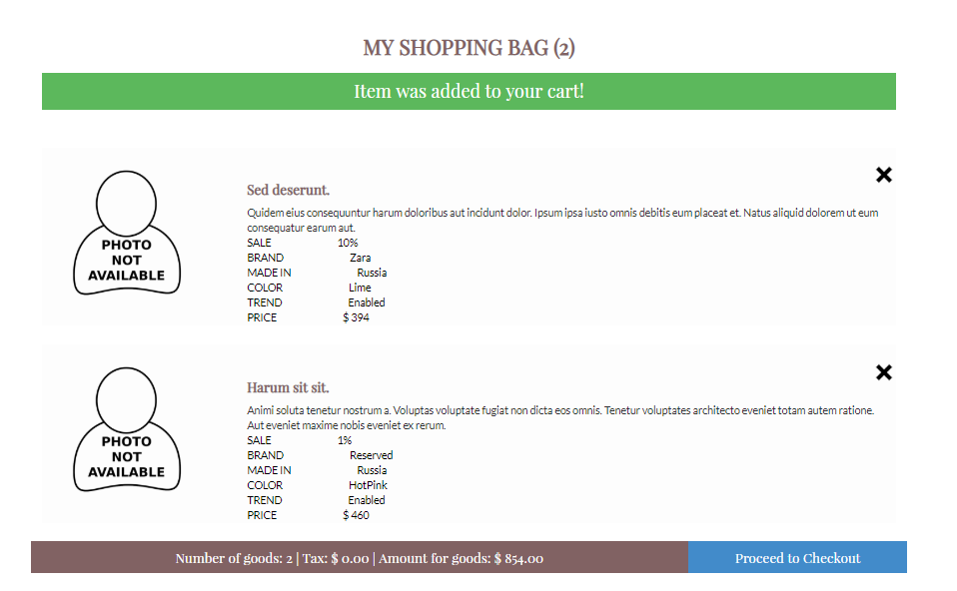
Cart

Slide 16
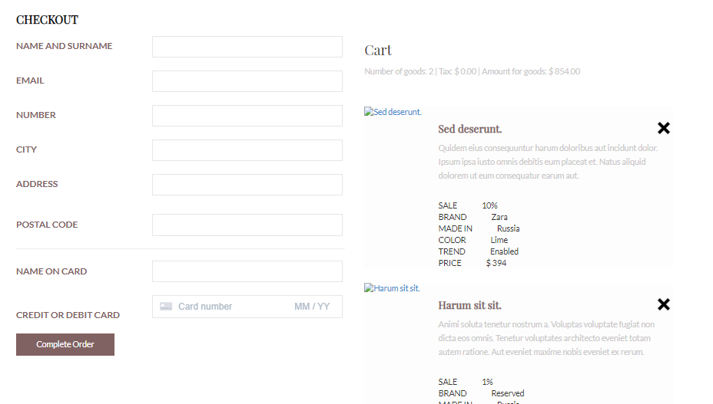
Checkout

Slide 17
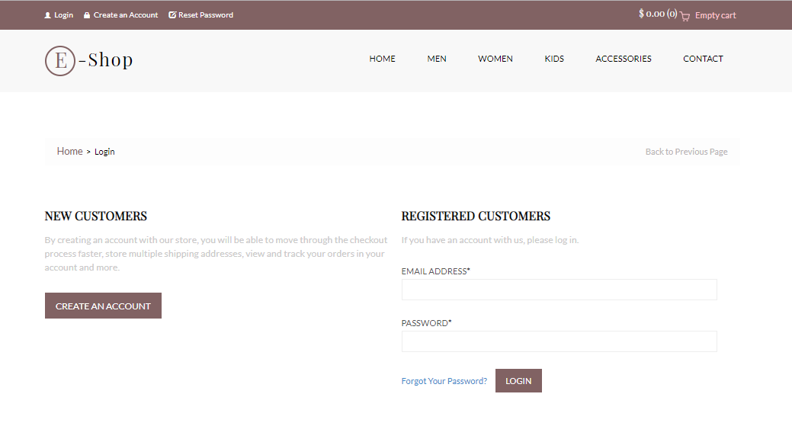
Login

Slide 18
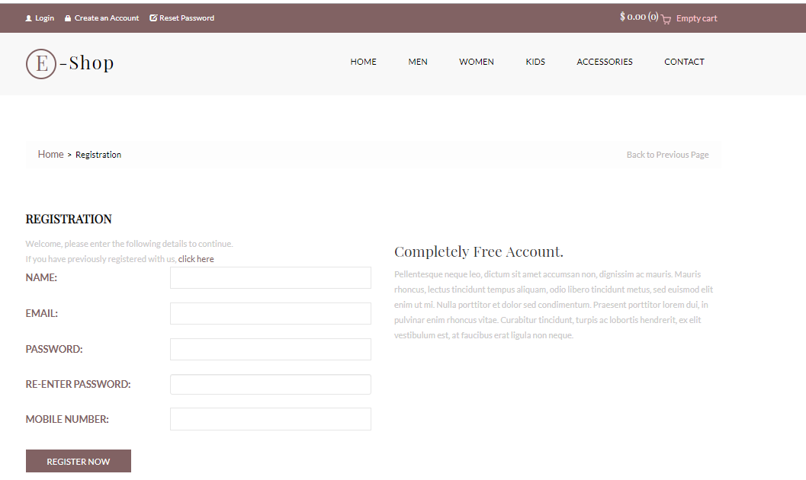
Registration

Slide 19
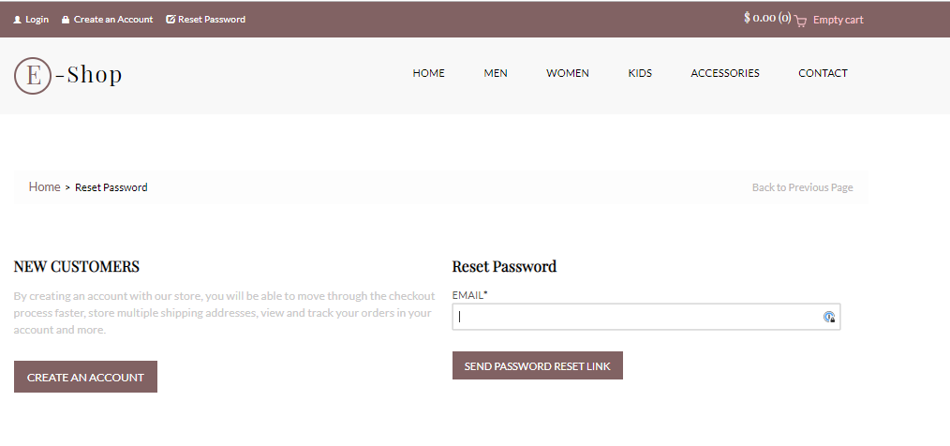
Reset Password

Slide 20
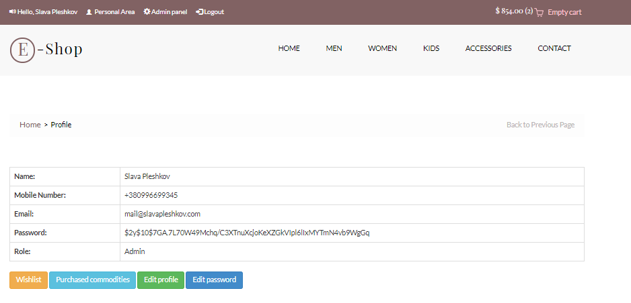
Profile

Slide 21
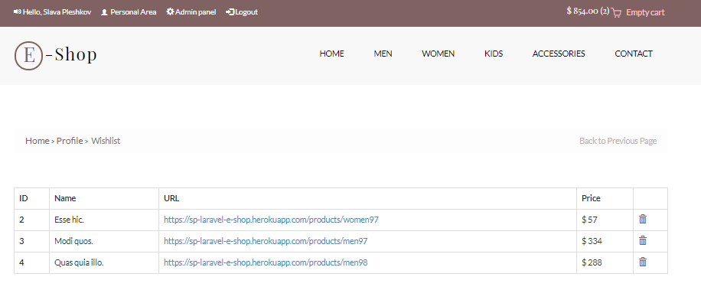
Wishlist

Slide 22
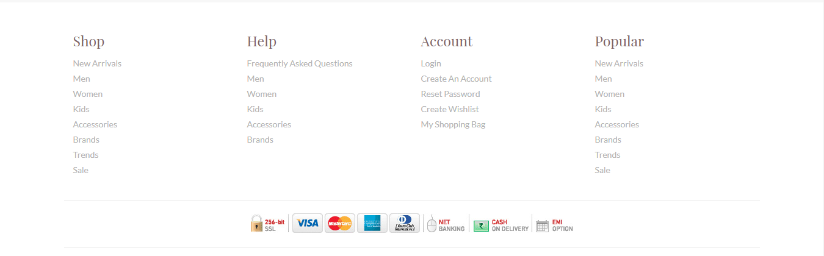
Fotter

Slide 23
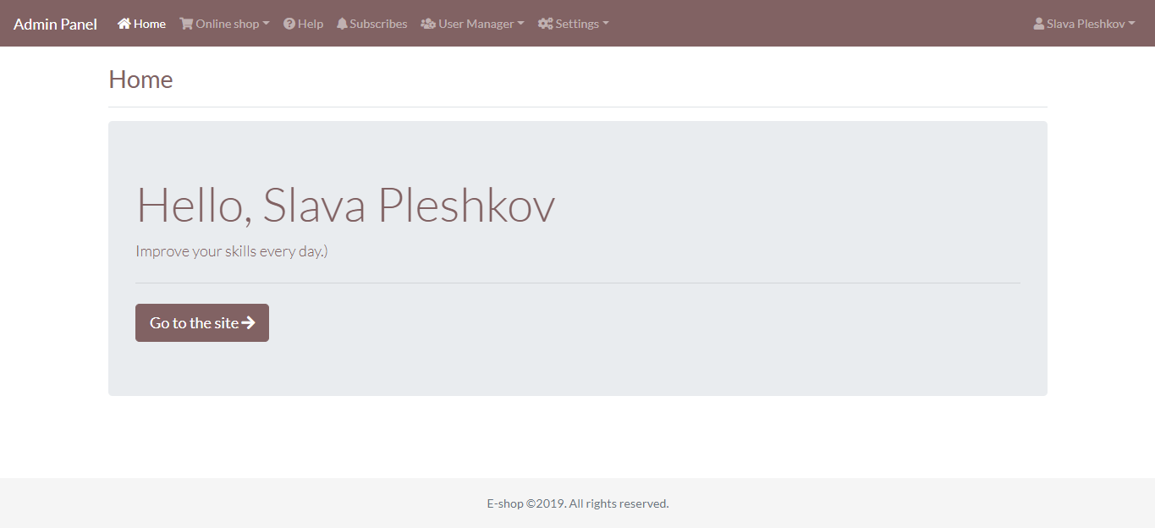
Admin Panel

Slide 24
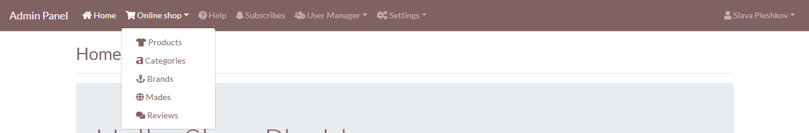
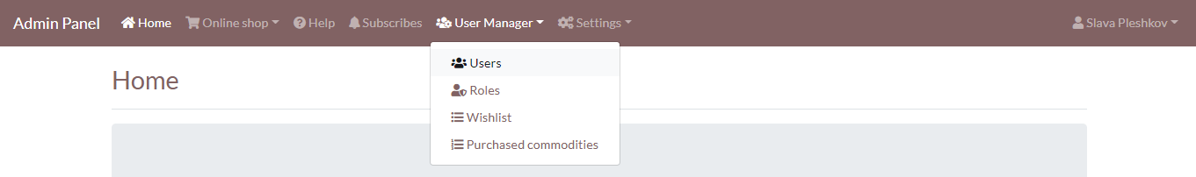
Admin Menu

Slide 25
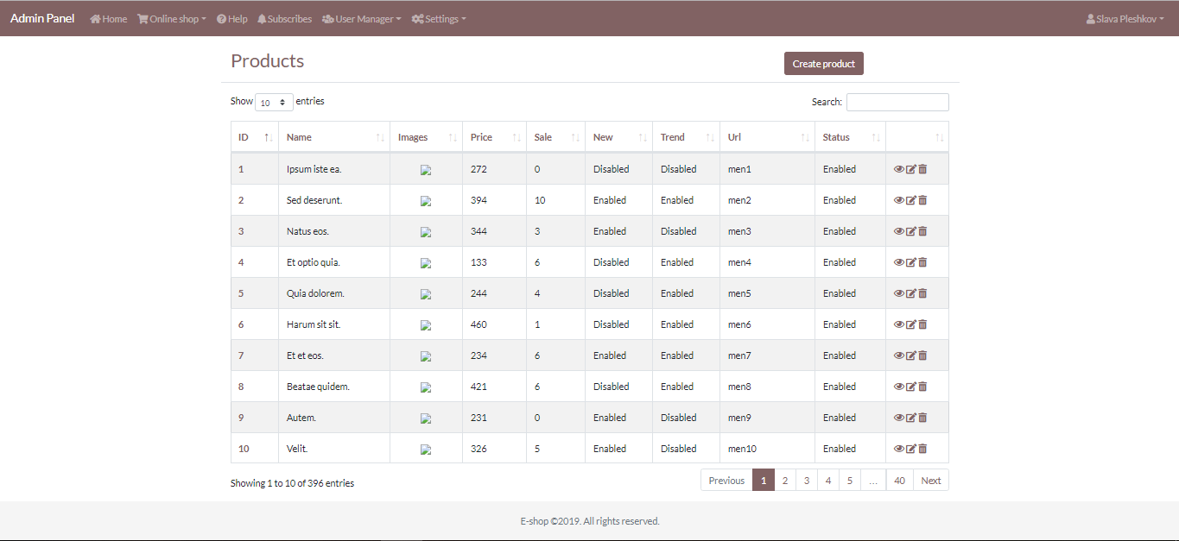
CRUD

Slide 26
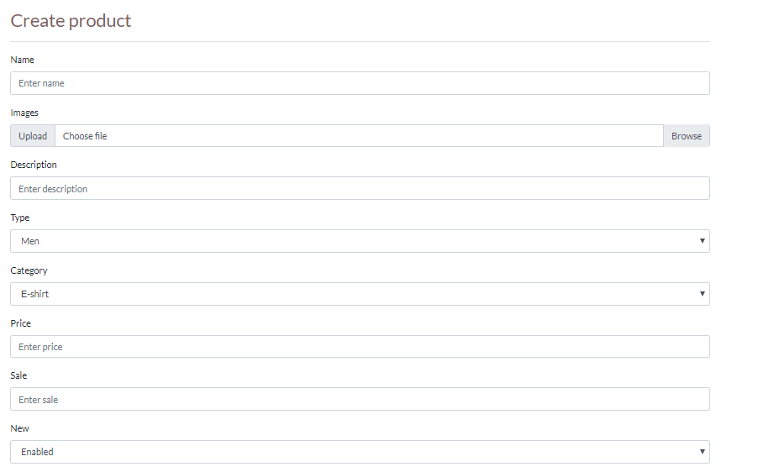
Create

Slide 27
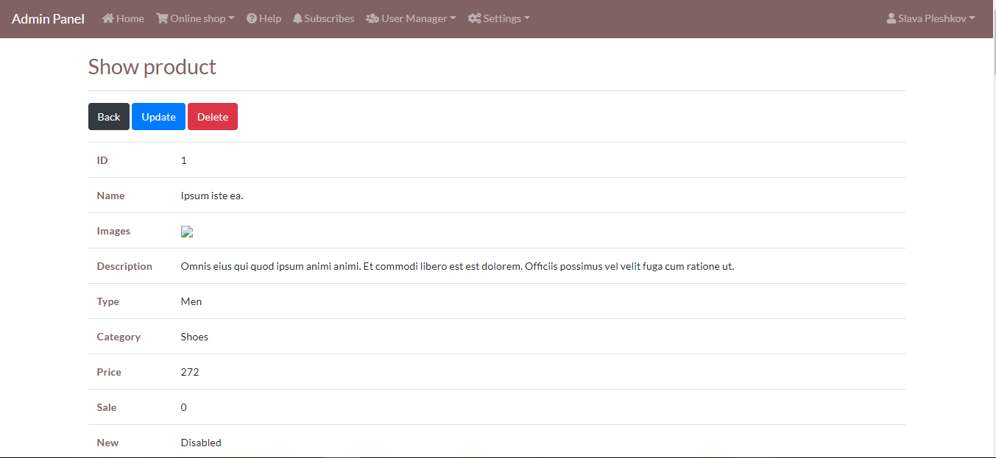
Read

Slide 28
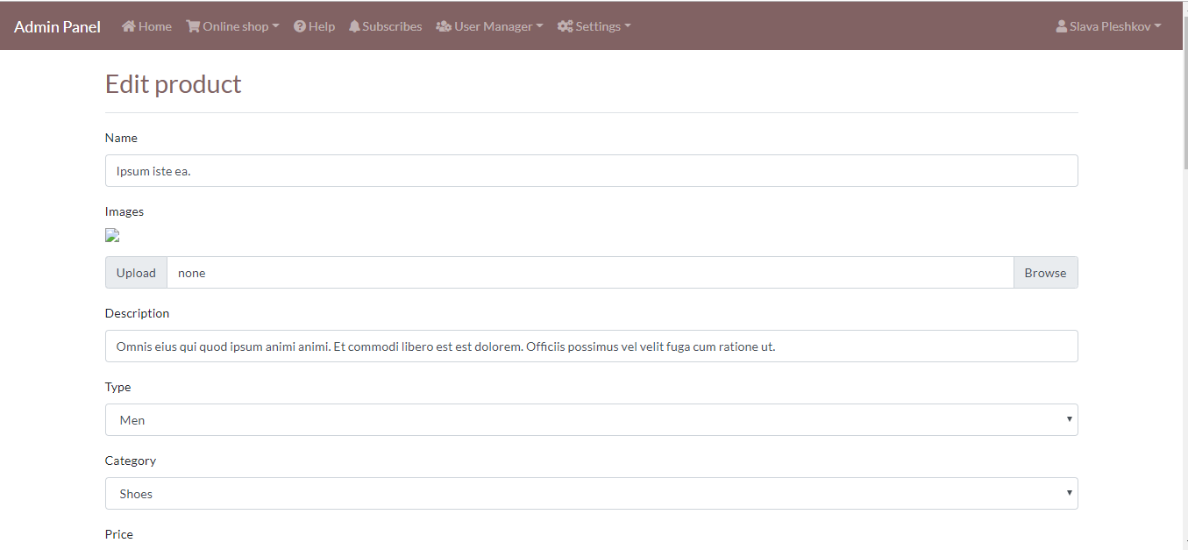
Update

Slide 29
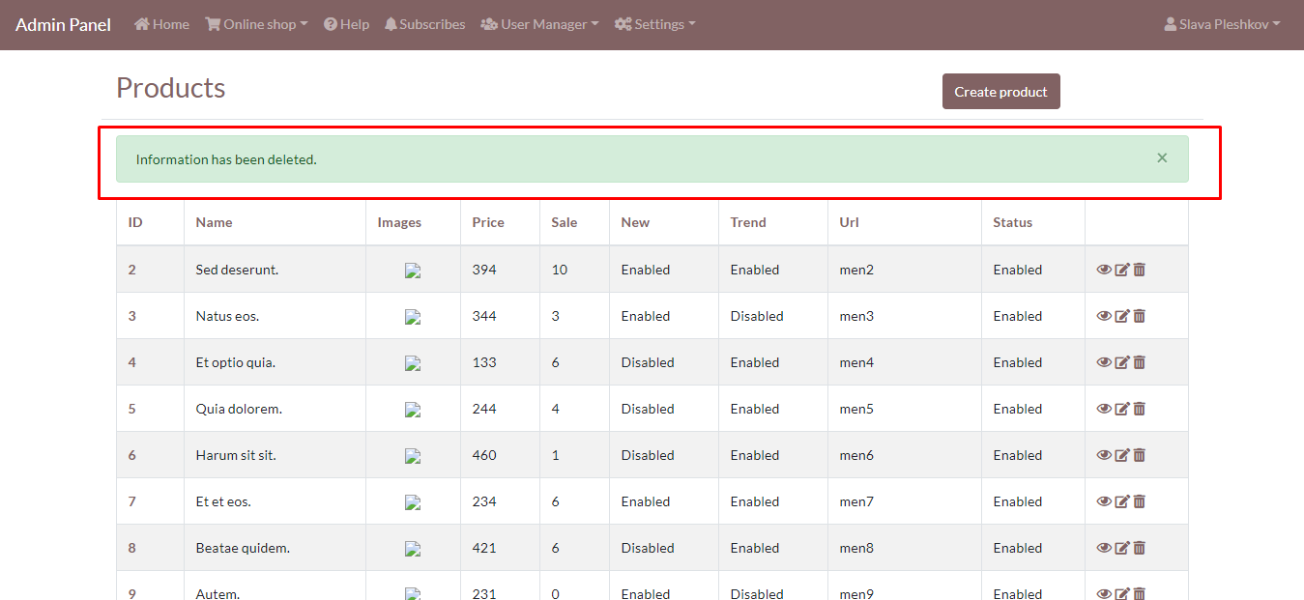
Delete

Slide 30
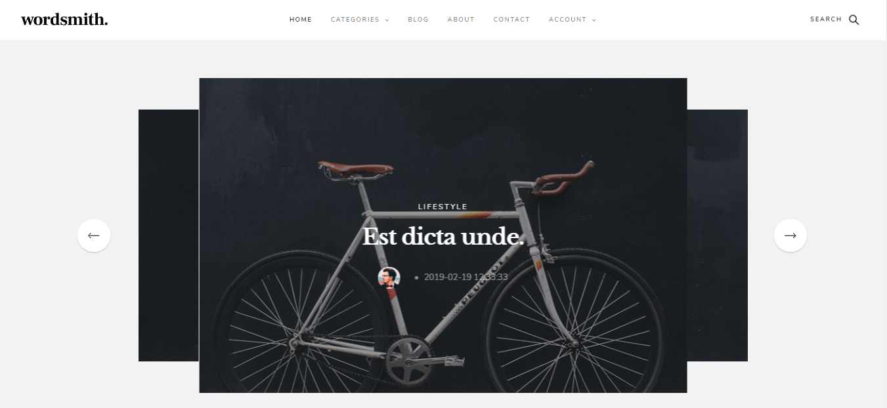
Blog

Slide 31
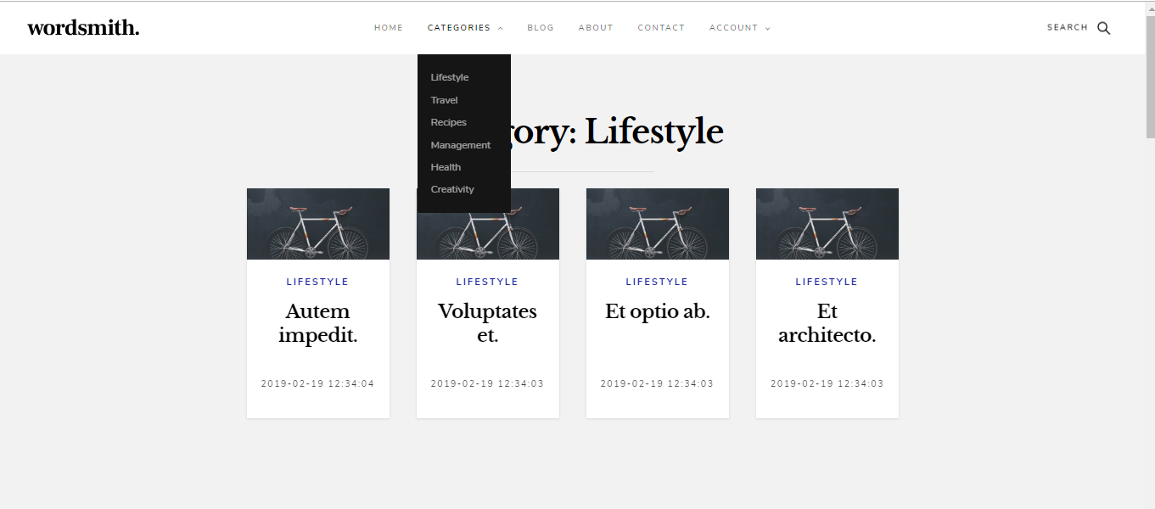
Category

Slide 32
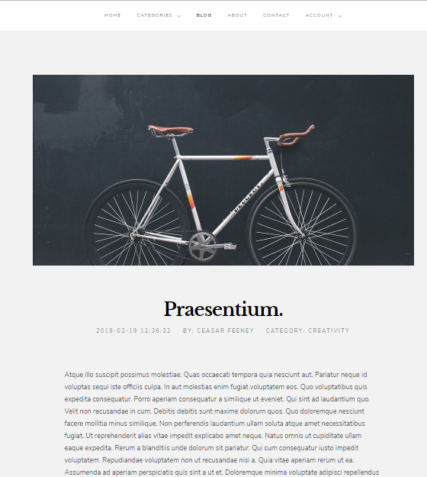
Post

Slide 33
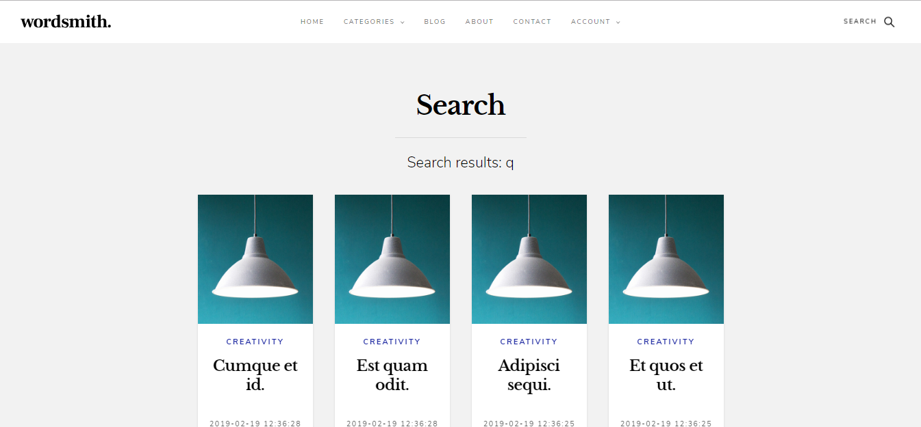
Search

Slide 34
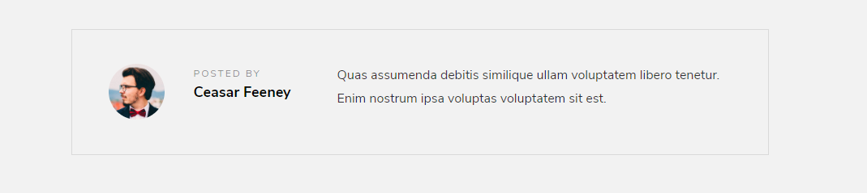
Author

Slide 35


Slide 36
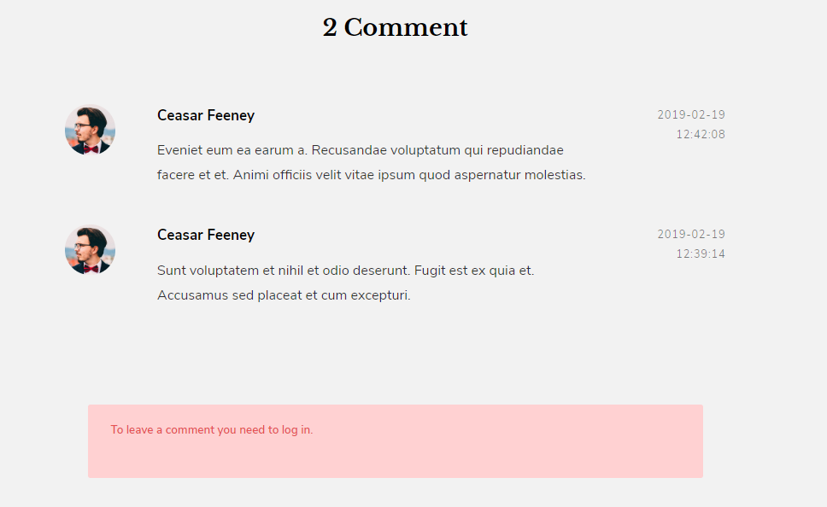
Comment

Slide 37
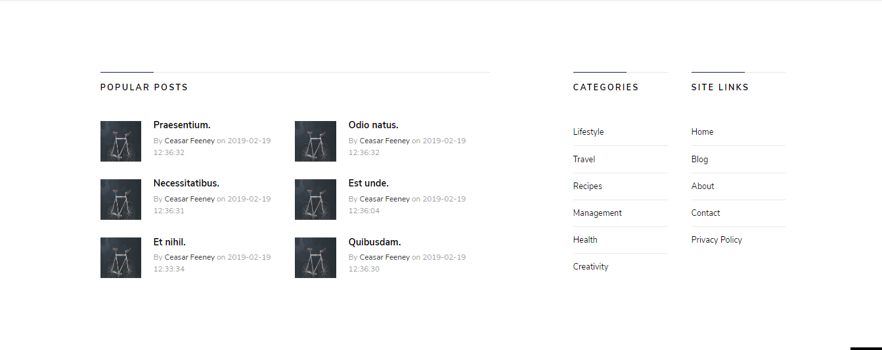
Fotter

Slide 38
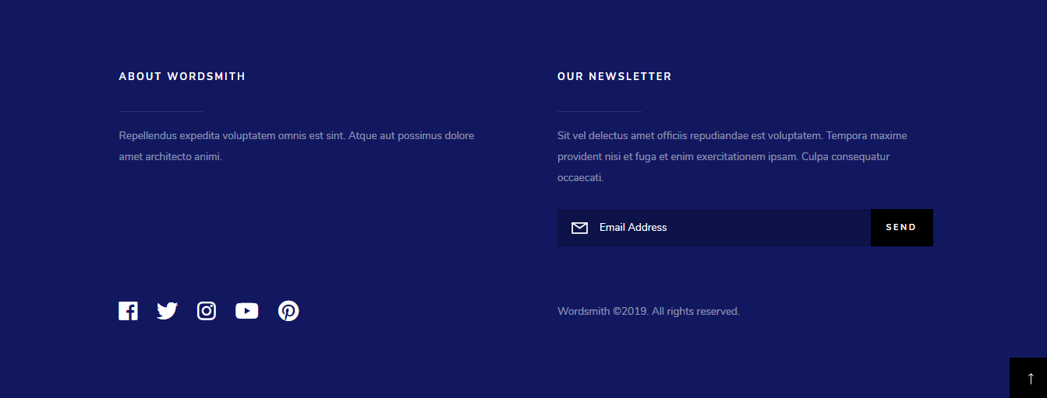

Slide 39
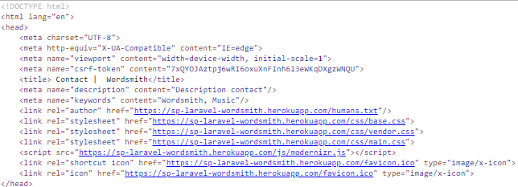
SEO

Slide 40
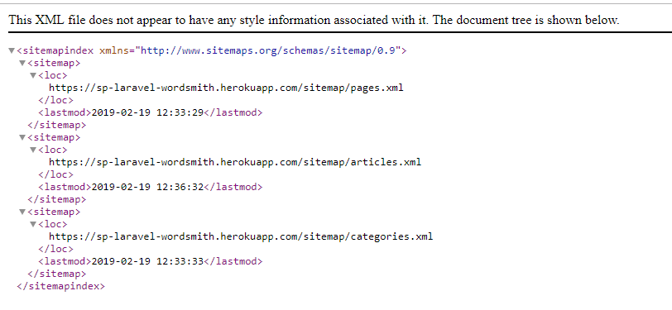
Sitemap.xml

Slide 41
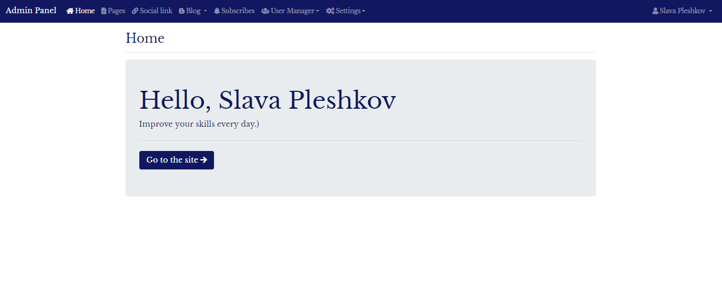
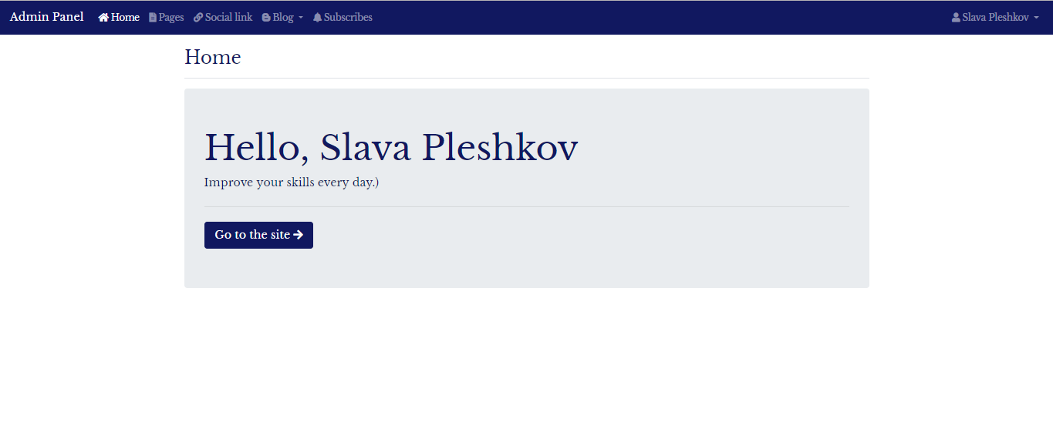
Admin Panel Role

Slide 42
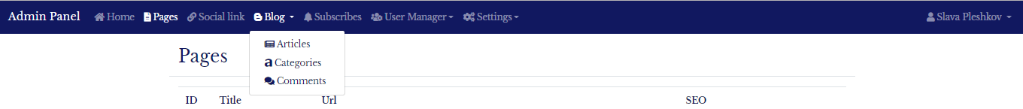
Menu

Slide 43
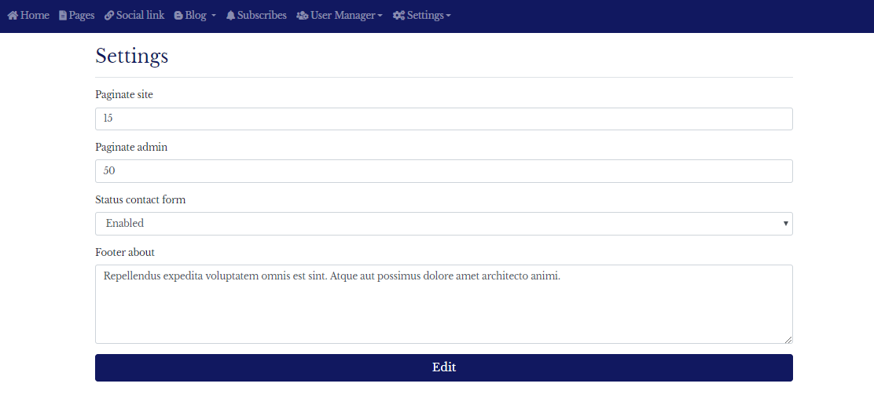
Settings

Slide 44
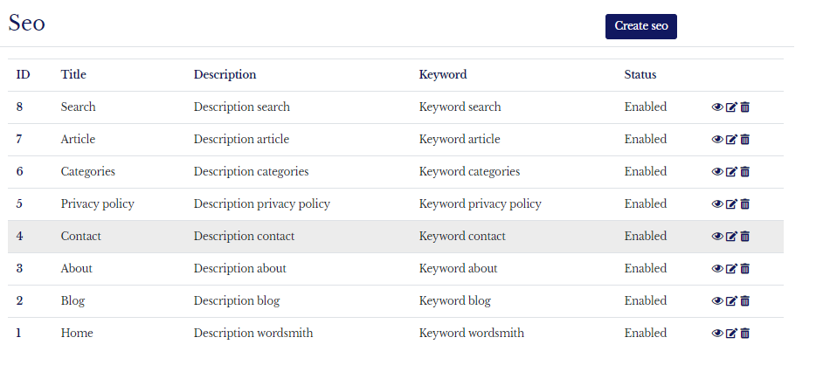
Amin SEO

Slide 45



Error

Slide 46
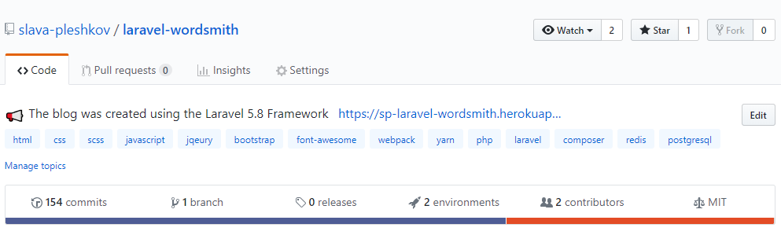
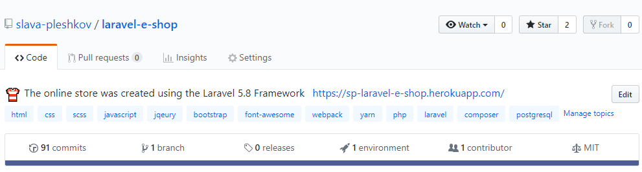
Code projects
GitHub Repository - https://github.com/slava-pleshkov/laravel-wordsmith
GitHub Repository - https://github.com/slava-pleshkov/laravel-e-shop

Slide 47

Ask questions
Download Presentation
OR
http://bit.ly/2WJ5Doa

