Slide 1
Shared storage management in the virtualization world
Liron Aravot, Senior Software Engineer
Red Hat
March 2016

Slide 2
Agenda
oVirt introduction
oVirt basic storage concepts
Shared storage management
Q&A

Slide 3
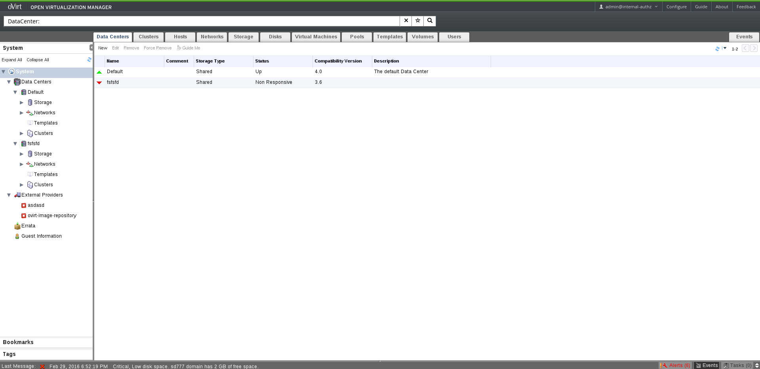
What is oVirt?
Virtualization management application
Manages nodes, storage and network resources
Deploys, runs and monitors virtual machines

Slide 4
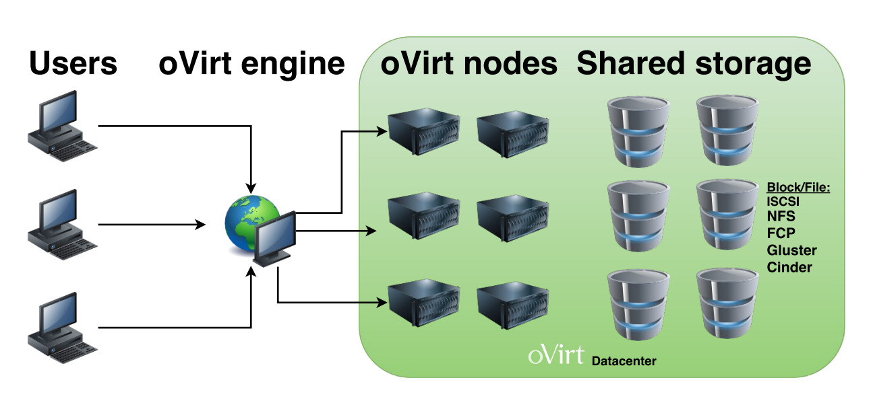
oVirt architecture

Slide 5
oVirt storage concepts

Slide 6
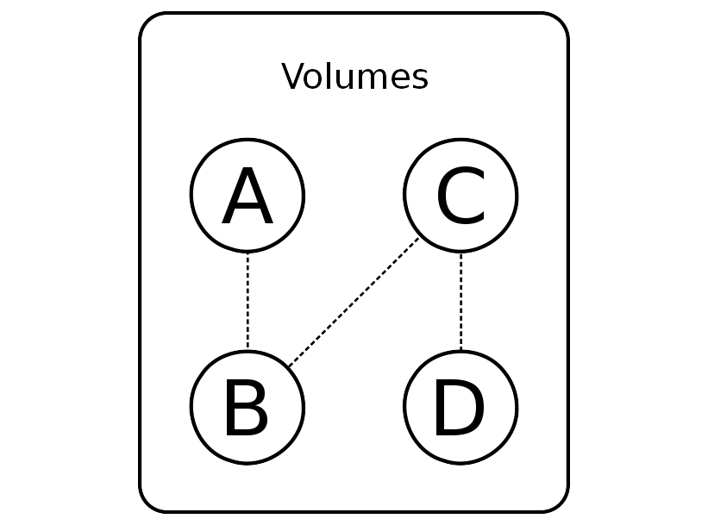
oVirt Images

Slide 7
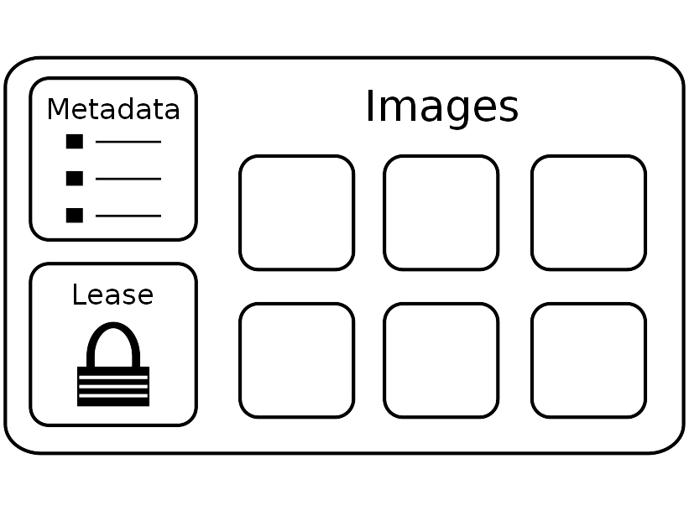
oVirt Storage Domain

Slide 8
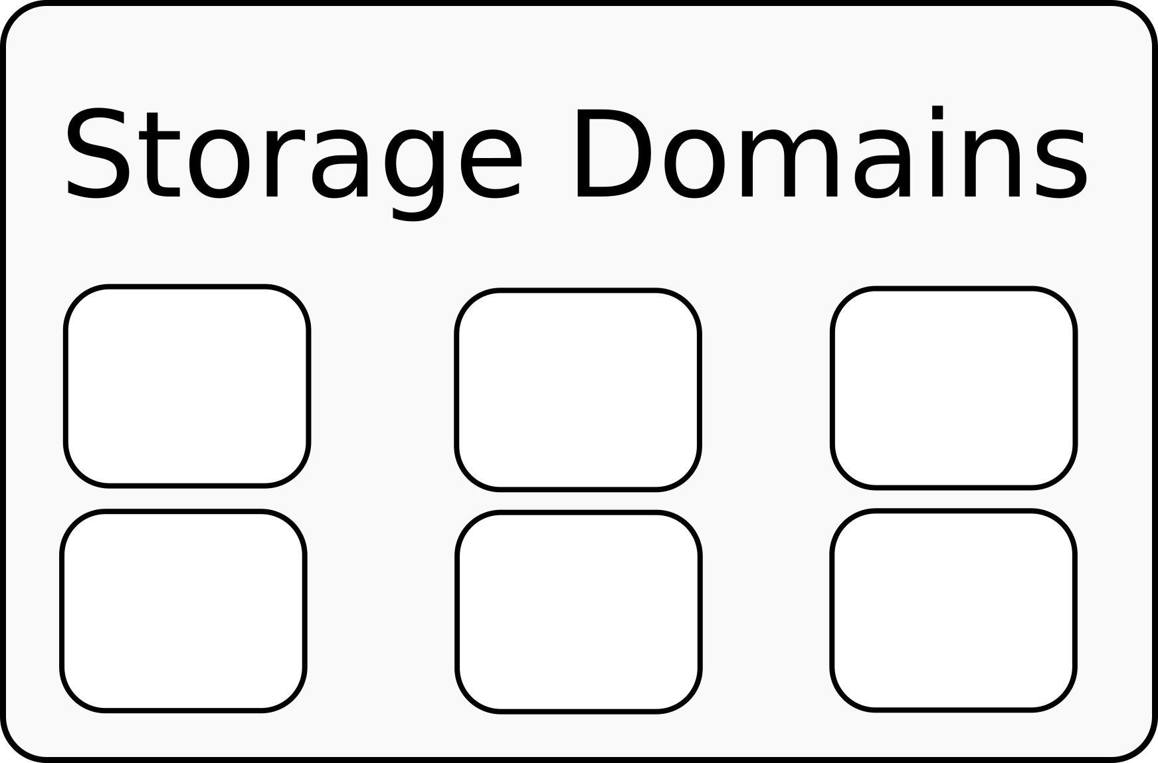
oVirt Storage Pool

Slide 9
oVirt Shared Storage Management

Slide 10
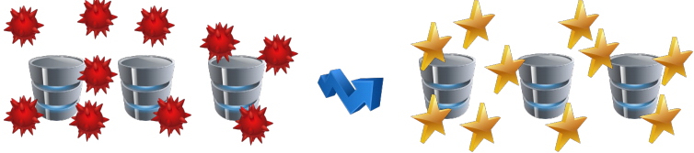
Why do we need management?
Data protection
Performance

Slide 11
Storage Pool Manager

Slide 12
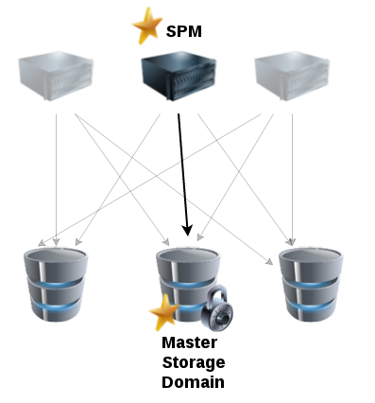
1 – Storage Pool Manager Architecture

Slide 13
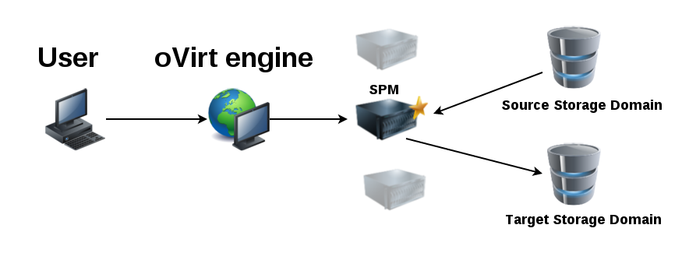
Flow Example – Move Disk
SPM creates target image (all volumes)
SPM copies data
SPM deletes the source image

Slide 14
Storage Pool Manager
Performs all shared storage operations
Holds lock on the master storage domain
SPOF
Easy to manage

Slide 15
Storage Domain Management

Slide 16
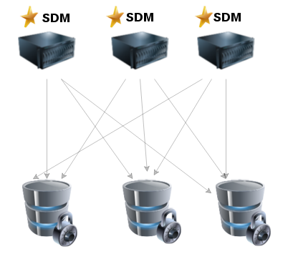
2 – Storage Domain Manager Architecture

Slide 17
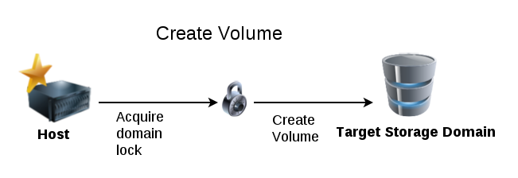
Locking
For consistency and preventing corruption
Engine level locking
Storage domain metadata lock (SANLock)
Volume level lock (SANLock)
Example: volume creation

Slide 18
SDM – Data operations
Long operations
Involve lots of I/O
Can be executed by any host in the cluster
Doesn't the Storage Domain metadata lock
Example: Data copy between volumes

Slide 19
SDM – Metadata operations
Short operations
Creation/Update/Deletion of oVirt storage objects
Can be executed by any host in the cluster
Requires the Storage domain metadata lock
Example: Volume creation

Slide 20
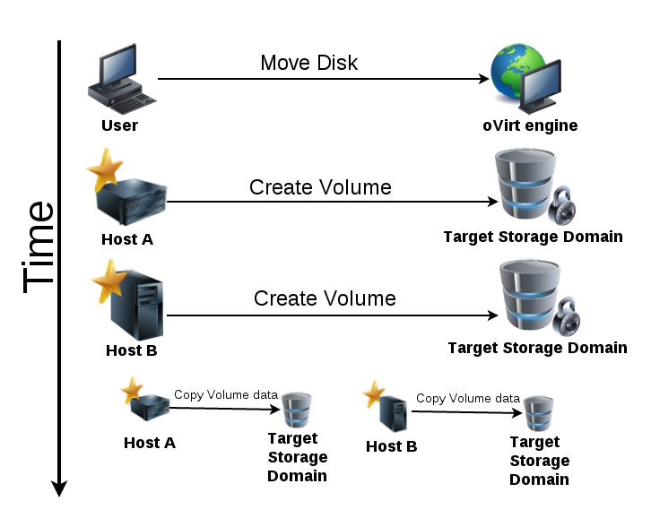
Flow Example – Move Disk

Slide 21
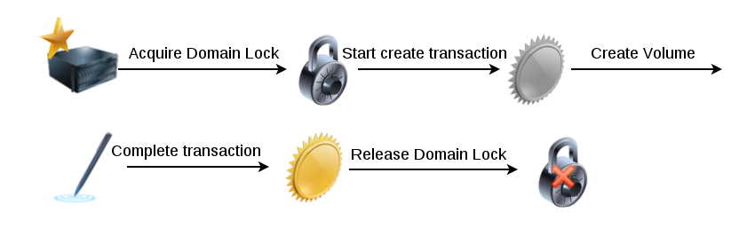
Storage transactions
Used for metadata operations
A transaction is opened with a marker operation
A transaction is committed by converting the marker
The domain lock is acquired during the transaction

Slide 22
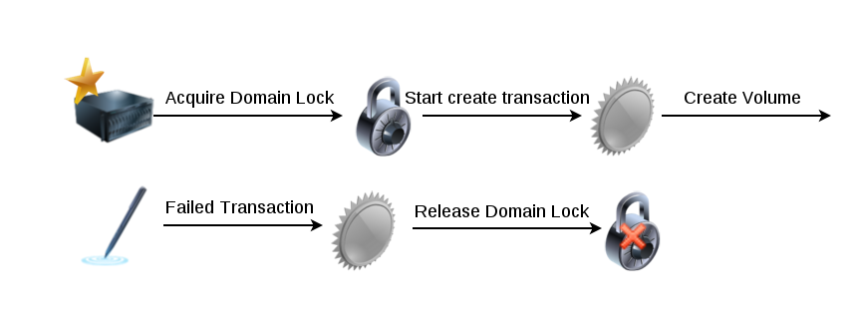
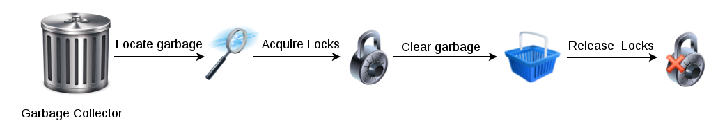
Garbage Collection
Runs periodically on an arbitrary host
Identifies candidates by finding markers
Acquires necessary locks for the candidate
Cleans garbage associated with the marker

Slide 23
Storage Domain Management
Operations can be performed by any host
Separation of metadata and data operations
Load balancing between the hosts
No SPOF

Slide 24
Wrap Up
What is oVirt?
oVirt storage concepts
SPM management
SDM management

Slide 25
Questions?

Slide 26
THANK YOU !
http://www.ovirt.org
http://lists.ovirt.org/mailman/listinfo
#ovirt irc.oftc.net
laravot@redhat.com

