Slide 1
The Institute Blinky Badge
(Burning Man 2015)
Or,
Nice Lights. Want to have sex?
bunnie / FOSSASIA2016

Slide 2
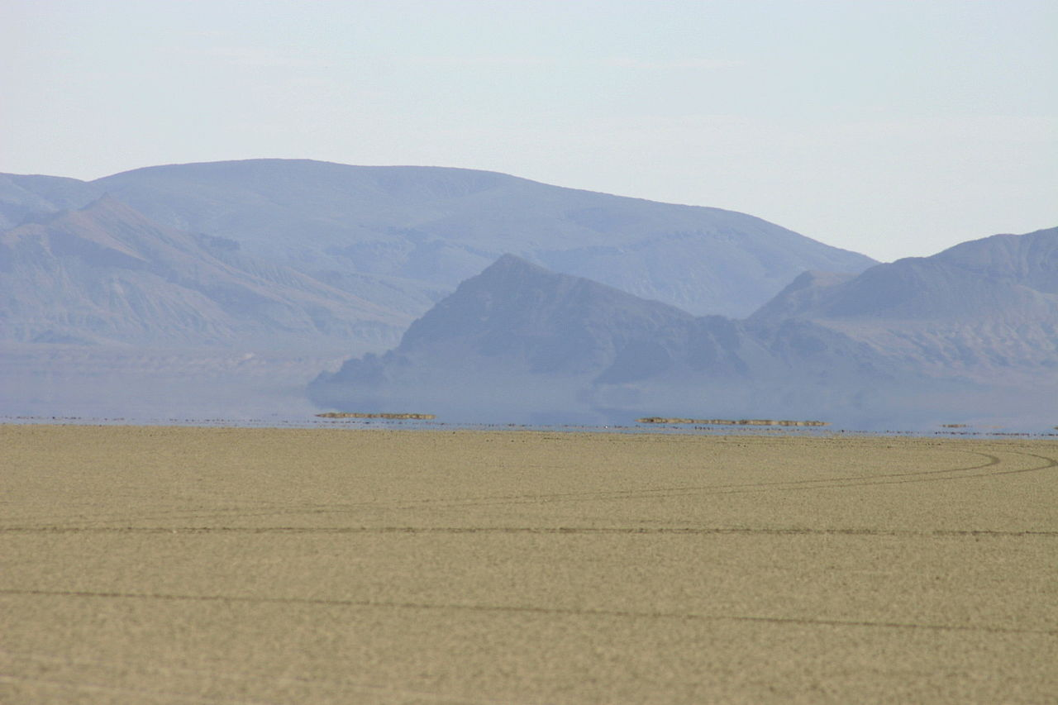
What is Burning Man?
Pack it in. Pack it out. Leave no trace.

Slide 3
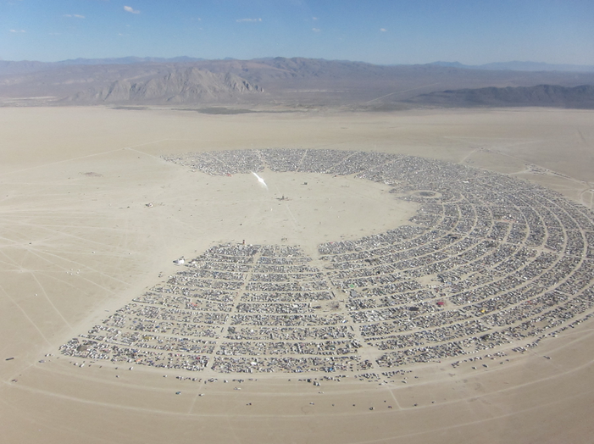
Burning Man For 7 Days a Year
The population of Bukit Timah (~69,000)
Approximately the same land area, not including airport.
About this many people land into Singapore every 1.5 days.

Slide 4
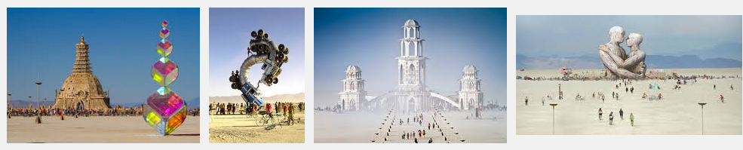
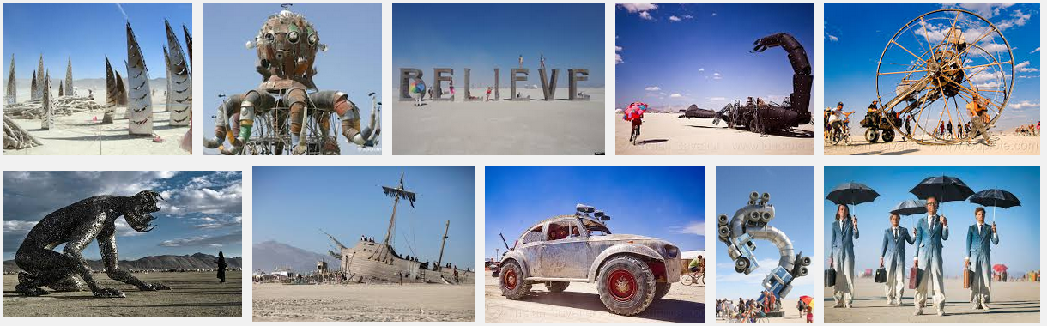
A lot of artwork

Slide 5
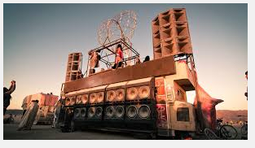
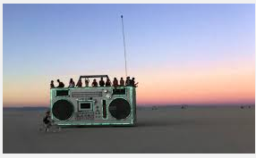
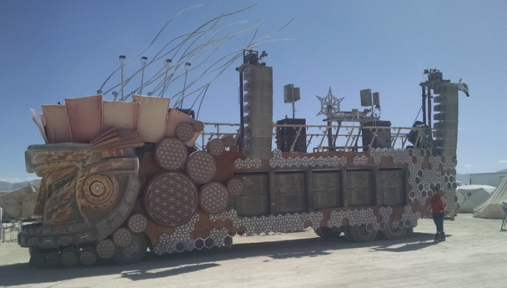
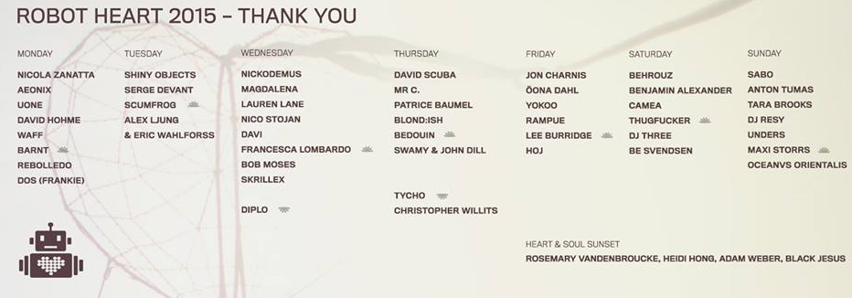
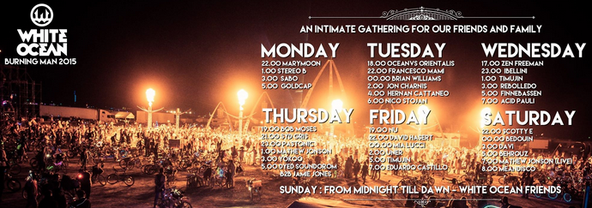
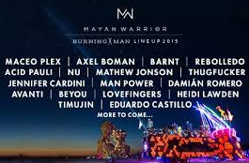
A lot of (loud) music

Slide 6
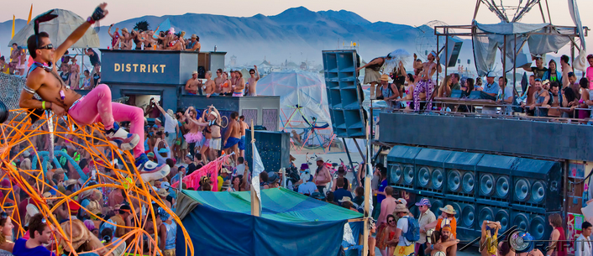
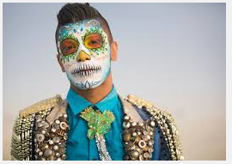
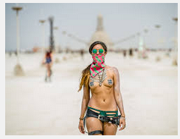
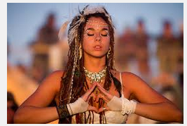
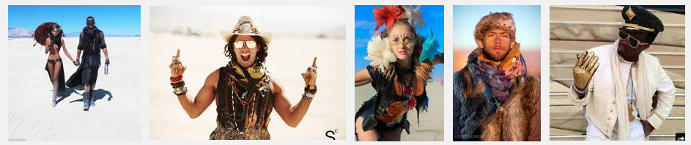
A lot of hippies... doing hippy things...

Slide 7
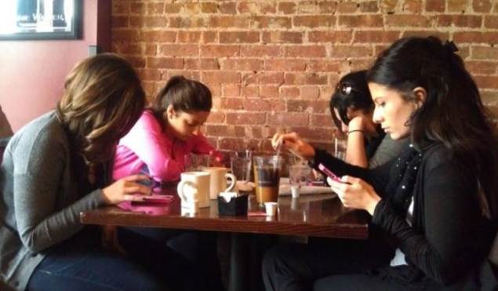
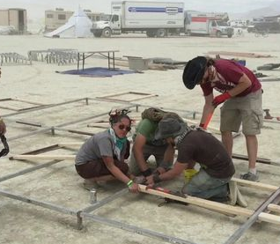
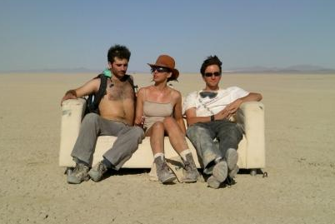
One of my favorite parts about Burning Man...
There's no Internet
There's no mobile phones
Total attention deficit. When everything is important, nothing is important.
100% focus on the task at hand, whether building, socializing or just pondering

Slide 8
Burning man at night (350 days a year)

Slide 9
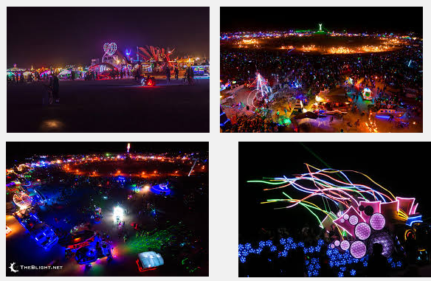
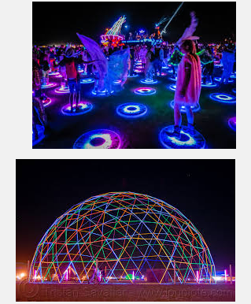
Thus, lights.

Slide 10
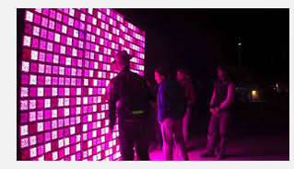
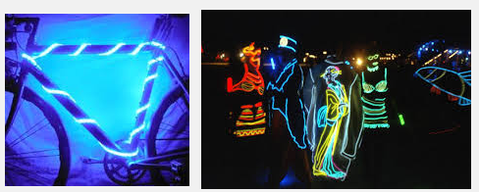
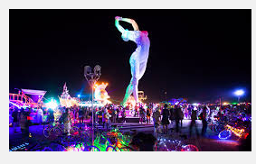
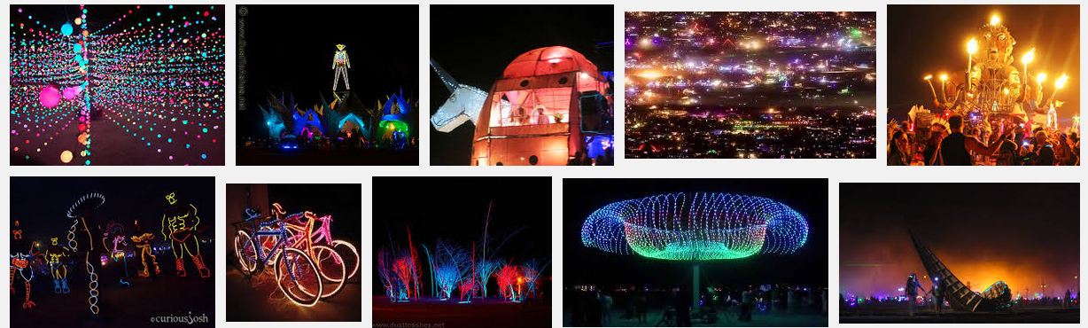
Lots and lots of lights...

Slide 11
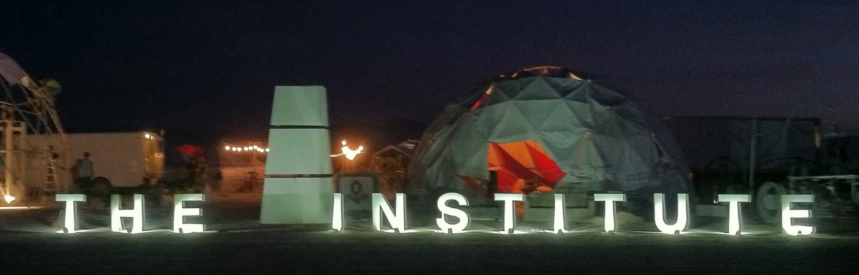

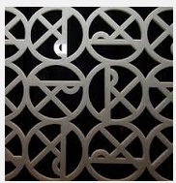
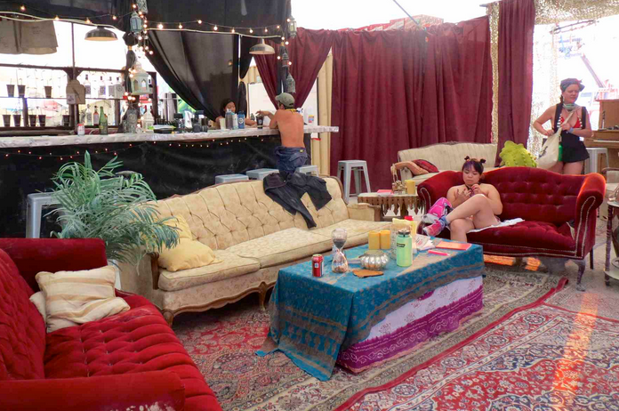

My camp

Slide 12
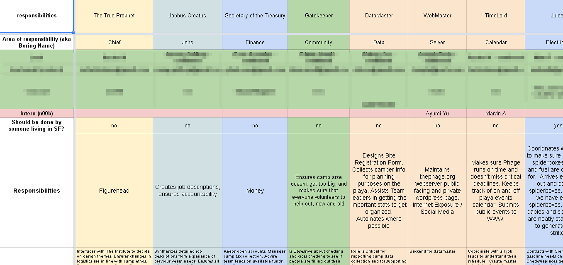
Everyone has to help

Slide 13
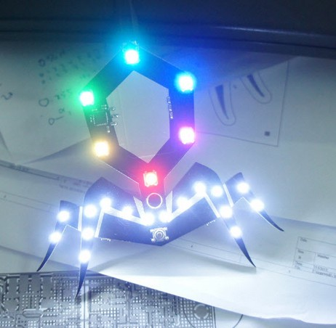
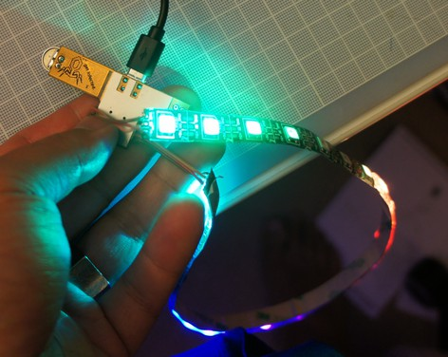
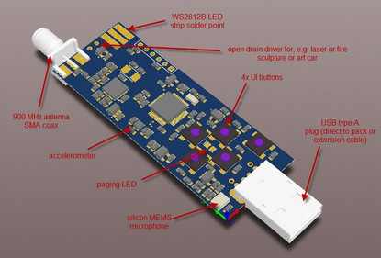
Blinkies of Phage Past
Cheap & small
Fragile, broke easily
Just an LED driver (reinventing the wheel)
Pretty, but spikey
Radio range was “meh”
Difficult to mount
Cheaper, but boring
Required soldering
Problematic UI
LED solder joints unreliable
Battery pack problem

Slide 14
Interactions
At the end of the day, the depth of engagement was shallow
  “Someone” is around
  Blinky is now cheap – you can buy blinky controllers for almost nothing
    Don't re-invent the wheel!

Slide 15
Institute Blinky Badge Goals
A bunch of practical (e.g. boring) goals:
  Reasonably-priced
  Robust mounting
  Integral battery & LEDs
    Eliminate cable tangle
    Eliminate pack sourcing issue
    Eliminate soldering issue
  Decent radio range
    Approximately the sound field of a single sound camp
Most Important: Interaction-focused design
  How do we make badges a social icebreaker, and not just a vanity element?
  Also Institute-wide: not just phage; let's get everyone interacting!
What this is NOT
  Not an SMS/messaging/chat platform
  Not for someone to sit alone and dick around with for hours

Slide 16
Interaction Focus: Sex
Sex is the answer to at least two problems:
  How do users configure their lights?
    Make lighting a social experience
  How do we encourage more interesting interactions between campmates?
What is the MVP for sex?

Slide 17
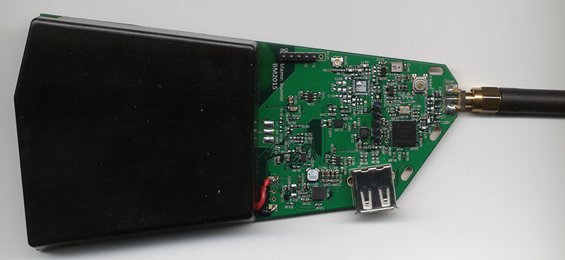
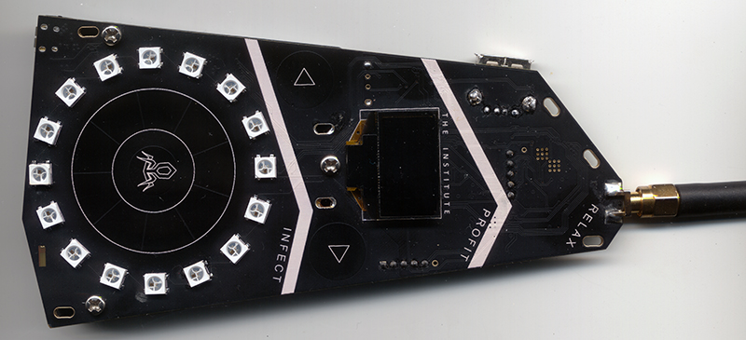

Slide 18
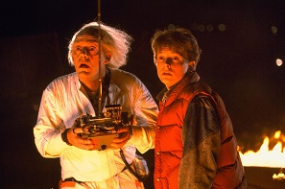
CPU Details
48 MHz Cortex M0+
  128k Flash (~90k used)
  16k RAM
Multithreaded RTOS
  ChibiOS
  Six concurrent threads
  LED effects bitbanging WS2812B in its own thread!

Slide 19
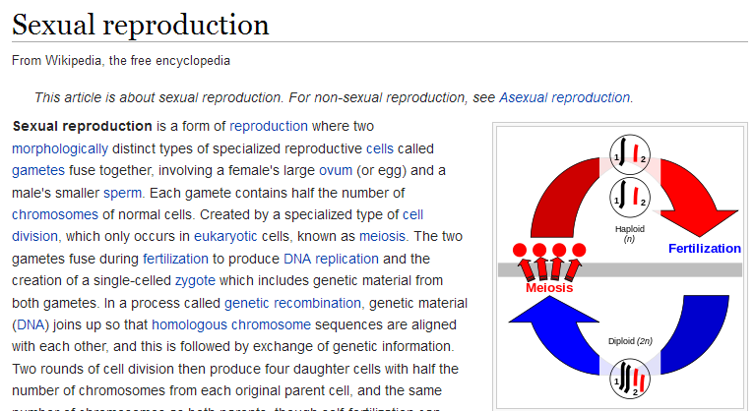
Sex is not a Gimmic
Blinky sex is modeled directly upon sexual reproduction
  However, you're probably thinking about “sexual intercourse”
  Sexual reproduction != sexual intercourse … but the double entendre is what makes it fun :)

Slide 20
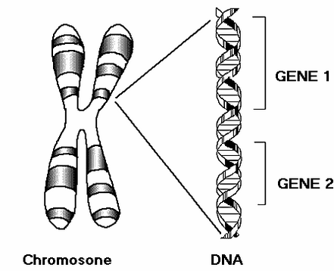
The Blinkome
Our blinkies have a genome.
  Diploid genome
  Multiple chromosomes, e.g.:
    Cyclic dimming (cd) chromosome
      Cd-period gene
      Cd-rate gene
      Cd-dir gene
    Hue (hue) chromosome
      Hue-ratedir gene
      Hue-base gene
      Hue-bound gene
  Use of HSV, not RGB, colorspace
    Mutations generally look more pleasant in HSV

Slide 21
The Blinkome in C
typedef struct genome {
uint8_t cd_period;
uint8_t cd_rate;
uint8_t cd_dir;
uint8_t sat;
uint8_t hue_ratedir;
uint8_t hue_base;
uint8_t hue_bound;
uint8_t lin;
uint8_t strobe;
uint8_t accel;
uint8_t nonlin; // nonlinearity selector
char name[GENE_NAMELENGTH];
} genome; // 11 + 20 = 31 bytes for a haploid gamete

Slide 22
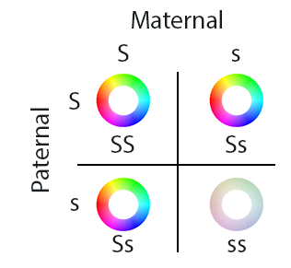
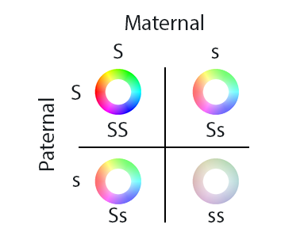
Phenotypes
Alleles are combined via an expression function to derive a phenotype
The expression function is responsible for dominant or recessive behavior
  Bright colors are dominant. So saturation is computed as (satA + satB)
    “Albinos” only happen when both satA and satB are small numbers
satA + satB
average(satA,satB)

Slide 23
Expression Functions
  Other variant examples:
    The “hotspot” → engineered to be in ~5% of the population without breeding
    Counter-clockwise dimming pattern ~25% of the population
    Fast or slow spinning (function is Average(spinA, spinB))
    Narrow-gamut colors (~75% chance of having saturated, wide-gamut colors)

Slide 24
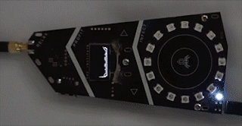
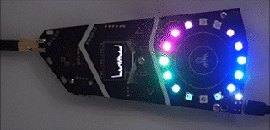
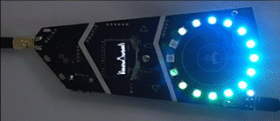
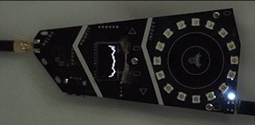
Light Pattern Examples

Slide 25
Mechanics of Sex
Sex is requested – don't be shy! the UX is designed to force you to ask in person
Positive response includes sperm packet
  Meiosis: Random selection of chromosomes from current diploid genome
Eggs locally generated on demand
  No menstruation needed!
Mutation function applied
  Data is converted to gray code prior to XOR with mutation vector
  Mutation rate increased by shaking the badge vigorously during sex
New genome is saved
Giggle about having casual sex with your friends
meiosis(&egg, &(oldfam->haploidM[i]), &(oldfam->haploidP[i]));
mutate(&egg, mutation_rate);
mutate(sperm, mutation_rate);
memcpy(&(newfam->haploidM[i]), &egg, sizeof(genome));
memcpy(&(newfam->haploidP[i]), sperm, sizeof(genome));

Slide 26
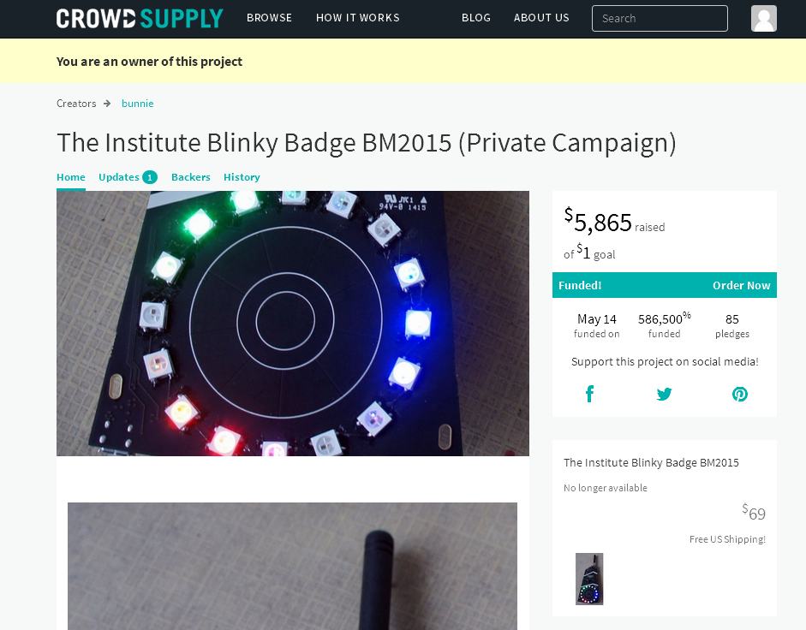
Funding the Badge

Slide 27
Building the Badge
Campaign total | $5,895.00
Fundraising fees | -$968.85
Shipping (within US) | -$254.50
Shipping (From China) | -$200.00
Injection molding | -$200.00
Test Jig | -$235.00
Assembly labor+stencils | -$650.00
PCB cost | -$488.50
Parts cost | -$2,561.36
Box & manual | -$50.73
After direct costs | $286.06
UN38.3 cert | -$900.00
Gas gauge devkit | -$200.00
Assembled in China
  PCB fab
  Assembly
  Injection molding
  Testing
  Boxing
These are extra-special friends-only pricing.
Don't try a startup based on these pricings.

Slide 28
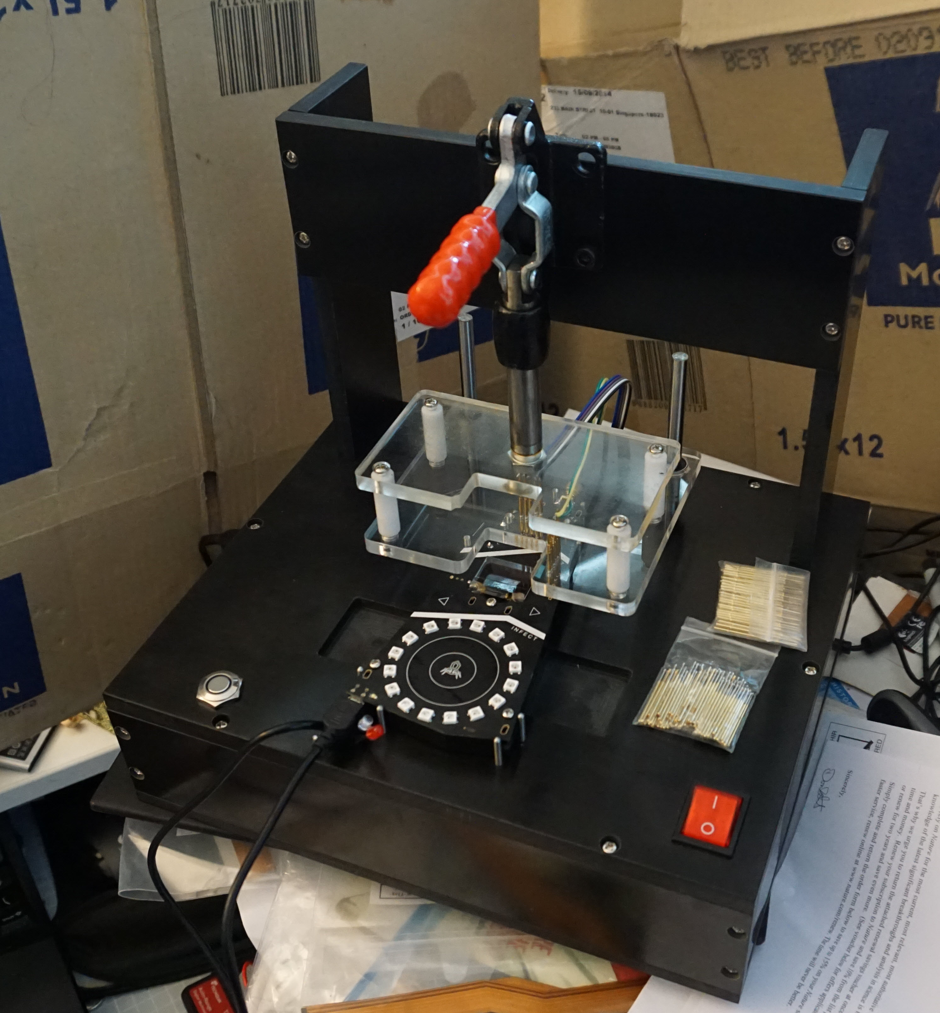
Life Cycle Management
There's no Challenger, Simlim Square, or element14
  Full repair kit, including soldering station, assisted optics, diagnostic tools
  Spare parts
  Spare units
Firmware updates must be handled for 100 people
  Automated firmware updater, operable at a single button push (“drunk hippie test”)
Chargers for 100 units
MicroUSB cords for 100 units

Slide 29
Thanks!

