Slide 1
JSON

Slide 2
Insights:
What is JSON?
Comparisons with XML
Data Types
Syntax
Usage
Demo

Slide 3
JSON is..
A lightweight text based data-interchange format .
Completely language independent.
Based on a subset of the JavaScript Programming Language.
Easy to understand, manipulate and generate by humans and machines.
Straightforward syntax

Slide 4
JSON is NOT…
Overly Complex
A “document” format
A markup language
A programming language

Slide 5
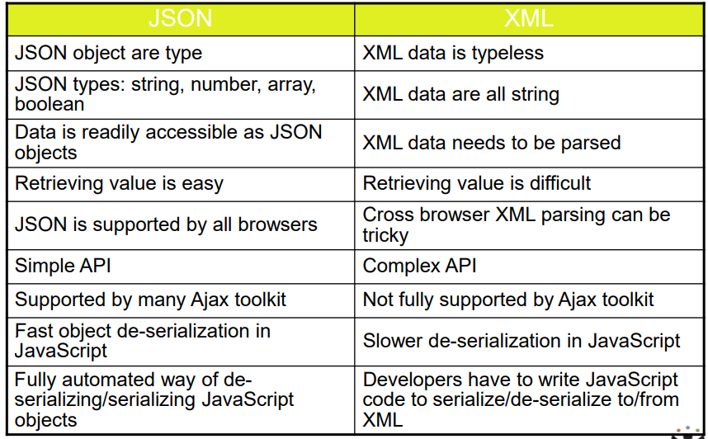
JSON VS XML

Slide 6
Knocks against JSON
Lack of namespaces
No inherit validation (XML has DTD and templates, but there is JSONlint)
Not extensible
It’s basically just not XML

Slide 7
Data Types
Strings
Sequence of 0 or more Unicode characters
Wrapped in "double quotes“
Backslash escapement
Numbers
Integer
Real
Scientific
No octal or hex
No None or Infinity – Use null instead.

Slide 8
Booleans & Null
Booleans: true or false
Null: A value that specifies nothing or no value.
Objects & Arrays
Objects: Unordered key/value pairs wrapped in { }
Arrays: Ordered key/value pairs wrapped in [ ]

Slide 9
JSON Object Syntax
Unordered sets of name/value pairs (hash/dictionary)
Begins with { (left brace)
Ends with } (right brace)
Each name is followed by : (colon)
Name/value pairs are separated by , (comma)
Commas are used to separate multiple data values.
Objects are enclosed within curly braces.
square brackets are used to store arrays.
Json keys must be enclosed within double quotes.
Example:
{ "employee_id": 1234567, "name": "Jeff Fox", "hire_date": "1/1/2013", "location": "Norwalk, CT", "consultant": false }

Slide 10
Arrays in JSON
An ordered collection of values
Begins with [ (left bracket)
Ends with ] (right bracket)
Name/value pairs are separated by , (comma)
Example:
{ "employee_id": 1236937, "name": "Jeff Fox", "hire_date": "1/1/2013", "location": "Norwalk, CT", "consultant": false, "random_nums": [ 24,65,12,94 ] }

Slide 11
How & When to use JSON
Transfer data to and from a server(ex: Browser, mobile Apps)
Perform asynchronous data calls without requiring a page refresh
Working with data stores
Compile and save form or user data for local storage

Slide 12
Demo

