Slide 1
Serialization
Date : 10-Mar-2017 By:
Fosscafe

Slide 2
Problem statement?
OSI badly needed a way of describing the structured data in protocols.

Slide 3
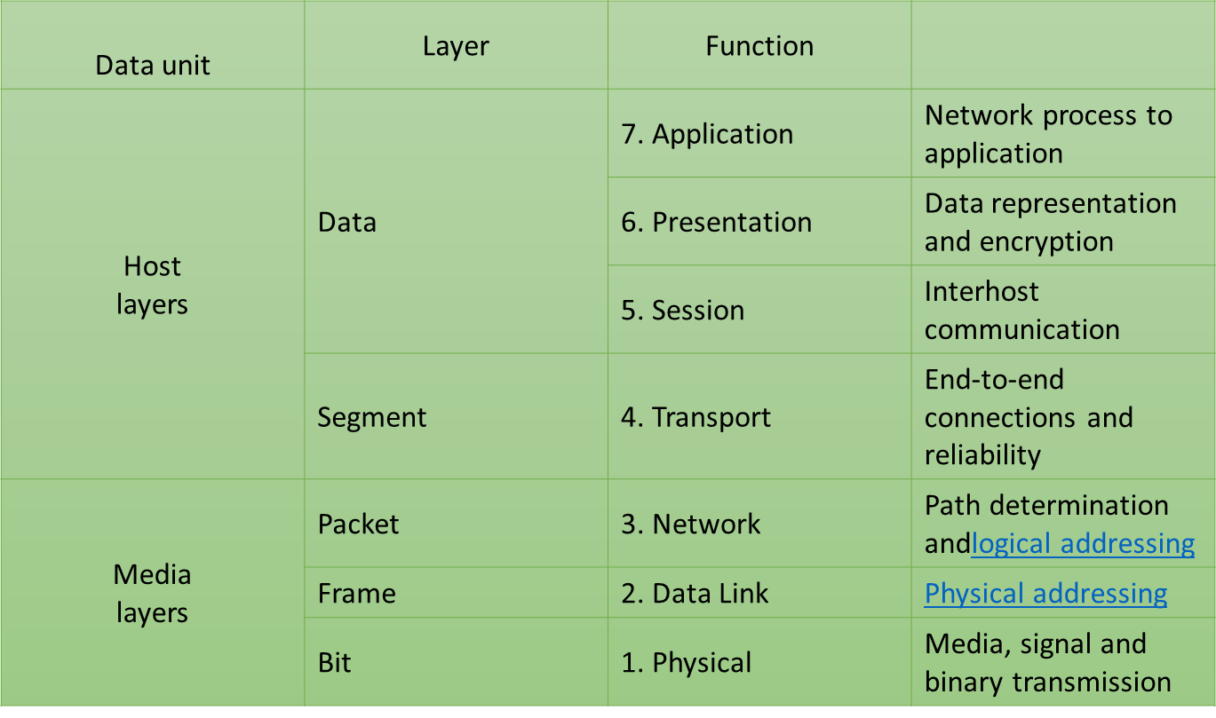
OSI Layer
HTTP,SMTP,DHCP,SMTP,POP
Serialization

Slide 4
Presentation Layer
Establishes context between application-layer entities, (in which the higher-layer entities may use different syntax and semantics , the presentation service provides a mapping between them).
If a mapping is available, presentation service data units are encapsulated into session protocol data units, and passed down the stack.
Provides independence from data representation (e.g., encryption) by translating between application and network formats(vice versa). This layer formats and encrypts data to be sent across a network. It is sometimes called the syntax layer.
Uses the basic encoding rules of Abstract Syntax Notation One (ASN.1), with capabilities such as converting an EBCDIC-coded text file to an ASCII-coded file, or serialization of objects and other data structures from and to XML(JSON, YAML, proto buff).

Slide 5
RFC
https://tools.ietf.org/html/rfc1085

Slide 6
Why & What Serialization?
In computer science,
In the context of data storage, serialization is the process of translating data structures or object state into a format that can be stored,
In a file
or Memory buffer
or Transmitted (across a network link)
and reconstructed later (possibly in a different computer environment).

Slide 7
Serialization is a mechanism of converting the state of an object into a byte stream. Deserialization is the reverse process where the byte stream is used to recreate the actual object in memory. This mechanism is used to persist the object and you can do stuff like store it on disk or send it over the network.
The byte stream created is platform independent. So, the object serialized on one platform can be deserialized on a different platform.
Use Cases:
A method of transferring data through the wires
A method of storing data
A method of remote procedure calls.(SOAP)
A method for detecting changes in time-varying data
A method for distributing objects

Slide 8
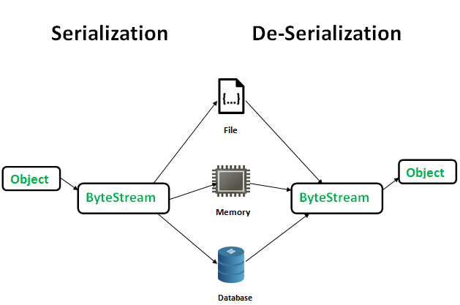
Serializing the data structure in an architecture independent format means preventing the problems of byte ordering, memory layout, or simply different ways of representing data structures in different programming languages.

Slide 9
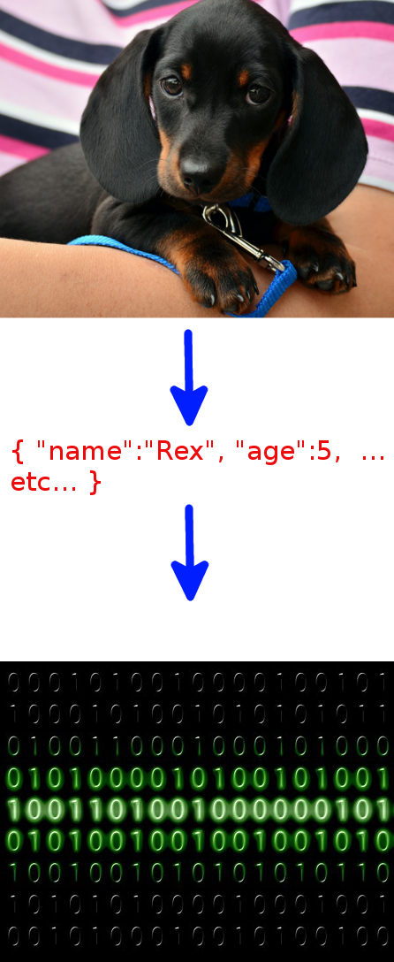
"Dude, what puppy?

Slide 10
Serialization format:
ASN.1
JSON
YAML
Proto buff
Thrift
avro
Above all are few independent scheme of serialization.

Slide 11
ASN .1 - Abstract Syntax Notation One
ASN.1 and its associated encoding rules are standards put forth by the ITU-T primarily for use within the telecommunications industry.
Nearly twenty years and have been constantly refined and updated over the years. The initial standards defined the ASN.1 schema language and the Basic Encoding Rules (BER). There has always been a clear separation between the schema language (ASN.1) and the encoding rules (BER, DER, PER, etc.).
A technology for exchanging structured data in a universally understood, hardware agnostic way. Many industrial, security and telephony applications heavily rely on ASN.1.
an interface description language
It is probably among the first serialization protocols in the history of computer science and technology.

Slide 12
To understand ASN.1, you must realize that ASN.1 separates two concerns: describing your data and describing what your data looks like in transmission.
The first part is describing your data. ASN.1 specifies an abstract syntax notation and second using appropriate encoding.
Example:
Coordinate is a complex value consisting of a sequence of two integers which must be between 0 and 100:
Coordinate ::= SEQUENCE {x INTEGER(0..100), y INTEGER(0..100) }

Slide 13
ASN.1 is closely associated with a set of encoding rules that specify how to represent a data structure as a series of bytes. The standard ASN.1 encoding rules include:
Distinguished Encoding Rules (DER)
Basic Encoding Rules (BER)
Canonical Encoding Rules (CER)
XML Encoding Rules (XER)
Canonical XML Encoding Rules (CXER)
Extended XML Encoding Rules (E-XER)
Packed Encoding Rules (PER, unaligned: UPER, canonical: CPER, canonical unaligned: CUPER)
Octet Encoding Rules (OER, canonical: COER)
JSON Encoding Rules (JER)
Generic String Encoding Rules (GSER)

Slide 14
A known usage of ASN.1
X.509(certificate used in HTTPS)- (DER is a type-length-value encoding is used)
Below is the data structure shown above encoded in DER format (all numbers are in hexadecimal):
30 13 02 01 05 16 0e 41 6e 79 62 6f 64 79 20 74 68 65 72 65 3f
30 — type tag indicating SEQUENCE
13 — length in octets of value that follows
02 — type tag indicating INTEGER
01 — length in octets of value that follows
05 — value (5)
16 — type tag indicating IA5String
(IA5 means the full 7-bit ISO 646 set, including variants,
but is generally US-ASCII)
41 6e 79 62 6f 64 79 20 74 68 65 72 65 3f — value ("Anybody there?")

Slide 15
Advantages of ASN.1? The ability to use tools to generate code. Along with that, the flexibility to produce different encodings (e.g. XML, PER) from the same abstract syntax.
Disadvantages of ASN.1? Probably complexity
Usage: Telecommunication
Signalling standards for the public switched telephone network (SS7 family)
Network management standards (SNMP, CMIP)
Directory standards (X.500 family, LDAP)
Public Key Infrastructure standards (X.509, etc.)
PBX control (CSTA)
IP-based Videoconferencing (H.323 family)
Biometrics (BIP, CBEFF, ACBio)
Intelligent transportation (SAE J2735)
Cellular telephony (GSM, GPRS/EDGE, UMTS, LTE)

