Slide 1
YAML

Slide 2
What is YAML?
YAML is a Data Serialization Language.
A New Language for Data
Modeled after Perl-like structures
But not just intended for Perl
• Human friendly, cross language, Unicode based data serialization language.

Slide 3
YAML can be taken as an acronym for either
Yet Another Markup Language
YAML Ain’t Markup Language
Like JSON, the purpose of YAML is to represent typical data types in human-readable notation

Slide 4
Why YAML if XML?
Unlike XML which is not easily readable by humans, YAML was created to be human-friendly and integrate easily with modern programming languages.
• Unlike with XML, YAML was intended to simplify the viewing and understanding of config files, log files, object persistence, and messaging, to allow the programmer to spend more time programming and less time formatting data.

Slide 5
YAML Design Goals
YAML design goals:
- YAML documents are very readable by humans.
- YAML interacts well with scripting languages.
- YAML uses host languages native data structures.
- YAML has a consistent information model.
- YAML enables stream-based processing.
- YAML is expressive and extensible.
- YAML is easy to implement.

Slide 6
Design consideration
To achieve Human/Computer easy processing
High Data/Markup (Signal/Noise) Ratio
To be the world's best Data::Dumper
To be great for Configs, Caches, and Logs
Unicode based
Speedy parsing
Alternative to XML (for some applications)

Slide 7
Basic YAML Syntax Rules
• Documents begin with --- and end with …
• Indentation of lines denotes the structure within the document.
• Comments begin with #
• Members of lists begin with –
• Key value pairs use the following syntax <key>:value>
YAML files should end in .yaml
YAML is case sensitive.
YAML does not allow the use of tabs. Spaces are used instead as tabs are not universally supported.

Slide 8
YAML Syntax Basics
Collections
Streams and Documents
Mappings (hashes / dictionaries)
Sequences (arrays / lists)
Comments

Slide 9
Contd..
Scalars (strings,integers, dates and other atomic data types)
Simple
Quoted
Block ( |)
Folded
Wiki
Escaping
Anchors & Aliases (&,*)
Tags (Data types)(“!”)
Nodes -YAML nodes have content of one of three kinds: scalar, sequence, or mapping. In addition, each node has a tag which serves to restrict the set of possible values which the node's content can have.

Slide 10
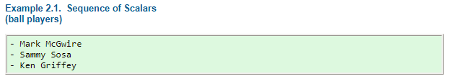
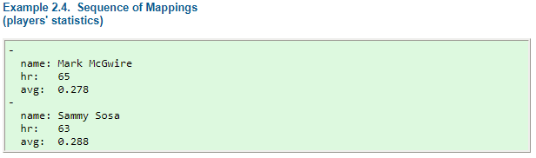
Collections:
YAML's block collections use indentation for scope and begin each entry on its own line.

Slide 11
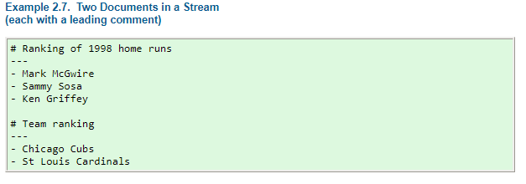
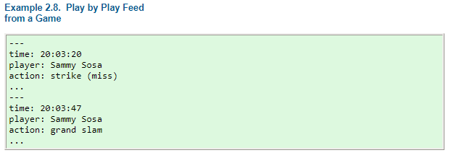
Structures – Streams & Documents
YAML uses three dashes (“---”) to separate documents within a stream. Three dots ( “...”) indicate the end of a document without starting a new one

Slide 12
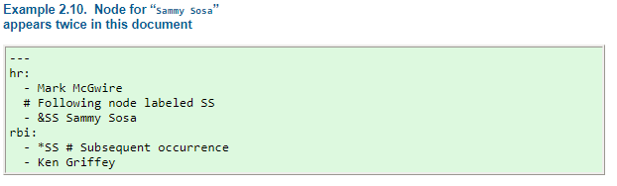
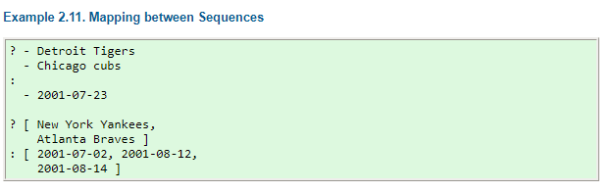
A question mark and space (“? ”) indicate a complex mapping key.
& and * indicate Anchors and Aliases

Slide 13
Mappings
A YAML mapping is like a Perl hash
Unordered Key/Value pairs
Separated by ': ' (space is mandatory)
---
name: Benjamin
rank: Private
serial number: 1234567890
12:34 PM: My favorite time

Slide 14
Sequences
A YAML sequence is like a Perl array
An ordered collection of data
YAML has a bullet like syntax '- '
---
red
white
blue
- pinko

Slide 15
Examples
---
Fruits:
- Apples
- Tomatoes
Veggies:
- Spinach
- Broccoli
Meats:
- Burgers
- Shrimp
Household:
- Candles
- Incense
- Toilet Duck

Slide 16
Ex2:The Matrix
---
-
- 3
- 5
- 7
-
- 0
- 0
- 7
-
- 9
- 1
- 1

Slide 17
Comments
Comments/blank lines can go almost anywhere
Must not be ambiguous with content
Comments begin '# '
# comment before document
--- #DIRECTIVE # comment
foo: bar # inline comment
phone: number #555-1234
### Comment
fact: fiction
---
blue: bird
# Comment

Slide 18
Scalars
A YAML scalar is strings,integers, dates and other atomic data types.
YAML has many scalar forms.
---
simple: look ma, no quotes
quoted:
- 'Single quoted. Like Perl, no escapes'
- "Double quotes.\nLike Perl, has escapes"
- |
A YAML block scalar.
Much like Perl's
here-document.

Slide 19
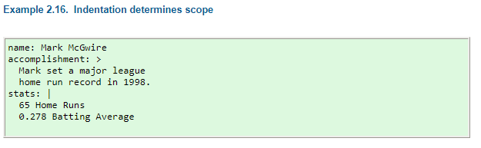
Scalar content can be written in block form using a literal style (“|”) where all line breaks count. Or they can be written with the folded style (“>”) where each line break is folded to a space unless it ends an empty or a “more indented” line.

Slide 20
Tags
http://yaml.org/type/

Slide 21
YAML Pros:
Cleaner format
Safe deserialization
Hashes sorted by default
Supports GLOB(*.txt), Regexp
Interacts with Ruby, Python, Java etc

Slide 22
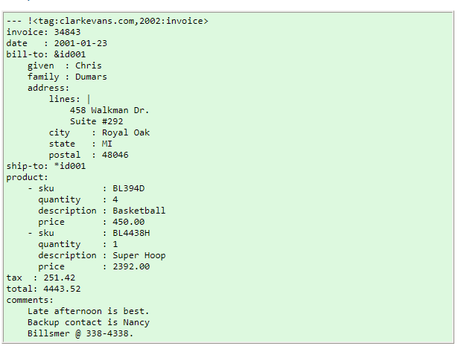

Slide 23
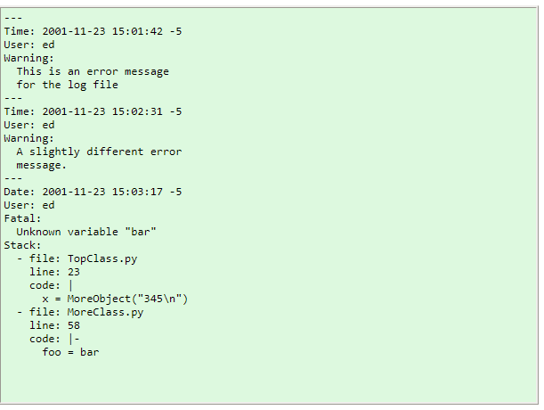

Slide 24
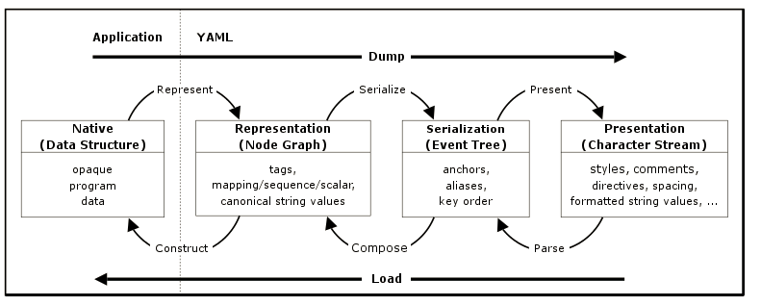

Slide 25
References:
https://learnxinyminutes.com/docs/yaml/
http://pyyaml.org/wiki/PyYAMLDocumentation
http://yaml.org/refcard.html
http://sangsoonam.github.io/2017/03/13/yaml-vs-json.html

