Slide 1


Slide 2
Version Control
Why?
Types
  Local
  Centralized
  Distributed

Slide 3
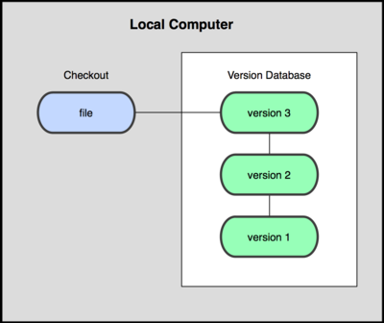
Local VCS

Slide 4

Centralized VCS

Slide 5

Distributed VCS

Slide 6
Git
Why git?
  Snapshots, not differences
  Operating locally
  Integrity using checksum

Slide 7
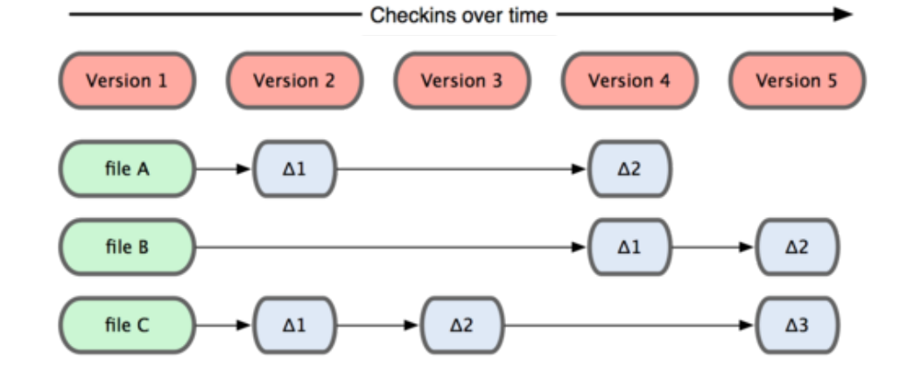
Traditional VCS

Slide 8
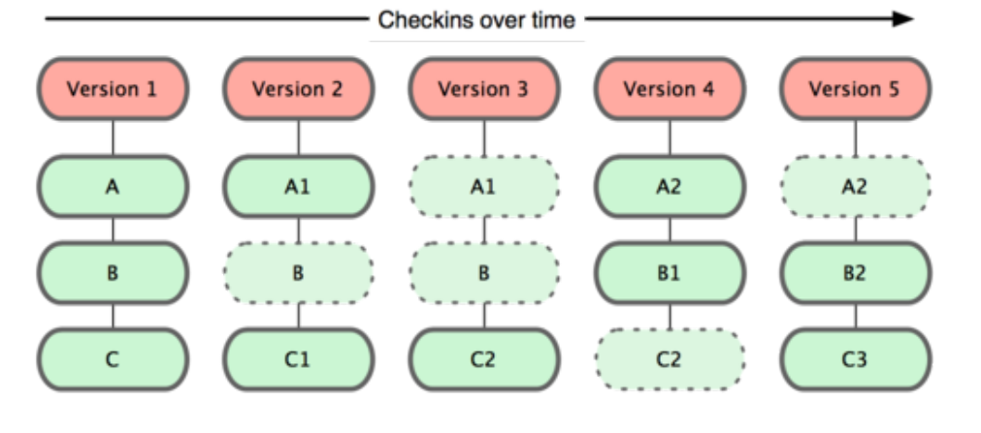
Git

Slide 9
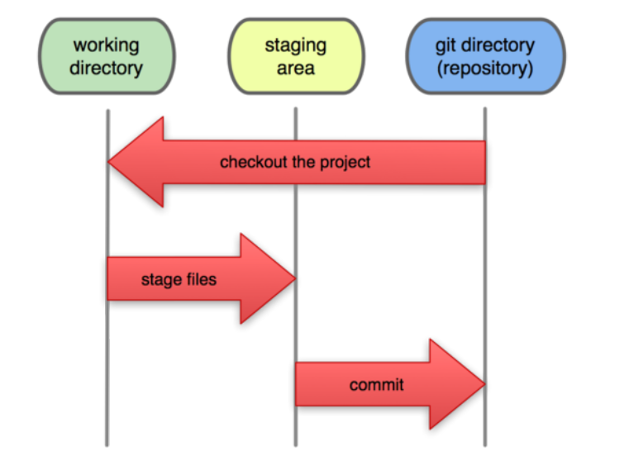
The Three States

Slide 10
Git Repo
Init
Add
Commit
Status
Log

Slide 11
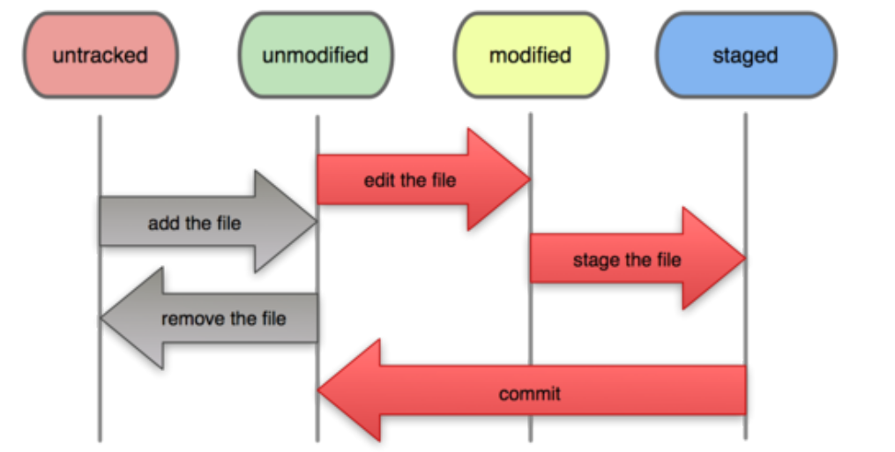
Recording Changes

Slide 12
Git Workspace
Unstaging using reset
Unmodifying using checkout

Slide 13
Remotes
Remote add
Pushing
Fetching-Merging
Pulling
Remote setUrl

Slide 14
Branches
Branch
Merge
Fetch
Pull
Push

