Slide 1
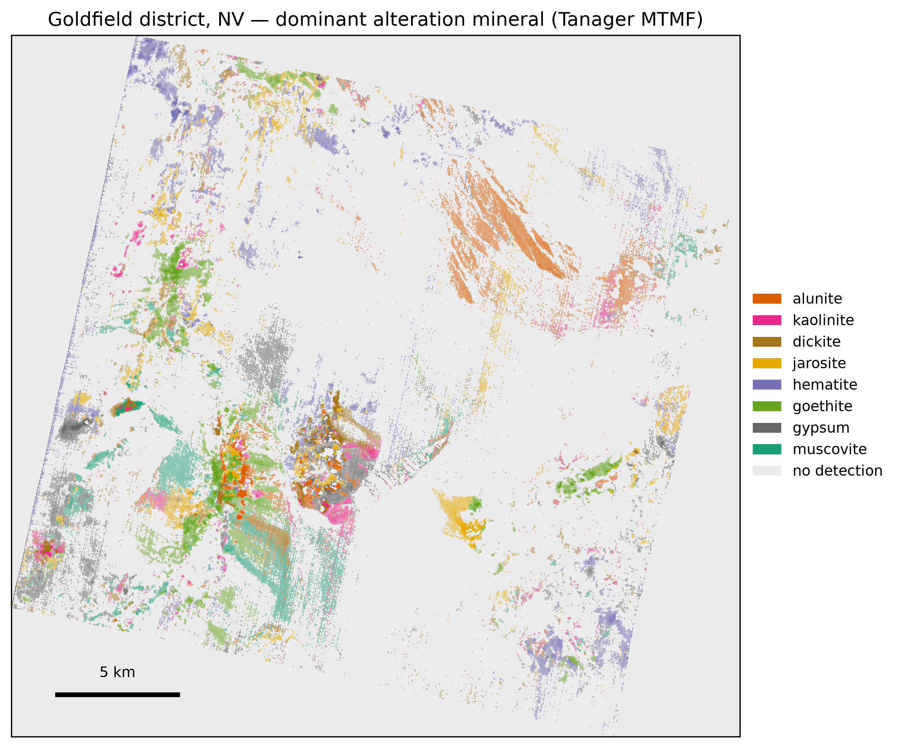
PLANET TANAGER OPEN DATA COMPETITION
Material identification from Tanager VSWIR
Mine-waste and alteration mineralogy blurred by broadband sampling
Alex Bradley Department of Earth, Environmental, and Planetary Sciences
Washington University in St. Louis · abradley@wustl.edu
Story page fossettlab.github.io/tanager-rocks Code (MIT) github.com/fossettlab/tanager-rocks

Slide 2
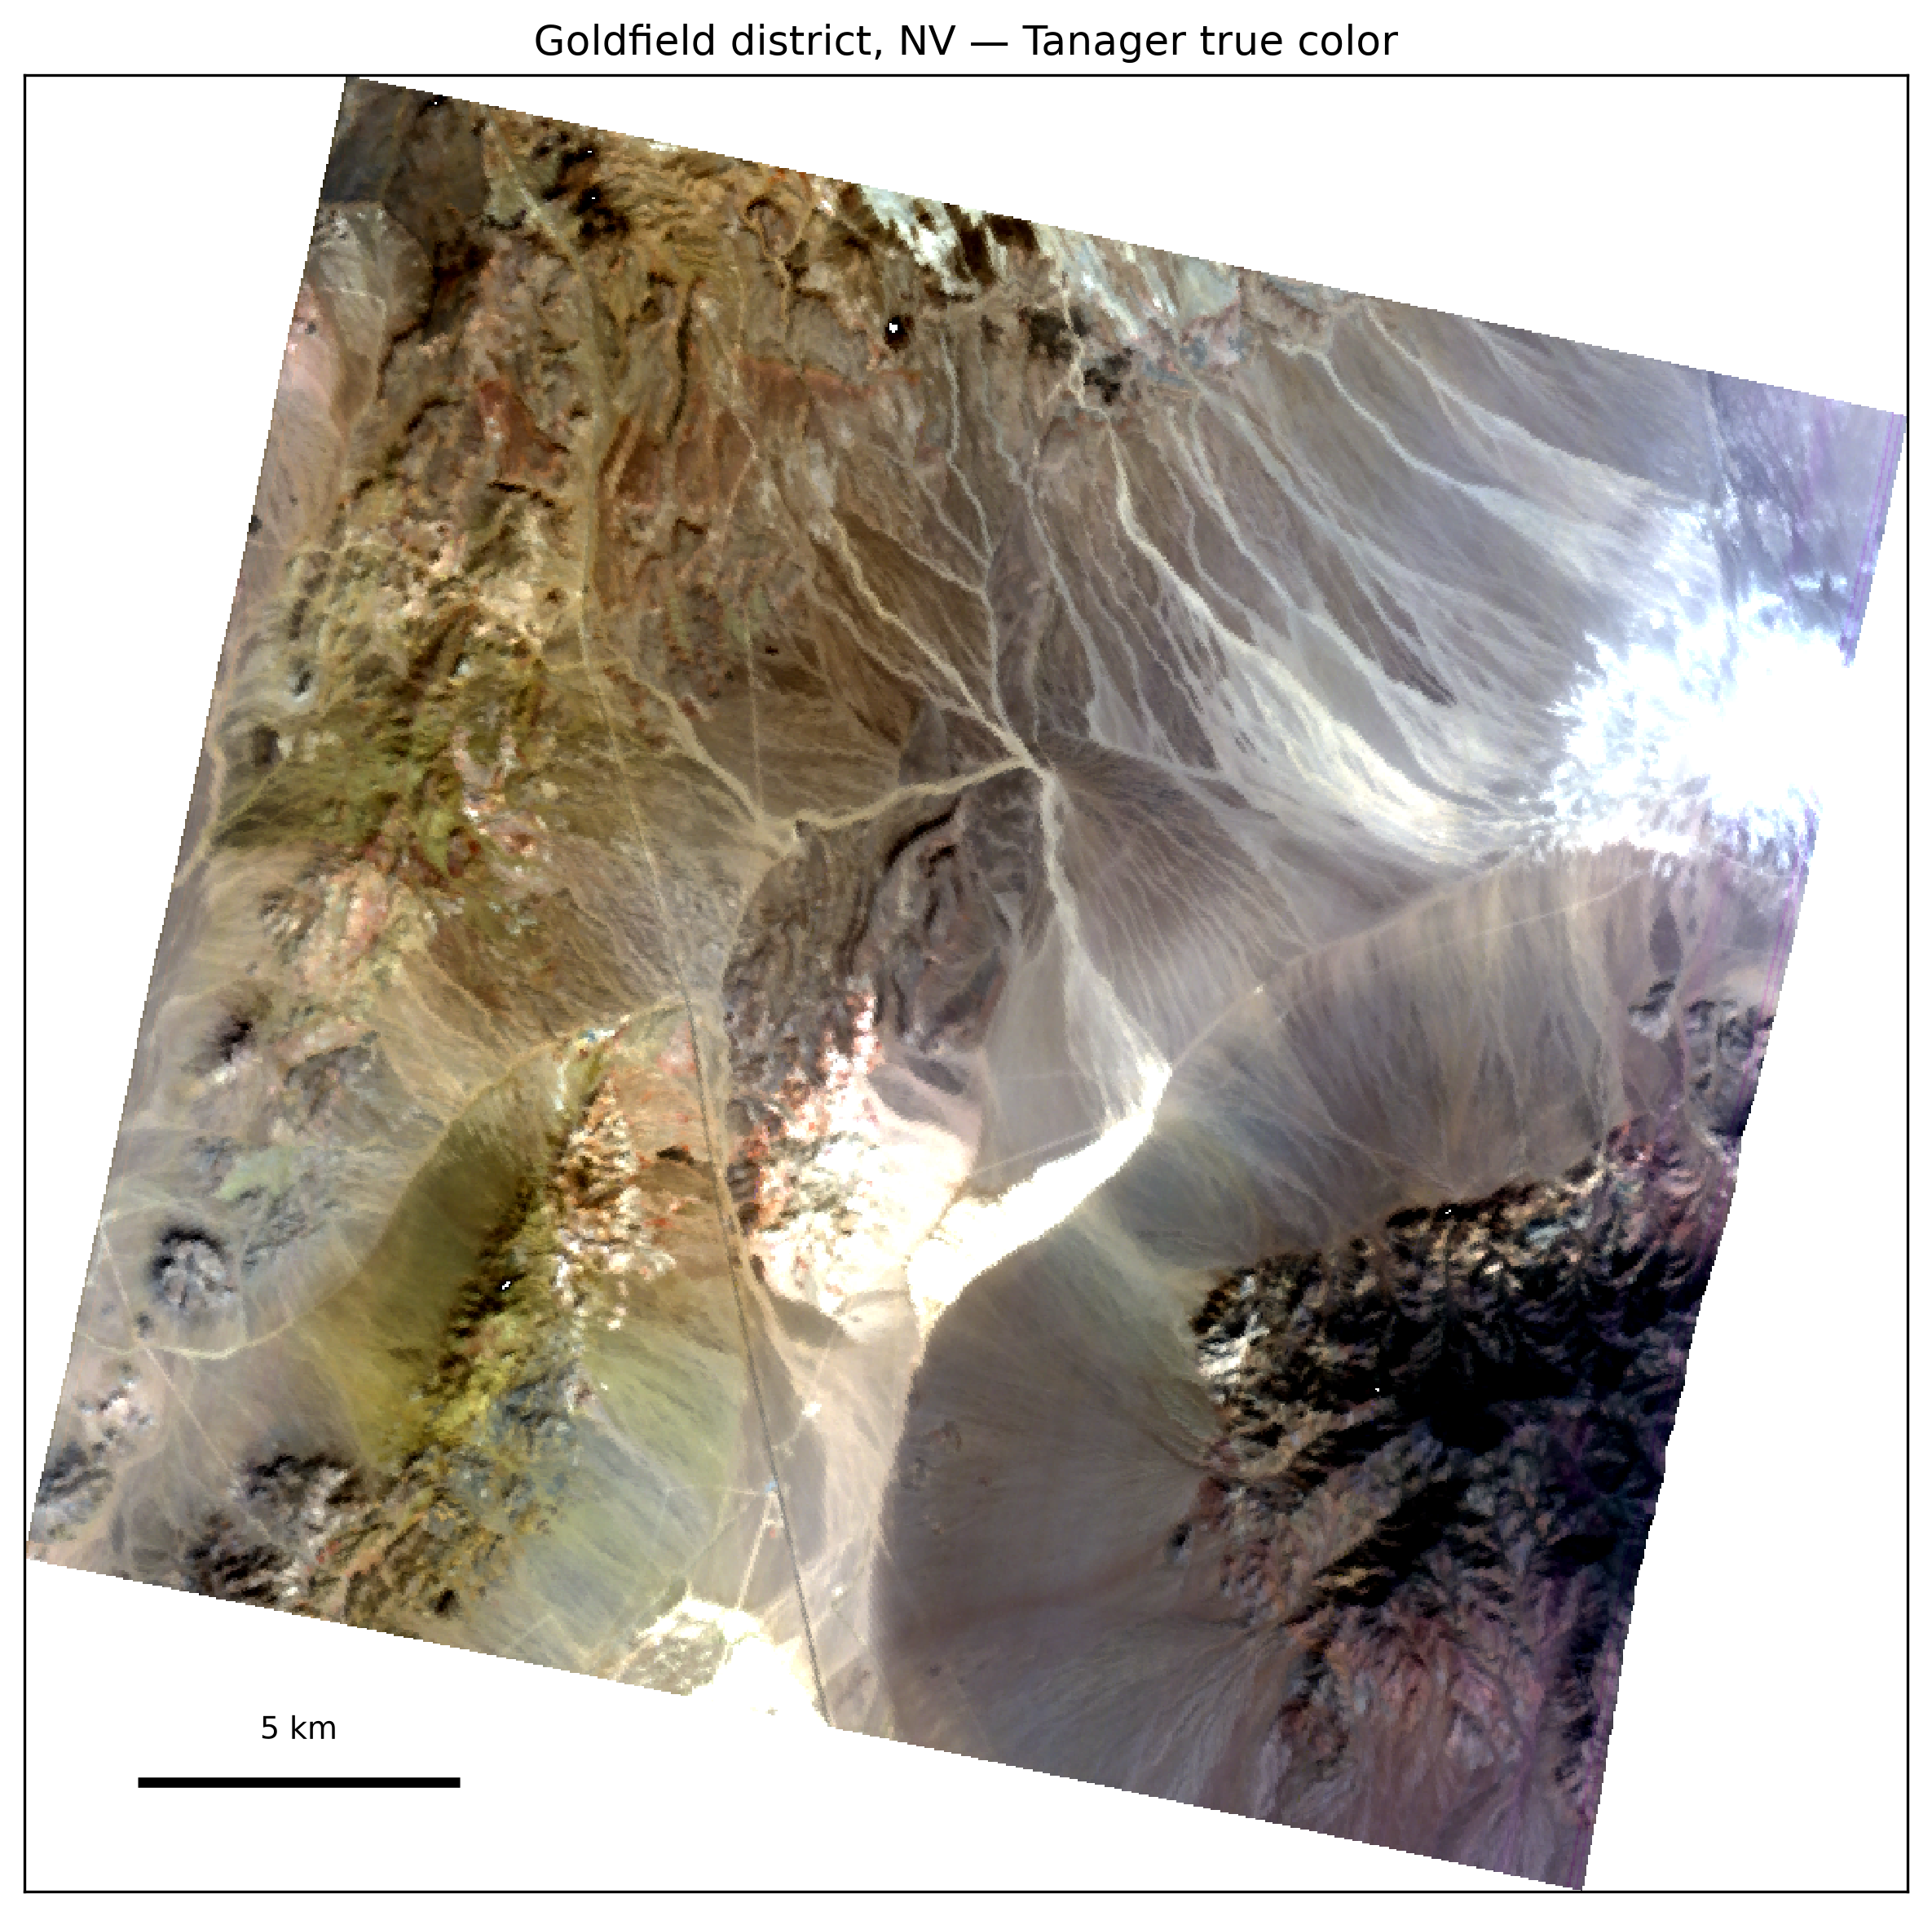
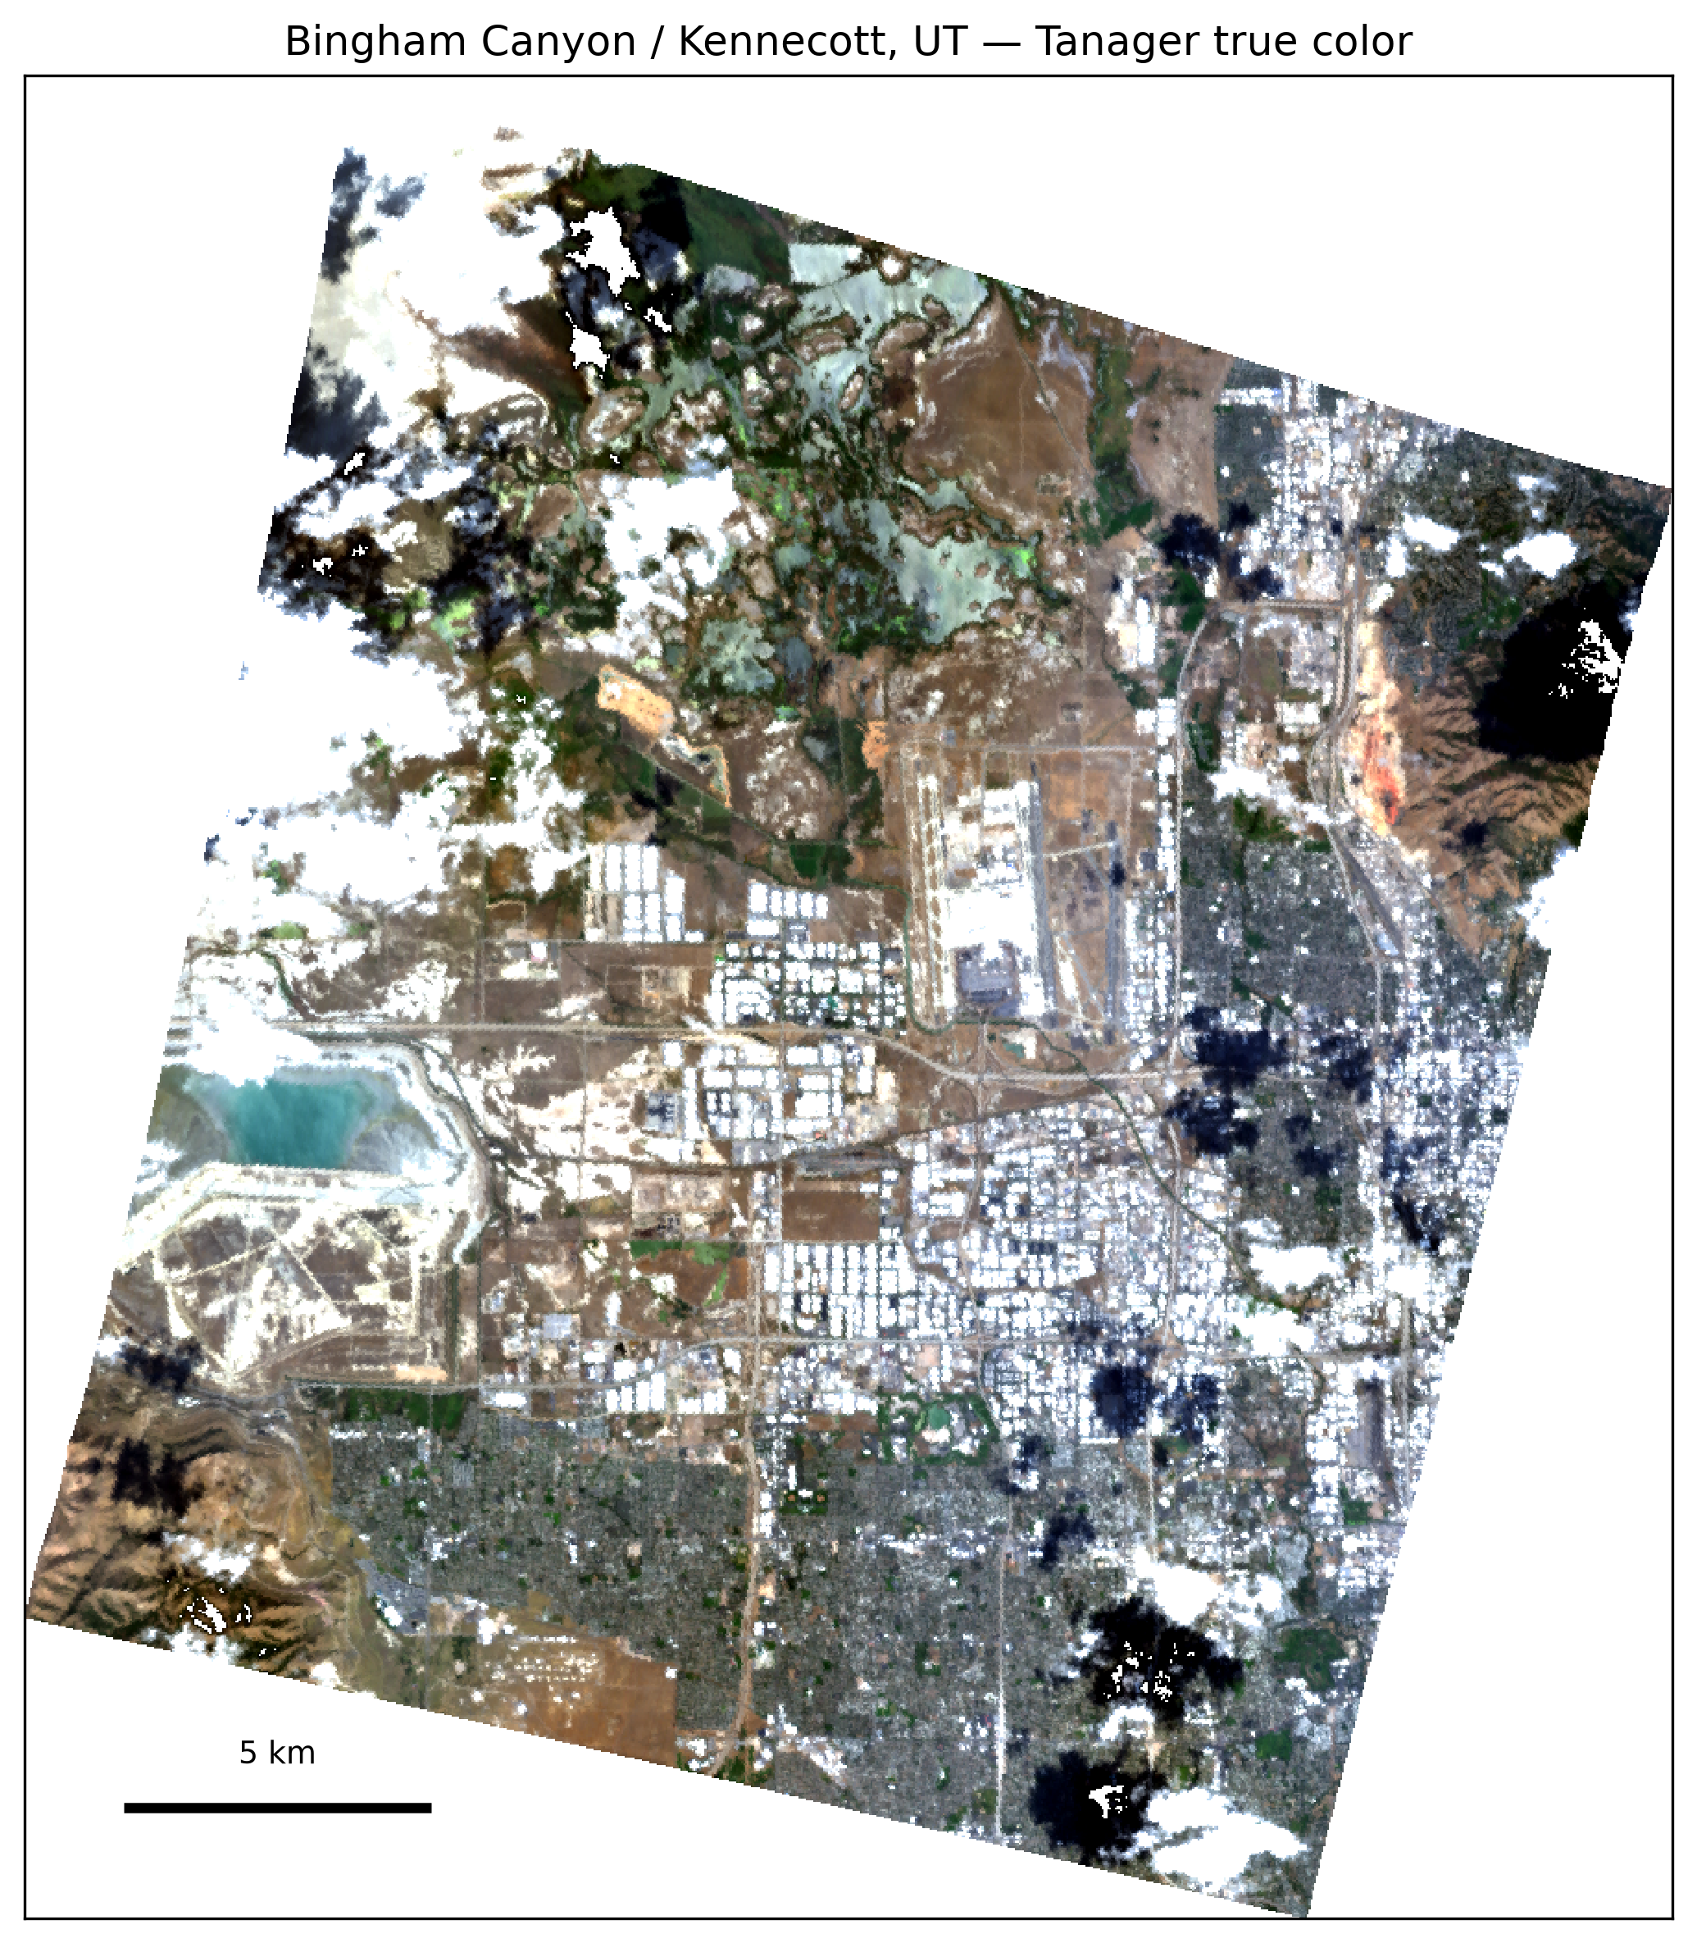
The question, at two named districts
What can Tanager's 426-band spectra tell us about mine waste that broadband satellite imagery cannot? We test whether Tanager preserves diagnostic mineral signatures that Sentinel-2 blurs, and whether those signatures can help identify mine waste showing evidence of acidic oxidative weathering.
Goldfield, Nevada — acid-sulfate hydrothermal district beside the USGS Cuprite spectral benchmark.
Bingham Canyon / Kennecott, Utah — large open-pit copper-porphyry mine with extensive tailings ground.
Library-anchored material screening: every mapped class traces to a measured spectrum from the USGS spectral library (v7, splib07a) — a named mineral phase, not a land-cover label.
Tanager true color — Goldfield (top), Bingham (bottom).
fossettlab.github.io/tanager-rocks · github.com/fossettlab/tanager-rocks
2

Slide 3
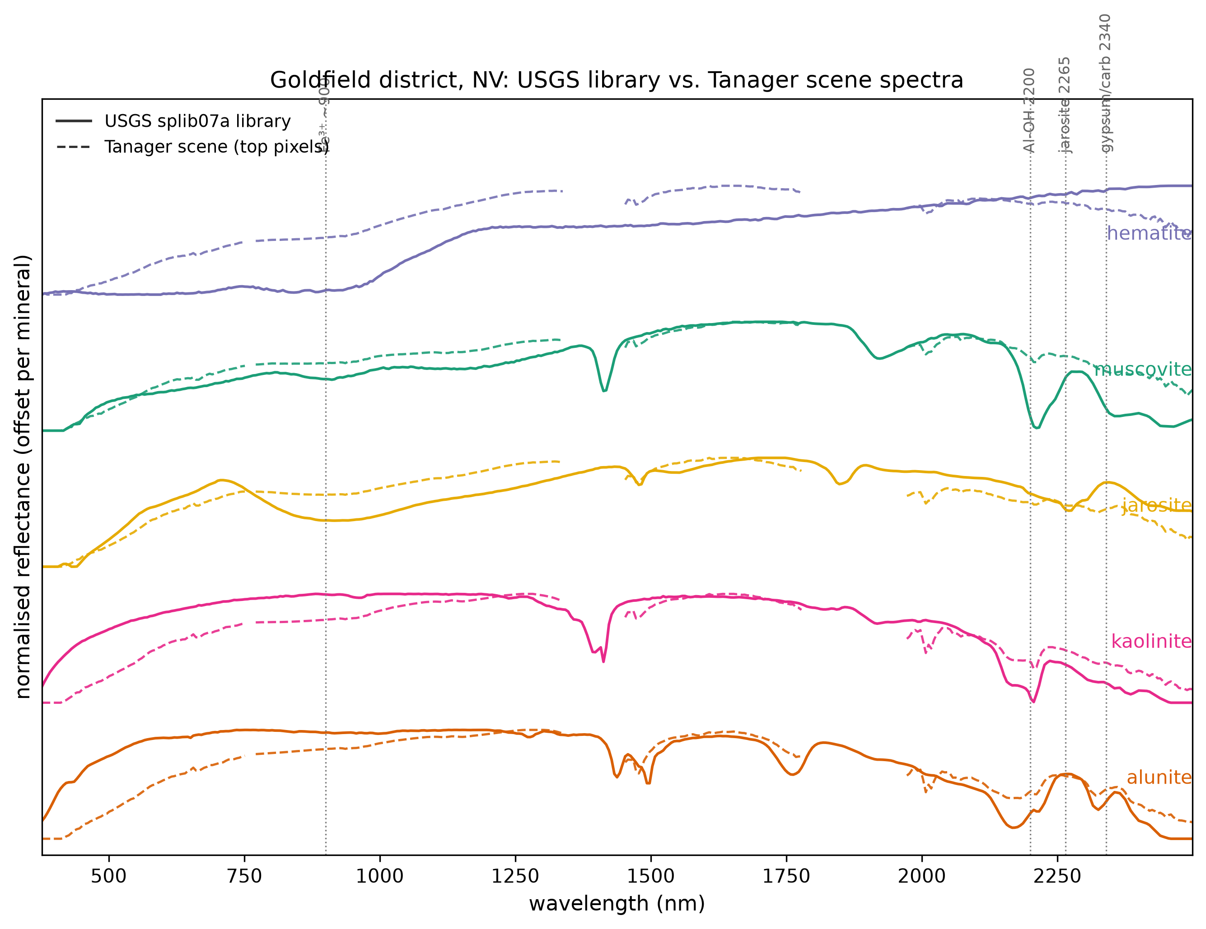
The minerals leave a spectral fingerprint
Measured, not synthesized. USGS library spectra (solid) against the mean spectrum of the most-detected Tanager pixels (dashed). The diagnostic absorptions — the 2200 nm Al-OH doublet, 2265 nm jarosite, 2340 nm gypsum-carbonate, and the VNIR ferric-iron bands — appear in both. The label traces back to the data.
fossettlab.github.io/tanager-rocks · github.com/fossettlab/tanager-rocks
3

Slide 4
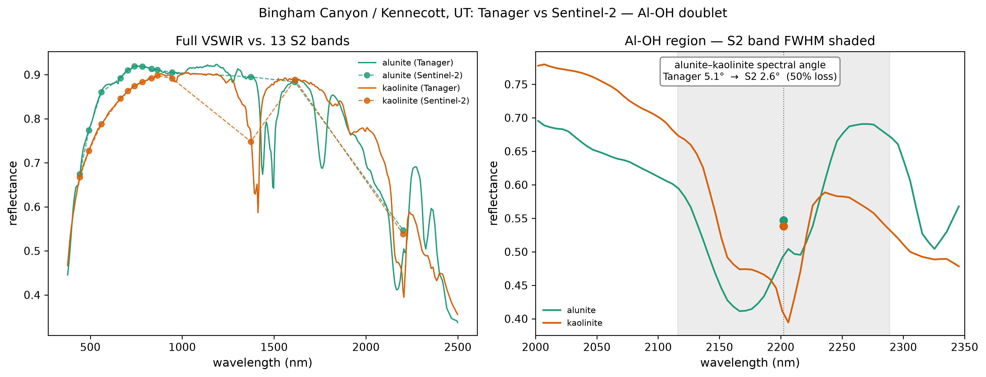
The 2200 nm test: Tanager vs Sentinel-2
49.8%
of alunite–kaolinite spectral-angle separability is lost when measured endmembers are convolved with Sentinel-2's published response functions: 5.138° → 2.578°.
Why it matters: alunite vs. kaolinite separates advanced-argillic from argillic alteration — a distinction that carries ore and acid-generation meaning. One broad band (B12) spans the whole 2200 nm doublet. The control: the VNIR jarosite–goethite contrast survives degradation — the loss is specific to narrow SWIR structure, not an artifact of resampling.
fossettlab.github.io/tanager-rocks · github.com/fossettlab/tanager-rocks
4

Slide 5
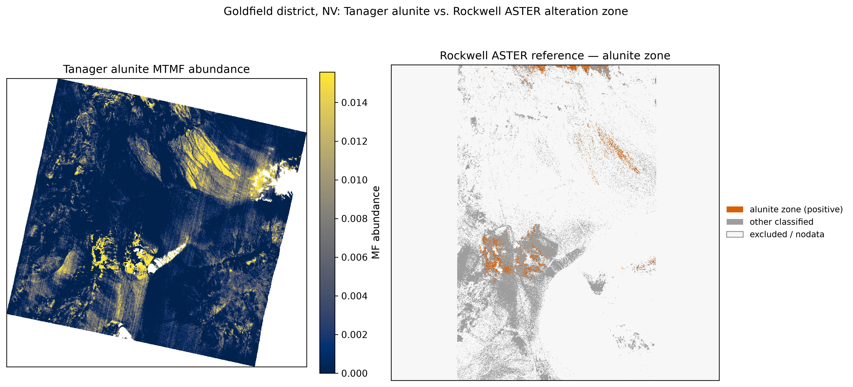
How the maps compare with USGS alteration mapping
0.784
Al-OH band-depth rank-AUC against Rockwell & Bonham (2017) ASTER alteration groups at Goldfield.
0.701
Alunite MTMF abundance rank-AUC, peaking in the advanced-argillic zone.
Stated honestly: descriptive pixelwise agreement with an independent remote-sensing product — not field validation. Fe-oxide and kaolinite layers separate less cleanly, and that disagreement is reported, not tuned away.
fossettlab.github.io/tanager-rocks · github.com/fossettlab/tanager-rocks
5

Slide 6
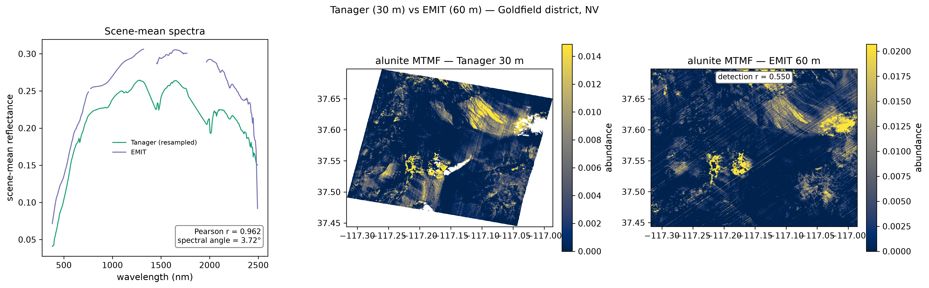
Cross-sensor consistency with NASA EMIT
r = 0.96
scene-mean reflectance correlation over 240 shared bands (3.72° spectral angle), pre-selected overlapping EMIT acquisition.
6 / 6
target minerals correlate positively between the two sensors' maps (r = +0.34 to +0.58; jarosite 0.58).
Scope: the same library-driven pipeline runs on both sensors, so this is shared-pipeline consistency — a strong check, but not independent mineral truth.
fossettlab.github.io/tanager-rocks · github.com/fossettlab/tanager-rocks
6

Slide 7
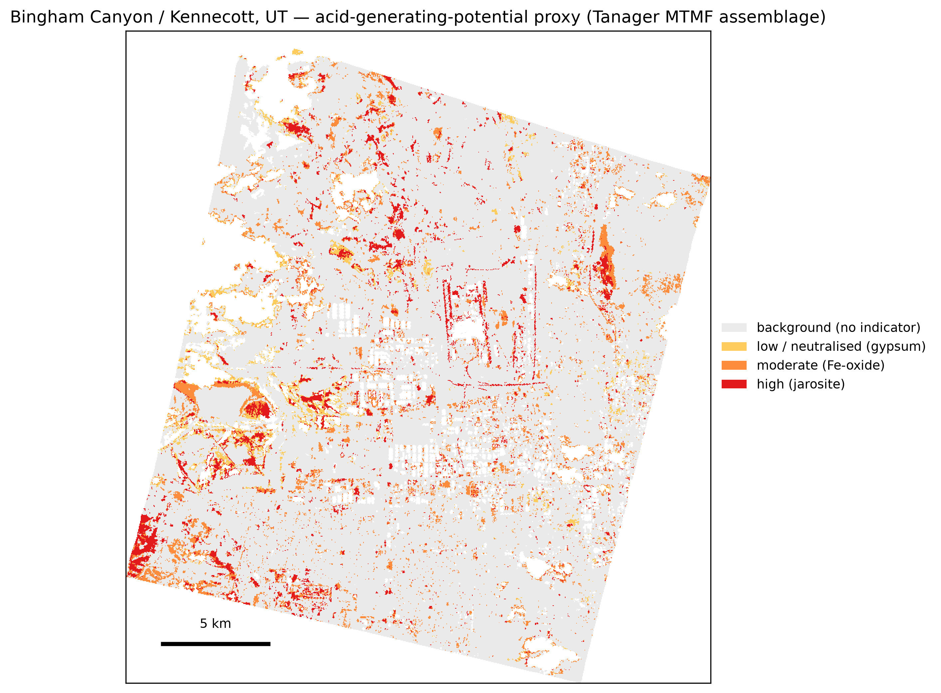
Screening mine waste from surface mineralogy
A surface-mineralogical proxy for acidic conditions. Each pixel takes the tier of the mineral indicator tied to the most acidic conditions detected: jarosite (acidic oxidative weathering) > Fe-oxyhydroxides (less acidic oxidation) > gypsum (comparatively buffered).
Bingham, QA-masked (514,262 px) jarosite 22,536 · Fe-oxide 30,678 · gypsum 12,949 · no indicator 448,099
A screening proxy: the tiers rank mineralogical evidence within the scene — not estimates of acid-generating capacity, pH, or acid flux.
fossettlab.github.io/tanager-rocks · github.com/fossettlab/tanager-rocks
7

Slide 8
Reproducible, open, and honest about limits
One command, one clone
Limits, stated up front
tanager-minmap CLI: seven stages from public inputs — map, unmix, ablate, amd, hero, emit, validate.
30 m grain resolves features larger than about one hectare.
Maps are of surface mineralogy, not bulk chemistry or depth.
Scope held to the well-characterized alteration assemblage.
No field validation yet — agreement is bounded at the alteration-group level.
The mine-waste acidity screening proxy is scene-relative and unvalidated at Bingham.
Open code (MIT), public data recipe, pinned inputs with frozen SHA-256 hashes, claim ledger tying every public number to a recorded source. github.com/fossettlab/tanager-rocks github.com/fossettlab/tanager-spec (shared data layer, v0.1.0)
fossettlab.github.io/tanager-rocks · github.com/fossettlab/tanager-rocks
8

Slide 9
Which 30 scenes should be open next?
Mining districts are where contiguous VSWIR matters most: the minerals that record ore, alteration, and acid generation are exactly the ones broadband sampling blurs.
Stratified expansion
Repeat acquisitions
Field follow-up
Preregistered scene selection across geology, climate, mine lifecycle, and background lithology — before choosing targets.
Test threshold transfer, seasonal stability, and boundary movement without scene-specific rescue tuning.
Portable spectroscopy and geochemistry at ranked targets and matched negative controls.
Potential users: state geological surveys, USGS, BLM, EPA — Tanager scene → quality-controlled mineral scores → ranked field targets → field confirmation.
fossettlab.github.io/tanager-rocks · github.com/fossettlab/tanager-rocks · Alex Bradley, WashU · Tanager data © 2024–2025 Planet Labs PBC (CC BY 4.0)

