Slide 1

FOSSGIS 2018
GeoPackage als Arbeits-
und Austauschformat
@PirminKalberer
Sourcepole AG, Zürich
www.sourcepole.ch
Notes:
Der GeoPackage-Standard ist im Januar 2013 vom OGC als Draft veröffentlicht worden. Er vereint die Speicherung von Vektor- und Rasterdaten im verbreiteten SQLite DB-Fileformat. Vektoren werden im SpatiaLite-Format und Rasterdaten wie MBTiles gespeichert.
Aufbauend auf der etablierten Embedded-Datenbank SQLite, steht seit März 2008 das Geodatenformat „SpatiaLite“ zur Verfügung. Damit können Vektor-Datensätze als Datenbank-Tabellen in einer einzigen Daten gespeichert und mit vollwertuger SQL-Funktionalität verarbeitet werden.
Abbildung : Shapefile-Import und SpatiaLite GUI
Der GeoPackage-Standard kombiniert die Vektordatenspeicherung mit der Speicherung von Raster-Kacheln ausgehend vom weitverbreiteten MBTiles-Format.
Diese Kombination eröffnet die Möglichkeit, Geodaten in einem praktischen Container-Format zu speichern, das auch von mobilen Geräten unterstützt wird und auf das sehr effizient zugegriffen werden kann.

Slide 2
Sourcepole
QGIS
  4 C++ core devs
  QGIS Server, Printing, Plugins, …
  QGIS Enterprise
Web-GIS
  QGISCloud
  QGIS Webclient 2
Other OSGeo projects
  Contributions to OGR/GDAL (Interlis, etc.) PostGIS, MapServer, Openlayers, Mapfish, OSGeoLive...

Slide 3
GeoPackage
OGC Standard published 2014
“An open standard non-proprietary platform-independent GeoPackage container for distribution and direct use of all kinds of geospatial data”
Vector and Raster data stored in SQLite file DB
http://www.geopackage.org/
Notes:
Im Februar 2014 hat das Open Geospatial Consortium (OGC) den GeoPackage Encoding Standard offiziell freigegeben. Dieses noch junge Format hat sich bereits gut etabliert und wird in vielen GIS-Produkten unterstützt.
In GeoPackage-Dateien können sowohl Vektor- als auch Rasterdaten mit zugehörigen Metainformation gespeichert werden. Damit können Geodaten einfach ausgetauscht und auch auf mobilen Geräten effizient genutzt werden.
Als Fileformat wird SQLite verwendet, welches einen effizienten Zugriff mit einem SQL-API bietet. Das Format ist erweiterbar und wird unter anderem bereits für die Speicherung von Point Cloud Daten verwendet. Auch Vektor-Tiles können darin für den Offline-Gebrauch abgelegt werden.
GeoPackage is an OGC standard combining vector data and raster tiles in a single database file. Since its official publication in February 2014 adoption has grown very quickly and the new format got support by most major Open Source and proprietary software products.
Its combination of easy distribution and efficient use thanks to an SQL interface makes it interesting in a wide range of usage scenarios from embedded devices up to Open Data portals.
This presentations shows the current state of support in Open Source applications like GDAL and QGIS, but also covers recent and planned extensions of the format. Examples are the proposed GeoPackage Elevation Extension, an extension for storing point cloud data and the recent QGIS all-in-one GeoPackage format. The latter implements storing map styling information right in the GeoPackage file, allowing to distribute a dataset together with map views and print layouts in one file.
https://github.com/rb-rialto/geopackage
https://github.com/mapbox/mapbox-gl-native/issues/3373
- GeoPackage Elevation Extension

Slide 4
GeoPackage introduction
Spatial extension to SQLite embedded database
  Like PostGIS extends PostgreSQL
  File based with SQL API
Spatial data types
Raster and tile pyramid data sets

Slide 5
GeoPackage data
OGC Simple Feature types (WKT, WKB)
  Point, MultiPoint
  LineString, MultiLineString
  Polygon, MultiPolygon
  XY, XYZ, XYM, XYZM
WKB based BLOB
One geometry column per table
R*Tree index tables
Raster tile sets (PNG, JPEG)

Slide 6
Limitations
One geometry column per table
No geoprocessing functions != Spatialite

Slide 7
Implementations
GDAL
QGIS
GeoTools
GeoServer
FME Desktop & Server (vector)
ArcGIS for Desktop, ArcGIS Pro (reading)
Geomedia (new default format)
MapInfo
and many more….
Notes:
Implementations
GDAL
GDAL is an open source C library to translate data formats, used practically everywhere. It supports GeoPackage Features as of version 1.11.0. Tiles support was recently developed and will be available in GDAL 2.0. See the GDAL GeoPackage vector and raster documentation for more information.
Luciad
Luciad uses GeoPackage as the core format in their LuciadMobile and LuciadFusion products, and LuciadLightspeed also supports GeoPackage. They recently released a freely available GeoPackage Viewer for Android. Also available is libgpkg, a small open source C library that allows developers to easily read and write GeoPackage compliant SQLite files.
QGIS
QGIS is the most used open source desktop GIS. It can read and write GeoPackage Features as of version 2.10.1 based on GDAL/OGR. GeoPackage Tiles will be available as soon as GDAL version 2.x is included in a future release.
Esri
Esri's GIS software is the most recognized in the world, and their ArcGIS for Desktop 10.2.2 and above support reading and writing GeoPackage Features. ArcGIS 10.3 for Desktop adds reading and writing GeoPackage Tiles. ArcGIS Runtime SDK's for Android and Java 10.2.4 and above support reading and writing GeoPackage Features, and reading GeoPackage Tiles. ArcGIS Pro version 1.1 supports reading GeoPackage Features.
National Geospatial-Intelligence Agency
National Geospatial-Intelligence Agency (NGA), in collaboration with BIT Systems, makes available under the MIT License a collection of GeoPackage Libraries.
GeoPackage MapCache (Android, iOS) - Sample applications demonstrating use of the SDKs to provide read and write access to features and tiles. Download the Android app here.
GeoPackage Mobile (Android, iOS) - Mobile SDKs providing creation, editing, management, visualization, import/export, and tile generation functionality.
GeoPackage Java - Java library providing GeoPackage file read, write, creation and command line tools.
GeoPackage JS - JavaScript library providing GeoPackage functionality and utilities to node and web applications.
Envitia MapLink
Envitia's latest release of MapLink Pro, a suite of powerful SDK's, enables viewing of GeoPackage Tiles and Features, and can also package both on the fly through a Web Processing Service (WPS).
SpatiaLite
GeoPackage is supported in SpatiaLite as of version 4.2.0. SpatiaLite is an open source library intended to extend the SQLite core to support fully fledged Spatial SQL capabilities.
GeoServer
GeoServer, an open source Java Server implementing WMS, WFS, WCS and WPS makes available a GeoPackage plugin that can handle both Tiles and Features. It can be the source of data for GeoServer, serving the data in the GeoPackage as a OGC web standards. GeoServer can also generate GeoPackages in a variety of ways (WMS or WFS output, or a WPS process). The plugin is still a 'community module', so it is unsupported and only available as a nightly build in the community section.
Safe Software
FME Desktop and FME Server both support reading and writing GeoPackage vectors in their latest version. Their next version will support GeoPackage tiles.
GeoTools
GeoTools, an open source Java-based geospatial library, supports GeoPackage Tiles and Features as of version 11.0. Recent improvements also add support for GeoPackage R-Trees.
TerraGo
TerraGo integrated GeoPackage with their GeoPDF technology, and the resulting OpenGeoPDF will be available soon with their TerraGo Publisher® for ArcGIS®, TerraGo Composer® and TerraGo Toolbar.
Engineer Research and Development Center (ERDC)
ERDC, in collaboration with Reinventing Geospatial, Inc, created a sample OGC GeoPackage of Whitehorse, YT. Open source Python scripts to create OGC GeoPackages can be found here.
OpenJUMP PLUS
OpenJUMP PLUS is a Java-based desktop GIS, which can read vector data from OGC GeoPackage data files. See this blog post for documentation on how to read a GeoPackage.
Skyline Software Systems
Skyline Software Systems is a leading provider of 3D earth visualization software and services.
The new TerraExplorer for Desktop v6.6 and TerraExplorer for Mobile v2.1 support GeoPackage imagery, elevation and feature layers.
Compusult
Compusult uses GeoPackage extensively across its geospatial management tools. Specifically, GeoPackage is used within GO Mobile, Compusult's widely used mobile app. As an integral part of its core functionality, GO Mobile provides read and write access to tiles and features. Compusult extends the functionality of GeoPackage by implementing several extensions that support styling, simplification, revisioning, elevation and relational metadata. Through Web Enterprise Suite's GeoPackaging Service, GeoPackages can be easily generated from a variety or sources including WMS, WMTS, KML, imagery, geodatabase, shapefile, etc. Compusult's GO Mobile, using GeoPackage, is currently deployed in the field with multiple customers covering several different industries.
ili2gpkg - INTERLIS 2-loader for GeoPackage
ili2gpkg is a commandline tool that converts between the Swiss INTERLIS geospatial data exchange format to and from GeoPackage (vector). It translates INTERLIS 2 data model definitions to a GeoPackage schema, loads INTERLIS 2 data into an GeoPackage database, and extracts INTERLIS 2 data from a GeoPackage database.
Carmenta
Carmenta supports reading vector data and raster tiles in GeoPackage standard in their Carmenta Server and Carmenta Engine products on Windows, Linux and Android.
Pitney Bowes Software
Pitney Bowes Software adopts the OGC GeoPackage specification across the LI Suite as of February 2016
MapInfo Pro and MapInfo Pro Advanced added support for reading, editing, and creating GeoPackage Feature Tables as of the 15.2.2 release in February 2016.
Spectrum Spatial Location Intelligence Module (LIM) added read support for Feature Tables in the Spectrum 10 SP 1 release for Windows and Linux and added support for editing of GeoPackage Feature tables in the v11 release in February 2016 release.
MapXtreme is a developer SDK for Microsoft .NET integration and added support for reading, editing, and creating GeoPackage Feature Tables as of the 8.0 release in February 2016.

Slide 8
Using GPKG in QGIS
Load from Browser, Drag and Drop, File dialog
Create new GeoPackage
Digitizing, Saving
Intermediate format in Processing
Limitations:
  Column editing (Rename, Add, Remove)
  Editing vews

Slide 9
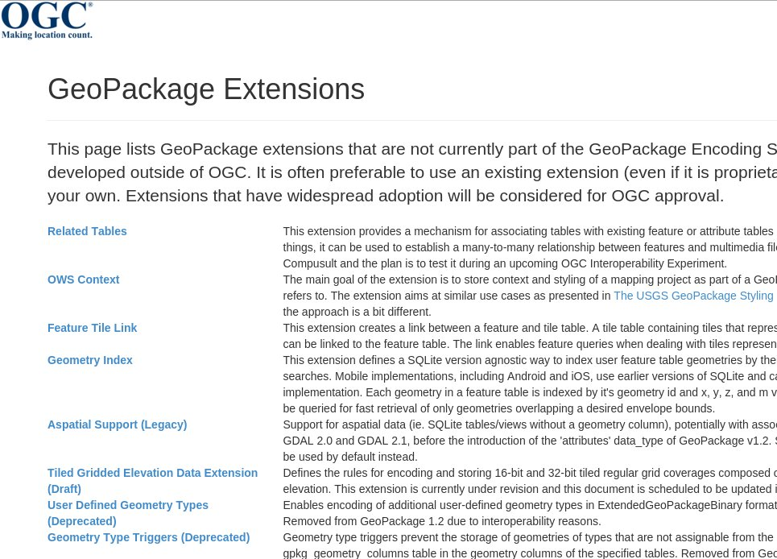
Extensions
http://www.geopackage.org/extensions.html

Slide 10
Useful Geopackage extensions
Non-Linear Geometry Types
  http://www.geopackage.org/spec/#extension_geometry_types
Tiled Gridded Elevation Data
Feature Tile Link
OWS Context
QGIS Map styling information
Notes:
GeoPackage Libraries by the National Geospatial-Intelligence Agency NGA
Feature Tile Link (NGA)
link between a feature and tile table
Geometry Index (NGA)
index user feature table geometries for fast ranged searches
Mobile implementations, including Android and iOS, use earlier versions of SQLite and can not rely on the R*Tree Module implementation.

Slide 11
QGIS map styling extension
Store QGIS projects in GPKG-File
Includes graphics for styling (e.g. SVG markers) and print layouts (e.g. JPEG logos)
Implemented as QGIS plugin
Exchange data including map views!
  https://github.com/pka/qgpkg

Slide 12
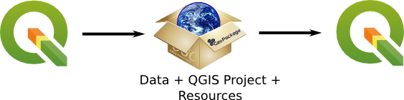
GPKG Plugin

Slide 13
GeoPackage Advantages
Data exchange and direct use
Single file
Vector and raster
From mobile to server
Custom extensions mechanism
Promote GeoPackage
  Provide GeoPackage
  Ask for GeoPackage
Open Data!

Slide 14

FOSSGIS 2018
Danke!
@PirminKalberer

