Slide 1
Team NO NAME
Henry Dinh, Khanh Phan, Peter Nguyen

Slide 2
Introduction
Topic: Stacked Overflow
Project Description/Outline
We will sort the dataframe and look for the most popular types of questions in Python, what day of the week people most frequently ask, to find the way to maximize efficiency when using Stack Overflow

Slide 3
Research Question
What is the average time it took to answer the questions?
How many questions about errors were posted per tag?
What is the most popular library?
What is the average score?

Slide 4
Hypothesis
Hypothesis: Higher Question Scores are associated with higher Answers Scores

Slide 5
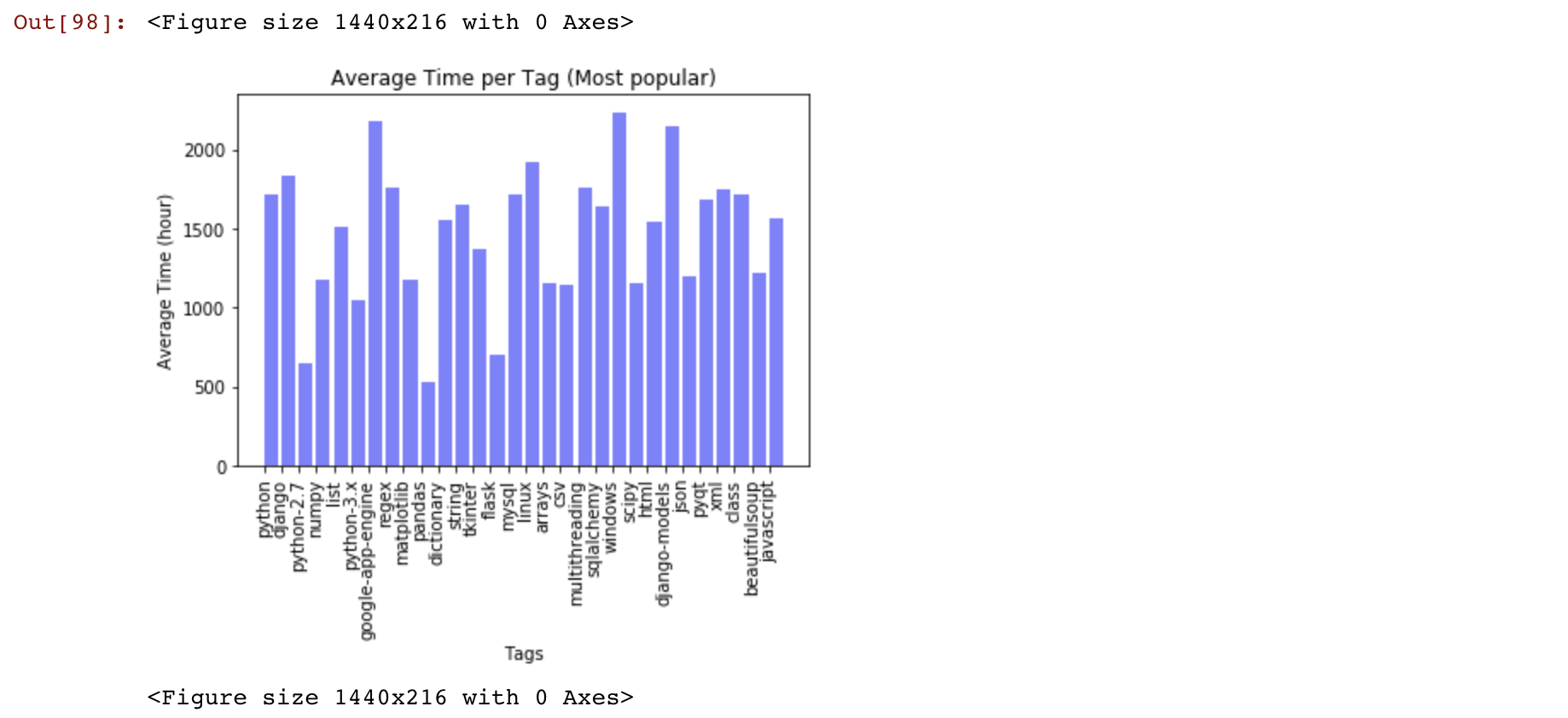
Visualization
This is the average time it took (hours) to respond to questions per tag based on 30 most popular tags

Slide 6
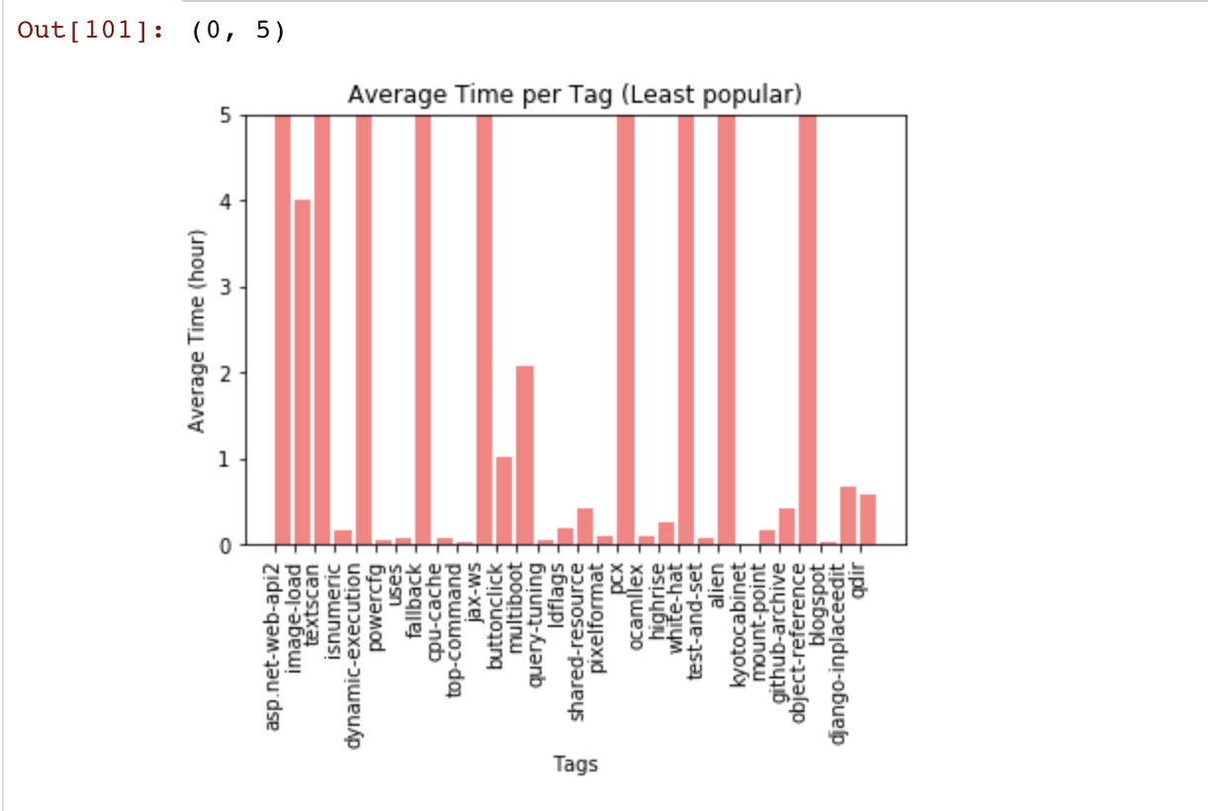
This is the average time it took (hours) to respond to questions per tag based on 30 least popular tags

Slide 7
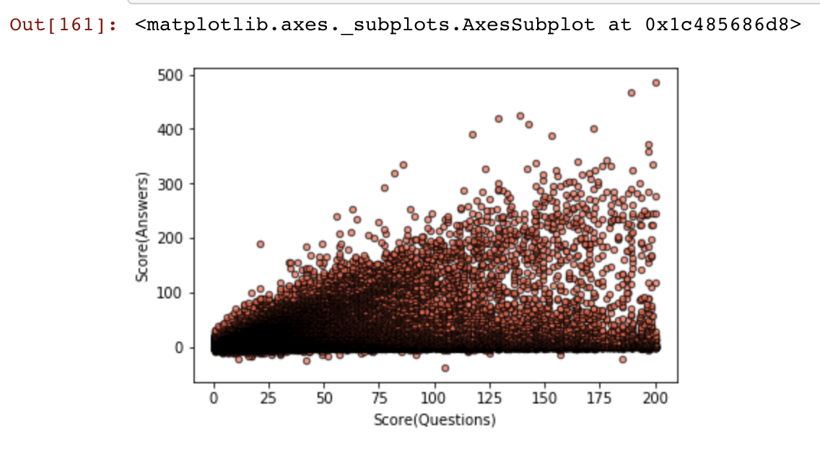
Scatter plot
Scatter plot gives us an overview of the correlation between questions' and answers' scores

Slide 8
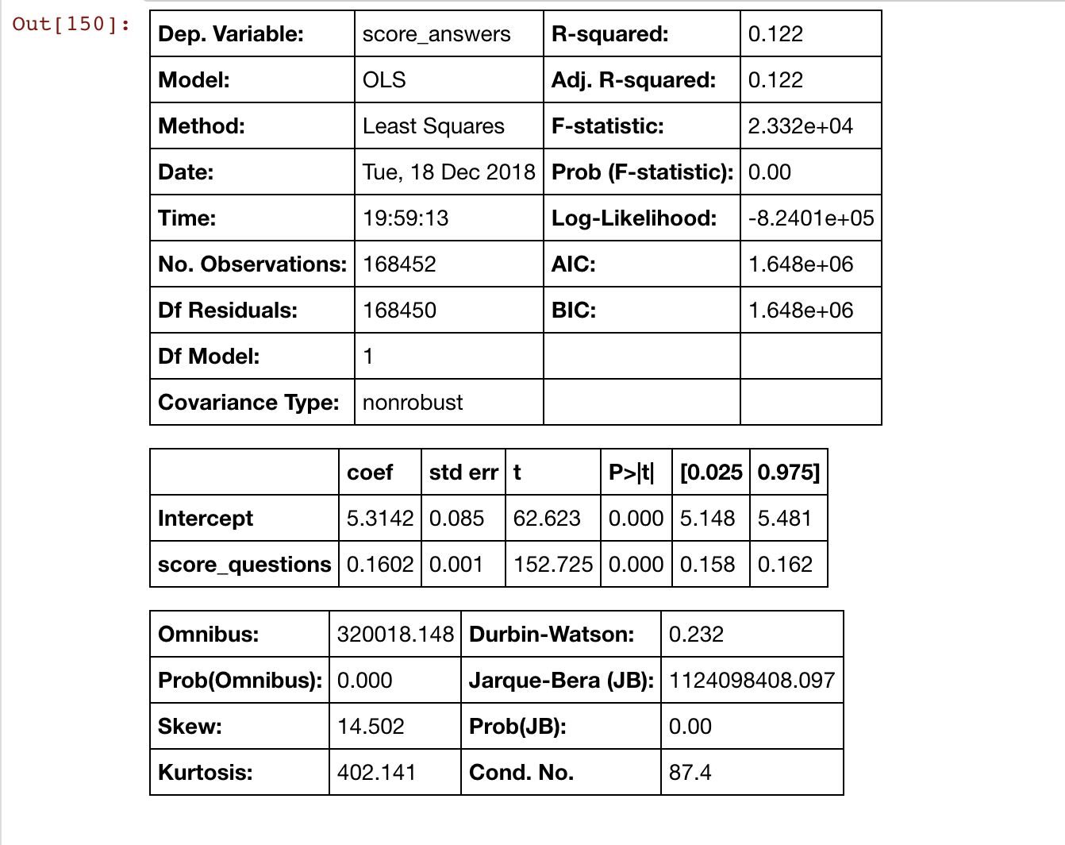
Population Analysis

Slide 9
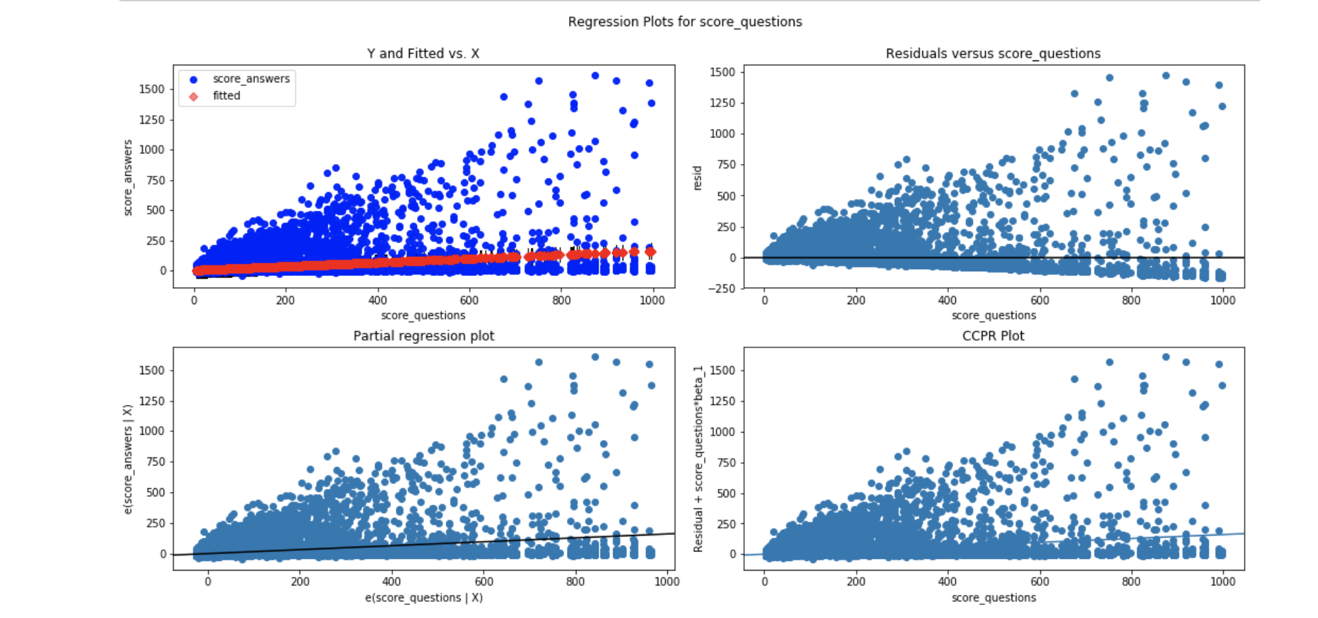
Regression

Slide 10
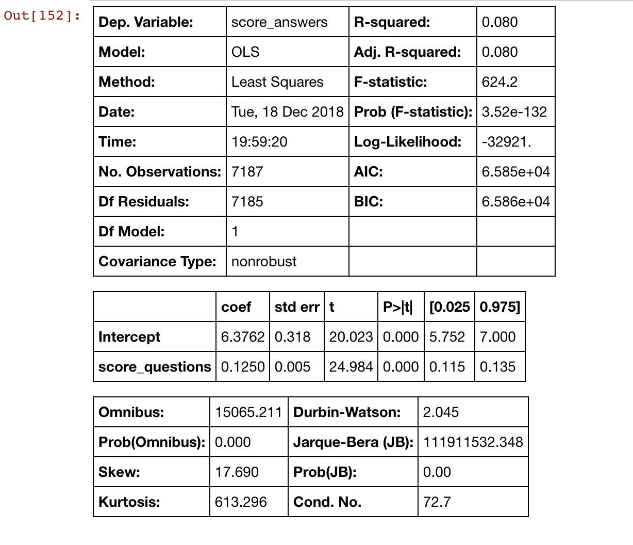
Mean Analysis

Slide 11
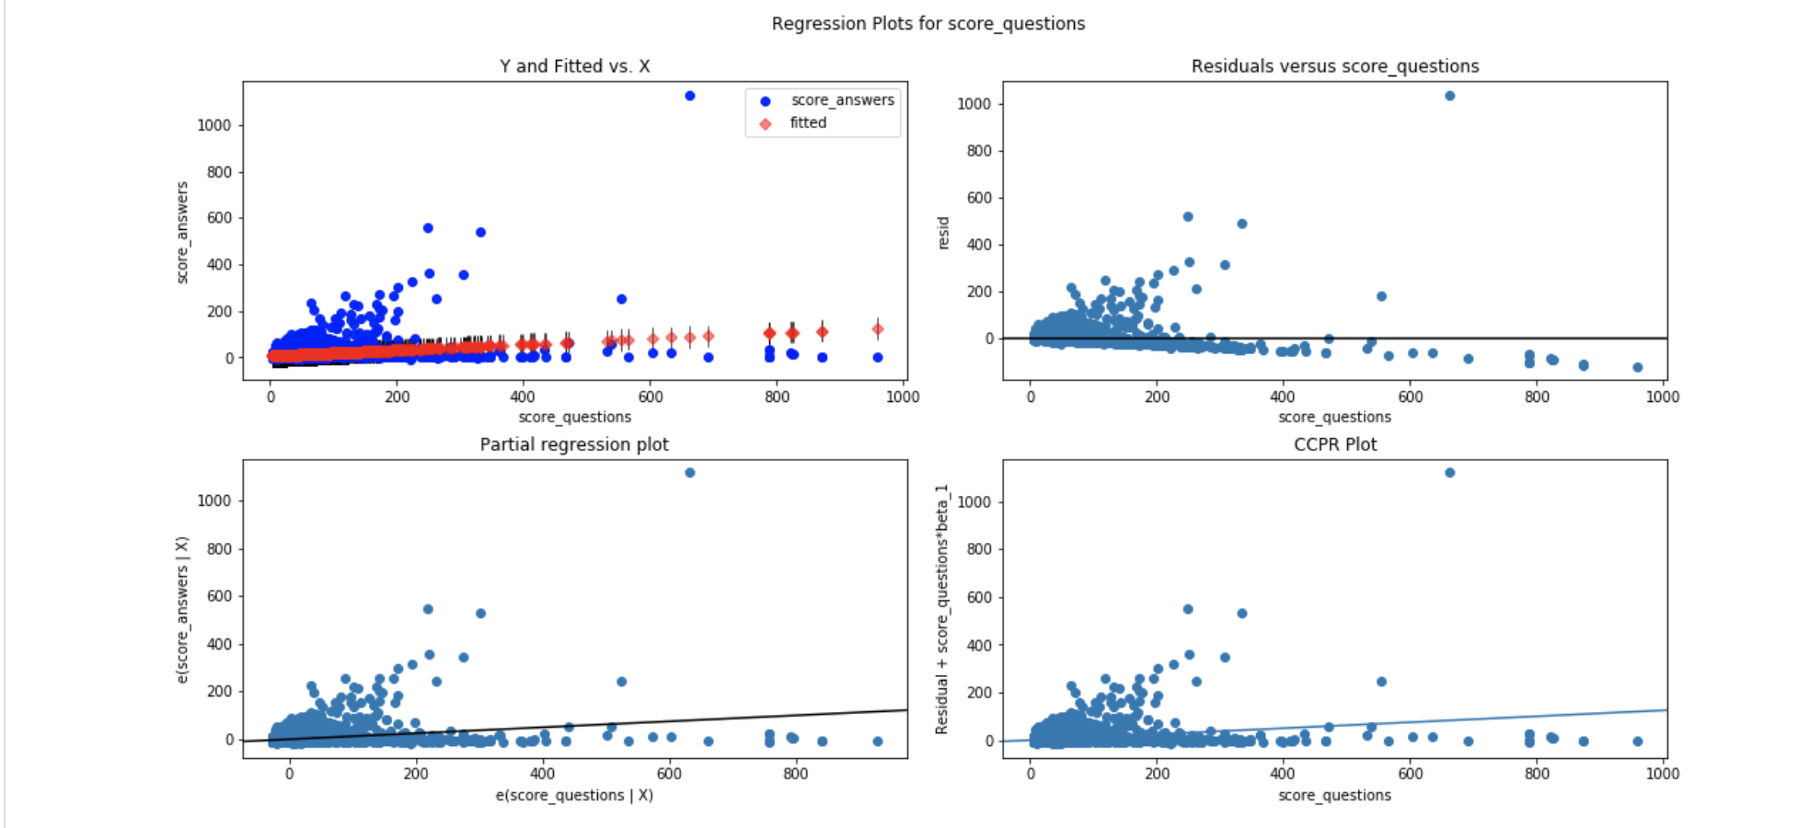
Mean Regression

