Slide 1
The Team with NO NAME
Henry Dinh, Khanh Phan, Peter Nguyen

Slide 2
Introduction
Topic: Stacked Overflow
Project Description/Outline
First, we will be sorting the data-frame for the most popular types of questions in Python.
Second, we will study the correlation between most upvoted questions and downvoted questions along with their corresponding answers.
Third, we will be comparing the average time it takes to answer the most/least popular tagged questions.

Slide 3
Research Questions
What is the correlation between the most upvoted questions and their answers?
What is the correlation between the most downvoted questions and their answers?

Slide 4
Hypothesis
Higher Question Scores are associated with higher Answers Scores.
Methodology:
Scatter Plots
Simple Regressions
Chi-Square Test

Slide 5
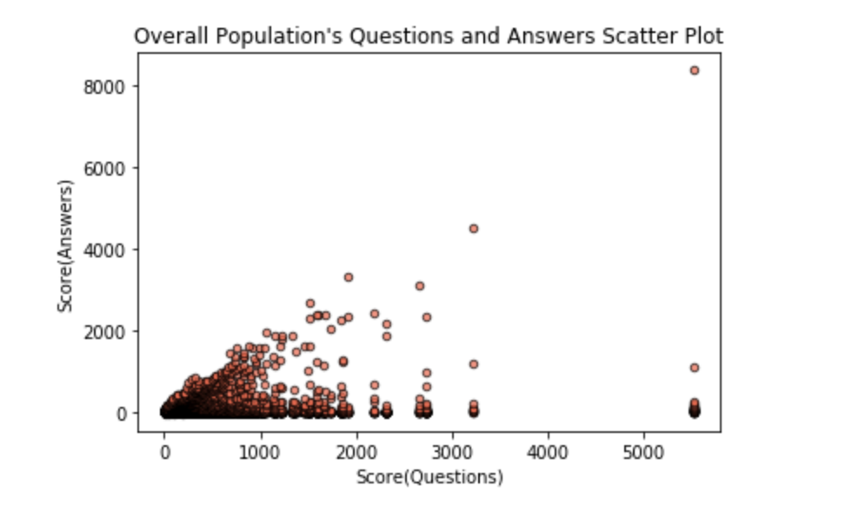
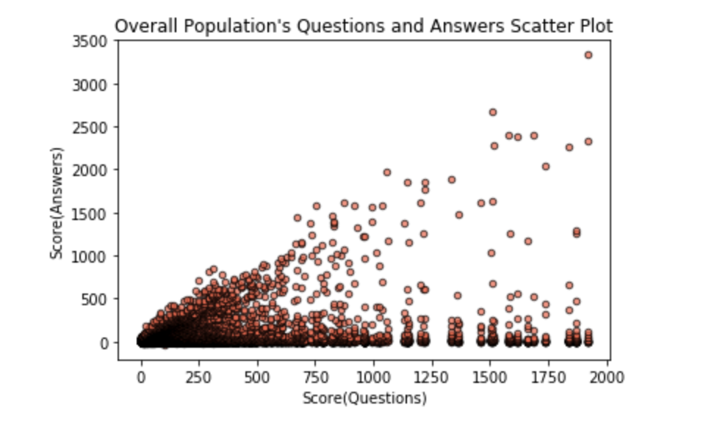
Population Scatter plot

Slide 6
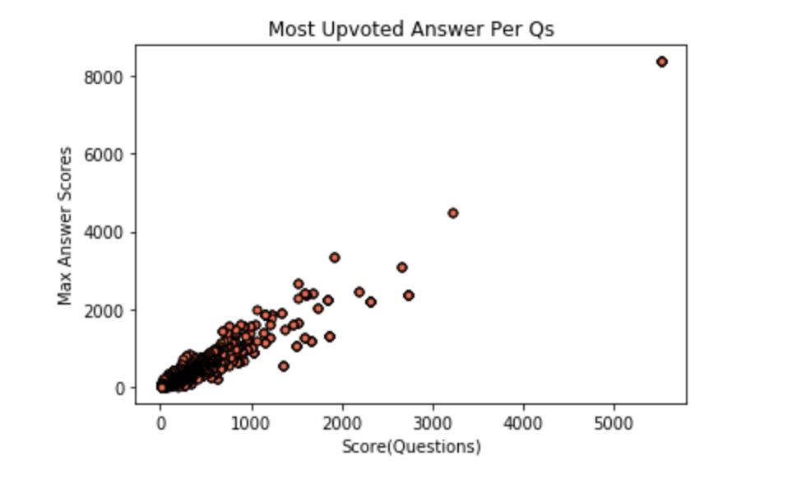
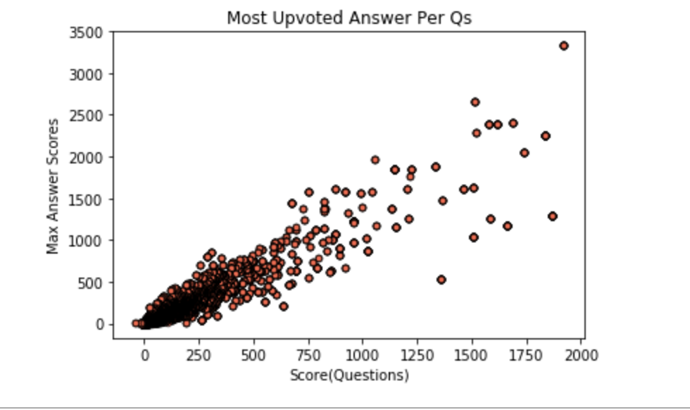
Most upvoted scatter plot

Slide 7
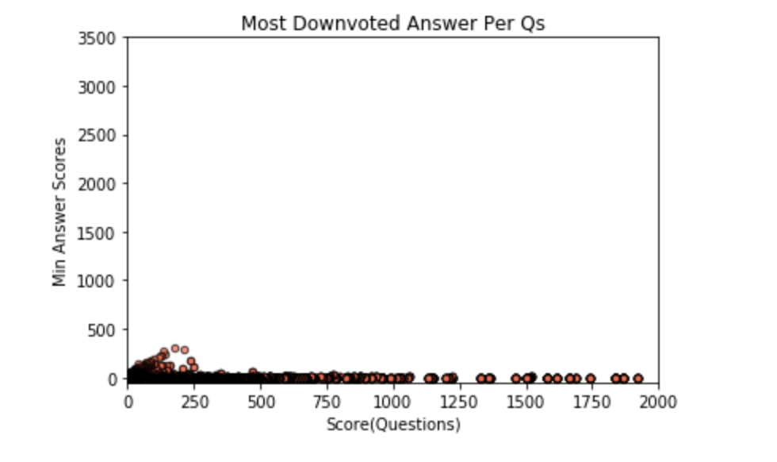
Most downvoted Scatter plot

Slide 8
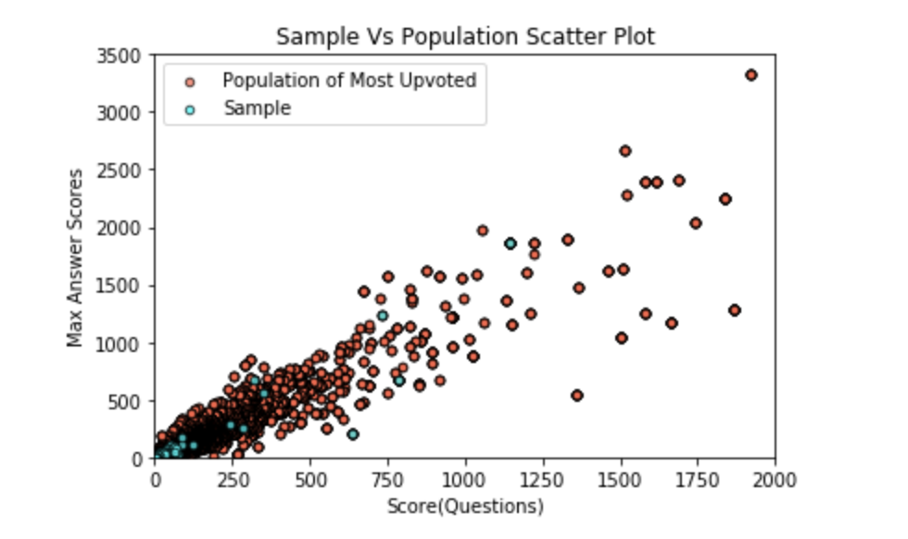
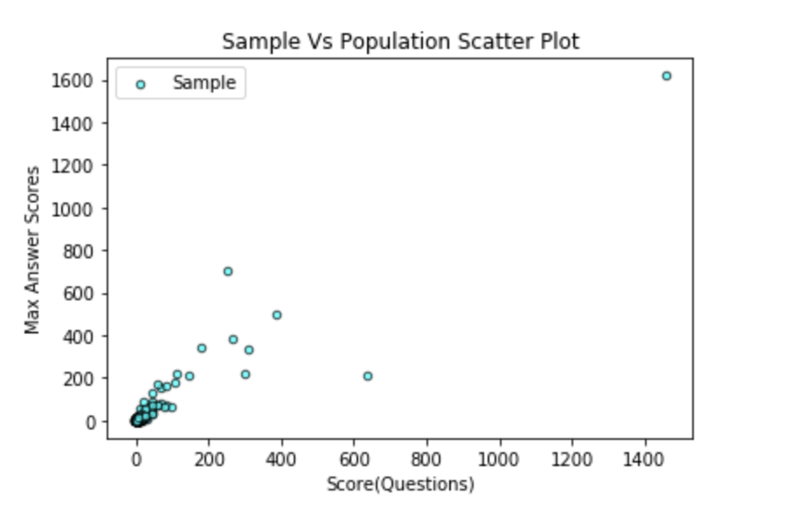
Random Sample Scatter Plot

Slide 9
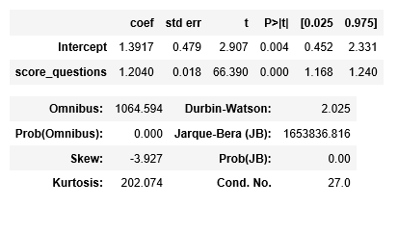
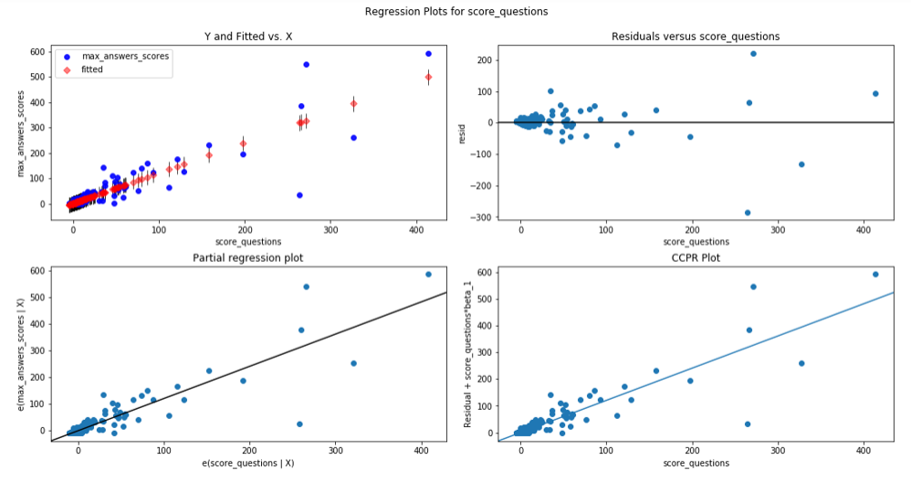
Sample Regression

Slide 10
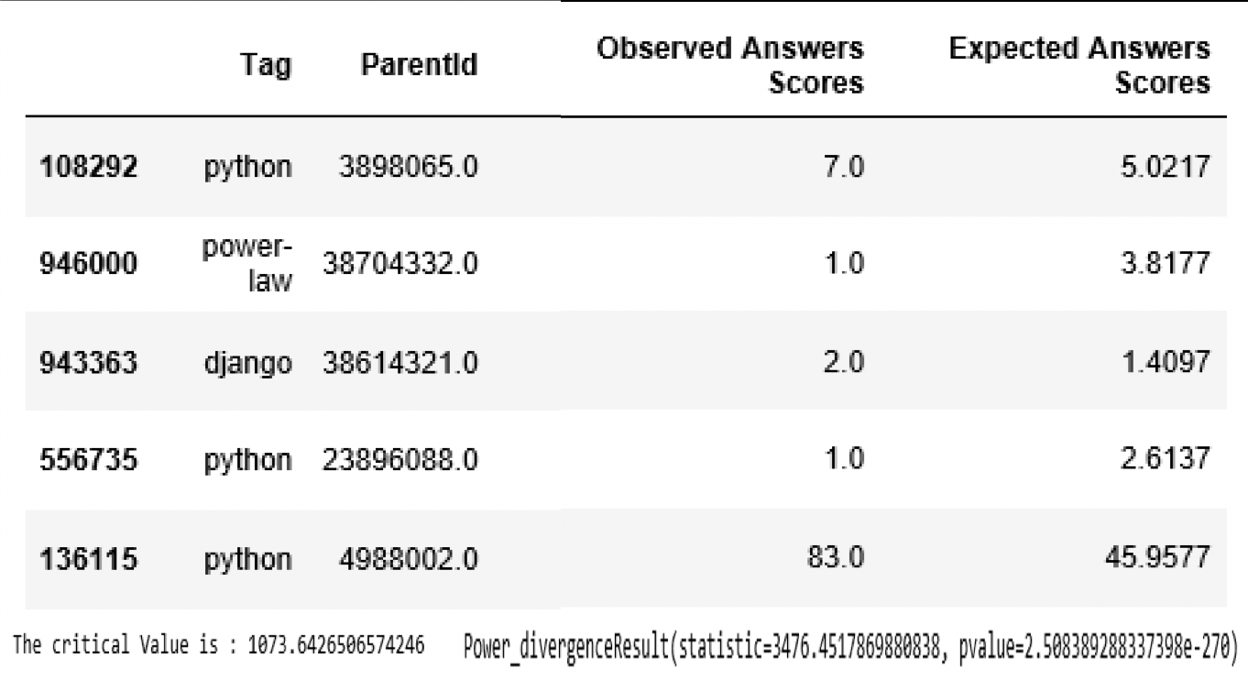
Chi-Square Test

Slide 11
Conclusion
Since the Chi-Square Value of 3476.45 exceeds the critical value of 1073.64, we conclude that the results are statistically significant. Therefore, we are able to reject the NULL Hypothesis; that the Question Scores has no impact on the Answer Scores.

