Slide 1
The Team with NO NAME
Henry Dinh, Khanh Phan, Peter Nguyen

Slide 2
Introduction
Topic: Stacked Overflow
Project Description/Outline
First, we will be sorting the data-frame for the most popular types of questions in Python.
Second, we will study the correlation between most upvoted questions and downvoted questions along with their corresponding answers.
Third, we will be comparing the average time it takes to answer the most/least popular tagged questions.

Slide 3
Research Questions
What is the average time it took to answer the questions?
What is the most and least popular libraries?
What is the average score per tag?
What is the correlation between most upvoted questions and downvoted questions along with their corresponding answers?

Slide 4
Hypothesis
Higher Question Scores are associated with higher Answers Scores.
Methodology:
Bar Graphs
Scatter Plots
Simple Regressions
Multi-Variant Regression

Slide 5
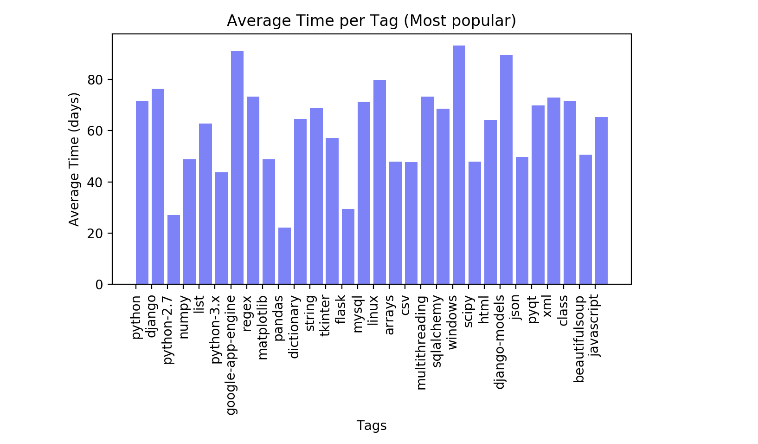
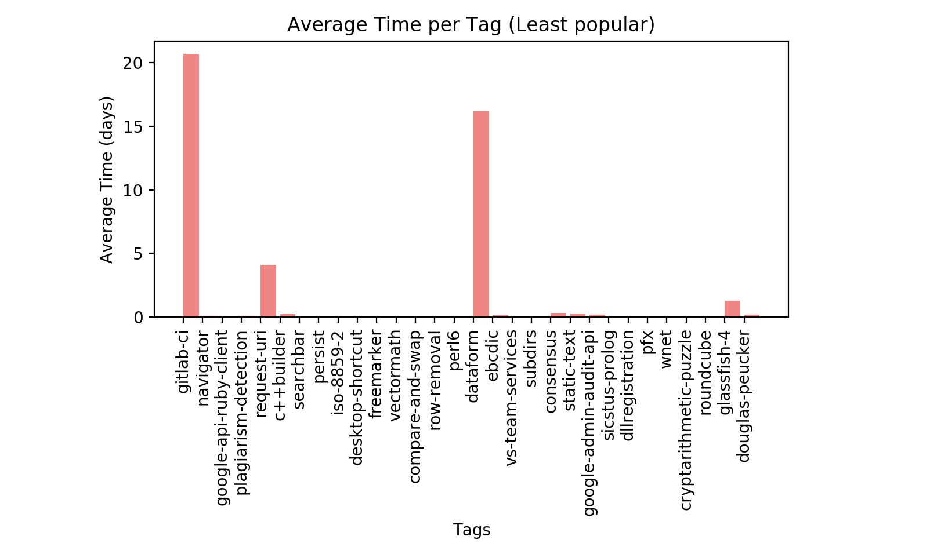
Bar Graphs
This is the average time it took (days) to respond to questions per tag based on 30 most popular tags.
This is the average time it took (days) to respond to questions per tag based on 30 least popular tags.

Slide 6
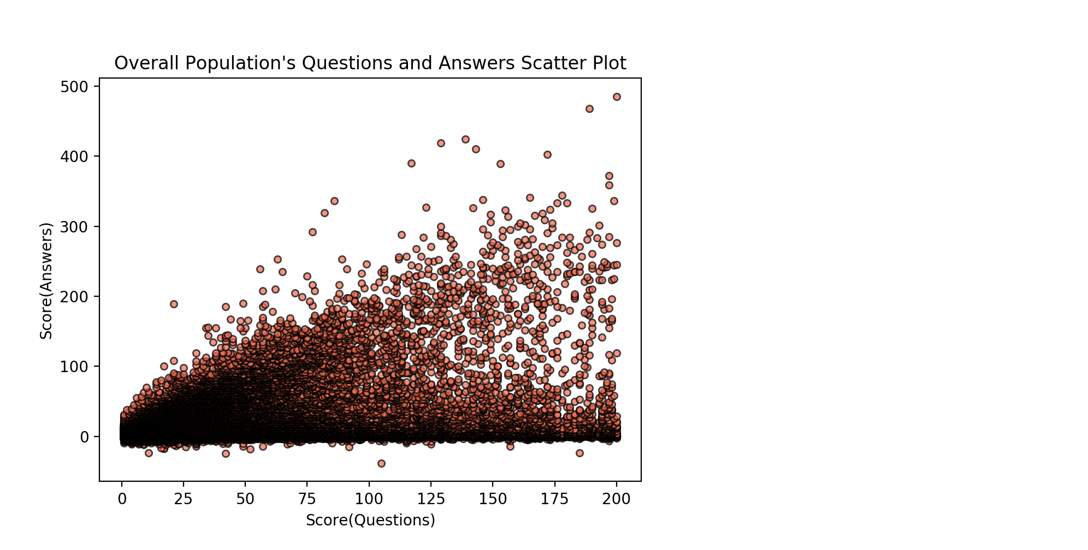
Population Scatter plot
Scatter plot gives us an overview of the correlation between questions' and answers' scores

Slide 7
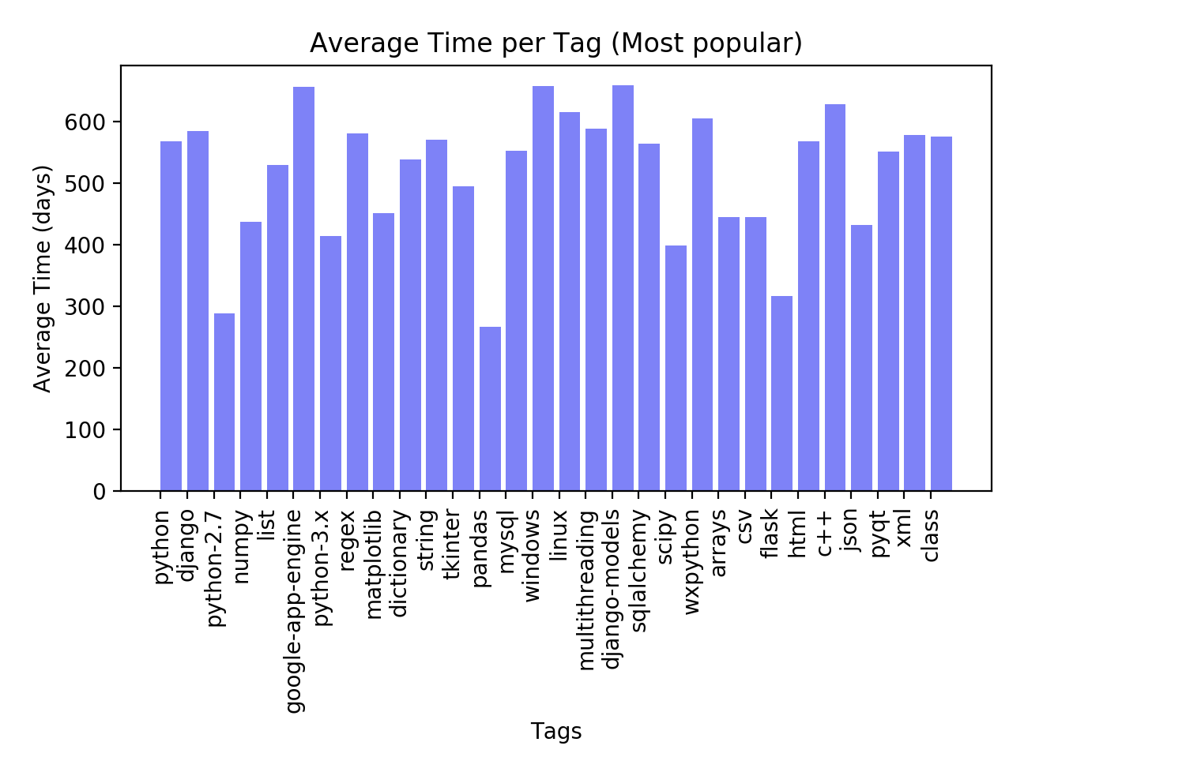
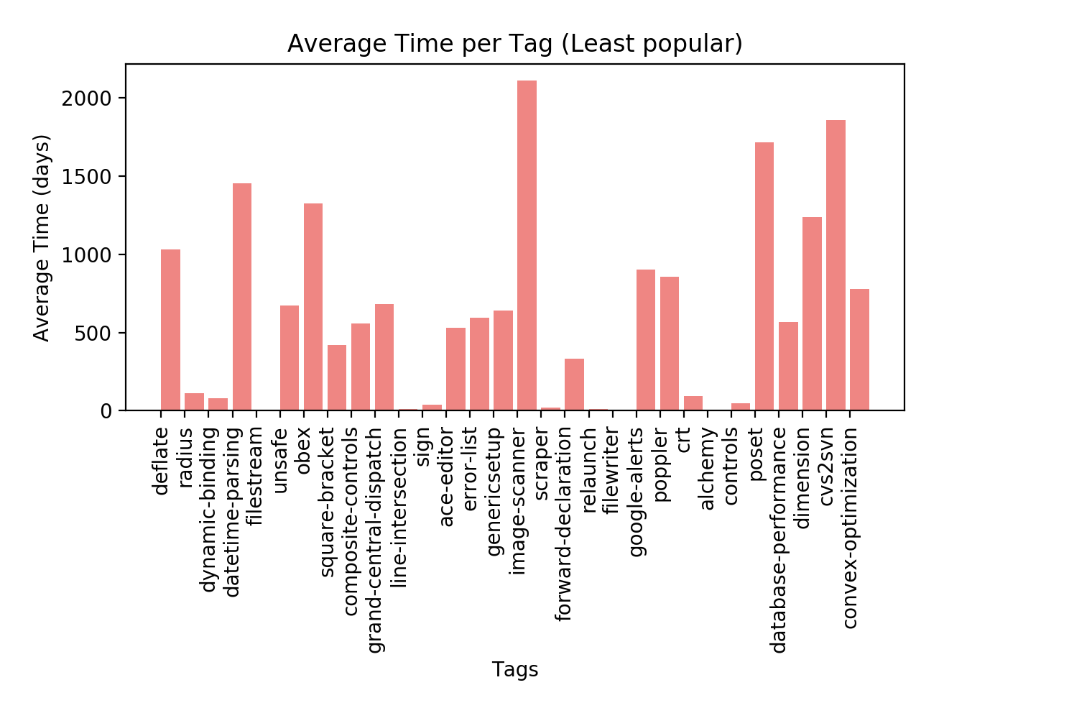
Old Questions Bar Graph
Note: These are the questions that took more than a week to answer

Slide 8
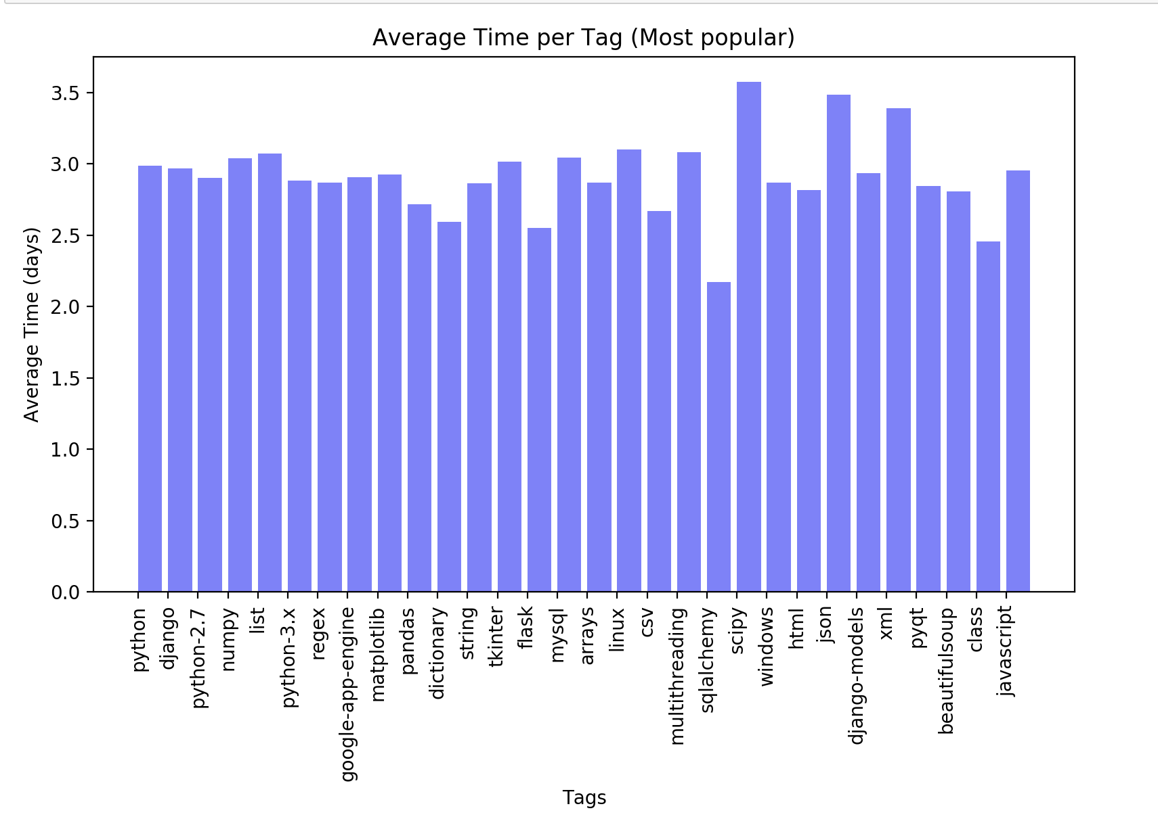
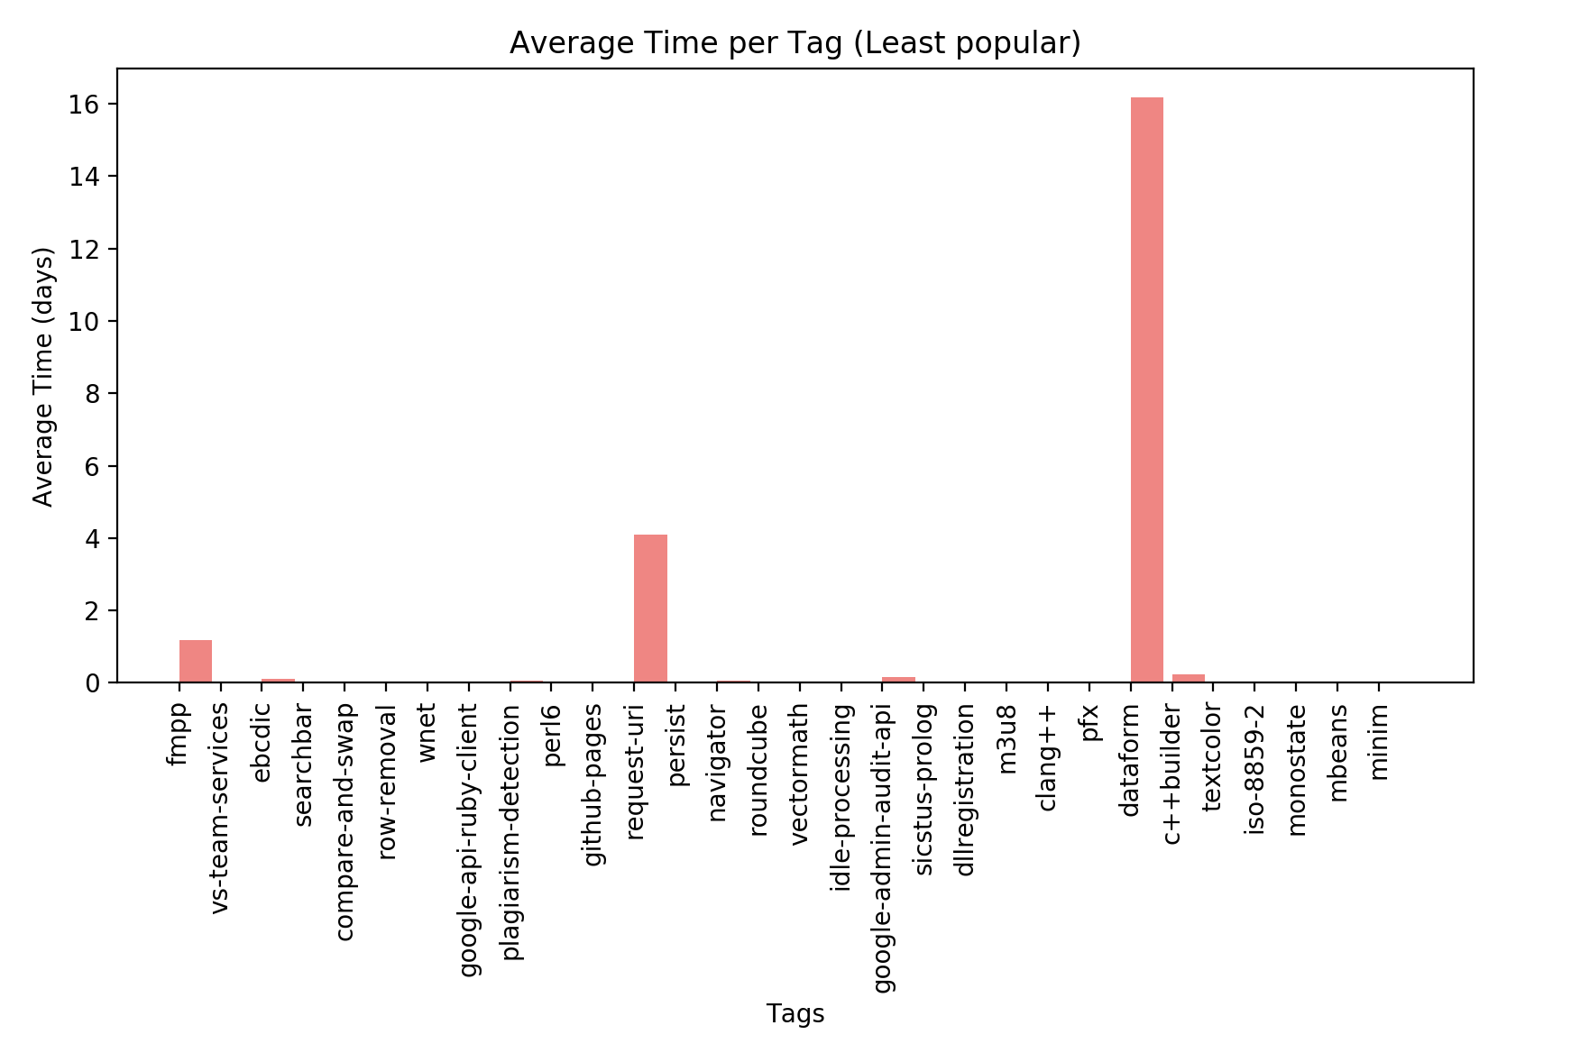
New Questions Bar Graph
We are using the most recently posted questions. Time interval of less than one week

Slide 9
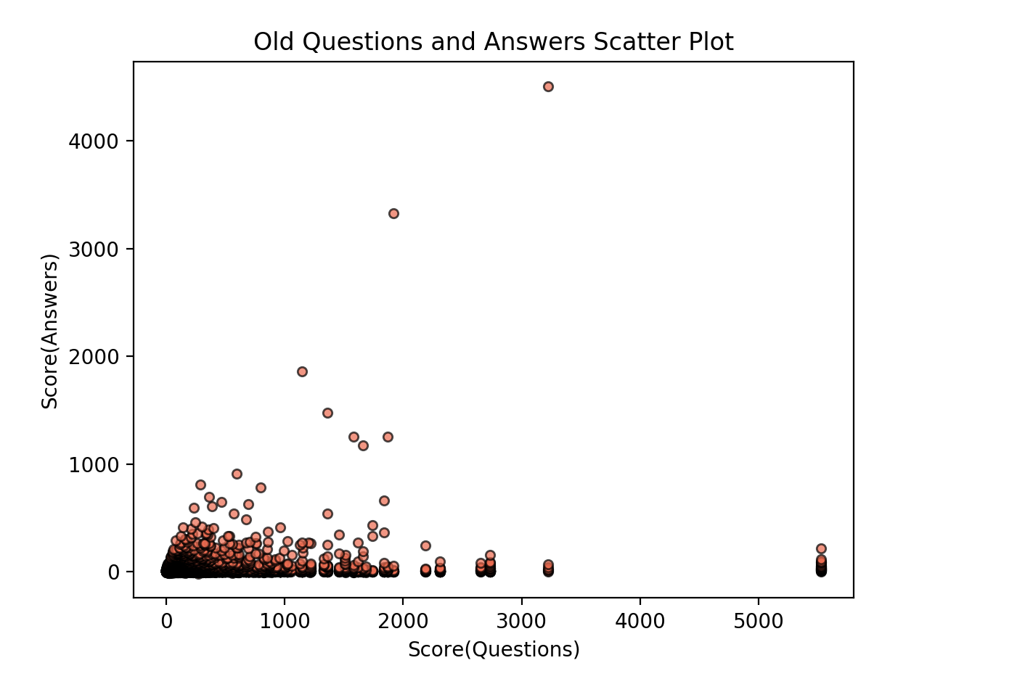
Old Qs scatter graph

Slide 10
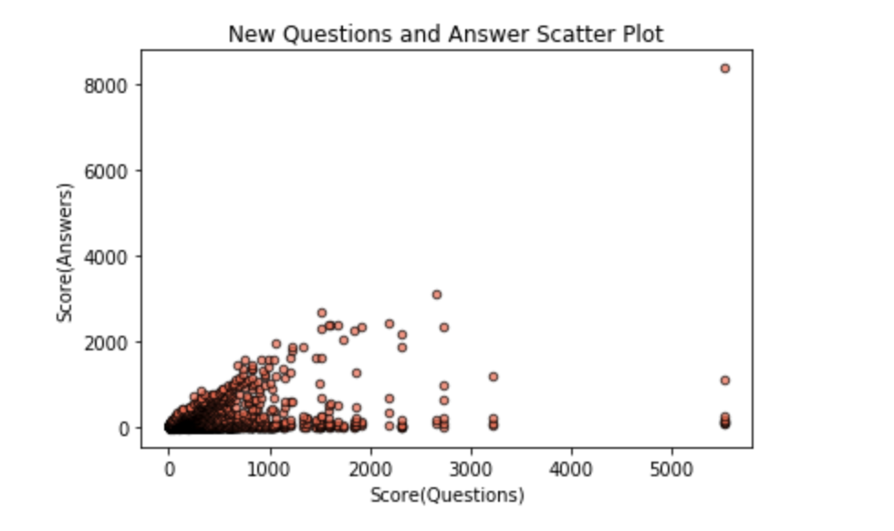
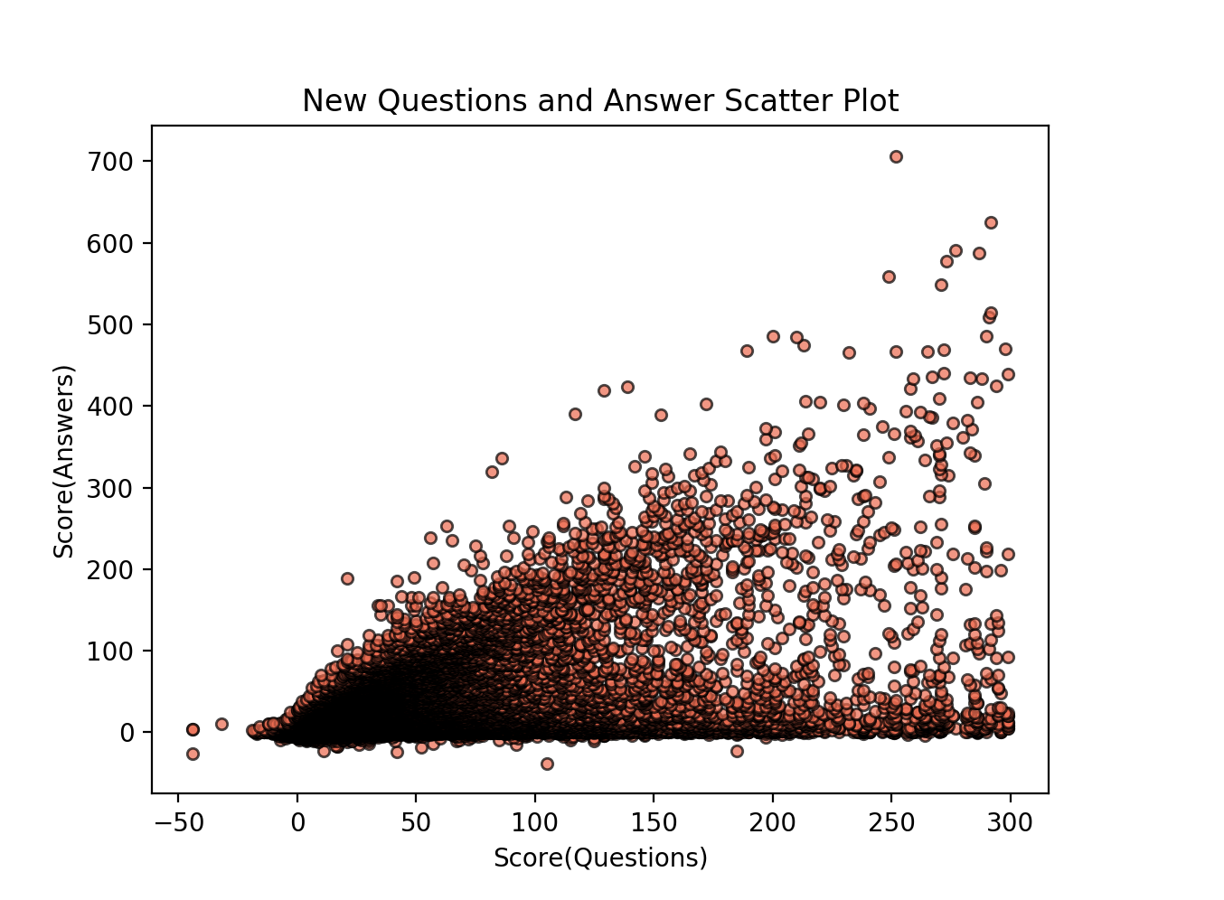
New Qs Analysis

Slide 11
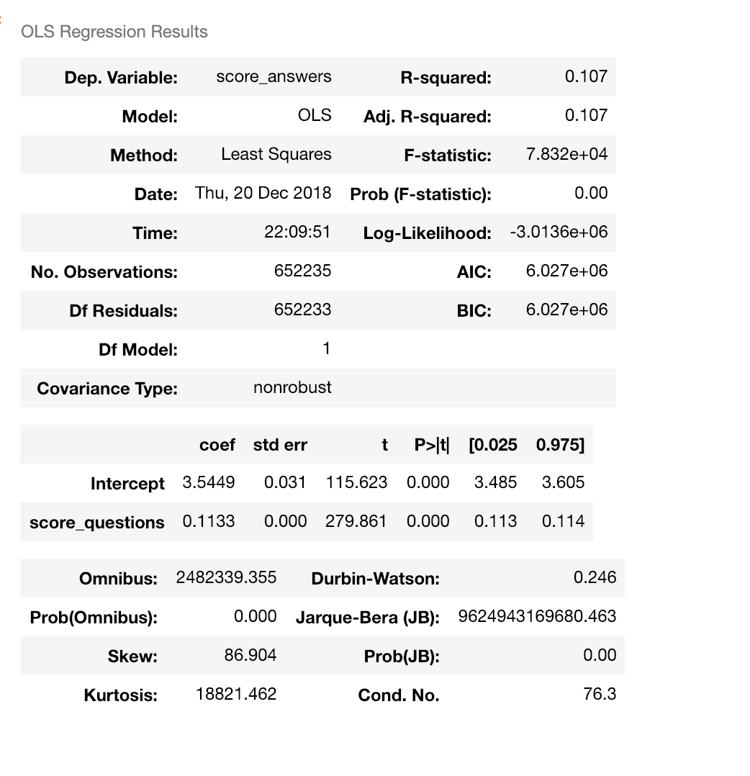
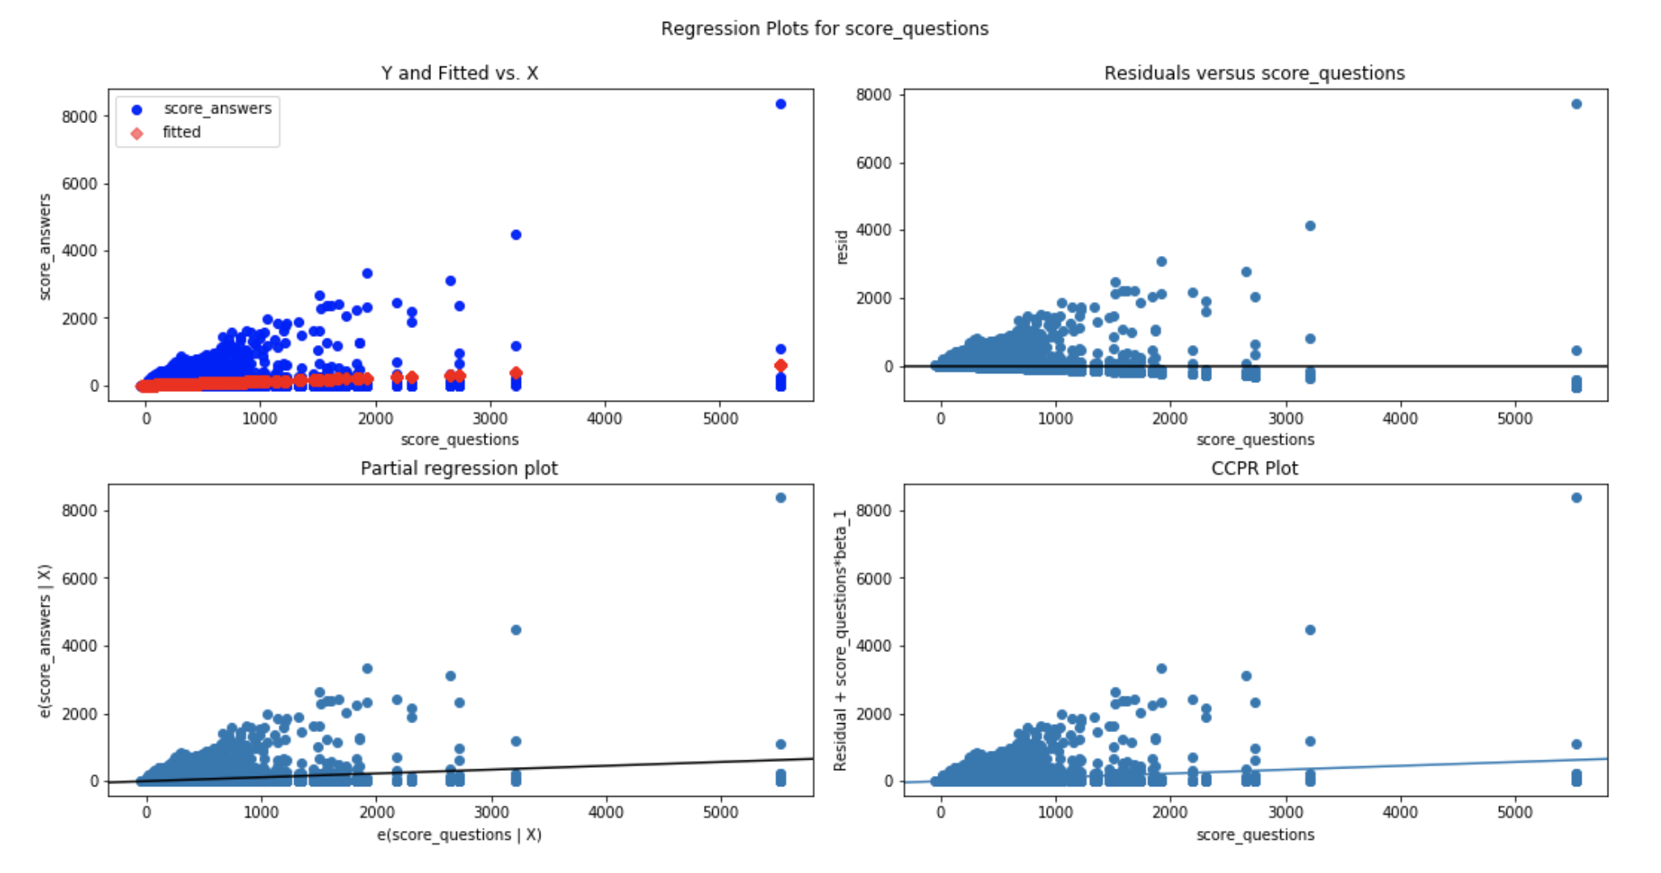
Simple Population Regression

Slide 12
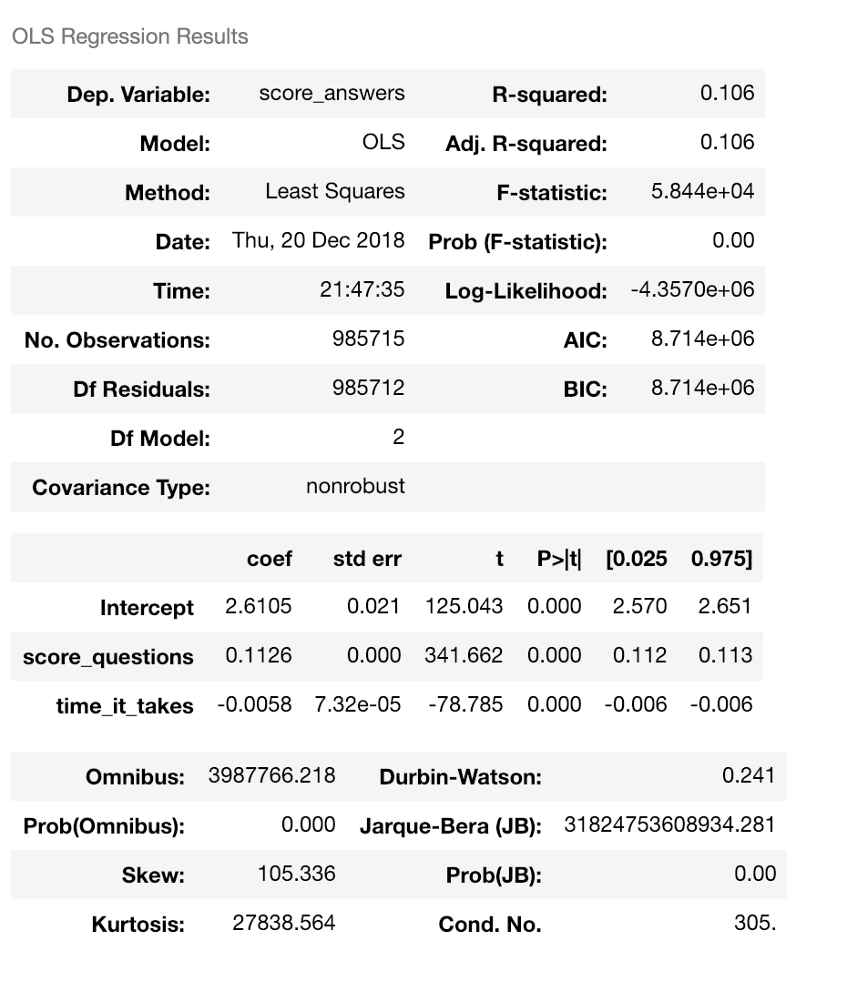
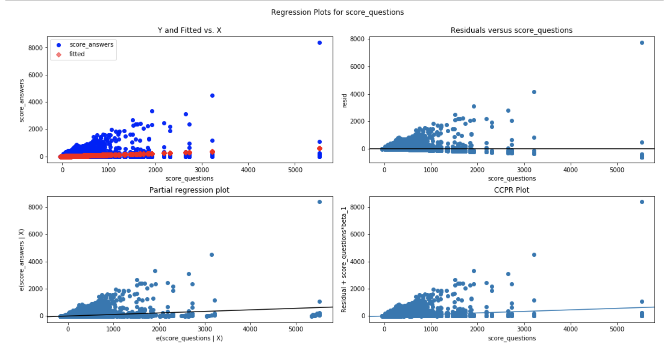
Multi-Variant Regression

Slide 13
Conclusion
Based on the Regressions we can see that there are more factors to take into consideration in order to establish a clear relationship between the most upvoted and downvoted questions and answers. Thus we need to perform further analysis by different categories in order to gain a better insight into the correlation between our data.

