Slide 1
Towards Embench 0.6
A Free Benchmark Suite for IoT from an Academic-Industry Cooperative
David Patterson (UC Berkeley)
Jeremy Bennett, Paolo Savini (Embecosm)
Palmer Dabbelt (SiFive)
Cesare Garlati (Hex Five Security)
21 September 2020

Slide 2

History (1)
Incorporate good ideas and avoid mistakes of past benchmarks
First learn from features of widely quoted benchmarks:
 | Linpack | Dhrystone | SPEC CPU | CoreMark | MLPerf 0.5
Year | 1977 | 1984 | 1989 | 2009 | 2018
Initial target | HPC | Sys. prog | Unix server | Embedded | ML server
Quality reputation | Low | Low | High | Low | Low
Free? | ✓ | ✓ | ✗ | ✓ | ✓
Easy to port | ✓ | ✓ | ✓ | ✓ | ✓
Revision freq. | None since 1991 | None since 1998 | 3 years | Never | 1 year (planned)
# programs | 1 | 1 | 10-23 | 1 | 7
Organization | ✓ | ✗ | ✓ | ✓ | ✓
Summary score | FLOPS | Speed ratio (S.R.) | Geomean S.R. | S.R | SR + Std. Dev.
Developer | Academia | Academia | Acad. + Industry | Academia | Acad. + Industry

Slide 3
History (2)
Incorporate good ideas and avoid mistakes of past benchmarks
First learn from features of less widely quoted benchmarks:
 | EEMBC | MiBench | BEEBS | TACLeBench
Year | 1997 | 2001 | 2013 | 2016
Initial target | Embedded | Embedded | Compiler | Worst Case Execution
Quality reputation | ? | ? | ? | ?
Free? | ✗ | ✓ | ✓ | ✓
Easy to port | ✗ | ✓ | ✓ | ✓
Revision freq. | Rare | Never | 2 years | Never
# programs | 41 | 36 | 80 | 52
Organization | ✓ | ✗ | ✗ | ✗
Summary score | ✗ | ✗ | ✗ | ✗
Developer | Industry | Academia | Acad. + Industry | Academia

Slide 4
7 Lessons for Embench
Embench must be free
Embench must be easy to port and run
Embench must be a suite of real programs
Embench must have a supporting organization to maintain it
Embench must report a single summarizing score
Embench should summarize using geometric mean and std. dev.
Embench must involve both academia and industry

Slide 5
The Plan
Jan - Jun 2019: Small group created the initial version
  Dave Patterson, Jeremy Bennett, Palmer Dabbelt, Cesare Garlati
  mostly face-to-face
Jun 2019 – Feb 2020: Wider group open to all
  under FOSSi, with mailing list and monthly conference call
  see www.embench.org
Feb 2020: Launch Embench 0.5 at Embedded World
Present: Working on Embench 0.6

Slide 6
Current Status
Set of 19 benchmarks for MCU class processors
  up to 64KB total memory
Early benchmark for context switching in RISC-V
  also needs benchmark for interrupt latency
Python build and benchmark scripts
  data available for Arm Cortex-M, RISC-V and ARC
  need to widen to more architectures
Ada version in progress
Embench 0.6 will add floating point suite for up to 1MB machines

Slide 7
Baseline Data
Name | Comments | Orig Source | C LOC | code size | data size | time (ms) | branch | memory | compute
aha-mont64 | Montgomery multiplication | AHA | 162 | 1,072 | 0 | 4,004 | low | low | high
crc32 | CRC error checking 32b | MiBench | 101 | 284 | 1,024 | 4,010 | high | med | low
cubic | Cubic root solver | MiBench | 125 | 1,584 | 0 | 3,831 | low | med | med
edn | More general filter | WCET | 285 | 1,324 | 1,600 | 4,010 | low | high | med
huffbench | Compress/Decompress | Scott Ladd | 309 | 1,242 | 1,001 | 4,120 | med | med | med
matmult-int | Integer matrix multiply | WCET | 175 | 492 | 1,600 | 3,985 | med | med | med
minver | Matrix inversion | WCET | 187 | 1,168 | 144 | 3,998 | high | low | med
nbody | Satellite N body, large data | CLBG | 172 | 950 | 640 | 2,808 | med | low | high
nettle-aes | Encrypt/decrypt | Nettle | 1,018 | 2,148 | 10,284 | 4,026 | med | high | low
nettle-sha256 | Crytographic hash | Nettle | 349 | 3,396 | 412 | 3,997 | low | med | med
nsichneu | Large - Petri net | WCET | 2,676 | 11,968 | 8 | 4,001 | med | high | low
picojpeg | JPEG | MiBench2 | 2,182 | 6,964 | 982 | 4,030 | med | med | high
qrduino | QR codes | Github | 936 | 5,814 | 1,505 | 4,253 | low | med | med
sglib-combined | Simple Generic Library for C | SGLIB | 1,844 | 2,272 | 800 | 3,981 | high | high | low
slre | Regex | SLRE | 506 | 2,200 | 121 | 4,010 | high | med | med
st | Statistics | WCET | 117 | 1,000 | 0 | 4,080 | med | low | high
statemate | State machine (car window) | C-LAB | 1,301 | 4,484 | 64 | 4,001 | high | high | low
ud | LUD composition Int | WCET | 95 | 720 | 0 | 3,999 | med | low | high
wikisort | Merge sort | Github | 866 | 4,296 | 3240 | 2,779 | med | med | med
Compiler: arm-none-eabi-gcc 9.2.0, Board: stm32f4-discovery
Options: -O2 for speed, -Os for code size

Slide 8
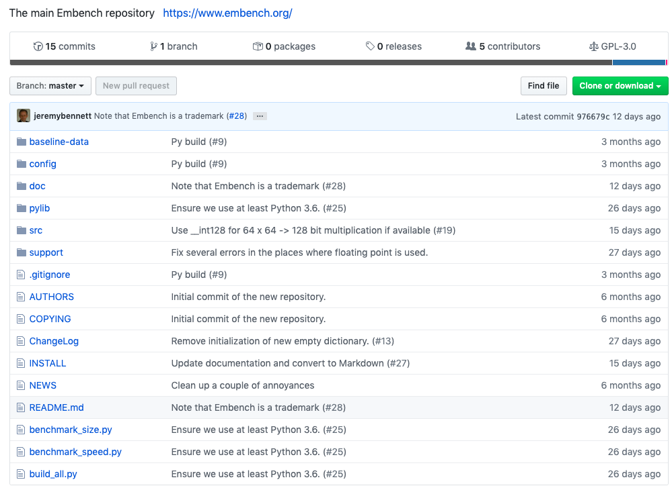
Public Repository

Slide 9
What Affects Embench Results?
Instruction Set Architecture: Arm, ARC, RISC-V, AVR, ...
  extensions: ARM: v7, Thumb2, …, RV32I, M, C, ...
Compiler: open (GCC, LLVM) and proprietary (IAR, …)
  which optimizations included: Loop unrolling, inlining procedures, minimize code size, …
  older ISAs likely have more mature and better compilers?
Libraries
  open (GCC, LLVM) and proprietary (IAR, Sega, ...)
Embench excludes libraries when sizing
  they can swamp code size for embedded benchmark

Slide 10
Impact of optimizations of GCC on RISC-V: Speed
-msave-restore invokes functions to save and restore registers at procedure entry and exit instead of inline code of stores and loads
  ISA Alternative would be Store Multiple instruction and Load Multiple instruction
PULP RI5CY RV32IMC GCC 10.2.0 (higher is faster)

Slide 11
Impact of optimizations of GCC on RISC-V: Size
-msave-restore invokes functions to save and restore registers at procedure entry and exit instead of inline code of stores and loads
  ISA Alternative would be Store Multiple instruction and Load Multiple instruction
PULP RI5CY RV32IMC GCC 10.2.0 (lower is smaller)

Slide 12
Instruction Set Observations
-msave-restore invokes functions to save and restore registers at procedure entry and exit instead of inline code of stores and loads
  ISA Alternative would be Store Multiple instruction and Load Multiple instruction
Reduces code size another 8%
Reduces performance 1%

Slide 13
Benchmarking Lessons?
Must show code size with performance so as to get meaningful results
Importance of geometric standard deviation as well as geometric mean
E.g., is -O3 -funroll-loops worthwhile compare to -Os ‑msave-restore?
    24% faster programs but
    186% bigger programs

Slide 14
Impact of ISA of GCC on RISC-V: Speed
Add
  M (multiply/divide)
  C (compress)
-O2 for speed
-Os ‑msave‑restore for size
PULP RI5CY GCC 10.2.0 (higher is faster)

Slide 15
Impact of ISA of GCC on RISC-V: Size
Add
  M (multiply/divide)
  C (compress)
-O2 for speed
-Os ‑msave‑restore for size
PULP RI5CY RV32 GCC 10.2.0 (lower is smaller)

Slide 16
Benchmarking/RISC-V Lessons?
Multiply/divide improves performance ~1.5x and reduces code size ~4%
Compress neglible impact on performance, reduces code size ~1.4x
Without hardware multiplication widely varying performance

Slide 17
Comparing Architectures with GCC: Speed
GCC 10.2.0
  higher is faster
Arm Cortex-M4, no FPU
PULP RI5CY RV32IMC GCC 10.2.0

Slide 18
Comparing Architectures with GCC: Size
GCC 10.2.0
  lower is smaller
Arm Cortex-M4, no FPU
PULP RI5CY RV32IMC

Slide 19
Comparing Compilers GCC v LLVM: Speed
PULP RI5CY RV32IMC
  higher is faster
Clang/LLVM variations
  -msave-restore enabled by default with ‑Os
  -Oz for further code size optimization
GCC 10.2.0
Clang/LLVM 11.0.0 rc

Slide 20
Comparing Compilers GCC v LLVM: Size
PULP RI5CY RV32IMC
  lower is smaller
Clang/LLVM variations
  -msave-restore enabled by default with ‑Os
  -Oz for further code size optimization
GCC 10.2.0
Clang/LLVM 11.0.0 rc

Slide 21
Code Speed over GCC versions
GCC 4.9.4 - 10.2
  higher is faster
  -O2
0.0
Arm Cortex-M4, no FPU
PULP RI5CY RV32IMC

Slide 22
Code Size over GCC versions
GCC 4.9.4 - 10.2
  lower is smaller
  -Os ‑msave‑restore
0.0
Arm Cortex-M4, no FPU
PULP RI5CY RV32IMC

Slide 23
Code Speed over Clang/LLVM versions
Clang 9.0.1 - ToT
  higher is faster
  Top of Tree commit 53ffeea6d59
  -O2
Arm Cortex-M4, no FPU
PULP RI5CY RV32IMC

Slide 24
Code Size over Clang/LLVM versions
Clang 9.0.1 - ToT
  higher is faster
  Top of tree commit 53ffeea6d59
  -Oz ‑msave‑restore
Arm Cortex-M4, no FPU
PULP RI5CY RV32IMC

Slide 25
Code Size of Different Architectures
WORK IN PROGRESS - DO NOT USE - WORK IN PROGRESS - DO NOT USE
AVR: ATXMega
RISC-V: RV32IMC -msave-restore
ARC: EM, no compressed instructions
Arm: Cortex M4, Thumb v2

Slide 26
Future Size Optimization Techniques
Embench data
Small is good
WORK IN PROGRESS - DO NOT USE - WORK IN PROGRESS - DO NOT USE

Slide 27
The Detail Matters: GCC Bit Manipulation
Code size with GCC Top of Tree 2020-04-01 -Os -msave-restore

Slide 28
The Detail Matters: GCC Bit Manipulation
Code size with GCC Top of Tree 2020-04-01 -Os -msave-restore
Highlighted > 2% benefit, best win is 28%

Slide 29
The Detail Matters: Clang/LLVM Bit Manipulation
Code size with Clang/LLVM Top of Tree 2020-07-12 -Oz -msave-restore

Slide 30
The Detail Matters: Clang/LLVM Bit Manipulation
Code size with Clang/LLVM Top of Tree 2020-07-12 -Oz -msave-restore
Highlighted > 2% benefit, best win is 20%

Slide 31
Bit Manipulation Lessons?
GCC only wins on one benchmark (but wins big)
Clang/LLVM wins on four benchmarks, but none as big as GCC
GCC needs to match more optimization patterns
Clang/LLVM could do more where it does match

Slide 32
Lots More to Explore with Embench
More compilers: LLVM, IAR, …
  and more optimizations
More architectures: MIPS, Tensilica, ARMv8, RV64I, ...
  and more instruction extensions: bit manipulation, vector, floating point, …
More processors: ARM M7, M33, M24, RISC-V Rocket, BOOM, ...
Context switch times
In later versions of Embench: Interrupt Latency
  floating point programs for larger machines in Embench 0.6
Published results in embench-iot-results repository
Want to help? Email info@embench.org

Slide 33
Conclusions
Code size and performance should be linked for embedded benchmarks
  loop unrolling and procedure inlining can triple code size
RISC-V M extension improves performance 1.5-1.7X and code size 3%-6%
ARM Thumb2 smaller than RV32IMC, but within one standard deviation
RISC-V GCC improved to shrink code size by 4% in last 12 months
Many more studies: more ISAs, more compilers, more processors, ...
We believe Embench 0.5 suite is already an improvement over single synthetic programs Dhrystone and CoreMark, and will get better
Let us know if you’d like to help: Email info@embench.org

