Slide 1
Crime analysis in Baltimore
Finding a new home for InfoDyne Corp

Slide 2
InfoDyne wants to move to Baltimore
Tax advantages to move
What crime exists in the city
Where is a good location that is low on robberies
Where would local food and gas be located
Will we be close to Baltmore shipping ports
Note: InfoDyne is a fictious company

Slide 3
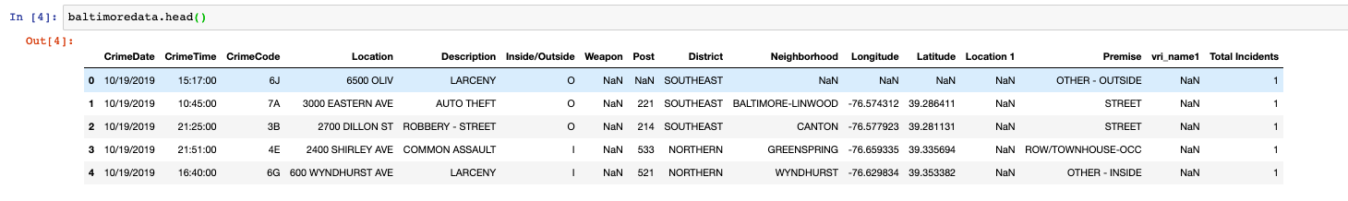
Data Acquistion and Cleansing
Baltimore Open Data has a good data set https://data.baltimorecity.gov/
Crime Data, broken out by location (lat/Long) and types of crimes from 2014 to present
Data dirty.. Missing fields, irrelevant old data exists, Date split

Slide 4
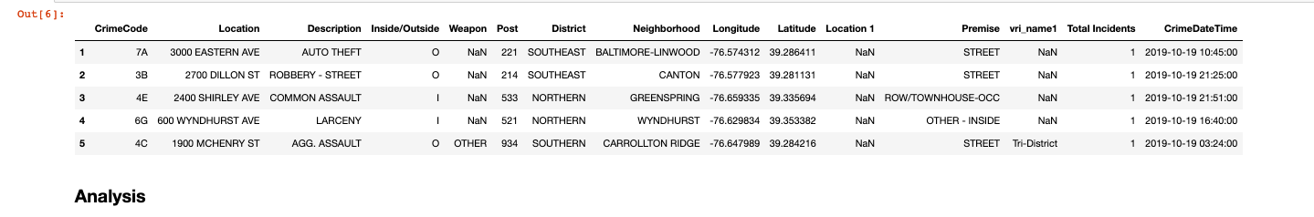
Clean up data
Combine date fields, remove records with missing lat/long

Slide 5
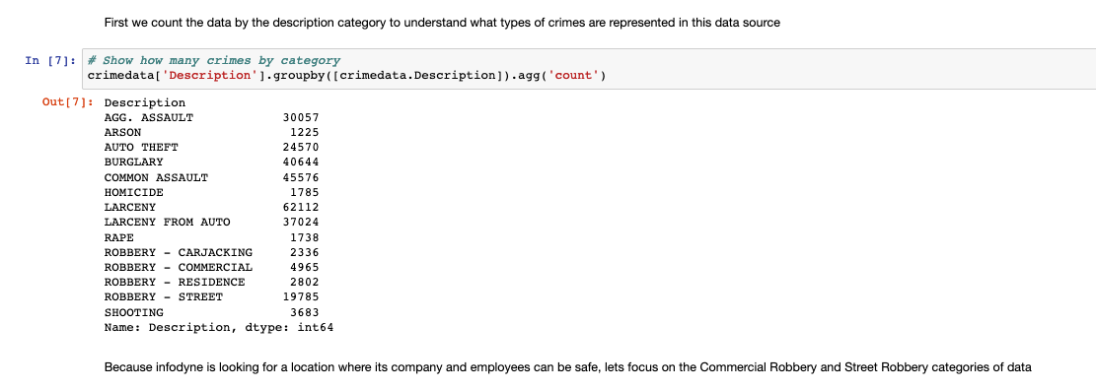
What types of crimes are represented?

Slide 6
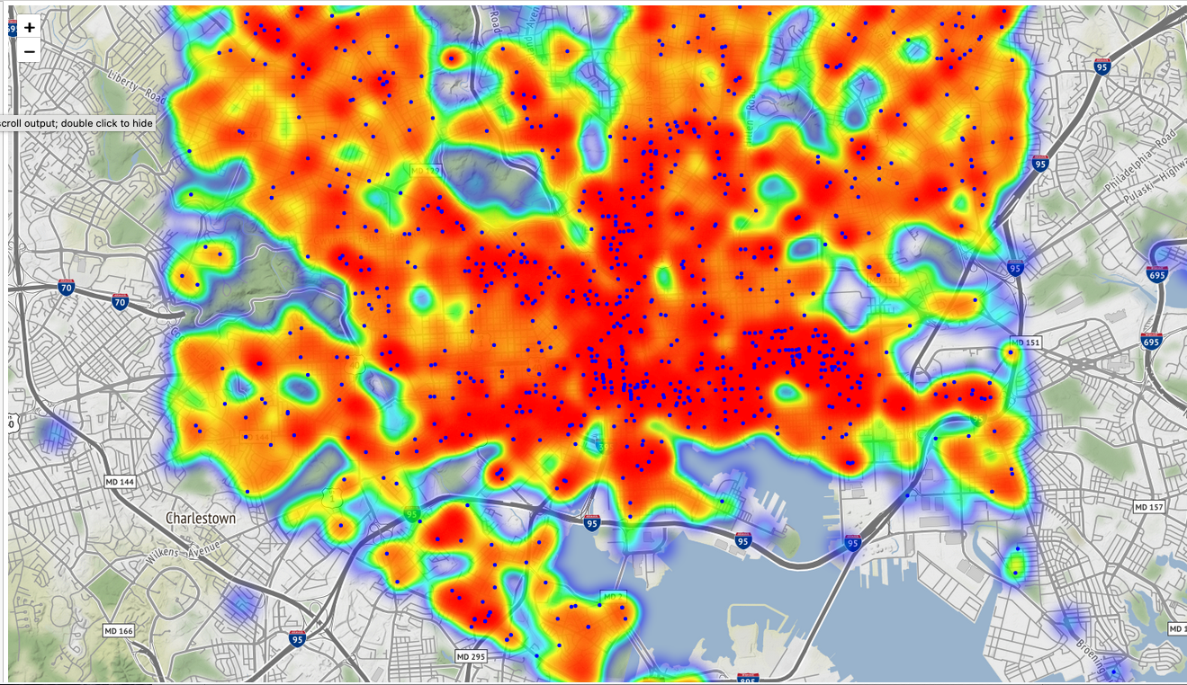
Draw heatmap of Robberies across Baltimore
This area
Around the
Horseshoe
Casino
Looks
Promising
“Lower”
robberies

Slide 7

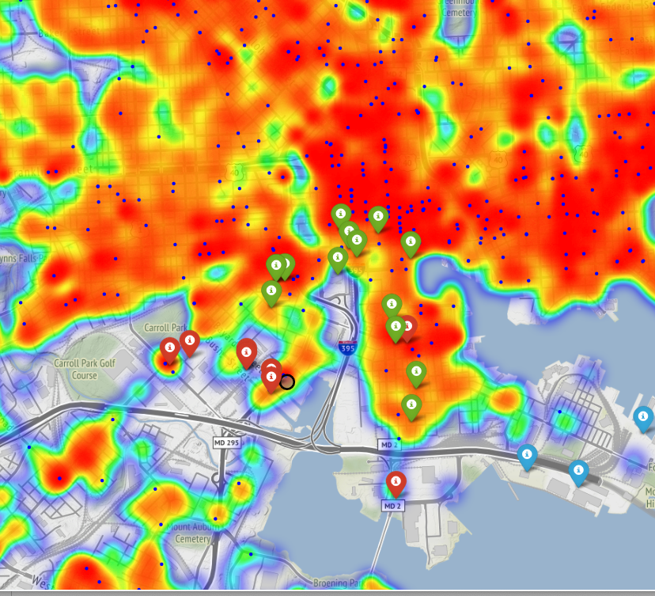
Analyze food, gas, and port facilities
Food facilites within 1.5km
Gas facilities within 1.5km
Easy access to major highways
Port of Baltimore facilities nearby

Slide 8
Conclusion
The fictitious InfoDyne Corporate could move its manufacturing operations to the south side of Baltimore.
Less ”robbery” crime than other areas
Food and Gas are nearby, but not ideal
Easy access to highway infrastructure
Easy access to Port of Baltimore for overseas shipments
Note: Casino distance could be a concern for employees on their lunch hour

