Slide 1
FOSSology: Introduction and Basic Workflow

Slide 2
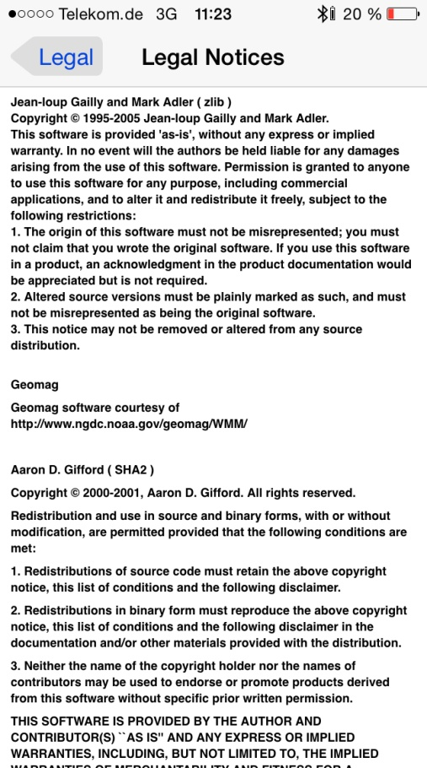
The Problem Actually
You know these examples
Distributing open source software requires to
  Provide licenses of involved software
  Provide copyright statements of involved authors
  Provide disclaimers
  … and much more

Slide 3
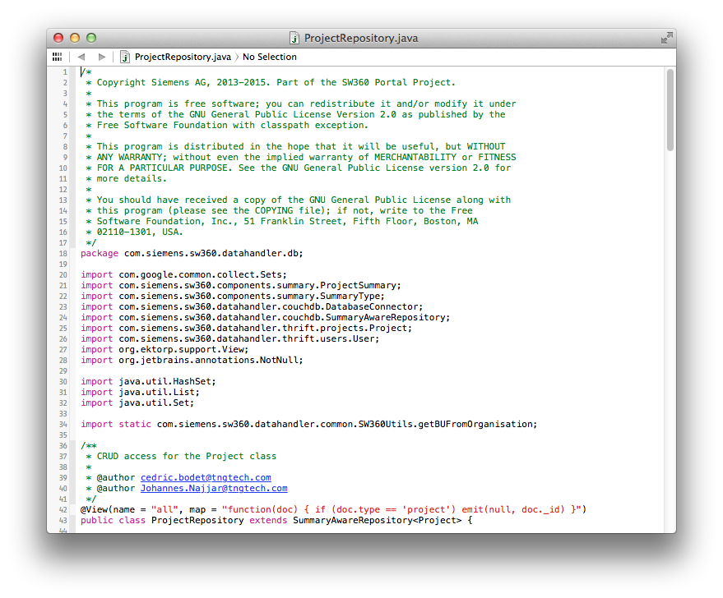
It is about finding licenses
Finding Licenses
  License texts
  References to licenses
  Written texts explaining licensing
  License relevant statements

Slide 4
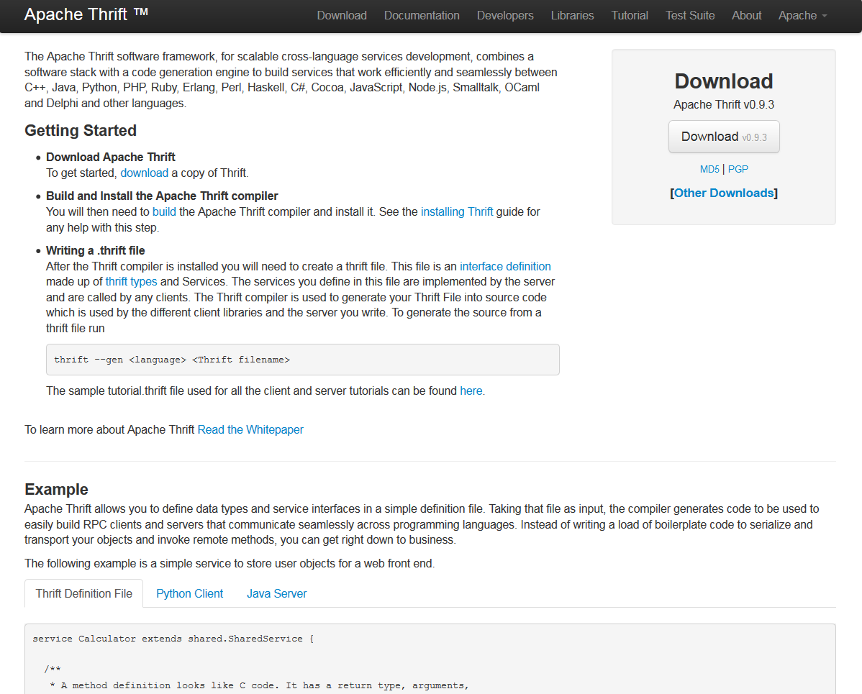
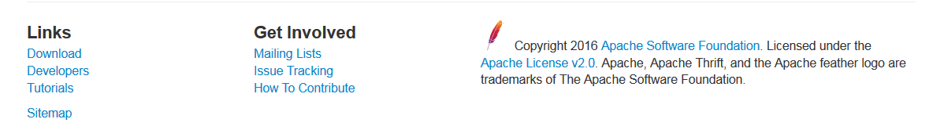
An Example – What do we find?
The Example
  (Apache projects are known for
  homogenous licensing)
  Such a project declares its licensing on its Website
  However, Open Source implies using other open source
  As such, a projects can contain also parts from other open source projects

Slide 5
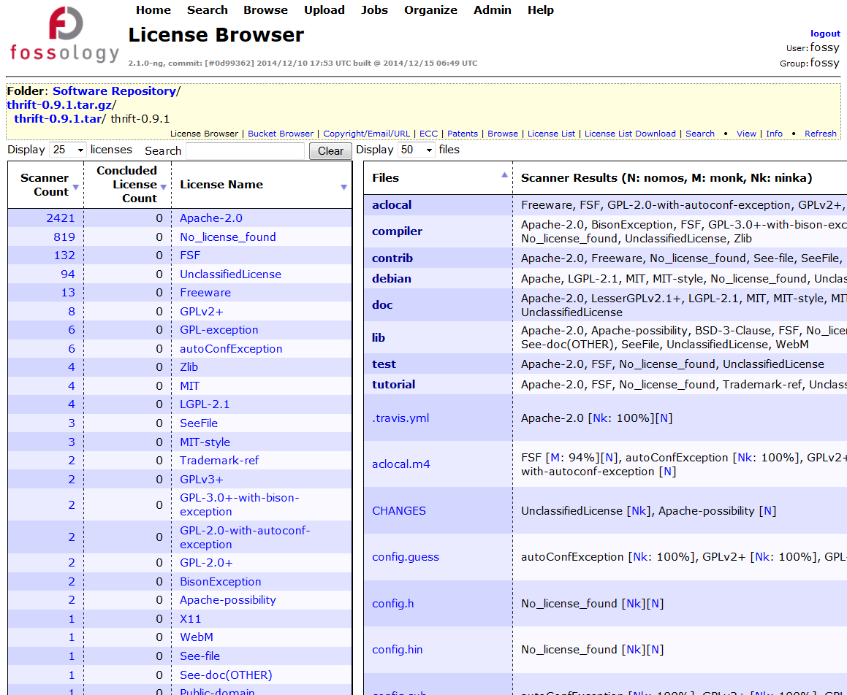
Using FOSSology with this Example
Open Source and Reuse
  It is natural that an OSS project reuses available https://github.com/fossology/fossology
  Likely OSS from other projects is found
  For example, FOSSology will find 25 other licensing relevant text occurrences in Apache thrift

Slide 6
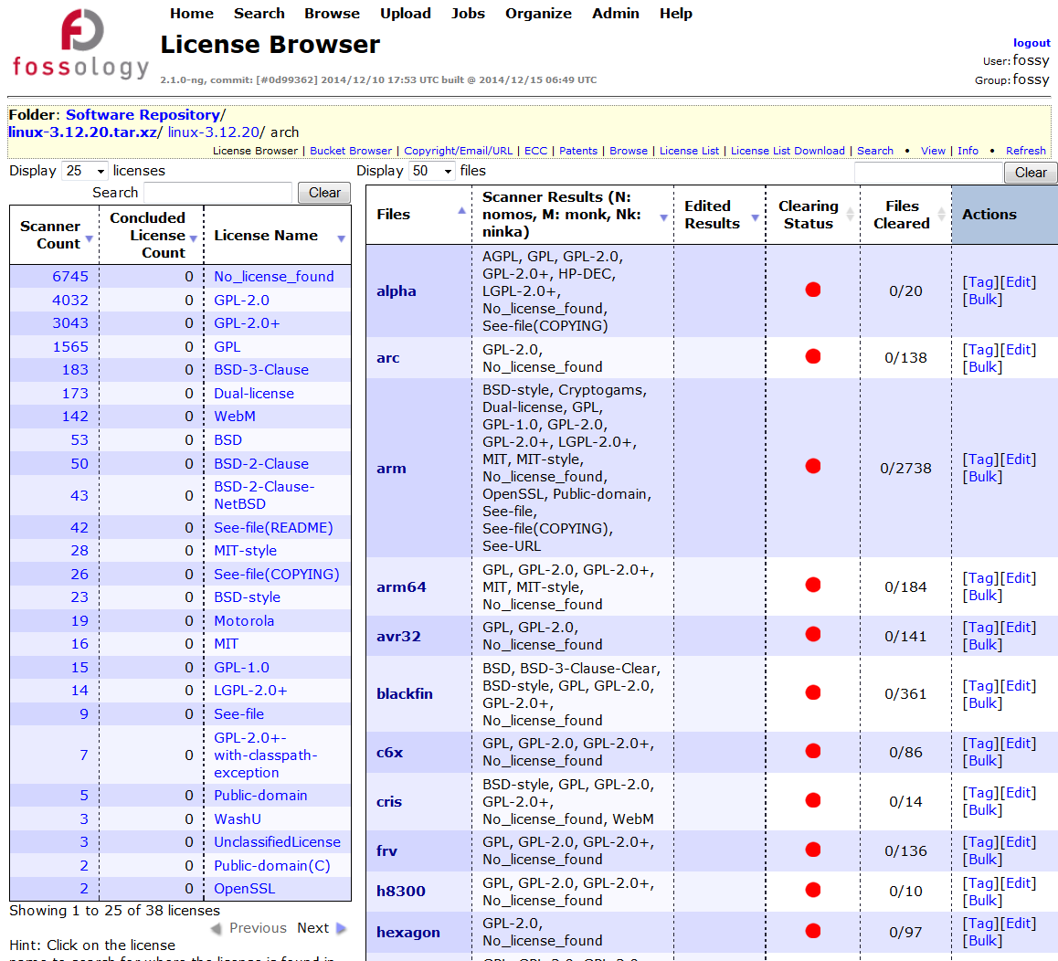
Using FOSSology with this Example
Another Example: Linux Kernel Project
  Looking at the Linux kernel will result in thousands of files containing license relevant information
  Analyzing them yields about 30 distinctive licensing statements

Slide 7
What is FOSSology?
A Web server application for license and copyright compliance of software components.
FOSSology Project
https://www.fossology.org/
FOSSology Development
https://www.github.com/fossology/fossology
  Published first in 2008, GPL-2.0
  2015: Linux Foundation collaboration project
  Web server based and command line interfaces
  Scanning agents searching for license and copyright relevant hits (and more …)
  A multi-user / multi-tenant Web UI for review organizing clearing job
  Standard Web application stack:
    Linux, Apache 2, PostgreSQL, PHP,
  Web-based UI in PHP, but scanners
  written in C / C++
  Two ways to interact:
    Web user interface
    Command line utilities
Notes:
Memo

Slide 8
How does FOSSology work? – Overview 1 of 2
See more details the Basic Workflow Description: https://www.fossology.org/get-started/basic-workflow
Upload OSS Package
  Upload an open source package to the server
  Select scan agents that analyze the software
Review and Adjust (“Clearing”)
  Review what scanners have found
  Review license occurrences and correct findings if necessary
Generate
  Generate report output
  For example list of licenses or SPDX
Notes:
Memo

Slide 9
Hands-On: Basic End-to-End Workflow
Functionality
Example
  Using FOSSology End-to-End
    From uploading …
    … to generating report: SPDX
  Uploading - offers a variety of selections
  Review the uploaded file in the license browser
  Review the found licenses in the aggregated view
  Do the clearing work
  Review the copyrights
  Review the Export Control and Customs (ECC)
  Generate desired report output
Upload ionicons-3.0.0
Go to license browser by clicking upload name or selecting clearing from the action menu
Select “go to all …. with licenses”
Review licenses and apply decisions
Select the copyright, e-mail, url section from the yellow menu bar area
Review copyright statements and correct in case
Select ECC from the yellow area and review
Go to Browse main view
Select the pop-up menu of the ionicons upload

Slide 10
How does FOSSology work? – Overview 2 of 2
Upload
Component
Uploading source code archive (*.zip, *.tar.gz, etc)
Agents scan for license relevant text
Copyrights, Export Control (ECC), your keywords to look for etc.
Agents
Scanning
Review scanner results for wrong license classification
Review other scanner findings (copyrights, ECC)
Review
Results
Generate
Reporting
Result of the “clearing”
  SPDX reporting
  Generated notice or readme file
  debian-copyright
Pass Report
to Client
Notes:
Memo

Slide 11
FOSSology Feature Overview
A Web server application for license and copyright compliance of software components.
License Scan features
Other features
  Regular expression scanner
  Text similarity scanner
  License (text) management
  Aggregation of licenses in hierarchical view
  License histogram
  Supporting concluded vs. found license
  Bulk processing of files with same licensing
  Reusing of license conclusions
  Copyright, authorship statements scanner
  Export control and customs scanner
  Command line interfaces
  Reporting
    SPDX RDF and tag-value
    Debian-copyright
    Plain text output
  Files sorting in buckets
  User, group and upload management
Notes:
Memo

Slide 12
Features: Two License Scanners: Nomos and Monk
Nomos Keywords
Nomos Reg. Expressions
Bulk Phrase Matches
Monk Full text Matches
  Finds all kind of license relevant texts
  Finds unknown Licenses
  Finds most license relevant texts
  Identifies also derivatives of licenses
  Good for finding actual licenses
  Identifies also derivatives of licenses
  Certainty that known license text is actually found and wording is exactly reproduced
Flexibility
  Very imprecise
  Does not identify license
  High number of false positives
  Only limited precision for identifying actual licenses
  False positives
  Limited to known phrases only
  Does not provide certainty about original or derivative
  Works only on known license texts
  Actual occurrences are minority
Precision
Notes:
Memo

Slide 13
More Features in FOSSology
  Workflow integration with command line interfaces
    Do uploads and scans from the command line, right from your scripts
    Or just run individual agents (e.g. for licenses) from command line
    Schedule activities / integrate them into automated workflows
  ECC (Export Control and Customs)
    Regular expressions searching for export control and customs
  License data sets import and export
    Regular expressions searching for export control and customs
  Buckets
    Define rules for files with license results for collecting them in dedicated lists / buckets

Slide 14



FOSSology is Open Source
What happens actually?
  As an organization distributing software there is responsibility for license compliance
  This work must be actually provided by 3rd parties as well!
  With FOSSology, a tool is freely available supporting all kind of organizations with their license compliance efforts
    GPL-2.0 licensed
3rd parties
Organization
Distributing
Customer / Organization

Slide 15
Overview: FOSSology Hands On
Basic End-to-End Workflow
Overview: What do I need to do actually to get the SPDX / Readme / DEP5
Accelerate the File Handling
Using bulk scanning to correct scan results
Reuse of Clearing Decisions
Process only differences for newer versions of a scanned component
Management of Licenses
See the licenses and where to edit
Export and import more licenses
Organizing the Uploads
Getting started with folders, uploads and access rights
Creating users and groups

Slide 16
Thank you for your attention!
© 2016-2018 Siemens AG, The Linux Foundation
CC-BY-SA 4.0
https://creativecommons.org/licenses/by-sa/4.0/
Internet
https://www.fossology.org
Github
https://github.com/fossology/fossology
Further Links
https://www.spdx.org
https://www.openchainproject.org
https://github.com/sw360/sw360portal
Notes:
Notes

