Slide 1
FOSSology: Hands On - Becoming Efficient

Slide 2
What is FOSSology?
A Web server application for license and copyright compliance of software components.
FOSSology Project
https://www.fossology.org/
FOSSology Development
https://www.github.com/fossology/fossology
  Published first in 2008, GPL-2.0
  2015: Linux Foundation collaboration project
  Web server based and command line interfaces
  Scanning agents searching for license and copyright relevant hits (and more …)
  A multi-user / multi-tenant Web UI for review organizing clearing job
  Standard Web application stack:
    Linux, Apache 2, PostgreSQL, PHP,
  Web-based UI in PHP, but scanners
  written in C / C++
  Besides Web UI:
    Command line utilities
Notes:
Memo

Slide 3
How does FOSSology work?
Upload
Component
Uploading source code archive (*.zip, *.tar.gz, etc)
Agents scan for license relevant text
Copyrights, ECC, your keywords to look for etc.
Agents
Scanning
Review scanner results for wrong license classification
Review other scanner findings (copyrights, ECC)
Review
Results
Generate
Reporting
Result of the “clearing”
  SPDX reporting
  Generated notice or readme file
  debian-copyright
Pass Report
to Client
Notes:
Memo

Slide 4
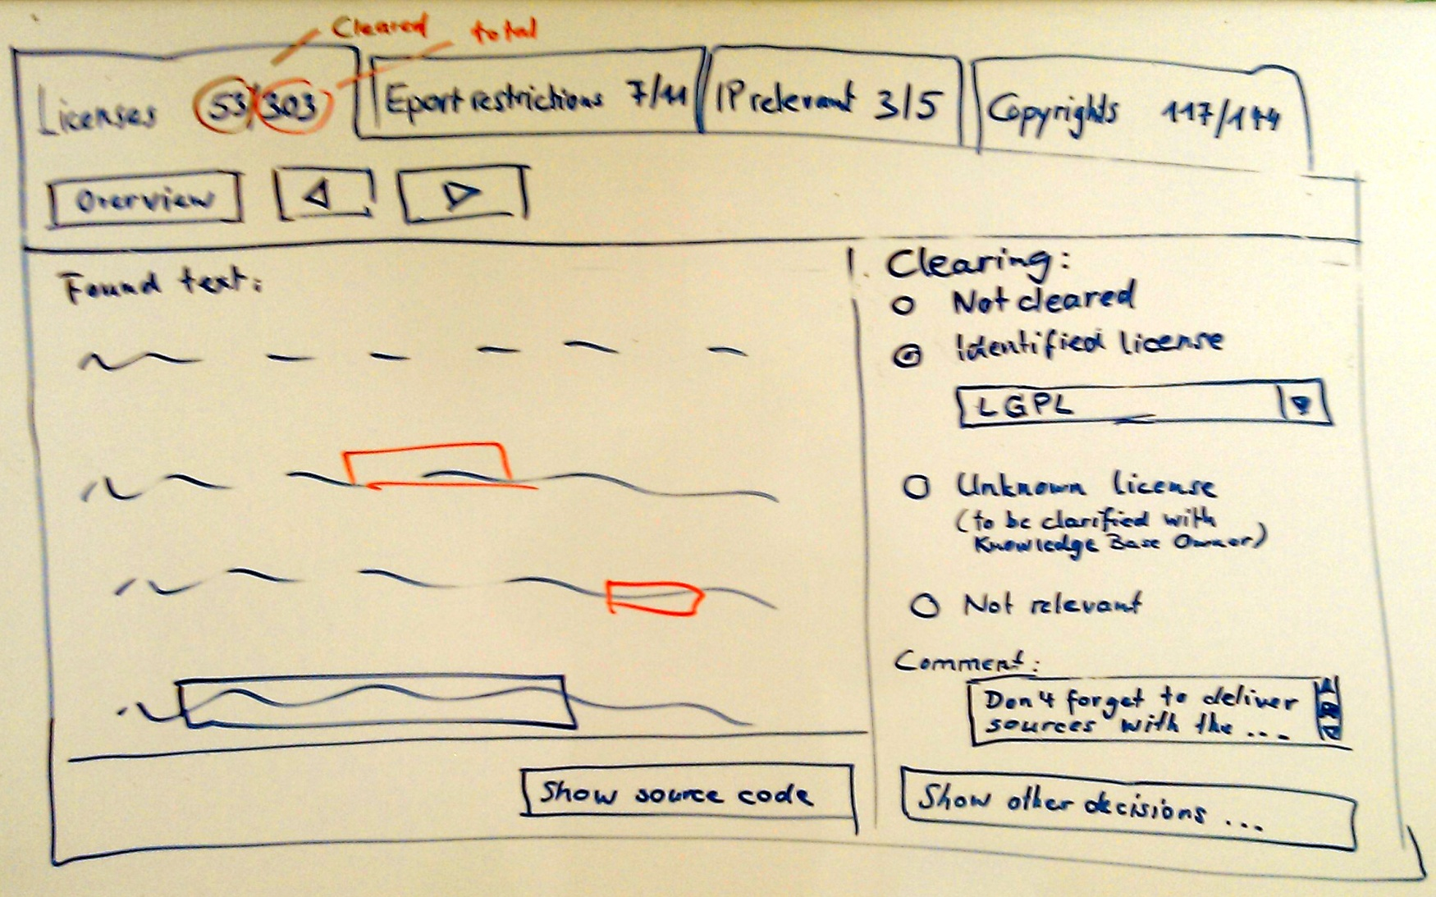
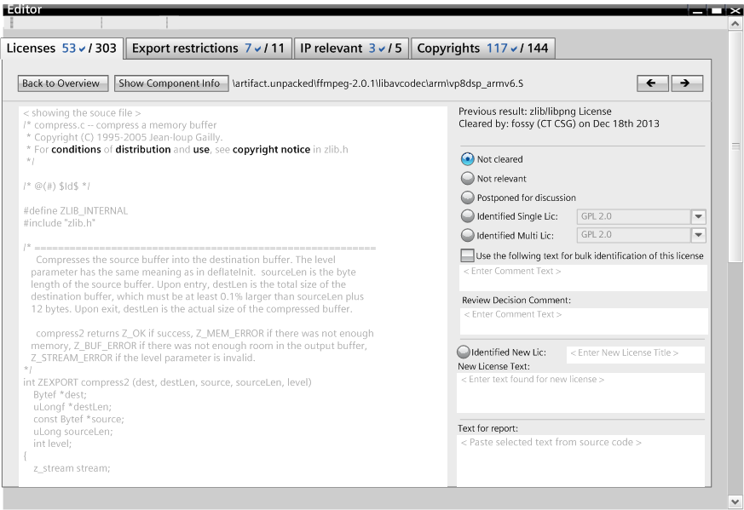
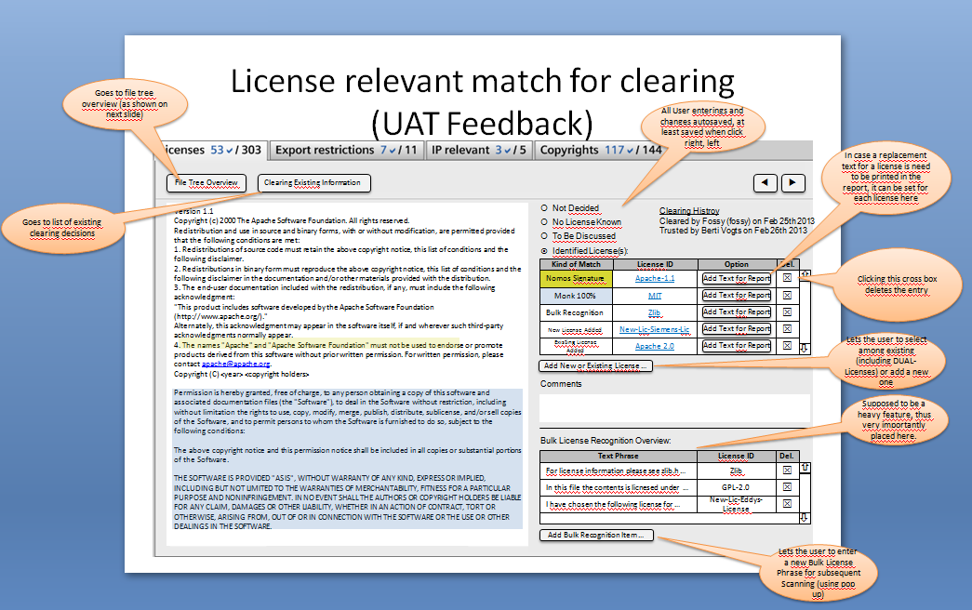
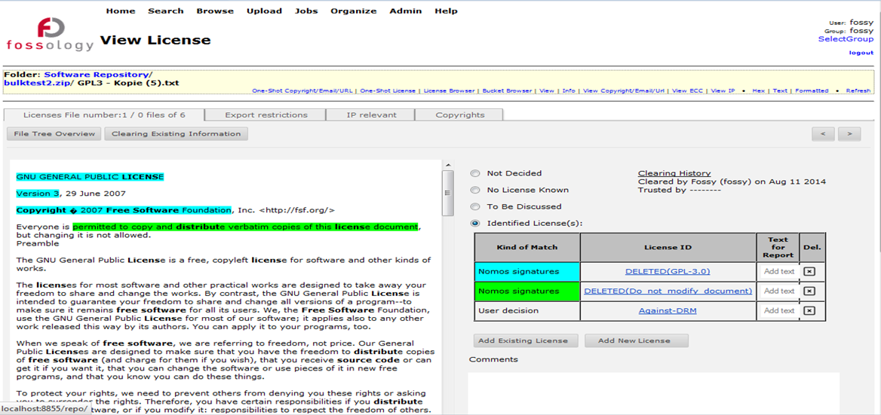
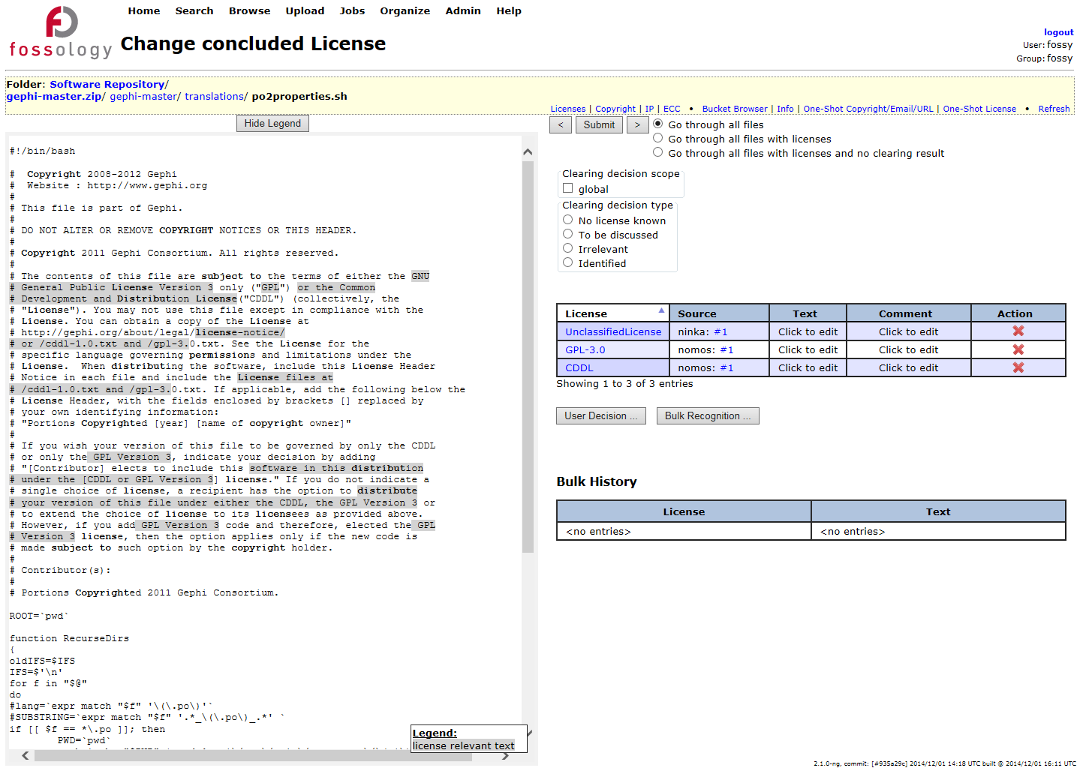
Features: Efficient User Interface
Evolution
  Most work intensive part: review and correction
  User interface went over many iterations the past years
  Support for large packages
  (> 10.000 files, such as Boost, Linux Kernel,…)

Slide 5
Hands-On: Basic End-to-End Workflow (Again)
Functionality
Example
  Using FOSSology End-to-End
    From uploading …
    … to generating report: SPDX
  Uploading - offers a variety of selections
  Review the uploaded file in the license browser
  Review the found licenses in the aggregated view
  Do the clearing work
  Review the copyrights
  Review the Export Control and Customs (ECC)
  Generate desired SPDX report output
  Upload an example file, jakarta-oro-2.0.7
  Select the options in the upload menu
  Go to browse and review the UI there
  Select licenses from drop-down menu at upload
  See the aggregated views and single file view: create decisions
    First use of the bulk
  Go to copyrights and correct found matches
    ECC will be the same
  Select SPDX output from drop-down

Slide 6
Feature: Reviewing Many Files at Once, Bulk Scan

Slide 7
Feature: Reviewing Many Files at Once: Bulk Scan
The FOSSology software cannot know all possible license relevant text phrases
Use Case
Solution
  Finding standard and known license texts is straightforward
  Do I need to create a clearing decision for every file?
  If the scanner yields wrong results, do I need to go into every file and correct then?
  FOSSology allows the user to define text phases …
    For confirmation …
    … or correction
  And assign license confirmations or corrections to it
    Every time a file is found with this text phrase (100%) …
    … the confirmation or correction is applied to it.
  No need to go through every file again.
  Does not apply with scan result conflicts
Notes:
Memo

Slide 8
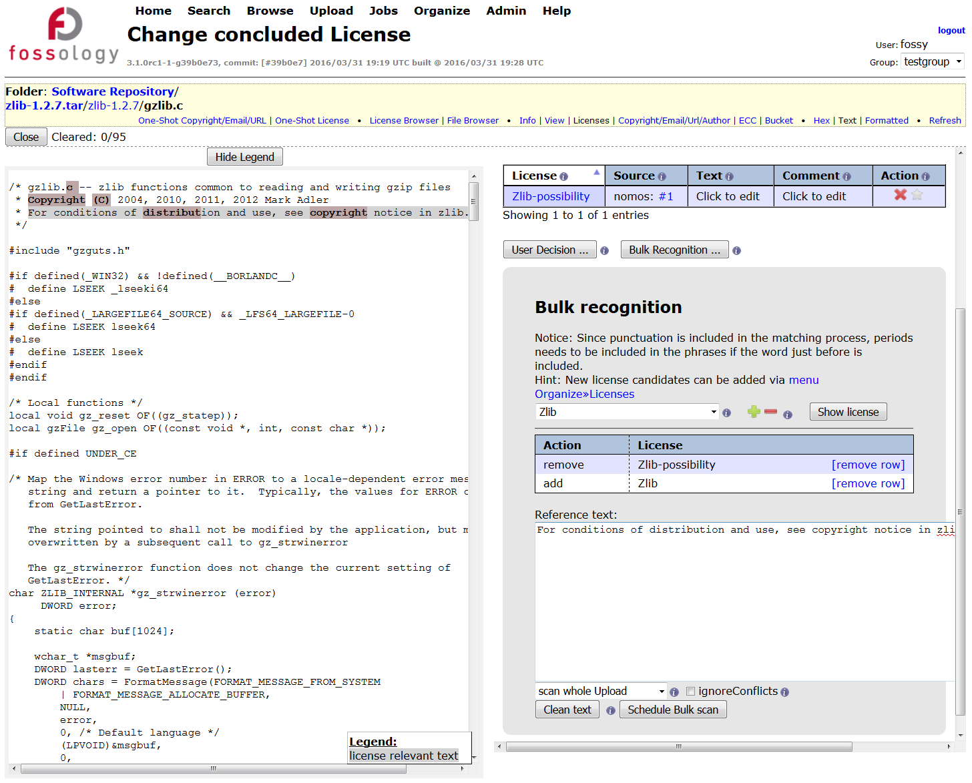
Feature: Using Bulk Scan
User Interface
  Copy a characteristic text phrase from file view left (1)
  Paste into the bulk scan text field (2)
    The application will search for file with this text
  Define scanner license findings (3)
    For correction / removal
    For confirmation, creating a clearing decision
  Bulk scan will run over all files of the package and apply clearing decisions or scanner corrections where matching (4)
1
3
2
4

Slide 9
Hands-On: Accelerate File Handling: Bulk Scan
Functionality
Example
  Upload open source package
    Based on scan results: what the scanner found
    Scanner found a license: either conform or correct
    Going file by file: select, identify, next
    Good, but not feasible for larger packages
  Use bulk scan to accelerate it
    Within an upload: select the text phrase
    Assumption: using text phrases within an upload appears safe
    Define a license for the text phrase – or a removal
    For every finding where scanner found the same license confirmation
  More edits on files at once
    Edit and bulk from aggregated view
    Edit is for irrelevant
  Upload zlib sources 1.2.7
    Go to first file in list
    (some zlib-possibility)
    Select zlib, remove zlib possibility, go next
  Go to another file
    Select zlib possibility
    Define bulk item: removing zlib possibility
    Define bulk item adding zlib
    See that decision is created
  Again
    Same story, another example: BSL-case in contrib of zlib

Slide 10
Feature: Bulk Scan – A few Things to Consider
Scoping Bulk Scan
  Bulk scan can be applied on folders but also an entire uploads
Larger bulk scan sections
  Prefer larger text portion instead of smaller ones, this increases the precision
  However, do not consider copyright statements for example, as they usually vary within an upload
Comment characters
  Comment characters such as #, //, * , /* are filtered out anyway, copying them in does not matter
  But other characters are not filtered out („%“). They will make a difference
No characteristic text phrase
  Consider correcting license scan results directly using the edit feature
  With the edit feature available in the license browser view, no text phrase is defined

Slide 11
Features: Processing Copyright Statements

Slide 12
Feature: Processing Copyright Statements
Edit is about a short cut at license review
Use Case
Solution
  Many license obligations ask for listing the copyrights at distribution.
  Example form BSD: “Redistributions in binary form must reproduce the above copyright notice,…”
  How do I find out all relevant copyright statements of an upload?
  FOSSology scans based on regular expressions
    Copyright statements (yes, also © in UTF-8, 1152, …)
    Authored by, contributed by, e-mail addresses
    E-Mail addresses and http/https URLs
  Stored on file level!
    Maintained by hashes of the file
    Editing the copyright of a file, edits it also for future uploads
    Recovery of deleted copyright statements possible
    Table-sheet editing up to come
Notes:
Memo

Slide 13
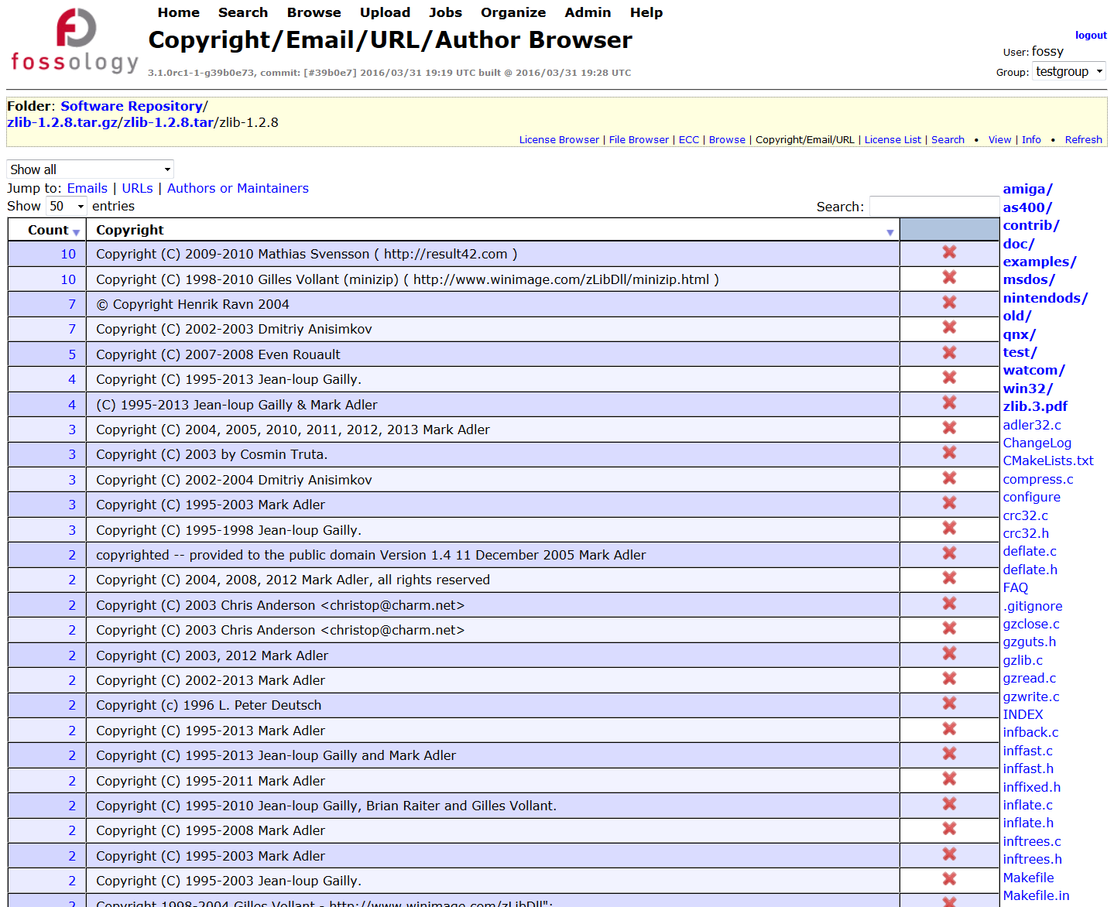
Feature: Processing Copyright Statements
User Interface
  Copyright findings are presented in an aggregated view
    For single files
    All found items at folder level
    All items of the upload
  Copyright statements can be deleted
    false positives
  Copyright statements can be tracked back to the referring files

Slide 14
Feature: Edit License Conclusions in License Browser

Slide 15
Feature: Edit License Conclusions in License Browser
Edit is about a short cut at license review
Use Case
Solution
  Within a software component, I know files / folders already.
  With a software component, I know that files are irrelevant.
    Unused architecture
    Test files, code examples
    Build infrastructure
  Do I need to look at the files?
  FOSSology allow to set / unset license on folder level
  In license browser, the user can set the licenses on folders
    Set or confirm licenses
    Remove scan results from the clearing decision
    Mark files as irrelevant
  What happens actually?
    The “Edit” creates clearing decisions
    The scan results are not touched (and preserved)
    No clearing decision final on scan result conflicts
Notes:
Memo

Slide 16
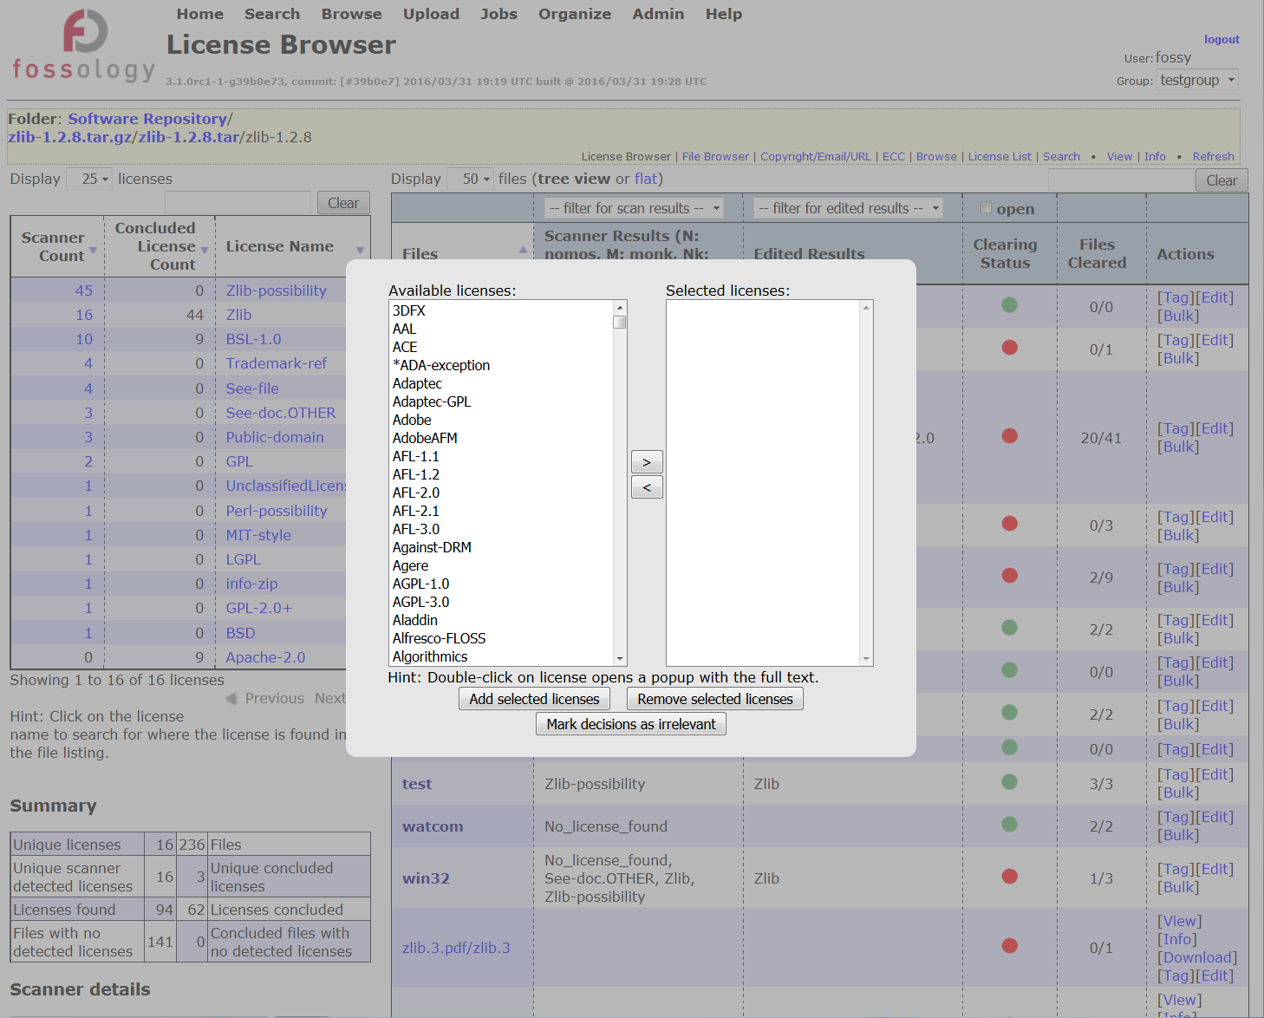
Feature: Using License Conclusions in License Browser
User Interface
  At aggregated license browser view select link [Edit]
  Select either licenses for decision …
  … or mark file trees irrelevant (for distribution)
2
1

Slide 17
Features:
Reuse of License Corrections
Candidate License Handling
Custom License Text
License Set Handling

Slide 18
Feature: Reuse of License Corrections
Reuse is about reusing already done work.
Use Case
Solution
  Upload and clearing of a component:
    Going file-based
    Maybe using bulk phrase
    Reviewing copyrights
  Uploading a newer version
    Do I need to go through all files again?
  FOSSology maintains hash values of every file
    It already reuses scans (rescan possible for new agent)
    Users want to reuse clearing decisions = what the user has decided
  Three different reuse functions
    Reuse clearing based on same file hashes
    Reuse bulk scan operation = individual text phrases
    Reuse where file differs by one line (using diff-tool = slow!)
Notes:
Memo

Slide 19
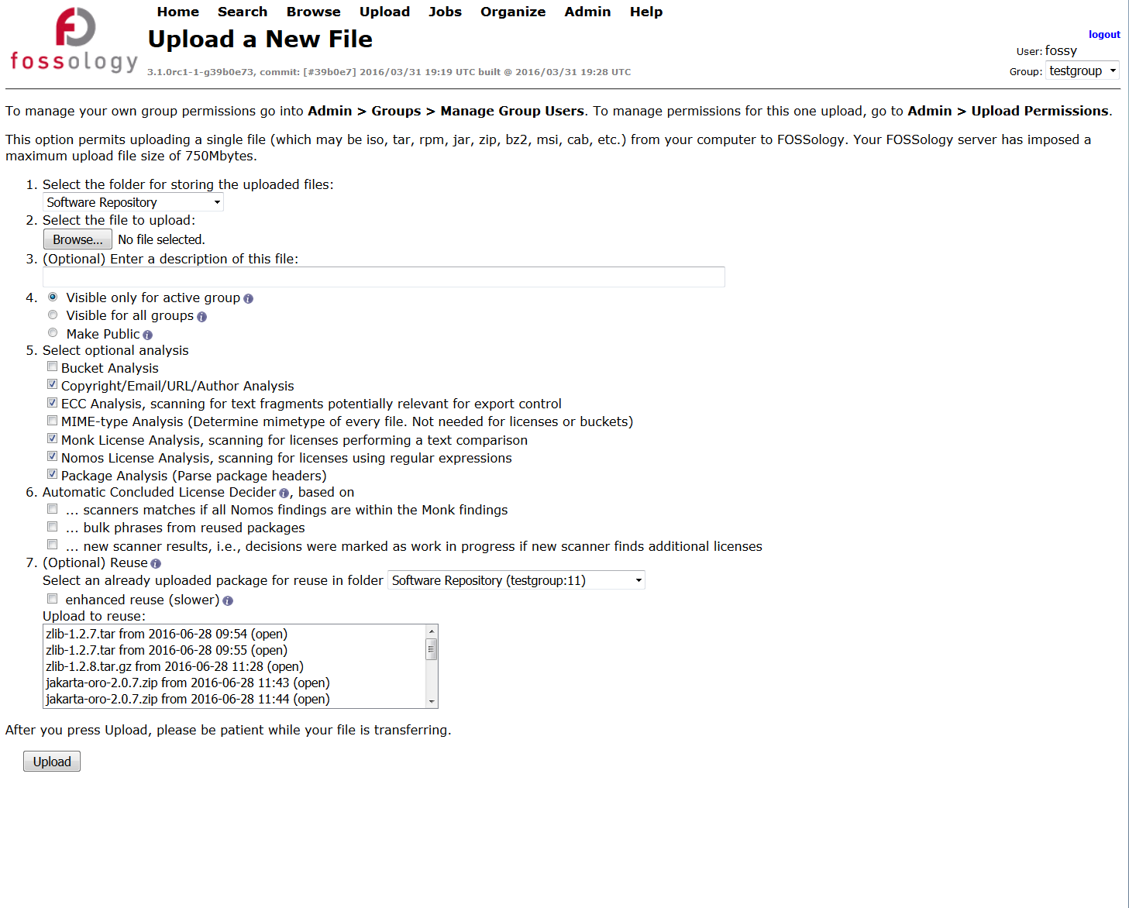
Feature: Using Reuse of License Corrections
User Interface
  At upload you can select another existing package on server for reusing license review data
  Three main reuse options given:
    Reuse license review data at same hash value calculated for files (1)
    Reuse license review data at one-line tolerance using the diff tool (2)
    Reuse bulk scan tasks entered for selected existing package also for new package (3)
3. Choose not only clearing decision from same files, but also identified text phrases
2. Choose same files either by hash-match or by diff-tool with 1-line tolerance
1. Select existing upload from where to reuse license decisions

Slide 20
Hands-On: Reuse of License Corrections
Functionality
Example
  Upload open source package
    Do the clearing work
    … or just some examples
  Upload a newer version of the package
    (it works actually with an older version as well)
    Assumption: using text phrases within an upload appears safe
    Select the appropriate reuse settings
      Select the existing upload
      Select the bulk phrases if appropriate
      Select the extended reuse if appropriate
  Check the reuse ratio in aggregated view
    It should be possible to reuse from multiple uploads
  zlib 1.2.7 source was uploaded
    Some clearing work was done
    From the previous part
  Upload “From File” zlib 1.2.8 source
    Select reuse uploaded package 1.2.7
    Nothing else
    Review the files reused
  Upload “From File” zlib 1.2.8 source again
    Select reuse package …
    Select bulk phrases reuse too
  Upload … again
    Select also extended reuse

Slide 21
Features:
Candidate License Handling
Custom License Text
License Set Handling

Slide 22
Hands-On: Custom License Text
Functionality
Example
During clearing you see a new license text
Overriding the standard text is required
For some licenses, the provided text in FOSSology is not helpful
Adding text replacement for license
Candidate licenses are valid for clearing
But not scanning – important for not altering scans
Create a candidate entry with a merge request
Check the output of the report
Create a report to review the license output
  Zlib 1.2.7 source was uploaded
    Go to license browser
    From the license histogram, select the public domain license occurrences: click on number
    Select one file, optionally: select multiple files with tabs
  Adding a text finding
    Review public domain license text
    Select the appropriate text phrase
    Add text in the license table
    Save decision
  Check output
    Go back to browse view
    Generate readme to review file result

Slide 23
Hands-On: Candidate License Handling
Functionality
Example
  During clearing you see a new license text
    There is the possibility of saving that license text in the license entry for that file
    Good, but only for that file
  Create a license candidate
    Candidate licenses are valid for clearing
    But not scanning – important for not altering scans
    Create a candidate entry with a merge request
  Admins can add candidate licenses
    Candidate licenses can be transferred into normal licenses
    Will be considered for full text matches by Monk agent, but not regular expressions
    UI allows for text comparison with exiting licenses
  zlib 1.2.7 source was uploaded
    Checking the ada example in contrib
    Reviewing the ada exception text
  Create a candidate license
    Filling out the entry
    Clean the text before
    Go back to the file occurrence
    Select from the candidate license
  Admin login
    See the candidate license
    Do the merge request

Slide 24
Hands-On: License Set Handling
Functionality
Example
  FOSSology can actually handle a larger set of licenses
    Can be imported by CSV-files
  Implemented is both: export and import
    Export is useful for actual format definition
    Import works vice versa
      Importer checks for existing texts by the way using an FOSSology scanner
    Import can distinguish between three things
      License text in file or just reference
      License variant or same – for deciding
  Import adds provisioning functionality
  Login with admin account
  Review the license export to learn about the format
  Add your own license text to it: Apache-2.0 header
  Upload the licenses
  Run an upload which is Apache-2.0 licensed, for example commons-collections-4-4-1-src.zip, to see that header is matched
  Use the example CSV-file from the WIKI

Slide 25
Feature: Auto Deciding

Slide 26
Feature: Auto Deciding
Review work can be tedious, if there are two scanner, why not letting them do the work?
User Case
Solution
  There are several scanners, Nomos with regular expressions, Monk with text similarity.
  If both scanners find the same license, do I need to check?
  Decider agent reviews licenses found for this file
  If there are no conflicts in the identified licenses from the two different scanners, you can apply automatically apply decisions
  Example for “no conflict situations” for a decider
    regular expression and text comparison the same license
    and all regex matches are inside a text match
    no other license information detected in file -> no review necessary
  It works with the third Ninka scanner as well
Notes:
Memo

Slide 27

Feature: Using Auto Deciding
User Interface
  At upload you can select auto deciding
  Select the checkbox for the setting auto deciding for Nomos and Monk
  If you have installed Ninka, you can select auto deciding considering result from all three scanners
1. Select existing upload from where to reuse license decisions

Slide 28
Hands-On: Auto Deciding
Functionality
Example
Automated license conclusions are selected at upload
At upload form, when selecting options for upload, the file automated license decider can be selected
Two modes are available
First: Monk text license match and Nomos regular expression matches are in same area.
Second: Monk and Ninka and Nomos agents have identified the same license
In case of conflicts (= on agents finds another different license), no decision is applied to this file
Review license results by picking examples
Get experience and understanding about this feature by reviewing individual results
(Assume license set including Apache 2.0 header has been uploaded
Go to upload file
Select commons-collections-4-4-1-src.zip,
Upload with automated license conclusions on, for Nomos and Monk combination
Upload
Review result in license file browser

Slide 29
Feature: Reporting

Slide 30
Features: Reporting
For distribution of OSS, the license relevant information must be provided
Use Case
Solution
  All the package has been analyzed, but to get the notice file contents: how do I get my results?
  FOSSology allows for exporting license and copyright information about the open source package in various formats:
    The Linux Foundation / OpenChain:
      SPDX 2.0 reporting in both Tag:Value and RDF/XML notations
    Debian ecosystem: Debian-copyright (a.k.a. DEP5) files
    For your use:
      Plain listing of licenses with files
      Generation of contents for Readme or notice files
      Template based (using twig): extend with your own report
Notes:
Memo

Slide 31
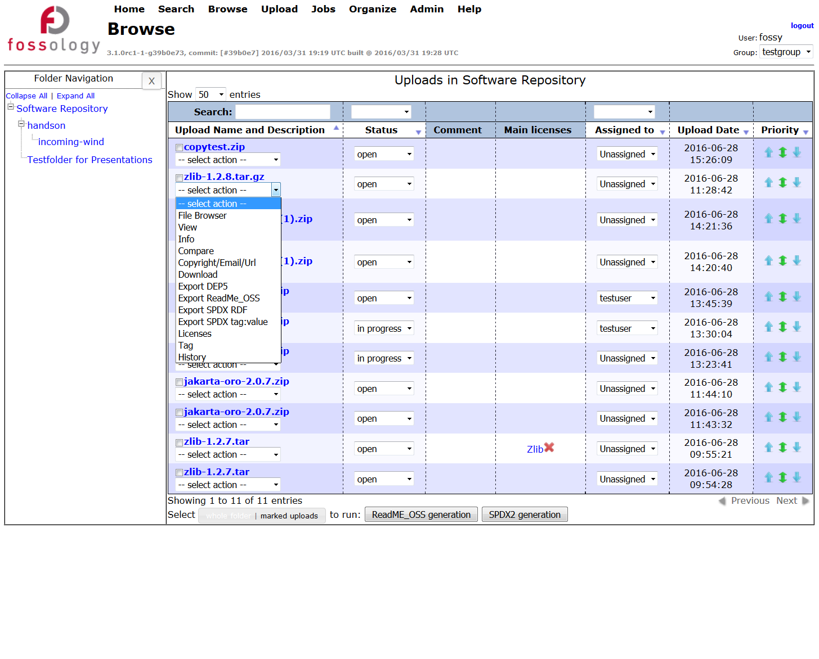
Features: Using Reporting
User Interface
  All upload items are listed in browser
  Selection of different report items in pop-up menu at every uploaded item, export
    Debian-copyright, DEP5
    Readme, notice file
    SPDX RDF/XML
    SPDX Tag:Value
    LibreOffice: Writer Report
1. Select existing upload from where to reuse license decisions

Slide 32
Feature: Administering FOSSology Server

Slide 33
Hands-On: Organizing Uploads, Users and Groups
Functionality
Example
  Creating folders
    Folders allow to organize your uploads
    You could create folders by software groups (e.g. all Apache projects)
    Or by your products or projects
    Or by your teams and involved persons
    Long term perspective: create a repository of reusable cleared components
  Create users and groups
    User creation (and modify existing users)
    Creating groups
    Groups cannot see other groups’ clearing decisions
  Move uploads and folders
    Access rights copying
  Create folders
    Trains
    Wind
  Create groups
    Train group
    Wind group
  Create users
    Robert (trains)
    Dan (trains)
    Andreas (wind)
    Daniele (wind)

Slide 34
What is FOSSology?
A Web server application for license and copyright compliance of software components.
FOSSology Project
https://www.fossology.org/
FOSSology Development
https://www.github.com/fossology/fossology
  Published first in 2008, GPL-2.0
  2015: Linux Foundation collaboration project
  Web server based and command line interfaces
  Scanning agents searching for license and copyright relevant hits (and more …)
  A multi-user / multi-tenant Web UI for review organizing clearing job
  Standard Web application stack:
    Linux, Apache 2, PostgreSQL, PHP,
  Web-based UI in PHP, but scanners
  written in C / C++
  Besides Web UI:
    Command line utilities
Notes:
Memo

Slide 35
Basic End-to-End Workflow
The summary of the basic way how to use FOSSology
Upload the open source package
Do the licenses until all files are clarified (= green dots)
Correct the copyrights, check authorship statements
Check the ECC findings
Generate an output reporting (SPDX, Debian Copyright, Readme)

Slide 36
Hands-On: “Not-So-Basic” End-to-End Workflow
Functionality
Example
  Using FOSSology End-to-End
    From uploading …
    … to generating report: SPDX
  Uploading - offers a variety of selections
  Review the uploaded file in the license browser
  Review the found licenses in the aggregated view
  Do the clearing work
  Review the copyrights
  Review the Export Control and Customs (ECC)
  Generate desired report output
  Upload the example file, time-1.7.tar.gz
  Select the options in the upload menu
  Go to browse and review the UI there
  Select licenses from drop-down menu at upload
  See the aggregated views and single file view: create decisions
    First use of the bulk
  Go to copyrights and correct found matches
    ECC will be the same
  Select output from drop-down

Slide 37
FOSSology Major Takeaways
  It is open source software
    No vendor lock-in, it can be shared among partners
  It is a server-based Web application
    Allowing for multi user operations, allowing for reuse
  It is many features for efficiency
    Reducing the actual efforts for analyzing OSS components

Slide 38
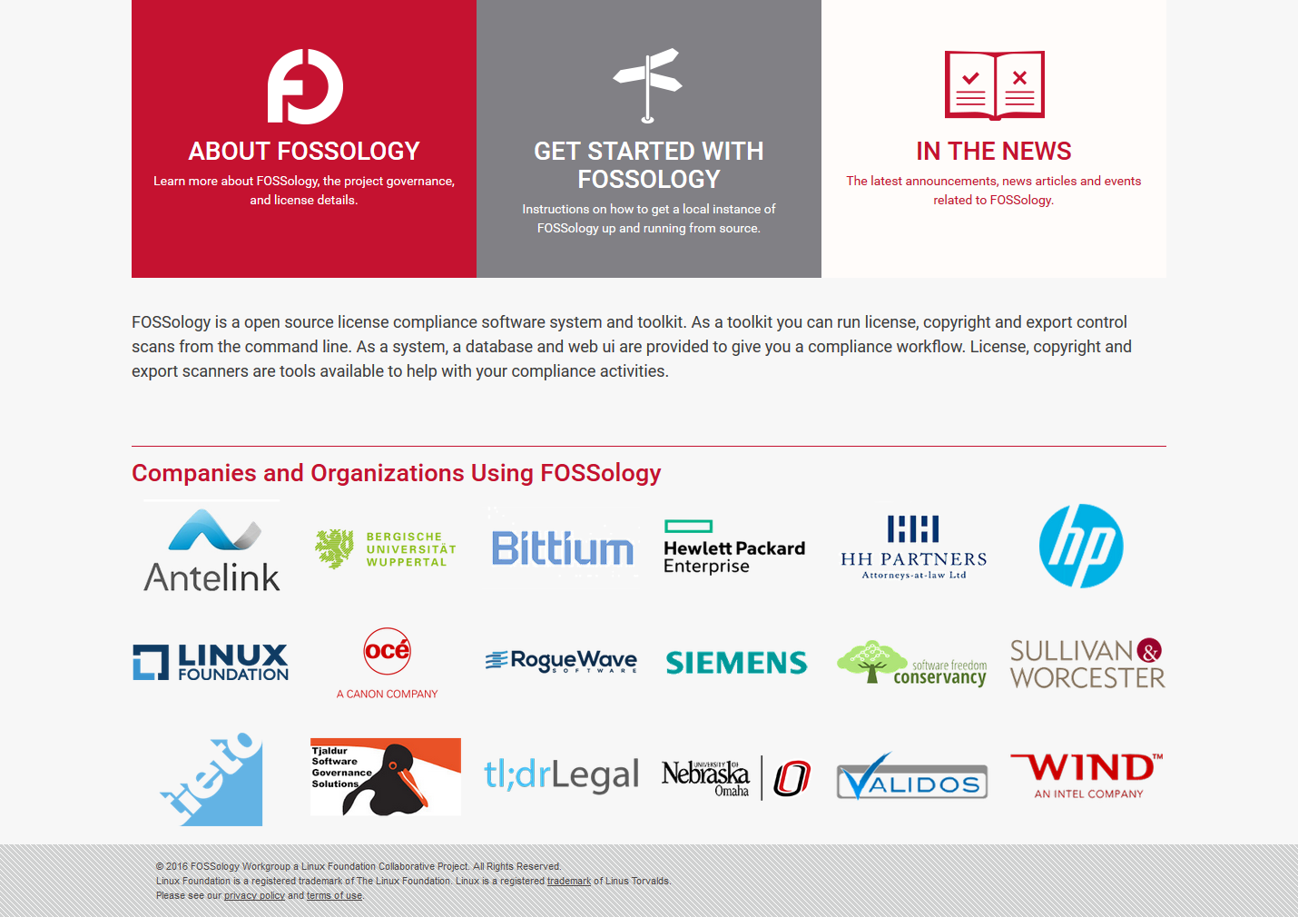
You like it, and would like to contribute?
  See the FOSSology.org website for the most recent list of public supporters.
  Not on this list? – Consider supporting the project with putting your logo there. To be included, send email to fossology-steering@fossology.org.
  Report issues on Github: https://github.com/fossology/fossology
  And of course… code contributions to extend and improve FOSSology are welcome!

Slide 39
And Help us Improve this FOSSology training :-)
Please fill out survey to help us improve this course:
https://tobe.creat.ed/newsurvey
If you include your email address, we will mail you back these slides from today.

Slide 40
Thank you for your attention!
© 2016-2018 Siemens AG, The Linux Foundation
CC-BY-SA 4.0
https://creativecommons.org/licenses/by-sa/4.0/
Internet
https://www.fossology.org
Github
https://github.com/fossology/fossology
Further Links
https://www.spdx.org
https://www.openchainproject.org
https://github.com/sw360/sw360portal
Notes:
Notes

