Slide 1
Searching Using Lucene
Chris Foster

Slide 2
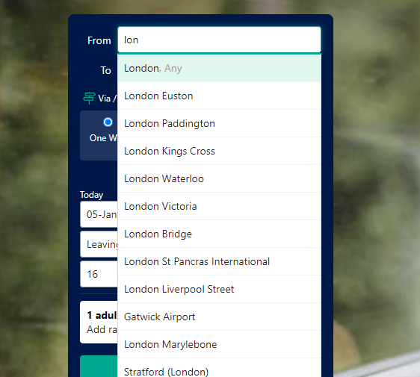
How did we get here?
Replaced Locations-Pot service and brought it into the back end & .NET
Moved from AWS CloudSearch in order to save response time and money
Gained full control of our search destiny

Slide 3

What is Apache Lucene?
A free and open source search engine library
Written originally in Java but ported to C#, C++, Ruby etc..
Several community developed plug ins
Powers most of the webs text search
Features:
Fast incremental indexing
Small memory footprint (~20/30% of indexed text)
Ranked searching
Fuzzy searching

Slide 4
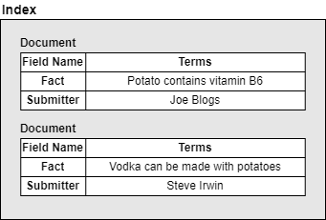
How does Lucene work?
The fundamental concepts in Lucene are index, document, field and term.
An index contains a sequence of documents.
A document is a sequence of fields.
A field is a named sequence of terms.
A term is a sequence of bytes.

Slide 5
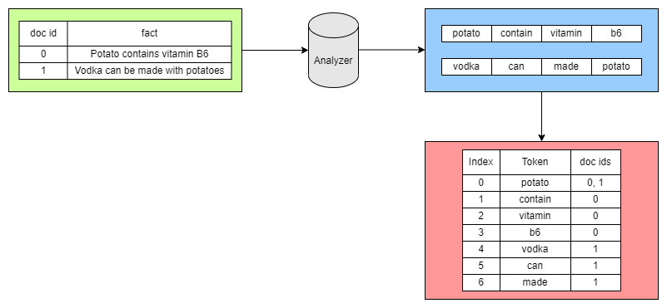
Analysis & Inverted Index

Slide 6
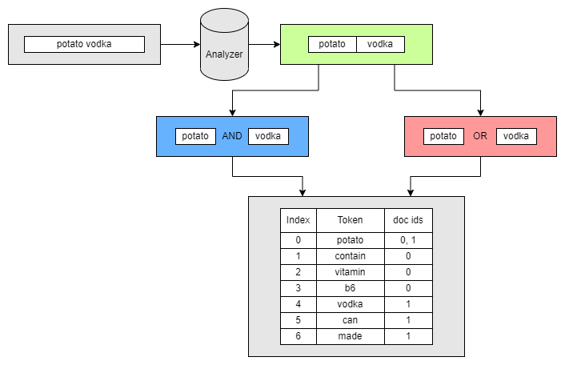

Analysis & Inverted Index

Slide 7
Demo Time!

Slide 8
Summary
Lucene is free and maintained by the Apache Software Foundation
Large developer community
Extensive Documentation
Fast & Customisable
Easy to use!
Improves searching for Trainline users through ReferenceDataSearch
Fuzzy Search
Searching by translated names
Improved term normalisation
Improving searches for colloquial location names

