Slide 1
Stress Level Prediction using Data Analysis and Machine Learning
Fotini Knai-April 2026

Slide 2
Project Objective
Analyze the factors that affect student stress levels.
Examine relationships between the variables in the dataset.
Present the findings through visualizations.
Build a machine learning model to predict stress level.

Slide 3
Dataset Description
We begin our analysis by loading the dataset from the file "StressLevelDataset.csv".
The dataset contains 1101 observations, each representing a student.
The dataset includes psychological, academic, and social factors.
Examples of variables: anxiety level, sleep quality, depression, and social support.
The variables can be grouped into psychological, social, and academic factors.
The target variable is stress_level, which indicates the level of stress.

Slide 4
Data Analysis
A correlation matrix was created to examine relationships between variables.
The heatmap shows both positive and negative correlations.
Several variables show strong relationships with stress_level.
Some variables are also correlated with each other.
This analysis helps identify important factors influencing stress.
Red areas indicate positive correlations, meaning variables increase together, while blue areas indicate negative correlations, meaning one variable decreases as the other increases.

Slide 5
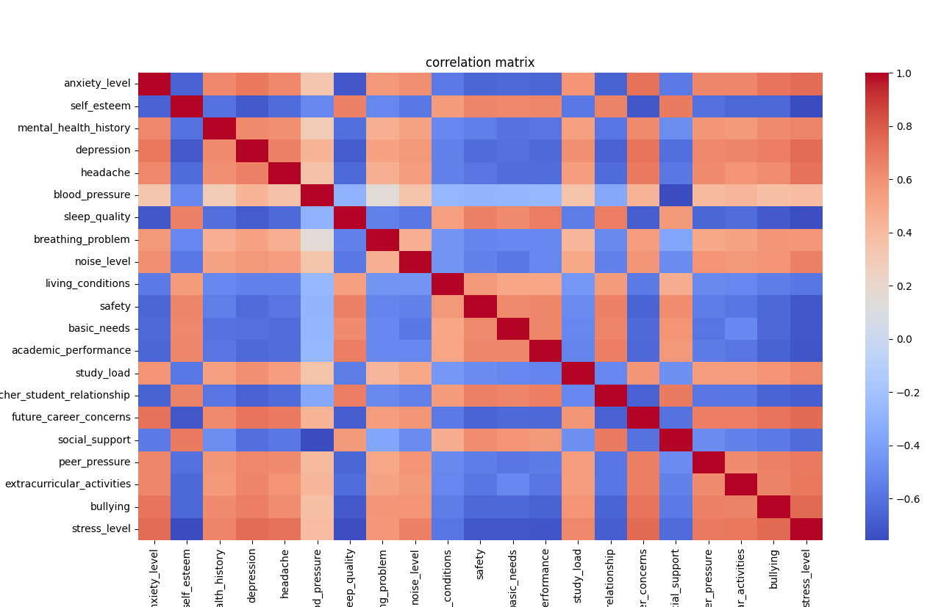
Correlation Heatmap
Red indicates positive correlation.
Blue indicates negative correlation.
Stronger colors represent stronger relationships between variables.
Each cell in the heatmap represents the relationship between two variables.

Slide 6
Key Insights
Anxiety and depression are positively correlated with stress.
Sleep quality is negatively correlated with stress.
Social support appears to reduce stress.
Some variables are strongly related to each other.
We can see that factors like anxiety and depression increase stress, while sleep quality and social support help reduce it.

Slide 7
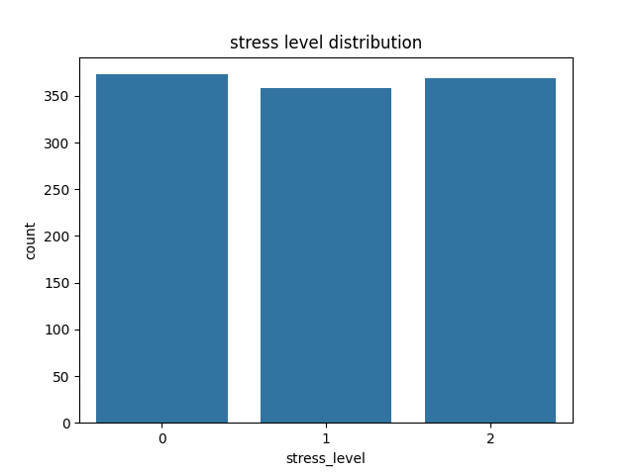
Stress Level Distribution
The dataset contains three stress levels:0,1, and 2.
The distribution of stress levels is relatively balanced.
This is beneficial for building a machine learning model.
Balanced data helps the model learn better and avoid bias.

Slide 8
Machine Learning Model
The dataset was split into training and testing sets (80% / 20%).
A Logistic Regression model was used.
The model was trained on the training data.
Predictions were made on the test data.

Slide 9
Model Evaluation
Model performance was evaluated using accuracy.
The model achieved an accuracy of 88,6%
This shows how well the model predicts stress levels.

Slide 10
Conclusion
Several factors influence student stress levels.
Strong relationships were observed between variables.
The model provides a basic prediction of stress levels.
The model can be improved with more advanced techniques.

