Slide 1
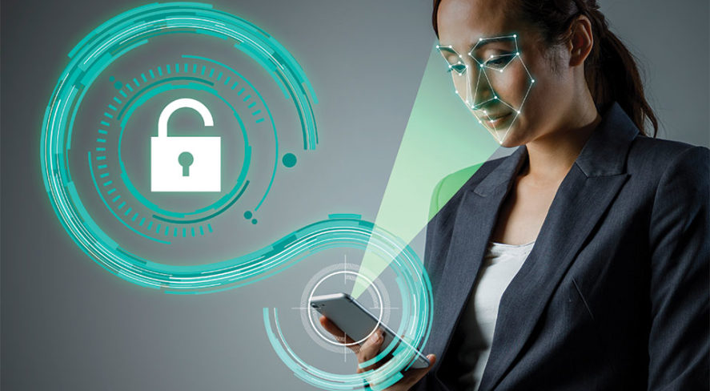


Face Verification App
ΠΑΠΑΔΗΜΑΣ ΦΩΤΗΣ
ΦΑΣΑΚΗΣ ΓΕΩΡΓΙΟΣ
MSc in Data Science – Deep Learning
Face Verification App

Slide 2
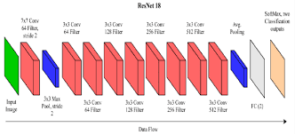
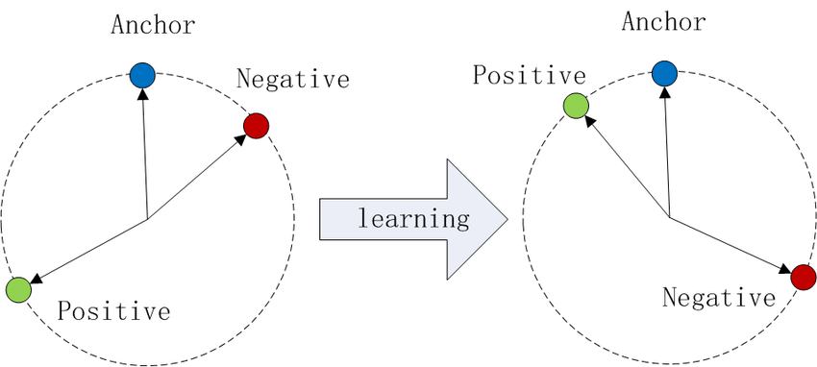
What we tried to create :
A face verification system
How?
Four ways :
1) A custom CNN we created that would classify images as being the person we wish to verify or not
2) A CNN with transfer learning using the resenet 18 that would do the same thing as our custom CNN
3)A triplet loss model that uses for the triplet selection the methods described in FaceNet: A Unified Embedding for Face Recognition and Clustering
4)A triplet loss model that selects triplets at random and uses the loss function described into A Conditional Triplet Loss for Few-shot Learning and its Application to Image Co-Segmentation
Face Verification App

Slide 3
Problems we encountered:
1) Creating the Dataset from which the models would learn.
2) The model learning to recognize the camera from which the photos came instead of a person.
3) Creating a diverse dataset of the person to be recognized.
4) Getting photos with the camera of other people.
5) How many layers to freeze on the transfer learning model.
6) Training and assessing the triplet loss models.
Face Verification App

Slide 4
Data preprocessing
1)We resized the images and kept the center of each image to make training faster.
2) We did a horizontal flip on our images to help the model generalize better and learn faces better. We could use random rotations as well.
3) We applied a random hue and color transformations on our data.
8) Finally we normalized the images before passing them to our model to help the model converge.
Face Verification App

Slide 5
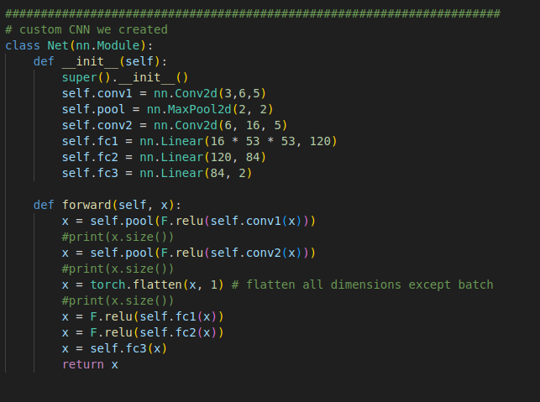
Custom CNN
1st convolutional layer
1st pooling layer
2nd convolutional layer
2nd pooling layer
3 fully connected layers
Optimizer used : Stochastic gradient descend
Learning rate : 0.001
Loss function : Cross Entropy loss
Training epoch : 25
Batch size : 4
Face Verification App

Slide 6
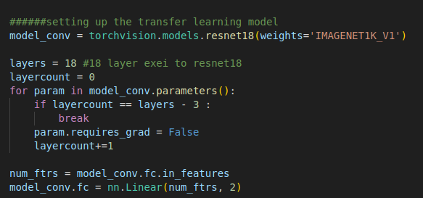
Transfer learning CNN
It is the resnet 18 model that from which the last layer has been replaced with one that outputs two classes and all but the last two layers have been frozen.
Optimizer used : Stochastic gradient descend
Learning rate : 0.001
Loss function : Cross Entropy loss
Training epoch : 25
Batch size : 4
Face Verification App

Slide 7
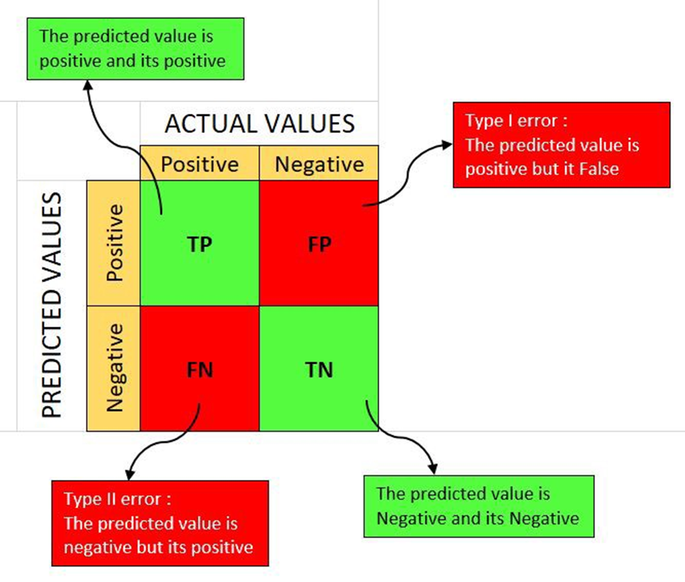
Metrics of the CNN models
False Match Rate (FMR) or known as False positive rate(FPR):
FMR = F P/N = F P/(F P + T N )
False Non-Match Rate (FNMR) we use in our graphs below False negative rate (FNR):
FNMR = F N/(F N + T P )
and the accuracy:
Acc = (T P + T N )/(T P + T N + F P + F N
Face Verification App

Slide 8
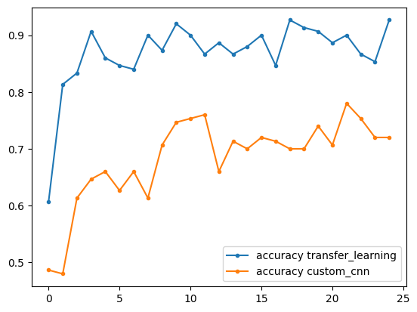
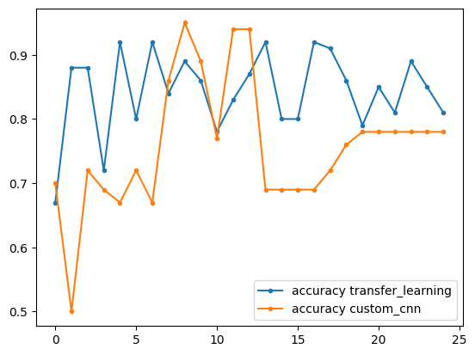
Comparison of the CNN models :Accuracy
Train
Test
Face Verification App

Slide 9
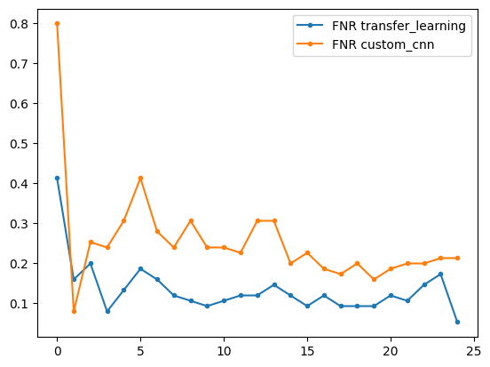
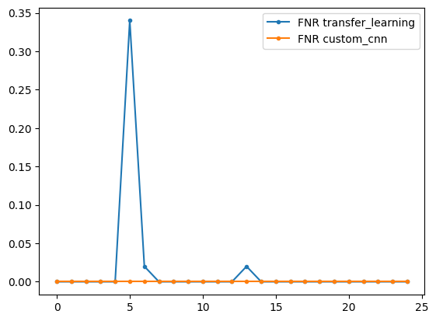
Comparison of the CNN models :FNR
Train
Test
Face Verification App

Slide 10
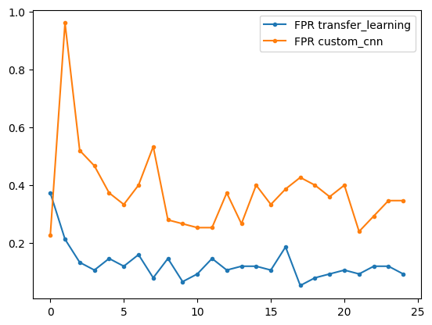
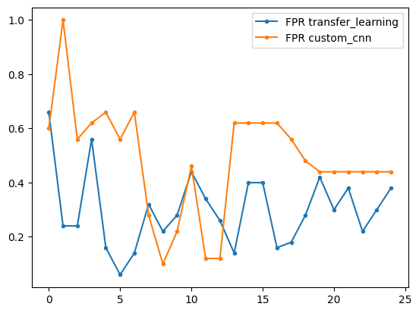
Comparison of the CNN models :FPR
Train
Test
Face Verification App

Slide 11
CNN Conclusions
While the CNN networks have similar accuracy the FPR of the transfer learning rate is
Lower. This is important as it affects the security of the system.
In both CNN’s the False negatives were a non factor.
IN the test set the behavior of our custom CNN is more unpredictable compared
to transfer learning
Face Verification App

Slide 12



Triplet loss models :FaceNet Approach
Create embeddings of the images and minimize the loss function
The triplets used for the loss function are the
anchor(A)
,positive(P)
and negative(N).
A margin a is used to avoid trivial solutions
Anchor and Positive embeddings are of the same class
Anchor and Negative embeddings are of different class
The idea is to minimize the distance betwenn anchors and positives
And maximize the distance betwenn anchors and negatives
FaceNet triplet selection: select hard positives and
hard/semi-hard negatives for each anchor
Hard positives :
Hard negatives:
Semi-Hard negatives:
Face Verification App

Slide 13

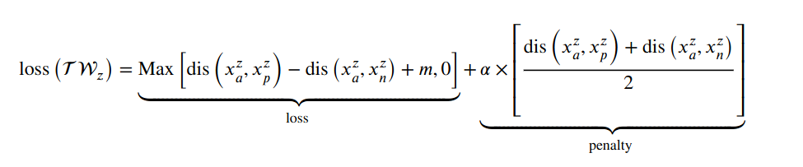
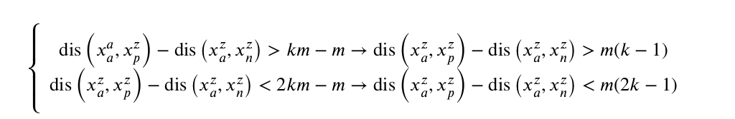
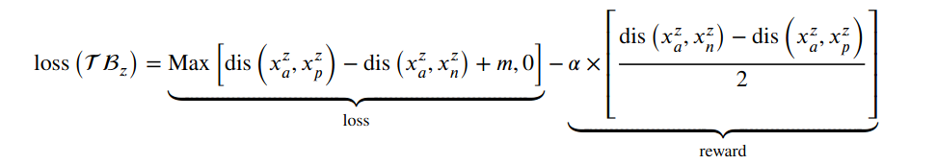
Triplet loss models :A Conditional Triplet Loss for Few-shot Learning and its Application to Image Co-Segmentation
If
Here triplets are chosen at random but they are penalized or rewarded based on whether they are considered good or bad
Then the triplet is considered as bad and is penalized as
If
Then the triplet is considered as good and is rewarded as
m: the margin used
k: real number between one and zero
For the triplets that do not meet the above the original loss function is used
Face Verification App

Slide 14
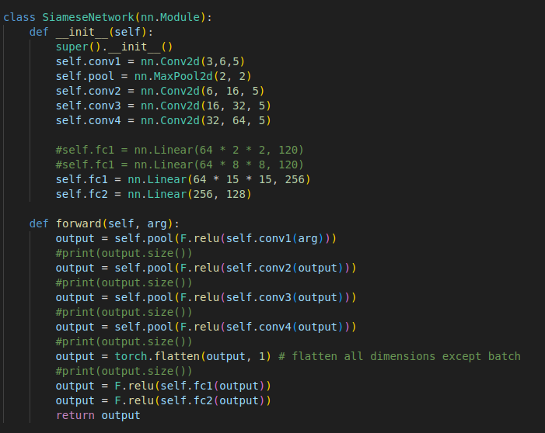
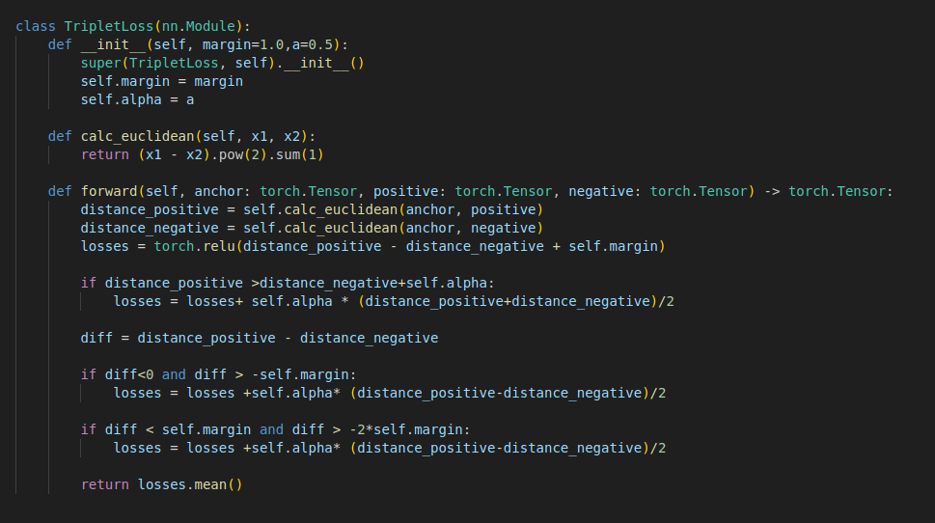
Triplet loss models
On both tries the same Neural net was used
The optimizer used in both cases was Adam.
Epochs were 75 each
Learning rate was 0.005
In the first try the TripletMarginLoss loss function
of pytorch
In the second try we created the required loss function
Face Verification App

Slide 15



Metrics of the triple loss models
The points that were correctly classified are :
The points that were incorectly classified are:
The paper defined the validation rate VAL(d) and the false accept rate
FAR(d) for a given face distance d are then defined as
Face Verification App

Slide 16
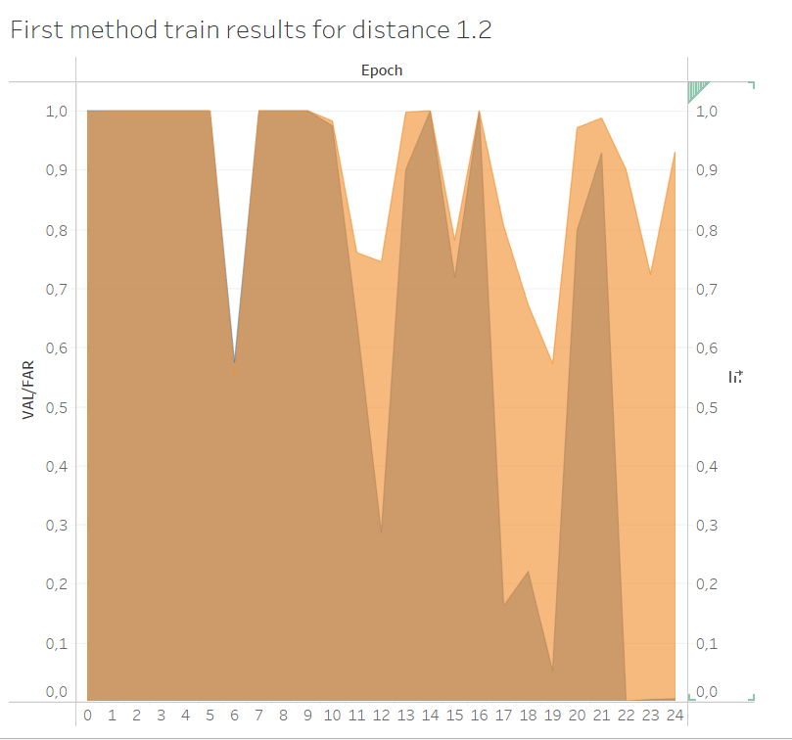
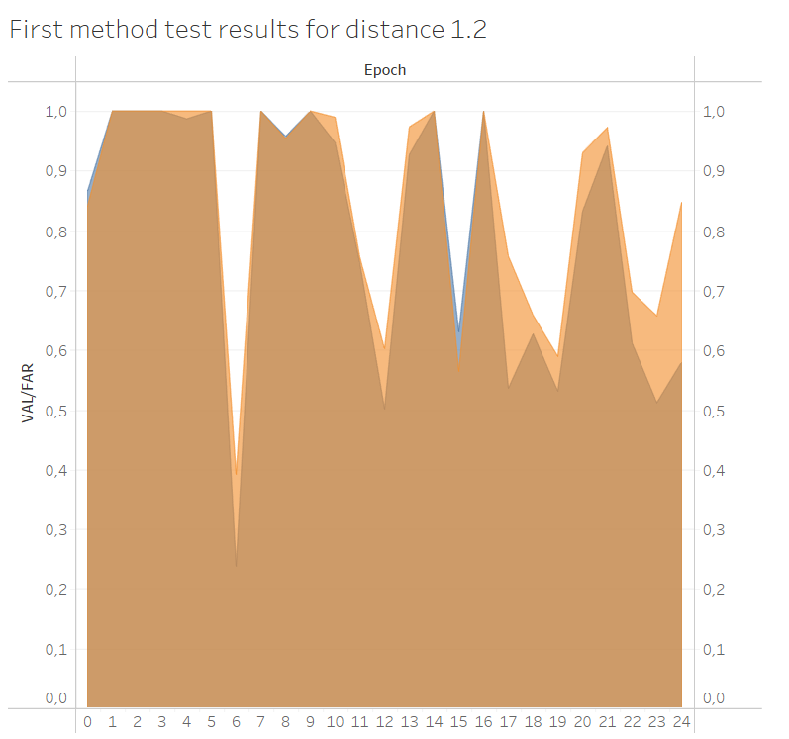
Comparison of the FaceNet Triplet loss model First 25 epochs
Train
Test
Face Verification App

Slide 17
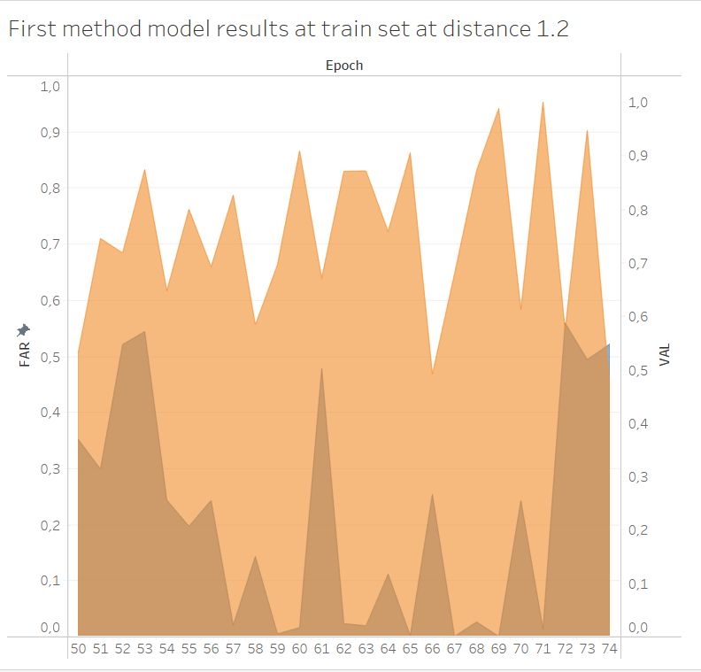
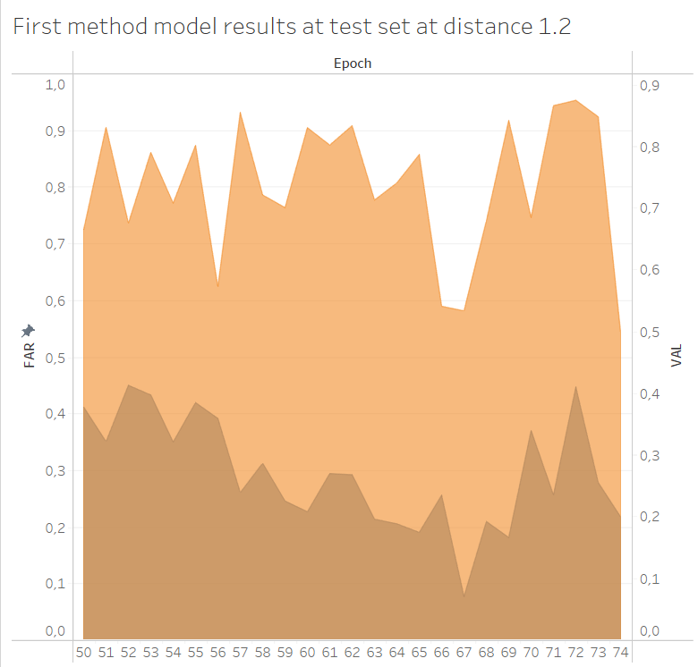
Comparison of the FaceNet Triplet loss model last 25 epochs
Train
Test
Face Verification App

Slide 18
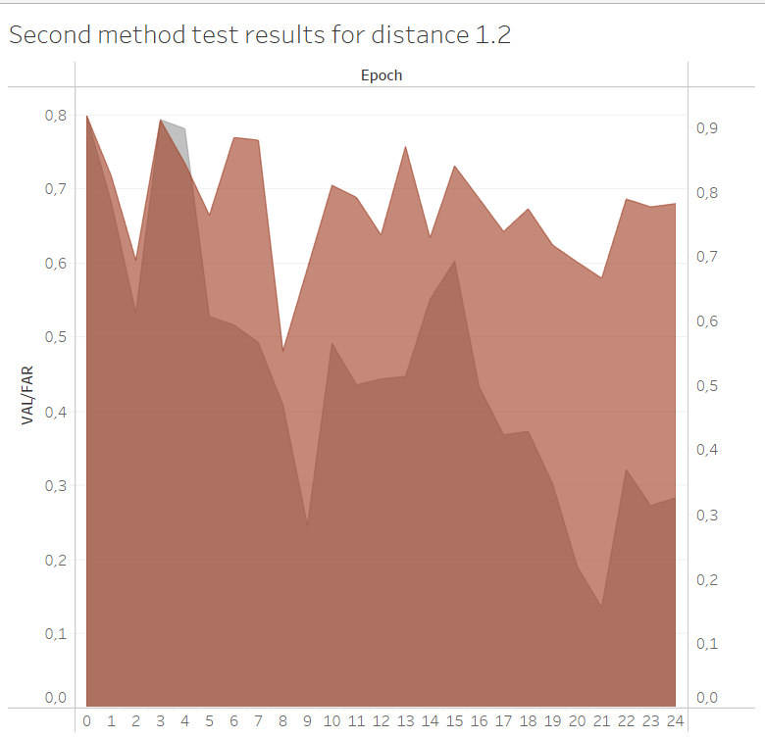
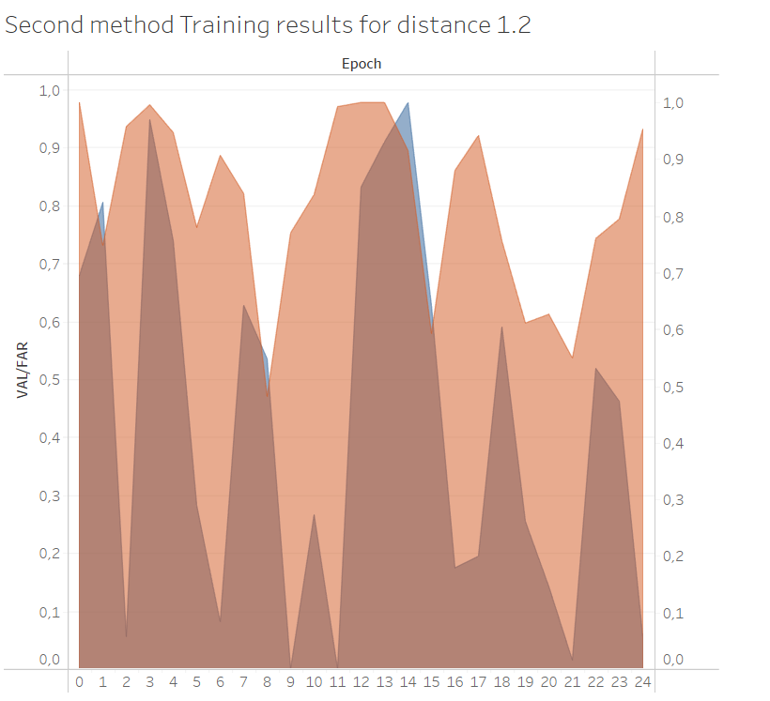
Comparison of the Conditional Triplet Loss model First 25 epochs
Train
Test
Face Verification App

Slide 19
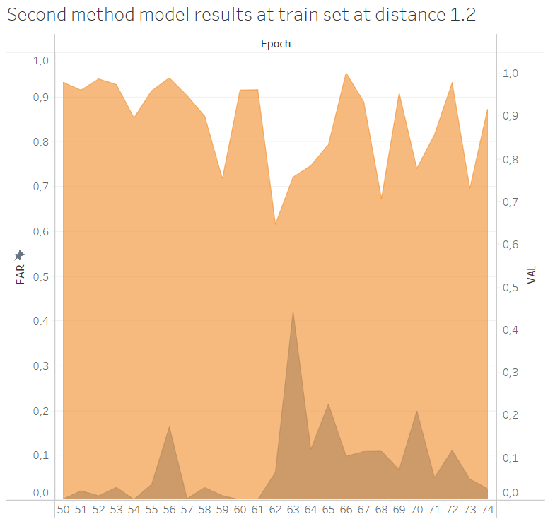
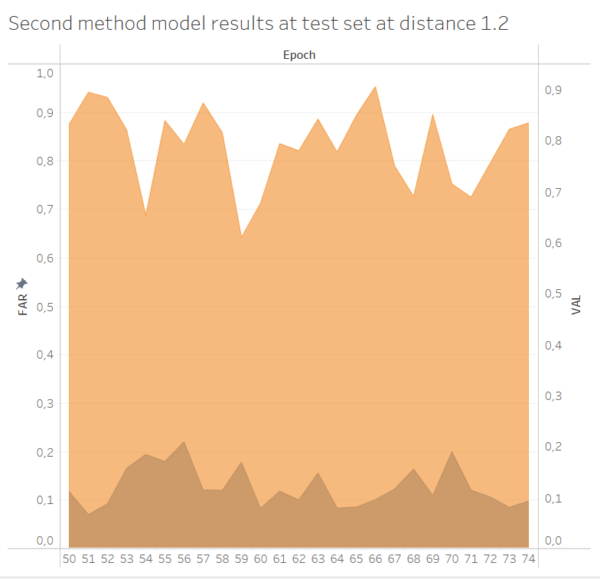
Comparison of the Conditional Triplet Loss model Last 25 epochs
Train
Test
Face Verification App

Slide 20
Triplet loss Conclusions
We see that in the first 25 epochs almost nothing happens.
This is probably because at the start the models converges all the embeddings into one point.
After running it for 75 epochs the model seems to be able to differentiate between the two classes
We observe that the conditional triplet loss converges faster and has better FAR.
Maybe if we let the FaceNet approach for more epochs its results could improve.
Another reason is that the selection of triplets in the facenet approach a lot of times fell to the hard negative selection which leads to local minima and can affect learning performance.
The training time for both networks were higher compared to CNN’s but that can be due
To our code.
Face Verification App

Slide 21
Conclusions/Observations
Out of the three methods when applied the most reliable is the CNN. Due to the low input data the triplet models have trouble with multicolored backgrounds.
There are problems with lighting and distance from the camera. The distance must be not too far or too close and the lighting not too bright.
While the two methods are not directly comparable comparisons can be made about the time they need.
The CNN’s were in the range of a 1 to two minutes while the triplet loss took from half an hour to an hour to train.
Face Verification App

Slide 22
Thank you !
Face Verification App

