Slide 1

Esports Prize pool
George Foto & Ryan Casey

Slide 2
Introduction
Esports is something we are both actively interested in.
Looking for different types of data, we saw the top 200 Esports tournaments ranked by their prize pool
So that made us wonder, does the prize pool vary that much for different games.

Slide 3
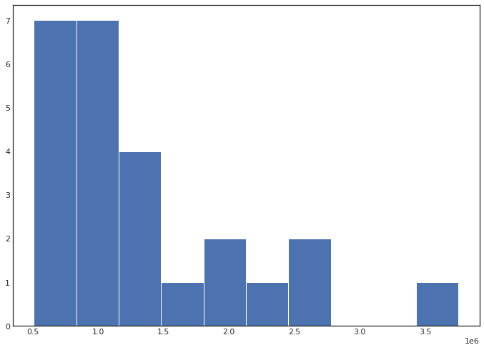
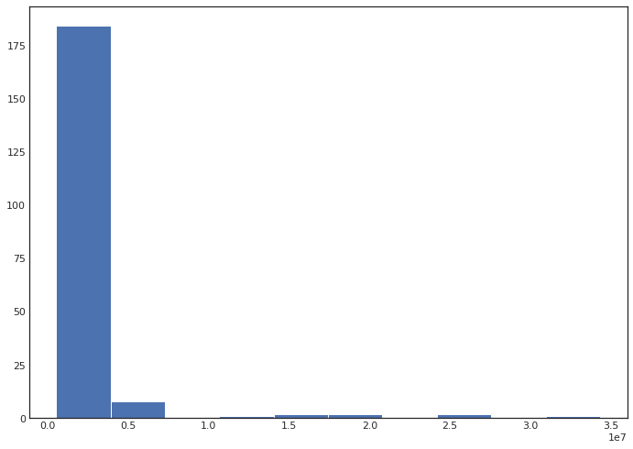
Selection of data
Average of Each Game
Like mentioned before the data set was taken off Kaggle.
The main data is very skewed to the right
While the averages of each game prize pool is less skewed than the original data.
The only modification we had to do to the data was to add a column specifying which game was played in the tournament
All Tournaments

Slide 4

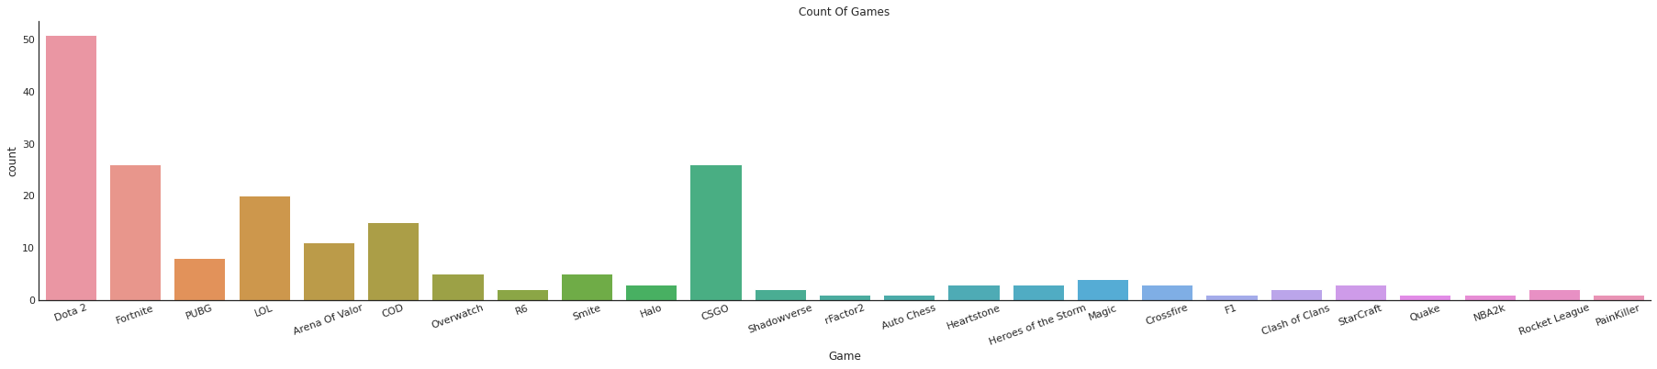
Method
Pandas
Seaborn
Python
Jupyter.cs.wit.edu

Slide 5
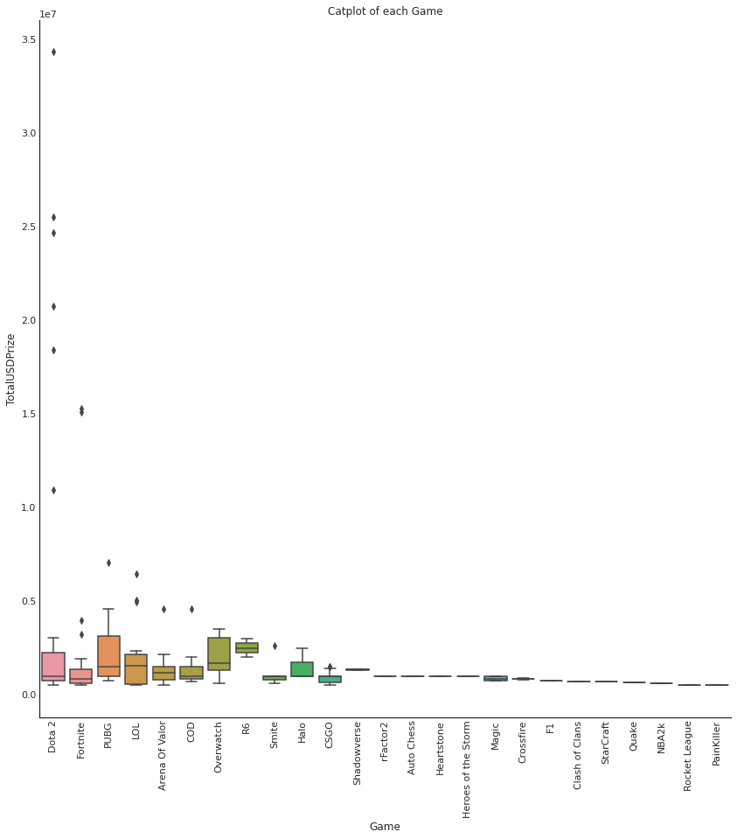
Results
We did a couple of tests.
We first looked at the averages of the all the prize pools which came out about 2,100,000
Looking at the graph to the left, there is a lot of outliers pulling up the average, especially from Dota which had over 50 counts.
We then grouped the games and calculated their own averages, and then calculated the avg of all games using their average, which came out to 1,320,000
One final thing would be seeing the median of all the tournaments prize pool and their median of the averages, Which all came out to 1,000,000.

Slide 6
Discussion
The answer tells that for the upper tournaments hosted by the game companies themselves, or grand finals for small games, the average prize pool is around 1 million to 1.3 million.
We do have some outliers like Dota finals and LOL worlds which do bring up the average quite a bit.
Overall, this could be the beginning to show what the real averages are, since all these tournaments are hosted by the respected game company, it can be hard to say if it affects other tournaments hosted locally as their prize pool would be a lot smaller.
With a more completely list of all the tournaments, we could use this as a start to see what the real average prize pool would look like rather than the top 200.

Slide 7
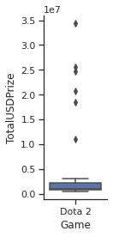
Summary
Out of the 200 most expensive prize pool tournaments in esports history, the average amount teams would win would be around 1 to 1.3 million.
This was calculated by grouping the games together and finding each games averages, and then finding the average of all the games averages.

Slide 8
Works Sited
https://www.kaggle.com/datasets/hbakker/esports-200-tournaments

