Slide 1
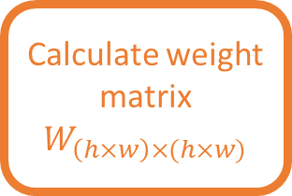

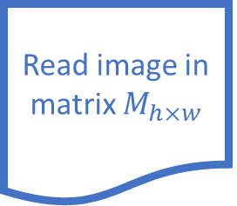
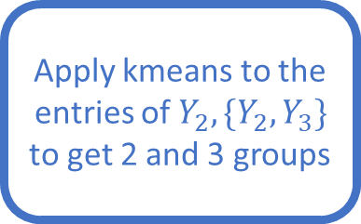
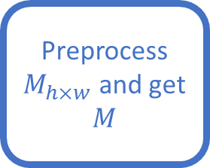
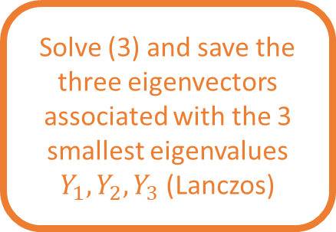
Original approach
Read image in matrix $M_{h×w}$
Preprocess $M_{h×w}$ and get $M$
Calculate weight matrix $W_{\left(h×w\right)×(h×w)}$
This is the current workflow that was used in the NormalizedCut miniproject using the Lanczos algorithm (performed by Antonio)
The orange steps were coded in C and the blue ones in R
Solve (3) and save the three eigenvectors associated with the 3 smallest eigenvalues $Y_{1},Y_{2}, Y_{3}$ (Lanczos)
Apply kmeans to the entries of $Y_{2},\{Y_{2},Y_{3}\}$ to get 2 and 3 groups
Apply groups to $M$

Slide 2
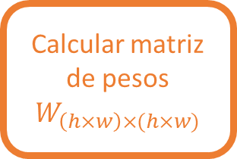
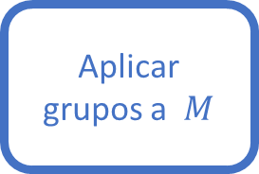

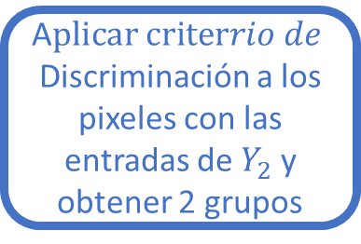
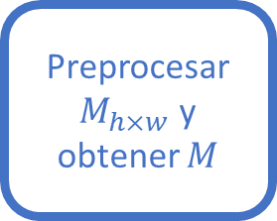
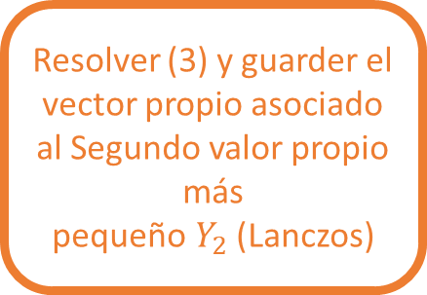
Original approach
Leer imagen en matriz $M_{h×w}$
Preprocesar $M_{h×w}$ y obtener $M$
Calcular matriz de pesos $W_{\left(h×w\right)×(h×w)}$
This is the current workflow that was used in the NormalizedCut miniproject using the Lanczos algorithm (performed by Antonio)
The orange steps were coded in C and the blue ones in R
Resolver (3) y guarder el vector propio asociado al Segundo valor propio más pequeño$Y_{2}$(Lanczos)
A$plicar criterrio de$
Discriminación a los pixeles con las entradas de $Y_{2}$ y obtener 2 grupos
Aplicar grupos a $M$

Slide 3
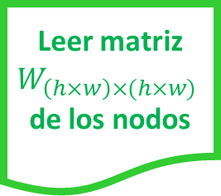
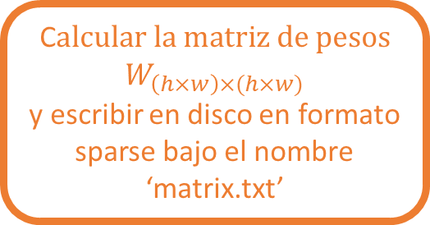


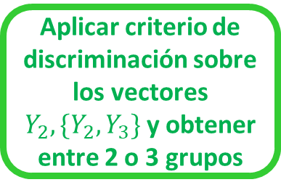
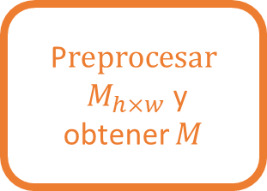
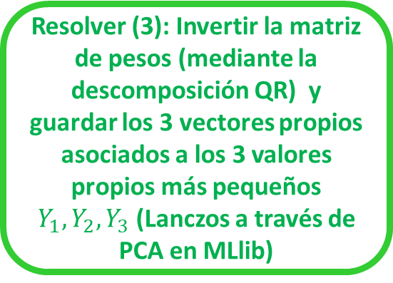
Leer imagen en matrix $M_{h×w}$
P$reprocesar$
$M_{h×w}$ y obtener $M$
C$alcular la matriz de pesos$
$$W_{\left(h×w\right)×(h×w)}$$
y escribir en disco en formato sparse bajo el nombre ‘matrix.txt’
Distribuir el archivo ‘matrix.txt’ a los nodos del cluster
Los recuadros en color naranja pertenecen al código escrito en el lenguaje C, los que están en azul corresponden a los procesos en Hadoop y los que están en color verde a aquellos en MLlib
Leer matriz $W_{\left(h×w\right)×(h×w)}$de los nodos
MLlib
Apache Spark
Apache Hadoop
Resolver (3): Invertir la matriz de pesos (mediante la descomposición QR) y guardar los 3 vectores propios asociados a los 3 valores propios más pequeños $Y_{1},Y_{2}, Y_{3}$ (Lanczos a través de PCA en MLlib)
Aplicar a $M$ grupos
Configurar un cluster con un nodo maestro y n nodos esclavo
Aplicar criterio de discriminación sobre los vectores $Y_{2},\{Y_{2},Y_{3}\}$ y obtener entre 2 o 3 grupos

Slide 4
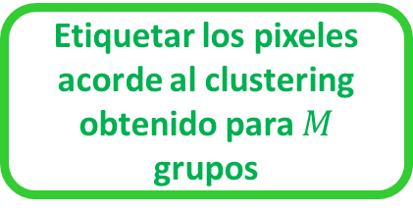
Leer imagen en matrix $M_{h×w}$
P$reprocesar$
$M_{h×w}$ y obtener $M$
C$alcular la matriz de pesos$
$$W_{\left(h×w\right)×(h×w)}$$
y escribir en disco en formato sparse bajo el nombre ‘matrix.txt’
Distribuir el archivo ‘matrix.txt’ a los nodos del cluster
Los recuadros en color naranja pertenecen al código escrito en el lenguaje C, los que están en azul corresponden a los procesos en Hadoop y los que están en color verde a aquellos en MLlib
Leer matriz $W_{\left(h×w\right)×(h×w)}$de los nodos
MLlib
Apache Spark
Apache Hadoop
Aplicar el método PowerIterationClustering() con k = 2 o 3 clusters
Etiquetar los pixeles acorde al clustering obtenido para $M$ grupos
Configurar un cluster con un nodo maestro y n nodos esclavo

Slide 5
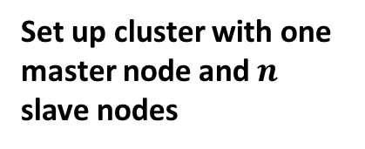
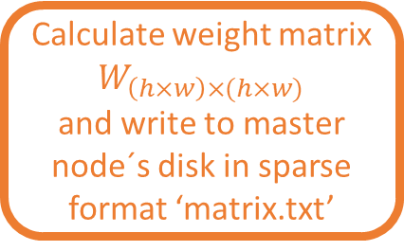


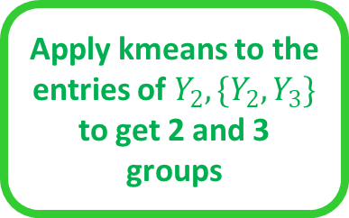
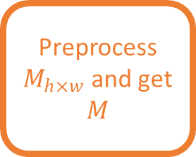
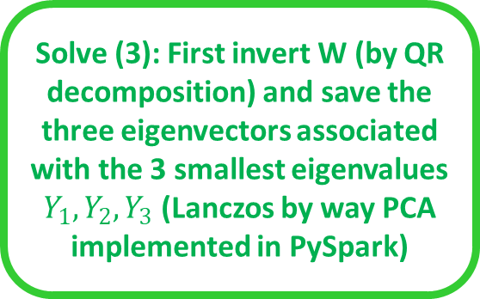
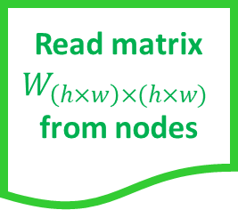
Read image in matrix $M_{h×w}$
Preprocess $M_{h×w}$ and get $M$
Calculate weight matrix $W_{\left(h×w\right)×(h×w)}$
and write to master node´s disk in sparse format ‘matrix.txt’
Distribute the ‘matrix.txt’ file to the cluster nodes
Approach 1
Read matrix $W_{\left(h×w\right)×(h×w)}$from nodes
This is the approach in which Kenny is working. If invert W es very expensive we present Approach 2
PySpark
Apache Spark
The orange steps were coded in C, the blue ones are Hadoop processes and the green ones are coded using PySpark
Apache Hadoop
Solve (3): First invert W (by QR decomposition) and save the three eigenvectors associated with the 3 smallest eigenvalues $Y_{1},Y_{2}, Y_{3}$ (Lanczos by way PCA implemented in PySpark)
Apply groups to $M$
Set up cluster with one master node and $n$ slave nodes
Apply kmeans to the entries of $Y_{2},\{Y_{2},Y_{3}\}$ to get 2 and 3 groups

Slide 6
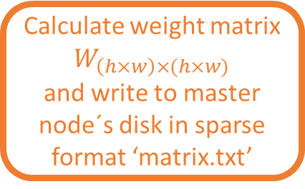

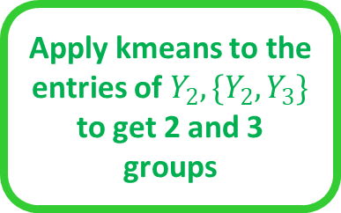

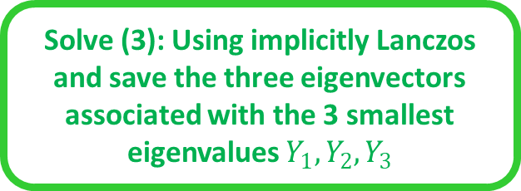
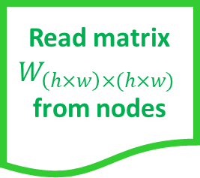
Read image in matrix $M_{h×w}$
Preprocess $M_{h×w}$ and get $M$
Calculate weight matrix $W_{\left(h×w\right)×(h×w)}$
and write to master node´s disk in sparse format ‘matrix.txt’
Distribute the ‘matrix.txt’ file to the cluster nodes
Read matrix $W_{\left(h×w\right)×(h×w)}$from nodes
Approach 2
PySpark
This is another approach in which Kenny is working.
Apache Spark
The orange steps were coded in C, the blue ones are Hadoop processes and the green ones are coded using PySpark
Code our implementation of implicitly restarted Lanczos method
with PySpark’ libraries
Apply groups to $M$
Apache Hadoop
Set up cluster with one master node and $n$ slave nodes
Apply kmeans to the entries of $Y_{2},\{Y_{2},Y_{3}\}$ to get 2 and 3 groups
Solve (3): Using implicitly Lanczos and save the three eigenvectors associated with the 3 smallest eigenvalues $Y_{1},Y_{2}, Y_{3}$

Slide 7
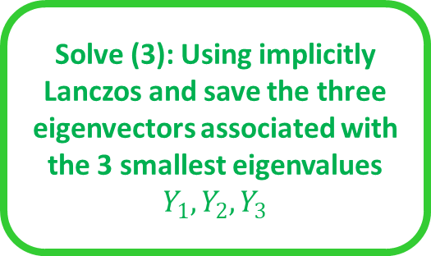
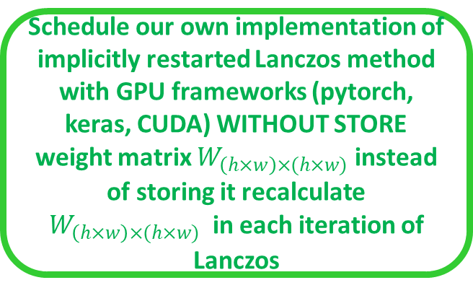

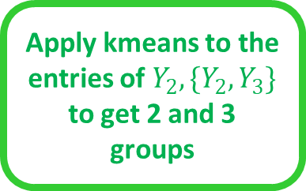
Read image in matrix $M_{h×w}$
Preprocess $M_{h×w}$ and get $M$
Schedule our own implementation of implicitly restarted Lanczos method
with GPU frameworks (pytorch, keras, CUDA) WITHOUT STORE weight matrix $W_{\left(h×w\right)×(h×w)}$ instead of storing it recalculate $W_{\left(h×w\right)×(h×w)}$ in each iteration of Lanczos
Solve (3): Using implicitly Lanczos and save the three eigenvectors associated with the 3 smallest eigenvalues $Y_{1},Y_{2}, Y_{3}$
Approach 3
This is the approach in which Antonio is working.
The orange steps will coded in C and the green ones will coded using a GPU environment
Apply groups to $M$
Apply kmeans to the entries of $Y_{2},\{Y_{2},Y_{3}\}$ to get 2 and 3 groups

